Slide 1
Engineering and Technology Education
Teacher name here

Slide 2
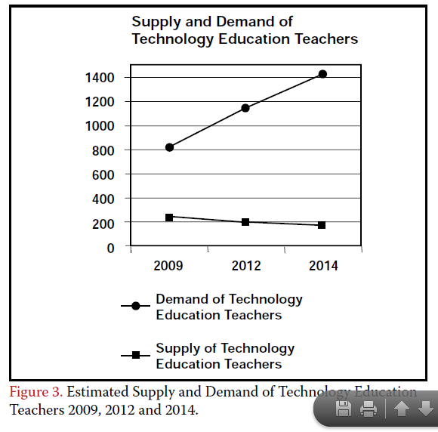
Supply and Demand of Engineering and Technology Teachers
What does this data mean for our future teaching force?
What does this data mean for engineering and technology courses?
How does a teacher shortage impact engineering and technology and other elective courses?
Source: Ndahi, Hassan B.; John M. Ritz. “Technology Education Teacher Demand, 2002-2005.” The Technology Teacher. April 2003. Found on: https://www.iteea.org/File.aspx?id=85503&v=f4c3be3e
Notes:
This slide could serve as an introductory activity to introduce students to engineering and technology education and give students a foundation for why it is important to take a close look at this potential career. The full article is a good read if time permits.

Slide 3
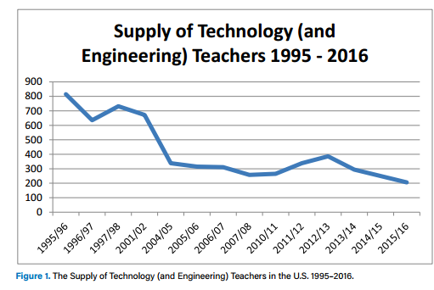
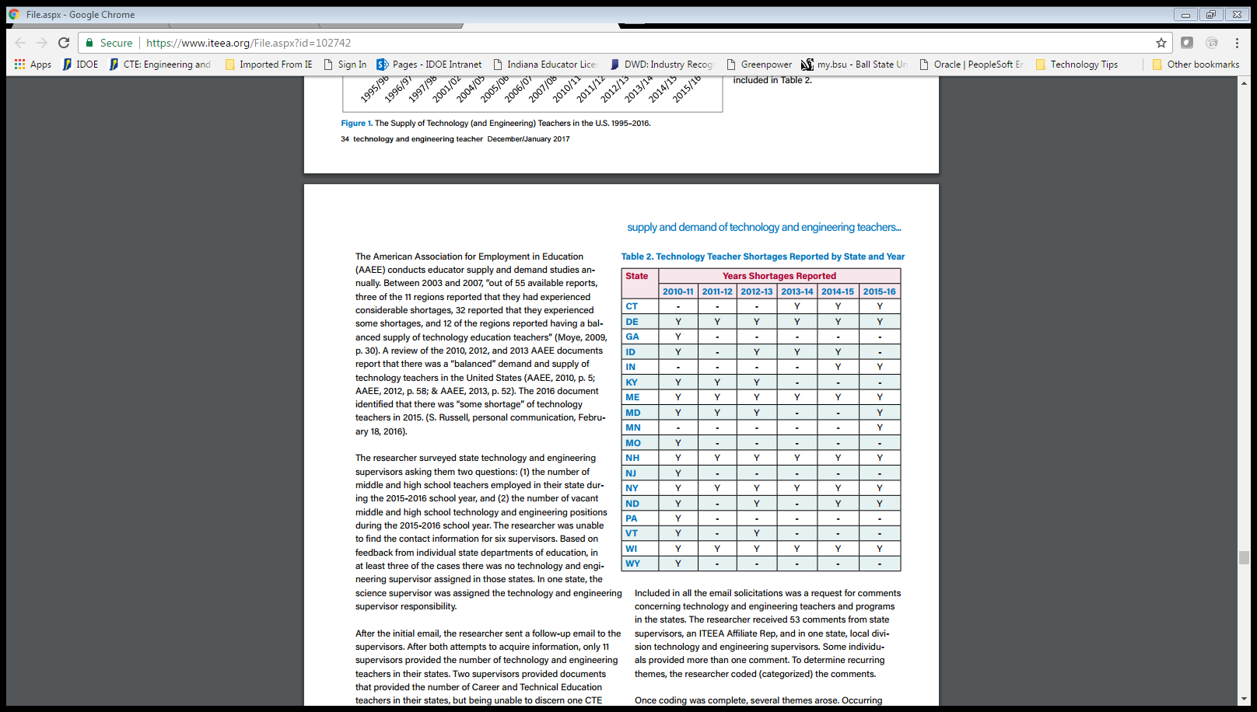
Additional data: connecting to supply and demand
Moye, Johnny. December 2016.
“The Supply and Demand of Technology and Engineering Teachers: Who Knows?” The Technology and Engineering Teacher. Retrieved from https://www.iteea.org/File.aspx?id=102742

Slide 4
Do you like to do any of the following?
Do you want to make the world a better place?
Are you interested in design and modeling?
Do you like to create and prototype solutions?
Do you enjoy Robotics or Technology Student Association (TSA)?
Is your favorite class an Engineering and Technology class?
Do you enjoy teaching others?
If yes, you should consider a career as an Engineering an Technology Teacher!
Notes:
Why do you teach? Take a moment to add your reasoning in here.

Slide 5
What is engineering and technology education?
Teach courses related to engineering and technology at the middle and high school level.
Write and implement lesson plans related to engineering and technology standards and objectives.
Work with hands-on and creative projects with students that often don’t have one answer.
Lead a club or organization like a FIRST or VEX robotics team, TSA chapter, or Supermileage (or many, many others!)
Courses that E&T teachers in Indiana can teach can be found at: http://www.doe.in.gov/ccr/course-titles-and-descriptions
  This list varies from state to state and is subject to change.
Notes:
Quite literally, engineering and technology educators teach engineering and technology courses in a variety of settings.

Slide 6
Where do Engineering and Technology teachers work?
Middle Schools
High Schools
After-School Programs
Universities
Industry
Curriculum/Texbook Companies
Notes:
A person with an engineering and technology education background is valuable! He or she can work in education in many different capacities beyond teaching, although that is the most common profession. With the interest and importance of STEM programs, teachers and specialists are needed to facilitate and manage these programs that understand engineering and technology.
ADD: Where have you worked in the past beyond the classroom? This is a great place to add your personal experience if you have something to share.

Slide 7
Why consider Engineering and Technology Education?
Helping students learn is rewarding!
Work with energetic colleagues in healthy and safe environments
Demand for teachers is high; job placement is 100% in Indiana!
#DoWhatYouLove while earning a living
Qualifying college major for the Next Generation Teacher Scholarship of up to $30,000!
Notes:
Why did you choose to purse E&T Education? This slide is a great place to share your story as an educator and share how you got to where you are and how your career is rewarding.

Slide 8
Interested in Teaching Engineering and technology education?
Talk with your teacher about his/her experiences.
Contact the main point of contact at each university program (BSU, ISU, and Purdue) and take a tour of each program to decide which one best fits your needs as a student.
Fill out an application to the programs you are interested in applying to.
Apply for the Next Generation Teaching Scholarship and other scholarships.
Consider working or volunteering in after-school programs or as a camp counselor to gain experience with children
Attend a Engineering and Technology Education program at ISU, BSU, or Purdue to earn a degree in engineering and technology teacher education.
  Pass Indiana CORE Assessment in Engineering and Technology.
  Apply for teaching license once teacher education program is completed.
Work at a school with a program opening in Engineering and Technology Education upon graduation!

Slide 9
Poster Project
Directions:
Create a Poster about a University that offers Engineering and Technology Education.
See project directions and rubric for more details.
Items to include:
Location
Enrollment numbers
Tuition Costs
Scholarship Opportunities in Engineering and Technology Education
College where Engineering and Technology education is “housed” or located
Sample course list for this college major
Contact for the Engineering and Technology Program
Other Important statistics
Notes:
Rubric and directions for poster project can be found in resources section.
Poster can be completed with paper and markers (traditional), on the computer on Publisher or Word, or online through Glogster (http://edu.glogster.com/) or another poster software.
If you opt to have students present or complete this project in another way, change the directions for this slide to project the information.

Slide 10
Exit slip
Are you interested in pursuing Engineering and Technology Education as a college major and possible career?
If so, what would you like more information on in order to make an informed decision?
If not, what career pathway are you planning to pursue and how do you plan to get there?
Notes:
Insert information about how you want students to complete this assignment.
Possible options include on their own paper, on a worksheet with the questions typed (see resources), or in a forum or another way through a learning management system like canvas.
Discussing the answers to the exit slips would be one way to open up the lesson the following way if you choose to continue with an extension activity.

