Slide 1

Hoosier Riverwatch
Basic Training Workshop
Instructor Name
Hoosier Riverwatch Instructor
Location of Workshop
Date of Workshop

Slide 2

Meet and Greet
Your name
Where you are from
What brought you here today
A favorite waterbody of yours
Notes:
Asking a favorite water body or similar question is a great ice breaker. I often receive diverse answers.

Slide 3
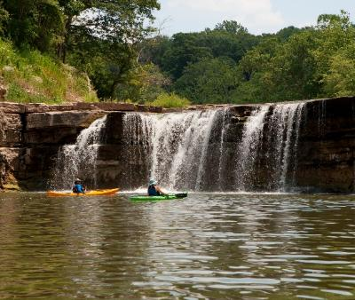
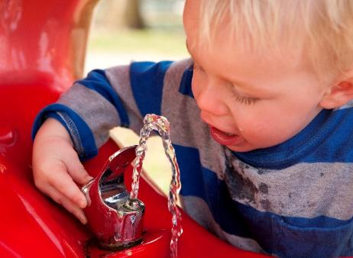
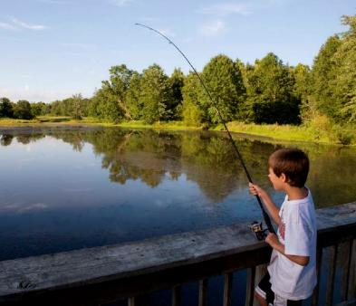
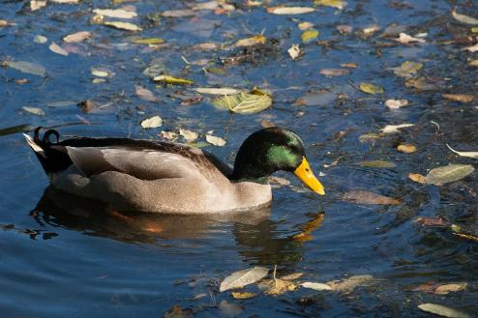
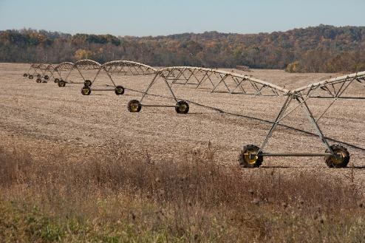
Clean Water Important to All
Notes:
Why do you value clean water, why are you here?

Slide 4
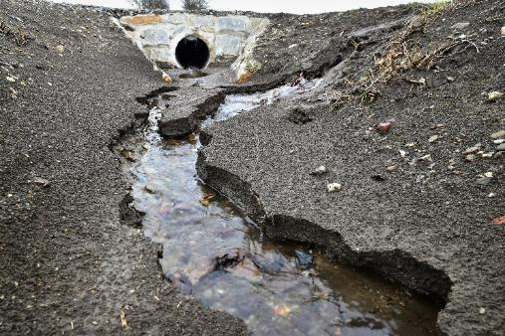
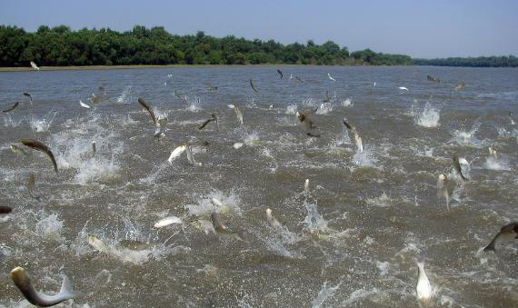
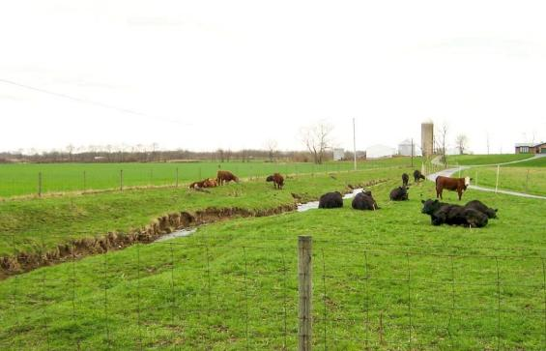
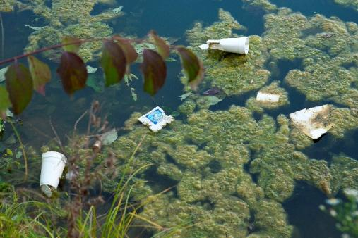
We Still Have Work to Do
Notes:
You are here because you recognize we all have a stake in water quality.

Slide 5
What is Hoosier Riverwatch?
Volunteer Stream Monitoring Program
  Established in 1996
Indiana Department of Environmental Management (IDEM)
  The Office of Water Quality's (OWQ) mission is to monitor, protect, and improve Indiana's water quality to ensure its continued use as a drinking water source, habitat for wildlife, recreational resource and economic asset

Slide 6
Hoosier Riverwatch Mission
To involve Hoosiers in
becoming active stewards of Indiana’s
water resources through watershed education, water monitoring, and clean-up activities.

Slide 7
Plan for the Day
How to Get Started
Watersheds & Pollution Sources
Physical/Habitat Assessment
Chemical Monitoring
Biological Monitoring
LUNCH
Data Reporting/Analysis
Tracking Volunteer Hours
Field Work at the Stream
Evaluations & Questions
Notes:
Review agendas (make agenda your own):
Hand out manuals (if not done so) – focus on them as resources that MUST be used during monitoring
They have permission to copy all/parts of the manual
Data sheets can be found throughout, but there are copy pages in the back, so they can write in the manual during the training
Datasheets are also online.
Highlighted are the ‘Big 3’ – categories for our parameters

Slide 8

Chapter 1
Safety
Equipment Program
Aquatic Invasive Species
Appendix A
Notes:
Highlights Safety First – read through each bullet point in Safety section
Intro to Aquatic Invasives but manual has full chapter on AIS in Ch. 6
Appendix A, place where folks can find info on equipment
Equipment program
Grant kits – application for schools, nonprofits & govt. agencies.
Loaner kits - located throughout the state (see online map), available to trained volunteers

Slide 9
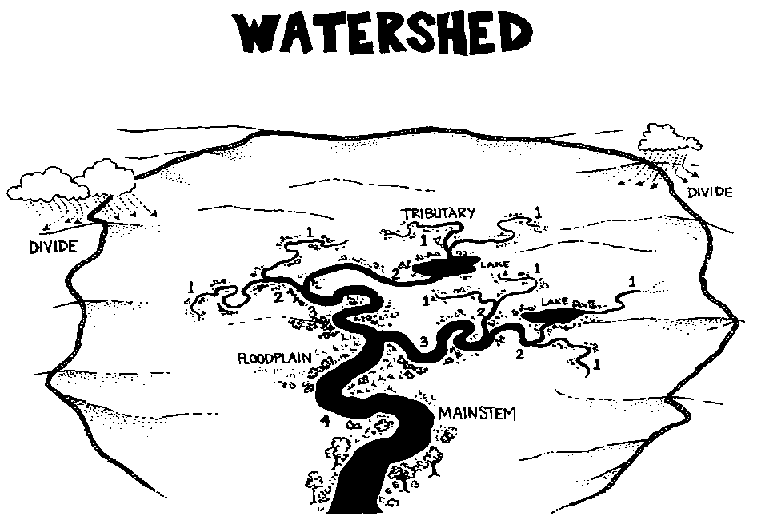
Chapter 2
Notes:
Ask the audience to give a definition of a watershed – want them to get that it’s the LAND AREA that drains into a particular water body.
Sometimes useful in illustrating this concept:
Water always flows downhill
Imagine you’re a water drop – if you land in a particular spot in the watershed, which direction will you go?
Can delineate watersheds by connecting high points on a topo map
Watershed Tarp Activity (optional)
Most important point: Actions in one part of the watershed (even a small, remote area) impact water quality “down stream”.
FYI – the numbers indicate Stream Orders – 2 First orders streams converge to make a Second order & so on…
70-75% streams worldwide are 1st or 2nd order streams (headwaters)
Ohio – 8th
Mississippi – 10th
Amazon – 12th

Slide 10
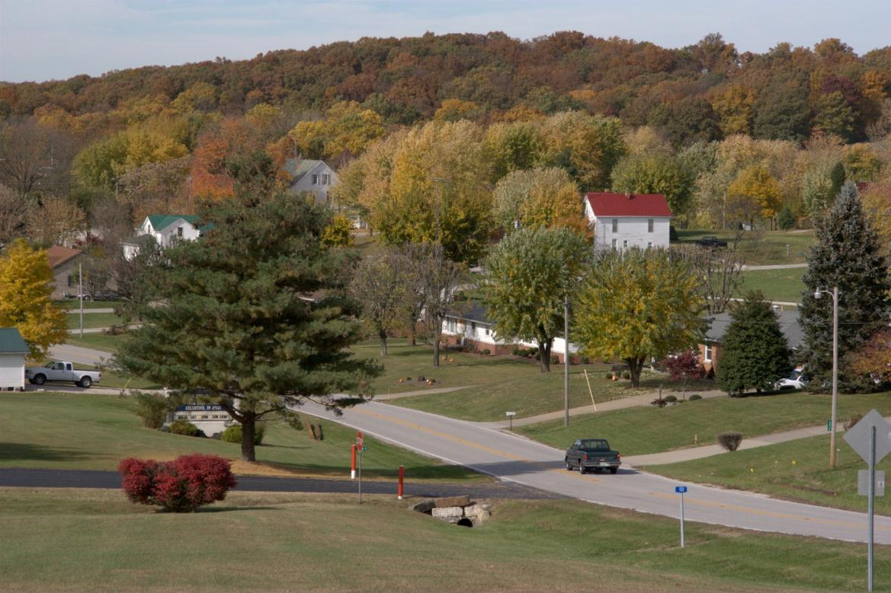
Your own backyard is part of a watershed.
Notes:
Everyone lives in a watershed – Your own backyard is part of a watershed. Down the street, there may be a small creek or drainage ditch, which will eventually lead to a larger stream, river, pond, or lake. This means that what happens in your backyard, and your neighbor’s backyard, affects your whole environmental neighborhood!

Slide 11
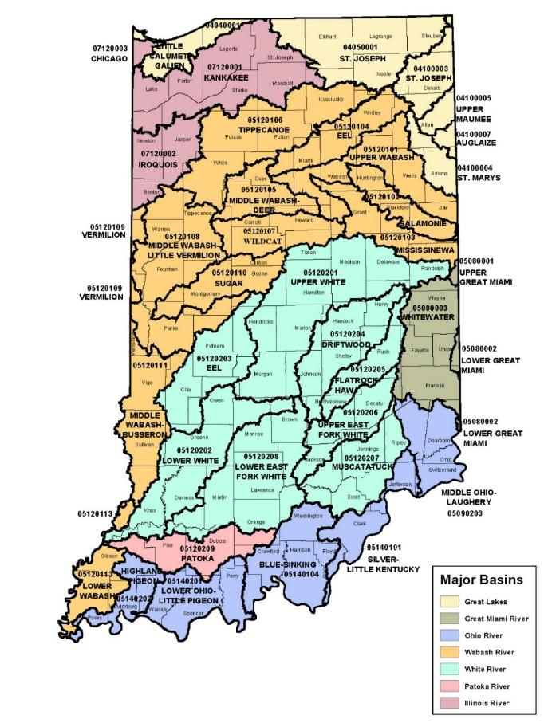
https://www.in.gov/idem/cleanwater/resources/indiana-huc-finder/
Notes:
Hoosier Riverwatch
Basic Training
https://www.in.gov/idem/cleanwater/resources/indiana-huc-finder/
These Hydrologic Unit Code Areas are watersheds delineated by the USGS
These cross state boundaries, and are used nationally to organize water quality data (used by EPA)
8-Digit Codes cover larger areas (outline and show example on map); 11- and 14-digit codes indicate smaller areas.
First two numbers are regions (21 total)
Discuss the direction that water flows in different parts of Indiana (may want to use colors to illustrate). Teachers often find this useful – relates to maps, social studies, etc.
04 – Great Lakes Watershed
05 – Ohio River
07 – Upper Mississippi
Ask them to find their watershed – write it on If they have trouble, they can call the Riverwatch office. However, tell them to consider the name of their river/creek and what it flows into – for example, if they can’t decide between the Sugar and Wildcat watersheds, but they determine that their creek ultimately flows into the Wildcat River, they have their answer.

Slide 12
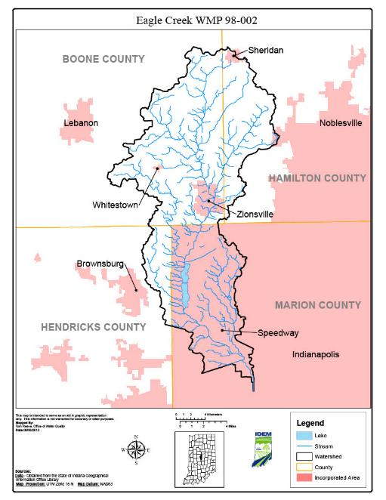
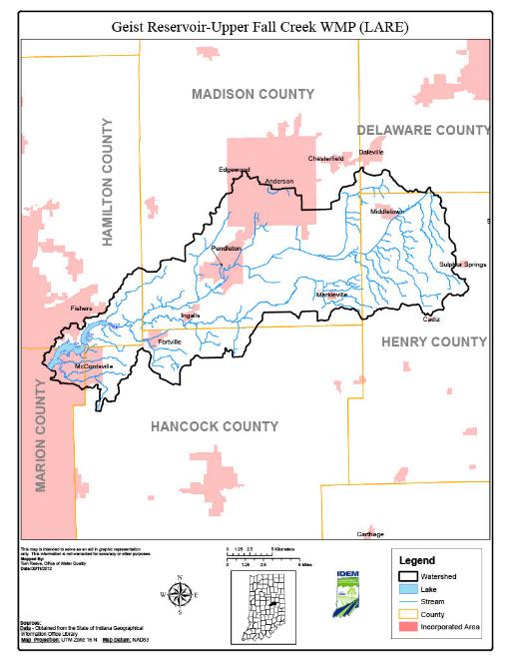
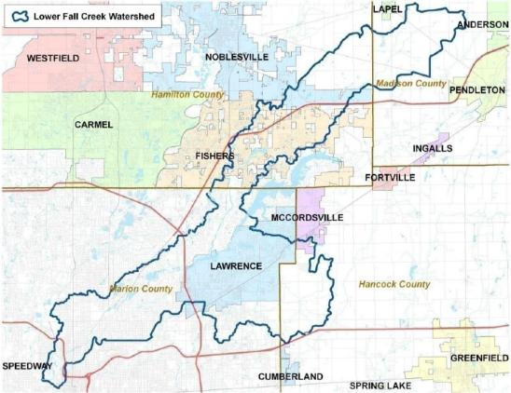
Notes:
These are examples of “sub-watersheds” in the Indianapolis area (Upper White watershed)
From left to right: Eagle Creek reservoir & its tributaries, Lower Fall Creek (enters White River downtown), Upper Fall Creek (Geist Reservoir & its tributaries)

Slide 13
What is the most common cause of pollution in streams, rivers, and oceans?
Dumping of garbage by cities
Surface water running off yards, streets, paved lots, and farm fields
Trash washed into the ocean from beaches
Waste dumped by factories
Notes:
Have your audience guess the correct answer (#2). (Go to next slide for more information.)

Slide 14
Point Source Pollution
25% of pollution in the U.S.
Direct discharge from industry, sewage treatment plants, etc.
Easier to identify due to “end of pipe”
Notes:
IDEM regulates point sources by use of permits.
Prior to 1972, the percentage of Point Source pollution would’ve been much higher, but regulation with Clean Water Act reduced dumping

Slide 15
Non-point Source Pollution
75% of Pollution in the US
General runoff of water contaminated
by poor land use, homes, streets, air, etc.
Difficult to identify
Notes:
If you notice the colorful sheen of motor oil in your creek, can you tell exactly which car it came from? No, this is non-point source pollution.

Slide 16
Types of Pollution
Organic
  Decomposition of once living material
  Human, animal waste, algae
Inorganic
  Suspended and dissolved solids
  Silt, salt, minerals
Toxic
  Heavy metals and lethal organic compounds
  Mercury, PCB’s
Thermal
  Water heated by urban runoff or industry
  Streets, nuclear power plants
Biological
  Introduction of non-native species (zebra mussels)
Notes:
PCBs = polychlorinated biphenyls – manmade chemical, yellowish oil, widespread use from 1920s until ban in 1979 but it persists in nature, slow to break down, detriment to human health

Slide 17
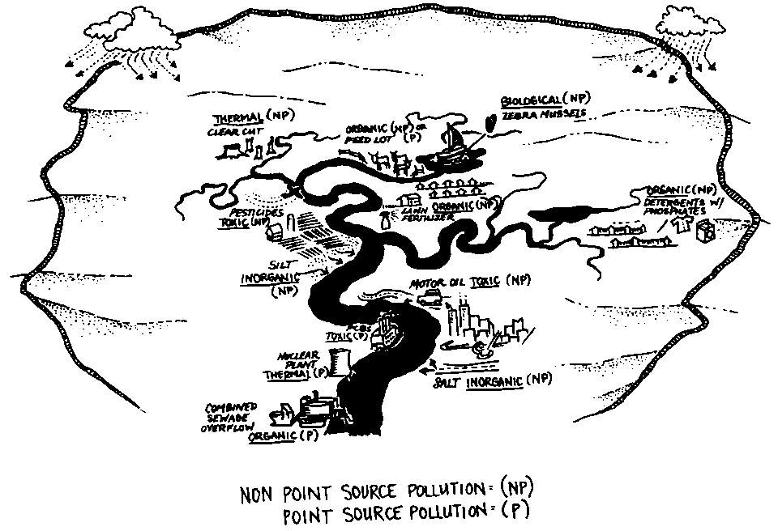
What is the leading source of water pollution in Indiana?
Notes:
Ask them for examples of point and non-point sources of pollution (can use drawing).
Be sure to cover thermal (ex. Cooling ponds, parking lots, clear cuts, etc.) and biological (zebra mussels, purple loosestrife, etc.) – these are not typically things that people think of as pollutants.
Leading source of water pollution? SEDIMENT (see page 17)

Slide 18
Why We Monitor
Identify pollutants and sources
Establish baseline data
Document changes and trends
Measure effectiveness
Inform stakeholders
Assess use attainment

Slide 19
What We Monitor
Should align with your “why”
Example
  What chemical and/or field samples are taken depends
  on objective and budget
  If interested in algae blooms, sample for nutrients and collect representative algae samples for ID

Slide 20
Where to Monitor?
Based on sampling goals/objectives
  Upstream/downstream
  At bottom of watershed
  Multiple sites
Physical location
  Distance/convenience and access/property rights
Safety
  Roadside parking, rocky inclines, high flow conditions, bacteria consideration
200-foot site, similar characteristics to larger area
Notes:
With safety as top priority, volunteers can choose any accessible 200-ft stretch they want

Slide 21
When to Monitor
Based on sampling goals/objectives
Before and after
  Monitoring before and after a large rain
  Useful for determining types of pollutants washed into
  stream after rain and reveal changes that occur as result
  of new land use
Change over time
  Monitoring the same site twice each year for a period of years
  Useful in identifying trends and picking up unusual situations
Daily & Seasonal Changes
Notes:
With safety as a top priority, volunteers can sample anytime they want

Slide 22
Who Monitors (Other Data Sources)
As few as 2-3 adults or students
Multiple tests for one parameter allows participation & quality control
Federal Agencies
  U.S. EPA
  USGS
  Forest Service
  NOAA
  Fish and Wildlife
States
  IDEM
  DNR
  Health Department
  Drinking Water Agencies
Universities
Counties
Municipalities
Tribes
Regulated Communities
Advocacy Organization
  Nature Conservancy
Sporting Organizations
Watershed Organizations
Schools, 4-H

Slide 23
Quality Assurance/Quality Control
Quality Assurance is a broad plan for maintaining quality in all aspects of a program
Quality Control methods are established to
control errors
  Follow protocol (read the manual!)
  Repeated measurements (find the average)
Notes:
The goal of QA/QC is to find accurate (representative of true value) & precise (repeatable) data
Hoosier Riverwatch data may not be as accurate as data collected with more sophisticated technologies (test strips vs electronic probes), but it does offer a “ballpark” figure

Slide 24
Measuring Water Quality
Chemical
Biological
Physical
Notes:
We recommend volunteers do all 3 to provide the best information about a site, but dependent on volunteer time, resources, etc.
Do volunteers need to complete every test? NO – some tests may not be applicable (habitat evaluation difficult on larger river)
You can suggest that:
Chemistry data can be collected more often than other data
Macros and habitat could be done seasonally
Collect at same time each year to minimize year to year variability (i.e. Spring after ice broken and late-stage larva are present or late fall when organisms are more mature.)

Slide 25
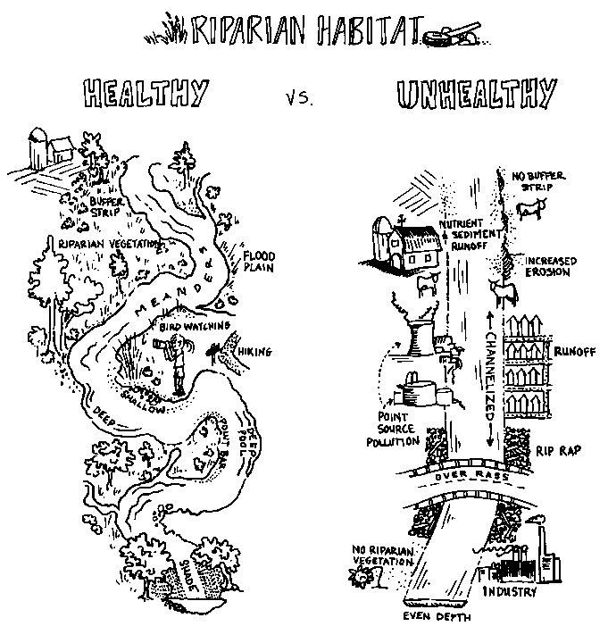
Notes:
Activity BEFORE showing this slide – draw a stream that you imagine is the perfect/healthy example of a stream habitat, share characteristics in discussion
Examples:
Meanders (curves) – decrease water velocity, decrease erosion, results in variety of depth and substrate conditions
Riparian vegetation – filters pollution runoff before it reaches water, roots hold onto soil (reducing erosion)

Slide 26
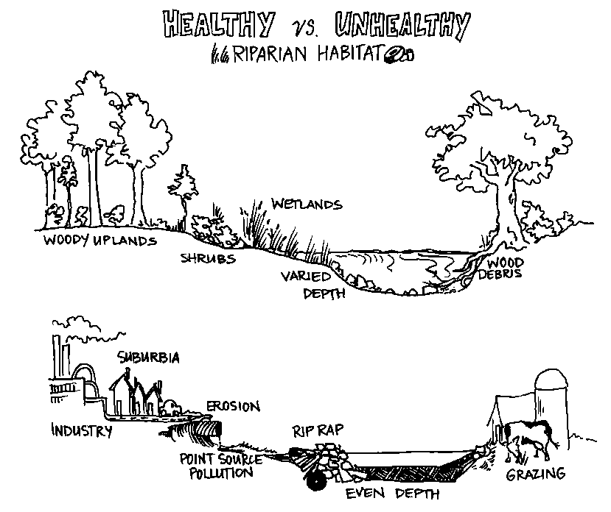
_{www.HoosierRiverwatch.com}
Notes:
Useful in explaining riparian vegetation (runs alongside and out from the stream).
Useful in illustrating variety of depths and substrates – some organisms are very picky, will only be found under certain conditions (ex. shallow and rocky).
Healthy streams tend to have a variety of habitats – can support a more diverse community of living things.

Slide 27
Citizens Qualitative
Habitat Evaluation Index
The following all contribute to habitat and
combine to give a final score:
  Substrate
  Fish Cover (pg. 25 for examples)
  Stream shape and human alteration
  Riparian area and local land use
  Depth/Velocity
  Riffles/Runs
Notes:
“CQHEI” – considers the factors important for healthy aquatic habitats
Based on the professional QHEI, used by IDEM, Ohio EPA, etc.
Designed for use in wadeable streams, not large rivers or intermittent streams.
Can still use it to assess habitat of these water bodies, but final score is not as meaningful.

Slide 28
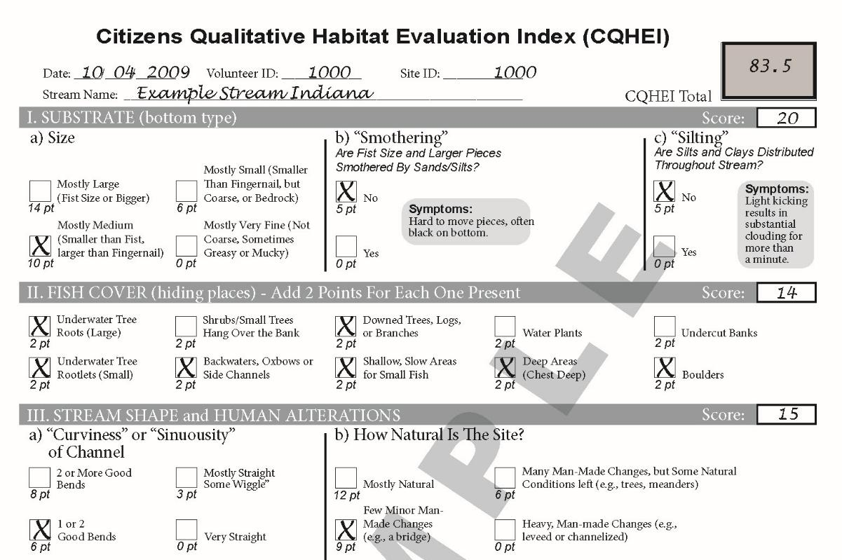
Notes:
Instructions - stress the importance of using these, particularly the first couple of times they use the CQHEI
The assessment is done over the entire 200 foot site.
Some sections are “select all that apply” but most require a single, best choice (“mostly” is a term used frequently and does introduce subjectivity into this test)
IF you are split 50/50 between two choices, you may take the average of both points
Stress the importance of filling out each section. The database will not allow them to submit the data if anything is left blank, OR if they choose more than 2 items (except in sections II and Vb).

Slide 29
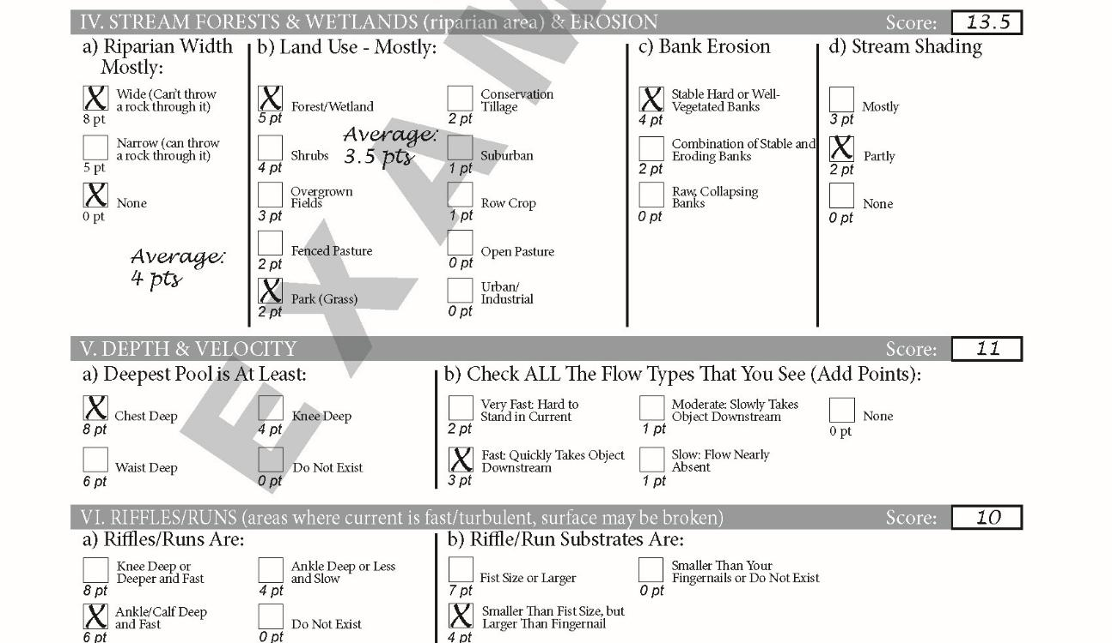

Slide 30
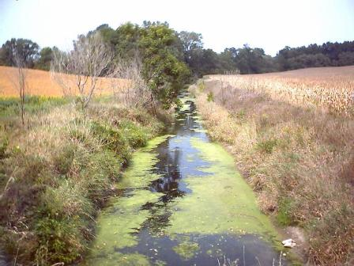
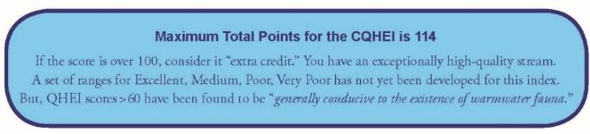
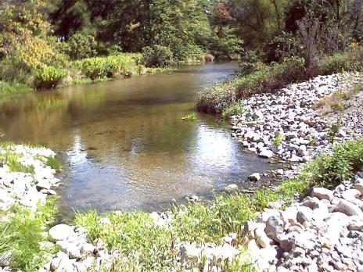
Notes:
Even if we cannot apply a specific grade, we have an innate ability to determine which of two streams is of higher quality (ex: right photo has better characteristics even if it does have rip rap, etc.)

Slide 31
Stream Flow
Water Quality
  Stream flow affects turbidity and dissolved oxygen
    High velocity streams more erosive and suspend sediments
    for longer time leading to greater turbidity
    Turbulent, fast streams are better aerated and higher DO levels
    Greater volume maintains cooler temps.
Aquatic Life
  Different stream flows create different habitats
Discharge = volume flowing in a stream
  cubic feet per second
  D = Width x Depth x Velocity x Roughness Coefficient

Slide 32
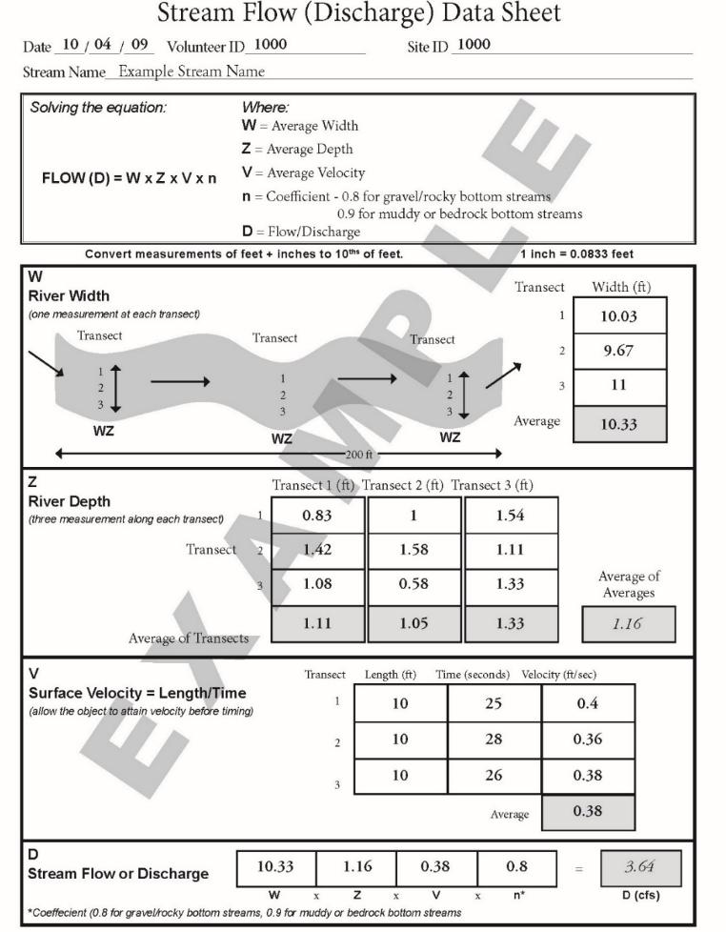
Your phone calculator can help find conversions
Notes:
Flow data helps interpret chemical, habitat, and biological data – a lot can change with high or low flow conditions.
Measurements MUST be recorded in FEET (or decimal feet) - NO inches or meters (because final unit is cubic FEET per second)
Surface velocity (float test) – demonstrate using Easter egg, fishing bobber, apple/orange, etc. Place into water (don’t drop) and time the travel
If very slow flow results in very long time for 10 ft. reduce to 5 ft (the equation length/seconds will still equate to the same velocity)

Slide 33
Chemical Assessment
Water Temperature
Dissolved Oxygen
pH
Phosphates
Nitrates and Nitrites
Turbidity/Transparency
Biochemical Oxygen Demand 5-day
E. coli and general coliforms
Notes:
These are 8 of the 9 tests selected by the National Sanitation Foundation in the 1970’s as the most meaningful for overall water body health.
Last two are the most skipped tests (due to the time constraint – 5 days for BOD & 48 hours for E. coli)

Slide 34
Hints for Chemical Testing
Safety first – gloves, eye protection, etc.
Sample in the main streamflow upstream of you
Rinse tubes with sample water
Dispose of waste properly

Slide 35
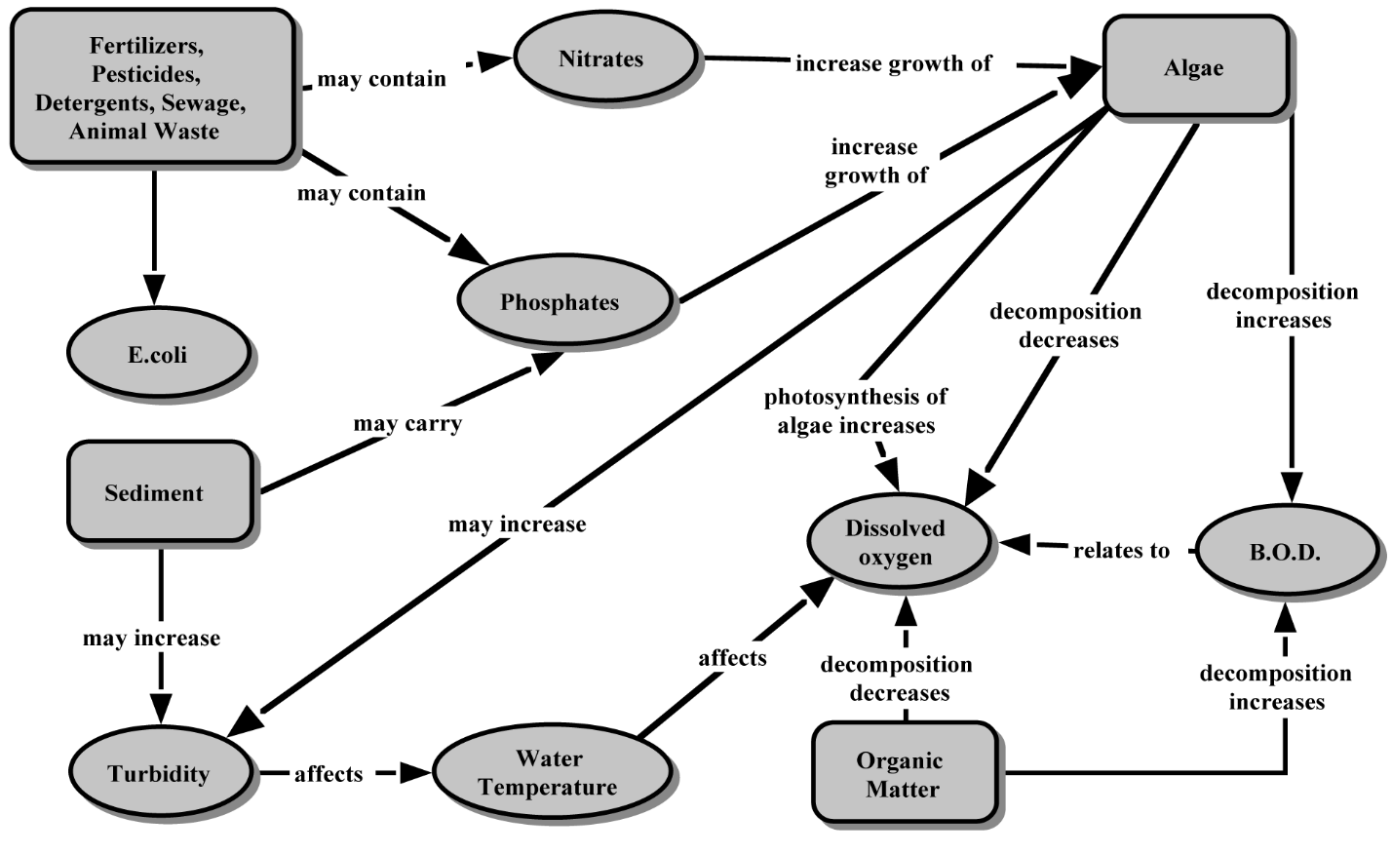
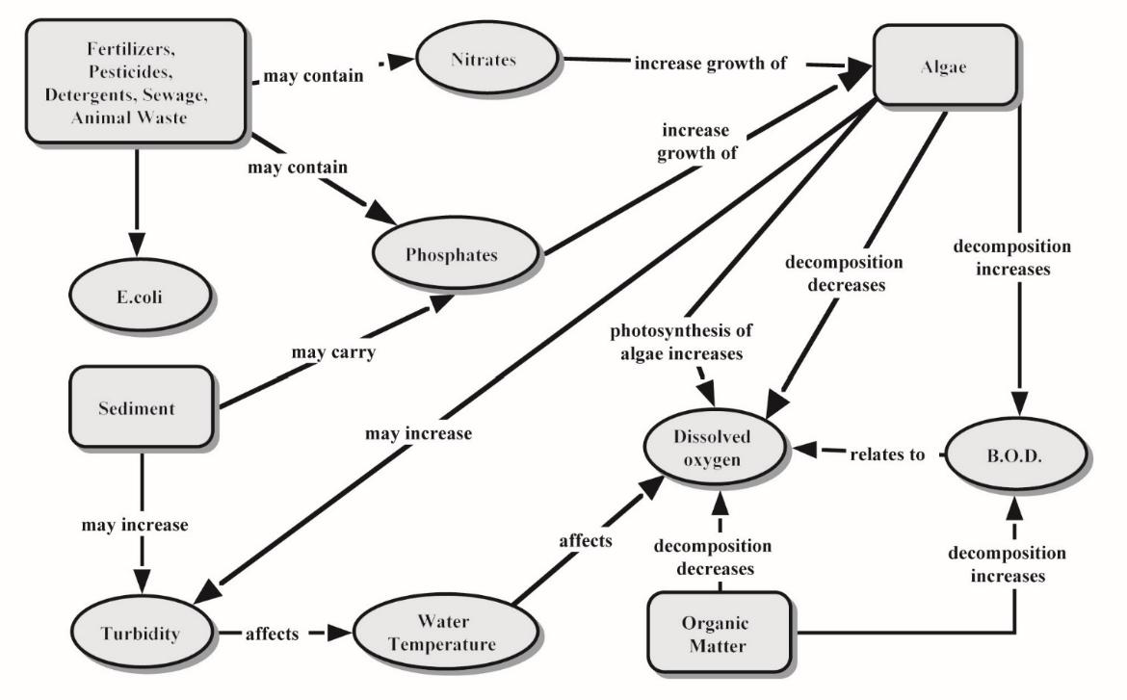
Interrelationships
Notes:
Concept diagram showing some of the possible relationships between chemical parameters (i.e. if sediment/turbidity rise, temperature rises, DO drops, etc.)
Optional: Introduce them to critical thinking questions (white form)

Slide 36
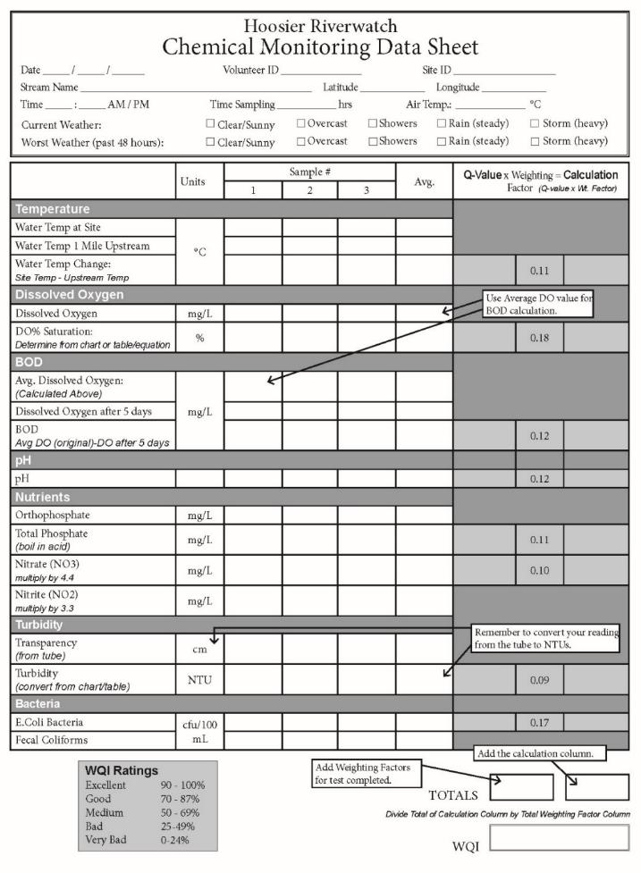
Notes:
Point out Samples #1-3 (we look for averages), gray column at right (Q-values & weighting factors)

Slide 37
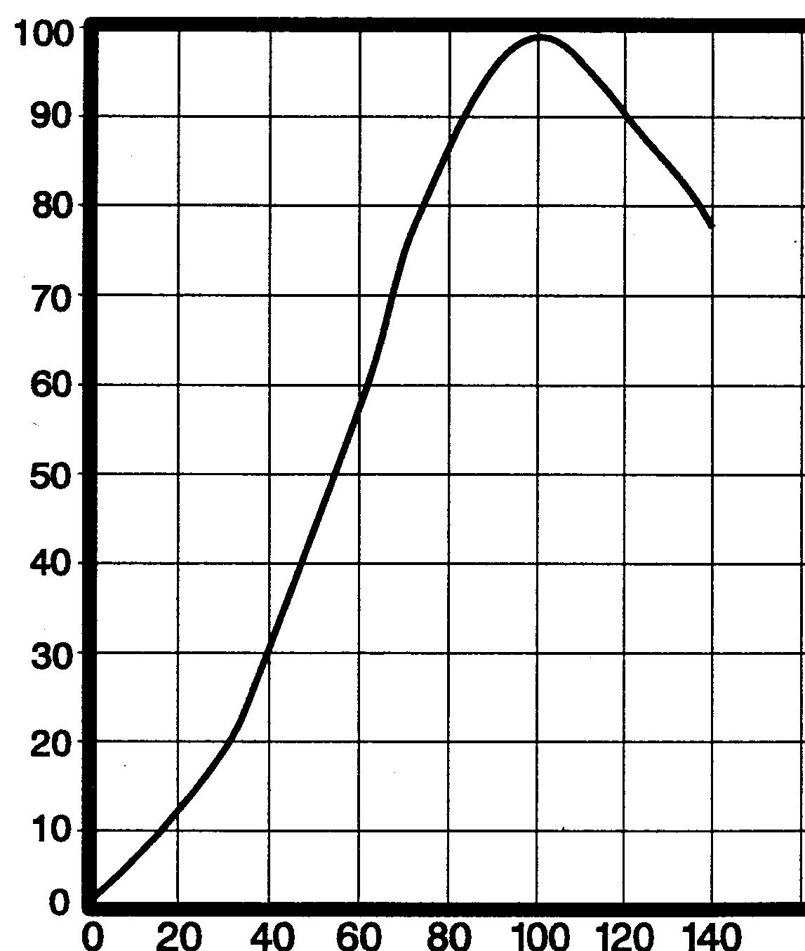
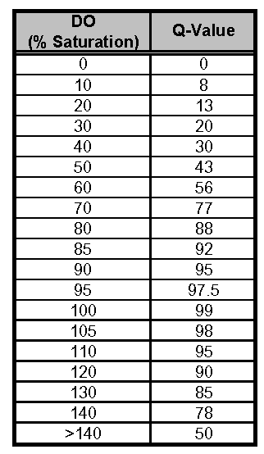
DO: Q-Value Graph & Table
Notes:
Talk about Water Quality Index and Q-values (Quality Values)
They help interpret results in terms of overall water quality (like a grade) AND allow easier comparison of different units (ppm vs cm vs CFU/100mL)
Q-charts found after most tests (No Q-values for Orthophosphate and Nitrite)

Slide 38
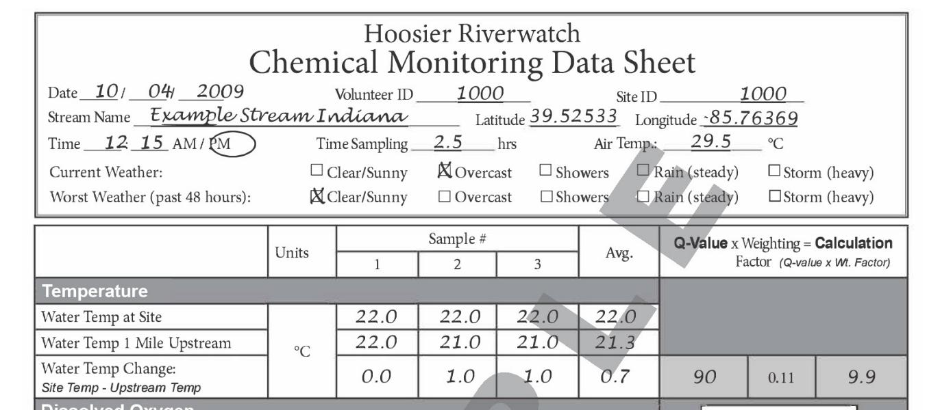
Notes:
Take air temp BEFORE dipping thermometer in water

Slide 39
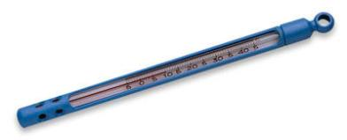
Water Temperature
Place thermometer below water’s surface
(approx. same depth at which other tests
are performed)
Equilibrate for about 2 minutes
Record in degrees Celsius

Slide 40
Water Temperature
Temperature affects:
  oxygen content of the water
    oxygen levels become lower as temperature increases
  rate of photosynthesis by aquatic plants
  metabolic rates of aquatic organisms
  sensitivity of organisms to toxic wastes, parasites,
  and diseases
  NO Q-value – seasonal fluctuations are natural

Slide 41
Water Temperature Change
Temperature change between sampling site and
1-mile upstream (if possible)
Causes of temperature change include:
  weather
  removal of shading streambank vegetation,
  impoundments (a body of water confined by a barrier, such as a dam)
  discharge of cooling water
  urban storm water
  groundwater inflows to the stream
Q-value present
Notes:
Take the water temp. at the site, then ~1 mile upstream, and subtract.
Testing for thermal pollution.
Drastic changes in temperature can have major impacts on the life in a stream.

Slide 42

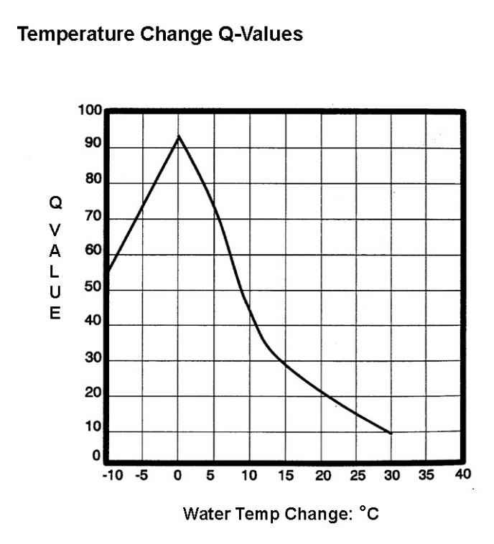
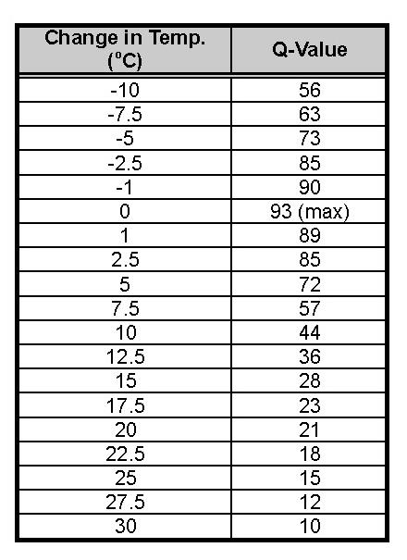
Site Temp – Upstream Temp

Slide 43
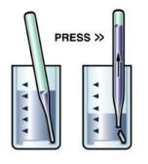

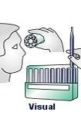
Dissolved Oxygen (CHEMetrics®)
Triple rinse, fill 25 mL sample cup
Snap ampoule tip in sample cup
Mix, wait 2 minutes
Compare colors with comparator
Record results in mg/L

Slide 44
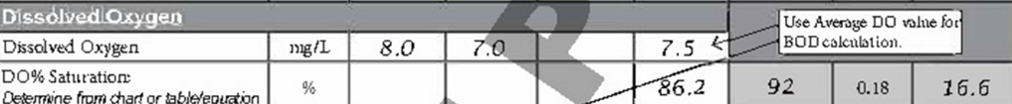
Dissolved Oxygen (DO)
Primary indicator of water quality
Oxygen is produced during photosynthesis and consumed during respiration and decomposition
  Higher DO → Higher diversity of aquatic organisms
  Generally < 3 mg/L is stressful to aquatic life
Units of measurement are:
  Concentration: mg/L = ppm
Percent Saturation
  Used to determine if water is fully saturated with oxygen at a particular temperature
Notes:
Riffles – water and air mix; tend to be excellent places to find macroinvertebrates.
NO Q-value for DO itself

Slide 45
Amount of DO (mg/L) your water sample would need to be 100% Saturated at the given temperature.*
*at sea level
Notes:
% Sat DOES have Q-value

Slide 46
Calculate % Saturation
DO mg/L (your sample)
Max DO mg/L (from chart determined by water temp)
X 100%
Dissolved
Dissolved
Temp
o
C
Oxygen
(mg/L)
Temp
o
C
Oxygen
(mg/L)
0
14.6
15
10.1
Example at 16º C:
8.0 x 100% = 81%
9.9
1
14.2
16
9.9
2
13.8
17
9.7
3
13.5
18
9.6
4
13.1
19
9.3
5
12.8
20
9.1
6
12.5
21
8.9
7
12.1
22
8.7
8
11.8
23
8.6
9
11.6
24
8.4
10
11.3
25
8.3
11
11.0
26
8.1
12
10.8
27
8.0
13
10.5
28
7.8
14
10.3
29
7.7

Slide 47
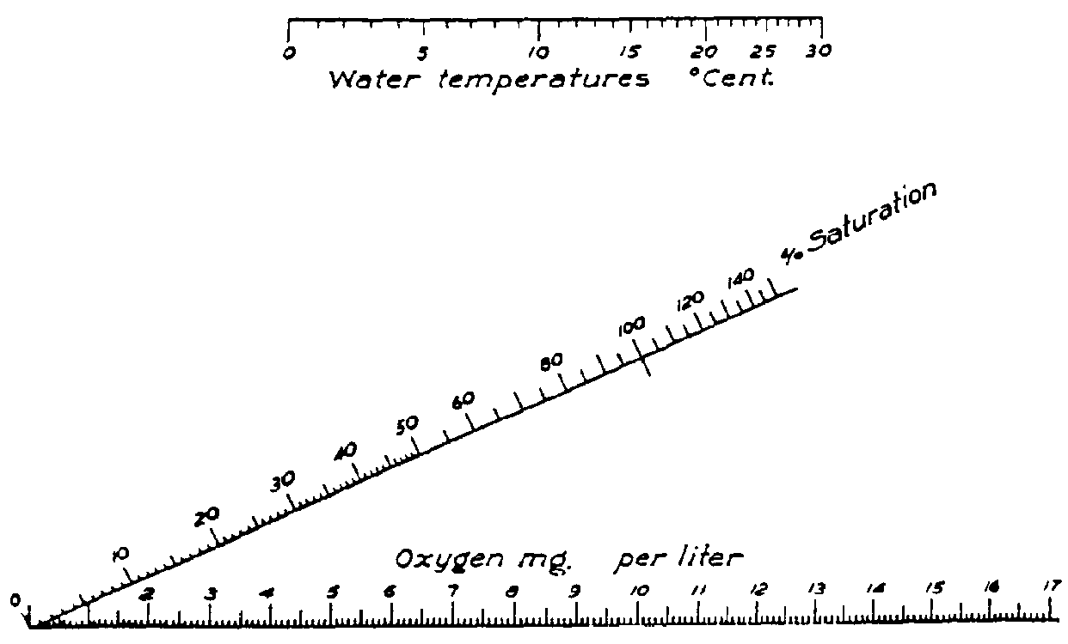
Notes:
This figure is used to determine % saturation for DO
Use a straight edge to connect the water temperature with the DO concentration – read %Saturation from middle line.

Slide 48
Biochemical Oxygen Demand 5
Amount of oxygen consumed by bacteria during breakdown of organic matter (sewage, plant, etc.)
  DO (Original sample) – DO (Day 5) = BOD5
High BOD5 = potential for oxygen depletion
in the water
High BOD5 generally correlated with high
nutrient levels
Indiana average = 2 mg/L
Notes:
Oxygen-consuming bacteria break down organic waste in water, so this is an indirect way of measuring the amount of organic waste. The more waste in the water, the greater the potential for oxygen depletion.
Fill bottle underneath the water so no bubbles can get in
Light proof bottles OR place in dark area so no photosynthesis

Slide 49
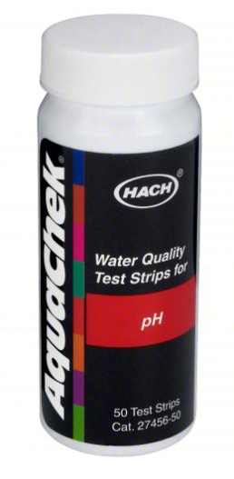
pH (Hach)
Dip test strip into water, remove immediately
Hold strip level, do not shake off excess water
Wait 15 seconds
Match closest color
Record results

Slide 50
pH
Measure of how acidic or basic the water is
  From 0 (very acidic) to 14 (very basic)
Influenced by geology, rain, and discharge from
point sources
Affects toxicity of other chemicals; many aquatic organisms are very pH-sensitive

Slide 51
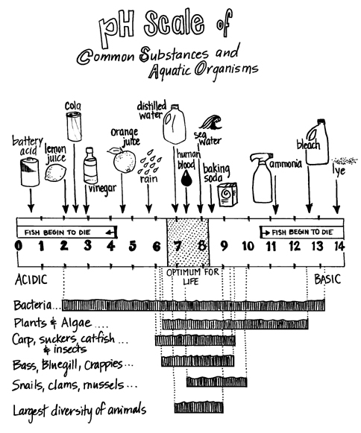
Notes:
Good place to mention the relationship between aquatic life and pH.
Some bacteria survive in bleach? Yes, the label will read 99.9% bacteria killed (0.1% can survive)

Slide 52
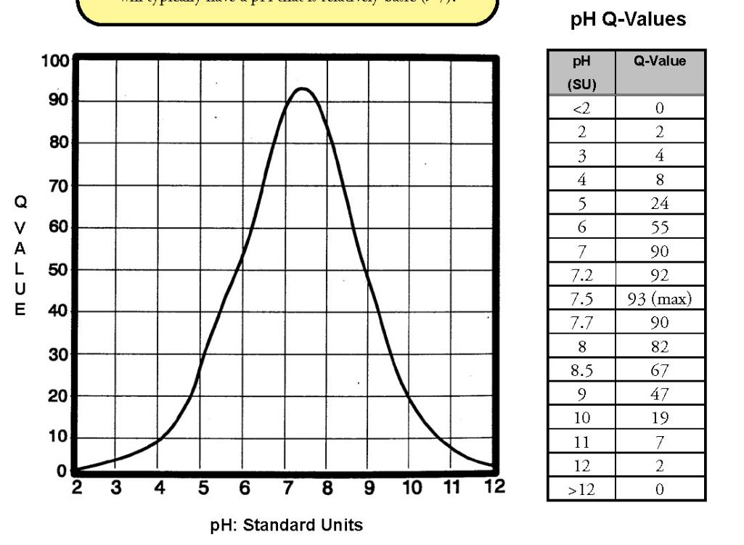
Notes:
Why is average Indiana pH 7.5 if rain is acidic? LIMESTONE geology!

Slide 53
Orthophosphates (CHEMetrics®)
Triple rinse, fill 25 mL sample cup
Add 2 drops of activator solution, cap & mix
Snap ampoule tip in sample cup
Mix, wait 2 minutes
Compare colors with comparators
Record results in mg/L

Slide 54
Phosphates
Nutrient essential to plant growth, naturally present in low concentrations
Enters water via runoff; present in fertilizers, attached to soil particles, and in organic waste
Can lead to eutrophication
  nutrient overload and the system’s response
  (lots of plant growth)
  High P often results in low DO
Notes:
Phosphate present in many forms (ex. orthophosphates are dissolved in the water).
High P → lots of plant growth → plants die → decompose (broken down by aerobic bacteria) → oxygen depletion

Slide 55
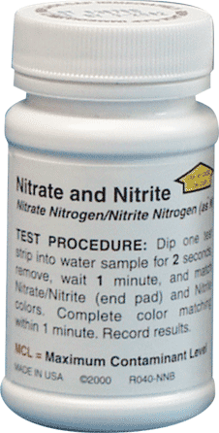
Nitrates (NO₃)/Nitrites (NO₂)
Dip test strip in for 1 second
Hold the strip level, do not shake
Wait 30 seconds
Match each pad to closest color
Apply conversions
  “Nitrate Nitrogen” ppm (from bottle) x 4.4 = “Nitrate” (on data sheet)
  “Nitrite Nitrogen” ppm (from bottle) x 3.3 = “Nitrite” (on data sheet)
Record results in mg/L
Notes:
Volunteers MUST convert the results from the test strips before recording on the data sheet.

Slide 56
Nitrates
Nutrients essential to plant growth
Sewage is main source to rivers and streams
Excessive amounts contribute to eutrophication
  High nitrate levels often correspond to high total phosphates and low DO
Notes:
Very similar to phosphates – both are nutrients
Don’t have to spend as much time explaining –
But point to sewage as main source

Slide 57
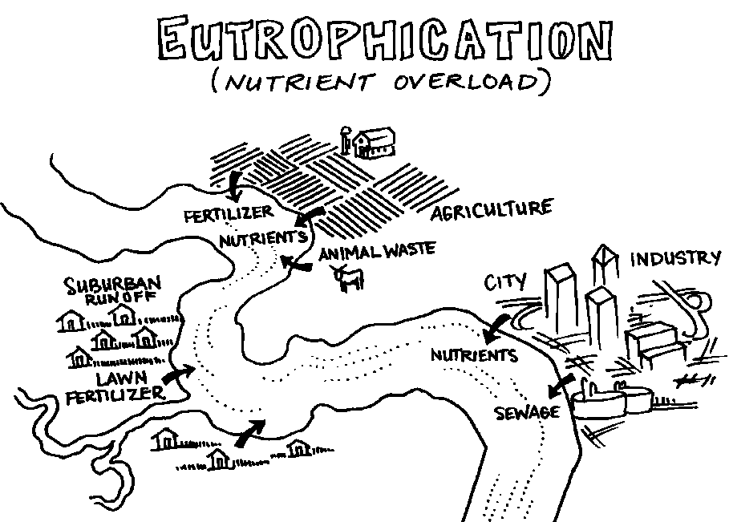

Slide 58
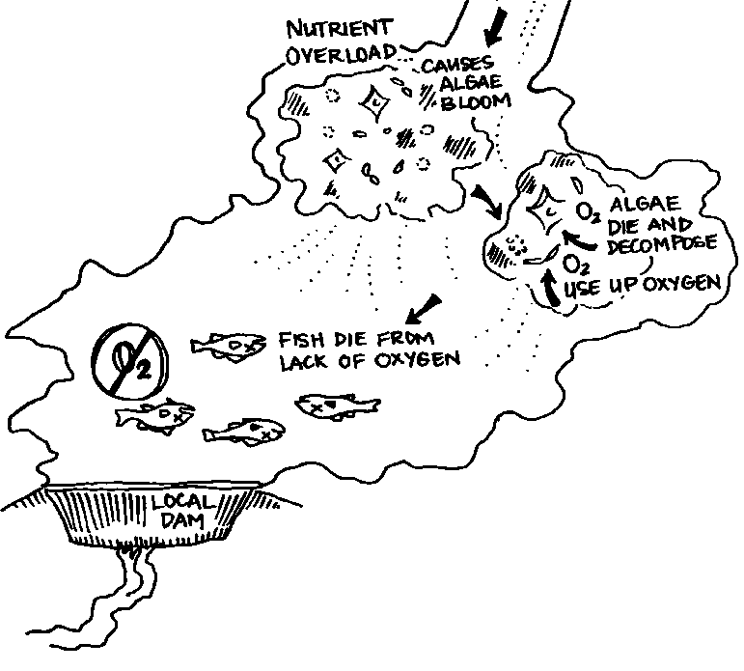
Notes:
Note: Fish kills occur in extreme cases

Slide 59
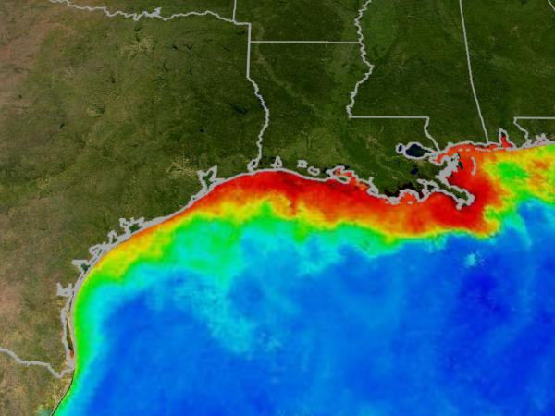
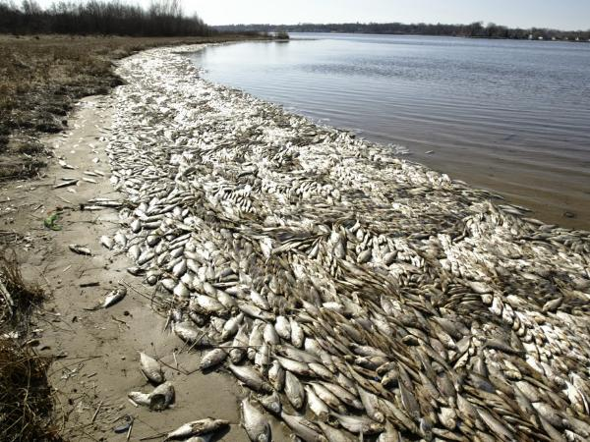
Gulf of Mexico – “Dead Zone”
Notes:
Example: Dead zone in the Gulf of Mexico – Several thousand square mile area of water has no oxygen (anoxic) – due to inputs of nutrients from the Mississippi River watershed (largest watershed in continental US). There are no fish, shrimp, or higher levels of aquatic life.
Also a hypoxic “dead” zone in Lake Erie.
State Nutrient Task Force: https://www.in.gov/isda/divisions/soil-conservation/indiana-state-nutrient-reduction-strategy/

Slide 60
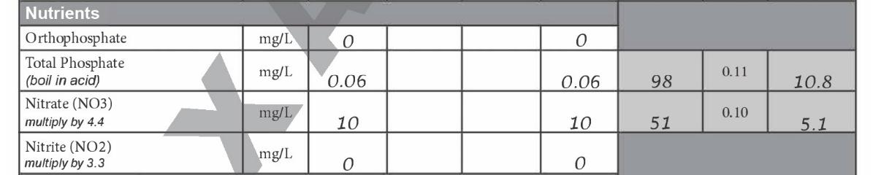
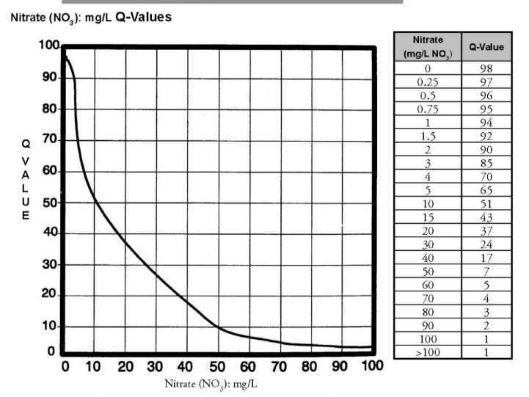
Notes:
No Q-value for Orthophospate
Make clear that we do NOT measure Total Phosphorus anymore (it requires heat & acid) for safety reasons.

Slide 61
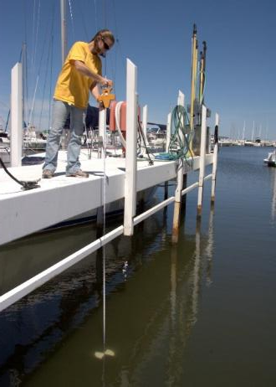
Turbidity
The relative clarity of water
Caused by suspended solids in
water (from soil erosion, algae, etc.)
May:
  Increase photosynthesis
  Increase temperature
  Decrease DO
  Smother habitat
  Clog gills
Notes:
Secchi disk used in lakes to measure this parameter, streams often not deep enough, so we use tube with secchi at bottom (show them the turbidity/ transparency tube).

Slide 62
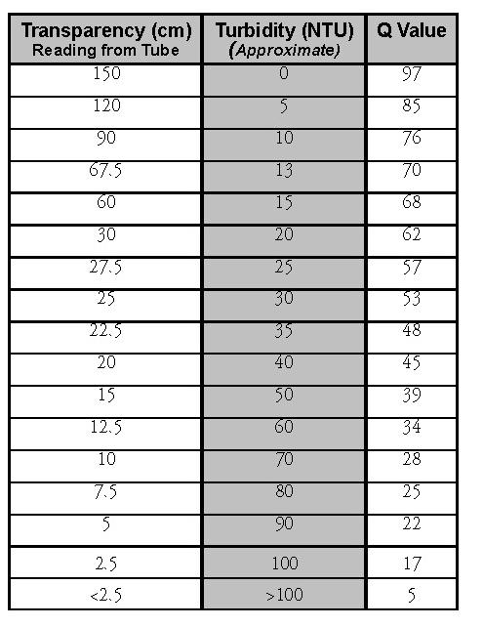
Notes:
Measure transparency (a measure of the scattering of light) then convert to Nephelometer Turbidity Units (NTUs)
Equipment may limit score – a 60 cm tube vs 120 cm tube could result in a Q-value difference of 17
HRW staff has been distributing 120cm tubes to allow higher (more accurate) scores

Slide 63
E. coli
E. coli is a particular species of Fecal Coliform bacteria
Enters water via Combined Sewer Overflows
(CSO’s), poor septic tanks, & agricultural animals.
Not necessarily pathogenic themselves; signal
the presence of dangerous pathogens/fecal contamination
Standards set by EPA for drinking water and recreational use
Often found in conjunction with high
nutrient levels
Notes:
We test for E. coli because it’s prevalent in fecal matter. If there’s fecal contamination, we’ll find E.coli. Its presence indicates that other (potentially more harmful pathogens) may also be in the water. Fecal material is also high in nutrients

Slide 64
Family
Enterobacteriaceae
Total Coliforms
Fecal Coliforms
E. coli
Pathogenic E.coli
Notes:
E. Coli are a subset of family of bacteria called enterobacteriacae. This family represents a group of organisms that includes nearly a dozen separate genus groups and more than 40 species.
Total coliforms – many species and strains for a variety of sources (fecal and non-fecal) including plants and animals.
Fecal Coliform – Includes bacteria from fecal matter (animal or human).
E. Coli – one type of bacteria within the fecal group, hundreds of different strains, most harmless, useful indicator organism.

Slide 65
Coliscan Easygel
Count after 24 hours of incubation (95⁰F)
  Blue and purple colonies are E.coli
  Teal and pink colonies are not E. coli
Contains 2 enzymes
Only E. coli produces both enzymes
  Red + Teal = Dark Blue/Purple
Goal- <200 colonies in the petri dish
Notes:
Can use .25 mL to 5mL of sample water.

Slide 66
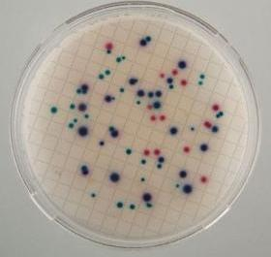




Slide 67
3M PetrifilmTM
Count after 24 hours incubation
Count blue colonies WITH gas bubbles
Don’t count blue colonies without gas bubbles
Don’t count pink or white colonies with or
without gas bubbles
Notes:
Can only use 1mL of sample water.

Slide 68





Slide 69
Units for E. coli
Use the number of colonies found in your
sample volume to estimate the number that
would be found in 100 mL of water.
Example:
  Used 3mL of water & counted 4 colonies
  Divide 100 by 3 = 33.3
  Multiply 33.3 x 4 = 133.2 colonies/100mL
State Standard for body contact = <235 CFU/100mL

Slide 70


Slide 71

Notes:
Example with all tests

Slide 72

Notes:
Add weighting factor values FOR ONLY THE TESTS COMPLETED. Add calculation values of Q-value x weighting factor.
Divide sum of calculation values by sum of weighting factors = WQI

Slide 73

Up Next…
Benthic Macroinvertebrates!

Slide 74
Benthic Macroinvertebrates:
Why do we monitor them?
Chemistry – just a snapshot in time
Macroinvertebrates:
  Not very mobile
  Spend extended period in the water
  Have different levels of tolerance to pollution
Macroinvertebrates provide idea of water quality over extended period of time
Notes:
CHAPTER 5
First, define Benthic Macroinvertebrate:
Benthic = bottom-dwelling
Macro = big enough to see without a microscope (though magnifying glasses are useful! Be sure you explain at some point that they can still be pretty tiny.)
Invertebrate = no backbone
~~~~~~~~~~~~~~~~~~~~~~~~~~
Be sure to explain that these organisms spend all or a portion of their lives in the water. Some require high levels of oxygen to survive; others can live in low oxygen situations. The presence or absence of certain organisms gives us an idea of how the water quality has been for a while, since many of these organisms spend months to years in the water. Chemical tests only reveal the water quality at the moment the water sample was collected.

Slide 75


Notes:
Macroinvertebrates are middle links in the food chain, with algae & phytoplankton on the bottom and fish & birds above.
Attention to detail is required to observe the anatomy of these creatures.

Slide 76

Notes:
Simply start at the top of the key, answering one question at a time. Once narrowed down to a small group, read the descriptions for the best match.
Practice on photos (next slide)

Slide 77




Notes:
Walk them through the identification keys in manual and the printed key.
Answer: Stonefly

Slide 78

Notes:
Once you have a positive ID, can you find it on this form?
Note that not all examples on the key are found on this page- some organisms that don’t fully rely on water quality (i.e. water beetles that breath air) are not included but are still a great example of biodiversity.
Also note, that the presence of Group 4 is NOT NECESSARILY bad news- these organisms can also survive in clean water. Be focused on the presence or absence of Group 1.

Slide 79



Slide 80

Notes:
Note that for scoring, we tally the TAXA present and not # individuals. Volunteers sometimes ask if # individuals needs to be recorded- the answer is no for HRW scoring (you will get a PTI rating regardless BUT this data is publicly available and some groups may need that data for their studies.

Slide 81

What if You Find Mussels?
Most endangered group
of animals in IN
Avoid mussel beds or live
shells if visible
Replace exactly where &
how found
It is ILLEGAL to possess
live or dead mussel shells
(1-800-TIP-IDNR)
Notes:
Make sure the participants understand that possessing mussel shells is ILLEGAL!!!
Mussels have had a tough time:
- Button industry
- Cultured pearl industry
- Sensitive lifecycle – male upstream, release sperm, female of same species may get fertilized and may release larvae to correct fish
overharvesting

Slide 82

Chapter 6
Invasive Species
Non-natives can cause ecologic/economic harm
Try to avoid spreading
  Clean/dry equipment
  Report species of interest to the DNR

Slide 83

www.hoosierriverwatch.com
Notes:
Show them the website’s data entry page. Use these slides if no internet access.

Slide 84

Notes:
IMPORTANT: Give the participants the Riverwatch website password – ‘dragonfly’
They can write this password on the inside cover of their manual
It is required to create a profile, site, etc.
Step 1: Register yourself as a volunteer (you will receive a Volunteer ID #)

Slide 85

Notes:
Step 2: Register a sampling site (in ‘site locator’ tab, drag pin on map to where you want the site) and fill out relevant info
Note: Check the ‘current sites’ tab to see if one is already established in your area of interest. If not, continue with creating a new site. If one is present, click the blue pin for the Site ID #.

Slide 86

Notes:
Not required, but volunteers can add their organization. First check to see if Org already exists in our list.

Slide 87

Notes:
Using ID #’s and ‘dragonfly’ password, begin to enter data starting with general details (date, time of day, weather, etc.). Note that it asks for worst weather in past 48 hours – this is because storm events may increase pollutants via runoff.

Slide 88

Notes:
Data entry should mirror paper data sheet with tabs for different categories. Some tests will result in auto population of scores on the right of the screen.

Slide 89


Slide 90

Notes:
Some tests won’t allow data entry until you select a ‘method’ from the drop down options. Most methods are ‘Chemetrics’ or ‘test strips’.

Slide 91

Notes:
Typing any key into the macro box will count that into Riverwatch scoring, but only accurate count #’s can be utilized by external partners.

Slide 92
Database Entry Tips
Keep hard copies of your data sheets
You get your Volunteer ID & Site ID #s when
you register online
You only need to register once
Check data for errors before submitting
Contact us if you need to make changes to
your registration information or the data
you submitted – DO NOT RESUBMIT!

Slide 93
Data Analysis
“Search”
  Can search datasets by watershed, county,
  volunteer ID, organization, etc.
  Filter for test, date, etc.
“Visualize”
  Compare two sites or one site across time
  Shows number of samples (n) and averages
  Can save/print graphs
  “more details” to see site locations
Notes:
These tools are publicly available.

Slide 94

Notes:
You can search via various parameters (i.e. county, river name, volunteer ID #)

Slide 95

Notes:
Volunteers can download data tables via the options at the upper right (i.e. Excel, CSV, PDF)

Slide 96

Notes:
Limited data visualization tools exist. HRW staff hopes to update this software in 2027 to allow for more visualization capabilities.

Slide 97


Slide 98
Appendices
Monitoring Equipment
Macroinvertebrates
What Can You Do to Prevent Pollution?
Ranges, Averages, and Q-values
Glossary
Other Resources
References
Extra Data Sheets
Notes:
Quickly walk them through the Appendices.
Note that volunteers can copy & reproduce ANY part of the manual for non-commercial purposes.
An electronic version of the manual is also available online.

Slide 99

Hoosier Riverwatch is partnering with NatureConnect
Step 1: Accept the invitation to join NatureConnect through Hoosier Riverwatch for FREE
Step 2: Join a project (‘Hoosier Riverwatch sampling’ or ‘workshop’)
Step 3: Log your hours and share stories/pictures
This process helps Hoosier Riverwatch staff track hours and paint a picture of the work being done out in the field!
NatureConnect is a 501c3 non-profit with a small team ready to support you if you have any questions or issues. You can reach us at help@3dnatureconnect.org.
Notes:
Share the new volunteer hour tracking platform, NatureConnect. After the workshop (when paperwork is submitted to HRW staff), participants will receive an email invite to join the project. It costs nothing & helps HRW staff demonstrate the importance of the program. Volunteers can explore other volunteer opportunities near them.

Slide 100



This is what a dashboard looks like when you log in.
GetNatureConnect.org

Slide 101



Headline Here
Header Here
Maecenas sed diam eget risus varius blandit sit amet non magna. Praesent commodo cursus magna, vel scelerisque nisl consectetur et. Nullam id dolor id nibh ultricies vehicula ut id elit.
Hoosier Riverwatch has a project for you to join to add hours. You also can click the New Story button and add stories & photographs.
GetNatureConnect.org

Slide 102

Headline Maecenas sed diam eget risus varius blandit sit
amet non magna. Praesent commodo cursus
_{Here} magna, vel scelerisque nisl consectetur et. Nullam id dolor id nibh ultricies vehicula ut id elit.
“What you do makes a difference, and you have to decide what kind of difference you want to make.”
– JANE GOODALL
You can explore other projects going on around you and join them if you want.
GetNatureConnect.org

Slide 103
Questions?
Contact Info
Notes:
Motivational Quote!!!
Margaret Meade was a pioneering woman scientist and anthropologist.

