Slide 1


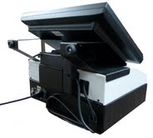
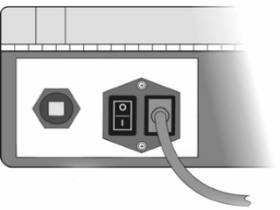

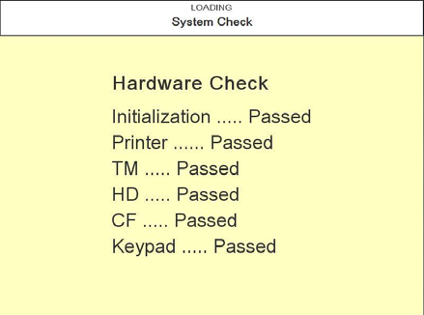
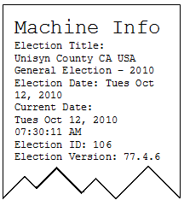
OVI – OpenElect Voting Interface
Opening The Polls
Unisyn Voting Solutions – Quick Reference Guide
STEP # 1
Remove the OVI from the case and place it in the designated ADA voting booth or table.
Plug in power cords located under screen and next to on/off switch located in back.
STEP # 2
Power Switch
Power Cord
A. Power on the scanner by flipping the power switch (on the back of the unit) so the “I” is toggled downward
STEP # 3
STEP # 4
The OVI will go through a series of system verification tests to ensure it is working.
The OVI prints a Machine Info Report with information on the OVI and the OVI is
now available for voting.

Slide 2
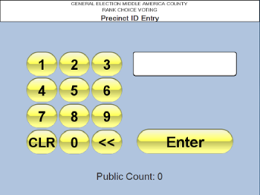
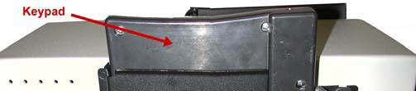
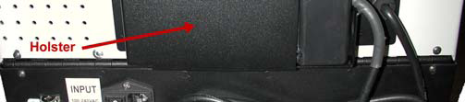
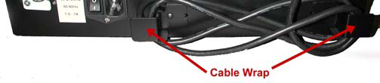
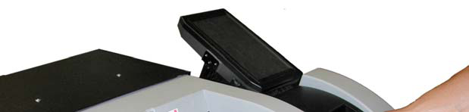
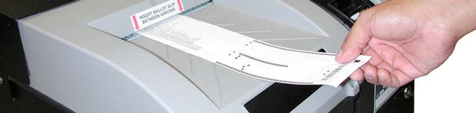
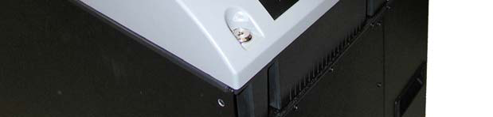
Opening The Polls
Unisyn Voting Solutions – Quick Reference Guide
STEP # 5
STEP # 6
The Poll Worker will escort the voter to the proper location, providing assistance as requested
by voter. The Poll worker will enter
the proper precinct ID to bring up the correct ballot for each voter.
The “Precinct ID” is the same as the 4-digit ID listed at the top of the paper ballot that the voter would have received from the poll judge at the registration table.
Remove the keypad from the keypad holster and set it next to the OVI to make it available for voters that require the use of the keypad and headphones for Election Day voting.
STEP # 7
Once the voter has completed the voting process on the OVI, the OVI will print a ballot which should be scanned on the OVO Scanner. To cast the OVI ballot on the OVO scanner, Place it (in any orientation) between the red arrows on the OVO scanner. Slide the ballot forward until the OVO accepts the ballot. Once the OVO has tabulated the ballot, the OVO will indicate that the ballot has been successfully read by displaying a message on it’s screen.

