Slide 1


Slide 2


Improving Hoosier
Health:
The First Year of HFI
Lindsay Weaver MD, FACEP
State Health Commissioner
June 21, 2024

Slide 3

Learning Objectives
Understand Health First Indiana and where to access more information including local data, priorities, and partnerships
Learn how local health departments with their local partners are addressing health outcomes

Slide 4

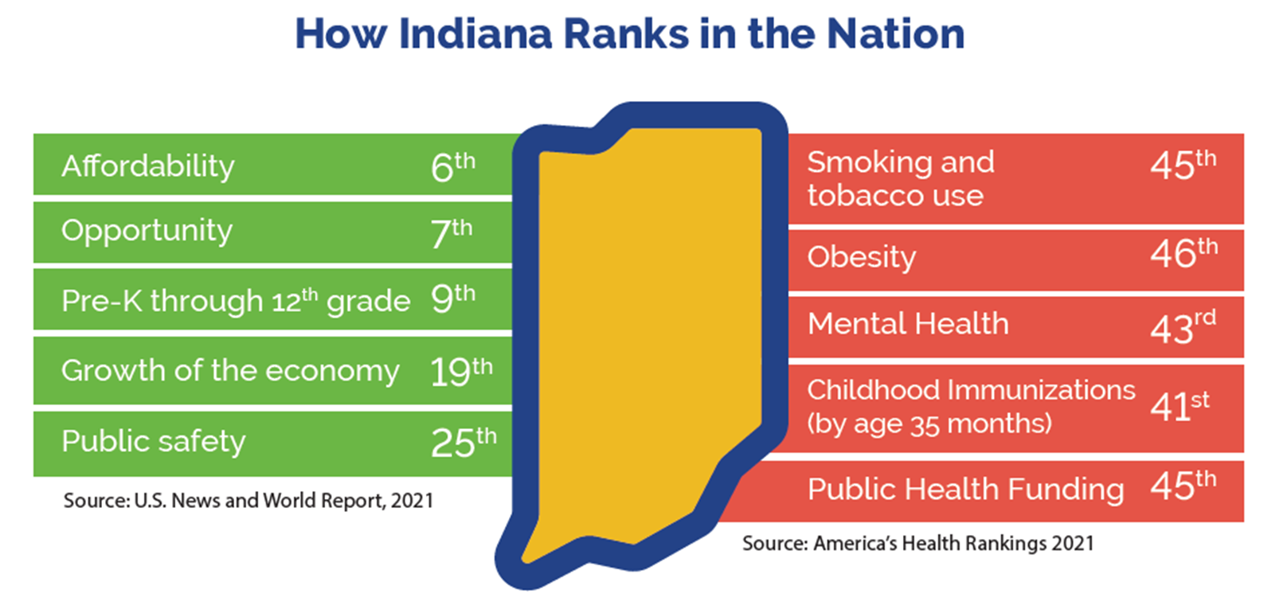
Slide Title
Bulleted text
Bulleted text
Bulleted text

Slide 5
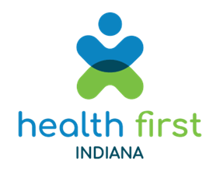
Health First Indiana
Historic, FIRST-of-its-kind investment in public health
  $75 M in 2024 and $150 M in 2025
Investment in prevention leads to healthier communities and workforce, which attracts businesses and benefits economy
Convenes local elected officials, public health, clinical health and community partners
Partnerships allow communities to organize care, reduce duplication of services, be more efficient
Benefits rural communities that often have fewer resources
Allows counties to create innovative solutions tailored to address local health needs

Slide 6
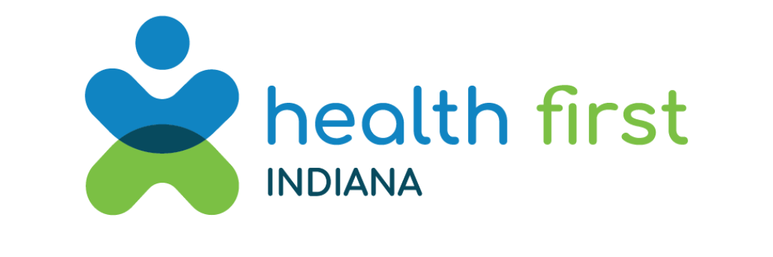
Health First Indiana
Gov. Holcomb announces all 92 Indiana counties opt in for second year of historic public health initiative

Slide 7
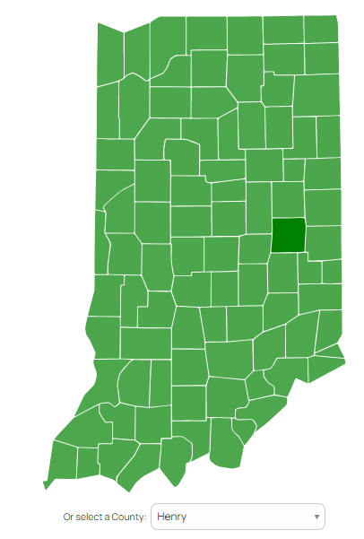
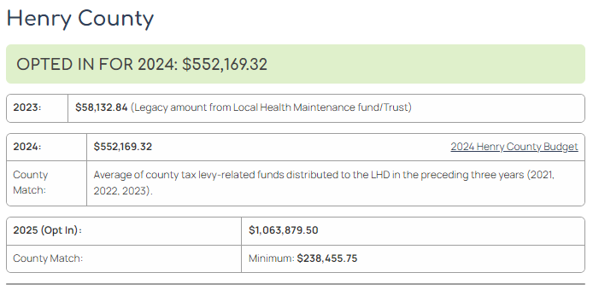

Slide Title
HealthFirstIndiana.in.gov
Bulleted text
Bulleted text
Bulleted text

Slide 8
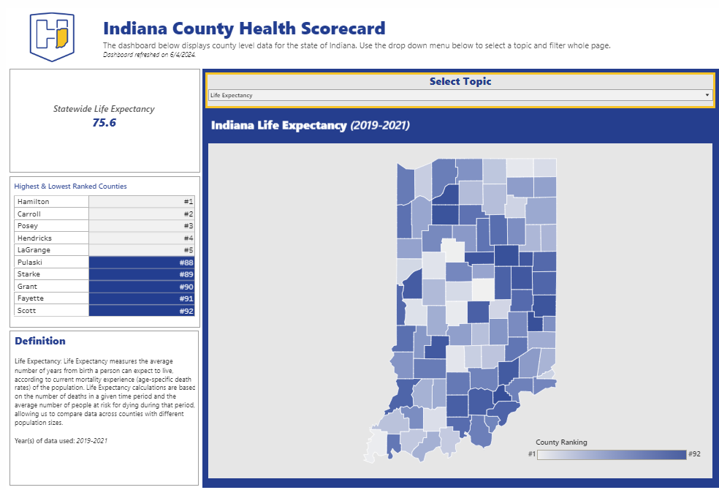
Slide Title
Indiana County Health Scorecard
Bulleted text
Bulleted text
Bulleted text

Slide 9
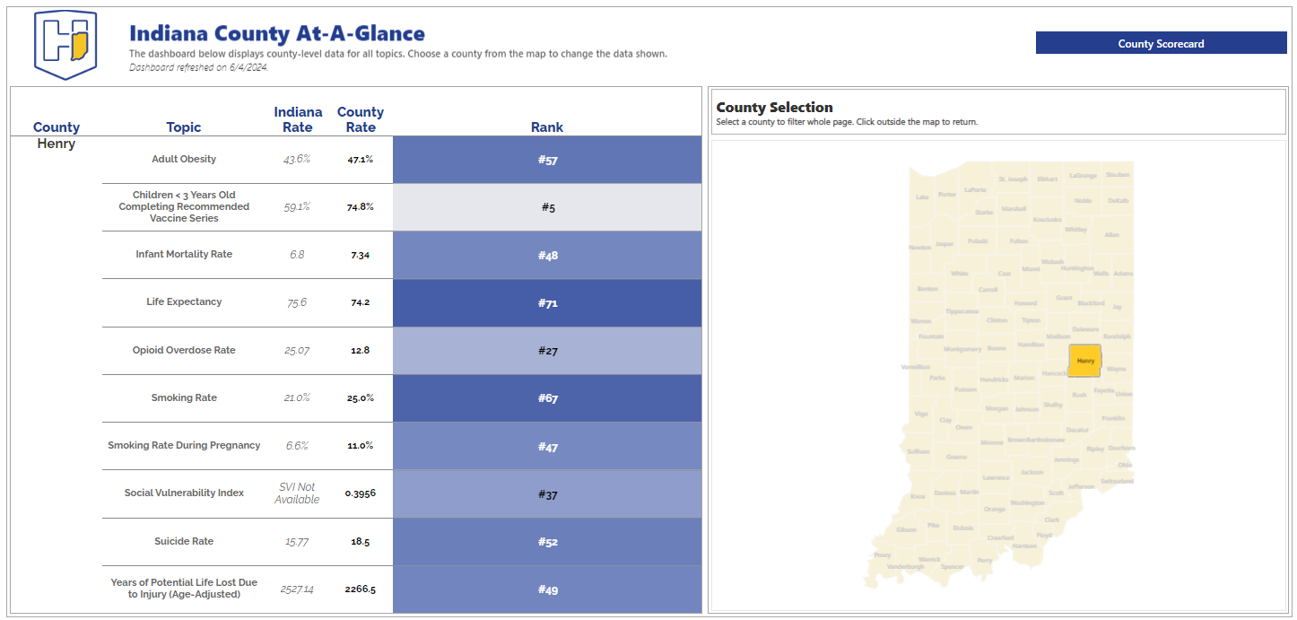
Slide Title
Bulleted text
Bulleted text
Bulleted text

Slide 10

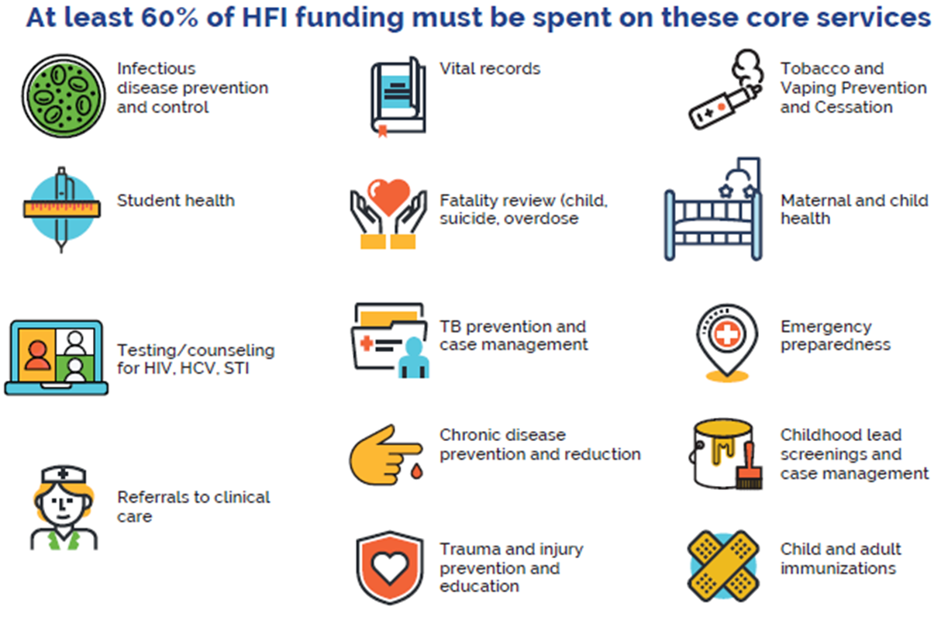
Core Public Health Services

Slide 11
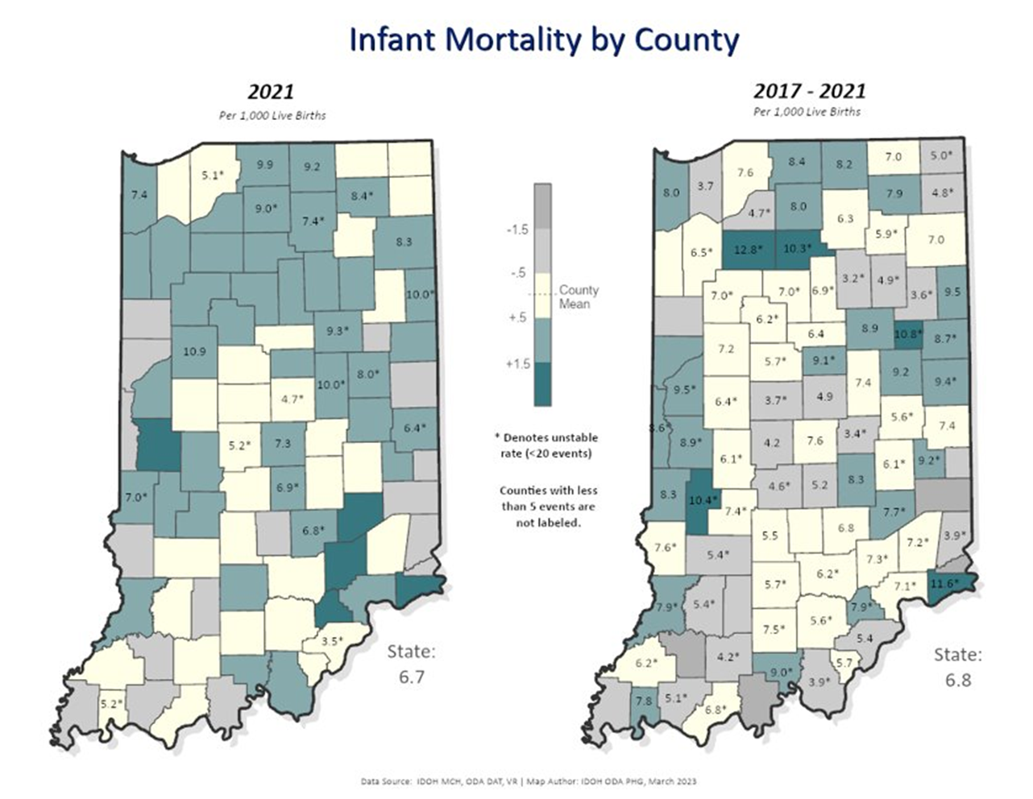
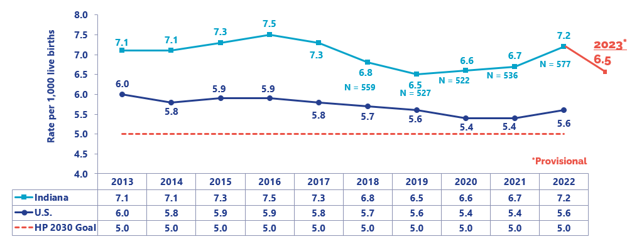
Slide Title
Infant Mortality
Bulleted text
Bulleted text
Bulleted text

Slide 12

Slide Title
Maternal & Child Health
The St. Joseph County Health Department and the Eck Institute for Global Health at the University of Notre Dame are piloting a Pop-Up Pregnancy & Family Village
The goal is to reduce post pregnancy-associated deaths by improving the health & wellbeing of mothers
Creates a 'one-stop-shop' for mothers and families to access connection to care, resources and support during pregnancy and the postpartum period
Partners: University of Notre Dame, Beacon Community Impact
Bulleted text
Bulleted text
Bulleted text

Slide 13


Maternal and Child Health
Dubois County Health Department began working with Vanderburgh County Health Department to expand their "Pre-to-3" home visiting program for pregnant women, infants and postpartum mothers
The program allows the health department to work with mothers before the child is born and up to three years of age by provide services in home
Services include safe sleep education, prenatal checks, and postpartum checks
The goal is to improve health outcomes for mothers and infants in the county

Slide 14
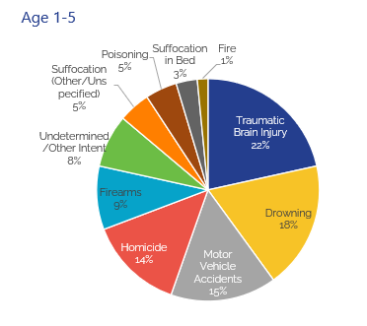
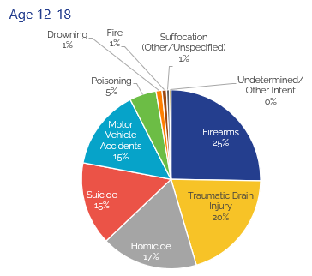
Trauma and Injury Prevention
Injury Deaths in Children in Indiana in 2020

Slide 15

Slide Title
Trauma and Injury Prevention
Delaware County Health Department has been partnering with YMCA of Muncie to provide aquatic safety knowledge and skills to their community.
Provide swim lessons to an additional 100 children
Certify 10 additional young adults as lifeguards
Provide Safety Around Water classes to 60 potentially at-risk youth
Bulleted text
Bulleted text
Bulleted text

Slide 16
Slide Title
Trauma and Injury Prevention
Fishers Health Department
  Hired 3 Community Health Advocates to complete follow up and connections to care for any high utilizers of EMS services, as well as develop programming aimed at frequent preventable causes of injury.
  A fall prevention program was developed for residents who have had a previous fall or who may be at risk for a fall due to age or other risk factors.
  Conducting in-home fall risk assessments, and installing durable equipment as needed.
Bulleted text
Bulleted text
Bulleted text
Partners: Shephard’s Center of Hamilton County and the Community Health Advocates

Slide 17
Slide Title
Trauma and Injury Prevention
Fishers Health Department
  A Licensed Clinical Social Worker (LCSW) now receives automatic notification from police following any emergency detention for mental health or suicide, which provides the LCSW with opportunities to coordinate mental health care assistance and offer grief support.
  In April alone, the social work program was able to serve 77 unique patients through 107 patient encounters, provide 75 referrals for community services, perform 43 crisis response follow-ups, and supply 115 residents with education.
Bulleted text
Bulleted text
Bulleted text
Partners: Fishers Fire Department

Slide 18
Slide Title
Trauma and Injury Prevention
Parke County Health Department, in collaboration with Rockville Lake, distributed 43 lifejackets to children participating in the Fishing Derby held on May 4, 2024.
Aims to raise awareness about the importance of water safety, particularly among children and families enjoying recreational activities near bodies of water.
Bulleted text
Bulleted text
Bulleted text

Slide 19
Slide Title
Trauma and Injury Prevention
Randolph County Health Department has partnered with Ball State to form a support group to help survivors deal with trauma caused from several young suicides and the March 2024 tornado.
Support for any adults or children who need assistance dealing with these situations and others will be available via Zoom over the summer and in-person in Winchester at the beginning of the school year.
Bulleted text
Bulleted text
Bulleted text

Slide 20
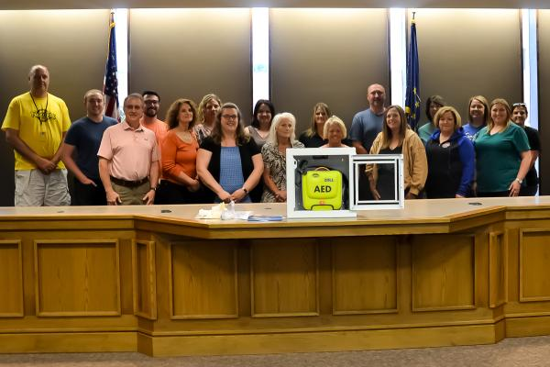
Slide Title
Trauma and Injury Prevention
Fulton County Health Department partnered with local schools to provide AEDs and other emergency medical supplies
16 AEDs were provided to four different public and private school corporations
Additional AEDs decreases emergency response time and leads to better outcomes
Bulleted text
Bulleted text
Bulleted text
Partners: Rochester Community Schools, Caston School Corporation, Tippecanoe Valley School Corporation, and Legacy Christian Academy

Slide 21
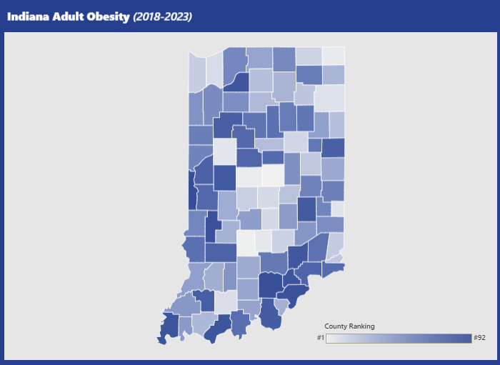
Slide Title
Obesity in Indiana
Indiana is the 9th most obese state in the U.S. (TFAH)
Two-thirds (71%) of Indiana adults are overweight or obese
  Enough to populate state of Kentucky or fill Lucas Oil Stadium 66 times
32.5% of Indiana youth are overweight or obese (2023 Youth Risk Factor Surveillance Survey)
Overwhelmingly, obesity rates are higher in minority populations and rural areas
Bulleted text
Bulleted text
Bulleted text

Slide 22
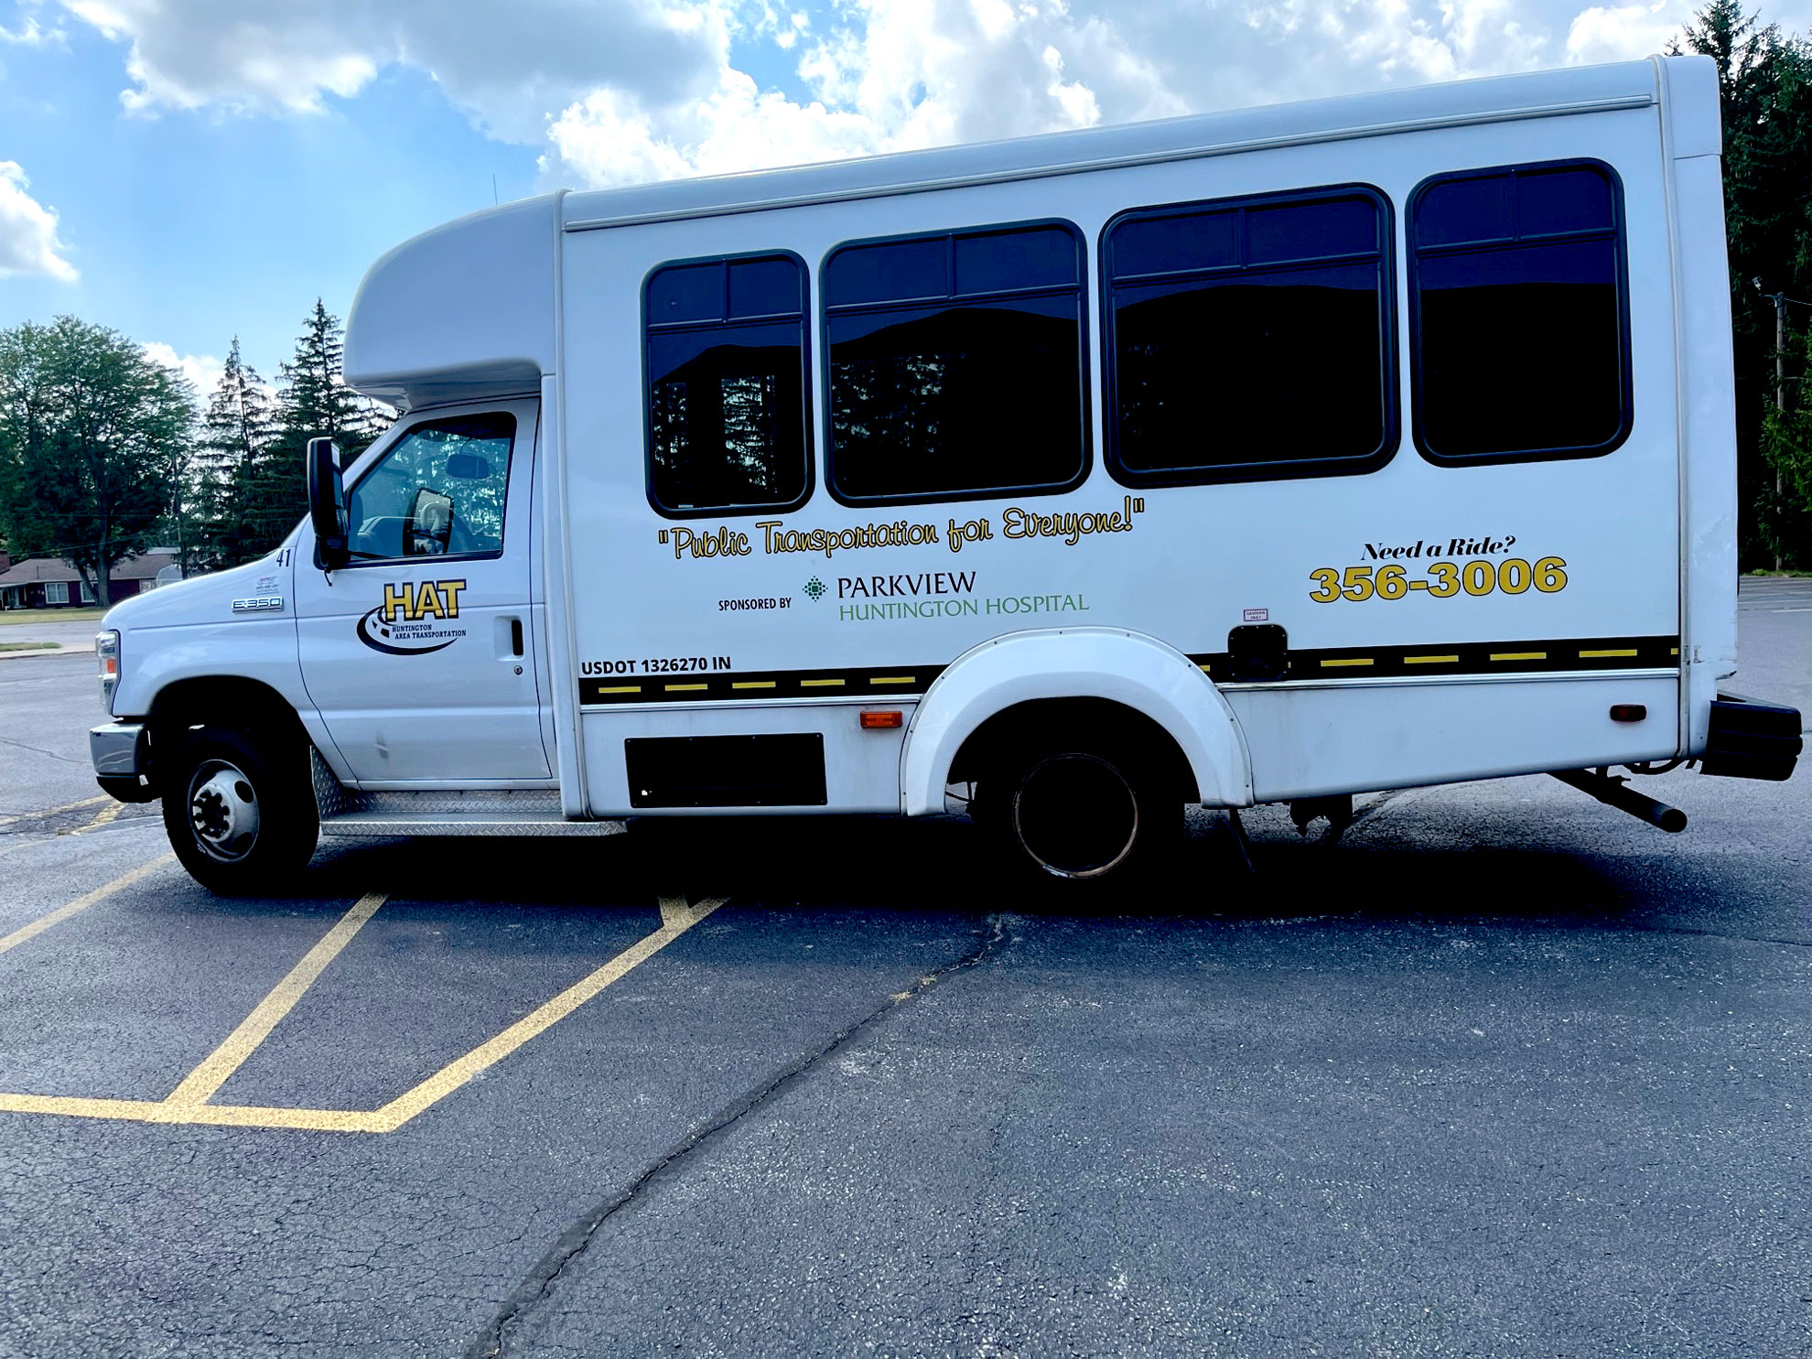
Slide Title
Chronic Disease Prevention
Huntington County Health Department allocated HFI funding to community partner, The Council on Aging, to assist with transportation
352 additional rides were given in January 2024 compared to January 2023
Medical trips increased by 32.1%
Their goal is to increase attendance of preventative screenings and appointments
Bulleted text
Bulleted text
Bulleted text

Slide 23
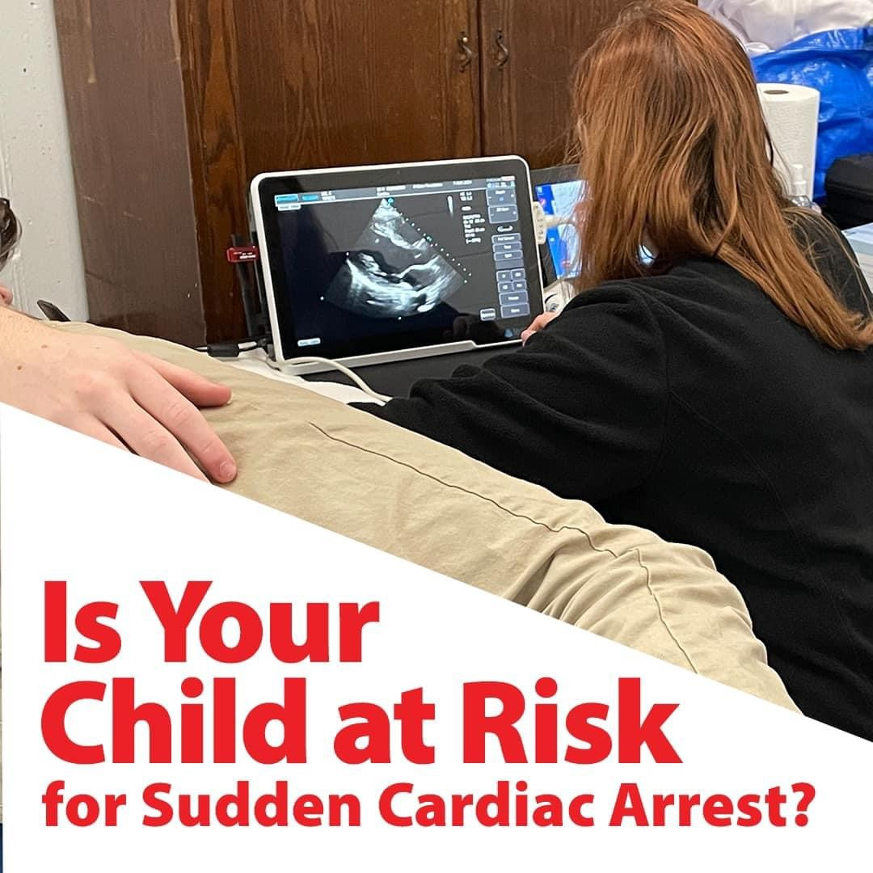
Slide Title
Chronic Disease Prevention
White County Health Department is holding a preventative cardiac screening on August 12th and 13th
The free screening is available to enrolled Twin Lakes School Corporation students ages 12 and up
Screening will offer electrocardiograms and echocardiograms with results read by local pediatric cardiologists
Bulleted text
Bulleted text
Bulleted text

Slide 24
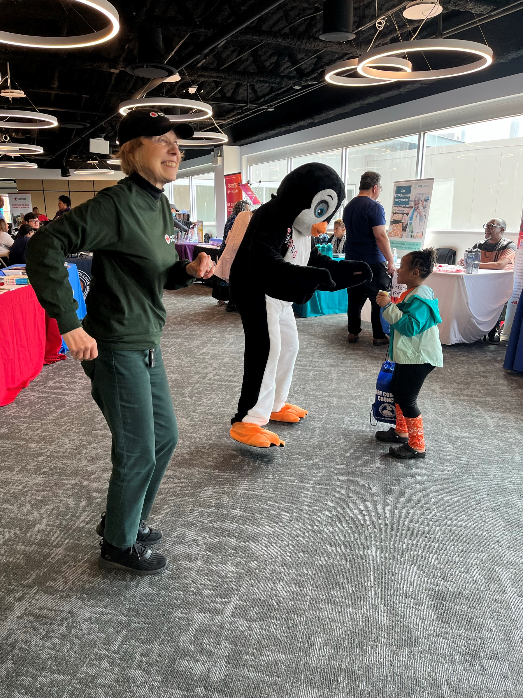
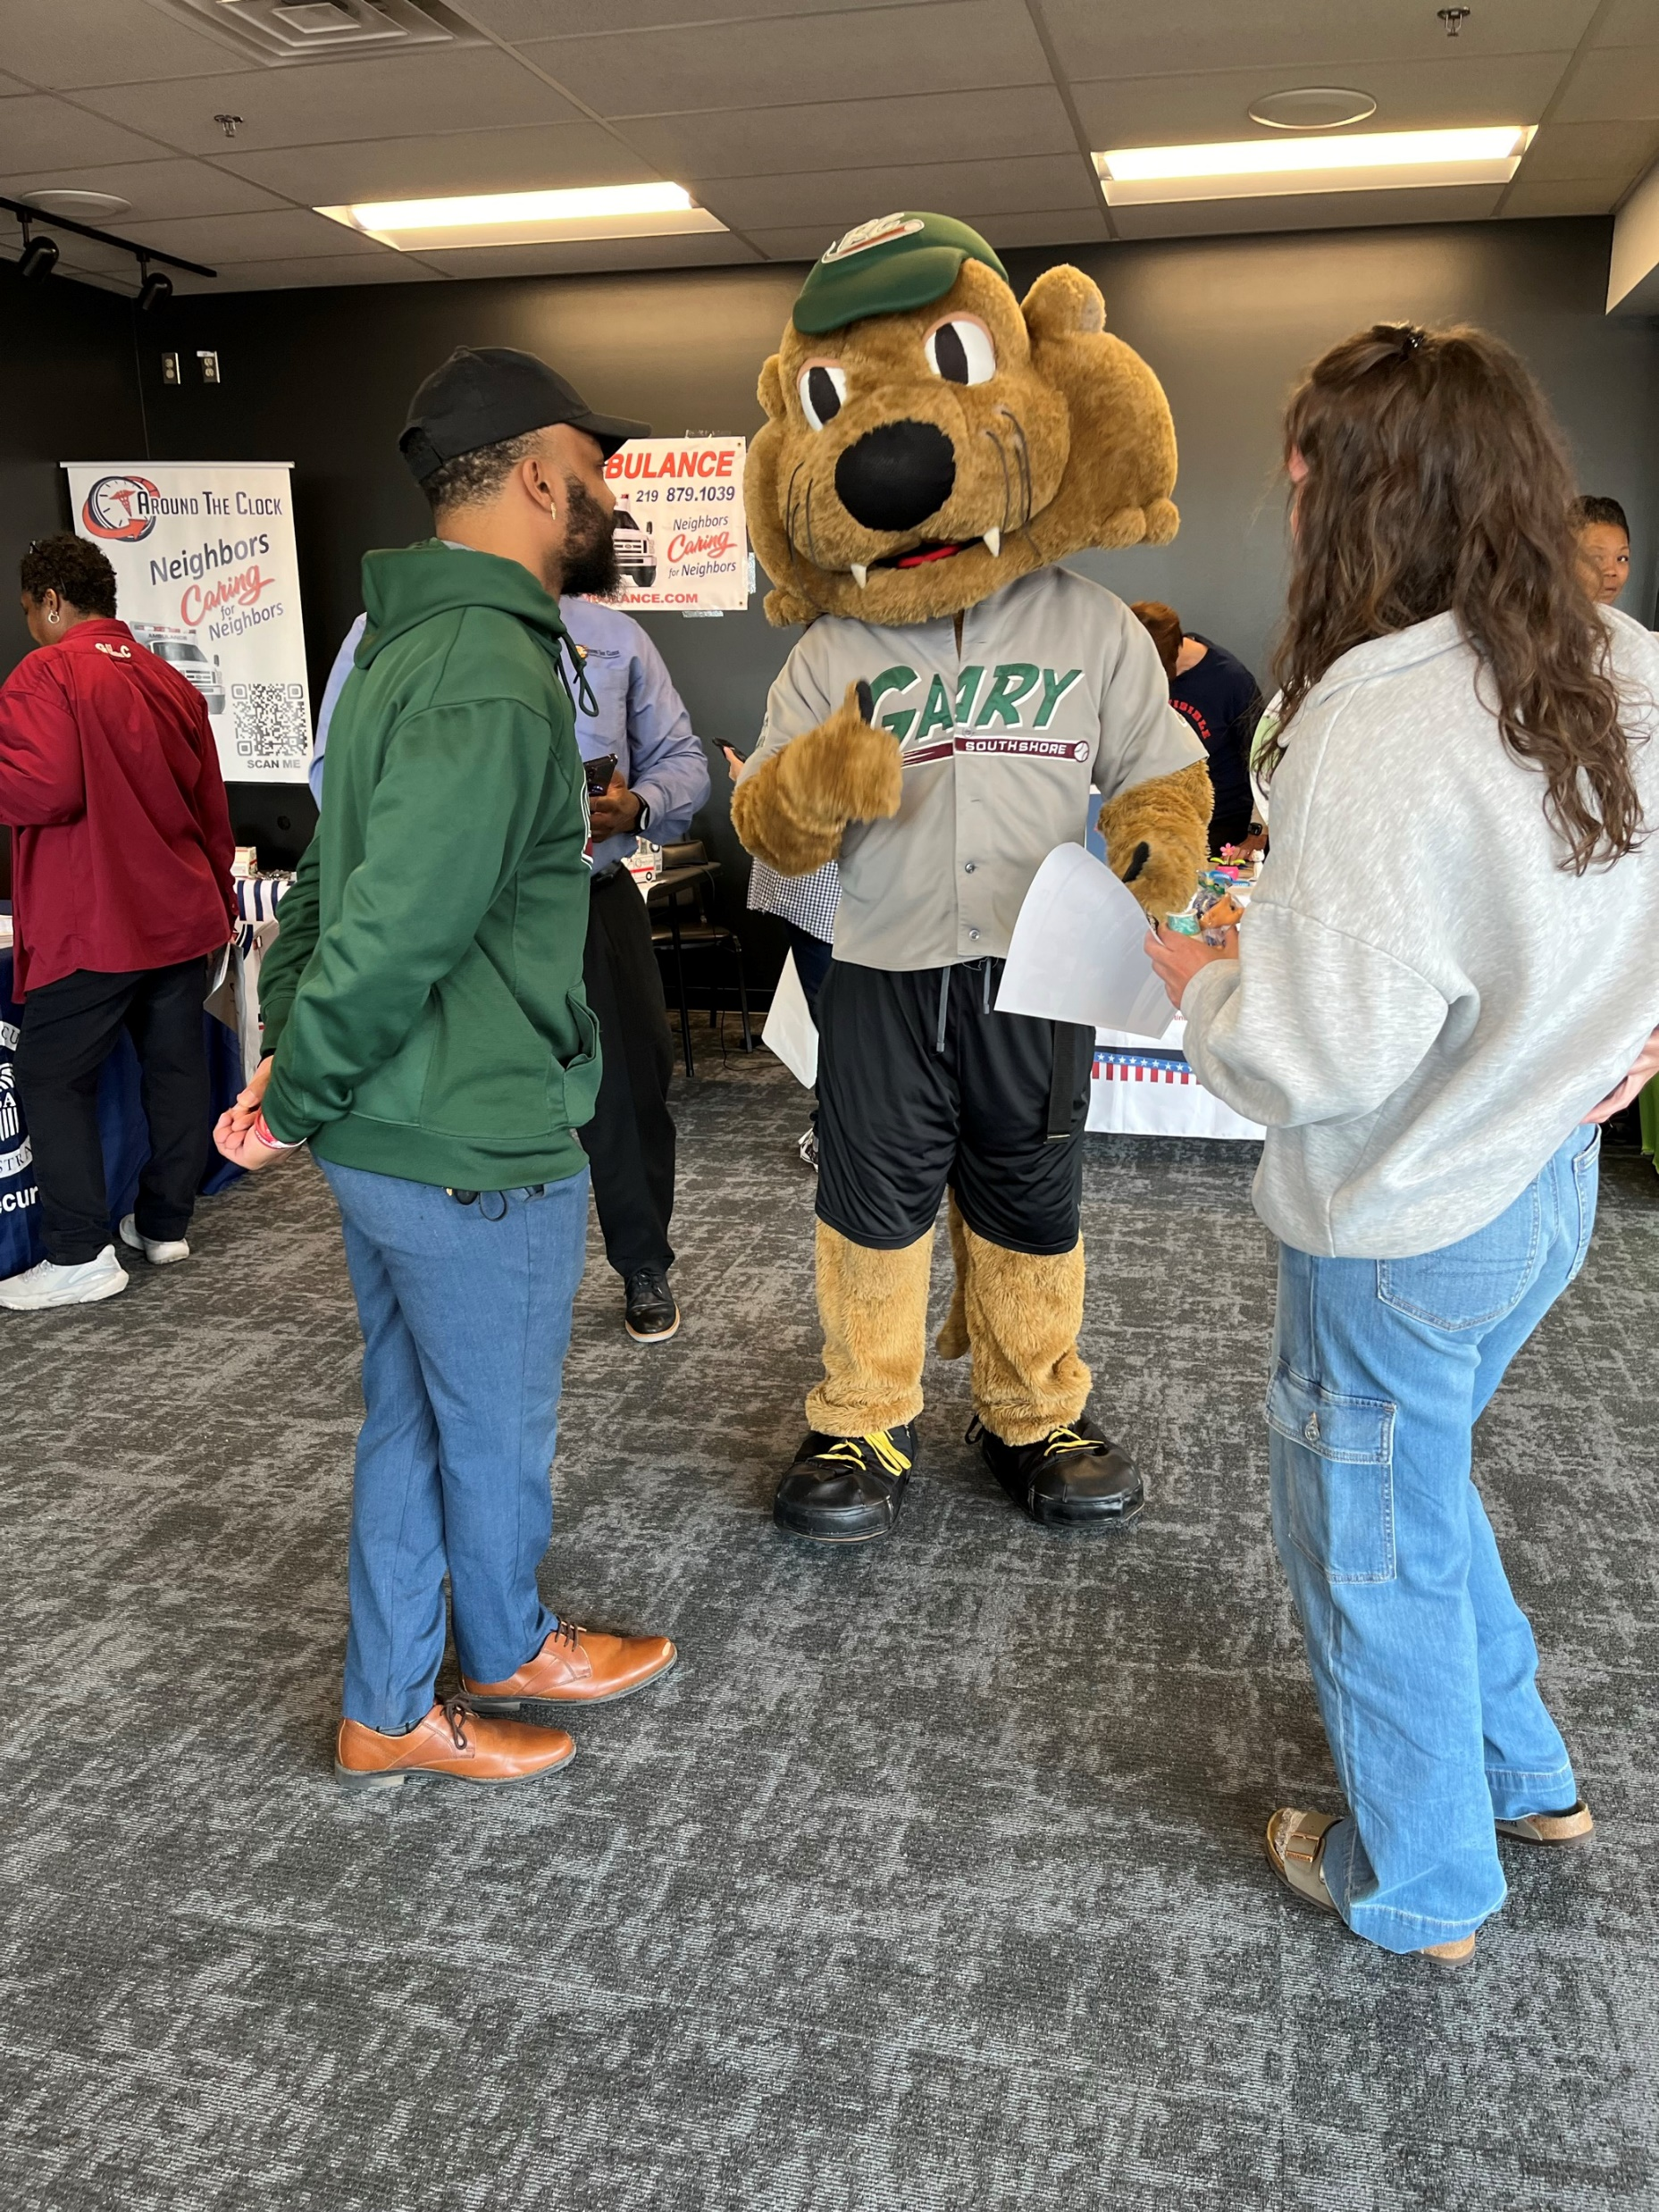
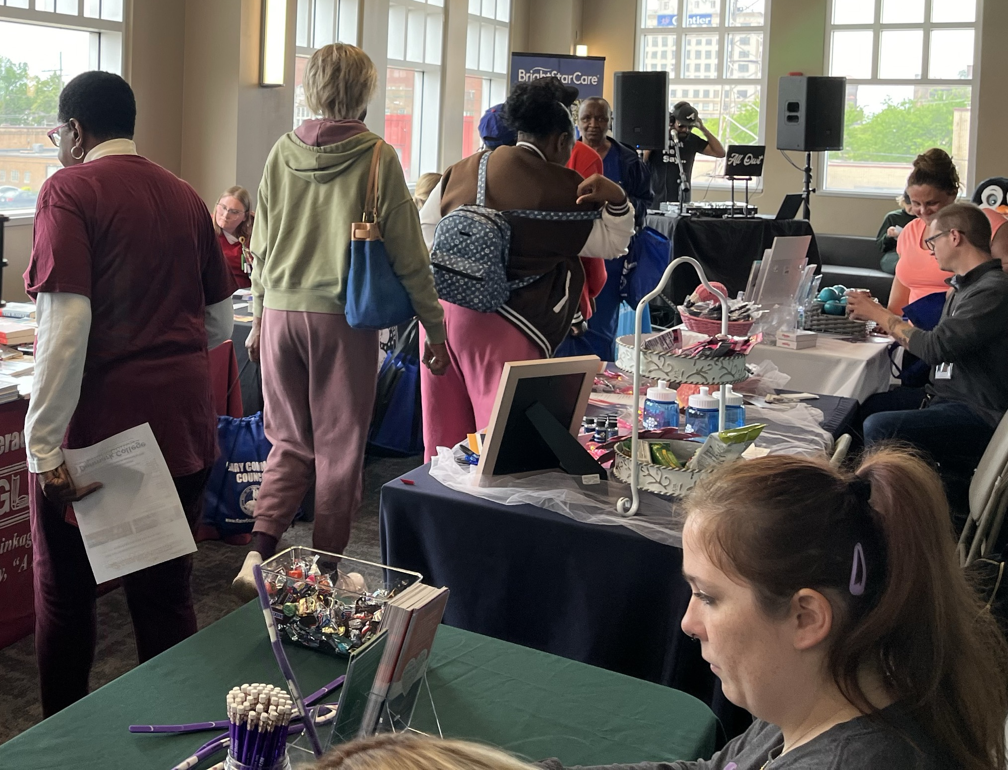
Slide Title
Chronic Disease Prevention
Gary Health Department hosted a high energy and well attended health fair with 25+ vendors
Blood pressure, hearing, vision, cholesterol, STI, and pregnancy screening were available
Lead, blood glucose, and STI testing opportunities
Bulleted text
Bulleted text
Bulleted text
Partners: Gary Common Council Railcats Stadium

Slide 25
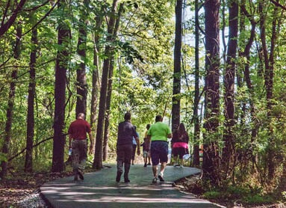
Slide Title
Chronic Disease Prevention
Cass County Health Department initiated Steps to Better Health, a community walking program
Residents are invited to walk from 7:30-10:30 am at Huston Park
Free blood pressure check provided
Partners: Logansport Parks Department

Slide 26
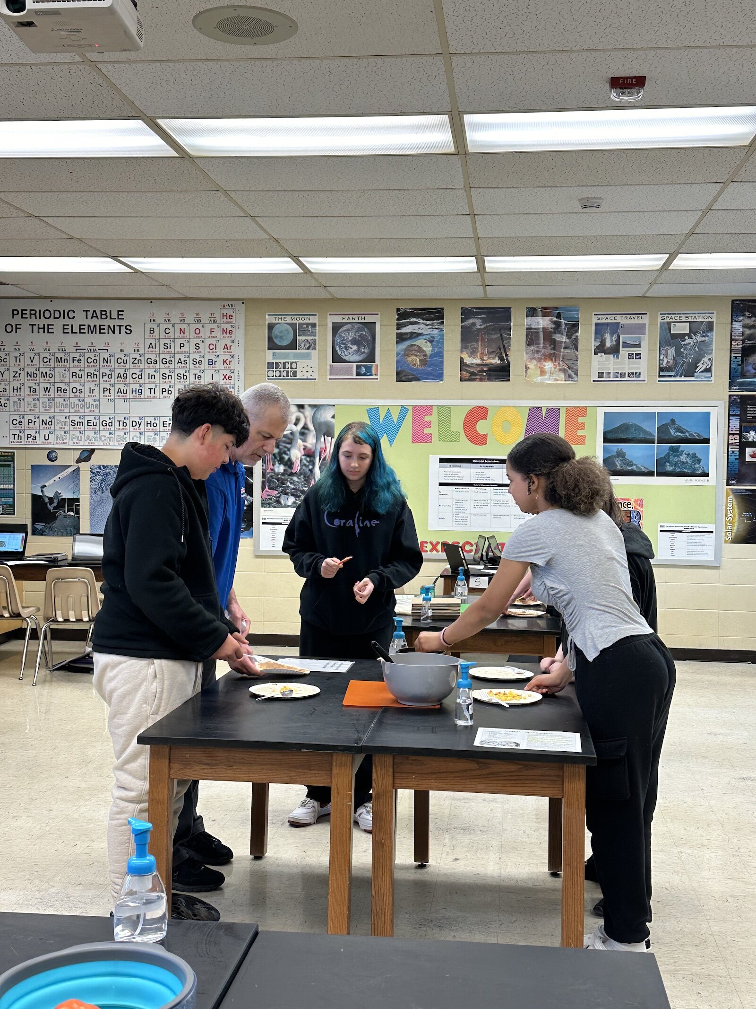
Slide Title
Chronic Disease Prevention
Allen County Health Department has allocated $2 million to community partners to address chronic obesity.
Nutrition classes at the YMCA
Cooking in the Classroom has engaged nearly 4,200 7th graders
Students had a nutrition knowledge increase of 46%
Partners: YMCA, Fort Wayne Community Schools, and Parkview Health
Bulleted text
Bulleted text
Bulleted text

Slide 27
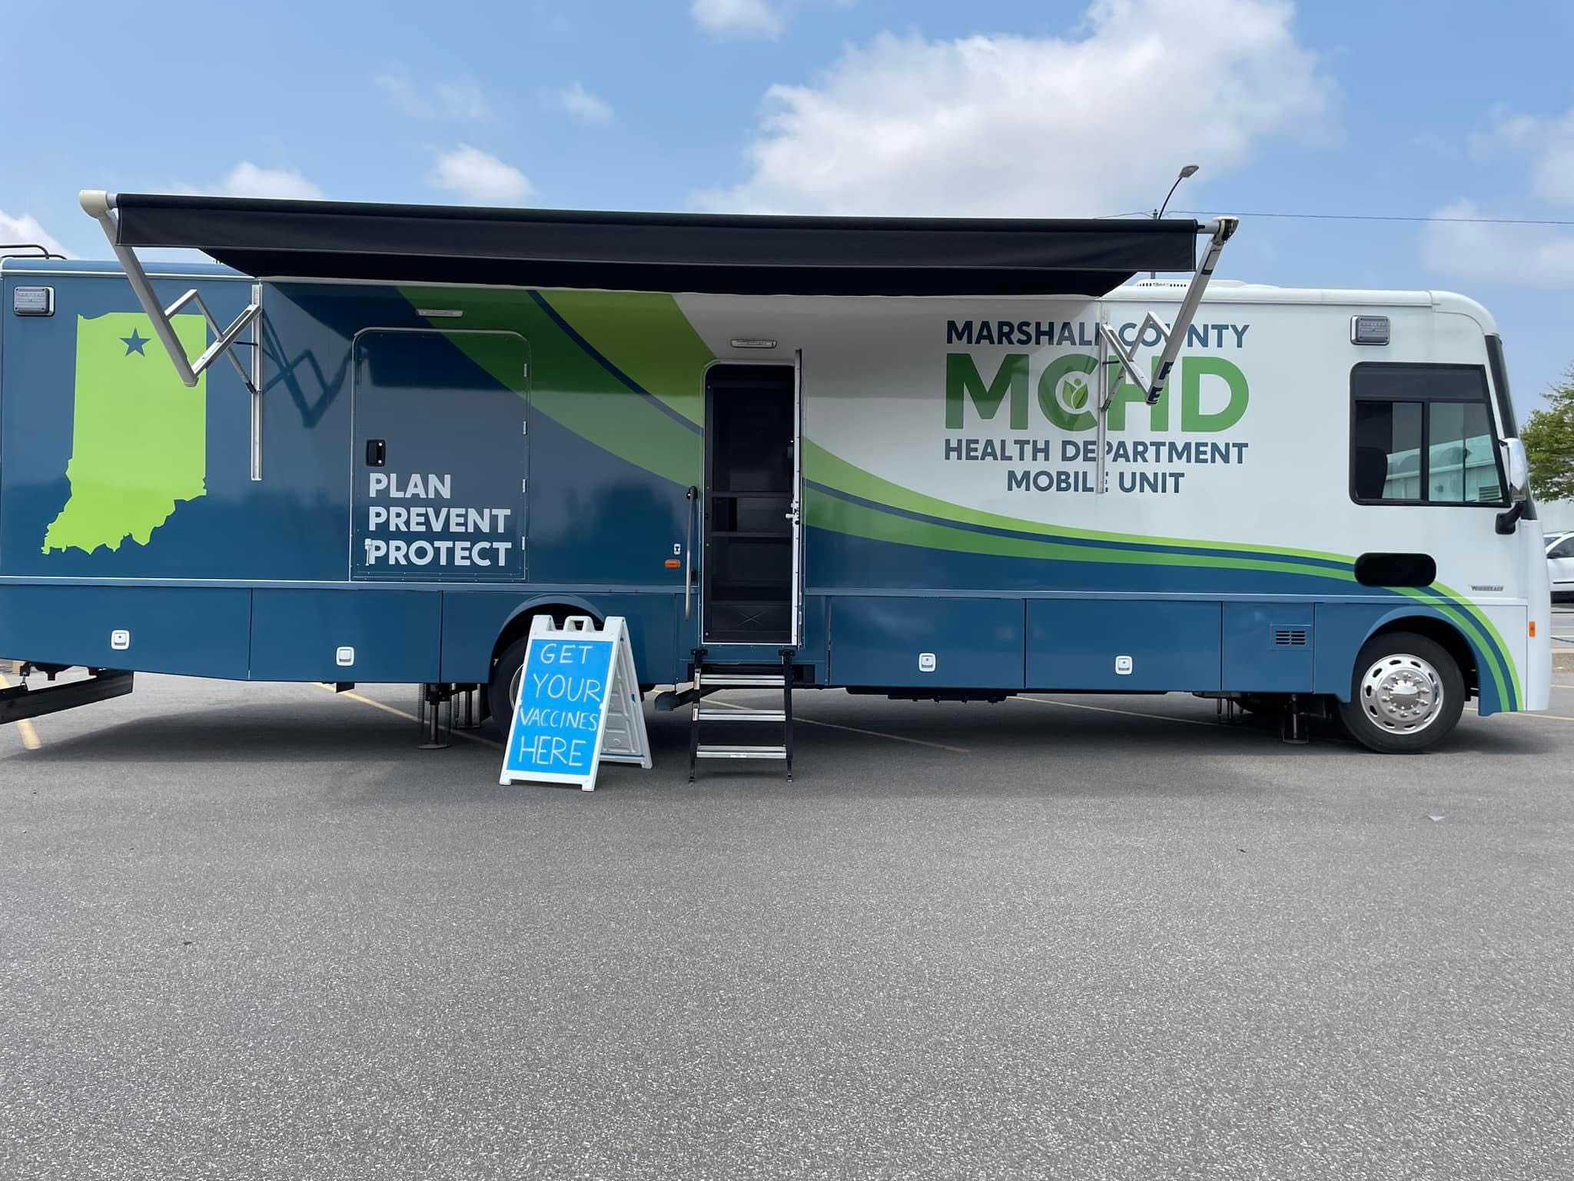
Slide Title
Bringing Services to Where the Need Is
Marshall County
Mobile Health Clinic
  Offers immunizations, lead testing, vision and hearing screenings.
  Offers diapers from their health department diaper pantry
  Visits their local Amish communities, all local schools, community events such as fairs and festivals
Bulleted text
Bulleted text
Bulleted text

Slide 28
Slide Title
Health First Indiana Pledge
Under encouragement from the Indiana Chamber and WCI, I pledge my organization will take action to improve Hoosiers’ public health outcomes within our communities.
I pledge my organization will take action on the following goals to improve health outcomes in Indiana:
Work with your leadership team to identify ways you can focus on prevention to improve health outcomes for your employees, their families, and your communities
Consider partnering with your local health department(s) and community leaders to specifically address at least one of the following core public health services:
  maternal and child health  smoking and vaping prevention
  chronic disease prevention (obesity) and cessation
Bulleted text
Bulleted text
Bulleted text
Reference. https://www.in.gov/healthfirstindiana/pledge-to-act/

Slide 29
Thank you!
Lindsay Weaver MD, FACEP
State Health Commissioner
lweaver@health.in.gov

Slide 30
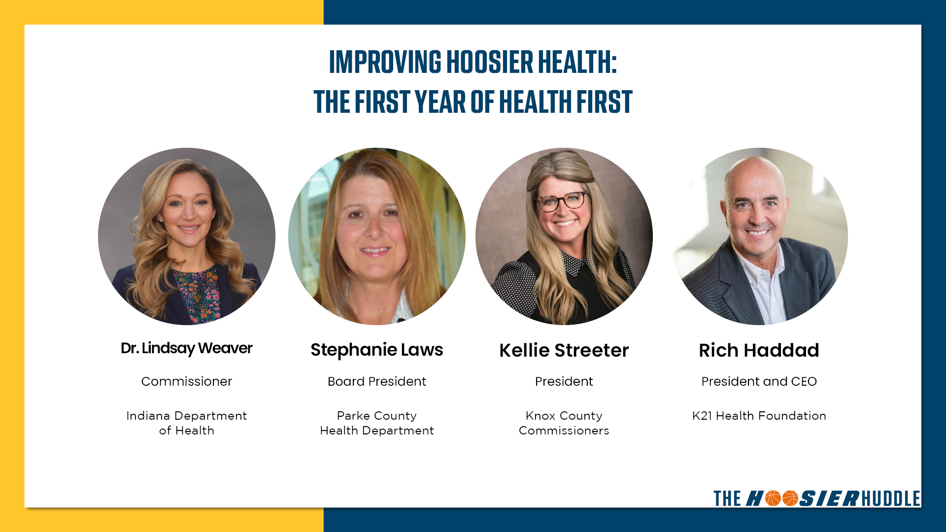

Slide 32


Slide 34
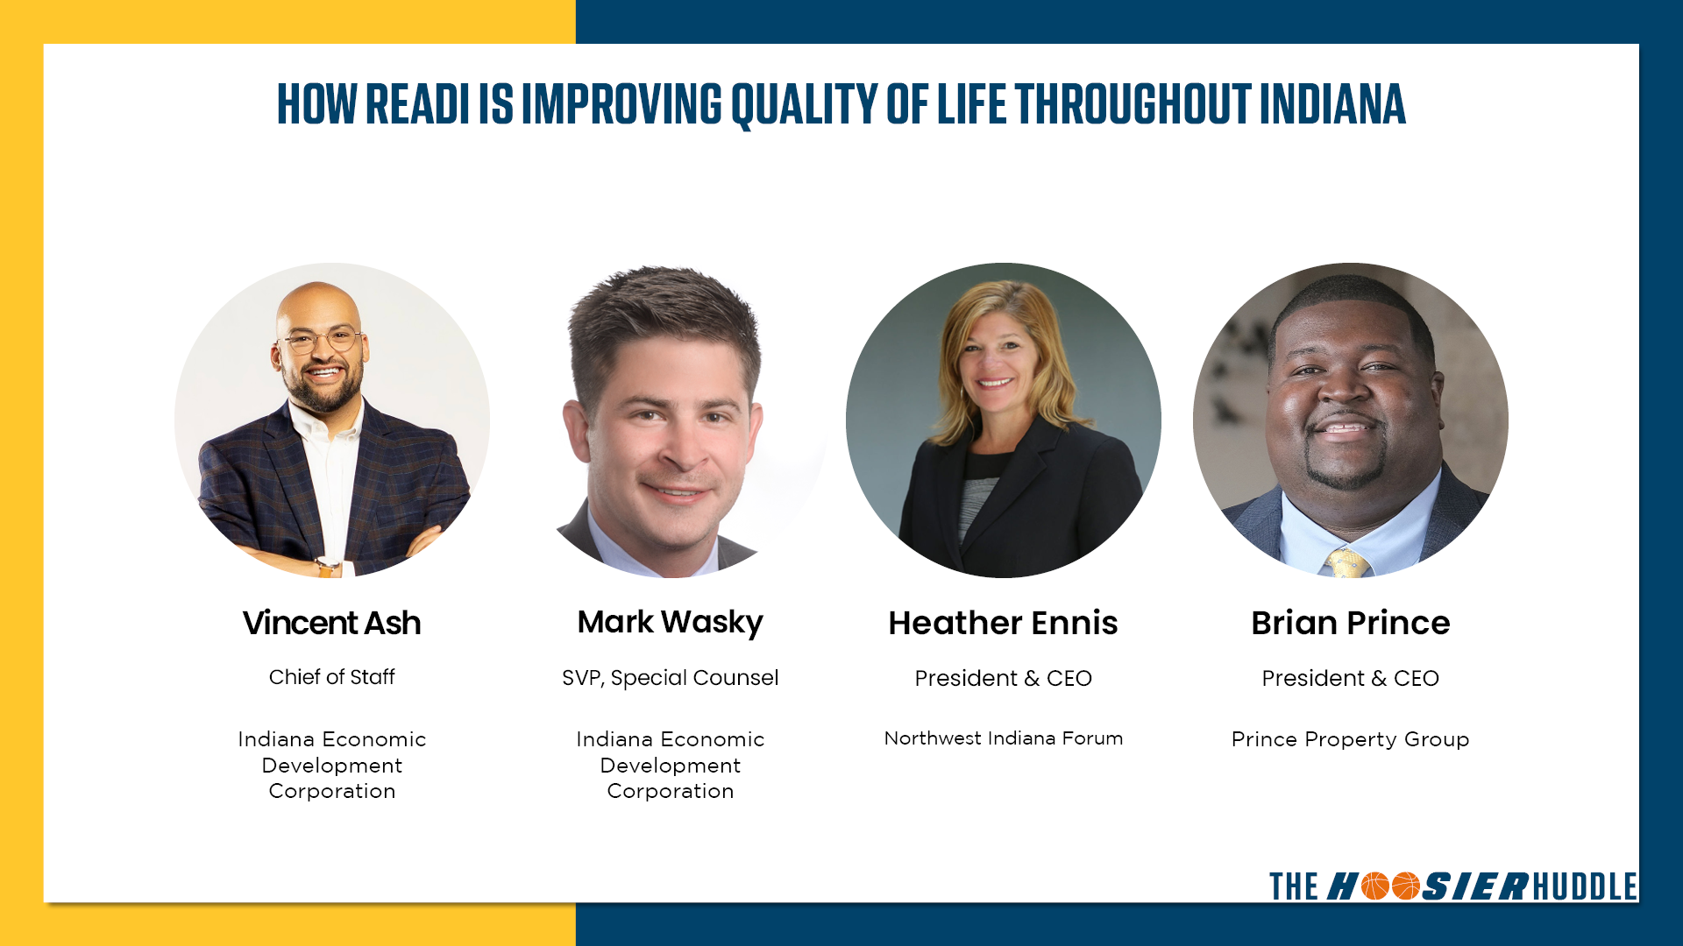

Slide 35
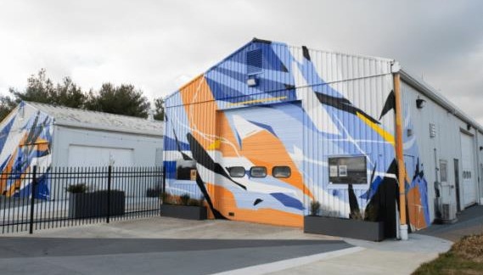




Slide 36













Shift from transactional to strategic, relationship-based organization – and have produced historic results
Growing the state economy, driving economic development and helping businesses launch, grow and locate to Indiana by executing our 5E strategy:
To create the opportunity for all Hoosiers to earn a good living and prosper in a diverse economic environment that encourages growth, creates and retains the jobs of today, and attracts and invests in the jobs of tomorrow.
Environment
Economy of the Future
Entrepreneurship
Energy Transition
External Engagement
Population Growth
Higher Wages
National Security

Slide 37




PROJECTS
208
PAYROLL
$7.6B
EXPECTED NEW JOBS
INDIANA RANKINGS
EJ2023
NEWCAPEX
$28.7B
(29% increase year over year)
#7
#7
Forbes
Business Facilities MANUFACTURING (JOBS)
BEST STATE TO START A BUSINESS
Tax Foundation 3#
PROPERTY TAX
RANK
Business Facilities #7 MANUFACTURING (OUTPUT)
AVERAGE HOURLY WAGE
Startup City Rankings 3#
BEST OF THE
MIDWEST (INDIANAPOLIS)
$36.07 27,866
Elevate Ventures MOST ACTIVE VC IN GREAT LAKES REGION
iiiitiitiiitiitiiiti
(3.9% increase year over year)

Slide 38


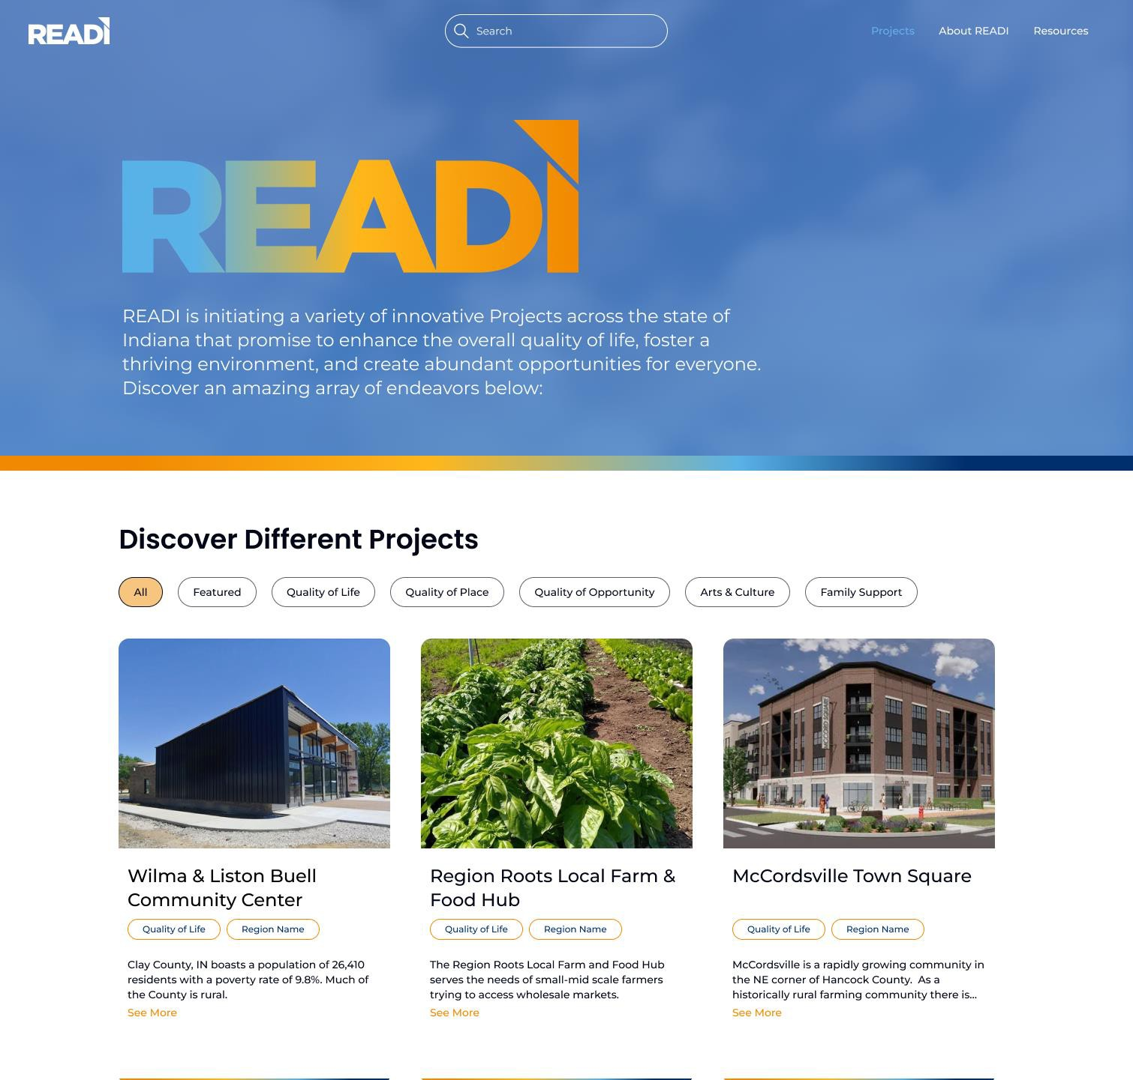
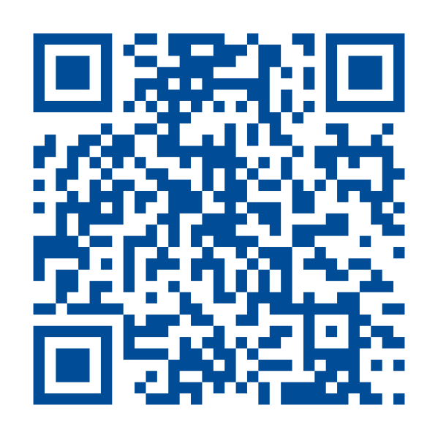

IndianaREADI.com

Slide 39
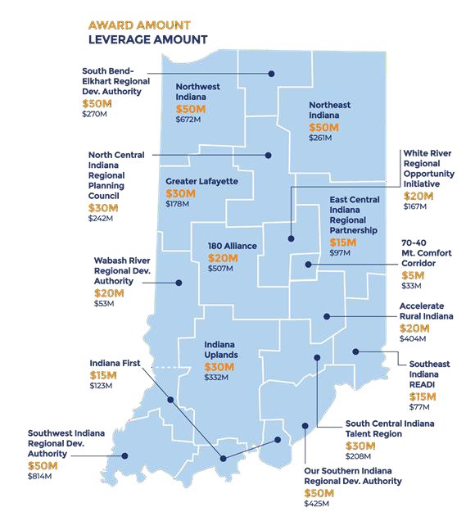



17 regional proposals represented more than $15B of investment demand in projects like trails, broadband, childcare and wellness initiatives, workforce development programs and marketing.
All 92 counties participated.
Proposals included nearly 800 projects and programs. 361 projects funded.
10:1 leverage from private and public sources to state
investment.
7:1 match from private sources to state investment, more than 66% of total investment from the private sector.
$50M max allocation for regions.

Slide 40

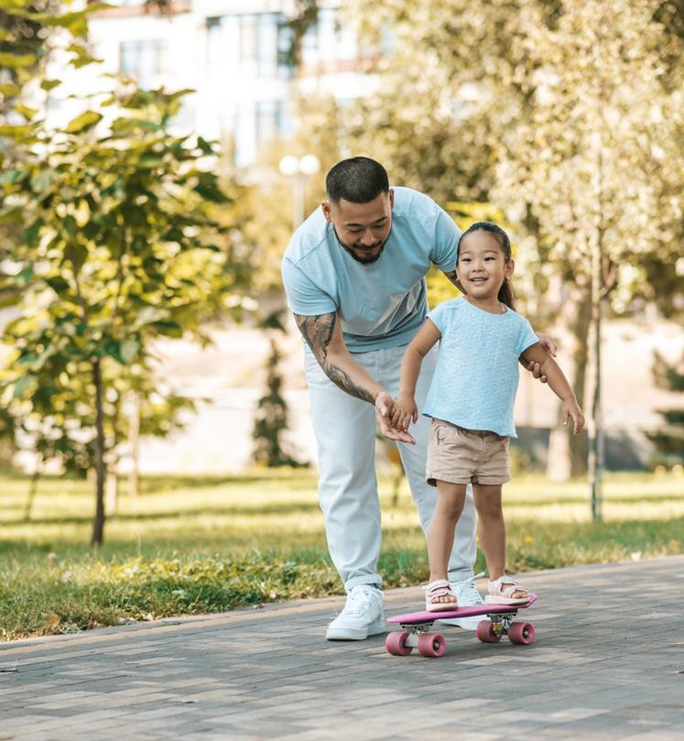







Tourism, Arts, Culture, Community
Family-support initiatives
Trails & Parks, Public Spaces
Housing Availability & Affordability
Growth Infrastructure
Mixed-use Developments
Infrastructure leading to jobs
Talent supply & education
Innovation & Entrepreneurship

Slide 41
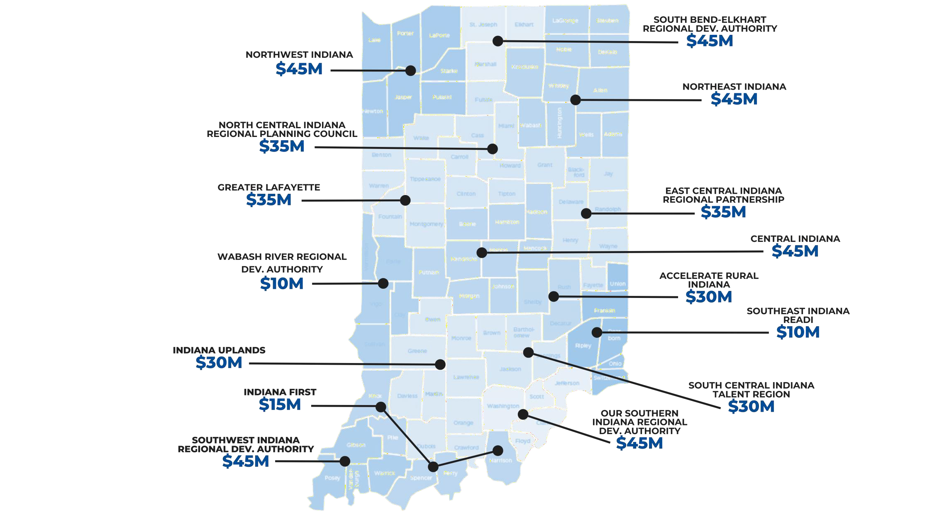



Slide 42

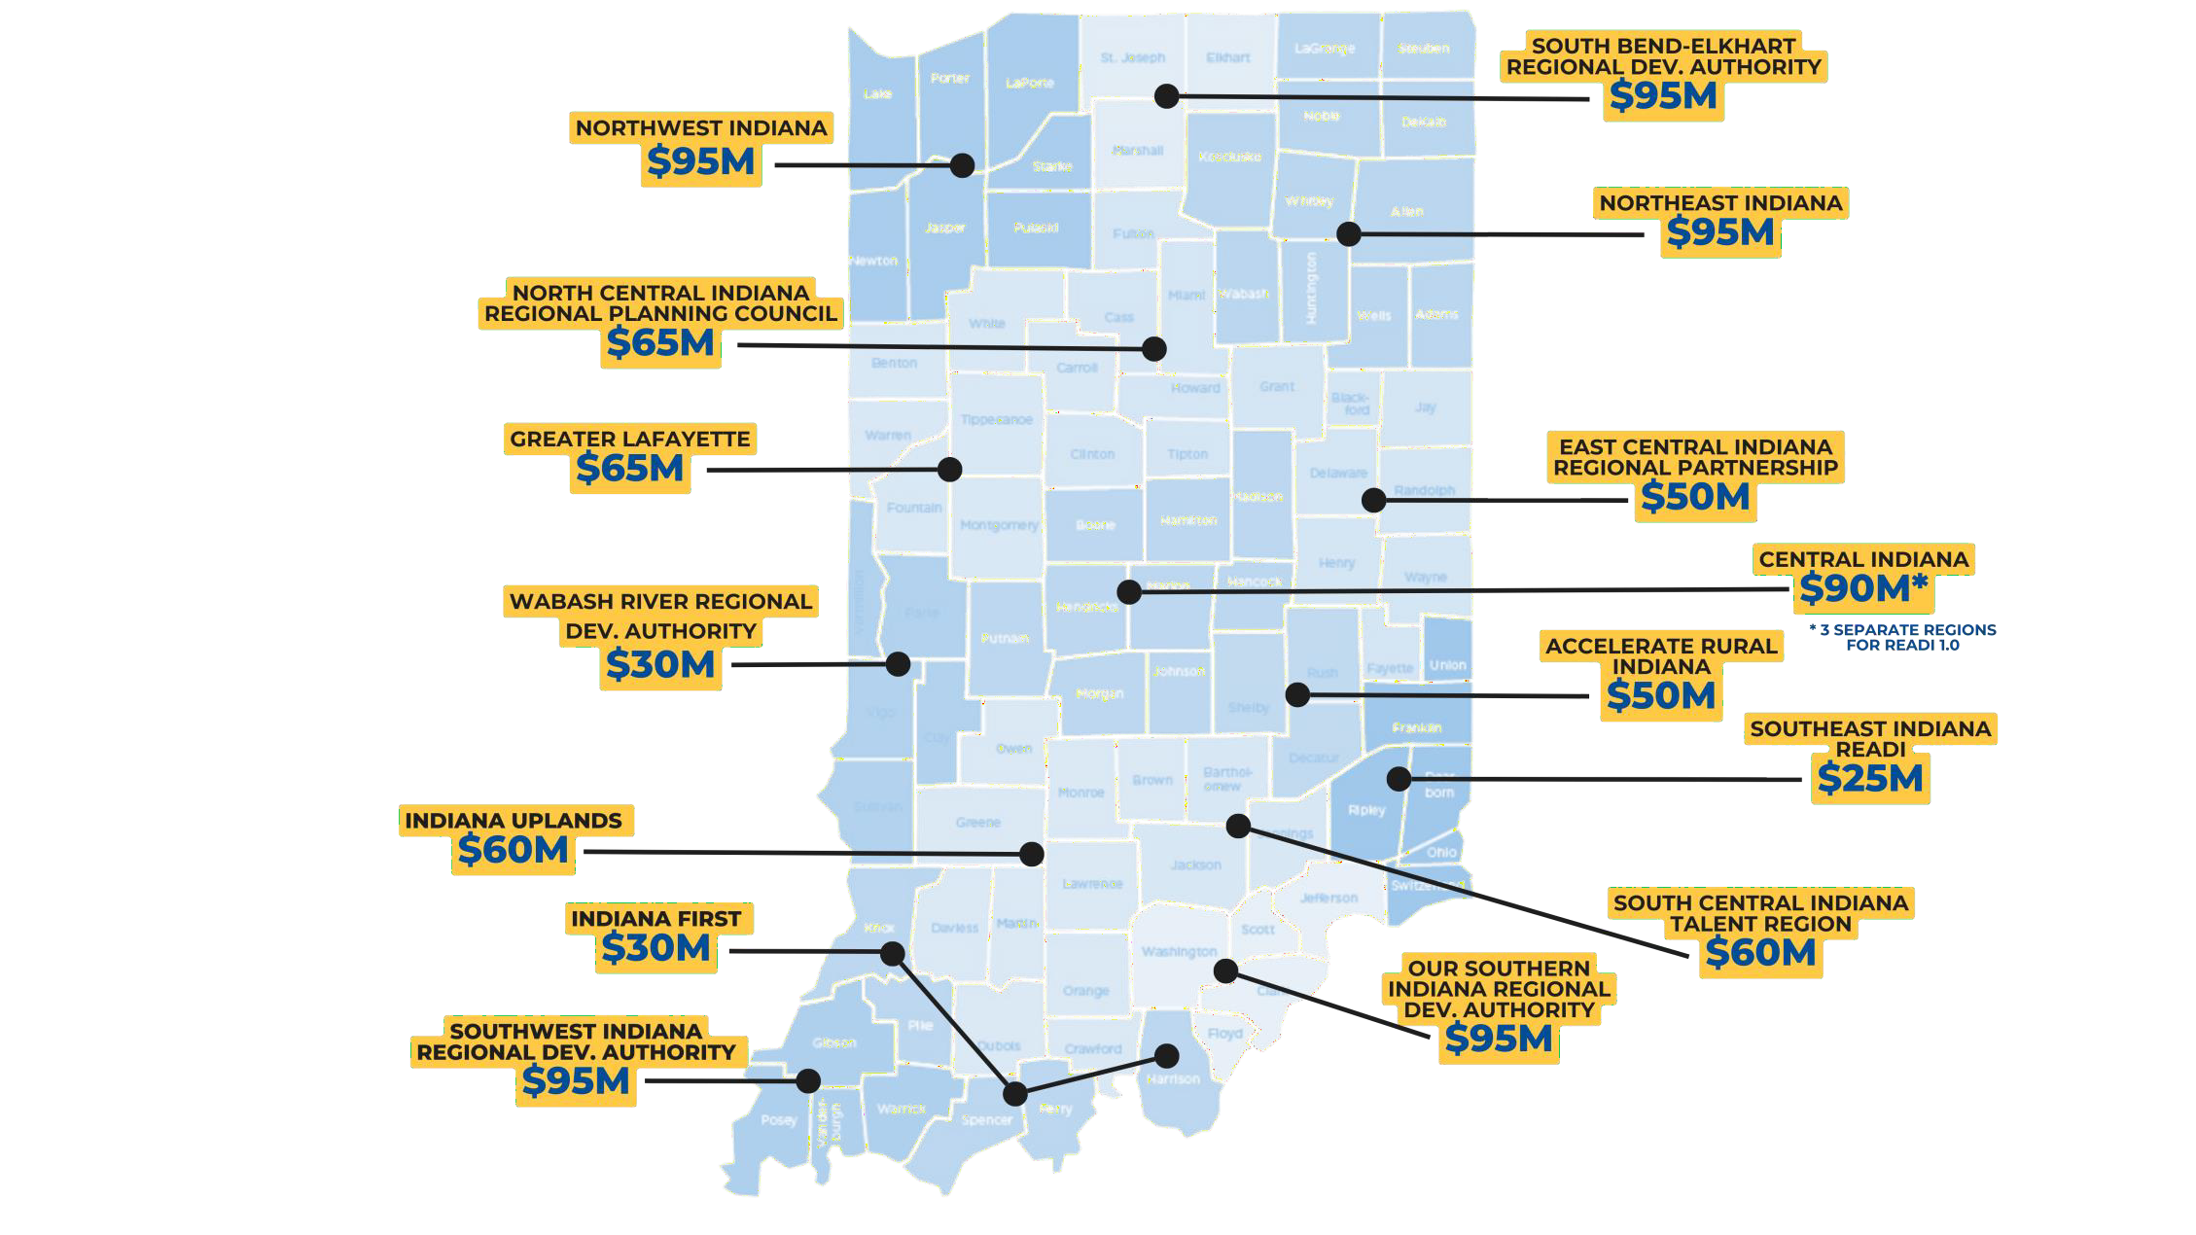



Slide 43
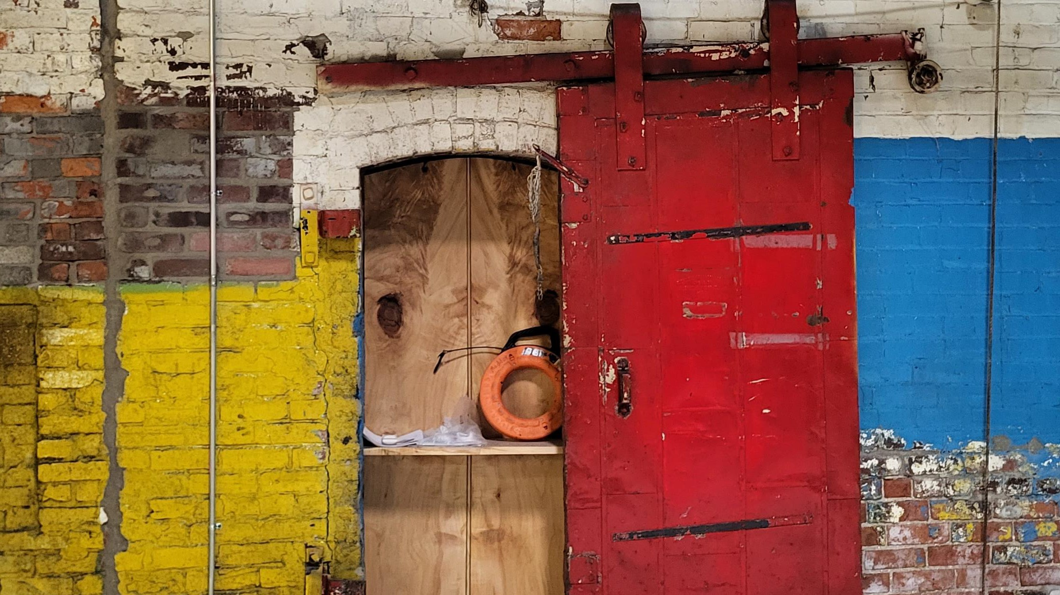










Eligible Entities
Only READI 2.0 regions that receive funding are eligible for this initiative.
Eligible Entities
Eligible proposals are restricted to READI 2.0 regional planning organizations that received a funding allocation.
Eligible Activities
Eligible Activities
Eligible projects must include properties that are either vacant, deteriorating, underutilized or blighted that have demonstrated an impact on the valuation of the subject assets and surrounding property values.
Public art including murals, sculptures, installations, programmable lighting on key assets or other artistic community improvements;
Development of museums, performing arts venues, art centers, art studio complexes or other culturally significant attractions or facilities (including improvements to existing facilities);
Eligible activities may include rehabbing historic structures, repurposing closed industrial plants to create inviting community spaces or mixed-use developments, or demolishing vacant, single-family homes to construct new affordable housing.
Art and cultural competitions or festivals, provided the applicant demonstrates long-term funding commitments to sustain any such effort;
Initiatives to attract nationally and internationally recognized arts and cultural performances to Indiana;
Total Appropriation:
Initiatives to support the further development of a region’s creatives and
creative economy; and
Development of visual architectural design elements that are unique to local communities
Total Appropriation:

Slide 44



