Slide 1

Local Road and Bridge
Matching Grant Funds
Kathy Eaton-McKalip
Director of LPA/MPO & Grant Administration
Indiana Department of Transportation

Slide 2
Welcome to CCMG
Application and Project Close-Out
Do’s and Don’ts Training

Slide 3
ITAP Registration Enrollment
INDOTs CCMG application requires your Agency to have an INDOT Technical Application Pathway (ITAP) account, and a registered Username to apply for Community Crossings funds.
  You must be a full-time employee of the LPA to register.
  You will need to know your Federal Tax ID to complete enrollment.
  You must have an Access Indiana Account to access ITAP.
    Instructions to Access Indiana is on INDOT’s website under: https://www.in.gov/indot/doing-business-with-indot/local-public-agency-programs/itap-for-lpas/
    Click on ITAP Quick Start Guide for instruction on How to Create an Access Indiana Account, and
    Click on Access Indiana Portal or itap.indot.in.gov to log into an existing account.
  A business is the city, town, or county, not a department within that government unit.
  If your city, town, or county has a new employee, their information will need updated.
  When enrolling with ITAP for the first time, your local government will need to enroll as a New Business.
  Contact Cassandra Hudson at chudson1@indot.in.gov with questions regarding ITAP.

Slide 4
Online Application
Applications MUST be completed by the LPA and no one else.
Something to think about - CCMG is for eligible construction projects that are ready for the bid process, and that can be closed out within 1 ½ years (18 Months) of award.
For questions regarding the CCMG Application contact your District Program Director.
    You can also request an appointment for assistance to complete a CCMG application with your District Program Director, in person or over the phone.
    INDOT is here to help you!
Applications take time to complete, so don’t wait until the last moment to start.
  INDOT does our best to review those applications submitted early for errors / missing documentations.
  If INDOT reviews your application and sends it back to you, review the comments, make the necessary changes, and resubmit the application ASAP.
  If application is not resubmitted, it will not be eligible.

Slide 5
Online Application continued
LPA may submit multiple applications.
  Each application for road work submitted can include up to 50 different road segments, however, you may only submit projects of the same work type on one application.
  Road preservation activities must be the same.
  Asphalt Overlay and Concrete Overlay are NOT the same (separate applications required).
  Only one bridge project can be submitted per application.
Each application will have its own Des. Number if awarded. Simply, each application is its own project.
  Example: If you submit 10 applications and 5 applications are awarded, you will have 5 different des numbers.
    Awarded funds cannot be moved from one Des. Number to another Des. Number unless they are on the same Local Roads and Bridges Matching Grant Agreement .
  We recommend that you group roads based on location or need, and that have the same work type on an application.
The ONLY Required documentation to submit a CCMG Application:
  Financial Commitment Letter.
  Detailed Estimates per road segment.
  Asset Management Plan approval letter from Indiana LTAP.
  Structure Inventory and Appraisal Report (SIA) is required for Bridge projects only.

Slide 6
Online Application continued
Financial Commitment Letter
Must be submitted on your Agency letterhead.
Must be signed (not typed) by someone who has the authority to sign on behalf of all the county commissioners, town, or city councils to bind the local government.
  (Either: Mayor, Town Board President, Town Manager/Clerk Treasurer, City Council President, or Commissioner).
One Letter per Application.
If letter is submitted without the proper authority and intent of financial commitment, the application will not be eligible.
An example of this letter is on the website: https://www.in.gov/indot/doing-business-with-indot/local-public-agency-programs/community-crossing-matching-grant-program/

Slide 7
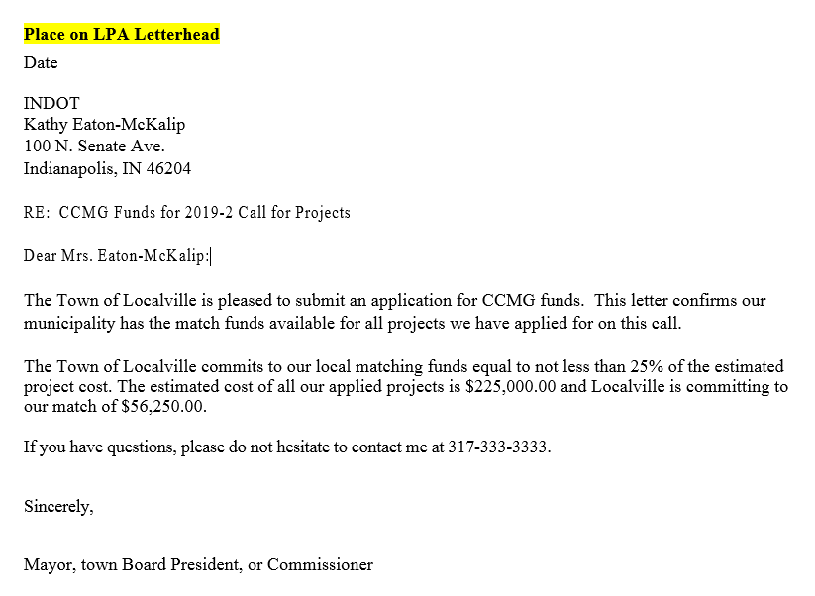
Online Application continued
Financial Commitment Letter example for a 75/25 match.
Revise accordingly for a 50/50 match.

Slide 8
Online Application continued
Detailed Estimate
  Each estimate must be detailed and itemized by each road or bridge; (with ‘to’ and ‘from’ points clearly defined).
  One estimate per / each road.
    If applying for 10 roads, 10 estimates will be submitted for that application. One estimate for each road.
  Lump sum estimates are not eligible.
  Estimates with contingencies will not be eligible.
  If estimates are not submitted with clear locations and clear estimates, the application will not be eligible.
There should be no confusion on the road you applied for, or the estimate per road.

Slide 9
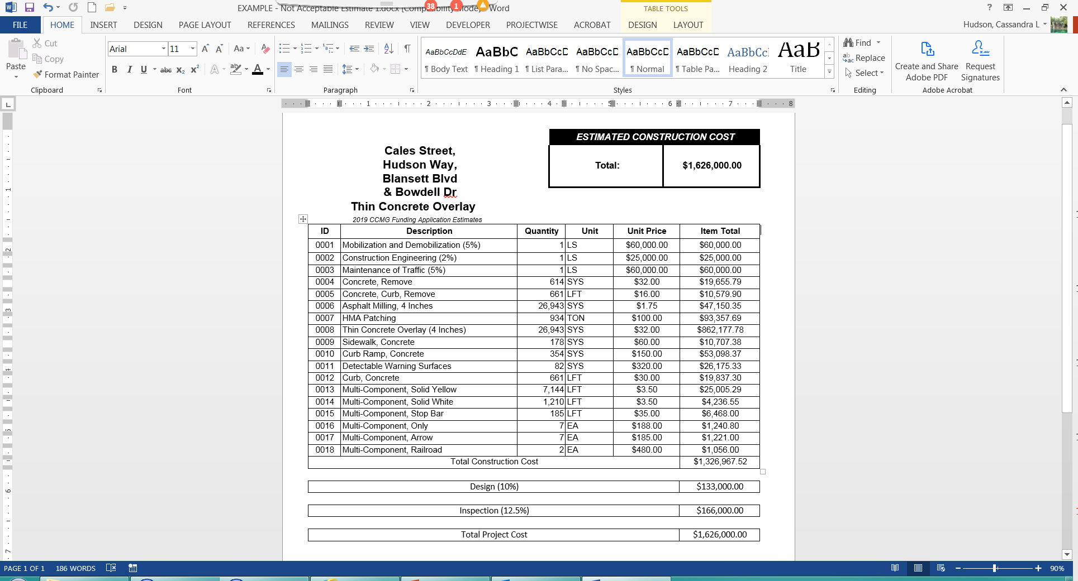
Online Application continued - Example 1 – Non-Acceptable Estimate
    This is not an acceptable estimate because it is lump sum for 4 streets, no to and from, and has design and inspection fees included.

Slide 10
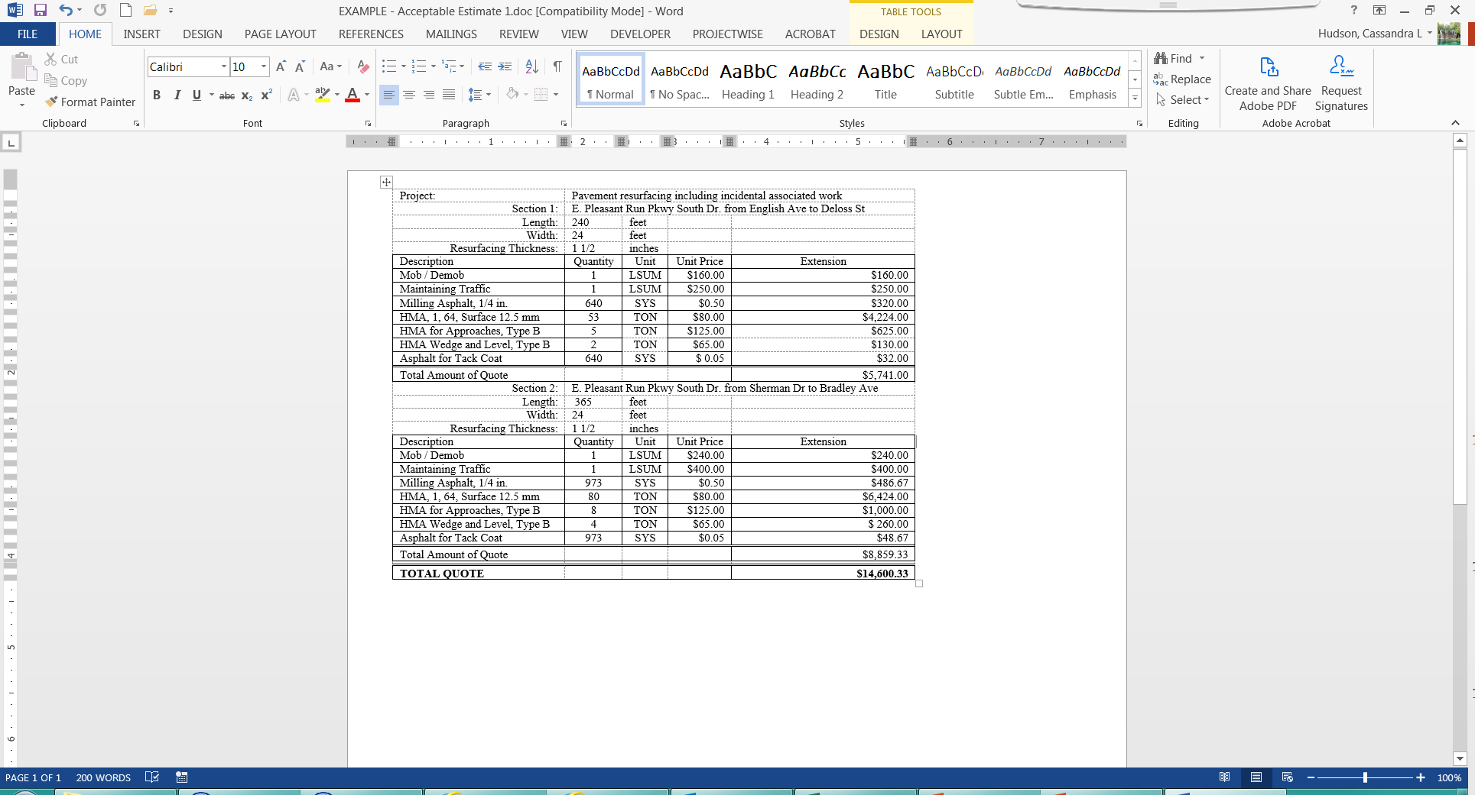
Online Application continued - Example 1 – Acceptable Estimate
    *

Slide 11
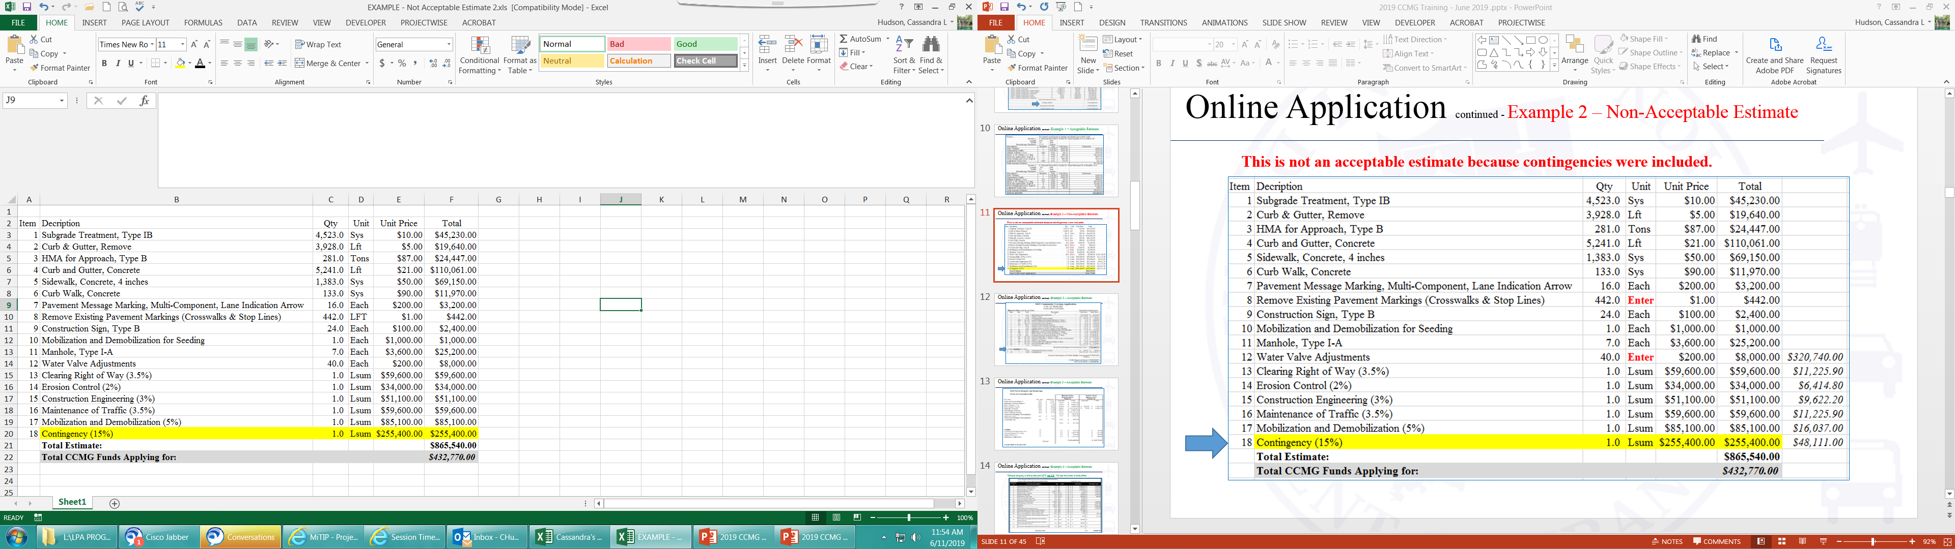
Online Application continued - Example 2 – Non-Acceptable Estimate
    This is not an acceptable estimate because contingencies were included and no road name (including the to and from) was listed.

Slide 12
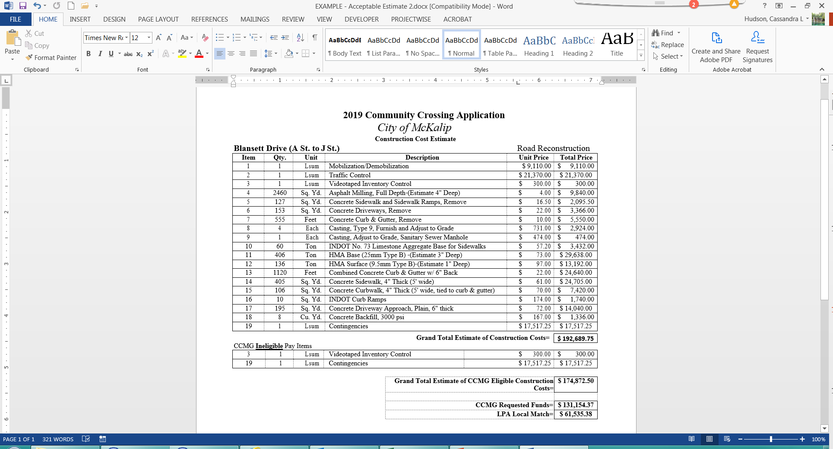
Online Application continued - Example 2 – Acceptable Estimate
    *

Slide 13
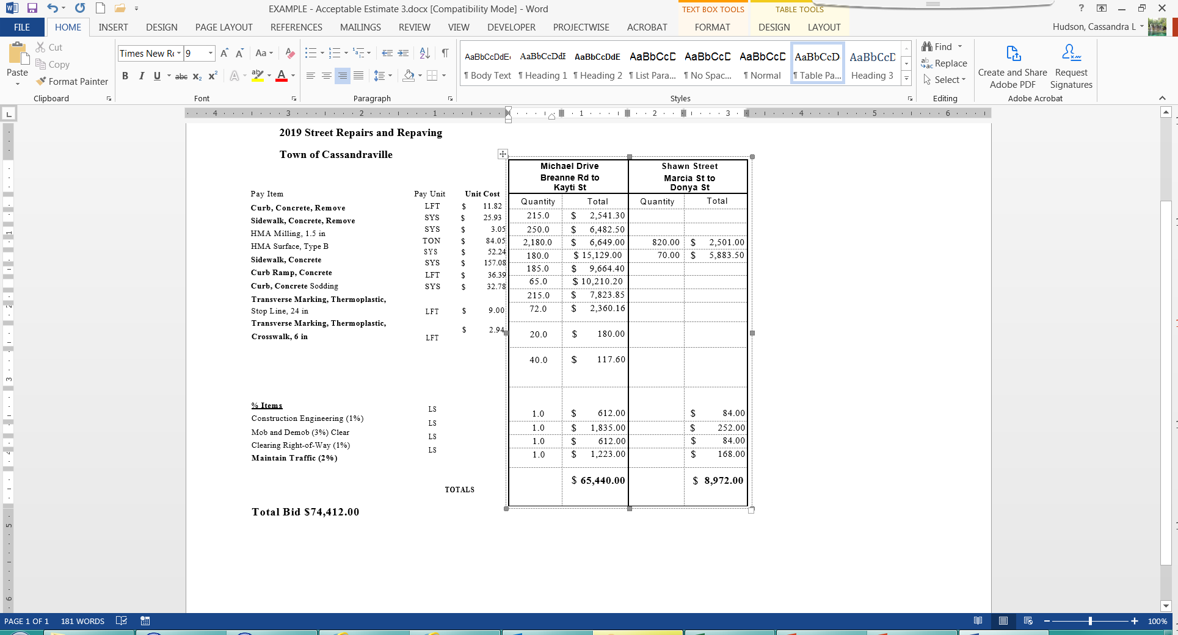
Online Application continued - Example 3 – Acceptable Estimate
    *

Slide 14
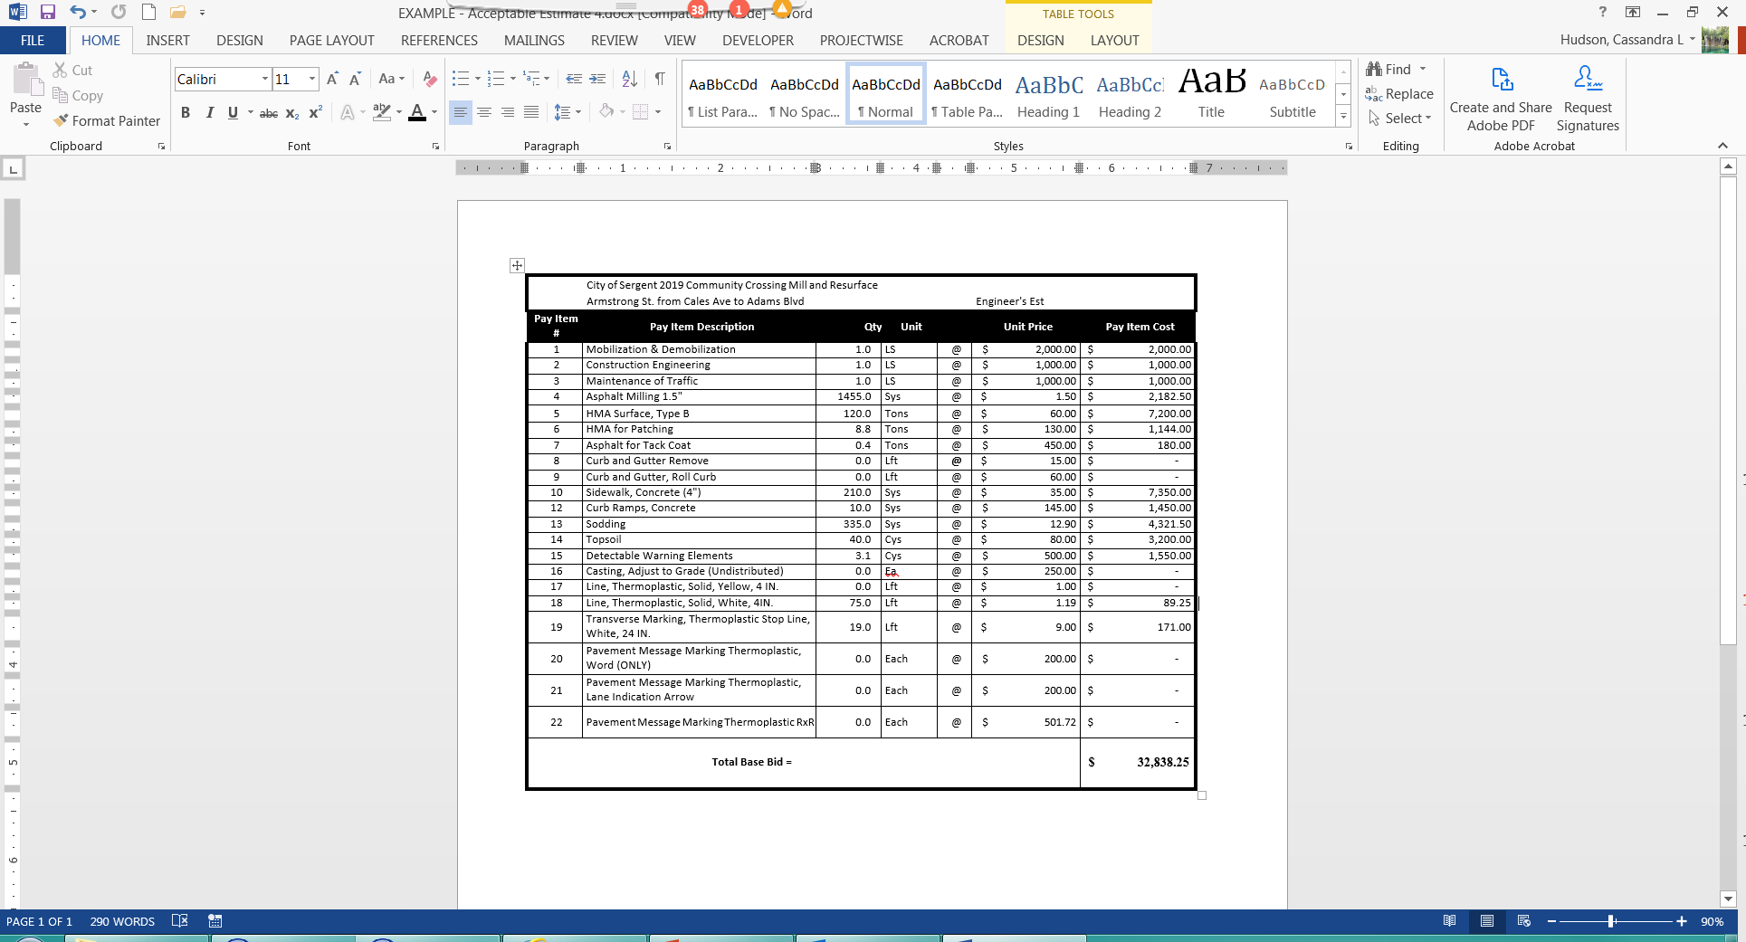
Online Application continued - Example 4 – Acceptable Estimate
    *Ensure striping is bid as the unit LFT, not LS. We see this error in estimates and bids often.

Slide 15
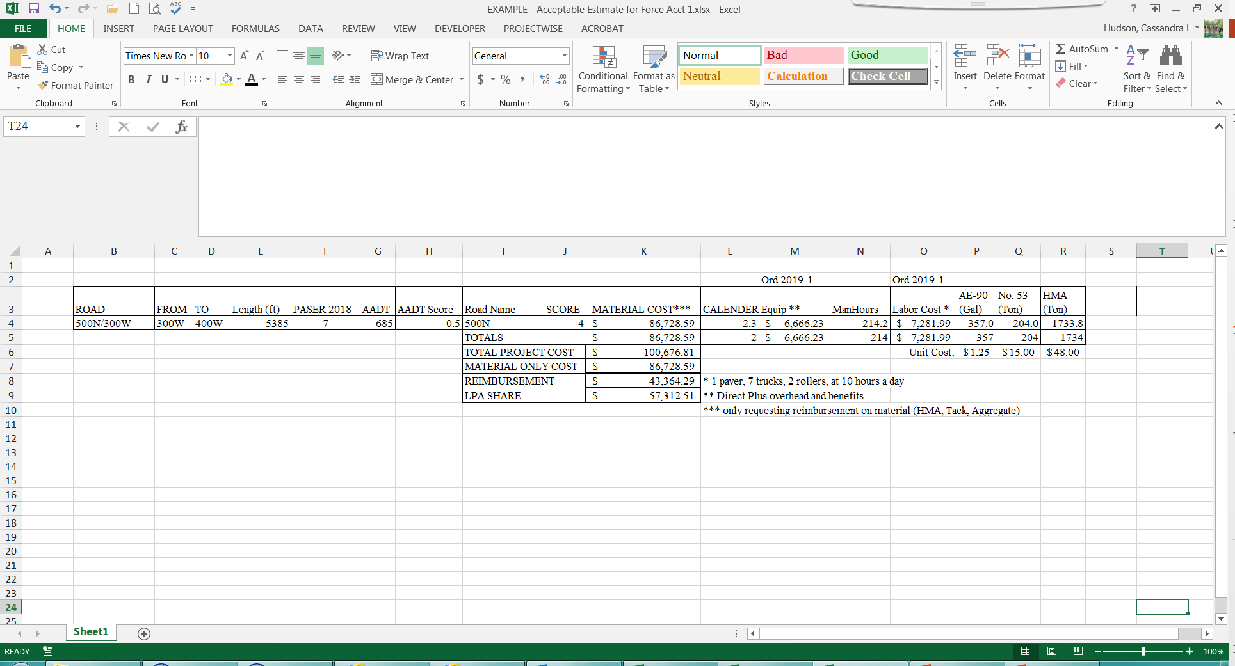
Online Application continued - Example 5 – Acceptable Estimate Force Account
    *

Slide 16
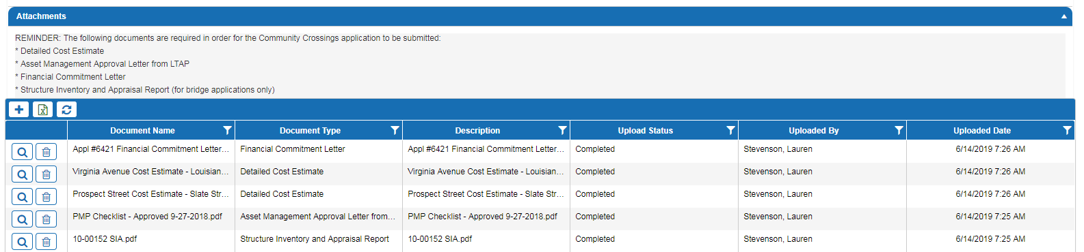
Online Application continued
Required documentation that needs to be uploaded
  Name Conventions
    Financial Commitment – Reference Application # in File Name
    Detailed Cost Estimate – Identify Road Segment in File Name (To and From should be included if have same segment with different locations)
    Asset Management Approval Letter from LTAP – Place Approval Date in File Name
    Structure Inventory and Appraisal Report – Place Bridge Number in File Name

Slide 17
Application Complications
Gravel Roads – converting a gravel road to a hard surface road.
  Separate application is required for converting a gravel road to an asphalt / concrete surface road.
  Work Type = Other Type Project (Miscellaneous).
  Detailed Project Scope field = must have a detailed scope.
Force Account work – per Indiana Code $250,000.00 total cost maximum.
Outside or Prep Work (slope, ground, pipe… etc.).
Reclamation of Materials.

Slide 18
Asset Management Plan (AMP)
To be eligible for CCMG funds, an Asset Management Plans (AMP) must be turned in to and approved by Indiana Local Technical Assistance Program-Purdue University (LTAP) once per year.
  LPA’s who submitted an AMP prior to December 1st of the previous year and have received their approval letter from Indiana LTAP, are eligible for the following years calls for projects.
Do not submit the entire AMP with your CCMG application, just the approval letter.
Pavement Asset Management Plans (AMP) are living documents and should be updated whenever improvements are made to roads/bridges, and then submitted to LTAP every year.

Slide 19
Asset Management Plan (AMP) continued
All Asset Management Plans should be submitted to LTAP, which will work with local governments to complete and approve all AMP’s. Asset management plans must be submitted to LTAP via their Data Management System. LTAP will contact you if revisions are required to your AMP’s once it is submitted.
Contact the Local Technical Assistance Program – Purdue University (LTAP). LTAP will be assisting all local governments with their plans. For any assistance with your Asset Management Plans or the Data Management System, including templates, examples, and resources, please contact:
Patrick Conner, PE - Lead Engineer, Asset Management, Indiana LTAP
Phone: 1-765-494-4971/ 1-800-428-7639
Email: connerp@purdue.edu or INLTAP@purdue.edu

Slide 20
Mapping a Road or Bridge
When mapping a road, ensure it is the correct road name and project length is accurately represented.
The road name that is used must be the same as what is in the Certified Road Mileage and Inventory
  Example: Road name is listed as E County Road 400 N on the map, correct road name is Vale Park Rd.
    There should be no confusion on the road you are applying for.
For questions on mapping contact Cassandra Hudson at chudson1@indot.in.gov.

Slide 21
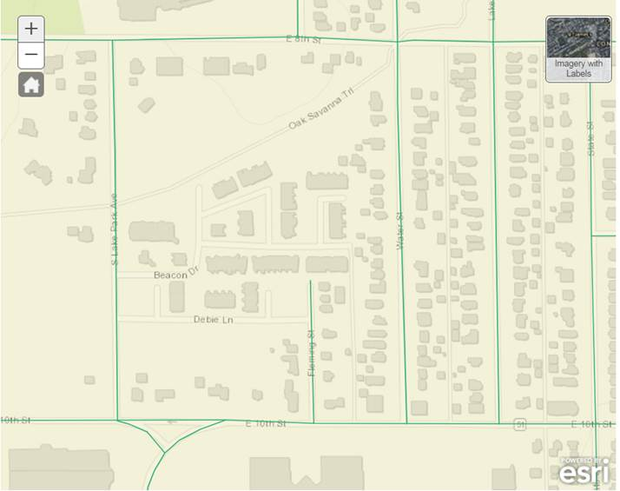

Mapping a Road or Bridge continued - Example 1 – Mapping Issues
Beacon Dr and Debie Ln are shown on the base map but are not roads within the certified road mileage and inventory, so they are not selectable. The base map is not INDOT’s.
If these roads are supposed to be in your inventory, you must get them added before INDOT is able to award funds for them.

Slide 22
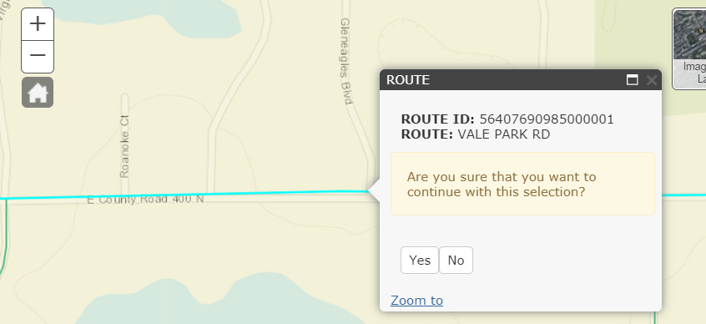
Mapping a Road or Bridge continued - Example 2 – Mapping Issues
Vale Park Rd (in the certified road mile and inventory) is shown on the base map as E. County Rd 400 N. If the name in the box is wrong, contact INDOT to get it corrected.
Notice the blue highlight goes beyond limits of picture, therefore once you say Yes, this is the correct road, you will have to zoom out to find the beginning and ending points.

Slide 23
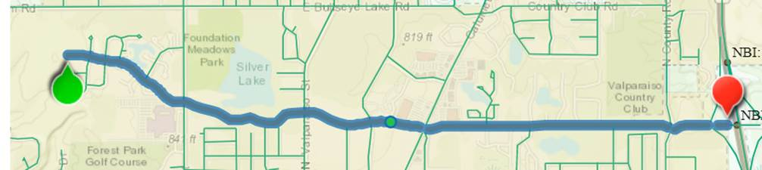
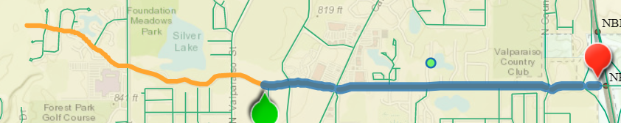
Mapping a Road or Bridge continued - Example 3 – Mapping Issues
The entire Vale Park Rd is 1 segment in the inventory.
Here we have dragged the beginning point (green pointer) along the road to new beginning point for the project.

Slide 24
Road Inventory
It is important to verify and update your Road Inventory.
  A Road Inventory is needed to ensure your Agency is compensated for all its road assets and to ensure your Asset Management Plan matches.
  Your state MVH funding is based on your Certified Road Inventory.
To receive a copy of your certified road mileage for your Agency’s Road Inventory contact Mark McMahan, INDOT Road Inventory Manager at 317-233-1057 or mmcmahan@indot.in.gov.
  To get a road added to or deleted from your Certified Road Inventory, contact Mark McMahan for details.
  Updates will take a minimum of 48 hours to be approved but could take a minimum of 2 weeks to show the change on the maps.

Slide 25
ADA & Title VI Certifications
INDOT is a recipient of federal funds. This means that if you receive any funding from INDOT, whether through a contract to perform work or provide professional services or as part of a grant or award for your community, INDOT is required to ensure you are in compliance with Title VI & Americans with Disabilities Act (ADA) nondiscrimination and accessibility requirements.
Our goal in monitoring our sub-recipients is to provide sufficient training, tools, and resources to make compliance efforts manageable and easier for our sub-recipients as we work together to improve Indiana communities by constructing roads, bridges, highways, and pedestrian facilities across the state.
Please contact Christopher Serak, Prequalification & Construction Compliance ADA/Title VI at chserak@indot.in.gov for more information and assistance.

Slide 26
Eligible For CCMG Funding
Road and bridge projects submitted must be included and a part of the local government’s complete asset management plan.
Local road and bridge preservation type projects.
Existing ADA ramp work is required when doing a minimum of a mill and overlay, regardless of the work type.
  Milling and overlaying is the process of grinding asphalt with a milling machine, removing the debris, and installing new asphalt. The overlay must be a minimum of 1 ½ inches.
Existing ADA sidewalks are eligible for rehabilitation if the road project is getting a minimum of a 1 ½ inch mill and overlay. No new sidewalk projects.
Drainage work that is associated with a specific road project is eligible along with pipe replacements to correct drainage.
  Water line and sanitary sewer separation projects are not eligible.
The conversion of gravel roads to hard surface roads.
Local Governments that perform their own work, such as chip sealing and crack sealing, can receive funds for the materials only.
  Labor and/or equipment costs are not eligible.

Slide 27
Not Eligible For CCMG Funding
Preliminary engineering, land purchasing (right-of-way), utility relocation.
Construction inspection.
Labor or equipment costs for governments that perform their own force account work.
Railroad crossing upgrades.
Water and sanitary sewer line replacements, or sewer separation projects.
Standalone curb and gutter projects.
Any project that has approved federal funding.
New roads.
New roundabouts are not eligible unless there is a history of personal injury and fatalities; safety driven.
Roads and alleys that are not in the LPA’s certified road mileage and inventory and in the AMP.
Parking lots and private roads.
Standalone sidewalk replacements or new installations.
Trails / Bike paths.
Projects that combine Force Account and Bidding.
Enhancement-type work, including:
  Streetlights
  Street informational signs
  Decorative pavers
  Trees and plants
  Trash receptacles
  Gateway aesthetics
Any change orders to the bid are not eligible for CCMG funds.

Slide 28

Procurement – State Laws
  State laws that apply:
  I.C. 36-1-12 (Public Works Projects)
  I.C. 8-23-10 (Qualifications of bidders for contracts
  I.C. 5-16-13 (Contractor requirements for public works projects)
  Indiana Code look-up http://iga.in.gov/

Slide 29
Procurement – Estimated Project Cost: < $50,000.00
Indiana Code 36-1-12-5
The board shall invite quotes from at least three (3) persons known to deal in the class of work proposed to be done by mailing them a notice stating that Plans and Specifications are on file in a specified office. The notice must be mailed not less than seven (7) days before the time fixed for receiving quotes.
The board may not require a person to submit a quote before the meeting at which quotes are to be received. The meeting for receiving quotes must be open to the public. All quotes received shall be opened publicly and read aloud at the time and place designated and not before.
The board shall award the contract for the public work to the lowest responsible and responsive quoter.
The board may reject all quotes submitted.
If the board rejects all quotes, the board may negotiate and enter into agreements for the work in the open market without inviting or receiving quotes if the board establishes in writing the reasons for rejecting the quotes.
The board may not proceed for the resurfacing (as defined in IC 8-14-2-1) of a road, street, or bridge, unless:
(1) the weight or volume of the materials in the project is capable of accurate measurement and verification; and
(2) the specifications define the geographic points at which the project begins and ends.
If contiguous sections of a road, street, or bridge are to be resurfaced in a calendar year, all of the work shall be considered to comprise a single public work project.
Quotes for public works projects costing less than twenty-five thousand dollars ($25,000) may be obtained by soliciting at least three (3) quotes by telephone or facsimile transmission. The seven (7) day waiting period does not apply to quotes solicited.

Slide 30
Procurement – Estimated Project Cost: > $50,000.00 but < $150,000.00
Indiana Code 36-1-12-4.7
The board shall invite quotes from at least three (3) persons known to deal in the class of work proposed to be done by mailing them a notice stating that Plans and Specifications are on file in a specified office. The notice must be mailed not less than seven (7) days before the time fixed for receiving quotes.
The board may not require a person to submit a quote before the meeting at which quotes are to be received. The meeting for receiving quotes must be open to the public. All quotes received shall be opened publicly and read aloud at the time and place designated and not before.
The board shall award the contract for the public work to the lowest responsible and responsive quoter.
The board may reject all quotes submitted.
The board may not proceed for the resurfacing (as defined in IC 8-14-2-1) of a road, street, or bridge, unless:
(1) the weight or volume of the materials in the project is capable of accurate measurement and verification; and
(2) the specifications define the geographic points at which the project begins and ends.
If contiguous sections of a road, street, or bridge are to be resurfaced in a calendar year, all of the work shall be considered to comprise a single public work project.

Slide 31
Procurement – Estimated Project Cost: > $150,000.00
Indiana Code 36-1-12-4
The board shall prepare Plans and Specifications describing the kind of public work required, but shall avoid specifications which might unduly limit competition. If the project involves the resurfacing (as defined by IC 8-14-2-1) of a road, street, or bridge, the specifications must show how the weight or volume of the materials will be accurately measured and verified.
The board shall file the plans and specifications in a place reasonably accessible to the public, which shall be specified in the notice.
The notice must specify the place where the plans and specifications are on file and the date fixed for receiving bids. The board shall advertise twice, at least one week apart, with the second advertisement at least 7 days before the bid opening.
The board shall require the bidder to submit a financial statement, a statement of experience, a proposed plan or plans for performing the public work, and the equipment that the bidder has available for the performance of the public work. The statement shall be submitted on forms prescribed by the state board of accounts. General Form No. 96 is available at www.in.gov/sboa/ Political Subdivisions/Counties/Electronic Forms.
The board shall award the contract for the public work to the lowest responsible and responsive bidder.
The board may reject all bids submitted.
If the board awards the contract to a bidder other than the lowest bidder, the board must state in the minutes or memoranda, at the time the award is made, the factors used to determine which bidder is the lowest responsible and responsive bidder and to justify the award. The board shall keep a copy of the minutes or memoranda available for public inspection.
The board shall require the bidder to submit an Non-collusion Affidavit
If the cost of the public work is estimated to be more than two hundred thousand dollars ($200,000), a bond or a certified check is required to be filed with each bid by a bidder in the amount determined and specified by the board in the notice. The amount of the bond or certified check may not be set at more than ten percent (10%) of the contract price.
If contiguous sections of a road, street, or bridge are to be resurfaced in a calendar year, all of the work shall be considered to comprise a single public work project.

Slide 32
Procurement – Estimated Project Cost: < $250,000.00 Using Own Workforce
Indiana Code 36-1-12-3
The board may purchase or lease supplies in the manner provided in IC 5-22 and perform the public work by means of its own workforce without awarding a public work contract.
Before the board may perform any work under this section by means of its own workforce, the political subdivision or agency must have a group of employees on its staff who are capable of performing the construction, maintenance, and repair applicable to that work.
Actual cost of materials, labor, equipment, and rental, use of trucks and heavy equipment owned and all other expenses equal TOTAL PROJECT COST.
Public work project whose cost is estimated to be more than one hundred thousand dollars ($100,000), the board publishes a notice under IC 5-3-1 describing the public work that the board intends to perform with its own workforce setting forth the projected project cost and determines at a public meeting that it is in the public interest to perform the public work with the board's own workforce.
A public work project performed by a board's own workforce must be inspected and accepted as complete in the same manner as a public work project performed under a contract awarded after receiving bids.
If contiguous sections of a road, street, or bridge are to be resurfaced in a calendar year, all of the work shall be considered to comprise a single public work project.

Slide 33

Itemized Bids
  Must advertise for the scope of work applied for and awarded funds.
    Do not decrease the scope of work, or your awarded funds will be rescinded to INDOT for that project.
    Do not increase the scope of work, unless your LPA intends to pay for that scope increase 100% locally.
      Estimates submitted with the application with less quantities than advertised and bid for should not be included when funds are requested.
  Contract bids must be detailed and itemized by each road.
    Contractors can do itemized bids, require them to do so.
    Itemized work being done per road and the bid (amount you are paying) per road should be contractually clear.
    Bids with contingencies will not be acceptable.
    Lump sum bids will not be acceptable.
    If contracts / bids are not submitted with clear locations and a clear bid, the request for funds will not be acceptable until made clear.
Examples of acceptable and non-acceptable bids are as follows.

Slide 34
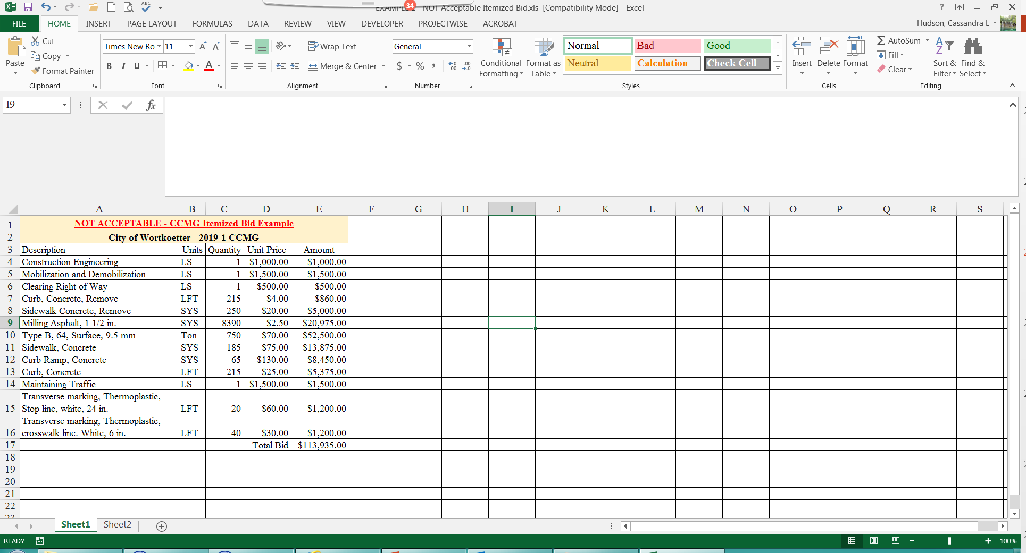
NOT ACCEPTABLE – Contractor’s Itemized Bid Example
This is for Castro Rd., Donya Dr., Carla Ave.
This is not an acceptable bid because
1) No To or From
2) Contractor lumped 3 roads, into one bid.

Slide 35
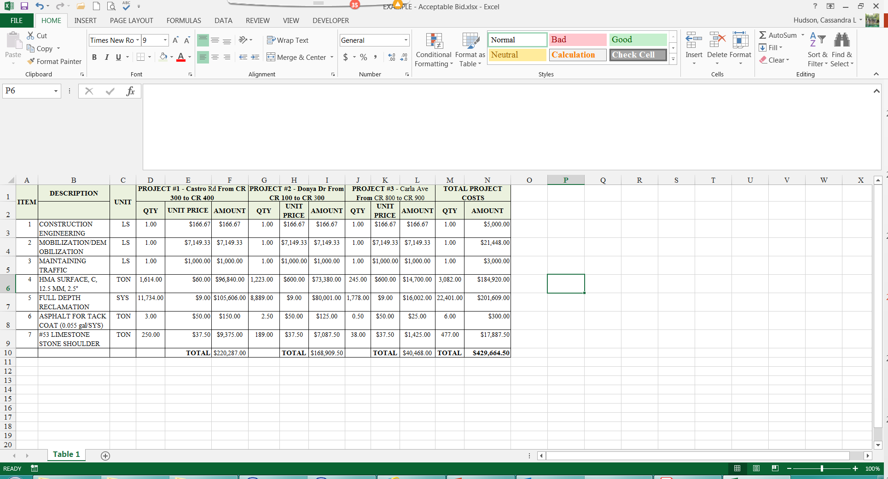
ACCEPTABLE – Contractor’s Itemized Bid Example

Slide 36
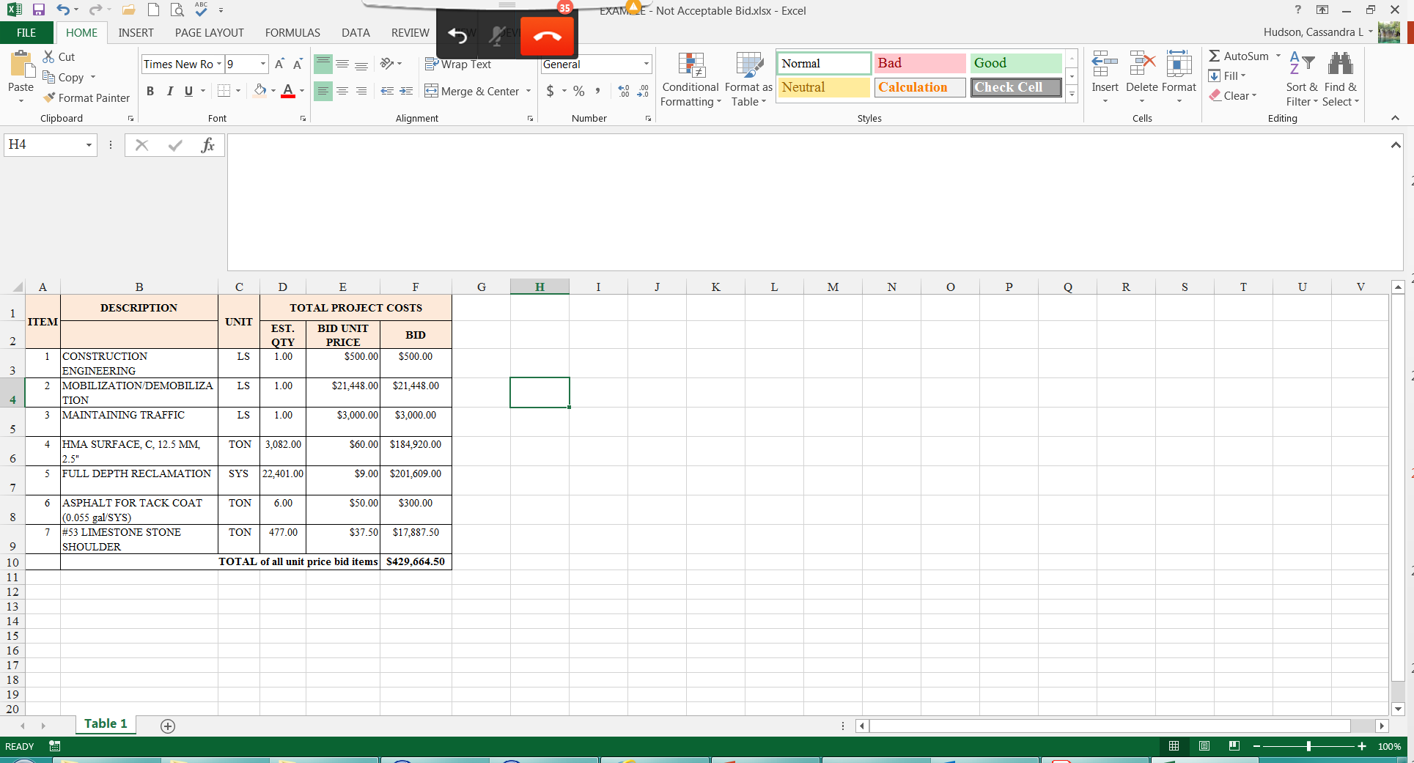
NOT ACCEPTABLE – Contractor’s Itemized Bid Example
This is for Hudson, Cales, Fox, Larue, Adams, Benner, & McKalip roads
This is not an acceptable bid because
1) No To or From
2) Contractor lumped 7 roads, into one bid.

Slide 37
ACCEPTABLE – Contractor’s Itemized Bid Example
Acceptable CCMG Itemized Bid Example
City of Blansett - 2019-1 CCMG
Steet Name | To | From | QTY | Unit | Description | Unit Price | Bid Amount
Hudson | Center | Green | 105.00 | SYS | Asphalt Milling, 1.5" | $1.70 | $1,785.00
 |  |  | 86.60 | TON | HMA Surface, Type A | $77.50 | $6,711.50
 |  |  | 22.00 | LFT | Stop Bar | $21.50 | $473.00
 |  |  |  |  |  | Total Rd | $8,969.50
Cales | Middle | Red | 2525.00 | SYS | Asphalt Milling, 1.5" | $1.70 | $4,292.50
 |  |  | 208.30 | TON | HMA Surface, Type A | $77.50 | $16,143.25
 |  |  | 12.00 | LFT | Stop Bar | $21.20 | $258.00
 |  |  | 100.00 | LFT | Piano Key Xwalk | $21.50 | $2,150.00
 |  |  |  |  |  | Total Rd | $22,843.75
Fox | 72nd | Blue | 500.00 | SYS | Asphalt Milling, 1.5" | $1.70 | $850.00
 |  |  | 41.20 | TON | HMA Surface, Type A | $77.50 | $3,193.00
 |  |  |  |  |  | Total Rd | $4,043.00
Larue | 4th | 9th | 4000.00 | SYS | Asphalt Milling, 1.5" | $1.70 | $6,800.00
 |  |  | 329.90 | TON | HMA Surface, Type A | $77.50 | $25,567.25
 |  |  | 36.00 | LFT | Stop Bar | $21.50 | $774.00
 |  |  |  |  |  | Total Rd | $33,141.25
Adams | Indiana | Ohio | 3030.00 | SYS | Asphalt Milling, 1.5" | $1.70 | $5,151.00
 |  |  | 249.90 | TON | HMA Surface, Type A | $77.50 | $19,367.25
 |  |  |  |  |  | Total Rd | $24,518.25
Benner | Penn | Texas | 1376.00 | SYS | Asphalt Milling, 1.5" | $1.70 | $2,339.20
 |  |  | 113.50 | TON | HMA Surface, Type A | $77.50 | $8,796.25
 |  |  | 28.00 | LFT | Stop Bar | $21.50 | $602.00
 |  |  |  |  |  | Total Rd | $11,737.45
McKalip | Iowa | Florida | 952.00 | SYS | Asphalt Milling, 1.5" | $1.70 | $1,618.40
 |  |  | 78.60 | TON | HMA Surface, Type A | $77.50 | $6,091.50
 |  |  | 24.00 | LFT | Stop Bar | $21.50 | $516.00
 |  |  | 2165.00 | LFT | 4" Yellow Thermo | $1.06 | $2,294.90
 |  |  | 2310.00 | LFT | 4" Yellow Thermo | $1.05 | $2,425.50
 |  |  |  |  |  | Total Rd | $12,946.30
 |  |  |  |  | Total Bid |  | $118,199.50
Mobilization/Demobilization and Maintaining Traffic included in unit price cost of individual items

Slide 38
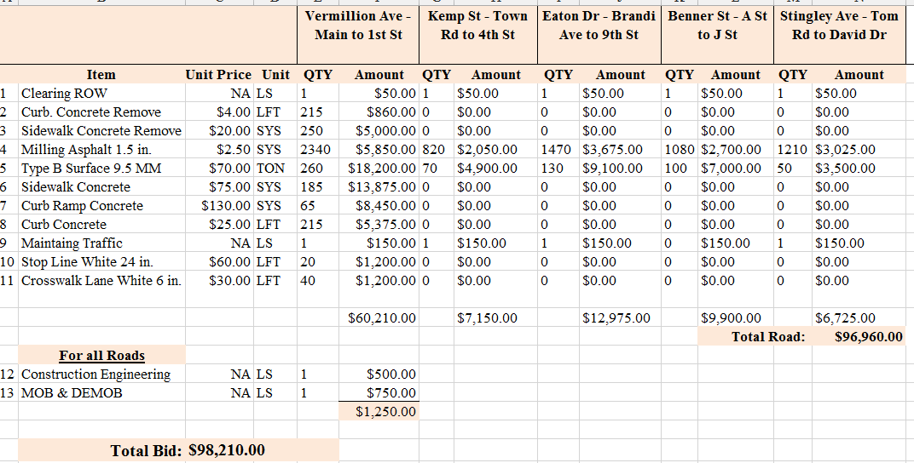
NOT ACCEPTABLE – Contractor’s Itemized Bid Example
This is not an acceptable bid because the Construction Engineering and MOB / DEMOB is not itemized per road.

Slide 39
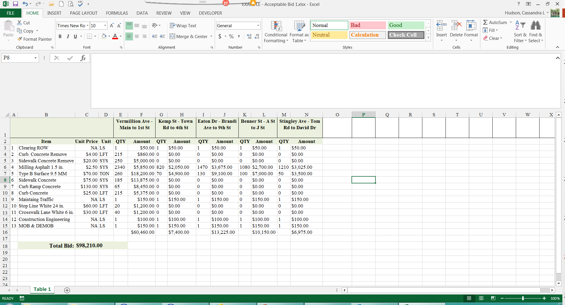
ACCEPTABLE – Contractor’s Itemized Bid Example

Slide 40
LPA Be Aware of When Bidding Awarded Project
Advertise bids with specific information to the contract, such as list of pay items, plans or specs should be on file. Contractors have expressed concerns that advertisements are vague, and they don’t know what they are bidding on.
It is the local governments responsibility to provide contractor with plans, specs and pay items on projects to be bid, not the contractor telling the locals what they need.
All bid packages must have plans and specifications, but do not have to be INDOT approved.
Bids should be itemized per road (with ‘to’ and ‘from’ points defined).
State law defines the project as the whole projects; can’t break projects apart to bypass state law.
  Bids or Quotes, even for Force Account work, must be project location specific.
Per the CCMG Agreement local governments have 4 months, from the award letter date (Attachment B of the agreement), to procure a fully executed contractor’s contract and send a copy to INDOT.

Slide 41

Close Out Grant After Construction is Complete
Notify INDOT once construction is complete, and all payments have been made and fully processed.
  Contact your District Program Director for help.
Submit the ‘Community Crossing Matching Grant Close Out’ letter with copies of contractor’s final invoice and proof of payment within 30 days of final payment.
  Submit all required documentation with this letter.
  These is required by SBA, and failure to submit the required documentation may result in the LPA repaying the grant funds.

Slide 42
Close Out Grant After Construction is Complete
Any under-runs must be paid back to INDOT within 30 days of being invoiced.
  LPA will be invoiced by INDOT for any funds owed back to INDOT.
  LPA must wait to send your payment with the invoice.
  INDOT will not accept payment unless LPA has been invoiced.
Any over-runs are not matched and the responsibility of the local unit.
Maintain records for five years for audit purposes.
There should be no confusion on the road you applied for, the bid per road, road contracted for, or the road in your close out documentation.

Slide 43
Review of Application Fatal Flaws
During Application Process
Financial Commitment Letter – content and proper signature (must be signed not typed)
Proper Detailed Estimates – per road/segment.
Accurate road name and to and from points (Mapping).
After Award
Improper bidding process – per Indiana Code and per application.
Scope changes.
The weight or volume of the materials in the project is NOT identified to be capable of accurate measurement and verification.

Slide 44
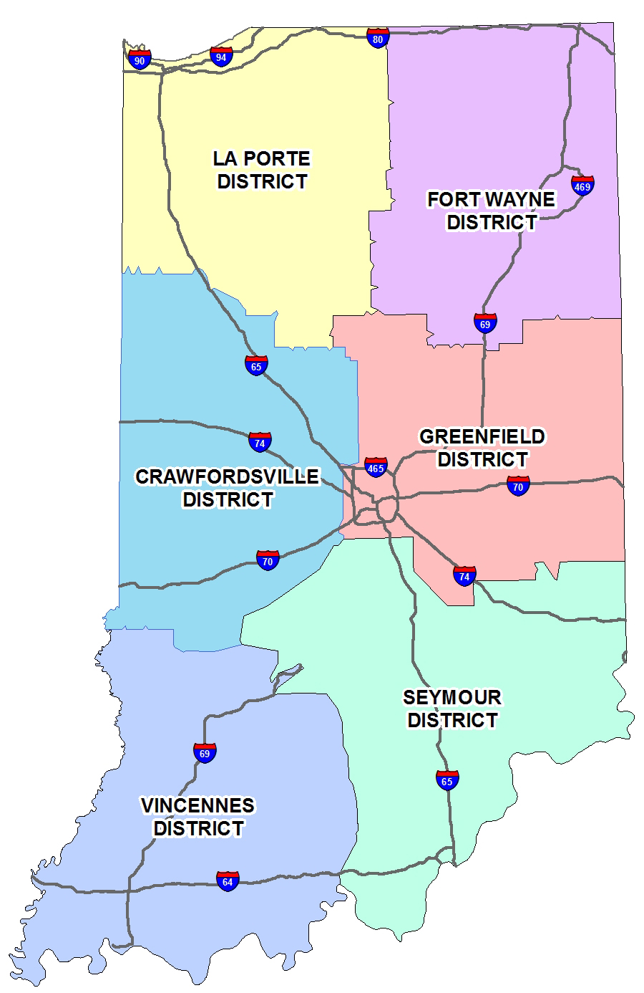
In Summary
Verify ITAP Registration Enrollment
Submit the On-Line Application in a timely fashion.
Complete or update your Asset Management Plan (AMP).
Verify your Road Inventory is up-to-date.
Verify your ADA & Title VI Certifications.
Ensure estimates are acceptable; detailed and itemized by each road.
Be aware of purchasing laws.
Ensure you have itemized bids.
Submit close out all documentation in a timely fashion.
  There should be no confusion on the road you applied for, the estimate per road, the bid per road, road contracted for, or the road in your close out documentation.
Watch out for Fatal Flaws

Slide 45

GovDelivery - Email and text updates
Recommend each local government have more than one staff member sign up
  Visit http://alerts.indot.in.gov
  Submit your email address or wireless number
  Select your regional district or statewide under LPA & Grants Administration and click submit

Slide 46
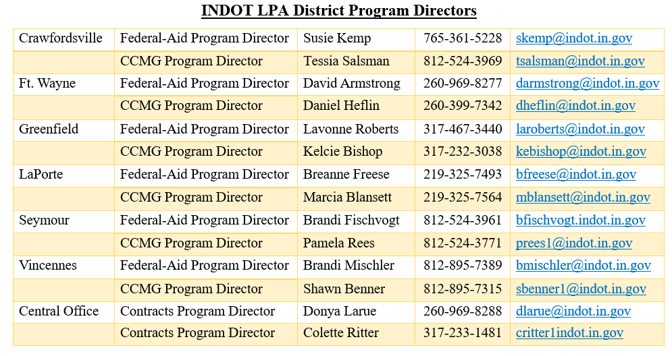
INDOT Contacts

