Slide 1
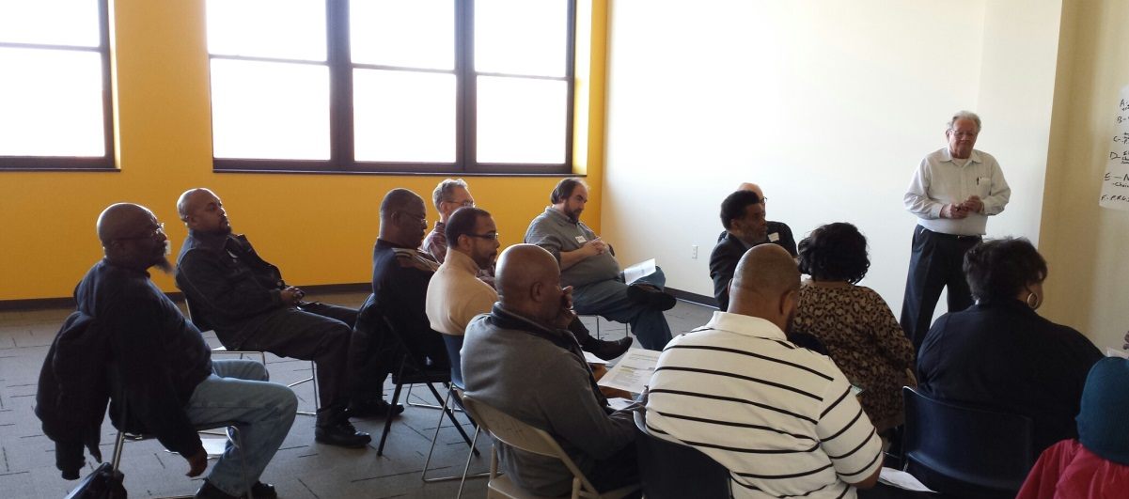
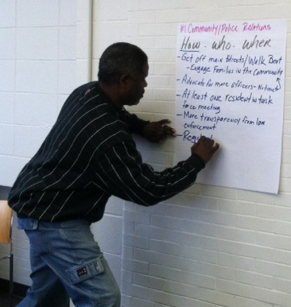
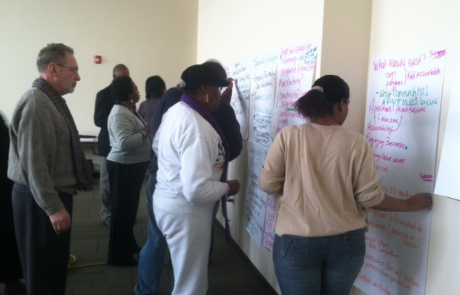
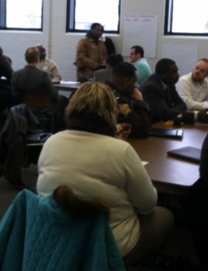
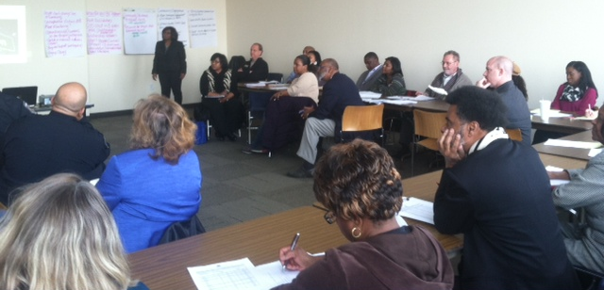

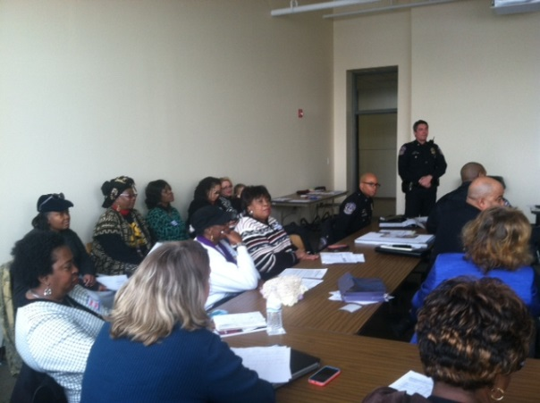
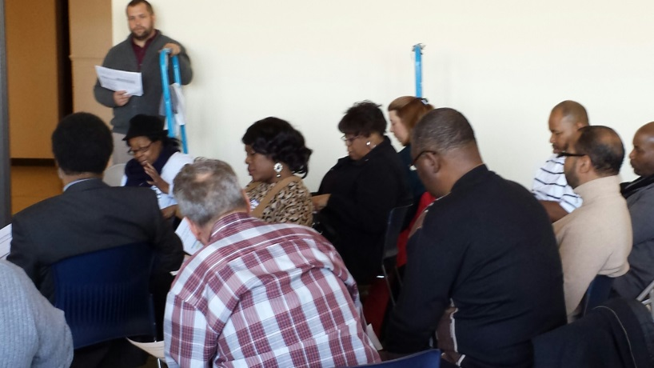


CITYWIDE CRIME PREVENTION & REDUCTION PLAN

Slide 2
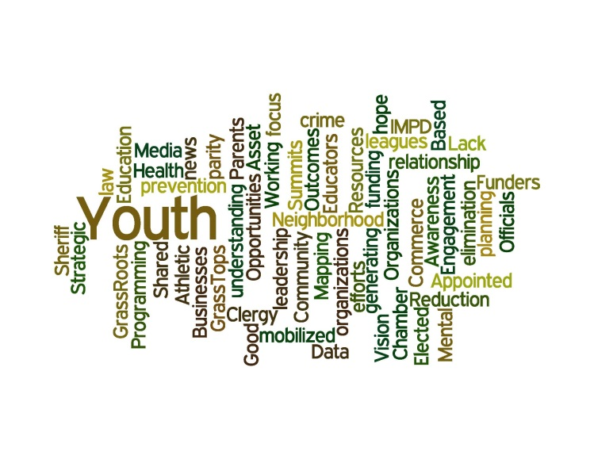
Executive summary
What: CITYWIDE CRIME PREVENTION AND REDUCTION PLAN
Why: To curb violence, to reduce the growing number of killings in the city and to develop specific, community-wide steps citizens and leaders can take
Who:
Forest Manor Multi-Service Center, convener
City of Indianapolis Public Safety Foundation, funder
Engaging Solutions, LLC, facilitator
Over 90 stakeholders, representing over 60 agencies
When: August 2013 to March 2014
How:
Public kick-off meeting (8.29.13)
9 listening sessions
4 workgroup meetings
Vision: To become a safer city
Target Zip Codes: 46218, 46201,46208,46205 , 46222
Focus Areas, Goals & Strategies (see full plan for action steps):
Intervention and Prevention - Creating parental supports, connecting youth with mentors, keeping young people in school and identifying triggers to prevent violence and crime
Establish and fund effective parent training programs for young parents and parents of challenging youth
Enhance agency collaboration among recipients of the Indianapolis Foundation Community Crime Prevention and City of Indianapolis Department of Public Safety grants and other existing agencies
Provide mentorship, educational support and enrichment activities through existing agencies that yield measurable results
Community Mobilization - Creating a community value system and ways to engage residents in activities such as neighborhood crime watches and other prevention programs
Create, promote and protect community values
Organize and/or enhance neighborhood programs in which neighbors come together to learn how to protect self, family, home and property
Suppression - Connecting communities and improving relations with local law enforcement to develop more effective community policing methods
  Improve cooperation and understanding between the police and their community
  Educate citizens on their rights and the role and responsibility of law enforcement officers
  Utilize foot patrols to improve community relations and suppress or prevent crime
  Ensure law enforcement officers are culturally competent
  Advocacy & Awareness - Coordinating, proposing and advocating for legislative and policy-related changes necessary to promote a safer community for all residents. A group of advocates for reducing and preventing crime will be established to advocate for 8 proposals:
  Increase foot patrols and additional officers
  Officers who mirror the community they serve
  Officer retention in urban areas
  “Common sense” district lines
  Officers trained in dealing with persons with disabilities
  Local landlords
  Equitable resource distribution and economic development in target zip codes
Contact Information:
Regina Marsh
Chief Executive Officer
Forest Manor Multi-Service Center
5603 East 38th Street
Indianapolis, IN 46218
317-545-1204 ext. 180
317-545-3096 FAX
rmarsh@fmmsc.org
www.fmmsc.org

Slide 3
Table Of Contents
Introduction Pg. 4
Process & Timeline Pg. 5
Public Meeting Participants Pg. 6
Workgroup Participants Pg. 7
Data Collection & Analysis Pg. 8-12
Work Plans Pg. 13-23
Metrics of Success Pg. 24
Acknowledgements Pg. 25
Press Conference/Implementation Kick-off Flyer Pg. 26

Slide 4
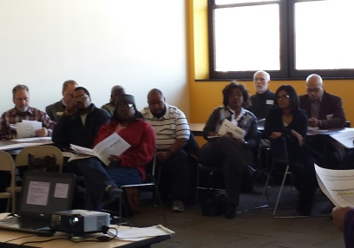
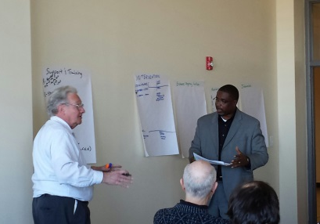
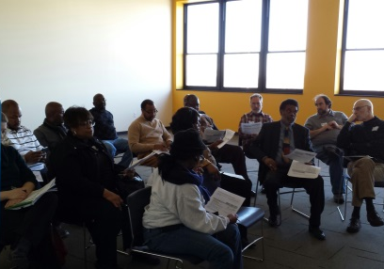
Introduction
A Call to Action
With record-setting homicide and crime rates plaguing the city, community and faith leaders came together with city officials, Indianapolis Metropolitan Police Department and other local agencies to find a solution.
Since August 2013, more than 90 individuals representing 60 diverse community organizations have participated in workgroup meetings to discuss ways to curb violence, reduce the growing number of killings in the city and to develop specific, community-wide steps residents and leaders can take to fulfill the vision of the plan: to become a safer city.
Work plans are organized by four key goals adapted from the Memphis Gun Down Plan and the Blueprint for Action: Preventing Youth Violence in Minneapolis and including: Suppression, Community Mobilization, Advocacy and Awareness and Intervention and Prevention.
The plan focuses on four key goals:
Suppression – Connecting communities and improving relations with local law enforcement to develop more effective community policing methods
Community mobilization– Creating a community value system and ways to engage residents in activities such as neighborhood crime watches and other prevention programs
Advocacy and awareness - Coordinating, proposing and advocating for legislative and policy-related changes necessary to promote a safer community for all residents
Intervention and prevention – Creating parental supports, connecting youth with mentors, keeping young people in school and identifying triggers to prevent violence and crime
The Convener
Forest Manor Multi-Service Center
Forest Manor Multi-Service Center (FMMSC) is a community-based social service organization located on the near eastside of Indianapolis. Our mission is to empower the lives of our neighbors by offering individuals and families the services and supports they need to become self-sufficient.
In the Forest Manor catchment area, an area highlighted on all crime prevention targeting maps, violent crime is an overwhelming reality. In fact, too many of our young residents have committed or been involved with criminal activity, have spent time in the juvenile justice system and are currently at risk of becoming repeat offenders. In addition, we are losing more of our youth to gun violence each year. The recent and dramatic increase in violence and crimes in our service area, specifically crimes committed by and directed at our youth, has spurred our organization to take a broader, more in depth look at crime and violence prevention strategies and techniques.
The Funders
City of Indianapolis Department of Public Safety Foundation and Indianapolis Foundation
This plan would not be possible without the financial support of the City of Indianapolis Public Safety Foundation and the Indianapolis Foundation.

Slide 5
Process & Timeline
A Call to Action public meeting was held August 29, 2013, at the English Building, with over 40 attendees, to share data surrounding violence in the city of Indianapolis, provide clarity on the planning approach, identify other community leaders who should be involved in the effort, and encourage community members to contribute and participate in work groups with the opportunity to sign up at the meeting.
Nine listening sessions were convened September through October 2013 based on the key strategic focus areas. The listening sessions were held to engage community members in strategy development and assisted in accurately interpreting the data and identifying community assets and resources.
Engaging Solutions, LLC was contracted as the facilitator in early November 2013 to ensure everyone had the opportunity to fully participate
in discussions and decision-making, and that all meetings were action-oriented and documented.
A Steering Committee consisting of a broad-based, multi-disciplinary group guided the development of the written plan.
Workgroups were formed, with chairs from the steering committee. The workgroups agreed on a shared vision, strategies, measurable objectives and activities.
As the workgroups began exploring topics and their implications, they discovered the need for contextual data to gain a better understanding of the issues.
The outputs from the public meeting, listening sessions, steering committee and workgroup meetings and data collection and analysis are documented within the plan that was unveiled on March 25, 2014.
Call to Action- Public Meeting
8/2013
50+ attended
Listening Sessions
9/1-10/31/13
9 listening sessions
Funding Awarded
10/1/13
Dept. Public Safety
Facilitator Engaged
11/1/13
Engaging Solutions
Community Unveiling
3/25/14
Steering Committee & Workgroup Meetings
12/1-2/28/14
90+ Attended

Slide 6
8.29.13
Public Meeting Participants
Name | Organization
Byron Johnson | Marion County Public Health Department
Andre Beverly | Concerned Clergy of Indianapolis
Olgen Williams | City of Indianapolis
Eric Simmons | Forest Manor Multi-Service Center
Joe Slash | Urban League
Val Washington | Department of Public Safety
Denise Herd | Herd Strategies
Bill Crawford | Indiana Black Legislative Caucasus
Haratio Luster | Ten Point Coalition
Jane Henegar | ACLU of Indiana
Dorry Holland | Holland and Associates
Alicia Barnett | Central Indiana Community Foundation
Vernon Brown | City County Councilor District 18
James Garrett | Indiana Commission for the Social Status of Black Males
James Taylor | John H. Boner Center
Joseph Hogsett | United States Attorney
Max Williams | Radio One
Nakaisha Tolbert-Banks | Mental Health America Indianapolis
Ontay Johnson | 100 Black Men
Owen Roper | Max Siegel, Inc.
Pam Hickman | City County Councilor
Laurel Jadkins | Prosecutors Office
Maggie Lewis | Dove House/City County Councilor
Jamal Smith | State of Indiana Civil Rights Commission
Reggie Jones, Sr.
Richard Hite | Indianapolis Metropolitan Police Department
Amos Brown | Radio One
Anthony Beverly | Stop the Violence Indianapolis
Bill Scott | Christamore House
Brandon Rasdell | MSD Lawrence
Ian Smith | MSD Lawrence
Cecely Brickley | Marion County Commission on Youth
Chayzee Smith
Chris Worden | Congressman Carson's Office
CL Day | Concerned Clergy of Indianapolis
Clint Johnson | YouthBuild Indy
David Hampton | Light of the World Christian Church
Doran Moreland | Exponent Strategies
Hodge Patel | Senator Donnelly's Office
Stephen J. Clay | Messiah Baptist Church
Tammy Robinson | Engaging Solutions
Tyrell Giles | Hoosier Occupational Training
William Benjamin | Marion County Sheriff’s Department
Bud Myers | Indianapolis Housing Agency
Dr. Preston Adams | Amazing Grace Church
Patrice Duckett | Hawthorne Community Center
Andrea Ekiyor | Indianapolis Housing Agency
C N Bolden
Jackie Burroughs | Governor's Office
Carlette Duffy | Southeast Community Service Center
Rev. M. Ajabu | Concerned Clergy

Slide 7
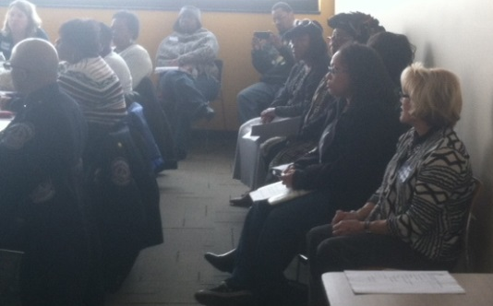
Workgroup Participants
Name | Organization
Millicent Jackson | East 38th Street Branch Library
Keesha Dixon | Asante Children’s Theatre
Cora Butler | Anthem Blue Cross & Blue Shield
Royce Fields | Bethesda Temple Apostolic
William Alexander | Beyond the Bridges
John Harris Loflin | Black & Latino Policy Inst.
Mike Sage | Branches of Life
Melissa Drew | Community Alliance of the Far Eastside (CAFÉ)
Bill Crawford | Marion County Deputy Treasurer
Alicia Barnett | Central Indiana Community Foundation
C.L. Day | Concerned Clergy
Bruce Farr | Community Resurrection Partnership
Charles McMillan | Culture thru Expression
Jim Neff | Devington Communities Association
Nancey Beals | Drug Free Marion County
Emma Williams | East 38th Street Branch Library
Nanci Lacy | Education Community Action Team
Immanuel Ivey | Edna Martin Christian Center
Karen Moore | Elevated Minds, LLC
Renee Bacon | Emmanuel Missionary Baptist Church
Joseph Collins | EMS Facilities Mgr.
Brent Freeman | The Excel Center
James W. Jackson | Fervent Prayer Church
Dwight Holland | Family and Community Partner
Wilbert A. Buckner | Flanner House
Angela Williams | Forest Manor Multi-Service Center
Kyle McIrath | Forest Manor Multi-Service Center
Pam Hickman | Forest Manor Multi-Service Center
Tiffany L. Jewell | Forest Manor Multi-Service Center
Marcus King | Gold Crown Enterprises NEOC
Martha Pabon | Habitat for Humanity
Janet Pensinger | Habitat for Humanity
Tranicia Hankins | Health Education Promotion & Training
James E. Garrett Jr. | Indiana Commission on the Social Status of Black Males
Andrea | Indianapolis Housing Agency
Brian Mahone | Indianapolis Metropolitan Police Department
Chief Rick Hite | Indianapolis Metropolitan Police Department
Lenard Nelson | Indianapolis Metropolitan Police Department
Michael Wolley | Indianapolis Metropolitan Police Department
Tom Kern | Indianapolis Metropolitan Police Department
Rocio Garcia | Indianapolis Metropolitan Police Department
LeEtta White | Indianapolis Metropolitan Police Department
Bud Myers | Indianapolis Housing Agency
Erika Smith | Indianapolis Star
Angela Hogan | Invoke the Spirit
Quintan Holland | Iota Phi Theta
Sharon Wade | Indianapolis Public Schools #69
Jessie Olvera | Indiana State Fair Commission
Myron Duff Jr. | IUPUI
Anna Carter | Center Township Assessor
Dina Batts-Davenport | Keystone, Millersville Neighborhood Association
Bonita Gupton | KMP
Aaron Laramore | Local Initiatives Support Corporation
Annie Kern | Marion County Prosecutors Office
Name | Organization
Nakeina Cane | Marion County Prosecutors Office
Dr. Willie Jenkins | Mayor’s Office
Mary McKee | Marion County Public Health Department
Shandy Dearth | Marion County Public Health Department
Anthony Burke | Marion County Public Health Department
Sonja Marion | Marion County Public Health Department
Anne Rincker | Marion County Prosecutors Office
Austin Shadle | Marion County Prosecutors Office
William Benjamin | Marion County Prosecutors Office
Bernard Mickle | Marion County Prosecutors Office
Gina Lewis Alexander | Oasis CDC
Andrea Scott | Office of Congressman Carson
Amy Harwell | One Voice- Martindale Brightwood
Vickie Driver | Oxford Neighborhood Association
Tim Nation | Peace Learning Center
Rev. M. Ajabu | PRUI
Stanley Proctor | PSA Security LLC
Benjamen Benjamen | Public Allies
Brandon Randall | Public Allies
Reese Burnett | Public Allies
Yahira Rosado | Public Allies
Megan Sims | Representative Carson's Office
Diana Creasser | Prescription for Hope-Eskenazi
Anthony Beverly | Stop the Violence Indianapolis
Antonio Torees | Student
Sylvia Trotter | United Northeast CDC
Joe Slash | Urban league
Fred Dorsey | Avondale Meadows YMCA
Rev. Malachi Walker | Young Men Inc., youth min.
Andre' Ellis | YouthBuild Indy
Clint Johnson | YouthBuild Indy
Darica Chambers | YouthBuild Indy
Isaac Mathews | YouthBuild Indy
Juanta Walker | YouthBuild Indy
Dennis Slaughter | Not Identified
Eunice Trotter | Not Identified
Jon Dawes | Not Identified
Vernon Compton | Not Identified

Slide 8
Data Collection & Analysis
The following data and narrative were provided by the Indianapolis Metropolitan Police Department, Department of Public Safety. For questions related to the data please contact:
Major Thomas Kern
City Wide Crime Strategist
Operations Division
Indianapolis Metropolitan Police Department
Department of Public Safety
50 N. Alabama Street
Indianapolis, IN 46204
Cell: 317-201-8985
Email: Thomas.Kern@indy.gov

Slide 9
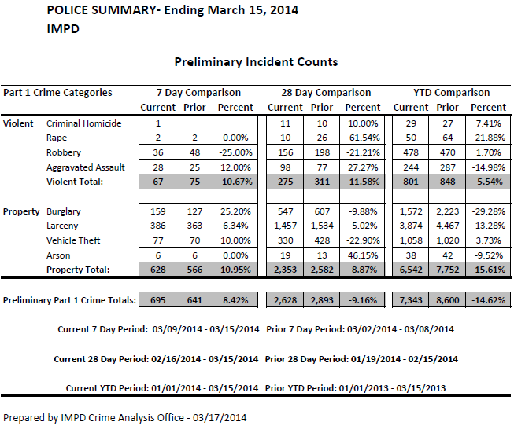
Data Collection & Analysis
Year | 1 | 2 | 3 | 4 | 5 | 6 | 7 | 8 | 9 | 10 | 11 | 12 | Total
2007 | 4853 | 3379 | 4668 | 4850 | 5497 | 5328 | 5643 | 5515 | 5123 | 5200 | 5109 | 4955 | 60120
2008 | 4864 | 4107 | 4749 | 4696 | 5018 | 5141 | 5686 | 5378 | 5184 | 5199 | 4516 | 4560 | 59098
2009 | 3998 | 3383 | 4223 | 4493 | 4907 | 4867 | 5235 | 5396 | 5271 | 5413 | 4980 | 4848 | 57014
2010 | 4268 | 3264 | 4788 | 4696 | 4985 | 4771 | 5171 | 5165 | 5118 | 4740 | 4642 | 4202 | 55810
2011 | 3876 | 3154 | 4051 | 4623 | 5140 | 5110 | 5873 | 5709 | 4853 | 4947 | 4722 | 4725 | 56783
2012 | 4328 | 3981 | 4446 | 4758 | 5420 | 5312 | 5496 | 5222 | 4928 | 4956 | 4503 | 4288 | 57638

Slide 10
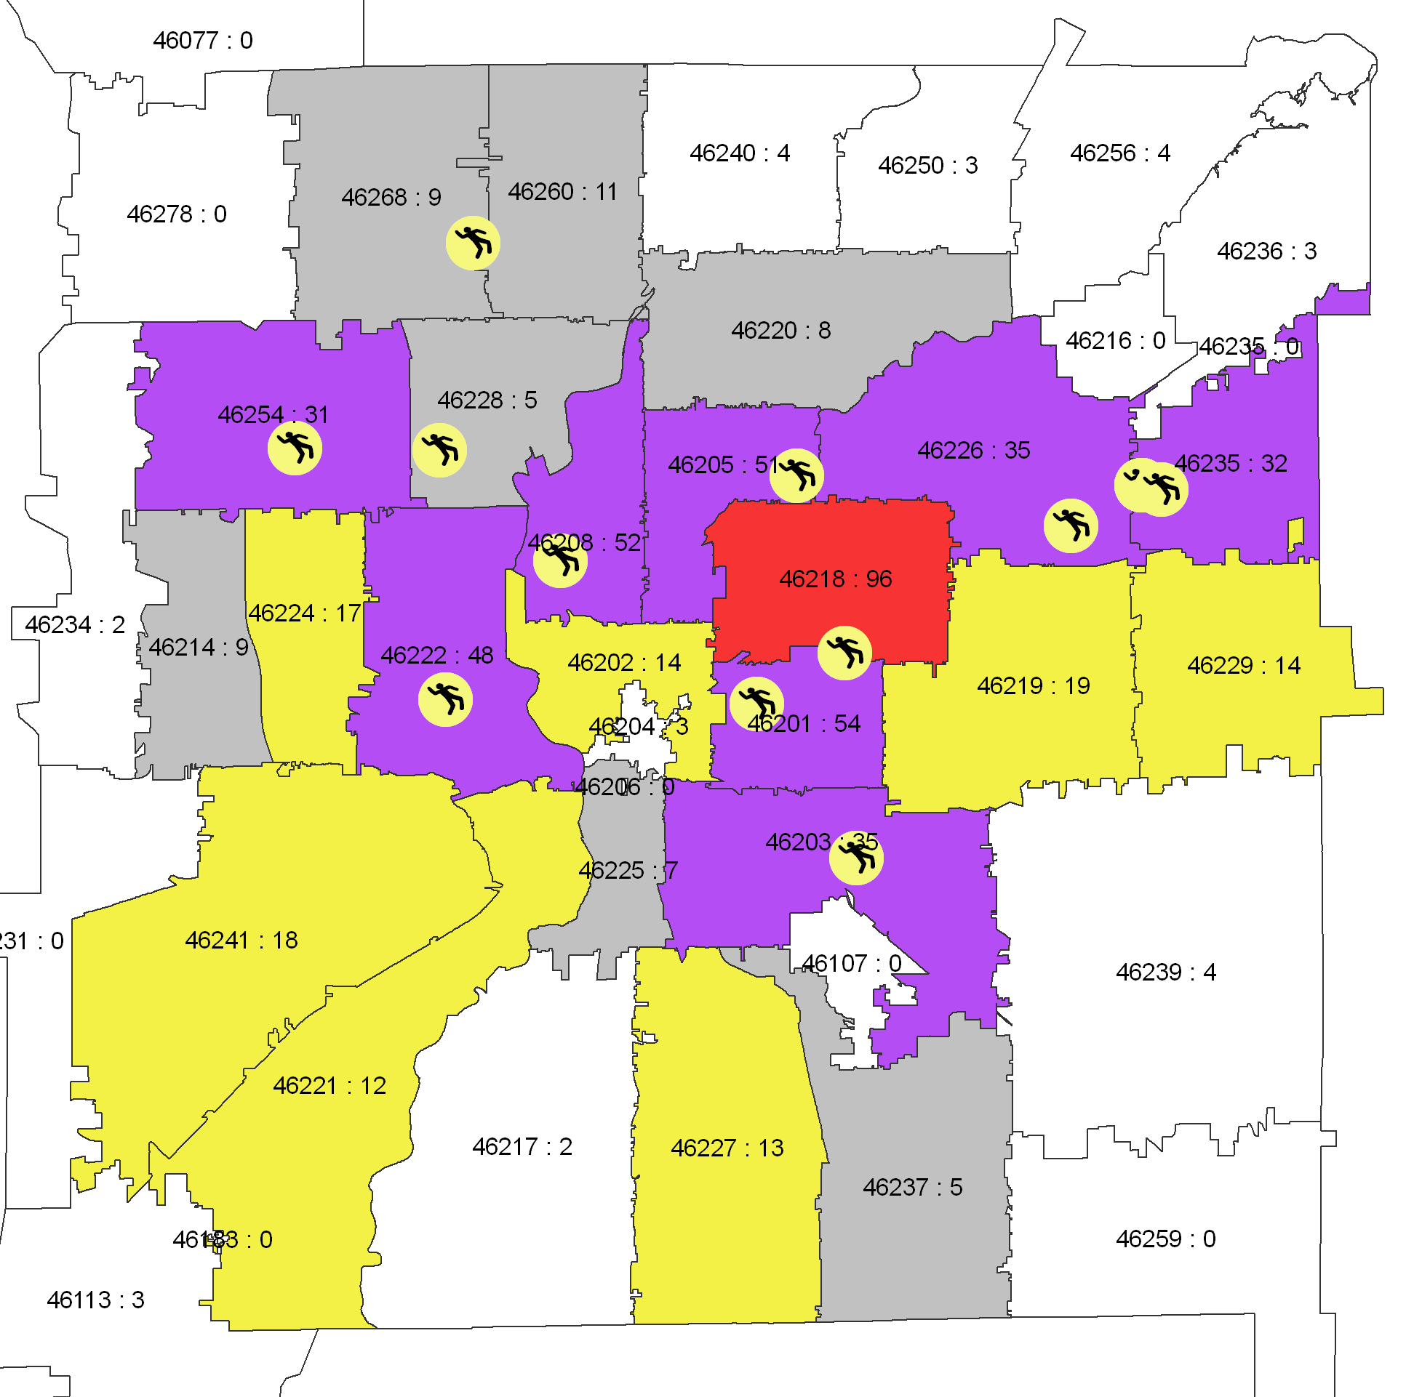
Data Collection & Analysis
Criminal Homicides By Zip Code 2007-2012
Zip Code | Criminal Homicides | Percentage of Total
46218 | 96 | 15%
46201 | 54 | 9%
46208 | 52 | 8%
46205 | 51 | 8%
46222 | 48 | 8%
46203 | 35 | 6%
46226 | 35 | 6%
46235 | 32 | 5%
46254 | 31 | 5%
46219 | 19 | 3%
46241 | 18 | 3%
46224 | 17 | 3%
46229 | 14 | 2%
46202 | 14 | 2%
46227 | 13 | 2%
46221 | 12 | 2%
46260 | 11 | 2%
5 Zip Codes: 48% of all Criminal Homicides

Slide 11
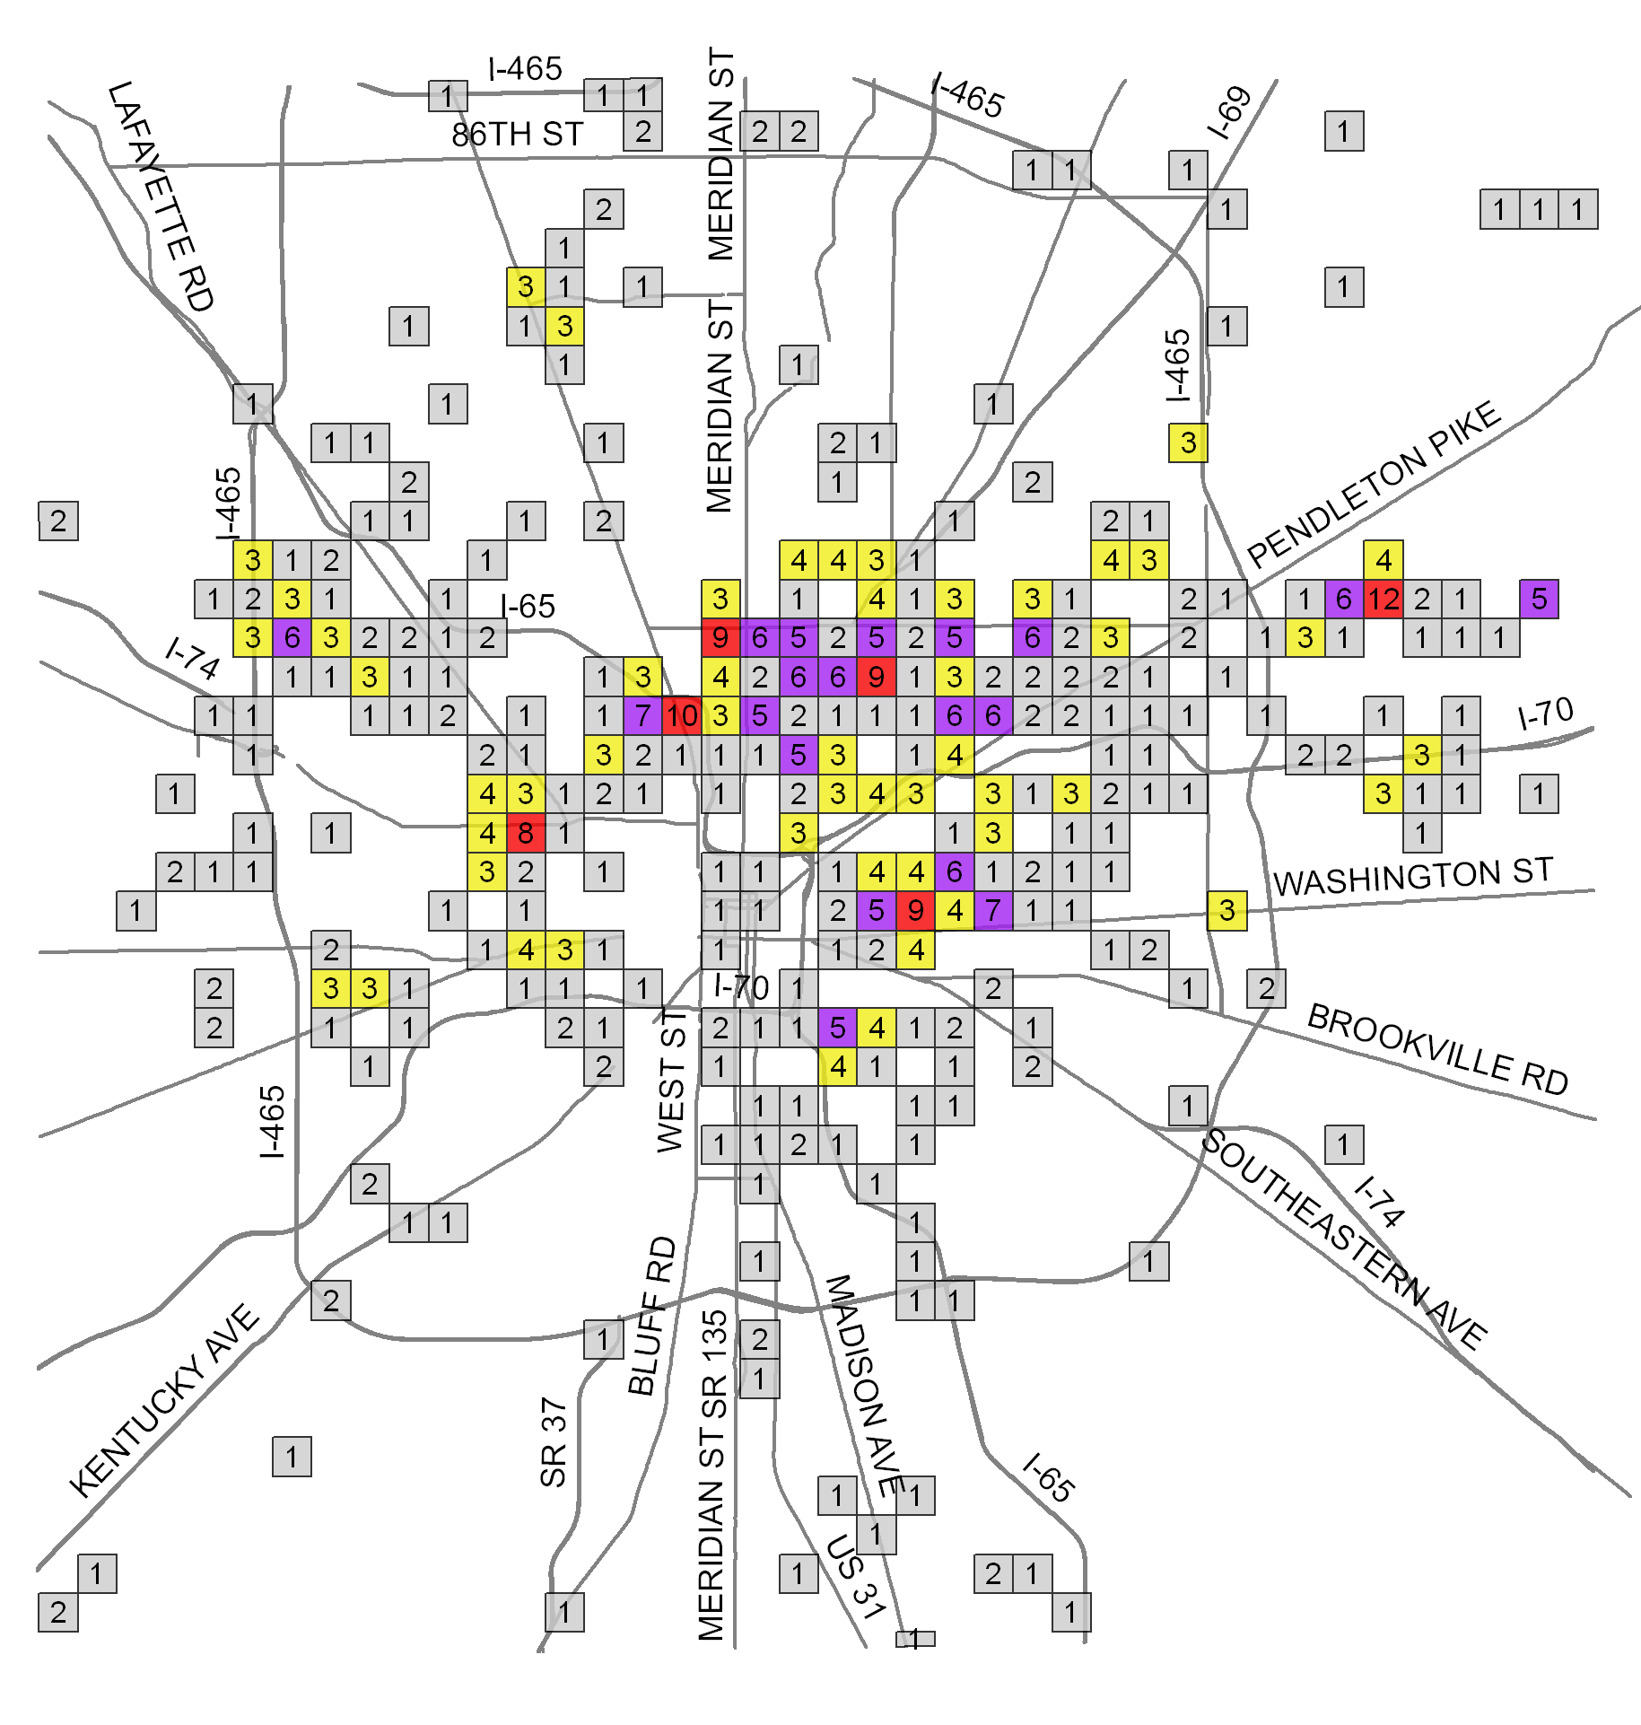
Data Collection & Analysis
Criminal Homicide Concentrations
Grid | Count
1297 | 12
1144 | 10
925 | 9
1194 | 9
1235 | 9
1005 | 8
1143 | 7
927 | 7
1243 | 6
1151 | 6
971 | 6
1224 | 6
1296 | 6
1152 | 6
1193 | 6
1192 | 6
1236 | 6
1239 | 5
1301 | 5
1146 | 5
788 | 5
924 | 5
1237 | 5
1102 | 5
1241 | 5
Homicides are geographically concentrated. The red and purple grids represent just 1.5% of IMPD’s service area but account for nearly 35% of all homicides since 2007.

Slide 12
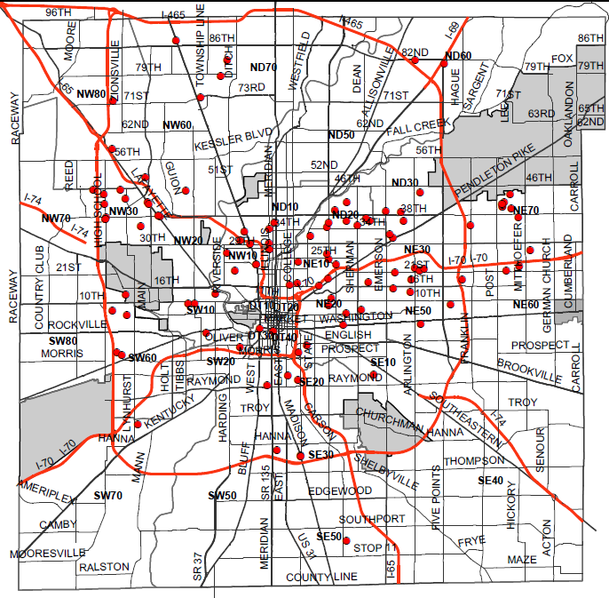
Data Collection & Analysis
2013 Criminal Homicide Locations
2013 Criminal Homicide Motive

Slide 13
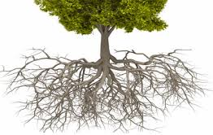
Several researchers have stated the root causes of crime include economic factors and poverty, social environment and family structure. The following work plans address all three root causes and provide goals, strategies, action steps, measures, potential partners and timelines to ensure Indianapolis becomes a safer city. Work plans are organized by four key goals adapted from the Memphis Gun Down Plan and the Blueprint for Action: Preventing Youth Violence in Minneapolis and including: Suppression, Community Mobilization, Advocacy and Awareness and Intervention and Prevention.
WORK PLANS
CRIME
Economic factors and poverty (EFP)
Social Environment (SE)
Family
Structure (FS)
GOALS & STRATEGIES
Intervention and Prevention - Creating parental supports, connecting youth with mentors, keeping young people in school and identifying triggers to prevent violence and crime
Establish and fund effective parent training programs for young parents and parents of challenging youth (FS, EFP)
Enhance agency collaboration among recipients of the Indianapolis Foundation Community Crime Prevention and City of Indianapolis Department of Public Safety grants, and other existing agencies (SE, EFP)
Provide mentorships, educational support and enrichment activities through existing agencies that yield measurable results (EFP, FS, SE)
Community Mobilization - Creating a community value system and ways to engage residents in activities such as neighborhood crime watches and other prevention programs
Create, promote and protect community values (EFP, FS, SE)
Organize and/or enhance neighborhood programs in which neighbors come together to learn how to protect self, family, home and property (SE, FS)
Suppression - Connecting communities and improving relations with local law enforcement to develop more effective community policing methods
  Improve cooperation and understanding between the police and their community (SE)
  Educate citizens on their rights and the role and responsibility of law enforcement officers (SE)
  Utilize foot patrols to improve community relations and suppress or prevent crime (SE)
  Ensure law enforcement officers are culturally competent (SE)
  Advocacy & Awareness - Coordinating, proposing and advocating for legislative and policy-related changes necessary to promote a safer community for all residents
  A group of advocates for reducing and preventing crime will be established.
  The group will advocate for 8 proposals detailed on page 21 (EFP, SE).

Slide 14

Intervention and Prevention
Creating parental supports, connecting youth with mentors, keeping young people in school and identifying triggers to prevent violence and crime
 | Performance Measures | Potential Partners | Timeline
Establish and fund effective parent training programs for young parents and parents of challenging youth:
Target parents of early age children and offer parenting classes and courses | Increased graduation rate | Indiana Healthy Family and Marriage Coalition, Marion County Public Health Department, Stand for Children, Branches of Life, Healthy Start, Indianapolis Public Schools, EdPower, Community Resurrection Partnership, Indiana Health Family and Marriage Coalition, Peace Learning Center, Powerhouse, Alpha Resources Counseling Center, Community Addictions Services of Indiana, Families First Service Association of Central Indiana, Legacy House, Reach for Youth, Inc., CHOICES, National Alliance for Mental Illness-Indiana | Year 1-5
Increase training and support programs for parents of at-risk youth, including juvenile re-entry, expelled and suspended youth, and youth with mental health issues including substance abuse and addictions | Reduced delinquent behaviors |  | Year 1-5
Establish a parent, teacher and public safety alliance that takes a “village raising” approach to guide youth to become productive adults and close communication gaps | Reduced suspension and expulsion rates |  | Year 2
Advocate to make parental education available for parents before they receive any public assistance (i.e. TANF, food stamps, housing) | 100% of parents on public assistance will receive parental training |  | Year 3-5
Establish and promote a Parental Helpline to connect parents to available resources | Parental Helpline in operation |  | Year 1

Slide 15
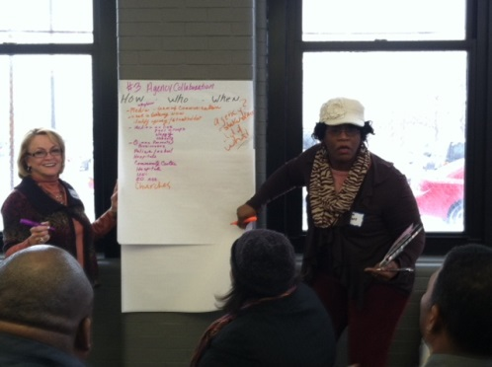
Intervention and Prevention
Creating parental supports, connecting youth with mentors, keeping young people in school and identifying triggers to prevent violence and crime
 | Performance Measures | Potential Partners | Timeline
Enhance agency collaboration among recipients of the Indianapolis Foundation Community Crime Prevention and City of Indianapolis Department of Public Safety grants and other existing agencies:
Establish a community crime prevention board comprised of all Indianapolis Foundation Community Crime Prevention and City of Indianapolis Department of Public Safety grant recipients | Crime prevention programming coordinated | Recipients of the Indianapolis Foundation Community Crime Prevention and City of Indianapolis Department of Public Safety grants and other existing agencies | Year 1
Develop multi-system teams among the grant recipients and other exiting agencies that provide service coordination, help youth and adults experiencing problems receive appropriate services and facilitate connections to the community | Multi-system teams established |  | Year 2
Establish re-entry planning team within Department of Public Safety | Planning team established |  | Year 2
Develop tools for information exchange and collaboration among grant recipients and other existing agencies | Tools developed |  | Year 2
Develop a public access forum to share collaboration | Public access forum developed |  | Year 2
Utilize pre-determined baseline data to evaluate effectiveness of collaboration and document outcomes | Evaluation metric developed |  | Year 3
Encourage funders to provide at least a three- year grant period for crime prevention grant recipients to ensure successful implementation and appropriate evaluation | Grant period extended to at least three years |  | Year 1

Slide 16
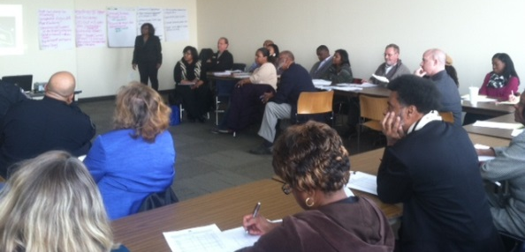
Intervention and Prevention
Creating parental supports, connecting youth with mentors, keeping young people in school and identifying triggers to prevent violence and crime
 | Performance Measures | Potential Partners | Timeline
Provide mentorships, educational support and enrichment activities through existing agencies that yield measurable results:
Develop “Big Fathers” program that connects youth raised in single parent, female-headed households with trusted male mentors | Program development complete and 100 Marion County youth enrolled | 100 Black Men, Young Men Inc. Impact Phase Program | Year 2
Connect youth to educational and employment opportunities through funded federal, state, and local programs (i.e. AmeriCorps, YouthBuild Indy) | Increased number of employed youth and adults in Marion County | Light of the World Christian Church, EdPower, YouthBuild Indy | Year 1-5
Connect youth in need to mental health programs | Increased number of youth accessing mental health services | Healing Your Hidden Hurts | Year 1-5
Provide young people who have an incarcerated parent with additional adult support by creating mentor programs that match these youth with individualized support | Reduced suspensions and expulsions | Marion County Prosecutor’s Office, Impact Phase Program | Year 1-5
Establish and promote a youth helpline to give young people a safe, confidential way to report trouble or seek help | Helpline operating | Marion County Commission on Youth, 211 | Year 2
Create a community program as an alternative to suspension and expulsion called the Peace Learning Academy | Reduce school to prison pipeline | Peace Learning Center, Asante Children’s Theatre | Year
Implement the Youth Violence Reduction Team (YVRT) through the Indianapolis Housing Agency | Reduce crime rate and delinquency in public housing communities | Indianapolis Housing Agency, Marion County Prosecutors Office | Year 1

Slide 17
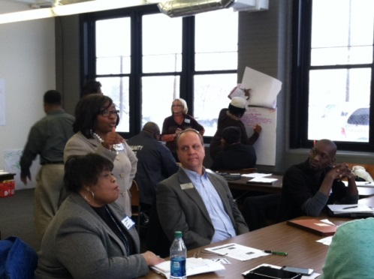
Community Mobilization
Creating a community value system and ways to engage residents in activities such as neighborhood crime watches and other prevention programs
 | Performance Measures | Potential Partners | Timeline
Create, promote and protect community values:
Convene citizens to write neighborhood-based value statements | Complete and publish the value statement | Marion County Public Health Department, Public Allies, Marion County Prosecutor’s Office, Radio One, Indianapolis Recorder, Indianapolis Neighborhood Resource Center | Year 1
Bring together community stakeholders, government officials, elected officials, law enforcement and others on a regular basis to develop policies and identify resources to advance the strategies within this plan | a. Funding secured for plan strategies to protect community values b. Policies enacted to protect community values | Mayor’s neighborhood liaisons, Indianapolis Metropolitan Police Department, neighborhood association presidents, Indianapolis-Marion County City County Council | Year 1-5
Work directly with area churches to bring awareness and encourage activism within our community | Target 100 churches to engage in plan implementation | Concerned Clergy, Church Federation of Greater Indianapolis, Community Resurrection Partnership, Northeast Corridor Faith-based Consortium | Year 1-5
Bring together community centers and community development corporations throughout Indianapolis in order to implement and evaluate crime prevention strategies with this plan | Community Centers and Community Development corporations engaged in plan implementation | United Way of Central Indiana, Indianapolis Neighborhood Housing Partnership, Local Initiatives Support Corporation | Year 1-5

Slide 18

Community Mobilization
Creating a community value system and ways to engage residents in activities such as neighborhood crime watches and other prevention programs
 | Performance Measures | Potential Partners | Timeline
Organize and/or enhance neighborhood programs in which neighbors come together to learn how to protect self, family, home and property:
Organize neighborhood Crime Watch block clubs | a. Increase the number of crimes solved b. Increase the number of active neighborhood crime watch groups | Marion County Public Health Department, Community Resurrection Partnership, Forest Manor Multi-Service Center, Edna Martin Christian Center, Indianapolis Housing Agency, Indianapolis Metropolitan Police Department | Year 1
Create a “crime reporting friendly” environment at the neighborhood level | a. Increase the number of crimes solved b. Educate neighbors who are concerned about the consequences of reporting a crime | Indianapolis Metropolitan Police Department, Ten Point Coalition, Young Men Inc., Youth Build Indy | Year 1
Encourage residents to get to know their neighbors and unite as a community | Decreased crime rate | Indianapolis Neighborhood Resource Center, IMPD-District Crime Watch Coordinator | Year 1
Engage residents in the “Your Life Matters” Campaign | Increase the number of residents who are aware of available resources | Radio One | Year 1
Establish a Bereavement and Mediation Center staffed by trained violence interrupters to reduce crimes motived by revenge and arguments | a. Bereavement and mediation center established b. Violence interrupters trained | Light of the World Christian Church, Northeast Corridor Faith-based Consortium, Healing Hidden Hurts | Year 2

Slide 19
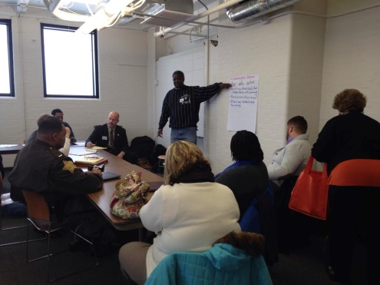
Suppression
Connecting communities and improving relations with local law enforcement to develop more effective community policing methods
 | Performance Measures | Potential Partners | Timeline
Improve cooperation and understanding between the police and their community:
Create opportunities for citizens of all ages and backgrounds to build positive relationships with police officers | a. Increased crime reporting b. Reduced number of complaints filed against police officers | Indianapolis Public Library, Forest Manor Multi-Service Center, Asante Children's Theatre, Peace Learning Center | Year 1-5
Encourage citizen participation in monthly Indianapolis Metropolitan Police Department (IMPD) task force meetings | Increased number of residents that attend IMPD task force meetings | Indianapolis Public Library | Year 1-5
Engage the community in recruiting law enforcement officers that reflect the diversity and values of the community served | Increased number of minority and women law enforcement officers | IMPD, Forest Manor Multi-Service Center, 100 Black Men, Urban League | Year 2-5
Expand the Police Athletic League (PAL) and increase the frequency of IMPD Community Days | a. Increased number of IMPD community days b. Increased participation in PAL | IMPD, Faith and Community-based Organizations, Schools | Year 1-5
Police and citizens will partner to analyze and work toward positive alternatives to community and neighborhood conditions | a. Increased number of neighborhood watch programs b. Increased security surveys for homes and communities | IMPD, Indianapolis Housing Agency, Indianapolis Neighborhood Resource Center | Year 2-5

Slide 20
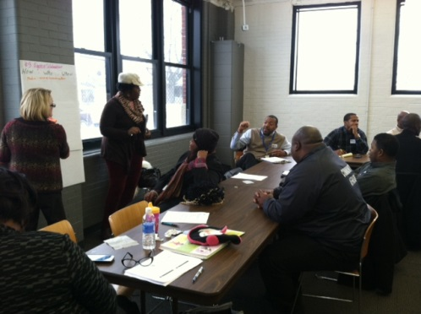
Suppression
Connecting communities and improving relations with local law enforcement to develop more effective community policing methods
 | Performance Measures | Potential Partners | Timeline
Educate citizens on their rights and the role and responsibility of law enforcement officers:
Hold monthly brown-bag sessions to educate citizens on their rights and the policies and procedures of law enforcement | Quarterly sessions completed | Indianapolis Public Library | Year 1-5
Increase participation in the Citizens Police Academy, Police Explorer Program, Volunteers in Police Service and Indianapolis Metropolitan Police Department (IMPD) Training Academy, especially from minority populations and citizens within the top five zip codes for criminal homicides | Increased number of participants in each program. | IMPD, Indianapolis Neighborhood Resource Center, Concerned Clergy, Church Federation of Greater Indianapolis | Year 1-5
Have public service announcements on television, social media and at schools about policing practices and laws | Completed public service announcements | Radio One | Year 2-5
Utilize schools as a mechanism to educate and involve youth in crime prevention strategies | a. Increased distribution of crime prevention tip sheets | IMPD, Marion County Schools | Year 1-5
Educate citizens on what to do when stopped by the police | a. Reduced number of arrests b. Reduced number of complaints filed against police officers | American Civil Liberties Union of Indiana, Indianapolis Public Library | Year 1-5

Slide 21
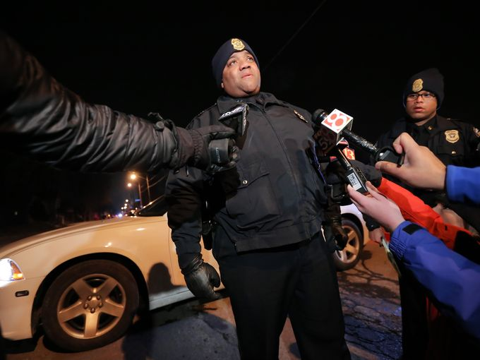
Suppression
Connecting communities and improving relations with local law enforcement to develop more effective community policing methods
 | Performance Measures | Potential Partners | Timeline
Utilize foot patrols to improve community relations and suppress or prevent crime:
Utilize geo-mapping to make data driven decisions regarding the deployment of foot patrols (i.e. date, time and location of previous service calls) | Representative maps completed | The Polis Center, Indianapolis Metropolitan Police Department-District CrimeWatch Coordinator, Neighborhood Associations, CrimeWatch Block Clubs, Ten Point Coalition, Community, Resurrection Partnership | Year 1-5
Utilize citizens, including business owners to identify priority areas for foot patrols by conducting a community survey and inviting participation in planning sessions | Community survey conducted and priority areas identified
Expand law enforcement to community through the recruitment of citizen volunteers to assist with foot patrols | Increased number of foot patrols
Advocate for “common sense” district lines that allow residents and business owners to be served by police stations in closest proximity | Increased response rate

Slide 22
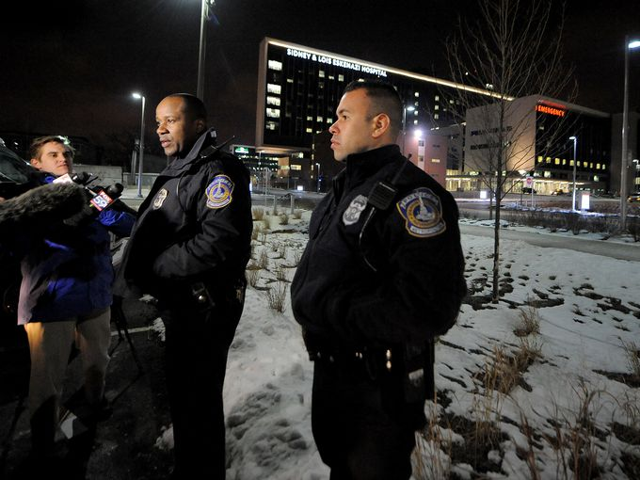
Suppression
Connecting communities and improving relations with local law enforcement to develop more effective community policing methods
 | Performance Measures | Potential Partners | Timeline
Ensure law enforcement officers are culturally competent:
Establish a “Charm School” for law enforcement officers with classes taught by civilians, college professionals and members of social service organizations | Charm School graduates | IMPD, Marion County Faith and Community Based organizations | Year 3-5
Provide continuing education to current law enforcement through mandatory interactive training on the culture of the community, current trends and changes | Training completed | Indianapolis Metropolitan Police Department
Utilize teens to develop a dictionary of street terminology and annually update | Dictionary completed | YouthBuild Indy, Public Allies, Indianapolis Metropolitan Police Department
During each roll call, IMPD officers are taught one term from the street terminology dictionary (i.e. “Word of the day” ) | Word of the Day implemented at Roll Call
Advocate for local law enforcement officers to receive training on how to interact with victims, witnesses, suspects and others who have disabilities | Reduced number of disability discrimination complaints filed against police officers | Indianapolis Metropolitan Police Department, The Arc of Indiana, Mental Health America of Indiana

Slide 23
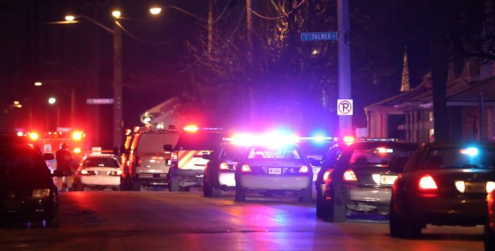
ADVOCACY
Coordinating, proposing and advocating for legislative and policy-related changes necessary to promote a safer community for all residents
 | Performance Measures | Potential Partners and Timeline
The workgroups identified the following proposals for legislative and policy-related changes:
Advocate for increased foot patrols in high crime areas (top 5 zip codes) and additional police officers | Law enforcement follow merit law Implement a public safety tax | A group of advocates for reducing and preventing crime will be established The work of the group will span Year 1-5
Advocate for police officers who reflect the diversity and values of the community served | Increased number of minority and women law enforcement officers
Advocate for officer retention in urban areas | Reduce officer turnover in urban areas
Advocate for “common sense” district lines that allow residents and business owners to be served by the police station in closest proximity | Increased response rate
Advocate for local law enforcement officers to receive training on how to interact with victims, witnesses, suspects and others who have disabilities. | Reduced number of disability discrimination complaints filed against police officers
Advocate for landlords to have a local presence | Adopt legislation requiring the annual registration of landlords and designation of a registered agent (property manager) authorized to accept a summons on behalf of the absentee landlord
Advocate for economic development in areas of need throughout Indianapolis and equitable distribution of resources | Reduced rate of unemployment Reduced crime rate Reduced poverty rate Increased educational attainment
Advocate for increased consequences for illegal gun activity and close any loopholes that allow ready access to guns without a criminal background | Decrease in number of illegal guns on the streets

Slide 24
Metrics of Success
The Citywide Crime Prevention and Reduction Plan will work directly to diminish crime in our neighborhood as well as equip youth and adults with the services and support they need to overcome the barriers they face and elevate the overall quality of life in communities. While the entire city will be positively impacted by the implementation of the plan, the first 5 years will focus on zip codes 46218, 46201,46208,46205 and 46222 (top 5 for criminal homicides).
Key measures have been selected to assess results of the plan. These measures were selected based on their validity and availability and involve data collected routinely by government agencies:
Criminal homicide rate
Aggravated assault rate
Simple assault rate
Juvenile arrests
Population in poverty
Children in poverty
Teen pregnancy among youth 15-18
Unemployed civilian labor force
High school graduation rate and college readiness
Funding for crime prevention strategies in communities with higher crime
Suspension and expulsion rates
We also expect the following measurable outcomes to be achieved:
Educational Services:
Increased GPA
Improvement in school attendance
Graduate from high school or earn a GED
Life Skills/Behavioral Assistance:
Decrease in illegal behaviors and/or gang involvement
Demonstrate conflict resolution skills
Participation in gang prevention/intervention curriculum
Mentorship:
Mentor match rate
Number of trained mentors
Amount of mentoring received
Workforce Development:
Learn how to prepare a resume, write cover letters and learn interviewing skills
Utilize job placement services, become gainfully employed and remain employed after 90 days
Engaging Families:
Participation rate in all family events from family members of participants
Parents will learn how to increase the quality of living for their families
Parents will report a better understanding of post-secondary educational opportunities
The methods of evaluating outcomes include:
Intake assessments
Pre- and post evaluations
Staff evaluation forms of participant progress
Data collected from Marion County courts
School/educational data for students enrolled in public school systems

Slide 25
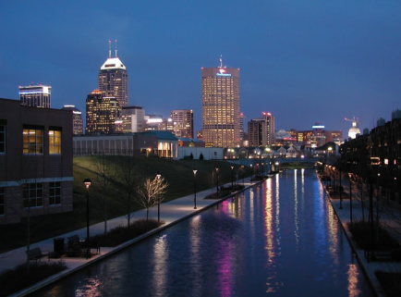
Acknowledgements
Special thanks to the following for contributing to the development of the plan:
Forest Manor Multi-Service Center, convener
City of Indianapolis Public Safety Foundation, funder
Indianapolis Foundation, funder
Engaging Solutions, LLC, facilitator
Indianapolis Metropolitan Police Department
37 Place
Edna Martin Christian Center
Indianapolis Housing Agency
YouthBuild Indy
Peace Learning Center
Stop the Violence Indianapolis
Charles A. Tindley Accelerated Schools
For additional information regarding the plan and upcoming events contact:
Regina Marsh
Chief Executive Officer
Forest Manor Multi-Service Center
5603 East 38th Street
Indianapolis, IN 46218
317-545-1204 ext. 180
317-545-3096 (fax)
rmarsh@fmmsc.org
www.fmmsc.org

Slide 26
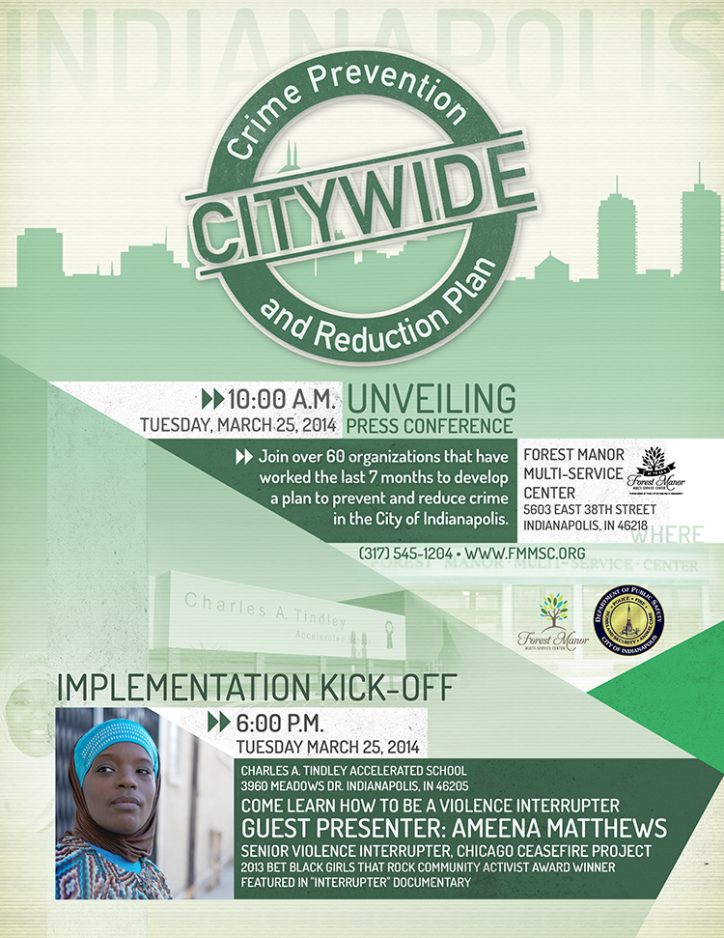

Slide 27


Slide 28
