Slide 1

I-465 at I-65 Interchange Modification
Public Meeting 6:00pm
Monday, October 1, 2012
South Grove Intermediate School
Beech Grove, Indiana

Slide 2
Welcome
Rickie Clark, INDOT Office of Public Involvement
Purpose/Explanation of Public Meeting
Public Meeting Format
Visit our sign-in table
Informational Handouts
Submitting public comments
Informal Q & A following formal presentation and comment session

Slide 3
INDOT
INDOT Mission:
  INDOT will plan, build, maintain and operate a superior transportation system enhancing safety, mobility and economic growth
INDOT Values:
  Respect
  Teamwork
  Accountability
  Excellence

Slide 4
INDOT Profile
6 district offices
3,722 employees
$396 million/annual operating budget
$1 billion/annual capital expenditures
28,410 total lane miles
  5,098 lane miles of interstate
  16,519 lane miles of two-lane roads
  5,320 INDOT-owned bridges

Slide 5
Public Meeting
Sign-in at attendance table to be added to project mailing list
A public meeting notice was mailed to known property owners within project area
Announcement of this hearing was posted to INDOT website at: http://www.in.gov/indot.htm
Electronic notification via e-mail

Slide 6
Project Team
Indiana Department of Transportation
Indiana Division Federal Highway Administration
Indianapolis Metropolitan Planning Organization
American Structurepoint, Inc. & United Consulting

Slide 7
Project Stakeholders
Indiana Department of Transportation
Indiana Division Federal Highways Administration
Indianapolis Metropolitan Planning Organization
Marion County
City of Indianapolis and local communities
Elected Public Officials
Community residents and citizens
Emergency Services
Commuters
Trucking Industry
Commercial District / local businesses
Community Organizations

Slide 8
Project Development Process
Engineering Assessment
Project purpose & need
develop project alternatives
Screen project alternatives
Release environmental document and preliminary design
Public Hearing to solicit public comment
Finalize design & environmental document
Real estate acquisition activities clear r/w
Construction
We Are Here
Notes:
8

Slide 9
Project Purpose & Need
Regional Growth & Development have resulted in increased congestion along I-465 & I-65
Interim improvement to address most critical congestion at interchange
  Westbound to southbound traffic
  Northbound to eastbound traffic

Slide 10
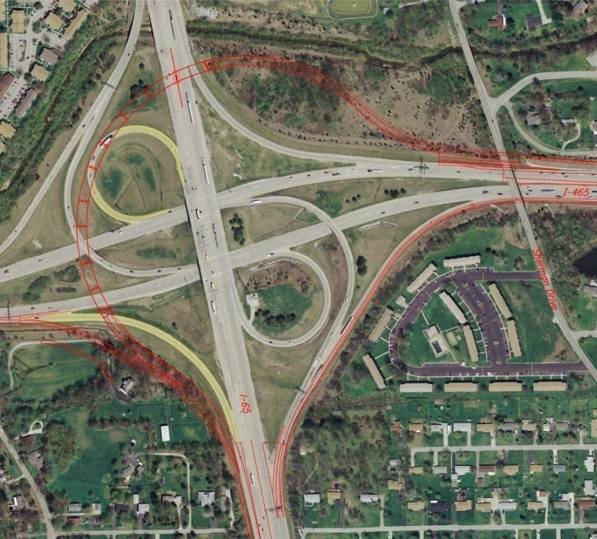
Proposed Improvements
I-465 / I-65 Interchange
  New ‘Flyover’ Ramp
    Westbound to Southbound
    Remove Existing Loop Ramp
Widen Existing Ramp
  Northbound to Eastbound
Relocate Existing Ramp
  Eastbound to Southbound
Replace Sherman Drive Bridge
Sherman Dr
I-465
I-65

Slide 11
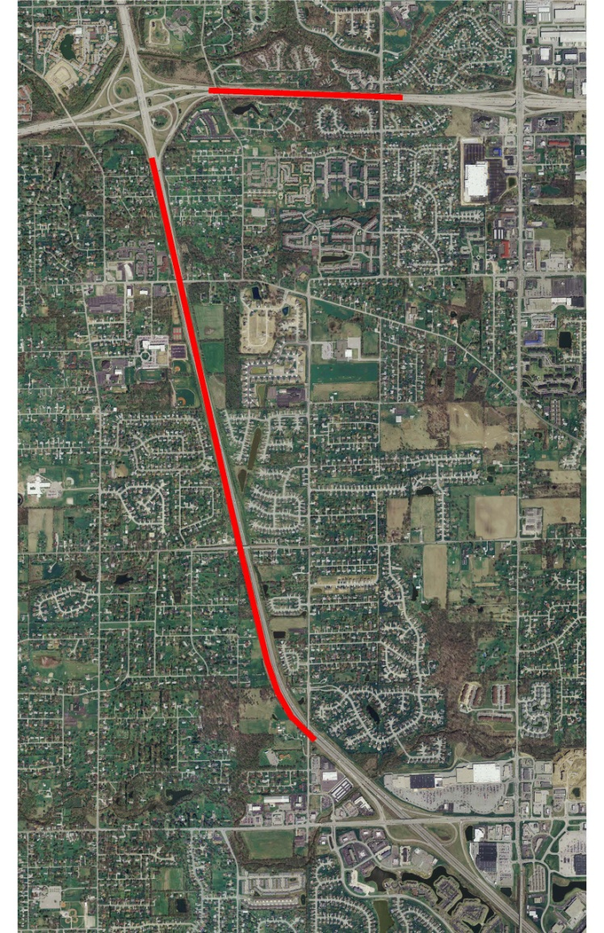
Proposed Improvements
I-465
  New Auxiliary Lane
    Emerson Avenue to I-65
    Eastbound and Westbound
    Widening for Flyover Ramp
    Westbound near Sherman Drive
I-65
  New Auxiliary Lane
    I-465 to Southport Road
    Southbound & Northbound
    Widening on Outside
I-465
Emerson
I-65
Southport

Slide 12
Noise Walls
Analysis required for added capacity projects
Noise abatement must be considered reasonable and feasible
Approved noise walls from original project scope
  I-465 Eastbound
  I-465 Westbound
  I-65 Northbound (Near Edgewood Avenue)

Slide 13
Noise Walls
Re-analysis required for the proposed I-65 northbound lane
New noise wall locations from re-analysis
  I-65 Southbound (Edgewood to near Roncalli High School)
  I-65 Northbound (Gray Road to Edgewood Avenue)
  I-65 Northbound (Edgewood to near Roncalli High School)

Slide 14
Project Schedule
Letting: Summer 2013
Construction: 2013 – 2014
Project Complete: Late 2014

Slide 15
Submit Public Comments
Submit public comments using the options described in 1st page of information packet
  Public Comment Form
  Via e-mail
  Participating during public comment session via microphone
INDOT respectfully requests comments be submitted by Monday, October 15, 2012
All comments submitted will become part of public record and project file. Comments will be reviewed, evaluated and given full consideration during decision making process

Slide 16
Resource Location
INDOT Greenfield District Office, 32 South Broadway, Greenfield, Indiana 46140
Construction, maintenance and transportation project development activities in East Central Indiana
Customer Service Center (855) 463-6848 eastcentralin@indot.in.gov
Brandye Hendrickson, Greenfield District Deputy Commissioner
  Dwane Myers – Public Affairs Director
  Nathan Riggs – Media Relations Director
  Katie Hilderbrand – Customer Service Manager

Slide 17
Thank You
Please visit with INDOT project officials
Project Open House
  View project displays and maps
  Copies of informational handouts are available at sign-in table
  Visit INDOT website to stay informed regarding project developments
  Thank you for attending this meeting
  www.IndyCommute.indot.in.gov

