Slide 1

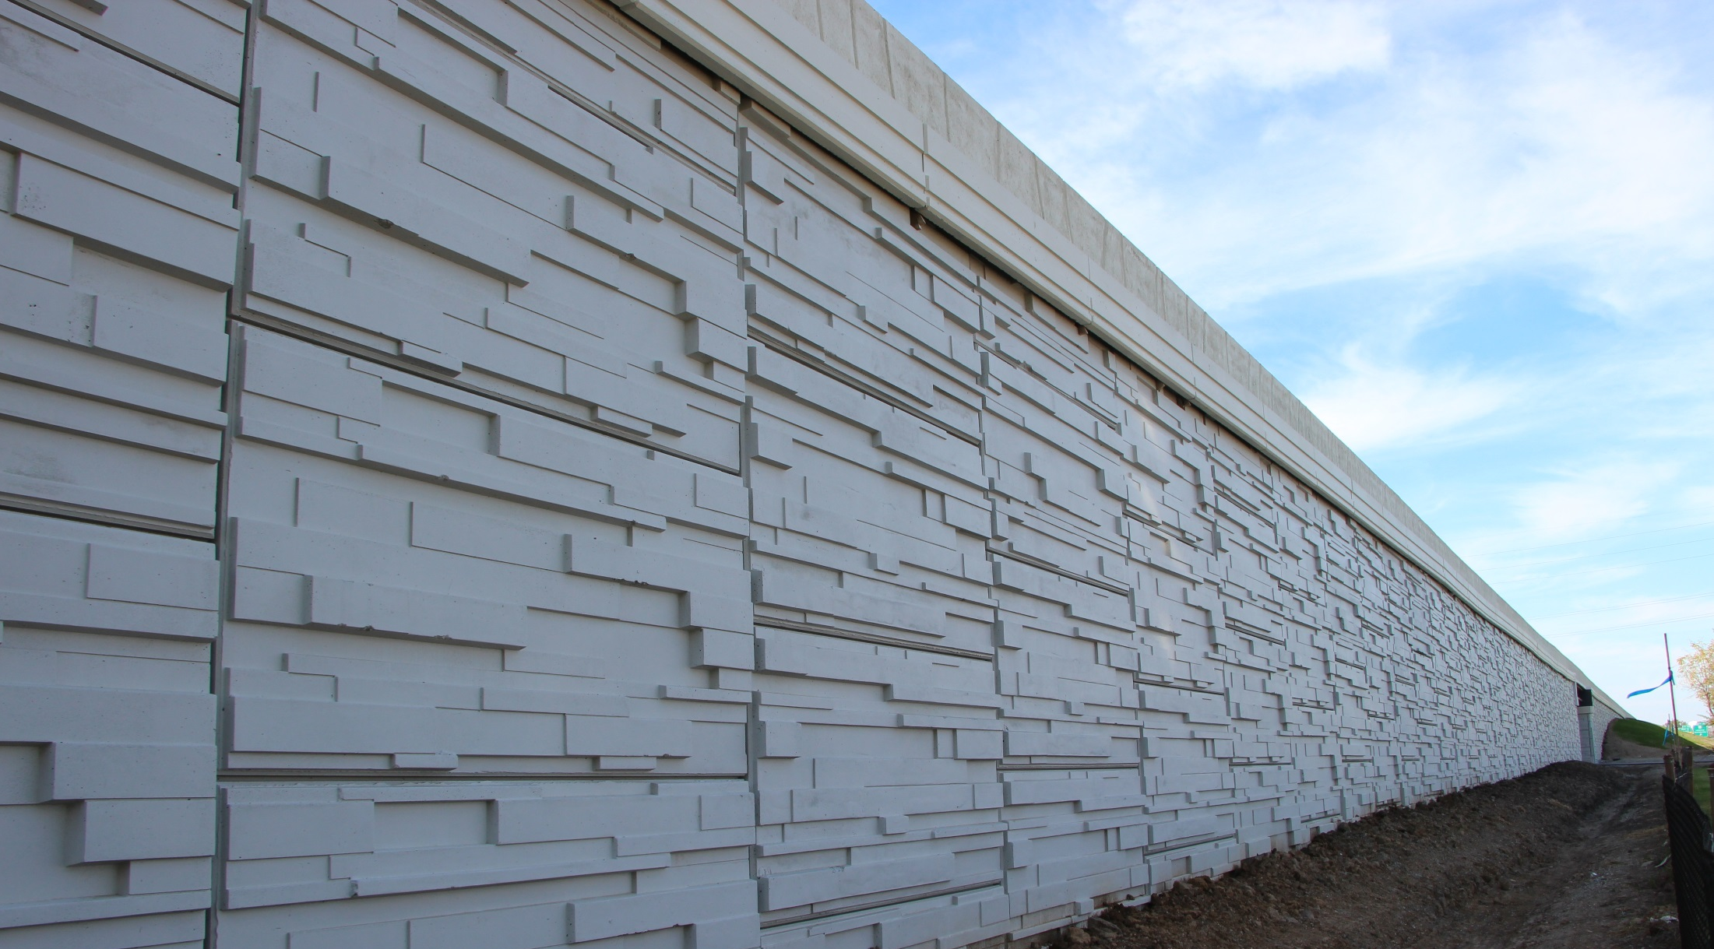


Guidelines for Inspectors and Contractors
MSE Wall
Construction

Slide 2

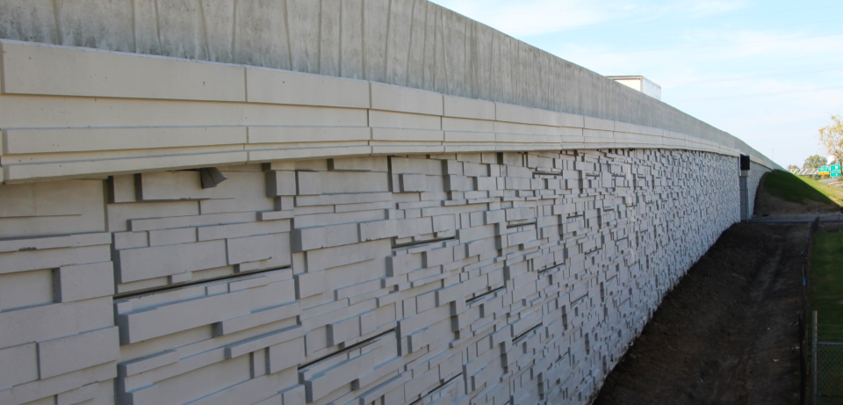

Mechanically
Stabilized
Earth Wall
MSE Wall
Construction

Slide 3

Mechanically Stabilized Earth Walls
Construction Methods of Mechanically Stabilized Earth Walls
The following presentation contains “Points of Emphasis” for construction of MSE Walls. It is recommended viewing for any INDOT or consultant team involved in a contract that includes this type of work. It is further recommended that, prior to construction, the presentation be viewed jointly by the inspection team and any contractor personnel that will be specifically responsible for constructing MSE Walls on their project.

Slide 4
INDOT Checklist for MSE Wall Construction
Mechanically Stabilized Earth Walls
The following is a general checklist to follow when constructing an MSE Wall.
Generally, the answer to each of these should be yes, unless plans, specifications, or specific approval has been given otherwise.
Has the contractor submitted wall shop drawings?
Has the contractor submitted backfill certification?
Has the contractor furnished a copy of any instructions the wall supplier may have furnished?
Has the contractor supplied a Certificate of Compliance that the wall materials comply with the applicable sections of the specifications? Has the contractor supplied a copy of all test results performed by the Contractor supplier to assume compliance with specifications?
Have the shop drawings been approved?
Has the geotechnical report been checked for undercutting?
Did the contractor receive the correct panels (shape, size, soil reinforcement connection layout) per the approved shop drawings?
Did the contractor receive the correct reinforcement (proper length and size)?
Have the panels and the reinforcement been inspected for damage as outlined in the specifications?

Slide 5
INDOT Checklist for MSE Wall Construction
Mechanically Stabilized Earth Walls
If any panels or soil reinforcement were found damaged, have they been rejected or repaired in accordance with the specifications?
Are the panels and the soil reinforcement properly stored to prevent damage?
Has the MSE wall area been excavated to the proper elevation?
Has the area been proof rolled?
Has all soft or unsuitable materials been compacted or removed and replaced?
Has the leveling pad area been properly excavated?
Has the leveling pad been set to the proper alignment?
Has the leveling pad cured for a minimum of 12 hours?
Is the first row of panels properly placed? Do they have proper spacing, bracing, tilt, and where required, do they have the spacers installed?
Has the proper filter fabric and adhesive been supplied?
Is the filter fabric being properly placed over the joints?
Is the adhesive being applied to the panel, rather than the filter fabric?
Is the filter fabric stored properly away from sunlight and protected from UV radiation?
Is the contractor using correct panels (size, shape, and connections) for that panel’s wall location and elevation?
Is fill being placed and compacted in 6” lifts?

Slide 6
INDOT Checklist for MSE Wall Construction
Mechanically Stabilized Earth Walls
Are all equipment being kept off the reinforcement until a minimum of 6 inches of fill is placed?
Are the lifts being placed by the proper method and sequence?
Is the fill being compacted by the correct equipment and in the correct pattern?
Is the proper compaction being met within 3 feet of the wall and greater than 3 feet from the wall based on DCP criteria?
Is the fill being brought up to or slightly above the soil reinforcement elevation before the reinforcement are connected?
Is the reinforcement being properly connected?
Is the soil reinforcement in the proper alignment?
Are the vertical and horizontal alignments checked periodically and adjusted as needed?
Is the contractor removing the wooden wedges as per specification?
At the end of each day’s operation, is the contractor shaping the last level of backfill to permit a positive drainage away from the wall such as temporary pipe etc.?
Has the contractor backfilled the front of the wall?
Is the correct coping being installed?

Slide 7
MSE Wall Shop Drawings
Mechanically Stabilized Earth Walls
MSE Wall Shop Drawings
(Also known as Working Drawings)
Shop Drawings are submitted by the fabricator in order to provide more specific details on how the wall is to be constructed. Shop Drawings are reviewed by INDOT as well as the designer of record for the contract. Once the review has been completed by both parties, the designer of record will provide a formal response to the fabricator, who will then make appropriate revisions. Construction should not begin until these drawings have been approved.
Below are 2 examples of items that are included in a typical set of Shop Drawings
A “General Note” page is usually part of the shop drawings and contains important information regarding wall design and construction. This page should be reviewed by the inspection team prior to the start of construction.
Orientation of straps (including orientation when obstructions such as piling or drainage structures are encountered)
See (731.04) for other items included in Shop Drawings.

Slide 8
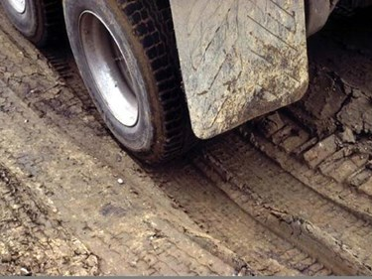
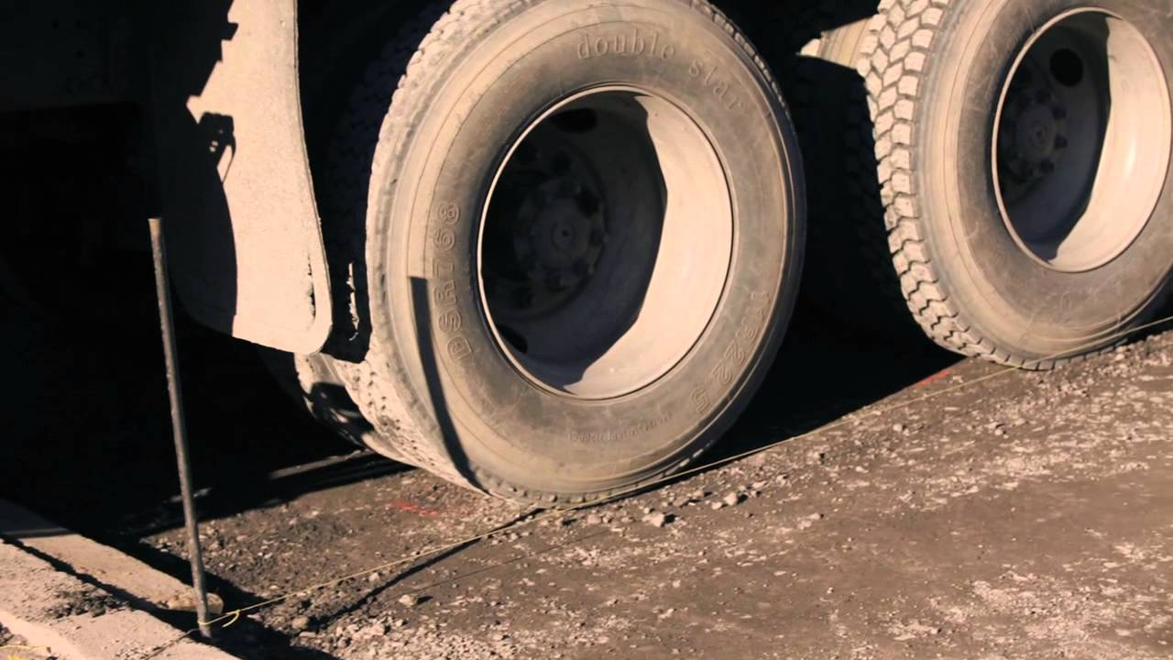
Foundation Preparation
Mechanically Stabilized Earth Walls
GOOD
PRACTICE
BAD
PRACTICE
Details for foundation preparation can be found in (731.07) of the standard specifications.
Proofrolling
Typically performed with fully loaded tri-axle dump truck (203.26)
Remove all unsuitable material
Replace unsuitable material with B borrow (211.02)
Compacted in accordance with (211.04)
Remove and replace the material in this area per (731.07)
Proofroll Passes. Construction may begin.

Slide 9
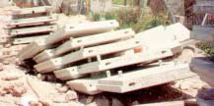
Improper Panel Storage
Mechanically Stabilized Earth Walls
GOOD
PRACTICE
BAD
PRACTICE
Panels should be elevated off the ground, and should be separated by blocks to protect the strap brackets.

Slide 10
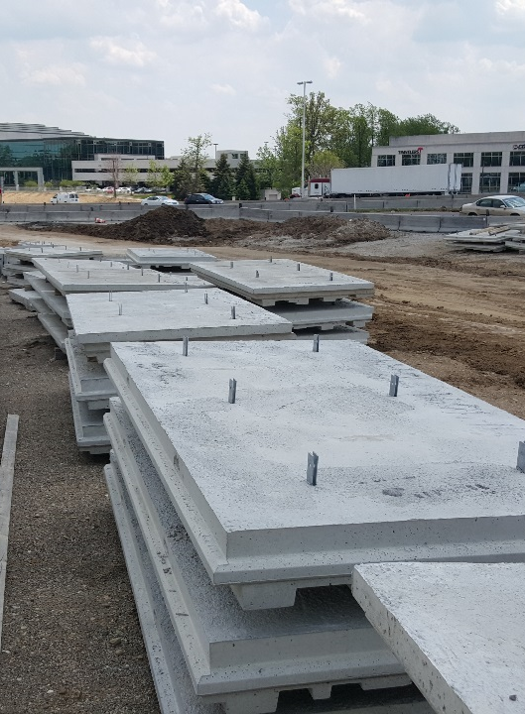
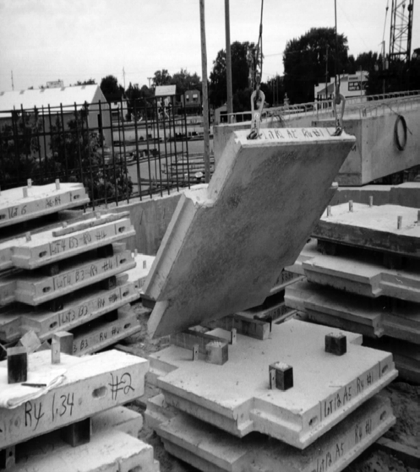
Proper Panel Storage
Mechanically Stabilized Earth Walls
GOOD
PRACTICE
BAD
PRACTICE

Slide 11
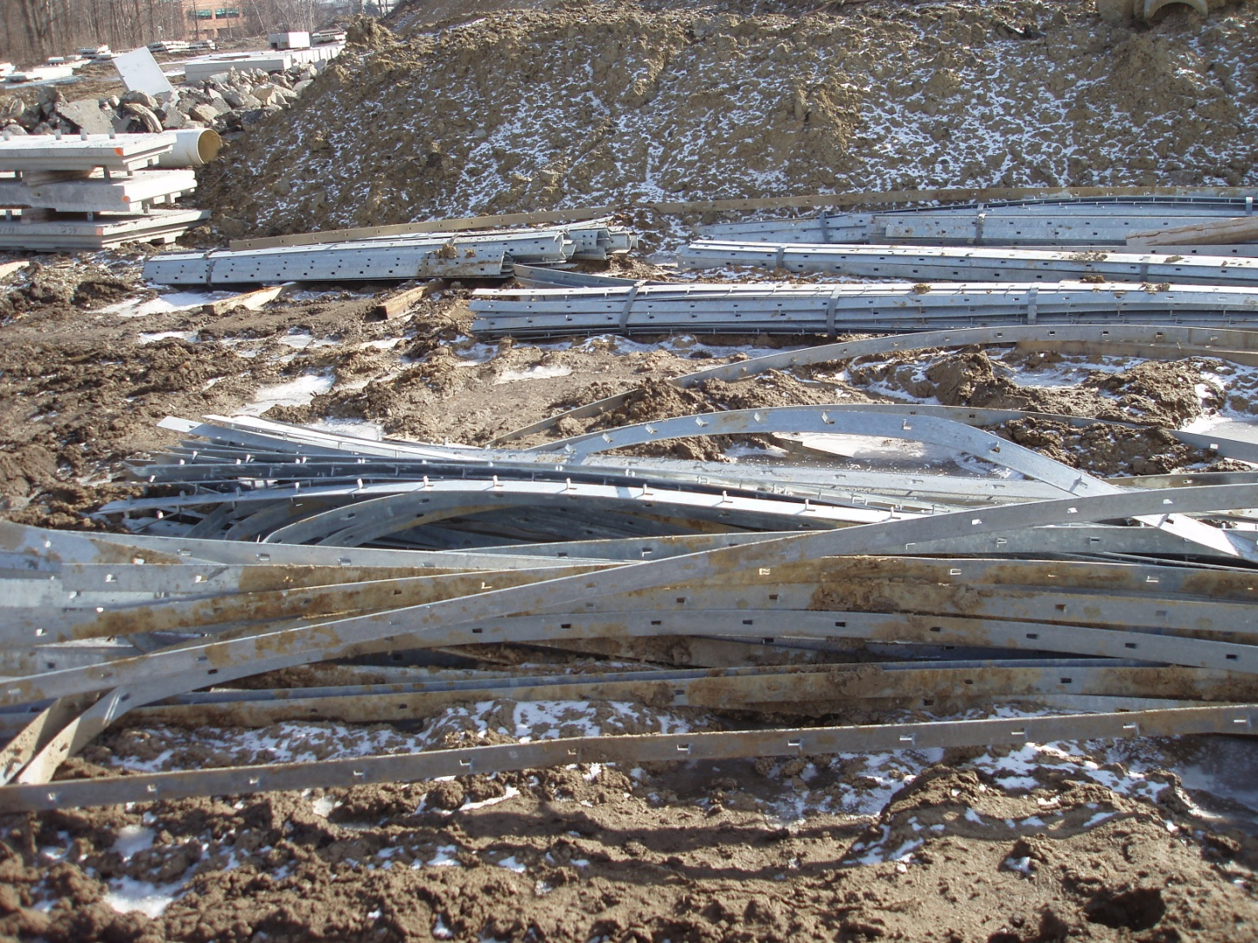
Improper Strap Storage
Mechanically Stabilized Earth Walls
GOOD
PRACTICE
BAD
PRACTICE

Slide 12
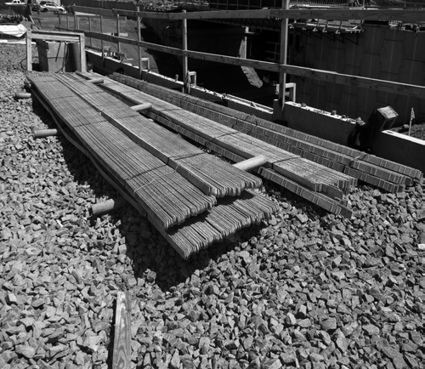
Proper Strap Storage
Mechanically Stabilized Earth Walls
GOOD
PRACTICE
BAD
PRACTICE
Reinforcement should be neatly stacked and elevated above the ground

Slide 13
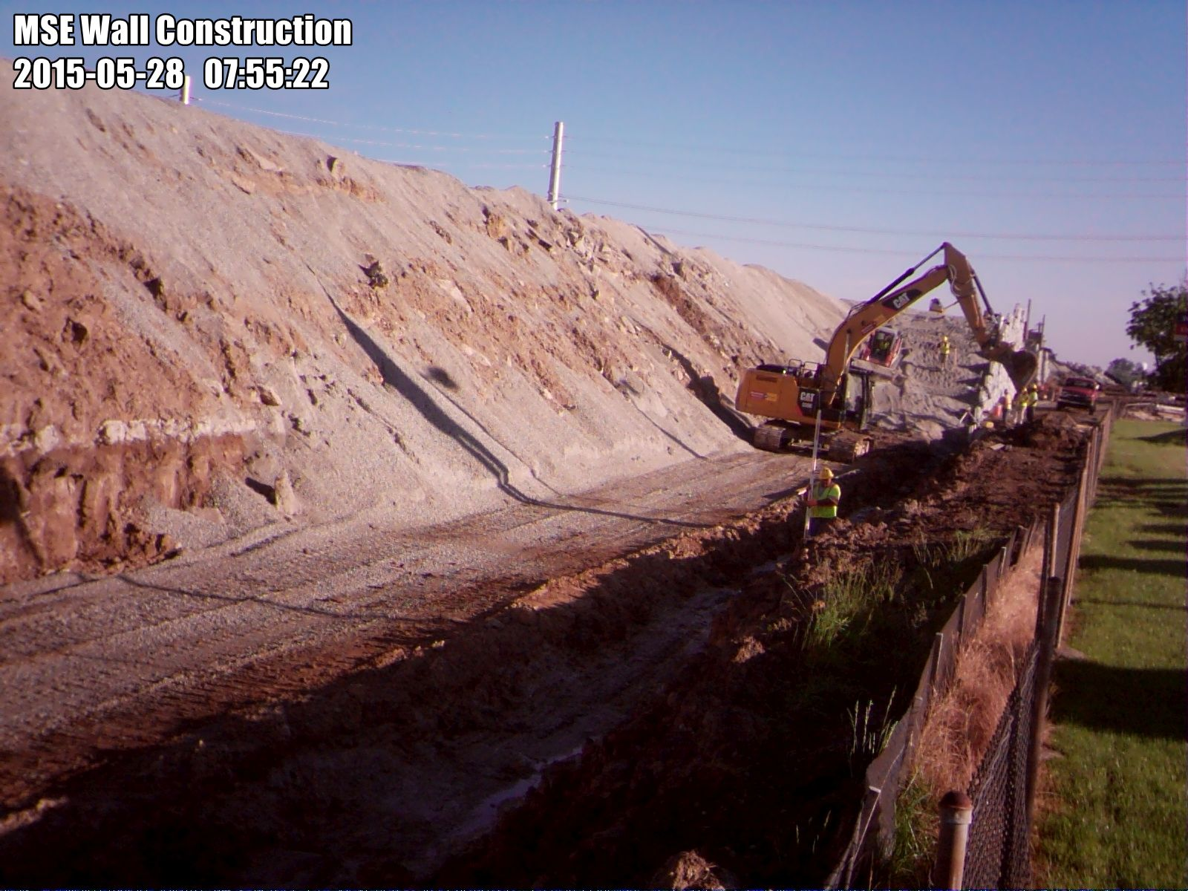
Foundation Preparation
Mechanically Stabilized Earth Walls
GOOD
PRACTICE
BAD
PRACTICE
Check Leveling Pad Elevation as per approved design plans

Slide 14
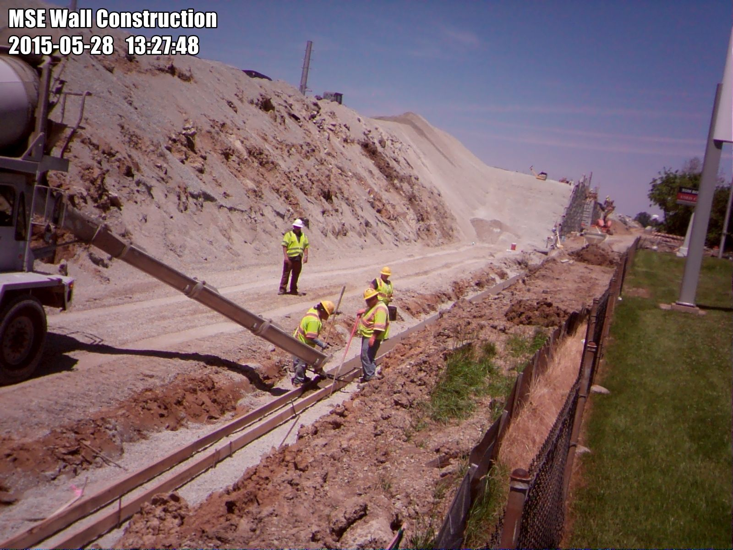
Leveling Pad Construction
Mechanically Stabilized Earth Walls
GOOD
PRACTICE
BAD
PRACTICE
Leveling Pad
Check to make sure pad is poured to proper width and thickness. Ensure that the pad is level.
Leveling Pad Must Cure a Minimum of 12 Hours before panels are placed

Slide 15
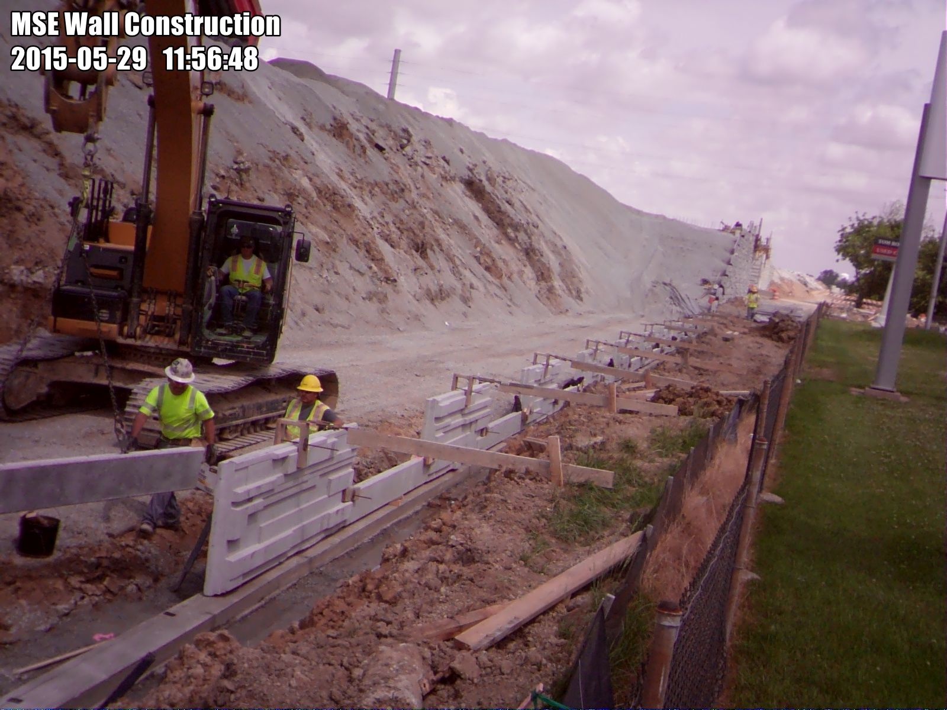
Panel Placement
Mechanically Stabilized Earth Walls
GOOD
PRACTICE
BAD
PRACTICE
Wooden Bracing
Wooden Support
Wooden Wedge
Neoprene Pads
Joint Spacers

Slide 16
Panel Placement
Mechanically Stabilized Earth Walls
GOOD
PRACTICE
BAD
PRACTICE
Bracing for first row of panels (731.09)

Slide 17
Panel Placement
Mechanically Stabilized Earth Walls
GOOD
PRACTICE
BAD
PRACTICE
Wooden Support Bracing is required with each new row of panels

Slide 18
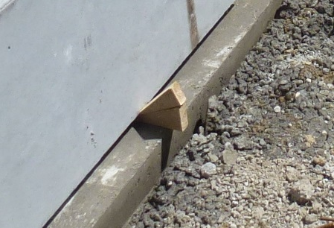
Panel Placement
Mechanically Stabilized Earth Walls
GOOD
PRACTICE
BAD
PRACTICE
Temporary Wooden Wedges should be used to keep panels in position during construction (731.09). Wedges should be removed prior to placing dirt against the outside of wall

Slide 19
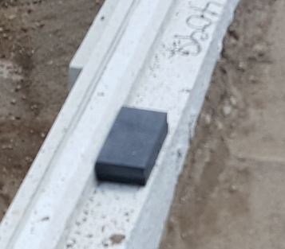
Panel Placement
Mechanically Stabilized Earth Walls
GOOD
PRACTICE
BAD
PRACTICE
Neoprene Pads
Joint Spacers
Neoprene Pads are required to prevent concrete-to-concrete contact on each new panel level (731.10)

Slide 20
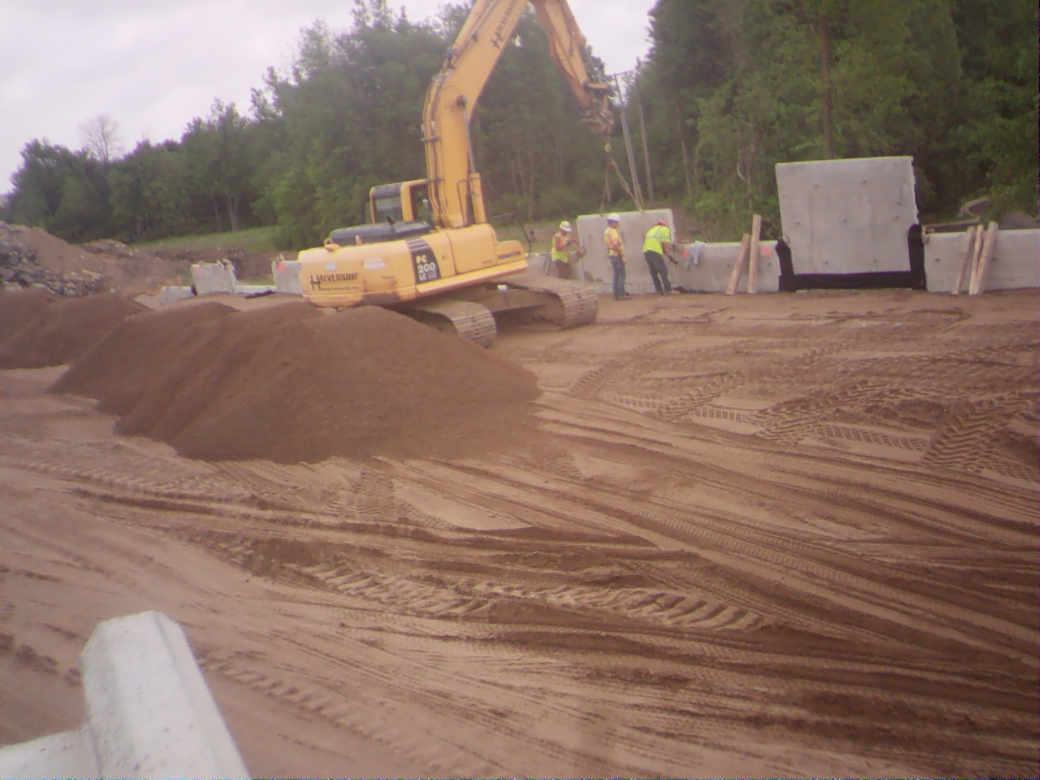
Joint Covering (Fabric)
Mechanically Stabilized Earth Walls
GOOD
PRACTICE
BAD
PRACTICE
5/19/2015
7:36 AM
Fabric should be placed on rear face of wall at every joint to keep backfill in place. Although Shop drawings usually note specifics regarding the fabric, it is often 12” wide.

Slide 21
MSE Construction
Mechanically Stabilized Earth Walls
GOOD
PRACTICE
BAD
PRACTICE
5/19/2015
7:36 AM
Fabric shall be affixed to wall by an adhesive recommended by the wall fabricator. This adhesive should be applied to the wall rather than the fabric in order to allow water to drain through the wall joints.

Slide 22
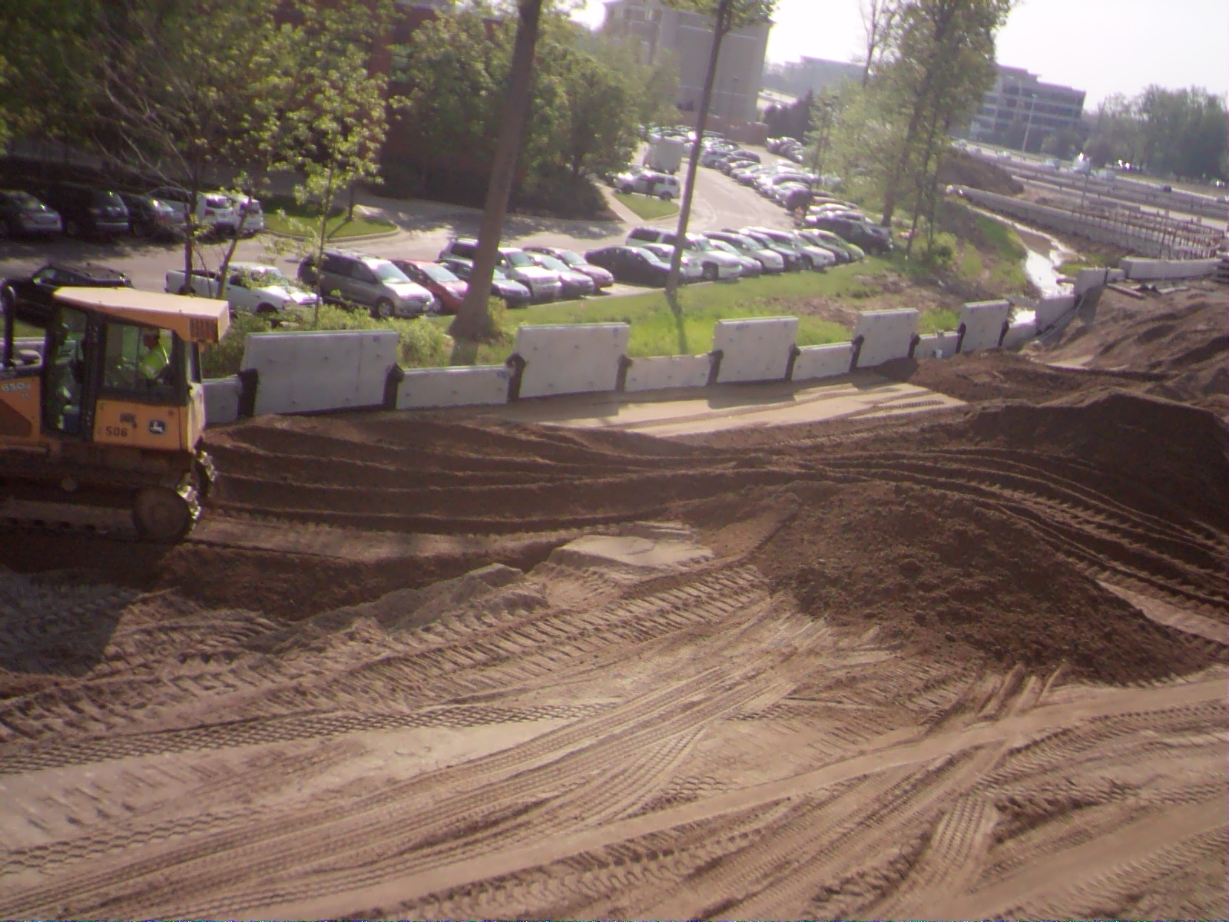
Earthwork
Mechanically Stabilized Earth Walls
GOOD
PRACTICE
BAD
PRACTICE
5/07/2015
9:50 AM
Avoid Pushing Backfill Toward Wall
Pushing backfill in this manner can result in bulging of the wall and broken strap connections. Preferred method is to push parallel to the wall and use hand tools if necessary to finish pushing backfill against the wall.

Slide 23
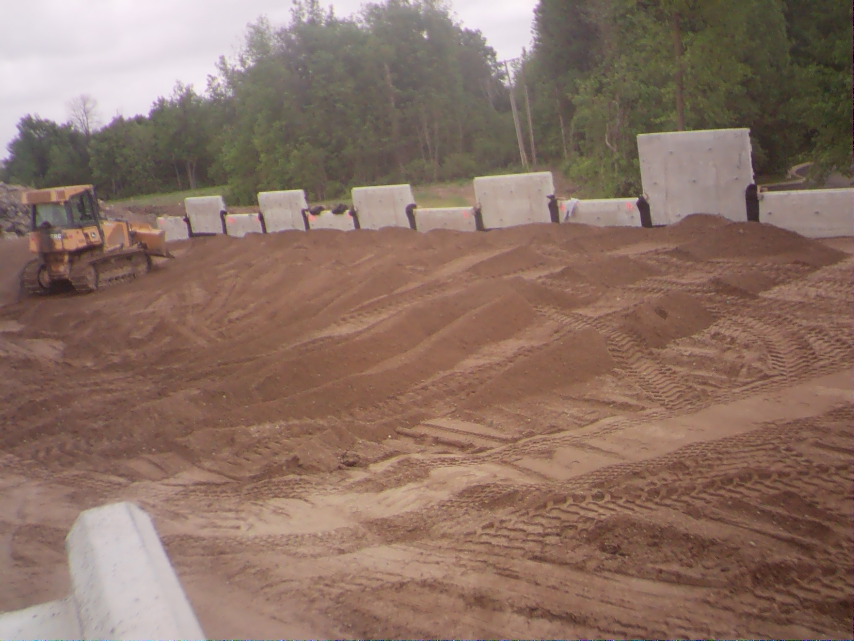
Earthwork
Mechanically Stabilized Earth Walls
GOOD
PRACTICE
BAD
PRACTICE
5/18/2015
11:53 AM
Backfill Should NOT be Pushed Against the Wall
WARNING: This will compromise the integrity of the wall.

Slide 24
Earthwork
Mechanically Stabilized Earth Walls
GOOD
PRACTICE
BAD
PRACTICE
5/18/2015
11:53 AM
Panels could be pushed out of alignment, straps could break, and the structure will not last the minimum 75 year design life

Slide 25

Earthwork
Mechanically Stabilized Earth Walls
GOOD
PRACTICE
BAD
PRACTICE
3’ Minimum
Push Backfill Parallel with Wall – Keep a minimum of 3’ From Wall

Slide 26
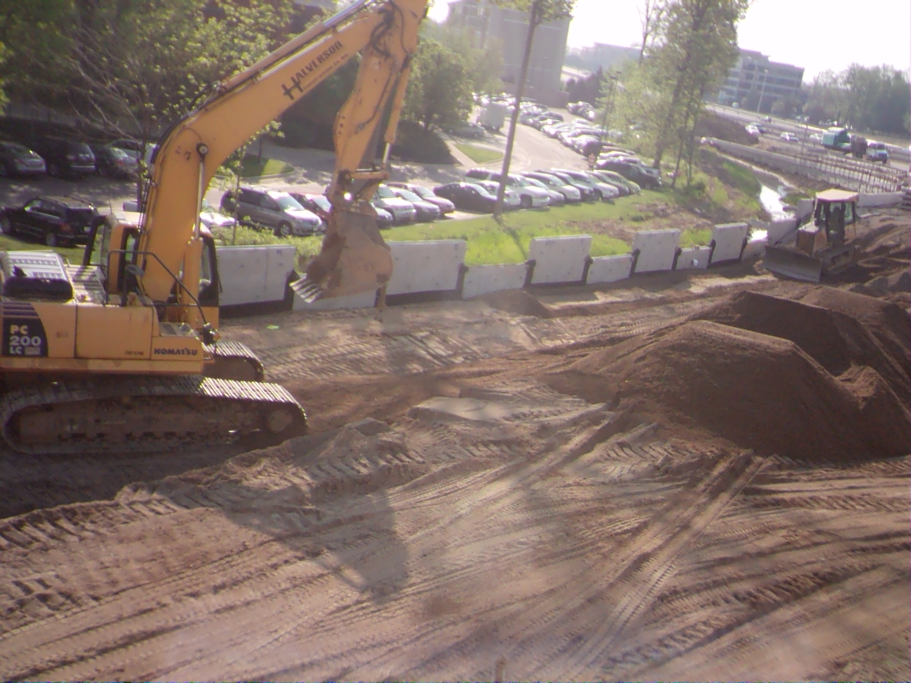
Earthwork – Loose Lift
Mechanically Stabilized Earth Walls
GOOD
PRACTICE
BAD
PRACTICE
5/07/2015
9:18 AM
Lift Thickness:
8” Maximum Loose Lift
Note: Fabric is about 12” wide. For sand backfill, an 8” loose lift will compact to a final thickness of about 6”

Slide 27
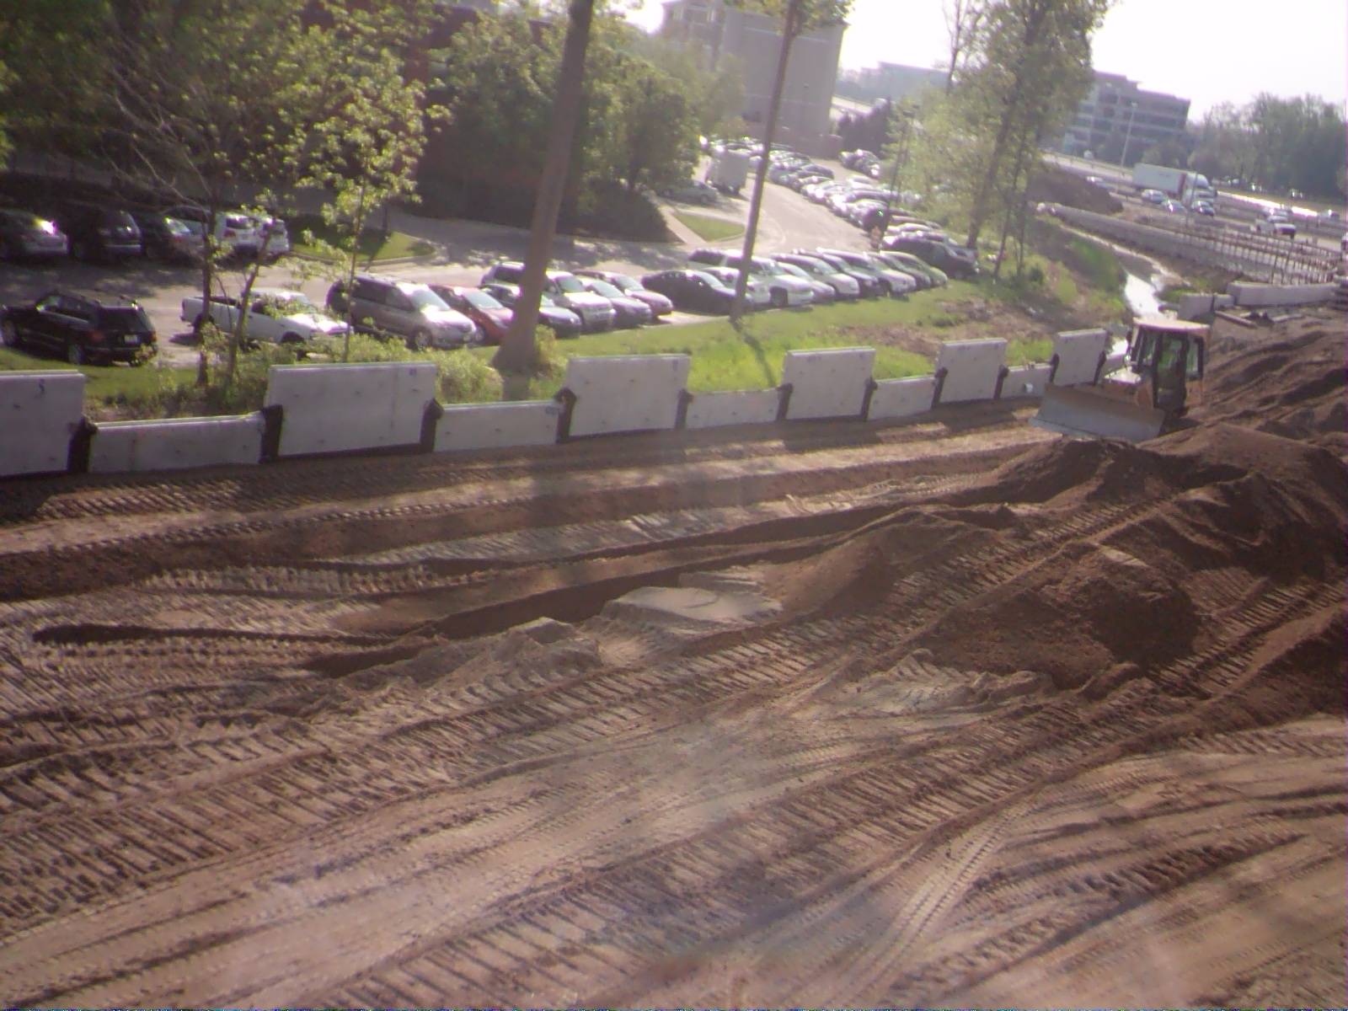
Earthwork – Loose Lift
Mechanically Stabilized Earth Walls
GOOD
PRACTICE
BAD
PRACTICE
5/07/2015
9:27 AM
Lift Thickness:
8” Maximum Loose Lift
Loose lift appears to be between 6-8”

Slide 28
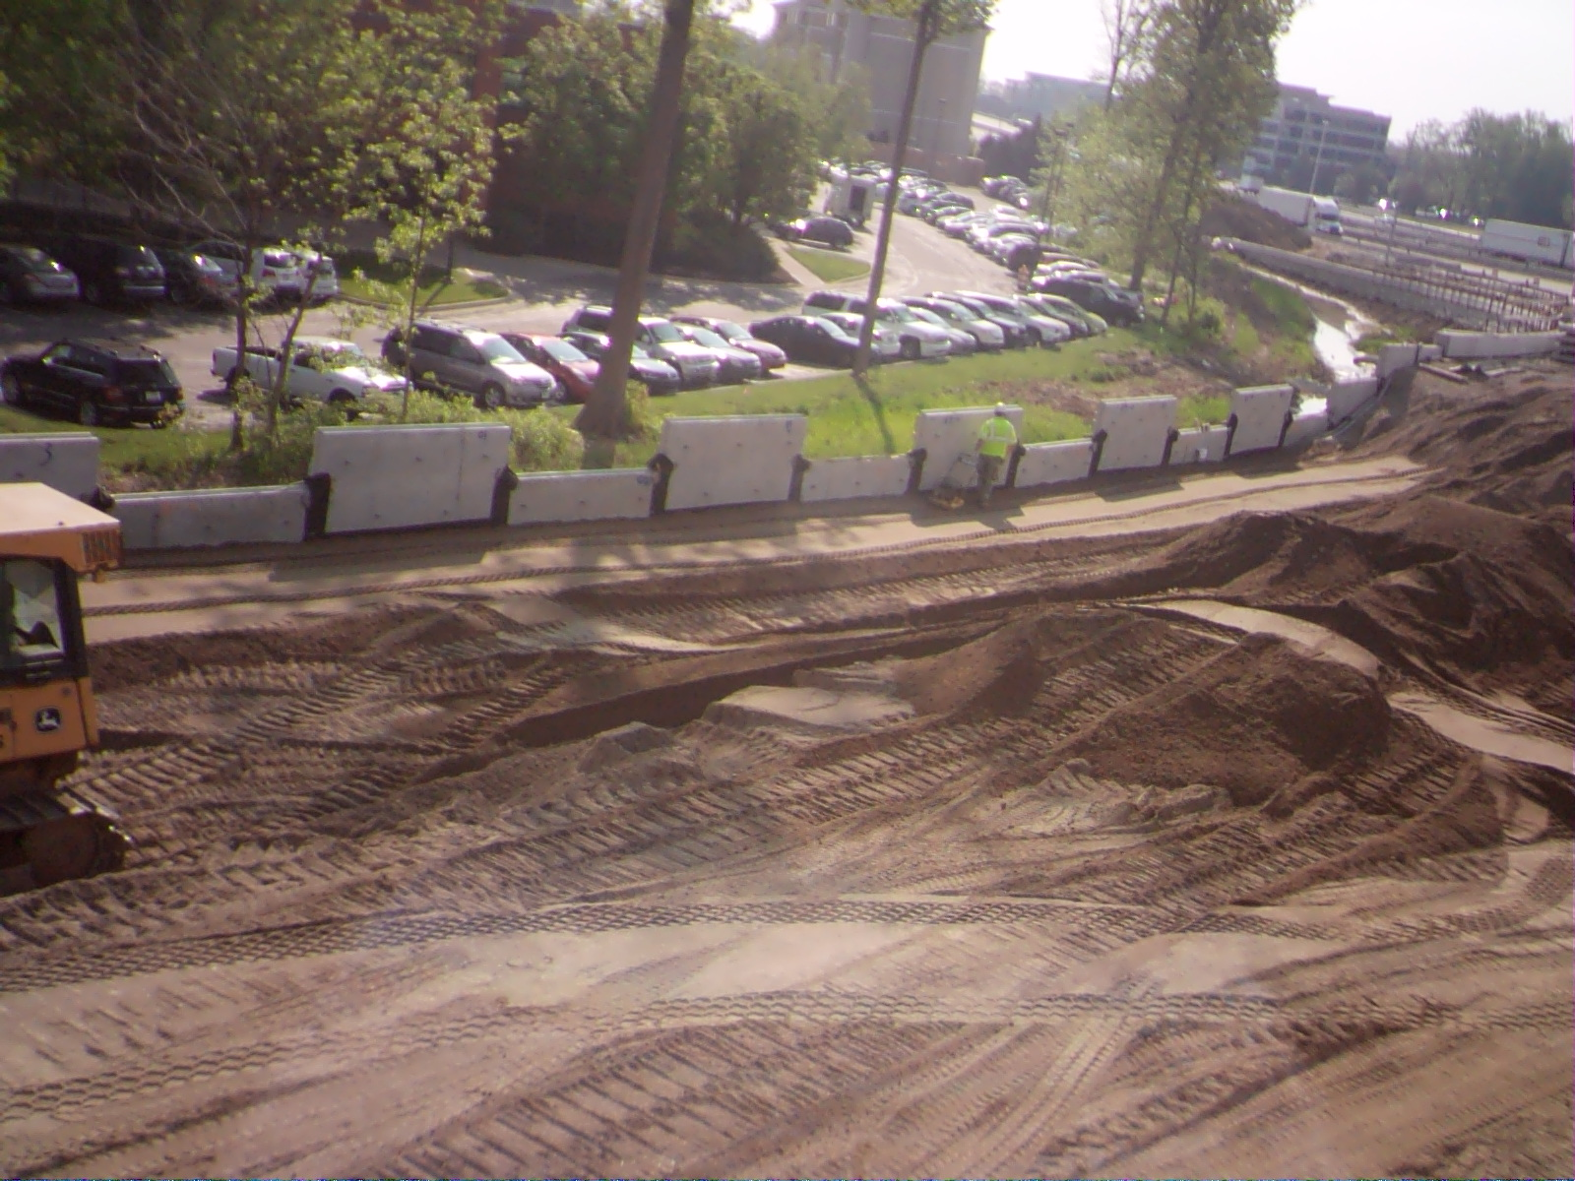
Earthwork – Loose Lift
Mechanically Stabilized Earth Walls
GOOD
PRACTICE
BAD
PRACTICE
5/07/2015
9:40 AM
Lift Thickness:
8” Maximum Loose Lift
Lift is being compacted properly. It is now clear that the lift was placed at the proper thickness.

Slide 29
Earthwork – Loose Lift
Mechanically Stabilized Earth Walls
GOOD
PRACTICE
BAD
PRACTICE
5/07/2015
9:40 AM
Lift Thickness within 3’ of Wall:
5” Maximum Loose Lift
Within 3’ of the wall, the maximum loose lift thickness is to be 5” (731.11)

Slide 30
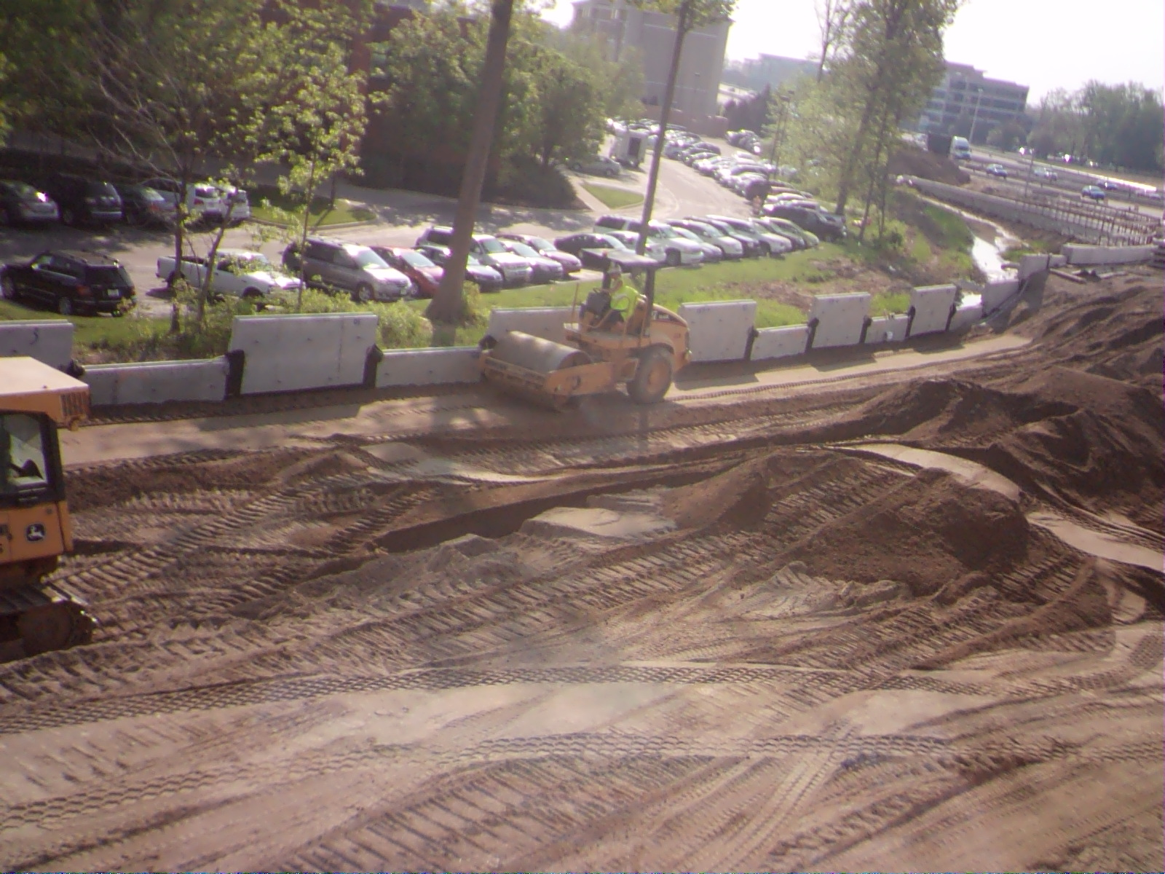
Backfill Compaction
Mechanically Stabilized Earth Walls
GOOD
PRACTICE
BAD
PRACTICE
5/07/2015
9:36 AM
Roller is too close to the wall.
During compaction, roller must not get any closer than 3 feet to the wall. Damage to straps or wall is possible.

Slide 31
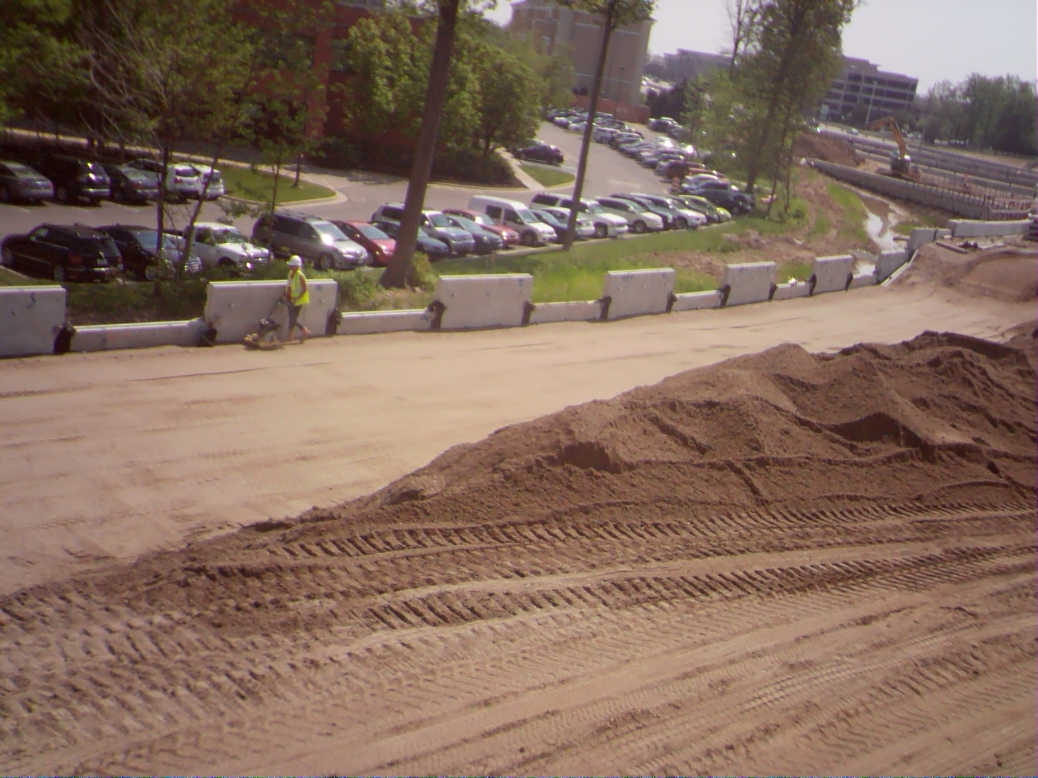
Backfill Compaction
Mechanically Stabilized Earth Walls
GOOD
PRACTICE
BAD
PRACTICE
5/07/2015
11:45 AM
5 Passes of Plate Compactor within 3 Feet of Wall
This is proper compaction within 3 feet of the wall. A minimum of 5 passes should be made to make 95% compaction.

Slide 32
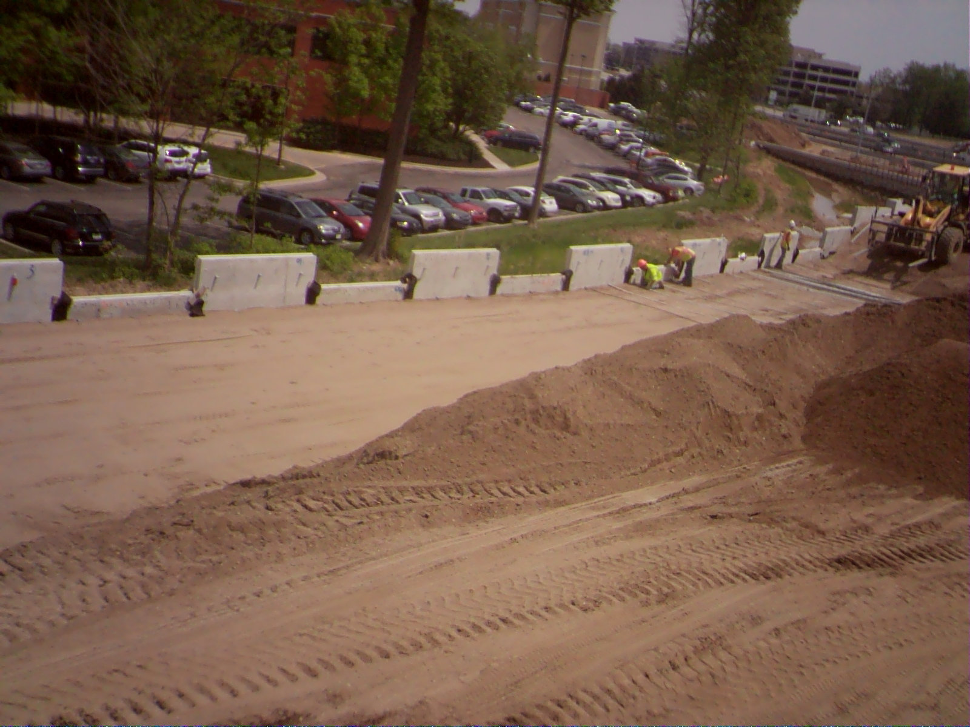
Reinforcement Straps
Mechanically Stabilized Earth Walls
GOOD
PRACTICE
BAD
PRACTICE
5/07/2015
1:59 PM
Wall Brackets

Slide 33
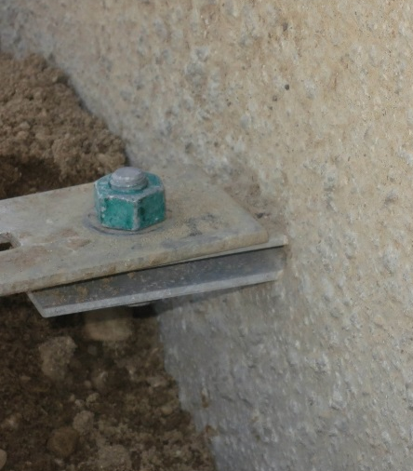
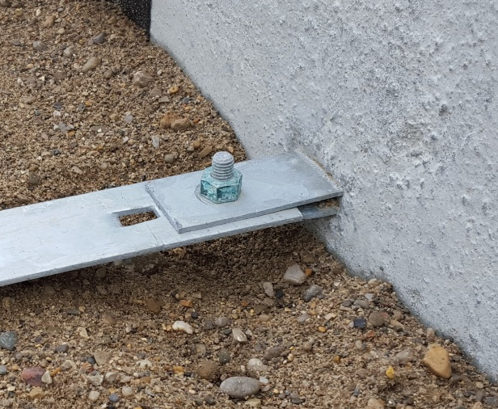
Reinforcement Straps
Mechanically Stabilized Earth Walls
GOOD
PRACTICE
BAD
PRACTICE
5/07/2015
1:59 PM
Strap should be attached between the top and bottom pieces of the bracket.
Incorrect: Correct:

Slide 34
Reinforcement Straps
Mechanically Stabilized Earth Walls
GOOD
PRACTICE
BAD
PRACTICE
Prior to placing ground reinforcement (commonly called straps), compacted lift should be slightly above the elevation of the strap connectors.
Backfill should then be removed by hand from under the connector.
Strap may then be connected to the wall.
By placing backfill in this manner, it is assured that material will be compacted properly next to the wall.
For any strap that has been field cut or damaged in such a way that the galvanizing material has been compromised, shall have the affected area covered with a galvanizing paint or coal tar to prevent corrosion of the metal.

Slide 35
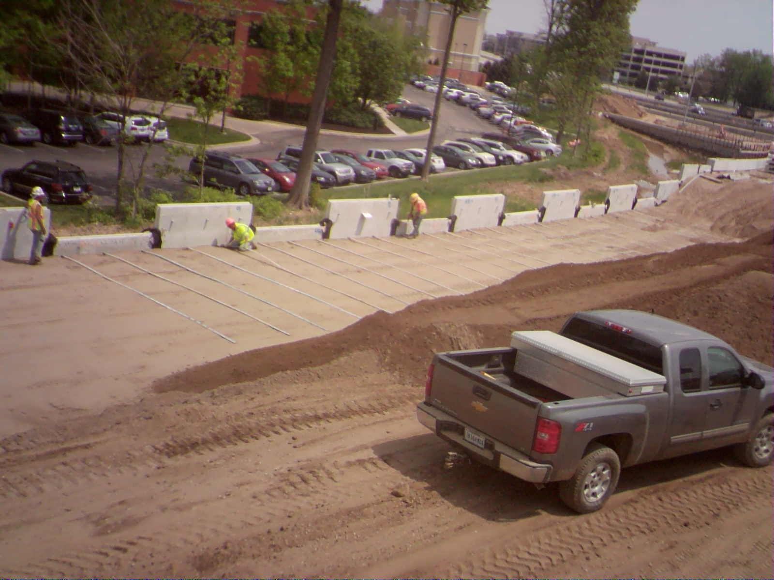
Reinforcement Straps
Mechanically Stabilized Earth Walls
GOOD
PRACTICE
BAD
PRACTICE
5/07/2015
2:10 PM
Little or No Gap Between Backfill and Strap Connections.
Proper installation technique is displayed here.

Slide 36
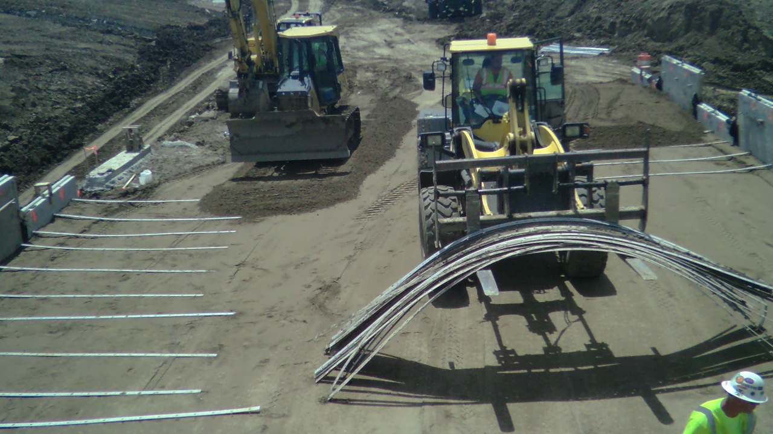
Reinforcement Straps
Mechanically Stabilized Earth Walls
GOOD
PRACTICE
BAD
PRACTICE
6/18/2015
12:51 PM
Note the gap under strap connections.
Backfill should have been brought up and compacted higher prior to placing the straps.

Slide 37
Reinforcement Straps
Mechanically Stabilized Earth Walls
GOOD
PRACTICE
BAD
PRACTICE
6/18/2015
12:51 PM
Once backfill is placed over these straps, their efficiency will be reduced due to lack of compaction around them, leading to wall movement. Also, a roller passing too close to the wall could cause connection of the straps at the wall to break.

Slide 38
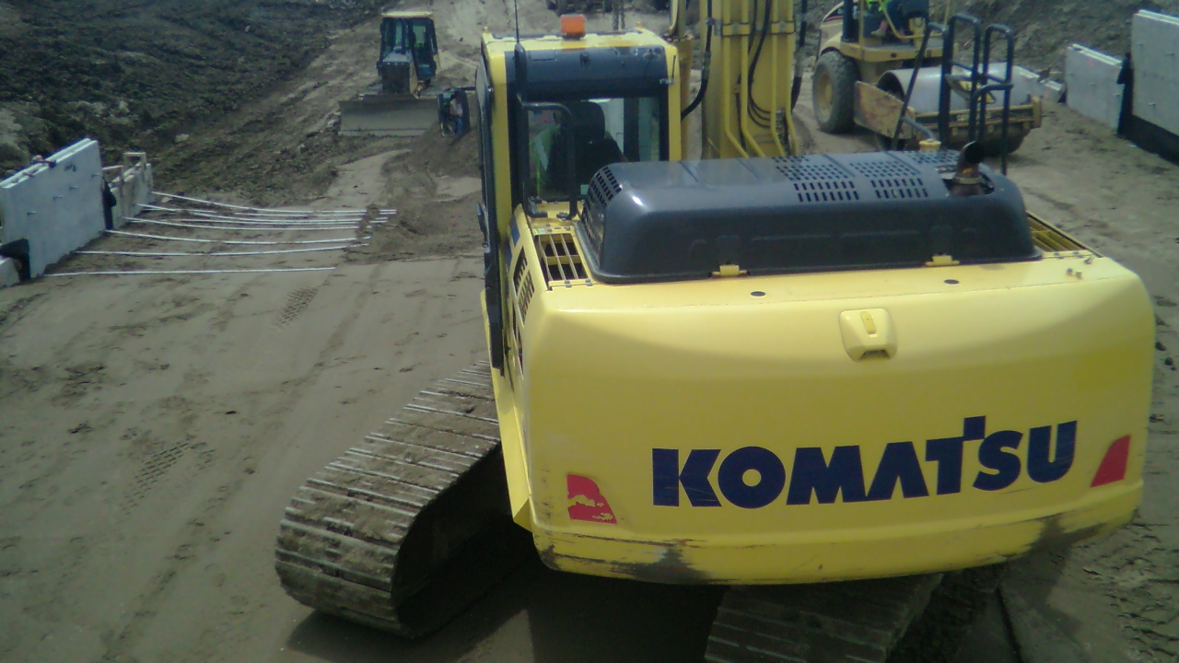
Reinforcement Straps
Mechanically Stabilized Earth Walls
GOOD
PRACTICE
BAD
PRACTICE
6/22/2015
12:41 PM
Large gap under strap connections.
Last two straps appear to be 6” or more above compacted backfill. These connections will likely break if compacted with a roller.

Slide 39
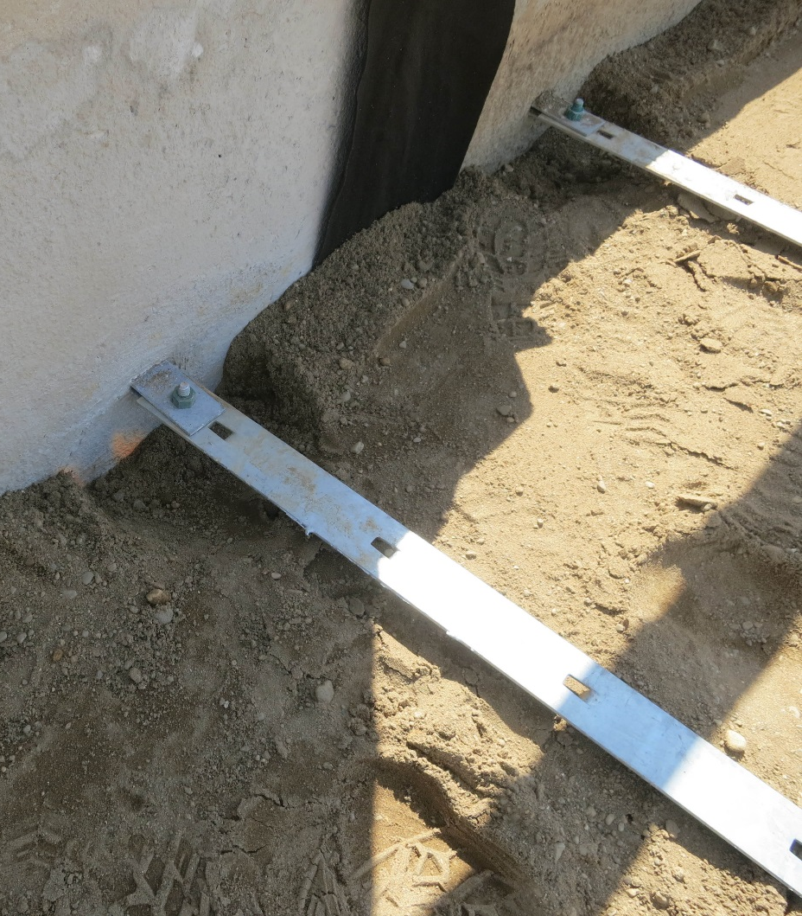
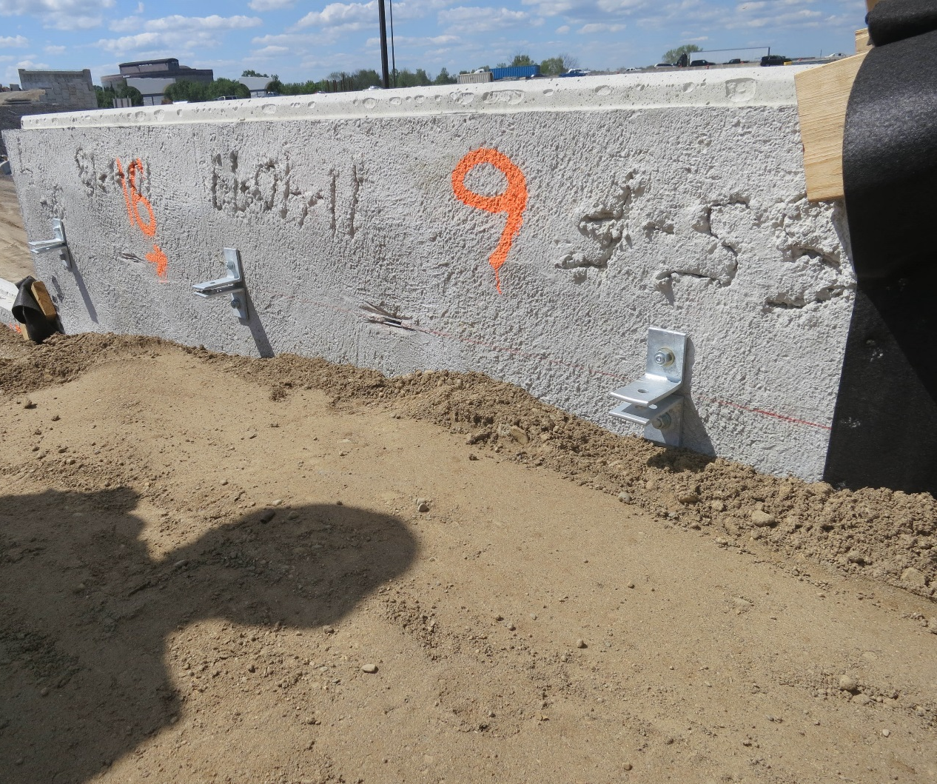
Reinforcement Straps
Mechanically Stabilized Earth Walls
GOOD
PRACTICE
BAD
PRACTICE
Proper Strap Connectors
This is not bad. A little more fill should have been placed under the straps. Backfill should be replaced where connection was made at the bracket.

Slide 40
Reinforcement Straps
Mechanically Stabilized Earth Walls
GOOD
PRACTICE
BAD
PRACTICE
Improper Fix of Strap Connectors
This is a repair that was made to the bracket. Typically, the brackets are embedded into the wall during the manufacturing process. On occasion, brackets are damaged or broken off. When this occurs, the designer of the wall is responsible to determine the means of repair or replacement. This decision should not be made in the field.

Slide 41
Reinforcement Straps
Mechanically Stabilized Earth Walls
GOOD
PRACTICE
BAD
PRACTICE
6/18/2015
12:51 PM
Strap Length is generally 0.7 x H (H = Height of wall)
Ensure 8’ minimum strap length is met or exceeded
Straps should be as per shop drawings
Refer to shop drawings to ensure proper strap lengths

Slide 42
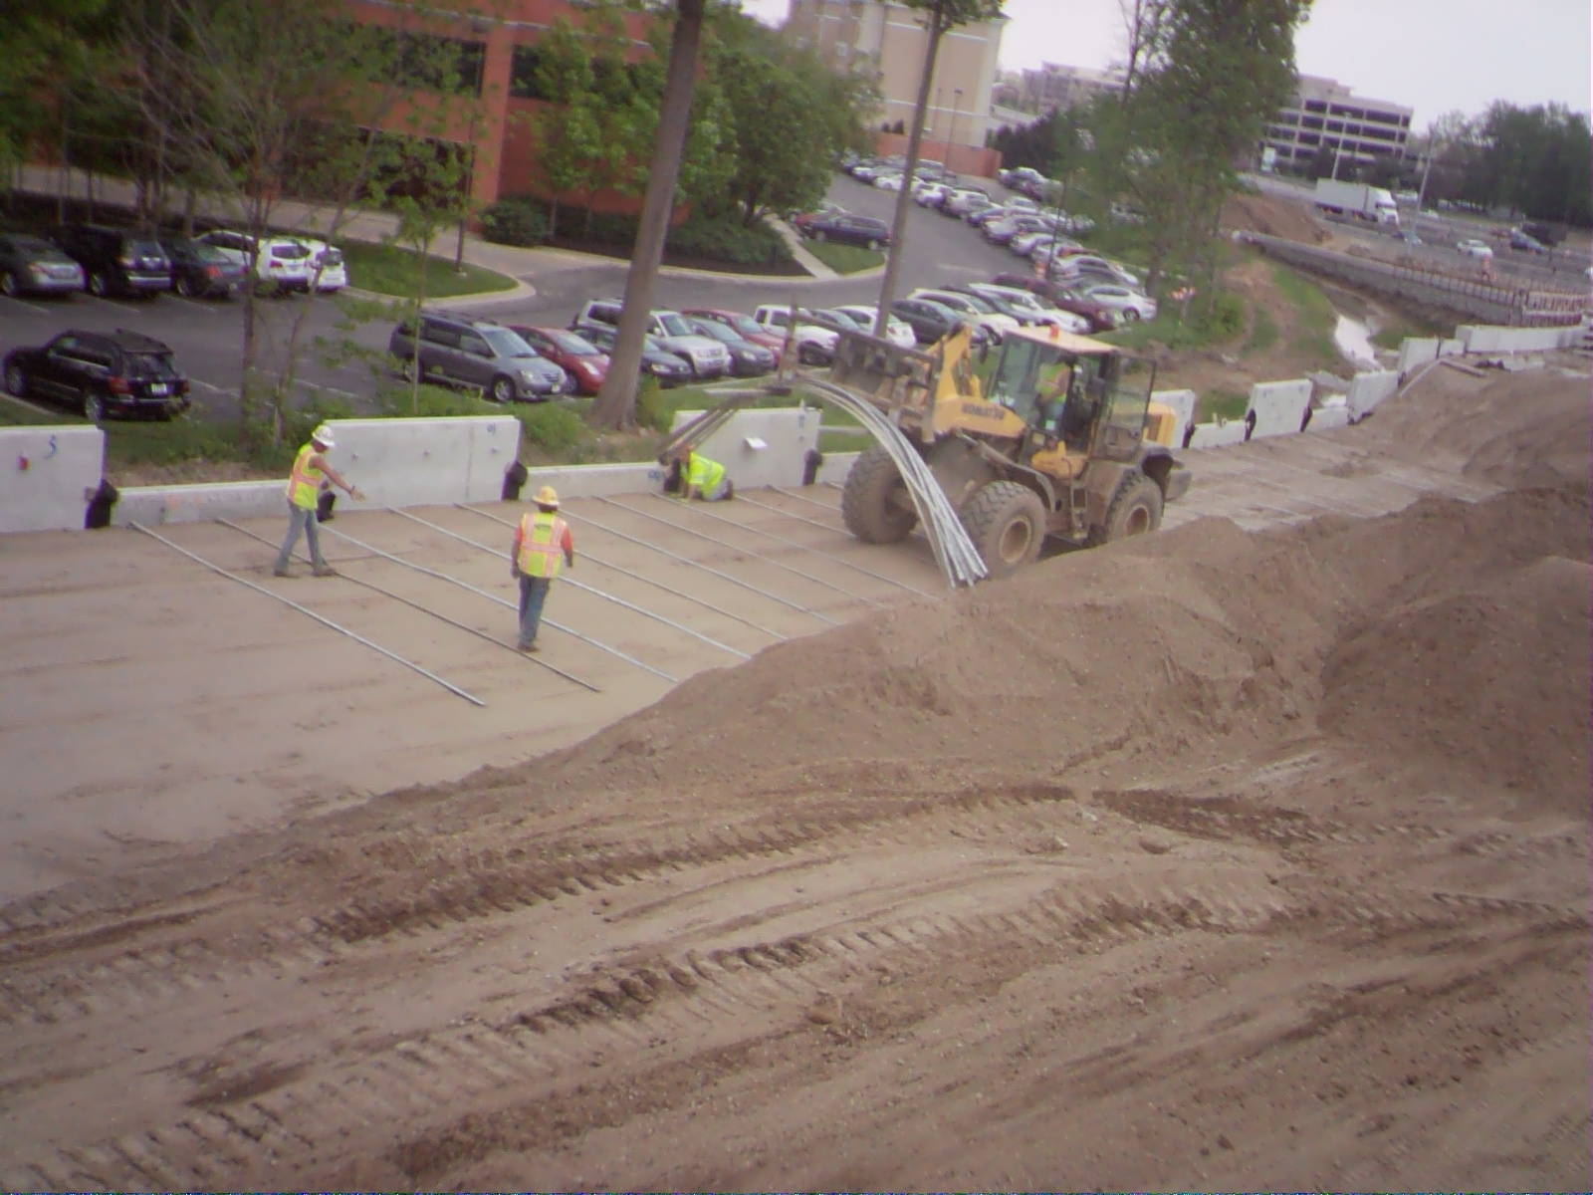
Reinforcement Straps
Mechanically Stabilized Earth Walls
GOOD
PRACTICE
BAD
PRACTICE
5/07/2015
2:08 PM
No Construction Traffic Allowed on Straps
Deformations to straps could decrease strap effectiveness. Connection from wall could be broken.

Slide 43
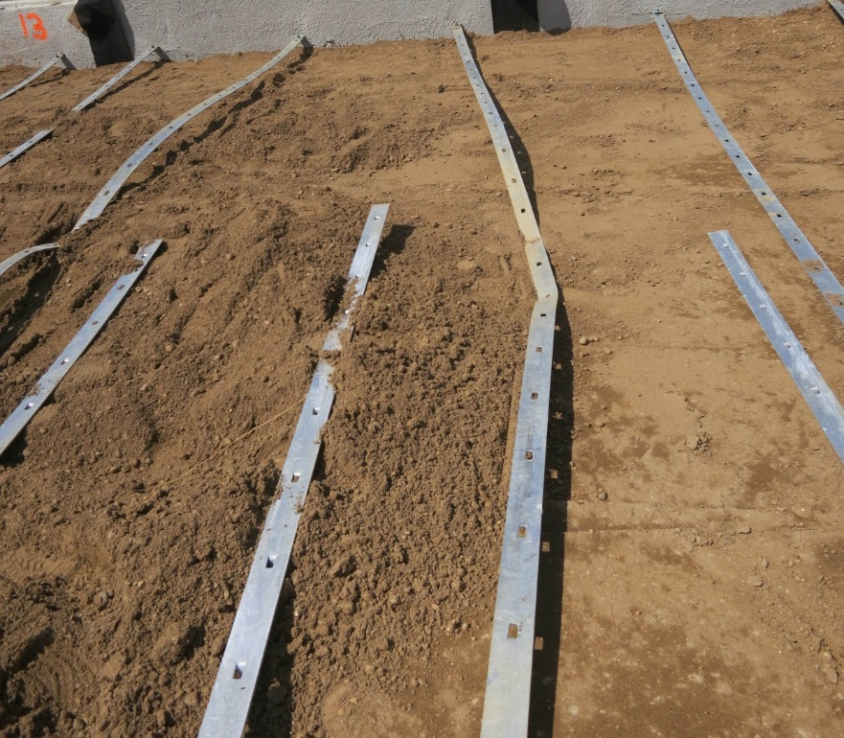
Reinforcement Straps
Mechanically Stabilized Earth Walls
GOOD
PRACTICE
BAD
PRACTICE
5/07/2015
2:08 PM
Result of construction traffic traveling on straps. Construction traffic may travel over straps once a subsequent lift of backfill has been placed over them.

Slide 44
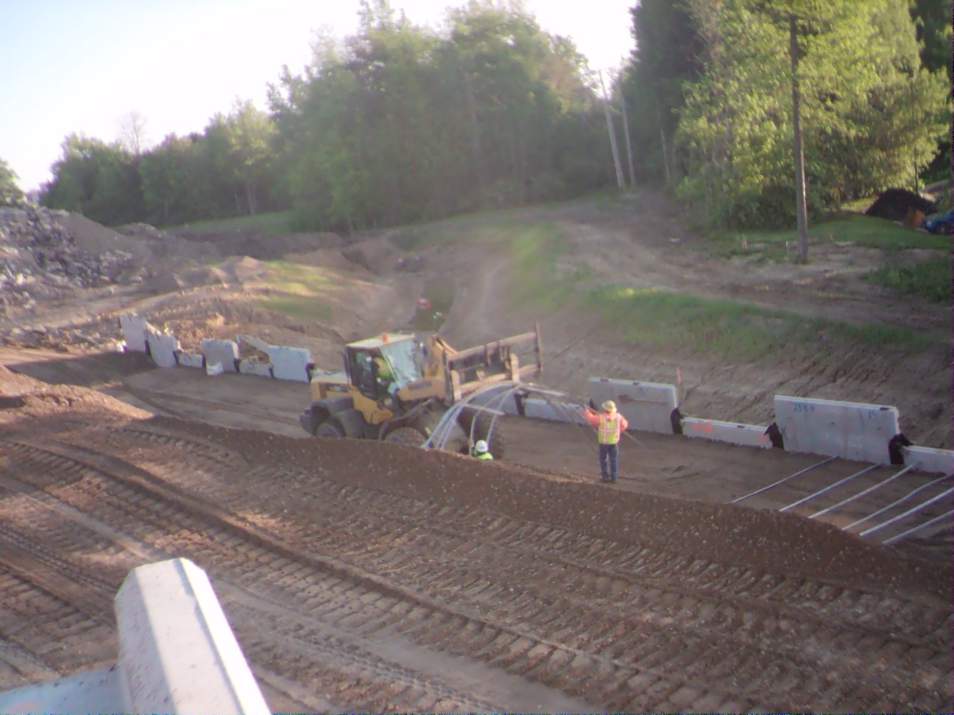
Reinforcement Straps
Mechanically Stabilized Earth Walls
GOOD
PRACTICE
BAD
PRACTICE
5/13/2015
7:31 AM
Proper Delivery of Straps
Loader does not drive over straps, preserving the integrity of the straps and wall connections.

Slide 45
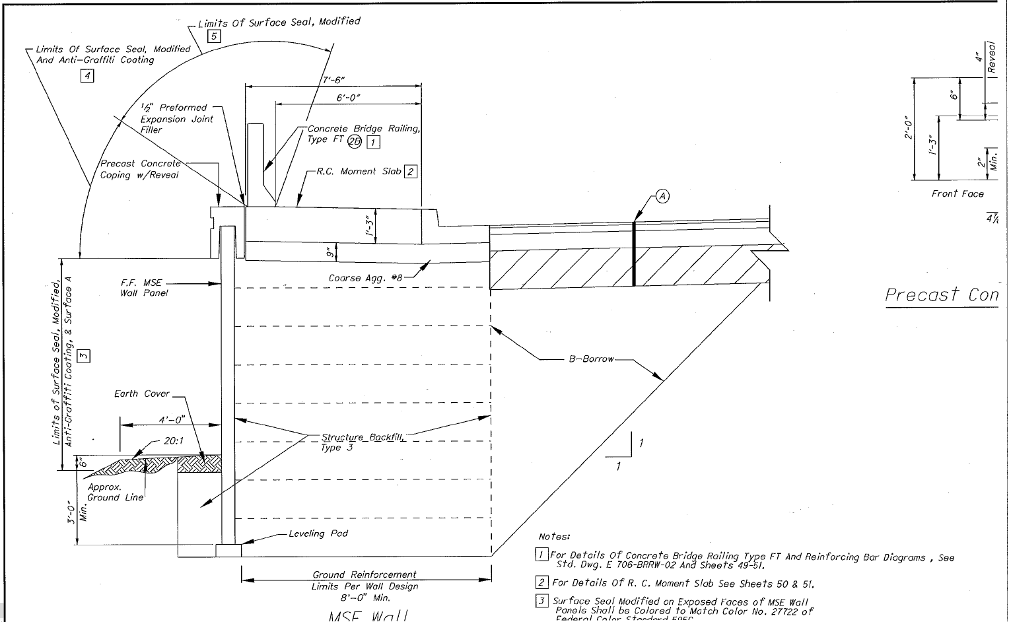
MSE Plan Drawings
Mechanically Stabilized Earth Walls
GOOD
PRACTICE
BAD
PRACTICE
Note the dimensions in this area.
Check plan sheets for topography of fill outside of the wall. Reasonable conformance to plans is expected.

Slide 46
MSE Plan Drawings
Mechanically Stabilized Earth Walls
GOOD
PRACTICE
BAD
PRACTICE
Note: 3 Foot Minimum:
Backfill must be placed against the front face of the wall to a minimum height of 3 feet above the top of the leveling pad.

Slide 47
MSE Plan Drawings
Mechanically Stabilized Earth Walls
GOOD
PRACTICE
BAD
PRACTICE
Ensure Slope Away From Wall
Allowing the backfill to be sloped toward the wall will result in a channel being created for water. This will eventually result in the undermining of the leveling pad. This is a typical detail for the side of the wall running parallel to the road in order for water to move gradually away from the wall as it drains down the slope

Slide 48
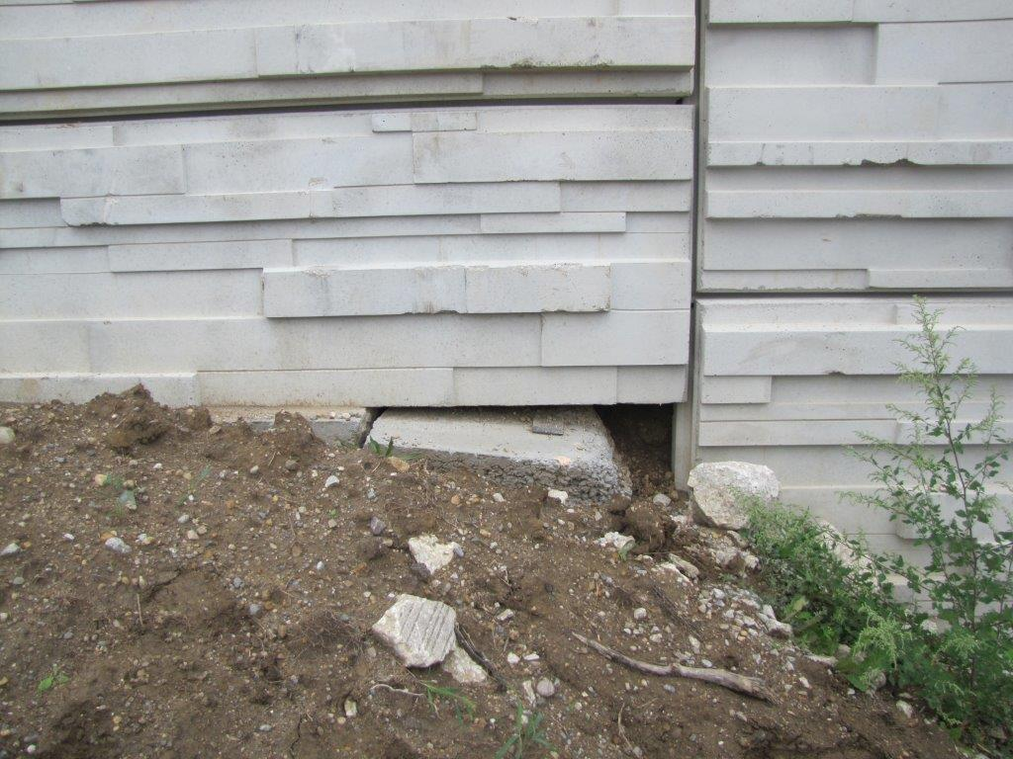
Result of Poor Grading
Mechanically Stabilized Earth Walls
GOOD
PRACTICE
BAD
PRACTICE
Backfill should be placed a minimum of 3 Feet Above Top of Levelling Pad
Results of Poor Grading Near the Wall
Poor Grading

