Slide 1
Next Level Jobs

Slide 2
Next Level Jobs by the Numbers
Results to date as of October 2019:
  20,826 Hoosiers have enrolled in high demand certificate programs at Ivy Tech, Vincennes or other eligible training providers
  8,957 Hoosiers have completed a Next Level Jobs Workforce Ready certificate program

Slide 3
Performance
NLJ applications are costing less than half of the industry standard for higher ed. search campaigns, and significantly less than other “tuition assistance program” search campaigns
Campaign | Cost Per Acquisition
Next Level Jobs | $51.37
Higher Ed Search Campaigns | $75.00
Tuition Assistance Programs | $100-$200

Slide 4
Demographic Takeaways
Ages 18-24 is the group most likely to apply (highest application rate)
Men will be harder and more expensive to reach than women for most campaigns
  men have lower volume, conversions, and conversion rates compared to women
Northern Indiana demonstrates the need for training
  5 of the 7 counties on Indiana’s northern border are in the top 10 for applications
    Lake, Porter, LaPorte, St Joseph, Elkhart

Slide 5
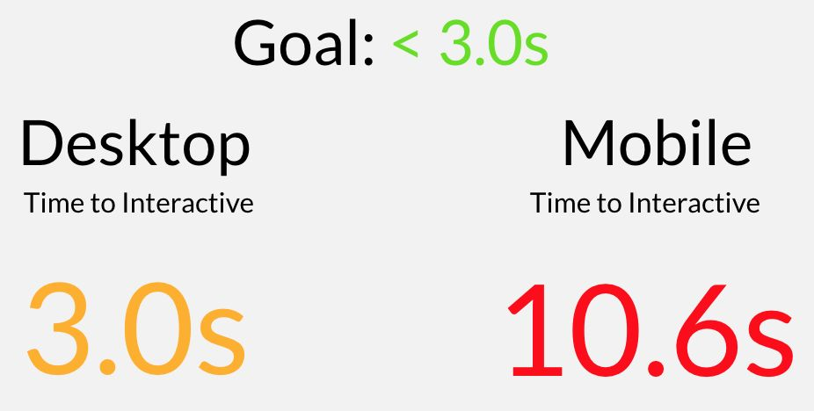
Website
StatWax performed a thorough audit of the NLJ website to maximize site visits and applications
  Most notably, over 64% of site visitors are on mobile, but the site was not designed to be mobile-friendly
  Site loading time by device:
  CHE is working on many improvements to the website to address these issues

Slide 6
Collaboration Opportunities
Utilizing existing, eligible populations to maximize reach
  Family & Social Services Administration (FSSA)
    Healthy Indiana Plan (HIP)
    Gateway to Work
    Supplemental Nutrition Assistance Program (SNAP)
  WorkOne
  Ineligible 21st Century Scholars

Slide 7

Student Success Story: Tiffany Steele
Tiffany Steele, Ivy Tech
Completed the Practical Nursing program certificate
Currently working as a Licensed Practical Nurse in a long term care facility in New Castle, IN
“I greatly appreciate the opportunity that this grant gave me to come out of the nursing program with no debt from my education. ”

