Slide 1

Hydraulics Updates to the IndianaDesign Manual
Mark Bailey, PE
Manager, INDOT Office of Hydraulics
mbailey1@indot.in.gov
David Finley, PE
INDOT Hydraulics Engineer
dfinley@indot.in.gov
March 8, 2017

Slide 2
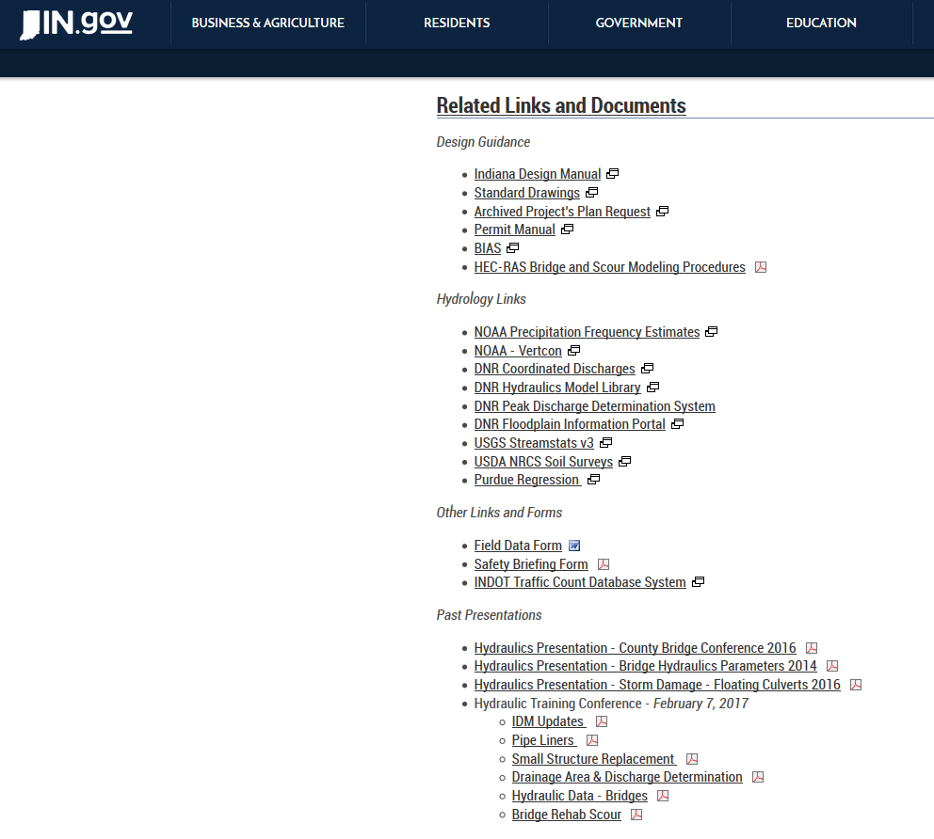
Updates to the IDM
How-to Information
Helpful set of presentations on the Office of Hydraulics website

Slide 3
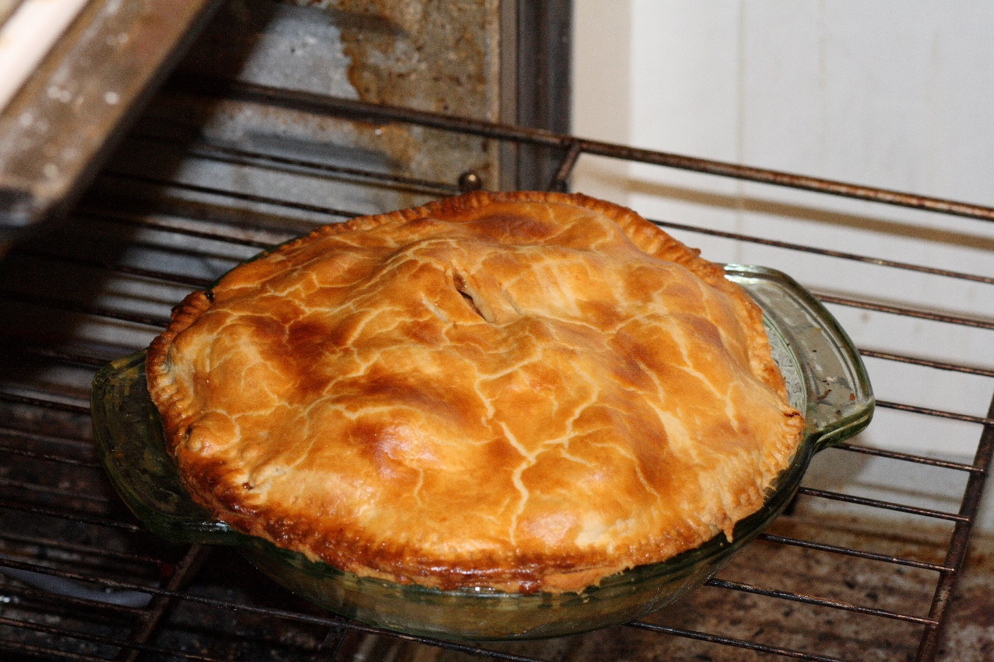
Updates to the IDM
Status of the current updates…
Mmmm…
It is done!

Slide 4
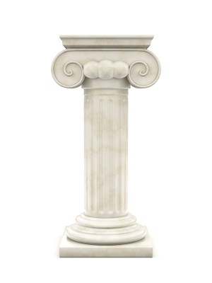
Updates to the IDM
Bridge REPLACEMENT Updates…
ONE FOOT

Slide 5

Updates to the IDM
Bridge REPLACEMENT Updates…

Slide 6

Updates to the IDM
Bridge Replacement
Backwater…
First assess the existing backwater
Basic backwater criteria:
If the existing backwater is… | The allowable backwater will be…
> 3 feet | 3 feet or less
Between 0.14 and 3 feet | Match or improve existing
Less than 0.14 feet | Up to 0.14 feet
This can be affected by other factors →

Slide 7
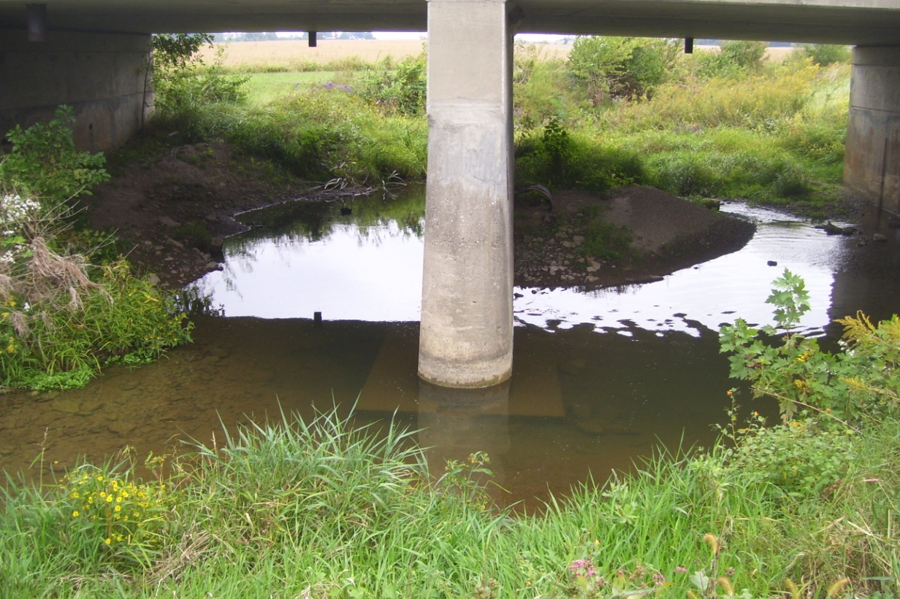
Updates to the IDM
Bridge Replacement
Backwater: Check velocity…
Requires judgment
Evidence of instability?
If the existing bridge is unstable, the average velocity in the proposed bridge waterway should be ≤ 1.5 * the downstream channel velocity.

Slide 8
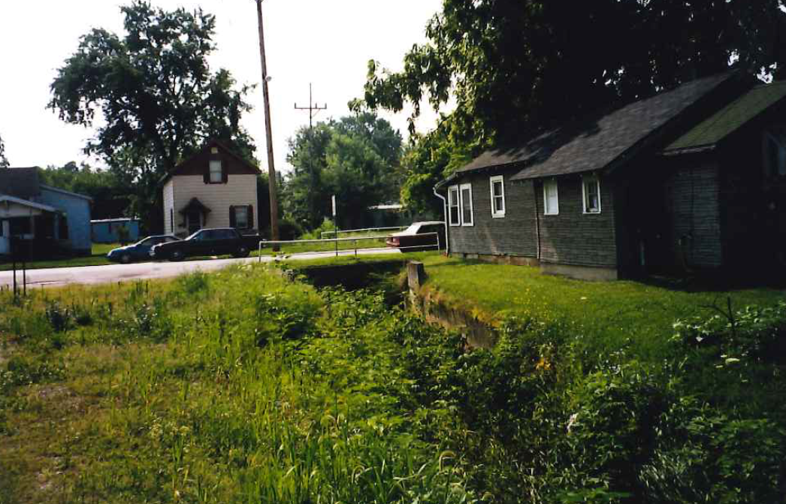
Updates to the IDM
Bridge Replacement
Backwater: U/S structures…

Slide 9
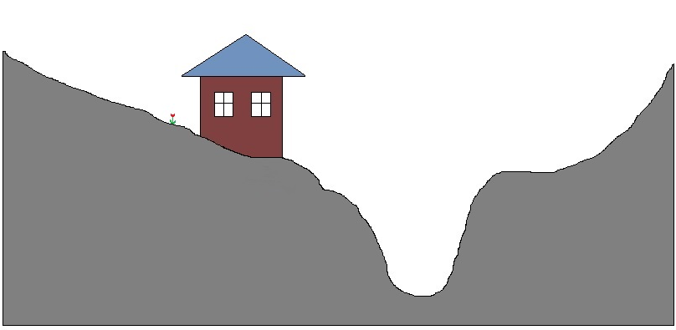
Updates to the IDM
Bridge Replacement
Backwater: U/S structures…
Lowest adjacent land grade
1 Foot
“Target” water surface elevation

Slide 10
Updates to the IDM
Bridge Replacement
Backwater: U/S structures…
Lowest adjacent land grade
Existing backwater
(More than 1 foot)
Is the “Target” water surface elevation less than 1 foot of backwater?

Slide 11
Updates to the IDM
Bridge Replacement
Backwater: U/S structures…
Lowest adjacent land grade
Existing backwater
(More than 1 foot)
“Target” water surface elevation = 1.5 feet of backwater. GOOD!

Slide 12
Updates to the IDM
Bridge Replacement
Backwater: U/S structures…
Lowest adjacent land grade
Existing backwater
(More than 1 foot)
Proposed water surface elevation for 1.0 feet of backwater. Allowed!
“Target” water surface elevation < 1.0 feet of backwater. OOPS!

Slide 13
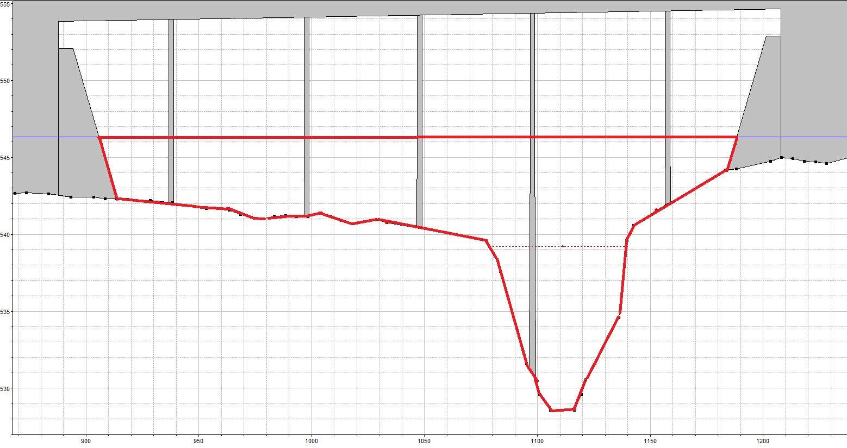
Updates to the IDM
Bridge Replacement
Backwater: Waterway areas…
Gross Waterway Area

Slide 14
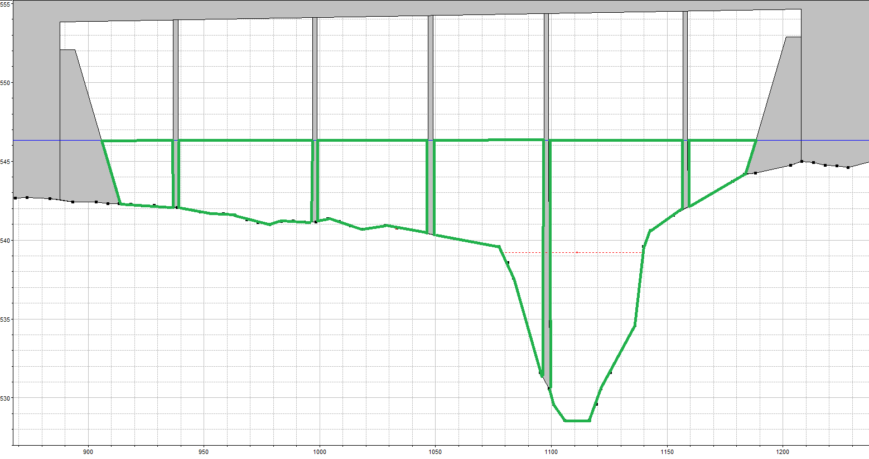
Updates to the IDM
Bridge Replacement
Backwater: Waterway areas…
Net Waterway Area

Slide 15
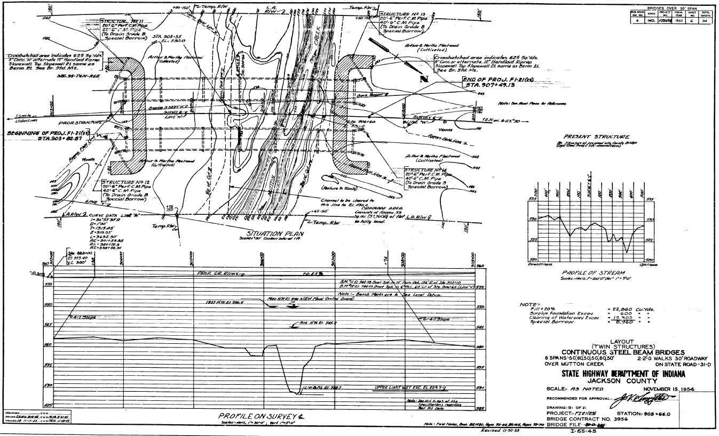
Updates to the IDM
Bridge Replacement
Backwater: Waterway areas…
Request plans at: http://www.in.gov/indot/2345.htm

Slide 16
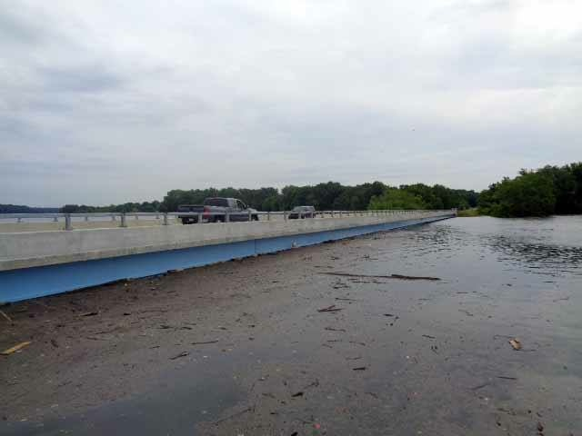
Updates to the IDM
Bridge Replacement
Other Criteria: Freeboard…
Current criteria:
Ideal is 2’ or…
maybe 1’ or…
maybe 3’
New criteria:
What do I
need to
achieve?

Slide 17
Updates to the IDM
Bridge Replacement
Other Criteria: Freeboard…
Goal: Meet the existing criteria
Three possibilities:
  The existing low structures is above the goal
  The existing low structure is in pressure flow
  The existing low structure is above the 1% EP elevation, but no pressure flow

Slide 18
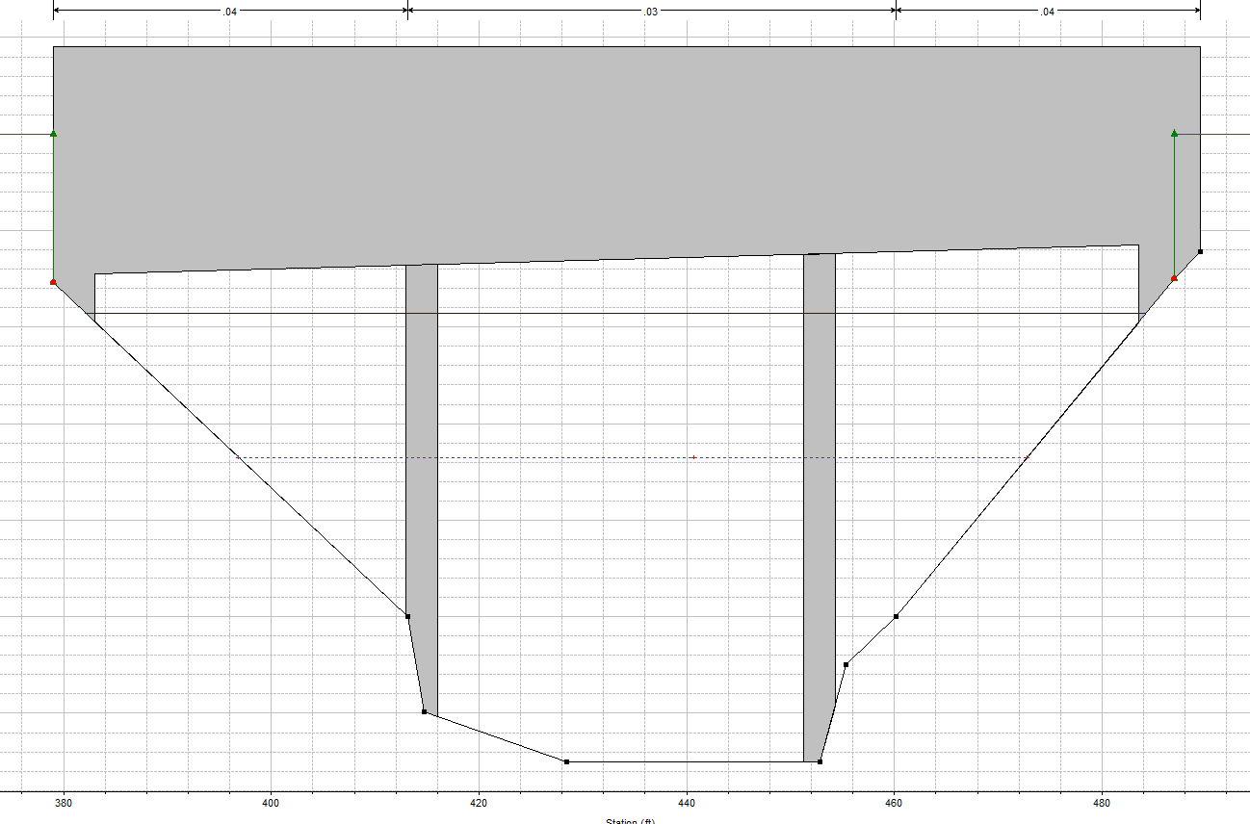
Updates to the IDM
Bridge Replacement
Other Criteria: Freeboard…
Matching existing freeboard
Debris issues?
Yes: Meet the current
criteria
0.81’

Slide 19
Updates to the IDM
Bridge Replacement
Other Criteria: Freeboard…
Matching existing freeboard
Debris issues?
Yes: Meet the current
Criteria
No: Can match the PROFILE
0.81’

Slide 20
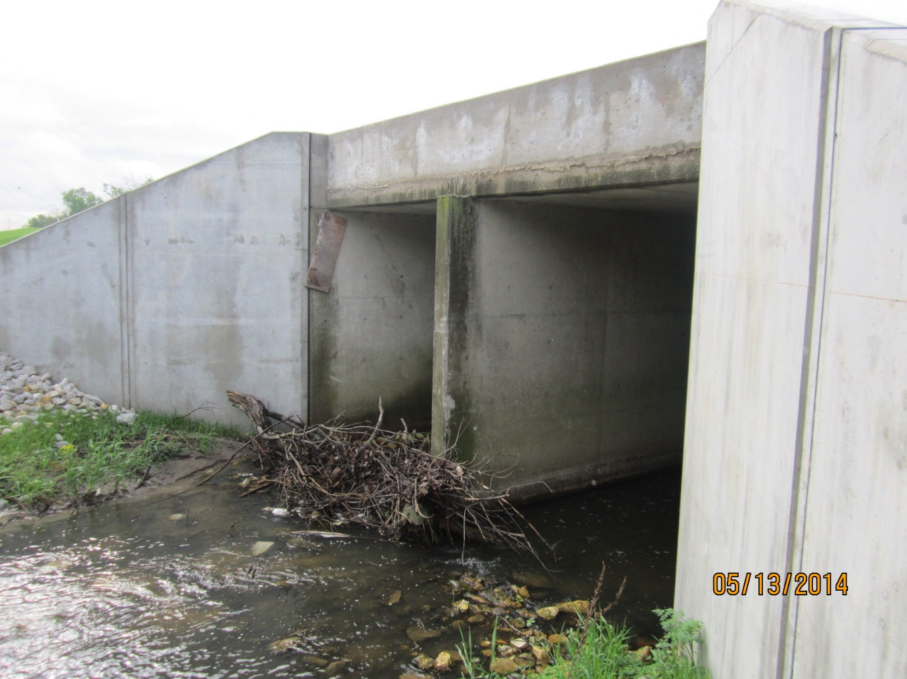
Updates to the IDM
Bridge Replacement
Two-Span Structures

Slide 21
Updates to the IDM
Culvert REPLACEMENT Updates…
Replacement in Kind…

Slide 22
Updates to the IDM
Culvert REPLACEMENT Updates…
Replacement in Kind… Is now the main policy!

Slide 23
Updates to the IDM
Culvert Replacement
Replacement in Kind… Is now the main policy!
Backwater…
Proposed backwater can be as much as 3 feet provided is less than the existing backwater
But what if an upstream structure would be affected? See the bridge design criteria…

Slide 24
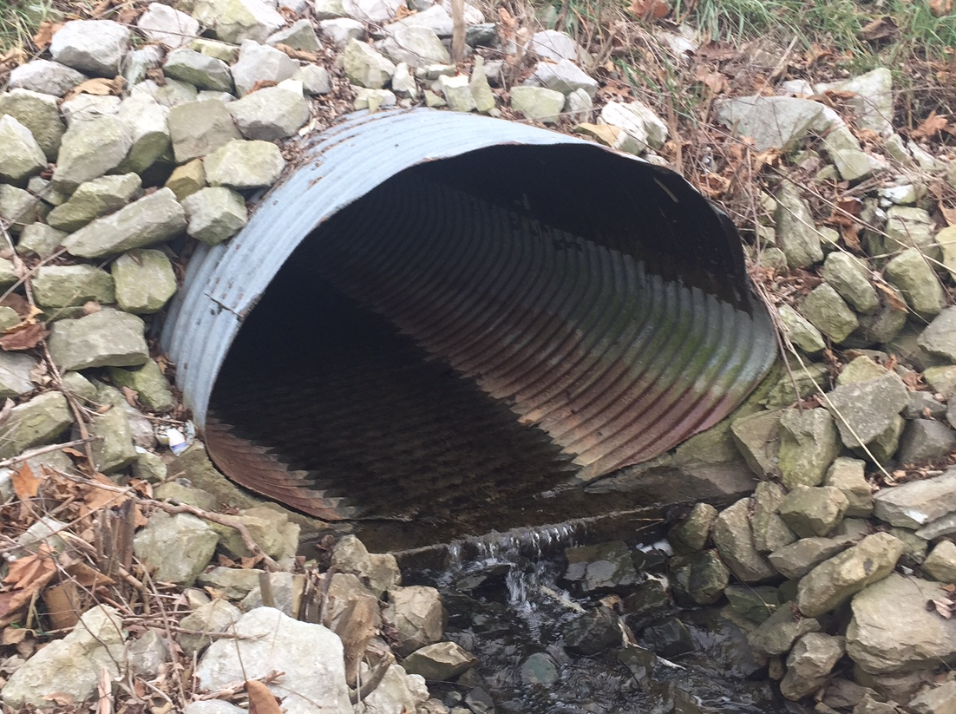
Updates to the IDM
Culvert Replacement
Other Criteria…
Span and
Waterway Area:
Proposed
≥
Existing
Existing Span
1% EP Water Surface
Existing Waterway Area

Slide 25
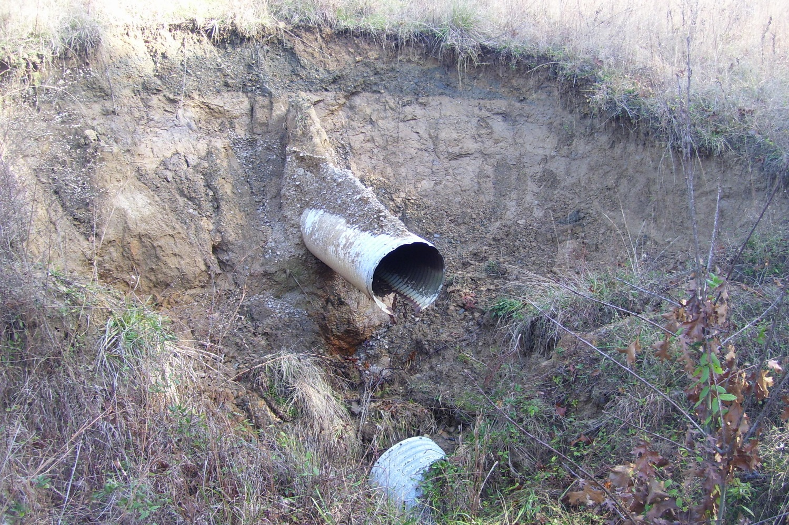
Updates to the IDM
Culvert Replacement
Other Criteria…
Outlet Velocity ≤
1.5 x Channel Velocity
Does the pipe have a scour issue?

Slide 26
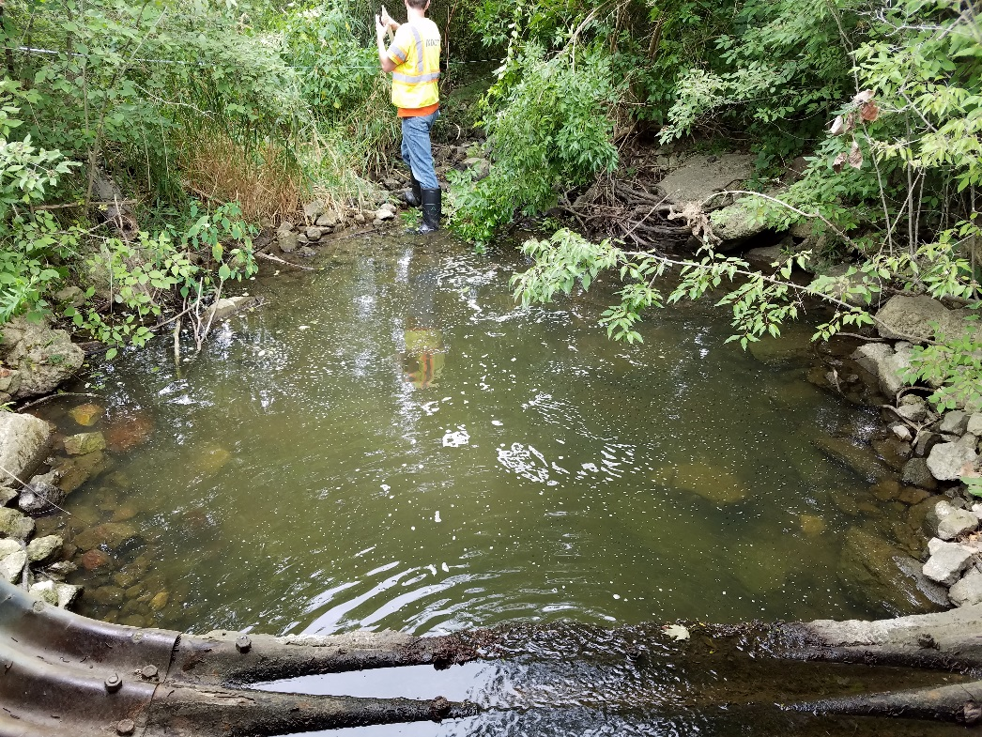
Updates to the IDM
Culvert Replacement
Other Criteria…
Outlet Velocity ≤
1.5 x Channel Velocity
Exceptions:
  Minimum outlet velocity = 6.5 ft/sec
  1 foot of backwater

Slide 27
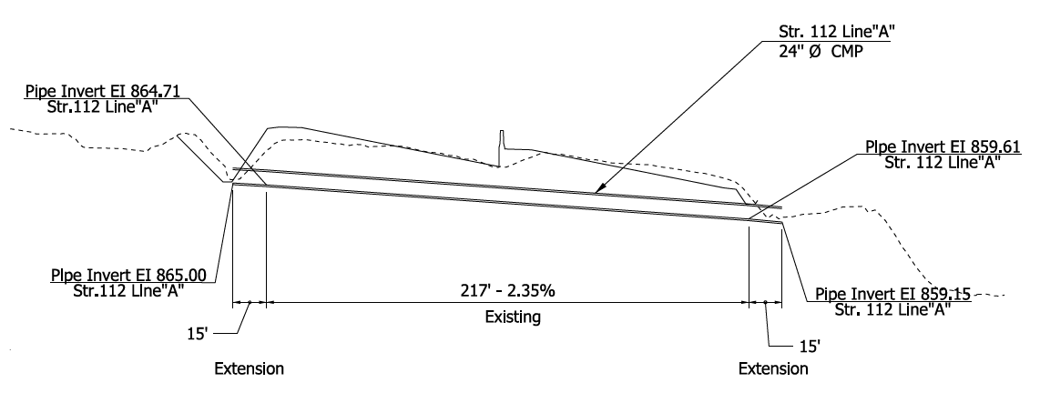
Updates to the IDM
Culvert Replacement
Culvert Extension
The headwater elevation has to stay the same
Remember: HEADwater, not BACKwater
How to deal with that?
If the culvert is extended, what happens to the headwater here?

Slide 28
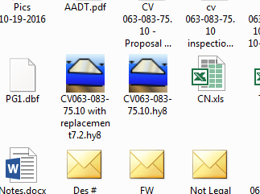
Updates to the IDM
Culvert Replacement
Other Things…
When making a submittal, include the electronic files – and mention the version that is used.
Is there concern about downstream impacts?
Contact the Office of Hydraulics.

Slide 29
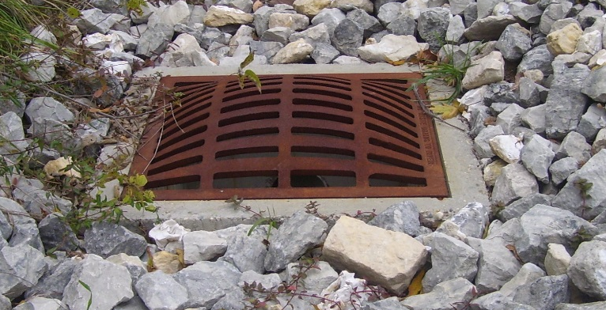
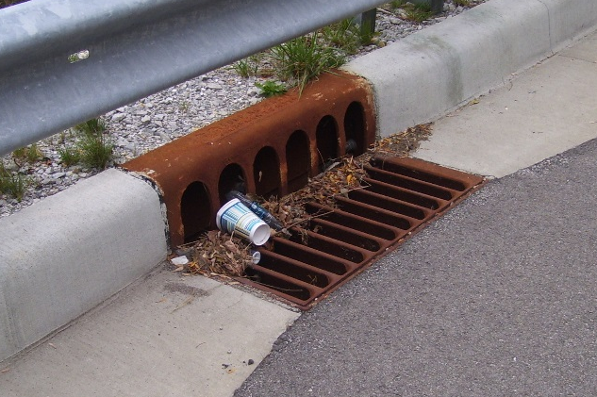
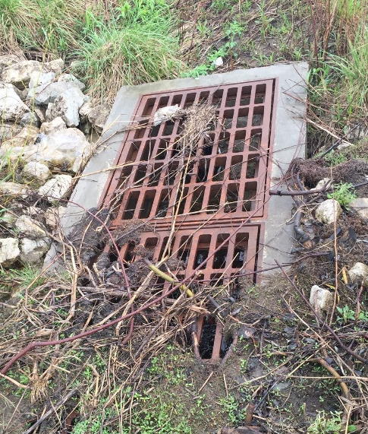
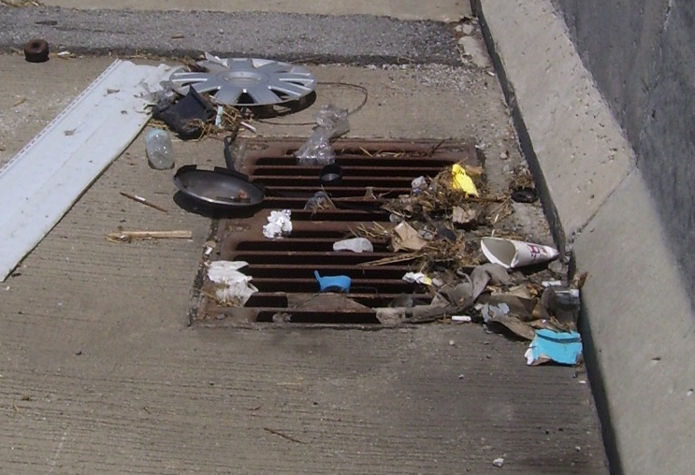
Updates to the IDM
Inlet Spacing Design
50% Clogging Factor…
REQUIRED
NOT REQUIRED
Sags with flanking inlets
Bridge deck drains

Slide 30
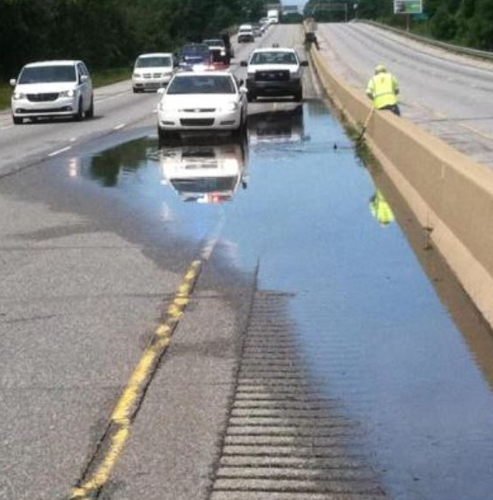
Updates to the IDM
Inlet Spacing Design
Flanking Inlets…
Required for curb and gutter sections.
Required for median and side ditches unless there is a good place for the water to go.

Slide 31
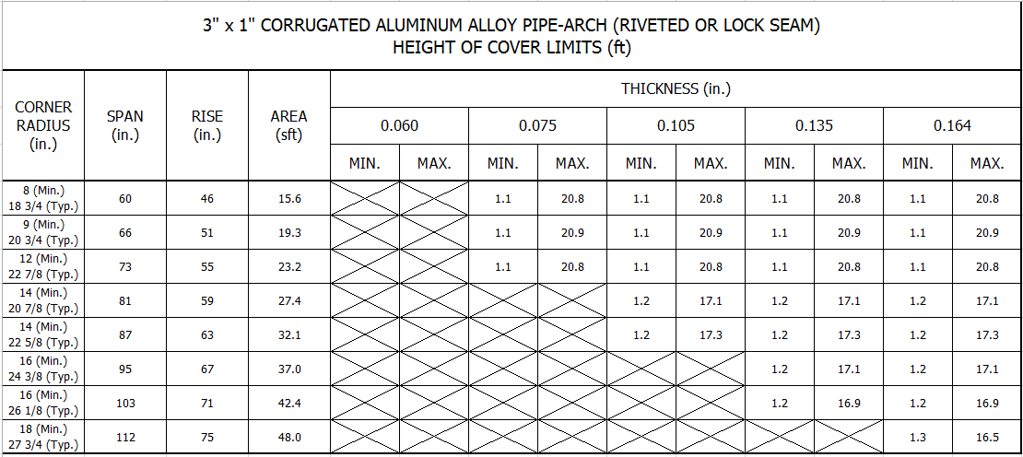
Updates to the IDM
Pipe Cover
New set of standard drawings…
Cover is now based on pipe type and size

Slide 32
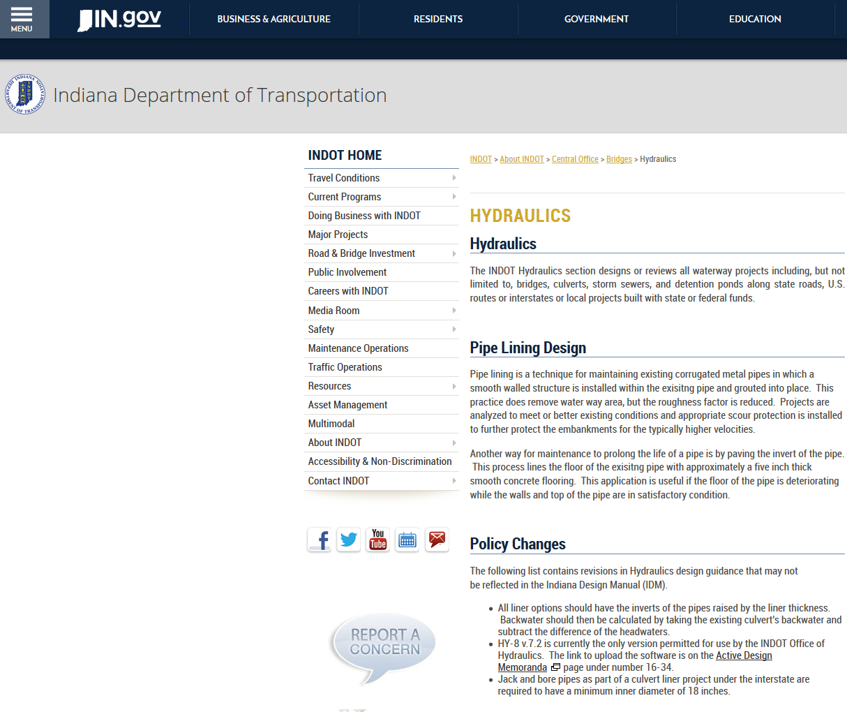
Updates to the IDM
More to come…
Culvert Lining and more…
Find information on the INDOT Hydraulics website
http://in.gov/indot/3595.htm

Slide 33
THANKS
Hydraulics Updates to the IndianaDesign Manual
Mark Bailey, PE
Manager, INDOT Office of Hydraulics
mbailey1@indot.in.gov
David Finley, PE
INDOT Hydraulics Engineer
dfinley@indot.in.gov
March 8, 2017

