Slide 1

State of Indiana-CrowdStrike Partnership
Michael Joyce-Regional Sales Manager
Jim Bergen-Regional Sales Director
Russell Harnish-Regional Solutions Engineer
Michael Padus - Falcon Complete
Notes:
Hello and thanks for joining us today. My name is _____
CrowdStrike is the company that pioneered cloud-delivered endpoint protection and is continuing to revolutionize the security market with new innovations. Today I’d like to introduce you to our company and learn more about your current security initiatives.

Slide 2
agenda
Introductions
CrowdStrike Falcon Complete Overview
Why organizations partner with CrowdStrike
Architecture
Case Studies –Ease of Deployment & 24/7 Staff Augmentation
Q/A

Slide 3


KEY CYBERSECURITY THEMES
$$$
Lack of Visibility and Control how can you secure what you cannot see?
Flat/Declining Budgets do more with less; must replace an existing tool
Data Fidelity
too much, not current, not relevant, not actionable
Cyber Threats
increasing in complexity, frequency and intensity
Staffing Challenges
challenging to hire, train, and retain
2021 CROWDSTRIKE, INC. ALL RIGHTS RESERVED.
Notes:
The CrowdStrike Falcon platform has revolutionized enterprise security for the cloud era. We were born in the cloud. Our single lightweight-agent architecture leverages artificial intelligence (AI) and offers real-time protection and visibility across the enterprise, preventing attacks on endpoints and workloads on or off the network.
We were finding that teams were
Orgs were frustrated with legacy security solutions,
How difficult they are to install and update,
how Ineffective they are against stopping attacks
In today’s hybrid office model, security teams needed modern endpoint protection with the ability of performing forensic and recovery efforts remotely which is critical in today’s models where working from home is increasingly prevalent.

Slide 4
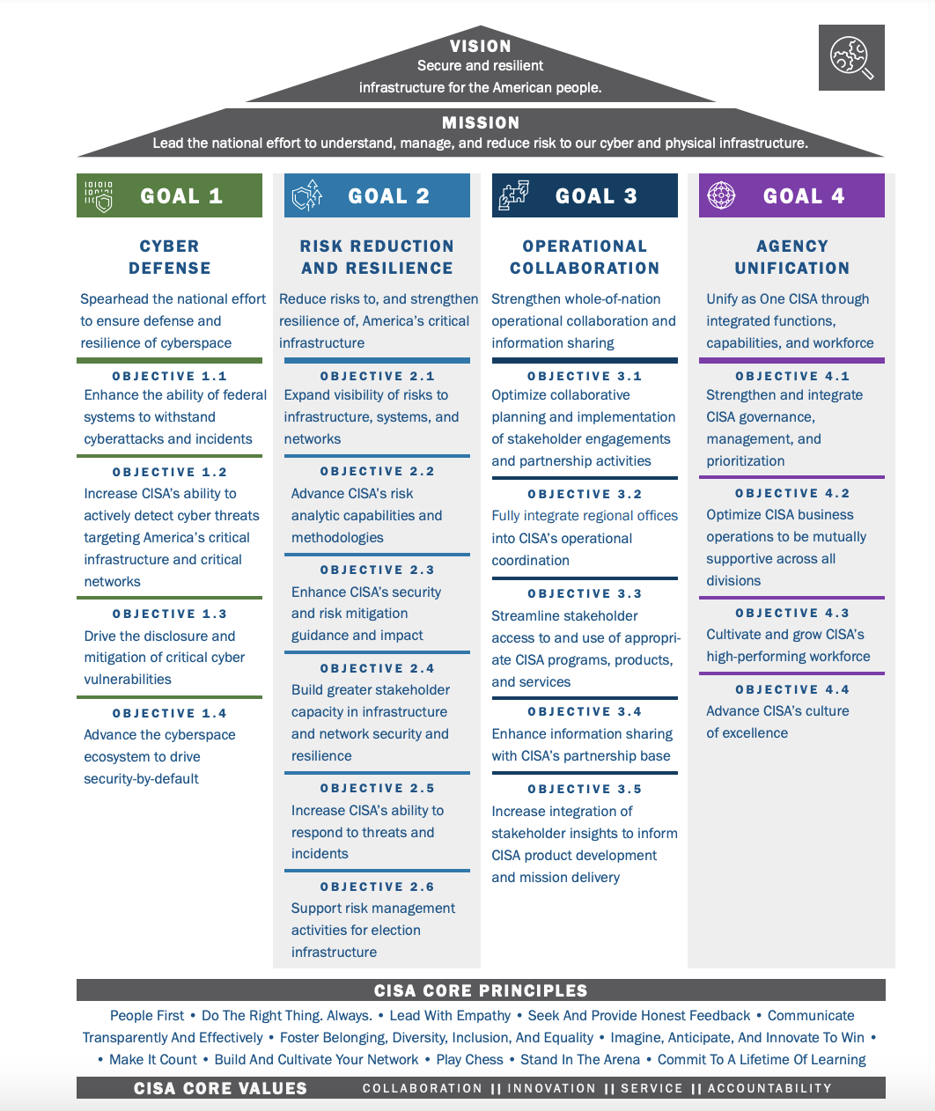
CROWDSTRIKE ALIGN’S WITH CISA’s VISION FOR:
Cyber Defense
Risk Reduction and Resilience
Operational Collaboration
Agency Unification

Slide 5





Established trust within
State | local | education
84%
56%
54%
US States
Top 50 Higher Education
Top 50 Counties
1.5K+ SLED Organizations count on CrowdStrike
DC
48%
Top 50 Cites
Standardized on CRWD
Falcon Complete Customer
Whole of State Customer
Notes:
© Copyright PresentationGo.com – The free PowerPoint template library
--NOTE didn’t put complete on MD (Maryland-National Capital Park and Planning Commission) or NY (NYPA is Complete). VA is booked to VITA
--August 2022 added Complete to NE, WY, MO. Removed Complete from OH & removed HI as customer
--November 22 added ID, TN, MT, did not add Complete to NY total now 40 states, Added IN & MD (+Complete) to the Standardized list & removed “Complete” as only a few sub agencies have it
--February 23 added KY; added Complete to NC ; 41 States
Colin C – 989 active customers
Tracey – 529 active customers
Date updated 11.2022

Slide 6

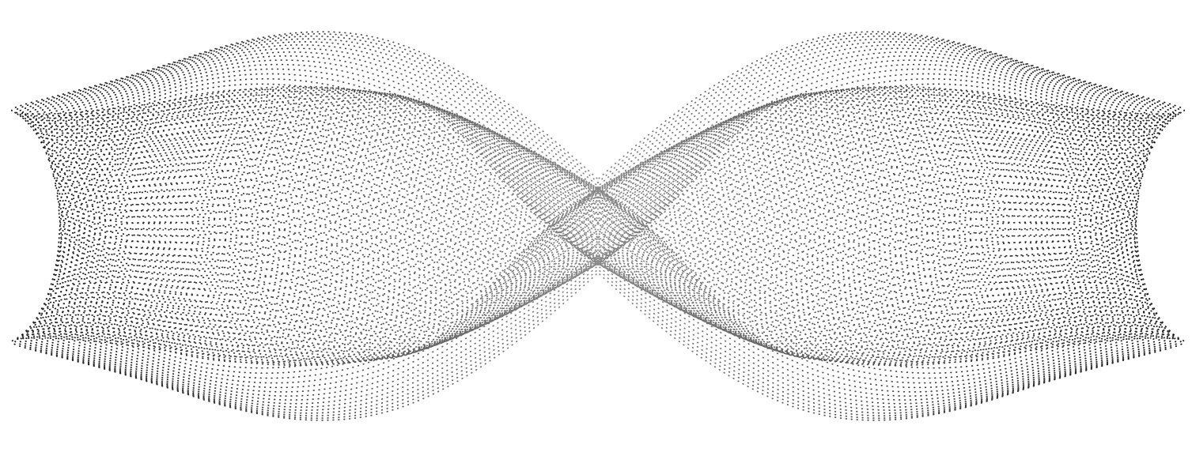



The Falcon Platform
Managed for You, By Us
Endpoint Security & XDR
Cloud Security
Threat Intelligence
Identity Protection
Security & IT Ops
Observability
Services
MDR
Threat Hunting
MDR
IR
Advisory
CrowdStrike Security Cloud
Falcon Fusion
XDR Data Normalization
Threat Graph
Intel Graph
Asset Graph
APIs
CrowdStrike Store
CrowdStrike Data Fabric
Lightweight Agent
Workstations
Servers
Virtual Machines
Containers
Cloud
Mobile
IOT
Notes:
The CrowdStrike Falcon Platform delivers a unique combination of technology, intelligence, and expertise that together form a comprehensive platform for true end-to-end security.
Falcon Complete adds to this, extending the value of the Falcon Platform. Leverage the same, industry-leading technology in a fully-managed offering with expert management, embedded threat hunting, monitoring, and end-to-end remediation. When Falcon Complete manages your Falcon instance, you can:
Address a wide gamut of security challenges.
Eliminate cost and complexity.
Deploy groundbreaking security technology hassle-free.
Gain proactive threat hunting to identify advanced threats.
Automatically perform surgical remediation (by Falcon Complete).
The power of the Falcon Platform along with the deep expertise of Falcon Complete: a powerful one-two combo that no other vendor can come close to rivaling.

Slide 7


Why Falcon Complete MDR
Industry-Leading Technology
Single agent, 100% cloud-native architecture
Power of the Security Cloud
Frictionless Protection
24/7/365 vigilance across MITRE ATT&CK lifecycle
Rapid onboarding and deployment, at any scale
Investigation of all alerts: high, med, low
Deep, Layered Expertise
Dedicated teams for threat hunting, threat intel, and MDR
Flat operating model with immediate deployment of experts and no inefficient SOC tiering structure.
We Own the Outcomes
Full, coordinated response execution.
Pioneer of the Breach Prevention Warranty
2022 CrowdStrike, Inc. All rights reserved.
Notes:
Falcon Complete delivers the most effective MDR service on the market.
It starts with best-in-class detection of threats. Falcon Complete is built on the industry-leading Falcon platform, proven to detect all types of threats across the entire MITRE ATT&CK lifecycle, from initial access to lateral movement, and beyond.
We augment that with Falcon OverWatch, our 24 x 7 team of elite human threat hunters. These experts are constantly hunting for hidden, sophisticated threats that are tailored to evade automated detection techniques. They find adversaries hiding in the woodwork, using techniques such as stolen credentials and living off the land with local admin tools to hide their activities.
This combination of human and machine-driven detection gives Falcon Complete the information they need to drive investigations and act.
Our team investigated and dispositions all alerts: high, medium, and low. Blocked and not-blocked. This ensure we can identify threats at the earliest possible moment, and minimize the potential for damage.

Slide 8
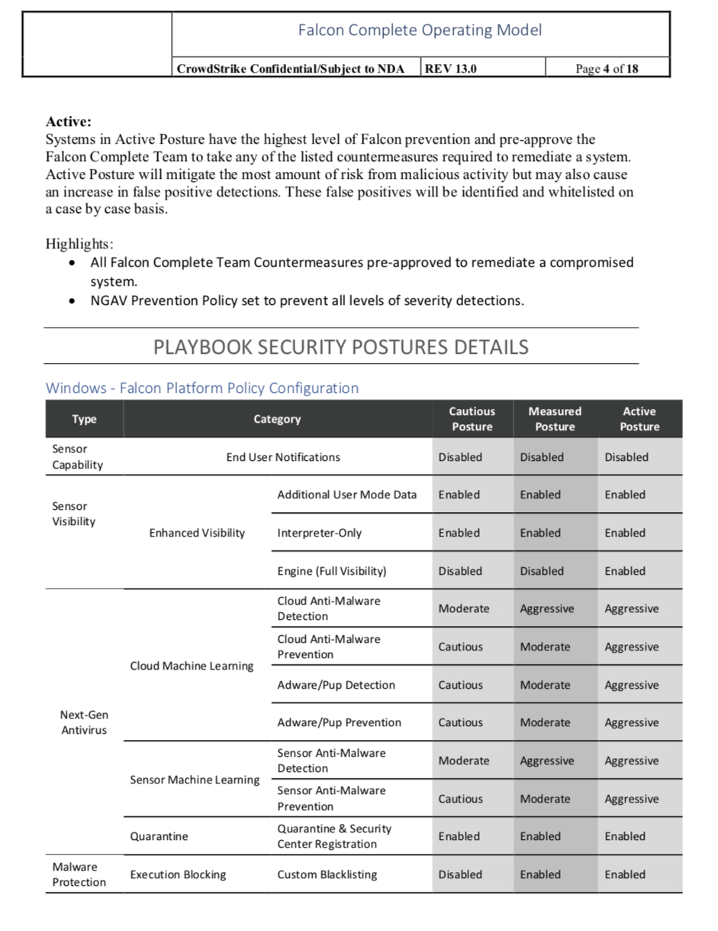
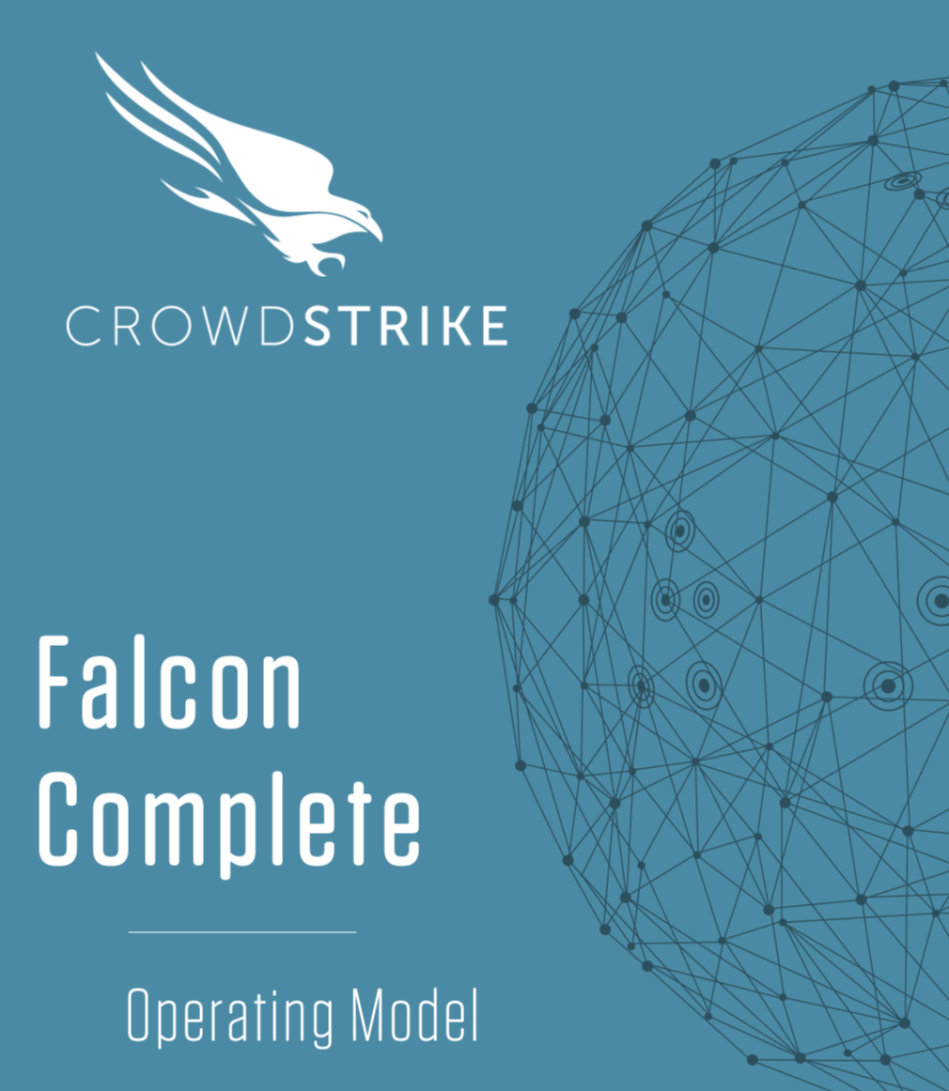
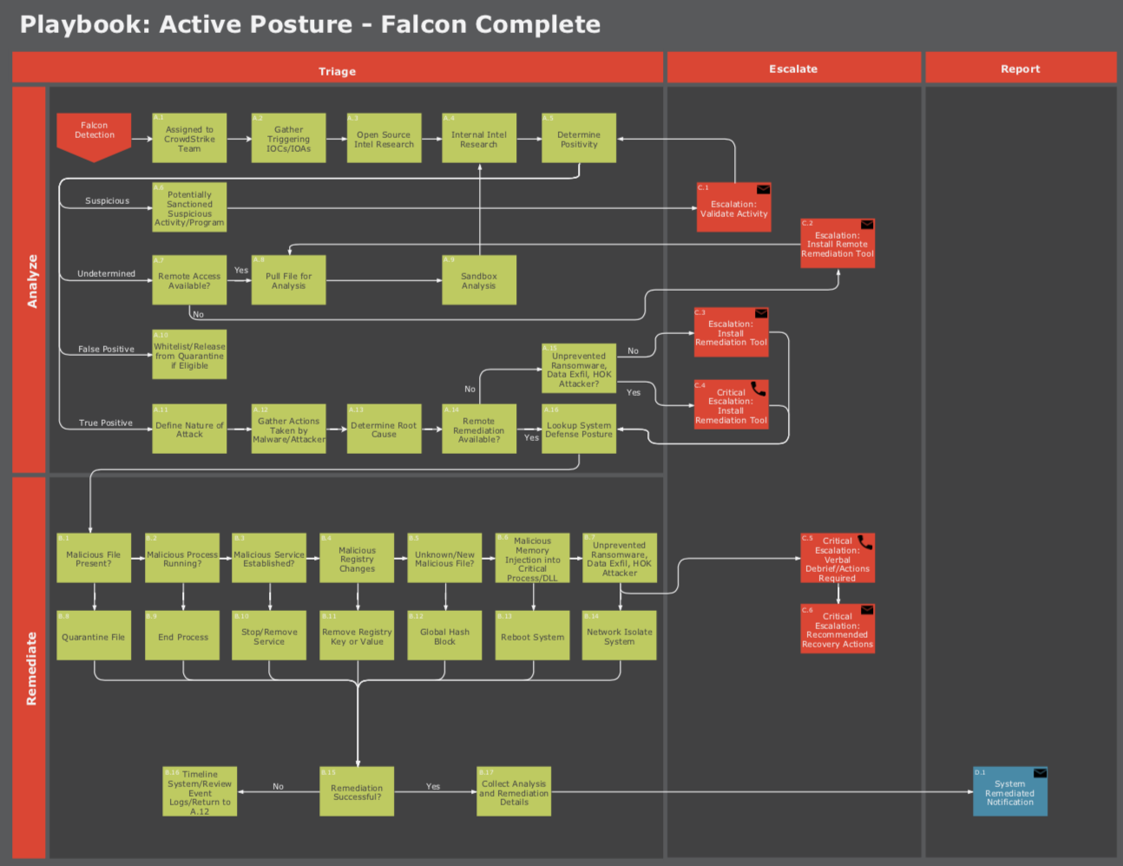
How We Do It
Operating Model
  Communications Plan
  Appendix B (Assets, Identities, Rules)
Security Postures
  Periodically updated as necessary
  Incident Handling Playbooks
  Sensor Update Policies
Notes:
The operating model is the document that governs the actions of our Falcon Complete Team. This is completed during our onboarding session and is where you apply your prevention policies and sensor update policy, to the asset zones you define. It’s important to note, this is an organic process that we continue to update and manage for you throughout the year.

Slide 9






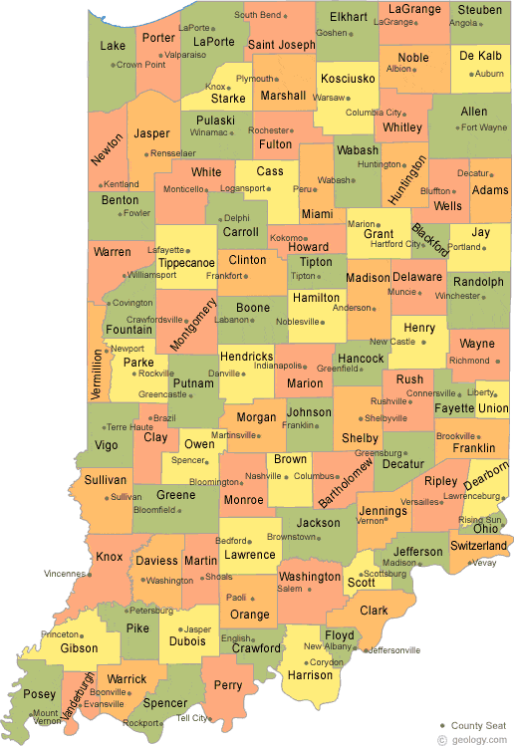
Whole of State Architecture
Whole of State Architecture
Centralized Management with Logical Grouping of Child CIDs
Aggregation from Child CIDs to Parent CID of:
  Detections
  Splunk Data
  Incidents (API only)
State Government Customers
Logical Segmentation
Analyst Host Access
Manage at Scale
Agencies
DOE
ISP
BMV
Indiana IoT
DOH
DOC
DOT
Propagation from Parent CID to Child CIDs of:
  Prevention Policy
  RTR Policy
  Host Update Policy
Child 1
Marion County
Lake County
https://www2.census.gov/govs/pubs/state_snapshot/gov07-ct.pdf
Notes:
Falcon Flight Control makes it easy for State Governments to organize and manage security at scale by allowing the environment to be logically segmented by Department, Agency, County, or Delivery Center
Ability to manage Falcon At Scale
Segmentation of which analysts can access which hosts, upholds privacy and autonomy
OA is given the capabilities to:
Have statewide visibility/read-only
Propagate baseline policies for Prevention, RTR, and Host updates
Flexibility to grant authority within multiple org structures
Falcon Complete
Flight Control Model – This will ensure that Local Entities within the state will have NGAV/EDR, Threat Hunting and 24/7 Monitoring/Remediation. A difficulty many cities and counties face is hiring, training and retaining security talent, on top of maintaining a 24/7 posture. Falcon Complete alleviates these issues by providing a force multiplier. We will oversee configuration of the technology, management, monitoring and remediation on a 24/7 basis.
Architecture - With the Flight Control Model, an agency within the State could adopt FC as a “master tenant” , then provide Falcon Complete to the top cities/counties. The master tenant would have overarching visibility to assist the Local entities, but each Local entity would still have their own FC CID(Op Model, App. B, etc.) With this model, the local entities have visibility into their own instance, their own runbooks and escalation pathways. Another key consideration for this will be structured onboarding for all of the Local entities included. Each FC CID will have an associated onboarding specialist that will transition to a Security Advisor. The States themselves would not be required to construct a detailed onboarding deployment strategy, we’ve already built that out in the Op Model!

Slide 10
SOc STATE
Falcon GOV1 Cloud
LEGEND
Visibility Instance
Parent Instance
Child Instance
SIEM/Log Collector
SIEM Connector
FDR Replication
Event Replication to Visibility Layer
Policy Inheritance
Event Flow
State SIEM
OR
SOC MASTER
Visibility Layer
STATE
CITY
CITY
CITY
COUNTIES
COUNTIES
Agencies
Central IT
Agencies/
Departments
Agencies/
Departments
Agencies/
Departments
Agencies/
Departments
Agencies/
Departments
Each Child CID can be connected to a different SSO (SAML 2 Compliant) provider.

Slide 11
SOC
PARENT CHILD DETAIL
SOC MASTER
Visibility Layer
LEGEND
Visibility Instance
Parent Instance
Child Instance
SIEM Connector
FDR Replication
Event Replication to Visibility Layer
Policy Inheritance
Event Flow
CID Group
CITY
Police Department
Fire Department
Department of Public Works, Parks & Streets
Office of Strategic Planning
Law Department
Division of Citizen Services
10 Additional Departments
Each Child CID can have CID Groups to segment environments as needed.
Each Child CID can be connected to a different SSO (SAML 2 Compliant) provider.

Slide 12
SOC
CHILD DETAIL
LEGEND
Child Instance
SIEM Connector
Event Replication to Visibility Layer
Policy Inheritance
Event Flow
CID Group
Police Department
From the Parent CID
View/Respond to detections in children
Manage policies for all children
Prevention
Real Time Response
Sensor Update
Manage users in children
Access child Splunk data
Manage API clients and keys
From the Child CID
View/Respond to detection - only this child
Manage local policies – only this child
Manage users – only this child
Each Child CID can have CID Groups to segment environments as needed.
Each Child CID can be connected to a different SSO (SAML 2 Compliant) provider.

Slide 13





Whole of State Examples
NEW JERSEY
FUNDING SOURCE – SLCGP
20k Complete, 35 CIDs, Operational Support
Rolling out statewide
Leveraging NJCCIC as SOC
Created a web-site to support on boarding
Counties, Towns, K-12s will contribute funding to stretch the SLCGP $$
LOUISIANA
FUNDING SOURCE – Mixed funding through state general budget and grants
200,000 endpoints across Agency, Local Gov, High Ed - 5 agencies – 154 CIDS
Incumbent – McAfee
Competitors - S1/MSFT
Partners – SHI
Keys to win – largest door opener was Intel and Flight Control architecture.,
MINNESOTA
FUNDING SOURCE -
75k EPP, 62 CIDs, state subsidizing deal for municipalities
Incumbent: Microsoft
Competitor: Microsoft
Partners: Insight
Upgrading to complete
Shared service model

Slide 14



Whole of State Examples
NEW YORK
FUNDING SOURCE – Self funded
150k Complete, 70CIDs, Operational Support
Rolled out to 62 Counties and 6 cities
Created a JSOC
Partnered with Deloitte for assistance with their program office for on boarding
State just extended funding
Does not include Towns & Villages or K-12 at this point
FLORIDA
FUNDING SOURCE – Self Funded
30k Complete & identity, 24k EPP/XDR
Incumbent: S1/MS
Competitor: various
Partners: KR2 Technology
keys to win – RFP response, GovCloud, CJIS, Complete, XDR, relationships,
ARIZONA
FUNDING SOURCE – originally funded with budget surplus – now some state and some federal funding.
100k EPP bundle, adding OW at renewal;, Operational Support –individual municipalities may upgrade on their own.
Incumbent: Microsoft
Competitor: Microsoft
Partners: SHI/AWS
3 years paid annually

Slide 15
Falcon Complete
Efficient Management
Fast start
Up and operational in days
Always up-to-date
No effort spent managing agents, signatures, policies
Always optimized
Always configured for best levels of performance and protection
Notes:
CrowdStrike’s Falcon Complete team takes care of all of the management overhead associated with mature endpoint security.
With our proven onboarding program, most customer can be up and fully operational in just a few days.
The team ensures your environment is always up to day, so you don’t need to spend any effort managing agents, signatures, or policies.
And they ensure that the environment is always optimized to combat the latest threats, so you get the best levels of performance and protection out of you Falcon investment.
You will see regular health check reports showing you what the team has done, and what updates they recommend, so you can have confidence that your endpoint protection is always under complete control.

Slide 16




Seamless Onboarding and Deployment
True Scalability: from SMB to Fortune 100
1
2
3
4
Contract executed
Onboarding
call
Sensors mapped and deployed
Protection fully operational
Protected in One Week
*Full onboarding time will vary based on customer agent deployment and input on Security Postures.
Notes:
Within a Week - Speed, time-to-value
MSSP players - 2-4 months to get service to the customer, as opposed to FC 1 week.
Explain the threat upfront - Customers - have the platform or have exp a breach, and tie it to the speed narrative here.
Replace Turn-key - operationalizing and optimizing. not white glove. What is FC vs what is not. Reframe the problem statement.
We have a well-defined process to onboard new customers of all sizes to Falcon Complete within a week.
We host our first call within 3 days of finalizing the order. We spend this time to cover our operating model, discuss and assign roles and responsibilities, and begin understanding your environment and inventorying assets.
After that call, we send over relevant instructional materials along with the Falcon sensor package. The new customer then reviews and fills out the documents and deploys the sensors. Once we have the environment documentation and the agents start checking in, we initiate the configuration and our 24x7 management, monitoring, and remediation begins!

Slide 17

Roles and responsibilities
STAGE | ITEM | CROWDSTRIKE | CUSTOMER
STAGE | ITEM | CROWDSTRIKE | CUSTOMER
ONBOARDING | Deliver the Operating Model Overview
 | Complete Appendix B
 | Create/configure asset groups
 | Configure prevention policies
 | Deployment of the Falcon sensors
 | Assign asset groups to prevention policies
 | Configure MFA connectors
 | Configure Identity rules
 | Baseline Identity tuning
REMEDIATION | Triage alerts to determine nature and severity of Falcon detections
 | Identify technical root cause, “source” of compromise
 | Define remediation strategy
 | According to security playbook, execute remediation strategy
 | Seek approval on counter measures for remote remediation are not pre-approved
 | Leverage call tree from Appendix B for critical escalations
 | Recommend recovery actions as needed per incident to address vulnerabilities in infrastructure not managed by CrowdStrike
MONITORING | Post deployment Falcon Platform management
 | 24x7x365 Monitoring Falcon Platform
 | Triage alerts and/or any OverWatch notifications
 | Verify/confirm whitelist requests, activity, and escalation that requires approval
REPORTING | Provide system remediated notifications after any remediation action taken
 | Provide monthly metrics report for Falcon Complete Team Performance
Notes:
Here you’ll see a deeper dive into the individual roles and responsibilities, as they break down between CrowdStrike and you the customer.

Slide 18
THANK YOU

Slide 19



Major Components of the CJIS Security Policy
Technology
Does our technology, including the cloud, meet the technical controls? (GovCloud is FedRAMP Moderate; soon FedRAMP High JAB)
People
Have our people been vetted, who may potentially access “CJI” (cloud admins) (Doing this process now for NY, CT and soon “ready” for all US states)
Agreement
Have we formally signed the CJIS Security Addendum with said state? (NY & CT, will onboard states based on demand)
Notes:
Effective risk management requires SecOps and IT teams to work together in concert. SecOps hunt, identify and respond to known and unknown vulnerabilities and threats, while the IT team is responsible for taking remedial steps by patching and configuring IT that were identified as vulnerable. Unfortunately, the two teams work in silos and are unable coordinate and collaborate in timely manner. Lack of asset knowledge, no business context, minimal attack surface visibility, inadequate prioritization of vulnerabilities, and without a robust response system leads to higher risk of breaches and MTTR. Falcon IT SecOps suite of modules can includes Falcon Spotlight, Discover, Surface, and Filevantage can simply be categorized in three pillars: Assess, Prioritize and Remediate.
Assess: Teams need to know what assets they have, internally and externally. Who owns them, where do they live and how exposed and vulnerable are they? Then identify blind spot that could lead to potential breaches.
Crowdstrike: Eliminate blind spots with full asset discover and visibility into the internal and external attack surface
Prioritize: Once a vulnerability or threat is identified, which ones do you prioritize? Which ones are the most relevant to your business? Teams are overburdened by tsunami of alerts, generated by plethora of siloed tools with high level of false positives, making it impossible to cancel the noise and prioritize on the ones that matter.
Crowdstrike: Make precise decisions with AI-powered risk prioritization based on adversary context, asset exposure, vulnerabilities, and file integrity
Remediate: This is the most important step, if done right and in time, can eliminate high risk vulnerabilities and stop costly breaches. But it requires SecOps and IT teams to work in concert, act on accurate intel, collaborate (without friction) using automated workflows and tools that enables them to respond faster.
Crowdstrike: Drive collaborative response across IT & security with integrated workflows, automation, and guided remediation

Slide 20
STATE STRATEGIC Objectives
STRATEGY/MISSION:
Collaborate with state agency partners to innovate and provide solutions that power the services all our citizens rely on every day; Keeping the state's IT assets secure and managing the tools state employees need to effectively do their jobs.
Strategic Objectives
Security Initiatives
Desired Outcomes
Metrics
Improve Protection
Reduce Time Investigating New Threats
Stable & Reliable Delivery of Critical Services
Secure the Attack Surface
Augment Skills + Expertise
Augment SOC Team & Avoid Cost to Staff Proactive Threat Hunters
Promote Long-Term Economic Sustainability
Increase Agency IT Accountability & Ownership
Security Efficiency & Efficacy
Reduce Efforts Alert Triage-Investigation
Enhance Risk Management
Reduce Risk of a Data Breach
Advance Technology: Innovating Today for Tomorrow
Transform Technology in the State
Reduce Complexity
Consolidate Solutions
©2023 CROWDSTRIKE, INC. ALL RIGHTS RESERVED.
Reduce Maintenance Effort + Cost
Notes:
Metrics (Benefit statements) are aligned to Complete: 25K EPs

Slide 21
FALCON COMPLETE – VALUE REALIZED
“OUR MISSION IS TO STOP BREACHES” (OPTION 2)
VALUE REALIZED
Oversees team of specialists optimizing the fireteam’s speed to detect/respond to threats
Fireteam Manager
24x7x365 SOC & threat hunting expertise
Comprehensive EDR management = 100% review of all alerts
Reduction in EP re-images and associated end-user downtime
Simplification/full support in security stack management/ongoing maintenance
Overall risk reduction/breach mitigation
Incident Response Analysts
(24/7/365)
Skilled Incident Responders with 3-10 years of experience performing analysis and responding to all detections (low, medium, high and critical
OverWatch Threat Hunters (24x7x365)
Threat Hunters identifying novel threats that technology/artificial intelligence alone cannot
Sr. Security Advisor
Responsible for continuously optimizing the technology to best practices / industry
1 FTE – Platform management
4.5 FTEs – Threat Hunting
4.5 FTEs – Incident Responders
>$1.3M Annual Labor Costs
©2023 CROWDSTRIKE, INC. ALL RIGHTS RESERVED.
Notes:
OPTION 2: No Premium Threat Intel included

Slide 22



















































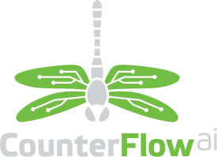













SECURITY OPERATIONS
CURRENT TECHNOLOGY PARTNERSHIP LANDSCAPE
CLOUD, NETWORK
& INFRASTRUCTURE
SIEM / UEBA
ENDPOINT & NETWORK SECURITY
SOAR
EMAIL & WEB SECURITY
CLOUD SECURITY
THREAT INTEL
ICS/IOT
Notes:
Updated Nov 05 2021

