Slide 1
Injury prevention advisory council (IPAC) & Indiana violent death reporting system (INVDRS) Meeting
02/17/2023

Slide 2
OUR MISSION:
To develop, implement and provide oversight of a statewide comprehensive trauma care system that:
Prevents injuries.
Saves lives.
Improves the care and outcomes of trauma patients
OUR VISION:
Prevent injuries in Indiana.

Slide 3
Round Robin and Introductions (in chat)
Name
Position
Organization/ Association
Updates
Current Projects and Programs
Upcoming events

Slide 4
Grant Updates
  Local Health Department Naloxone Grant
    Expecting to open the application in March.
    Contact Laura Hollowell: Lhollowell@health.in.gov

Slide 5
Upcoming Events
February
Teen Dating Violence Awareness Month
Senior Independence Month
Burn Awareness Week (Feb. 5-11)
March
Brain Injury Awareness Month
Ladder Safety Month
Poison Prevention Week (Mar. 19-25)
Drug and Alcohol Facts Week (Mar. 20-26)
April
Distracted Driving Awareness Month
Youth Sports Safety Month
Window Safety Week (Apr. 3-9)
Public Heath Week (Apr. 3-9)
Work Zone Awareness Week (Apr. 11-15)

Slide 6
intentional injury presentation: assault and intimate partner violence
Morgan Sprecher
Indiana Violent Death Reporting System Epidemiologist

Slide 7
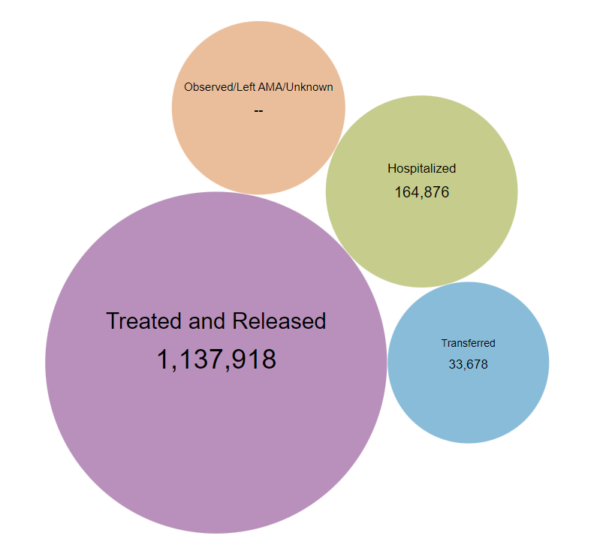
WISQARS - Assault Disposition, 2020

Slide 8
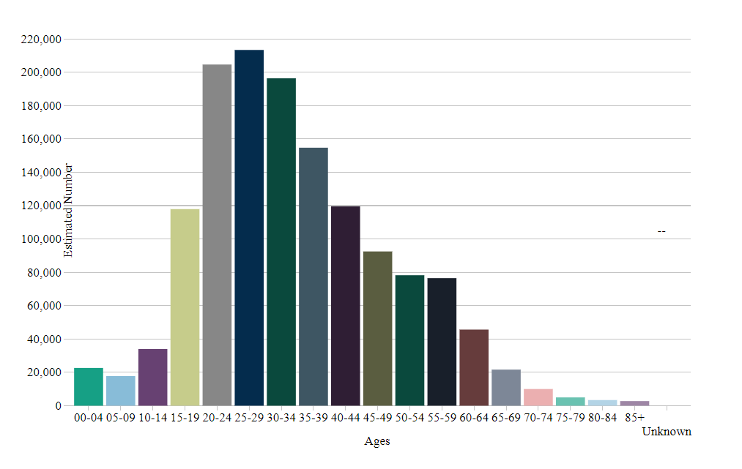
WISQARS - Assault by Age, 2020

Slide 9
ED Visits for Assault in Indiana
Age

Slide 10
Coroner and Law Enforcement Reports
Intimate Partner Problem Definition:
Problems with a current or former intimate partner appear to have contributed to the suicide or undetermined death. Code as “Yes” if at the time of the incident the victim was experiencing problems with a current or former intimate partner, such as a divorce, break-up, argument, jealousy, conflict, or discord, and this appears to have contributed to the death.
2016-2021 coroner cases: 801
2016-2021 law enforcement cases: 755
Intimate Partner Violence Definition:
This variable identifies cases in which the homicide or legal intervention is related to immediate or ongoing conflict or violence between current or former intimate partners. This includes all deaths where a victim is killed by their current or former intimate partner.
2016-2021 coroner cases: 162
2016-2021 law enforcement cases: 157

Slide 11
Intimate Partner Problem in Young Adults
Coroner Reports, 2016-2021
Law Enforcement Reports, 2016-2021

Slide 12
Intimate Partner Violence in Young Adults
Coroner Reports, 2016-2021
Law Enforcement Reports, 2016-2021

Slide 13
Rape Prevention and EDucation
Caitlin Segraves
Violence Prevention Program Director
2/17/2023

Slide 14
OUR MISSION:
To promote, protect, and improve the health and safety of all Hoosiers.
OUR VISION:
Every Hoosier reaches optimal health regardless of where they live, learn, work, or play.

Slide 15
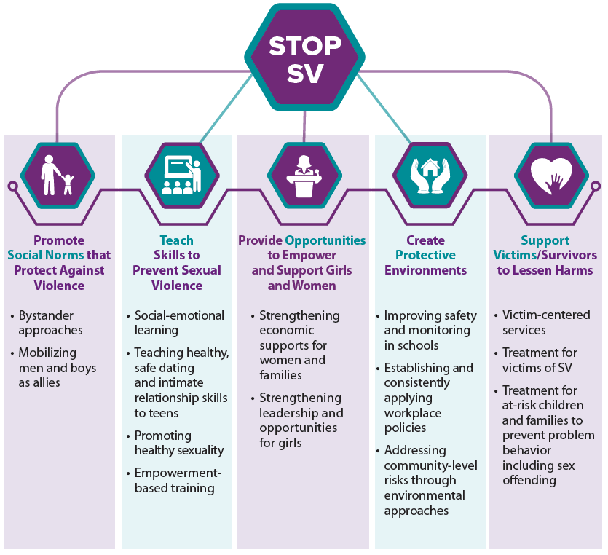
RPE Guidelines
Established by the passage of VAWA in 1994; reauthorized in 2022.
Primary Prevention
  Preventing first time occurrence of sexual violence.
  Reducing risk factors and improving protective factors for sexual violence perpetration and victimization.
  Addressing all four levels of the social-ecological model: individual, relationship, community, and societal.
STOP SV: A Technical Package to Prevent Sexual Violence
  Breaks down the rationale behind the strategy, provides possible approaches to take, offers potential outcomes, and shares the research behind the approach.

Slide 16
YWCA Greater Lafayette
Provide Opportunities to Empower and Support Women and Girls
    Empowerment Services Initiative
      STRIVE – teaches digital skills, soft interpersonal skills, case management, empowerment, interviewing, and employment search support.
      Dress for Success - offers interview and work wear for women seeking new employment as well as career coaches to help professional development and job seeking.
Create Protective Environments
  Racial and Social Justice Program – increase opportunities for employment, academic achievement, access to social services, and emotional connectedness
    Diversity Education Program
      Provides educational workshops for businesses, institutions, and organizations; participants are encouraged to set goals and implement a strategic plan for equity improvement.
      Engages with youth and adult community members to deliver their own racial justice programming; building relationships with other racial justice-focused local groups to encourage violence prevention in the community.
    Intercultural Development Inventory – customized profile for individuals or groups that shows how to engage cultural days in day-to-day interactions; informs what training(s) are needed; increased proficiency
    Hiring Report Card consultation - examines hiring practices of companies and scores them either A, B, C, D, and F.

Slide 17
Multicultural Efforts to End Sexual Assault (MESA)
Create Protective Environments
  MESA Director provides TA to preventionists that connects SVPP risk and protective factors with anti-oppression efforts such as worker rights, racial justice, immigration justice, gender justice, health equity and mental health.
    Works with marginalized community organizations and coalitions, service providers, rural communities, faith-based organizations, universities and colleges, prevention and crisis support agencies, and more.
  MESA Director provides TA for implementation of evidence-based and –informed, culturally affirming best practices for SVPP efforts among target communities.
  Works collaboratively with Indiana Migrant/Seasonal Farm Worker Coalition to develop seminars and resources for preventing SV in farm worker communities.
  Partners with Indiana Coalition Against Domestic Violence, Indiana Coalition to End Sexual Assault and Human Trafficking, Indiana Disability Justice, the Sexual Violence Primary Prevention Council and other state-wide organizations to offer expertise on SVPP implementation regarding low income and working-class people, communities of color, people with disabilities, immigrants and refugees, and migrant farm worker communities.

Slide 18
LifeSmart Youth
Teach Skills to Prevent Sexual Violence
  CARE (Communicating with and Respecting Each other) Curriculum – implemented in schools identified as high-risk; teaches students about healthy relationships, how to identify an unhealthy relationship among peers, and ways to inform a trusted adult.
  LifeSkills Training – Partners with Starfish Initiative and EmployIndy to teach youth about anger management and emotional regulation.
Create Protective Environments
  Educating trusted adults on best practices of trauma-informed care and how to respond to teen dating violence.
    Partners with IYI to implement in Youth Worker Café events; trains providers at Starfish Initiative
  Youth Advisory Council's awareness campaigns.
    Promoting access to resources and creating an environment that doesn't tolerate SV.
  TEACH Alliance Leadership Team - group of healthcare professionals, educators, and community leaders convene to work towards advancing health equity and access to care for minoritized youth.

Slide 19
Indiana University - Bloomington
Promote Social Norms That Protect Against SV; Teach Skills to Prevent SV; Engage Underserved Populations
  Healthy Relationships for Rural Youth Initiative
    Utilizes the Our Whole Lives curriculum's strengths in preventing sexual violence and promoting healthier communications and is continuously refining and updating their curriculum to ensure it is culturally appropriate
      Developmentally appropriate education on technology safety, boundary setting and boundary respect, and relationship coercion.
    Family members, parents/guardians, faith-based leaders and other youth-facing adults are also provided the information and resources being taught to the students to reinforce positive social norms that protect against sexual violence and to share information and resources related to everything the student is learning.
  Healthy Relationships for Rural Youth Initiative – Facilitator Training
    Youth-serving community leaders will be invited to participate in the HRRYI-FT so they are able to implement the HRRYI intervention and create protective environments within their organizations.
    Provide educational group facilitation skills and discussion of how those messages can be reinforced in the home.

Slide 20
Indiana Coalition Against Domestic Violence
Promote Social Norms That Protect Against Violence; Create Protective Environments
  Indiana Disability Justice
    Originally convened as a task force in 2018 led by a multisectoral group of people with disabilities; became a resource hub for sexual violence experienced by a Disabled person or a person with a disability, this has created an outlet for people with disabilities where they can share and be compensated for their work; also host webinars on related topics.
    Currently providing TA to multiple organizations throughout the state and nation to increase prevention strategies that center and include Disabled people.
Provide Opportunities to Empower and Support Girls and Women; Create Protective Environments
  Black Women's Council's Community Action Plan
    Informed by surveys of AABWG, focus groups, and Black Girls Matter listening session
    Partnering with state and national organizations to influence policy legislation and changing organizational practices to promote health equity for marginalized communities
    Plans to convene a statewide BIPOC affinity group promoting connectedness, supporting self-care, and identify gaps in service that will lead to better prevention strategies.

Slide 21
Questions?
Caitlin Segraves
Violence Prevention Program Director
CSegraves@health.in.gov

Slide 22
Discussion
What do we, in Indiana, do well when it comes to the topics from today?
How can / where can we improve this?

Slide 23
Discussion – Part II
Comments on the SharePoint Drive
Sign-ups for future presentations

Slide 24
2023 Meeting Dates
February 17
May 19
August 18
November 17

Slide 25
THANKS!
Presenter | Phone | Email
Morgan Sprecher | 317-234-9825 | msprecher@isdh.in.gov
Maria Cariaso | 317-234-4943 | mcariaso@health.in.gov
Caitlin Segraves | 317-914-8332 | csegraves@health.in.gov
Meredith Hawes |  | mhawes@nfpa.org

