Slide 1


Infant and Maternal
Health
Eden Bezy, MPH
Assistant Commissioner
Women, Children, and Family Health Commission
June 21, 2024

Slide 2

Learning Objectives
Provide a short overview of Indiana's birth outcomes
Share statewide policies supportive of improved birth outcomes
Share how state funding is supporting families in Indiana

Slide 3


Indiana's birth outcomes data
Reference.

Slide 4

Slide Title
Infant Mortality Rates (IMRs)
2013-Preliminary 2023
Bulleted text
Bulleted text
Bulleted text
Preliminary 2023 data as of 3/6/2024; subject to change
Reference.

Slide 5
Slide Title
Factors Contributing to Infant Mortality
Obesity
  Indiana ranks 12th highest in the U.S. for percentage of adults who have obesity (36.3% of adults)
  35.6% of Indiana births in 2022 were to pregnant women who have obesity (additional 26.1% overweight)
  Pregnant women who have obesity have an increased risk of preterm birth (13.0% of Indiana births to those who have obesity were preterm compared to 9.4% of births to those in the normal BMI range)
Smoking
  6.6% of births exposed to smoking during pregnancy
  12.2% of births to mothers on Medicaid were exposed to smoking during pregnancy while 2.6% of births to mothers not on Medicaid were exposed to smoking
Limited Prenatal Care
  29.1% of births were to women not receiving prenatal care during the 1st trimester (a statistically significant increase compared to 2021)
Unsafe Sleep Practices
  17.0% of infant deaths in 2022 can be attributed to SUIDs
Bulleted text
Bulleted text
Bulleted text

Slide 6
Slide Title
Maternal Mortality
In 2021, 80 women in Indiana died during pregnancy or within the first year after childbirth
Of those deaths, 77% were determined to have some chance or a good chance to have an altered outcome
Bulleted text
Bulleted text
Bulleted text
Notes:
Regardless of the pregnancy relatedness

Slide 7

Supportive MCH Policies
Notes:
INSERT PIC HERE

Slide 8
Slide Title
Perinatal Levels of Care
Bulleted text
Bulleted text
Bulleted text
In September 2019, 410 IAC 39, or Perinatal Hospital Services, went into effect
Requires all hospitals that offer obstetric and neonatal care to be certified as Level I, Level II, Level III or Level IV, based on the services they offer
Perinatal Centers: nine delivery hospitals who provide support and mentorship to other OB Departments across the state
Notes:
Indiana is unique in this! Levels of Care is a policy that ensures we have hospitals across the state ready to take care of those moms and babies
This is especially critical for women in high-risk pregnancies. A study by the American Academy of Pediatrics shows that states with levels of care certifications have lower numbers of infant and maternal deaths and illnesses.
The perinatal levels of care has created a culture and standard for all birthing facilities to collaborate by focusing on quality improvement, trainings, and maternal/ neonatal transport services
We are one of just a few states that have Levels of Care codified. Allowed us to build close relationships with our hospitals.

Slide 9
Slide Title
Perinatal Levels of Care
In 2023, the PLoC:
Assisted in improving care coordination by facilitating maternal and neonatal transport services to higher-level care facilities
More than 80% of our birthing facilities increased their communication and partnerships amongst birthing facilities to share hospital policies, protocols, and practice changes
Birthing hospitals are now actively collecting and analyzing data, which has helped drive quality improvement projects to enhance the overall standard of care.
100% of birthing facilities have conducted at least one multidisciplinary simulation training, with many noting at least two per year
Bulleted text
Bulleted text
Bulleted text

Slide 10
Slide Title
Fatality Review teams
Maternal Mortality Review Committee (MMRC) reviews the death of all Indiana residents who died while pregnant or within one year of pregnancy, irrespective of cause.
  Statewide team
Fetal Infant Morality Review (FIMR): Local teams are required to review deaths that occur during pregnancy and deaths that occur within 12 months following delivery
  In Indiana, there are 22 FIMR teams covering 69 counties
  Also includes bereavement services for women and families who experience pregnancy loss
  Community Action Teams (CATs) act as the prevention arm of the FIMR process
Bulleted text
Bulleted text
Bulleted text

Slide 11
Slide Title
Fatality Review teams
Child Fatality Review teams review sudden and unexpected deaths of infants and children under 18.
  CFR teams are local, with coverage in all 92 counties.
  Includes a state team
Suicide & Overdose Fatality Review (SOFR) teams review deaths by suicide and overdose ages 18 and above
  Currently 30 team covering 31 counties
HFI expectation that Local Health Departments participate on their local fatality review teams
  Provide critical information for prevention activities at the local level
  Local reviews mean local solutions
Bulleted text
Bulleted text
Bulleted text

Slide 12

Community & clinical investments in infant and maternal health
Notes:
IDOH supports programming across Indiana that promotes healthy families
Many come from investments the legislature has made over the past fiscal years

Slide 13

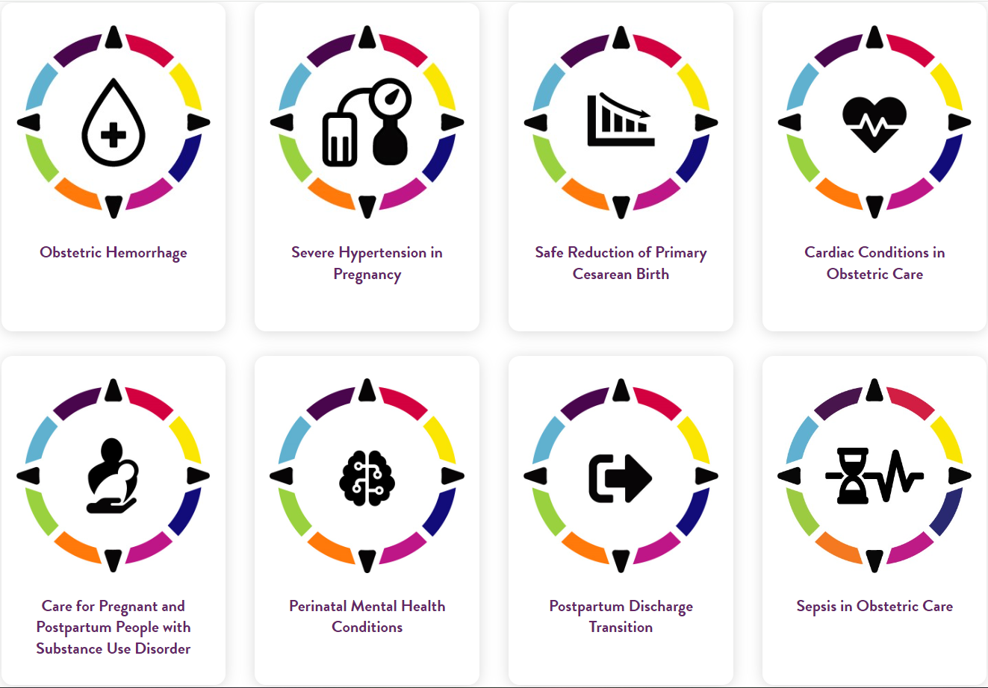
AIM: Alliance for Innovation on Maternal Health
The purpose: A HRSA and ACOG partnership with states to promote consistent and safe maternity care that reduces maternal morbidity and mortality by equipping, empowering, and emboldening every state’s maternal health leaders, providers, and systems.
  First bundle: Obstetric Hemorrhage
  Second bundle: Severe Hypertension in Pregnancy
  Third/Fourth: Piloting both Care for Pregnant and Postpartum Persons with Substance Use Disorder and Postpartum Discharge Transition
Working with all delivery facilities to improve patient safety care and reported data on pregnancy outcomes.

Slide 14
Slide Title
WIC (Women, Infants, and Children)
Bulleted text
Bulleted text
Bulleted text
The Indiana WIC program focuses on the assessment of nutrition risk for income-limited mothers, infants, and children. This assessment guides the program's provision of nutrition education, healthy supplemental food, and breastfeeding support.
Indiana WIC has clinics in all 92 Hoosier counties, improving food security, health outcomes, and breastfeeding support for mothers and their children up to age 5.
Indiana WIC served an average of 148,000 individuals per month across the state of Indiana
Indiana WIC's investment in local communities results not just in healthier families, but also stable, local jobs; investment in infrastructure; and a natural partner with the state's Health First Indiana initiative

Slide 15
Slide Title
My Healthy Baby
Bulleted text
Bulleted text
Bulleted text
My Healthy Baby (MHB) connects pregnant women to family support providers in their own communities
Through Indiana home visiting programs, family support providers offer personalized guidance and support to pregnant women during their pregnancy and after baby’s birth
Established by House Enrolled Act 1007, from a unanimous vote, MHB was signed into law by Gov. Eric Holcomb in 2019
MHB began implementation in 2020 and is active in all Indiana counties since 2023

Slide 16
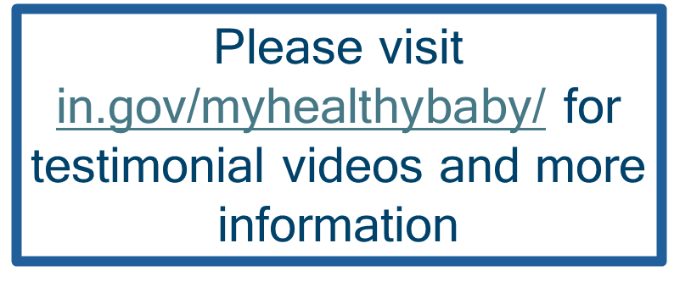
Slide Title
My Healthy Baby
Bulleted text
Bulleted text
Bulleted text
MHB has worked closely with home visiting programs in every county
MHB has provided specialized training, quality improvement workshops and Communities of Practice for Indiana home visiting agencies
To date, we’ve referred over 19,000 women to home visiting programs!

Slide 17
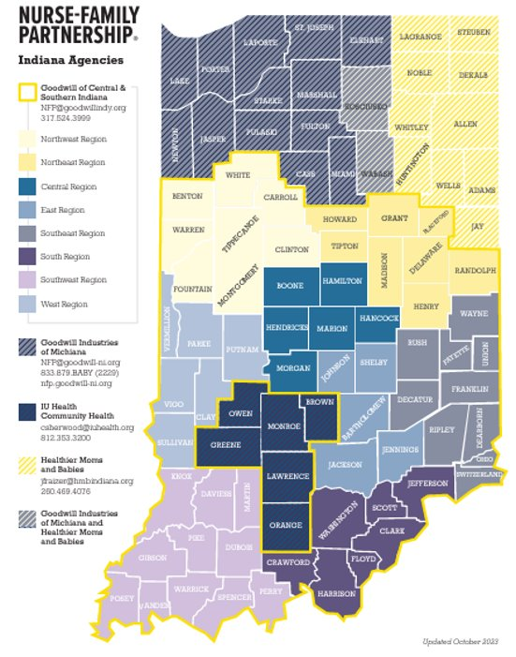
Slide Title
Nurse-Family Partnership
Nurse-Family Partnership (NFP) is a national, evidence-based, community health program with over 40 years of evidence showing significant improvements in the health and lives of first-time moms and their children.
Beginning in December 2022, additional state funding was allocated to expand NFP programming statewide
  NFP programming is available statewide in partnership with four local agencies
Enhancing the statewide system to improve programming:
  Increased quality assurance & improvement
  Expanded data capacity & statewide performance measures
  Developed opportunities for cross-agency collaboration & statewide training
Bulleted text
Bulleted text
Bulleted text

Slide 18
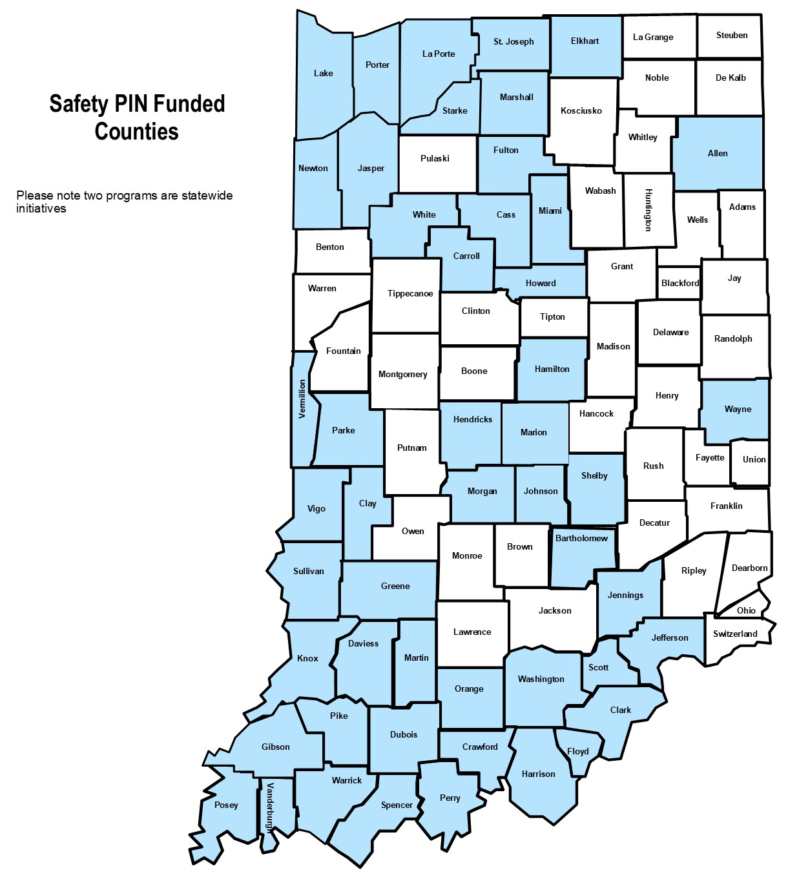
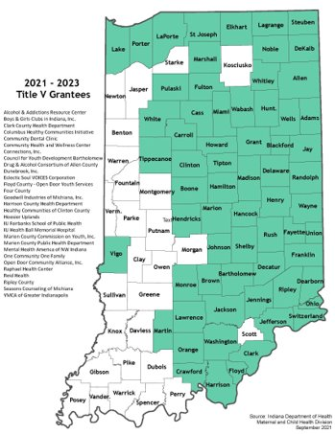
Slide Title
State and federally funded programs
Bulleted text
Bulleted text
Bulleted text
  Home visiting
  Doula services
  Mobile integrated health
  Care coordination
  Safe sleep promotion
  Fetal infant mortality review teams, education and outreach services.
  Housing navigation and case management for pregnant and postpartum women
  Improved access to contraceptive care
  And much more

Slide 19

Slide Title
Maternal and Child Health Initiatives
    Alliance Health: Federally qualified health center (FQHC) supporting high-risk pregnancies among non-English speakers – ensuring the best possible health outcomes.
    Community Health Clinic: Supporting genetic testing and counseling among Amish and Plain populations statewide to ensure optimal birth outcomes.
    Indiana Hospital Association: Distributing "The Cuff Kit" to pregnant women statewide to better monitor blood pressure during pregnancy to reduce the risk of preeclampsia.
    Wellness Council of Indiana and Indiana Breastfeeding Coalition: Working to implement the state breastfeeding plan and expand IBCLCs in the state.
Bulleted text
Bulleted text
Bulleted text

Slide 20

Slide Title
Looking ahead with Health First Indiana
    Supporting Local Health Departments to get connected to MCH resources that already exist in their communities
      WIC
      MCH Funded partners
      Nurse Family Partnership and other home visiting partners
    Support LDHs who are ready to get started on their own initiatives related to safe sleep, breastfeeding, healthy eating, and other strategies to improve infant and maternal health outcomes
    Improvements in the health and well-being of ALL Hoosiers will improve outcomes for mothers and babies
Bulleted text
Bulleted text
Bulleted text

Slide 21
Thank you!
Eden Bezy, MPH
Assistant Commissioner
Women, Children, and Family Health Commission
ebezy@health.in.gov

Slide 22
Health Across the Ages
Age Forward Together, Indiana PathWays for Aging, and the CHOICE Program
Daniel Rusyniak, M.D.
Secretary, Indiana Family and Social Services Administration
June 21, 2024

Slide 23
Growth Mindset
Currently, there are 1.1 million Hoosiers over the age of 65​.
From 2010 to 2030 the percentage of Hoosiers over age 65 will grow from 13% to 20%.​
By 2035 there will be more people 65 and older than 18 and younger​.
​As the population ages, healthcare expenditures are projected to increase by 30%​.
The retirement of baby boomers is impacting the workforce​.
There is a growing demand for housing, transportation, meal programs, and home and community-based services.
Notes:
These trends highlight the need for strategic planning in healthcare, housing, and social services to address the needs of Indians growing senior population

Slide 24

Multi-Sector Plan On Aging
Notes:
State-led, multi-year planning process that convenes cross-sector stakeholders​
Indiana was past of one of the first cohorts of states to begin developing this strategic plan​
A collaborative effort to address the needs of an aging population, including older adults and people with disabilities, as the aging population increases significantly by 2030- how do we plan today for this, embrace this change and the opportunities that can come with it​
Guides the restructuring of state and local policy and programs​
Creates systems-based solutions in healthcare, human services, housing, transportation, consumer affairs, employment and income security across the life continuum​
This is a movement that is growing across the country- and last week, the U.S. Department of Health and Human Services, through its Administration for Community Living, released “Aging in the United States: A Strategic Framework for a National Plan on Aging.”: Per the ACL announcement, “The report lays the groundwork for a coordinated effort – across the private and public sectors and in partnership with older adults, family caregivers, the aging services network, and other stakeholders – to create a national set of recommendations for advancing healthy aging and age-friendly communities that value and truly include older adults. The national plan on aging will advance best practices for service delivery, support development and strengthening of partnerships within and across sectors, identify solutions for removing barriers to health and independence for older adults, and more.”​
​

Slide 25




Age Forward Together is Indiana’s multisector plan on aging. It is a vehicle for bringing public and private stakeholders together to build a more vibrant and inclusive future for all Hoosiers as they age.
Age-friendly Economies
Build and sustain age-friendly state and local economies so that all ages and abilities can thrive where they choose
Reframe aging
Create stronger and more lasting bonds across all generations of Hoosier families and communities by reframing how we value aging as a state
Reduce barriers
Reduce barriers to access for care, services, housing, and other supports at all points across the lifespan
Each journey supported
Build roadmaps for increased employment, volunteerism, and engagement for Hoosiers across the lifespan so enduring paths are built with each journey supported
Notes:
State-led, multi-year planning process that convenes cross-sector stakeholders
Indiana was past of one of the first cohorts of states to begin developing this strategic plan
A collaborative effort to address the needs of an aging population, including older adults and people with disabilities, as the aging population increases significantly by 2030- how do we plan today for this, embrace this change and the opportunities that can come with it
Guides the restructuring of state and local policy and programs
Creates systems-based solutions in healthcare, human services, housing, transportation, consumer affairs, employment and income security across the life continuum
This is a movement that is growing across the country- and last week, the U.S. Department of Health and Human Services, through its Administration for Community Living, released “Aging in the United States: A Strategic Framework for a National Plan on Aging.”: Per the ACL announcement, “The report lays the groundwork for a coordinated effort – across the private and public sectors and in partnership with older adults, family caregivers, the aging services network, and other stakeholders – to create a national set of recommendations for advancing healthy aging and age-friendly communities that value and truly include older adults. The national plan on aging will advance best practices for service delivery, support development and strengthening of partnerships within and across sectors, identify solutions for removing barriers to health and independence for older adults, and more.”

Slide 26

Age Forward Together is a statewide partnership.
Including:
Indiana state government agencies
AARP Indiana
Local government
Higher education
Industry Associations
Health and Social Services Providers
Community Based Organizations
Private and Philanthropic Entities
And growing…
Notes:
Through our recent Kick-off event, have already started engaging with organizations and representatives across sectors, including:​
Indiana state government agencies (FSSA, Arts Commission, Department of Health, Housing and Community Development Authority, Economic Development Corporation, Department of Workforce Development, Indiana Office of Court Services Adult Guardianship)​
AARP Indiana​
Local government (Indianapolis City-County Council & other local municipalities across the state)​
Higher Education (Indiana University, University of Indianapolis)​
Industry Associations (Indiana Association of Area Agencies on Aging, Alzheimers Association, Indiana Farm Bureau, Indiana Chamber of Commerce)​
Health and Social Services Providers (Ascension St Vincent, Gentiva Hospice, Joy’s House)​
Community Based Organizations (Area Agencies on Aging, NeighborLink Indianapolis, United Way of St. Joseph County)​
Private/Philanthropic Entities (Grantmakers in Aging)

Slide 27
Timeline
August
3rd Round of Workgroup Meetings
Begin 1st MPA draft
September
Finalize 1st Draft
Feedback process
Incorporate draft feedback
October
Stakeholder Feedback
Finalize MPA
May
Kick-Off
Workgroup prep
July
2nd Round of Workgroup Meetings
June
1st Round of Workgroup Meetings
Notes:
54 attendees at the May 15 kick-off event representing a diverse cross-section of people and organizations with expertise and passion for this work. Ambitious timeline to keep momentum on this strategic plan

Slide 28


Indiana PathWays for Aging Overview

Slide 29
Long-Term Services and Supports (LTSS) Reform
Long-Term Services and Supports (LTSS) program reforms align with our values of Participant Choice, Quality, and Sustainability.
Objective: 75% of new members >60 live and receive services in a home and community setting
Access to faster HCBS services
Better coordination through managed care
Moving from transactions to outcomes
Integrated LTSS data systems
Recruit, retain, and train the direct service workforce
Notes:
The Indiana PathWays for Aging program is a statewide managed care initiative that offers Medicaid services for eligible individuals aged 60 years and older. The objectives of the program are to support eligible Hoosiers in navigating the various options and care transitions associated with long-term care services and supports​
​
This program intends to address the current opportunities to improve the care coordination between Medicaid and Medicare, provide additional caregiver support, offer enhanced benefits and increased access to services at home or within the community, and improve the overall quality of care. ​
​
There are 3 over arching program goals - ​
1) Person-Centered Services and Supports - Develop service plans and deliver services in a manner that is person-centered, member-driven, holistic, involves caregivers, and addresses social determinants of health (SDOH). ​
2) Ensuring Smooth Transitions - Ensure continuity of care and seamless experiences for members as they transition into the Indiana PathWays for Aging program and ongoing as transitions occur between providers, settings, or coverage types. ​
3) Access to Services (Member Choice) - Assure timely access to appropriate services and supports to enable members to live in their setting of choice and promote their well-being and quality of life. ​
​
​
The FSSA, through a procurement process, has contracted with three Managed Care Organizations (MCOs) to implement this program. Individuals can choose one of these healthplans to provider their Medicaid benefits: ​
Anthem Blue Cross and Blue Shield​
Humana Healthy Horizons​
United Healthcare Community Plan​
​

Slide 30
Managed Long-Term Services and Supports
MLTSS is a delivery system that uses managed care entities (MCEs) to coordinate medical care and long-term services and supports (LTSS) to enrolled Medicaid beneficiaries
Indiana has introduced an MLTSS program for Medicaid-eligible Hoosiers 60+ called Indiana PathWays for Aging
Enrollment in PathWays is underway and members have the ability to change their plans
MCEs participating in PathWays will deliver acute and preventive care services as well as Home and Community-Based Services (HCBS) and Nursing Facility (NF) services

Slide 31
What are the benefits covered by PathWays?
All Members
Hospital care
Labs/tests
Surgical care
Preventive care
Primary care visits
Prescriptions
Behavioral health and addiction treatment
DME
Home health
Hospice
Dental
Vision
Hearing aids
NEMT
Dual Eligible Members*
*Medicare pays primary if also a covered Medicaid service. Medicaid pays Medicare Part B premiums and/or cost-sharing.
Part A: Hospital care, short term SNF, hospice, labs, surgery, short term home health
Part B: Physician/provider visits, medical, preventive care, DME, behavioral health, limited outpatient prescription drugs
Part D: Prescription drugs
Part C (Medicare Advantage plan/D-SNP): If member is enrolled in a Medicare Advantage plan or D-SNP, Part A/B and usually Part D benefits and services are covered by the plan. These plans also provide supplemental benefits like OTC drugs, fitness/wellness programs, vision, dental, home-delivered meals and/or other service
Notes:
PathWays provides the standard Medicaid benefits including:
Coverage for medical expenses such as doctor visits, hospital care, therapies, medications, prescriptions, and medical equipment
Preventive care, such as regular check-ups, and mental health and substance abuse treatment
Care coordination services are available to every PathWays member. Members who meet the functional eligibility requirements have access to service coordination and MCEs offer different enhanced benefits.
Part D pays for prescription drugs. Members eligible for Medicare are required to have Part D coverage. If a member opts-out of Part D coverage, Medicaid does not pay for the member’s prescription drugs.

Slide 32












Current State vs. July 1, 2024, State
Indiana Current State
Indiana PathWays for Aging
Enhanced Home & Community Based Service Offerings​
Fee-For-Service Medicaid
Medicare Integration
Strong State Oversight
Comprehensive Care Coordination​ - Including with Aligned Medicare
Provider Protections​
MLTS
Incorporation of Member & Caregiver Voice​
Comprehensive Provider Network​
Medicare
High-Quality, Indiana-Based Health Plan Administration​
Indiana Family and Social Services Administration

Slide 33
Who is Eligible?
Indiana residents who are Medicaid enrollees that meet the following requirements: ​
60 years of age and older​
Eligible for Medicaid based on age, blindness or disability​
It may also include individuals:​
Eligible for full Medicare benefits (dually eligible)​
Residing in a nursing facility​
Individuals receiving home and community-based services (A&D Waiver)​
Who is not eligible:​
Anyone aged 59 and under​
Partial Medicare benefit dually-eligible​
DDRS waiver recipients (including TBI waiver)​
I/DD residents in an ICF​
PACE recipients​
RCAP, ESRD Waiver, MA-12, ESO Family planning only, MAGI, TBI out of state.

Slide 34

How will PathWays support Members?
Enrollment Broker: To help members choose and change a managed care entity, just call 877-284-9294
Care Coordinator: To support member health care needs
Service Coordinator: To support member waiver needs
Assistance with navigating both Medicaid and Medicare benefits
Member Support Services Vendor*: Helps members or caregivers resolve issues they may experience while enrolled in PathWays
* This is in addition to the Long-Term Care Ombudsman
Notes:
MLTSS will provide members with a lot of additional support to help navigate the complex healthcare system. The new system will provide for seamless coordination of benefits regardless of program or setting and is designed to help to reduce the confusion created by having multiple systems.
Each member will have access to a care coordinator who will help to support their health care needs. The care coordinators will also ensure that all Hoosiers have access to quality care and can achieve similar health outcomes regardless of race, entity, or geography.
The Service Coordinator will support your LTSS or waiver needs.
And there will be additional support for those who are in both Medicaid and Medicare to help coordinate both of the programs.

Slide 35
CHOICE Program Overview

Slide 36
CHOICE Program
State-funded home and community-based services for older adults and individuals with disabilities, including, for example:
  Attendant Care
  Care Management
  Home Delivered Meals
Does not require Medicaid financial eligibility or Medicaid waiver functional eligibility to access services
Participants may have an income and/or asset-based cost share
Homemaker/Chore
Home Modifications
Transportation

Slide 37
Long-Term Services and Supports
A variety of resources exist to provide supports to enable individuals to remain at home and in the community.
Contact the local Area Agency on Aging for resources, information, and access to programs, such as CHOICE, to support home and community living.
What is an Area Agency on Aging (AAA)?
  Public or private non-profit agency designated by the state to address the needs and concerns of older persons in a specific geographic area.
  AAA is a generic term and actual names vary.
  AAAs coordinate and offer services that help older adults remain in their homes, if that is their preference.
In Indiana, the network of Area Agencies on Aging is called the INconnect Alliance.

Slide 38
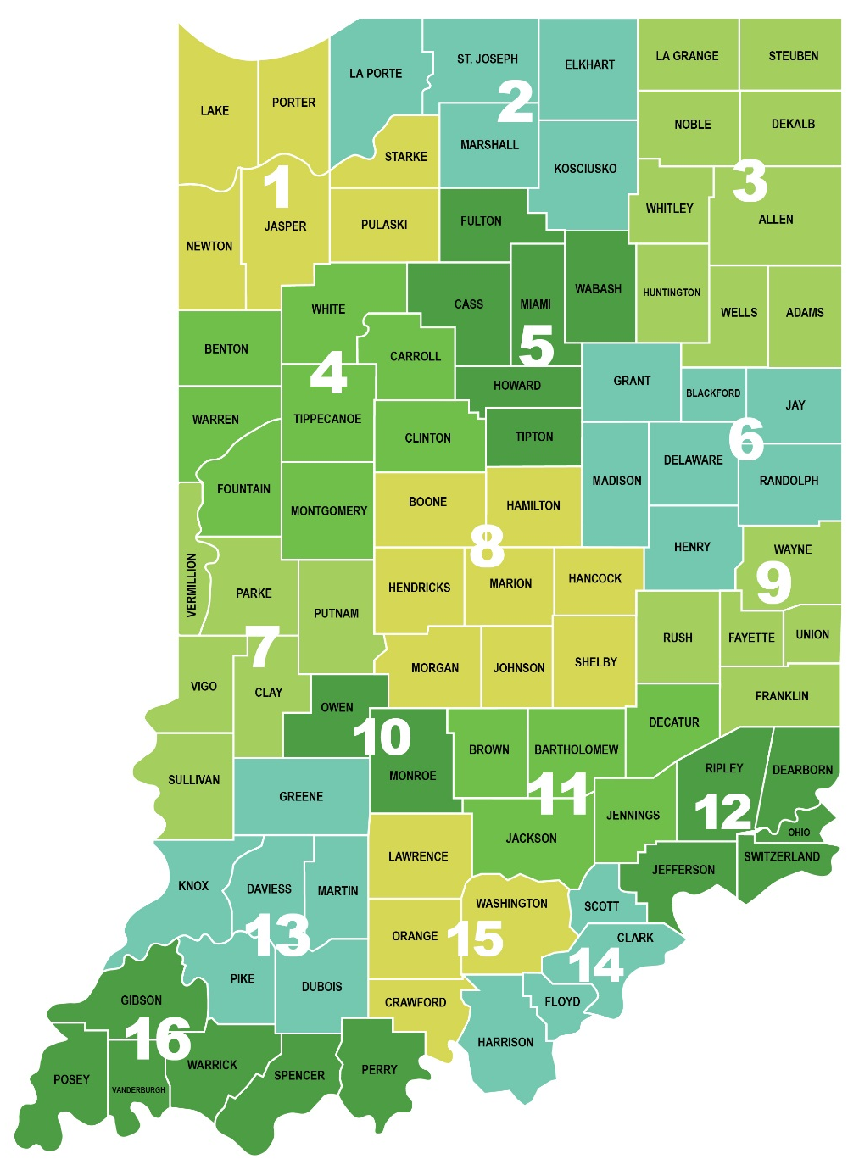

www.INconnectAlliance.org
1-800-713-9023

