Slide 1

Traumatic Brain Injury as a Risk Factor for Opioid Misuse and Overdose
Lance E. Trexler, PhD, FACRM
Rehabilitation Hospital of Indiana
Indiana University School of Medicine

Slide 2
Pain and Substance Abuse Treatment in TBI
Providers often don’t know that the patient has TBI and related impairments.
Patients with brain injury take 2-3 times more treatment.
Patients and providers don’t know why they are failing treatment.
Providers don’t know what TBI resources might be available or how to accommodate for the effects of the TBI.

Slide 3
Clinical History: Summary
Pre-TBI Substance Abuse
  May be proceeded by childhood TBI
TBI
  Pain associated with TBI
Opioids Initiated
  DC from acute care on opioid without a discontinuance plan
Opioid Use Disorder and Overdose

Slide 4
Substance Abuse as a Risk Factor for TBI
35-50% of TBI’s were found to be use related.
71% of TBI secondary to assault were use related.
Alcohol use was 83% and more than half used marijuana.
Those with TBI consumed significantly more than national averages pre-injury, but after injury, use was consistent with national averages after one year but increased again by two years post-injury.
Approximately 20% who either abstained or were “light” drinkers pre-TBI showed high use post-injury.
Corrigan JD, Rust E & Lamb-Hart GL (1995). The nature and extent of substance abuse problems in persons with traumatic brain injury. Journal of Head Trauma Rehabilitation, 10(3), 29-46.
Parry-Jones B, Vaughn FL & Cox M (2006). Traumatic brain injury and substance misuse: A systematic review of prevalence and outcome research (1994-2004). Neuropsychological Rehabilitation, 16(5), 537-560.
Ponsford, J, Whelan-Goodinson R & Bahar-Fuchs, A (2009). Alcohol and drug use following traumatic brain injury: A prospective study, Brain Injury, 21(13-14), 1385-1392.

Slide 5
TBI and Types of Pain
Of TBI patients admitted to an acute rehabilitation unit:
  40-50% reported headache at 3, 6 and 12 months post-injury.
  12% developed complex regional pain syndrome.
  11% developed painful heterotopic ossification.
  10% were found to have peripheral neuropathic pain.
  51.5% .of people with TBI will have chronic pain.
Hoffman, J.M, Lucas,S., Dikmen, S., Braden, C.A., Brown, A.W., Brunner, R.,...Bell, K.R. Natural history off headache following traumatic brain injury. J Neurotrauma 2011; 28(9): 1719-1725.
Nampiaparampil, DE. Prevalence of chronic pain after traumatic brain injury: A systematic review. JAMA 2008; 300(6): 711-719.

Slide 6
Narcotics Prescription During Inpatient
TBI Rehabilitation – TBIMS Data
# received in sample 2103;
% received among the other agents
Oxycodone (864; 37%)
acetaminophen (APAP) + hydrocodone (688; 30%)
morphine (205; 9%)
fentanyl (145; 6%)
tramadol (142; 6%)
hydromorphone (85; 4%)
propoxyphene N + APAP (84; 4%)
codeine (48; 2%)
methadone (44; 2%)
APAP + codeine (14; <1%)
meperidine (4; <1%)
buprenorphine (4; <1%)
propoxyphene N (4; <1%)
10 sites; n = 2,103
72% sample received narcotics: Highest frequency of meds studied
55%1st 2 days:
45% Last 2 days:
% in sample received:
    26% scheduled
    63% PRN
Hammond FM, Barrett RS, Shea T, Seel RT, McAlister TW, Kaelin D, Horn SD. Psychotropic medication use during inpatient rehabilitation for traumatic brain injury. Arch Phys Med Rehabil 2015; 96(8): S256-73.
Notes:
6
7/22/2019
Interagency TBI-PBE prelim findings_6-14-2011

Slide 7
Deaths Due to Accidental Poisonings following TBI
ACCIDENTAL POISONING BY: | n
Unspecified drug | 14
*Opiates and related narcotics | 13
*Analgesics antipyretics and antirheumatics | 11
*Methadone | 6
Psychostimulants | 7
Alcohol + | 6
*Other specified analgesics and antipyretics | 2
Local anesthetics | 2
*Aromatic analgesics, not elsewhere classified | 1
Other specified sedatives and hypnotics | 1
Agents affecting blood constituents | 1
Agents acting on muscles & respiratory system | 1
Other specified drugs | 1
Other specified gases and vapors | 1
n = 14,398
1,519 died (11%)
4.4% (67) AP deaths
AP death 11x more likely than general population
Hammond FM, Ketchum JM, Dams-O'Connor K, Corrigan JD, Miller AC, Haarbauer-Krupa J, Faul M, Trexler L, Harrison-Felix C. Mortality secondary to unintentional poisoning after inpatient rehabilitation for traumatic brain injury. In preparation.

Slide 8
Clinical History: Summary
Pre-TBI Substance Abuse
  May be proceeded by childhood TBI
TBI
  Pain associated with TBI
Opioids Initiated
  DC from acute care on opioid without a discontinuance plan
Opioid Use Disorder and Overdose

Slide 9
Neuropsychology of Opioid Misuse following TBI
Orbitofrontal: Impulsivity, Reduced Judgement
Frontal and Temporal Effects
Dorsolateral Frontal: Impaired Initiation & Ability to Generate Problem-solving Strategies
Opioid Misuse and Overdose
Orbitofrontal: Impulsivity, Reduced Judgement
TBI
Amygdala:
Irritability & Anger
Resulting Mood Disorders
Anxiety, PTSD
& Depression

Slide 10
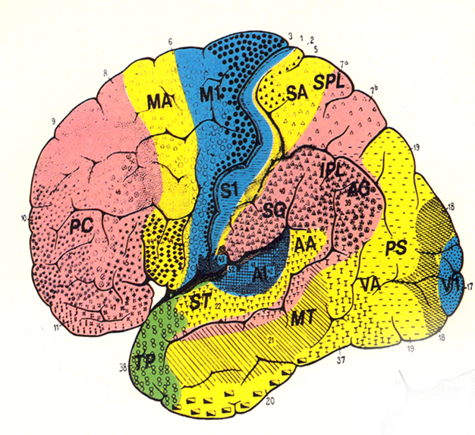
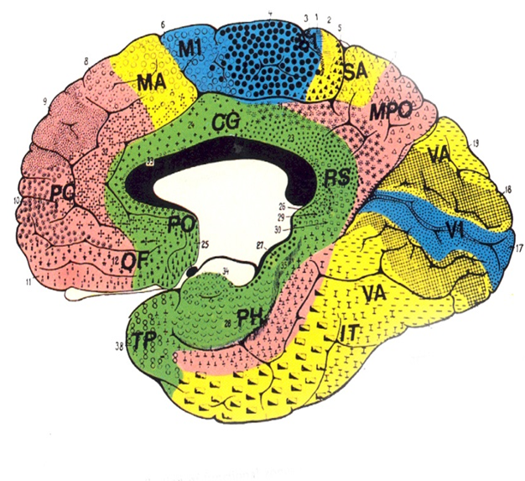
Prefrontal Executive Functions
Area: FUNCTION | IMPAIRMENT
Dorsomedial: Initiation & sustaining a response or cognitive persistence | Difficulty developing goals, impersistence, “poor motivation”
Dorso- and Ventrolateral: Organization-planning, strategy selection, sequencing, monitoring, modification of strategy | Difficulty generating problem solving strategies (left) and poor self-monitoring (right), apathy & flat affect
Ventral-medial: Regulation of cognition and affect | Regulation of social and emotional behaviors interfere with performance, impulsivity and disinhibition, mood swings
Frontopolar: Integrates executive cognitive functions with social-emotional adaptability | Difficulty carrying out goals, pre-occupation with one’s self and loss of empathy, disintegration of cognitive and emotional responses

Slide 11
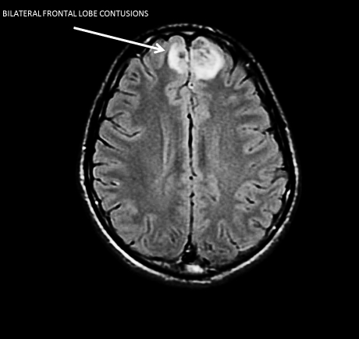

Slide 12
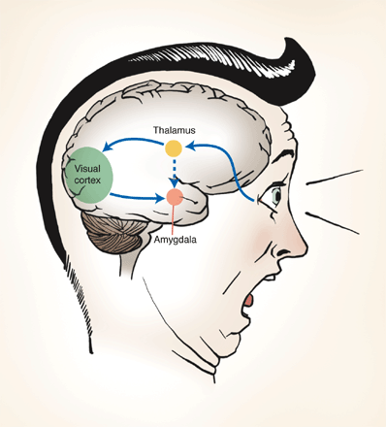
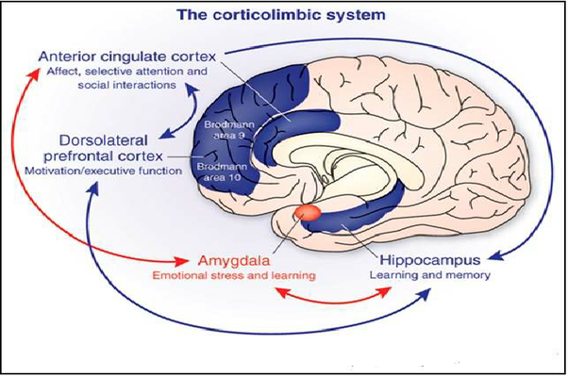
The Amygdala and the Corticolimbic System

Slide 13
Depression and TBI
42-77% of TBI
patients become
depressed
Alexander, 1992; Kreutzer, Seel & Gourley, 2001; Varney, Martzke & Roberts, 1987.

Slide 14
Associated with Prominent Major
Depressive Disorder is Anxiety Symptoms
Among TBI subjects with MDD, 77% met DSM-IV criteria for anxiety disorder.
MDD is significantly associated with aggression in TBI (34% of TBI subjects within first 6 months of injury).
Robinson RG & Jorge RE. Mood Disorders. In: Textbook of Traumatic Brain Injury. Arlington, VA: American Psychiatric Publishing, 2005, Pp 202-203.

Slide 15
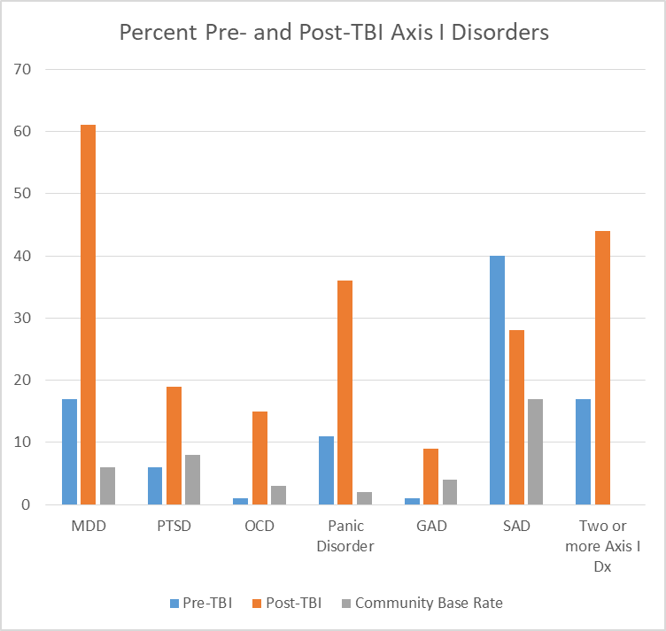
Depression and Substance Abuse
Study of 100 people with TBI
7.6 years post-injury
All severity of TBI, but
  41% had LOC < 1 week
  30% mTBI
62% of MDD resolved
PTSD, OCD, and Panic Disorder showed some improvement
GAD demonstrated no improvement over time
Hibbard MR, Uysal S, Kelper K et al (1998). Axis I psychopathology in individuals with traumatic brain injury. Journal of Head Trauma Rehabilitation, 13(4), 24-39.

Slide 16
Secondary Mania
Prevalence not well studied.
About 9%
Significant association of mania or hypomania with post-traumatic seizures (especially partial complex or temporolimbic seizures).
Secondary mania is associated with right hemisphere basopolar temporal lesions.
Basis for misdiagnosis of primary bipolar disorder.
Shukla S, Cook BL, Mukherjee S et al. (1987). Mania following head trauma. American J Psychiatry, 144: 93-96. Jorge RE, Robinson RG, Starkstein SE et al (1993). Secondary mania following traumatic brain injury. American J Psychiatry, 150: 916-921.

Slide 17
Suicide and TBI
Rate of suicide for TBI is between 2.7- 4.1 times the population when matched for age & sex (Teasdale & Engberg, 2001).
Reasons include (Tate et al., 1998):
  Suddenness of onset of disability.
  Global negative effects.
  Grieving/loss of previous lifestyle.
  Increasing awareness of effort required.
  Diminished cognitive resources to cope & problem-solve.

Slide 18
Suicide and TBI
34.9% of TBI subjects report clinically significant levels of hopelessness & suicidality (Simpson & Tate, 2002).
17.4% report suicide attempt within previous 5 years which converts to a 26.2% lifetime rate (Simpson & Tate, 2002).

Slide 19
Neuropsychology of Opioid Misuse following TBI
Orbitofrontal: Impulsivity, Reduced Judgement
Frontal and Temporal Effects
Dorsolateral Frontal: Impaired Initiation & Ability to Generate Problem-solving Strategies
Opioid Misuse and Overdose
Orbitofrontal: Impulsivity, Reduced Judgement
TBI
Amygdala:
Irritability & Anger
Resulting Mood Disorders
Anxiety, PTSD
& Depression

Slide 20
Summary
Substance abuse is a risk factor for TBI.
51.5% of people with TBI will have chronic pain.
70% of people with TBI are prescribed an opioid.
TBI results in neuropsychological impairments that affect self-regulation and self-management of drug taking behavior.
Treatment with opioids also treats some of the consequences of TBI (e.g., mood).
People with TBI are at significantly greater risk for opioid misuse and accidental overdose.

Slide 21
This presentation was funded by a grant from the ISDH and the CDC Rapid Response Project
Grant 5 NU17CE002721-03-00

