Slide 1

Indiana Commission for Higher Education Legislative Update
Indiana General Assembly, 2015 Session

Slide 2
CHE Legislative Update
2015 Budget Bill
CHE Agenda Bills
New CHE Duties and Other Significant Legislation

Slide 3
2015 Legislative Implementation: Budget Bill
21st Century Scholars: The budget fully funds the 21st Century Scholars program for 2016 and 2017. Since 1990, the 21st Century Scholar program has provided up to four years of full-tuition scholarships for low-income Hoosiers.
Performance Funding: The General Assembly maintains its commitment to Indiana’s nationally-recognized performance funding incentives for public colleges by dedicating money for performance at the level of 4 percent of schools’ total state funding in 2016 and 6.5 percent in 2017.
Total State Funding Allocated to Indiana Colleges: $1.9 billion or more than 12 percent of the state’s total budget for 2016 and 2017.

Slide 4
2015 Legislative Implementation: Budget Bill
Commission Recommendations
Final Budget
Performance Funding
7% [4/3] 8% [5/3]
4% [2.3/1.7] 6.5% [3.0/3.5]
Capital
Priority 1 for all institutions (except Ivy Tech) funded with debt + 6 additional projects with various funding sources
Priority 1 for all institutions funded with debt
Return & Complete
$9M per fiscal year
Not funded
Repair & Rehab
0.50% over biennium using previous methodology
0.50% over biennium using previous methodology
Dual Credit per
Credit Value
$50
$50
Line Items
No new; existing equal to operating increase; CHE Admin (-3%)
IU – 2%; others – 0%; CHE Admin +2%
Student Financial Aid
Flat; fund 21st Century with appropriation
Flat; funds 21st Century with appropriation

Slide 5
2015 Legislative Implementation: Budget Bill
CHE Responsibilities
Implementation Timeline
Return & Complete
In conjunction with colleges, conduct targeted outreach to students who have completed some college courses without earning a degree
Provide colleges with guidelines for administering the Return-and-Complete project, including the sharing of data used to support targeted outreach to students
The entire Return and Complete project runs through 2020
CHE and institutions must adopt guidelines for administering project – including the share of data – by 1 August 2015
Ivy Tech Study
Review Ivy Tech programs with low graduation rates and either (1) require a restructuring of the program, (2) eliminate the program, or (3) take no action
No deadline specified
STEM Teacher Recruitment
Provide grants to nonprofit organizations that place new STEM teachers in elementary and high schools in underserved areas
CHE will immediately transfer existing responsibilities from Education Roundtable
Annual Reporting
Annually determine for each state institution the percentage of students receiving in-state and out-of-state tuition
Report data to budget committee and legislative council before December 1 each year
Collect data from institutions in late October and prepare report
IPFW Classification
Establish policies that recognize IPFW’s “unique role in the Indiana system of public higher education”
In consultation with Commission members, develop policies by June 2015

Slide 6
CHE Legislative Update
2015 Budget Bill
CHE Agenda Bills
New CHE Duties & Other Significant Legislation

Slide 7
SEA 509 – Adult Student Grant
Background
CHE Responsibilities
Non-traditional (generally adult) college students are twenty times more likely to earn a degree by mixing full- and part-time enrollment – i.e., attending full-time when able and falling back to part-time when circumstances change – as opposed to attending part-time only
Currently, to receive the part-time grant currently administered by CHE, students may not enroll full-time. SEA 509 changes the statute to allow adult students to combine full- and part-time enrollment
Alter program materials and IT infrastructure to reflect updated program design
High Level Timeline
Activities
6/1
7/1
8/1
9/1
10/1
11/1
12/1
1/1
Policy and Operations
Restructure Adult Student Grant Eligibility
Confirm that language on 21st Century Scholars affirmation form reflects language in statute
Determine award amounts for Priority Sectors Grant
Messaging and Communications
Update relevant information on 21st Century Scholars website
Change name of part time grant on all official materials and CHE website
Message Adult Student Grant through Return and Complete

Slide 8
HEA 1333 – Financial Aid Cleanup
Background
CHE Responsibilities
Currently, Indiana National Guard members whose parents do not live in Indiana and those independent students who live across state lines are not eligible to receive the supplemental grant. HEA 1333 changes the statute so that these members are eligible to receive the award.
Recipients not historically required to use federal aid first. HEA 1333 changes the statute so that students must use all federal aid before state aid “kicks in.”
The law also modifies EARN Indiana’s eligibility requirements such that all students demonstrating financial need – not just those receiving a CHE financial aid award – may participate in the program.
Alter program materials and IT infrastructure to reflect updated program design
High Level Timeline
Activities
6/1
7/1
8/1
9/1
10/1
11/1
12/1
1/1
Policy and Operations
Work on eligibility change for EARN IN
Determine EFC threshold for EARN eligibility

Slide 9
CHE Legislative Update
2015 Budget Bill
CHE Agenda Bills
New CHE Duties & Other Significant Legislation

Slide 10
HEA 1323 – Medical Residency Subsidy and Startup
Background
CHE Responsibilities
There are more graduates of Indiana medical schools than residency spots available
A doctor is 50% more likely to remain in the state in which s/he had a residency
Law provides funding to support existing and emerging residency programs
Recipients of money from the fund must provide 25% match
Law establishes a 10-member board appointed by the governor to provide technical assistance
Administer the fund
Establish application procedure for hospitals and nonprofits seeking grants
Provide staff for the Graduate Medical Education Board, notify members and call first meeting
By 1 Nov 2016 submit report to General assembly RE expansion of graduate medical education in the state
High Level Timeline
Activities
6/1
7/1
8/1
9/1
10/1
11/1
12/1
1/1
Planning
Contact medical schools
Messaging & Communications
Write informational material for medical schools
Develop application and materials for applicants
Develop online application system
Post information to CHE website
Board Management
Compose orientation packets for board members
Call first meeting to order
Submit report to the General Assembly

Slide 11
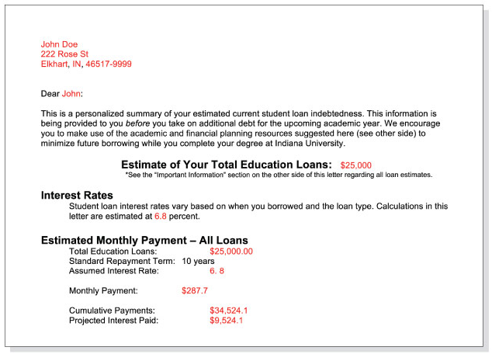
HEA 1042 – Debt Literacy
Background
Sample Letter
Student loan debt in the U.S. has swelled to $1.2 trillion
Federal default rate (for the first three years students are required to make payments) is 14.7 percent – compared to 5.4 percent a decade ago (when the rate was measured over two years)
By sending student borrowers an informational debt letter, IU estimates it has reduced undergraduate student borrowing across the university by 16 percent over 2 years, resulting in $44 million in debt savings
HEA 1042 mandates that all IN colleges – public and private – that receive state aid money send their students such a letter annually
Required Disclosures
Estimate of total loans taken out
Estimate of potential total payoff amount and monthly repayment amounts (including principal and interest)
Percentage of borrowing limit reached
CHE Responsibilities
Although not required by statute, the Commission will send an informational memo to all colleges and universities describing the requirements of the legislation
Image: Bloomberg Business

Slide 12
SB 1 – State Board of Education Governance
Current Structure
SB 1 (effective June 1)
Composition
(1) State Superintendent
(8) Members Appointed by Governor
(1) Member Appointed by House Speaker
+ (1) Member Appointed by Senate Pro Tem
= 11 Total Members
(1) State Superintendent
+ (10) Members Appointed by Governor
= 11 Total Members
Restrictions on Appointments
At least six of the Governor’s appointments must have professional experience in education
Governor’s appointments must be from “different parts of Indiana” with no more than one appointee from the same congressional district
Governor may not make more than 6 appointments from same political party
Appointments by House Speaker and President Pro Tem may not be members of General Assembly
At least four appointments must be “actively employed in the schools in Indiana” and hold valid teaching licenses
At least one appointment from each congressional district
No more than six appointments from same political party
Board Chair
Chairperson and vice chairperson elected annually by members of board. NB: Sup. Ritz will continue to serve as board chair until end of her term – 31 December 2016 – at which point the new election policies take effect
State Superintendent (Glenda Ritz)
Term Length
4 years
4 years

Slide 13
Additional Bills Related to Higher Education
HB 1108 requires teacher preparation program to contain content that helps students recognize dyslexia.
HB 1188 requires student teachers to be mentored by teachers who have been ranked “Effective” or “Highly Effective” in their performance review.
HB 1194 calls on the Core 40 Subcommittee (part of the Indiana Career Council) to recommend changes to high school diploma requirements that account for “different learning styles and abilities.”
HB 1637 adds higher education representatives to the academic standards committee and requires CHE to set the college remediation cut scores in consultation with state colleges and universities.
HB 1045 protects school-run recreational facilities from lawsuits.
SB 123 is a technical bill altering the formal names of some campuses in the IU Medical School System.
SB 434, a variant of agenda bill HB 1333, enables students in the military who receive in-state tuition for undergraduate programs to receive the same benefit for graduate work.

