Slide 1
Million Father March
The First Step To Cultivating
Year-Round Father Involvement

Slide 2
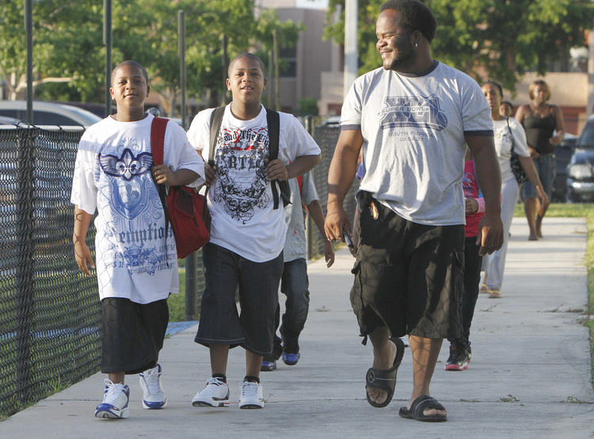
What is The Million Father March ?
The Black Star Project's Million Father March is the most important March that any man will ever make in his life. It is not a march to Springfield or to Washington or to city hall. This March is from your house to your child’s school.

Slide 3
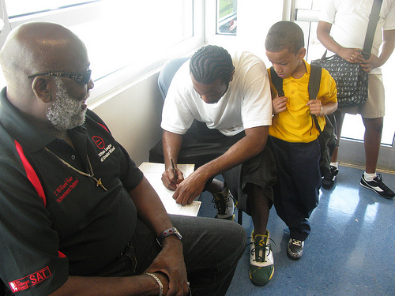
What is the Million Father March ?
The Million Father March is fathers and men accompanying their children to school on the first day of the school year. These fathers become an honor guard of strong, positive men supporting all children at schools. The Million Father March also marks the beginning of a year-long commitment by men to children educationally, socially, financially, emotionally and spiritually.

Slide 4
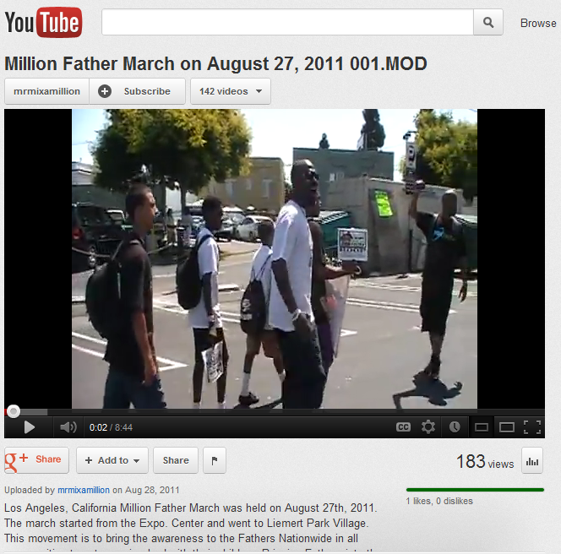
History of the
Million Father March
Million Father March in California
http://www.youtube.com/watch?v=ILpS9bD_B6Q

Slide 5
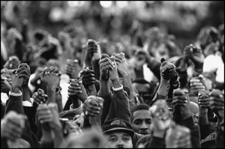
History of the
Million Father March
Ten men started the Million Father March in 2004 in the basement of St. Paul and the Redeemer Church on the South Side of Chicago.
Combined two ideas:
1. Million Man March
2. Fathers in South America

Slide 6
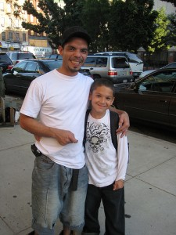
History of the
Million Father March
Year Number of Cities Men and Fathers Participating
2004 25 40,000
2005 83 150,000
2006 127 250,000
2007 235 400,000
2008 475 600,000
2009 487 580,000
2010 609 800,000
767 1,050,000
525 1,000,000

Slide 7
Million Father March 2013
In 2012, the March exceeded its national first-day participation objective when it reached the estimated 1million father mark with 525 cities in action.
Although The Black Star Project recruits organizations nationwide and supports local organizing efforts across this country with toolkits and direct technical assistance, we also network, highlight and share organizations’ creative strategic approaches with organizers everywhere. And local groups in more than 525 cities manage their own on-the-ground, first-day events while we coordinate the Chicago campaign. In this way, The Black Star Project concentrates its efforts on empowering those with the most at stake to be in effective action.

Slide 8
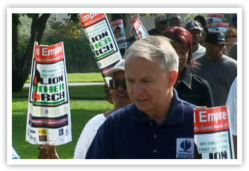
Million Father March 2013
Participants in the event include fathers, grandfathers, foster fathers, stepfathers, uncles, cousins, big brothers, significant male caregivers, mentors and families’ friends. Men and women of all ethnicities are encouraged to take their children to school on their first day. Businesses are asked to give fathers and men 2 hours off that morning to take their children to school. Men are encouraged to volunteer at schools throughout the year. A special effort will be made to coordinate Latino Fathers in La Marcha de los Padres.

Slide 9
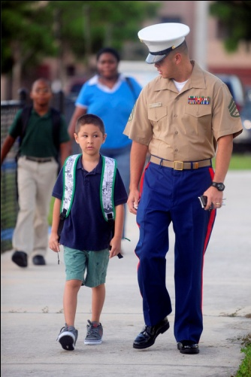
Best Practice:
School-District Partnership
Case Study: Broward County Florida
The Broward County Board of Education adopted, supported and institutionalized the Million Father March such that the entire county school system participates in this annual Million Father March tradition.
In 2011, more than 38,000 fathers in Broward County participated in the Million Father March, according to the Sun Sentinel, and the district plans to increase that number this year.

Slide 10
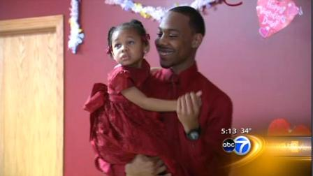
Best Practice:
Year-Round Events
Case Study: New York City, New York
Organizers of the Million Father March began an annual tradition, around Valentine’s Day, to promote a positive bonding experience for fathers and daughters. The event, which is catching on around the country, is designed to support fathers to demonstrate the acceptable social etiquette daughters should expect on future “dates.”
Click for Daddy Daughter Dance: http://abclocal.go.com/wls/video?id=8557311

Slide 11
Research Shows
Children whose fathers take an active role in their educational lives earn better grades, score higher on tests, enjoy school more and are more likely to graduate from high school and attend college.
Children have fewer behavior problems when fathers listen to and talk with them regularly and are active in their lives.
A good father is part of a good parent team and is critical to creating a strong family structure.
Strong family structures produce children who are more academically proficient, socially developed and self-assured. Such children become adults who are valuable assets to their communities.
Better parents produce better communities, better schools, and better students with higher academic achievements.

Slide 12
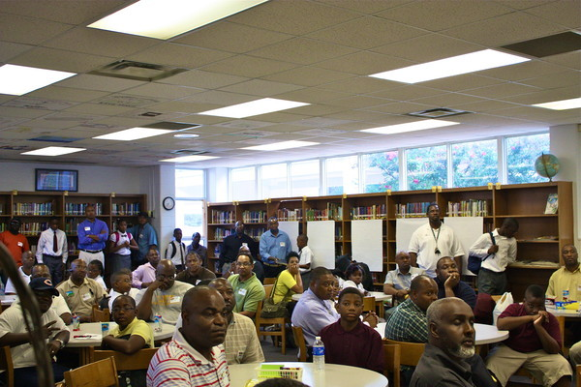
Best Practice:
Million Fathers Clubs
Case Study: Danville, Illinois
Danville city councilman and lead organizer for the city’s Million Father March produced a Million Fathers Club, the first evidence of an institutionalized follow-up effort to sustain fathers’ constructive involvement in their children’s lives year ‘round. This popular Million Fathers Club builds its ranks to support fathers to be a major positive force in the social, developmental and educational lives of their children.

Slide 13
Million Father March
Volunteer Ideas
Mentor children at the school.
Tutor children at the school.
Read to children during class.
Chaperone children on field trips.
Monitor children in the lunchroom.
Monitor children in school hallways.

Slide 14
More Volunteer Ideas
Become a member of the Local School Council, Parent Teacher Association, or School Board.
Watch students before and after school to provide safe passage.
Clean school facilities (wash chalkboards, sweep and mop floors, maintain the grounds, etc.).
Coach a sports team.
Help a teacher grade papers.

Slide 15
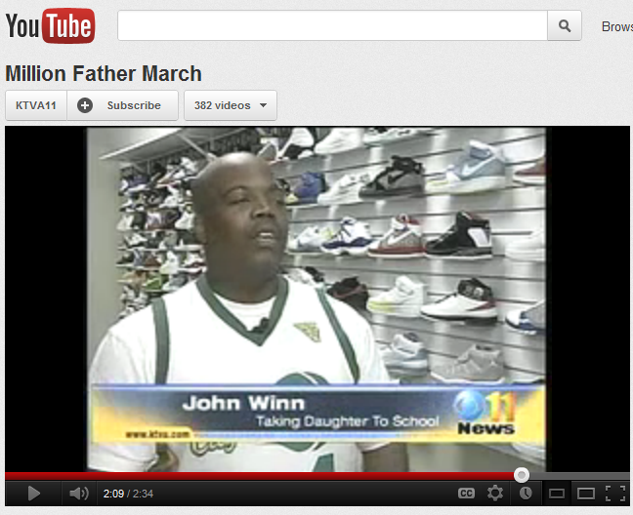
History of the
Million Father March
Million Father March in Alaska
http://www.youtube.com/watch?v=MB5T43Swows

Slide 16
Best Practice:
Securing Sponsorship
and Promotion
Case Study: Des Moines, Iowa
The organizer recruited a volunteer team, secured sponsors and worked with legislators to expand public awareness about the March and the vitally important role fathers serve in the lives of their children, especially their children’s educational success.
Leading up to the March, the team educated community residents with public service announcements, promotional posters and T-shirt distribution. These efforts plus a first-day-of-school donated limo ride (for one father and his children) helped popularize the event and highlight the importance of fathers’ active involvement in their children’s educational lives.

Slide 17
Best Practice:
Elected Official Partnership
Case Study: Omaha, Nebraska
Approximately 20 city and state elected officials signed on to support the Million Father March including the Governor of Nebraska, Omaha City Council Members and many Nebraska State Legislators. Elected officials greeted fathers and children at a featured school on the first day. Omaha Mayor Jim Suttle held an auditorium session to welcome back the students and parents. Organizer Willie Hamilton’s local radio and television shows greatly helped promote the event.

Slide 18

History of the
Million Father March
Million Father March in Nebraska
http://www.youtube.com/watch?v=gZ9uFGbFTpY

Slide 19
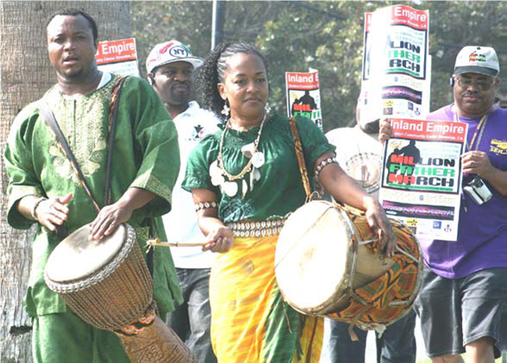
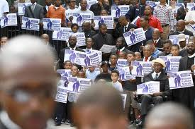
Best Practice:
Back-to-School Parade
Case Study: Southern California and
Chicago, Illinois

Slide 20
Best Practice: Involving
Incarcerated Fathers
Case Study: Hilo, Hawaii
Organizers in Hilo, Hawaii didn’t want to leave anyone out, so they began a project in partnership with the prison system to
involve incarcerated fathers in the March. Fathers were encouraged to write letters to their children to inspire them to do their best in school. These men also wrote letters asking friends and family to be surrogates by taking the men’s children to school on the first day.

Slide 21
Best Practice:
Street Outreach
Case Study: Chicago, Illinois
In September, 2011 Million Father March organizers achieved the highest first-day-of-school attendance in more than two decades. The Black Star Project managed massive outreach: visited homes, put up thousands of yard signs across the city and passed out tens of thousands of flyers at major city events and public transportation hubs during August and the first week of September.
).

Slide 22
Best Practice:
Elected Officials and Earned Media
Case Study: Chicago, Illinois
Congressmen Danny Davis, Commissioner Robert Steele, and Aldermen Pat Dowell, Willie Cochran, and Lona Lane were among the elected officials who welcomed students and fathers on the first day at schools during the Million Father March in Chicago. The Black Star Project coordinated a media campaign that earned coverage by all the major local television outlets (CBS, NBC, ABC, WGN, CLTV, FOX, and CAN-TV), radio stations (WBEZ, WBBM, WVAZ), and print media (Chicago Tribune, Chicago Sun-Times, and the Chicago Defender)

Slide 23
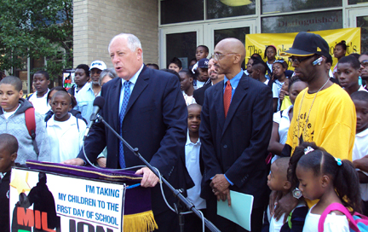
History of the
Million Father March
Million Father March in Illinois
http://www.youtube.com/watch?v=mnnYWV7OJbk

Slide 24
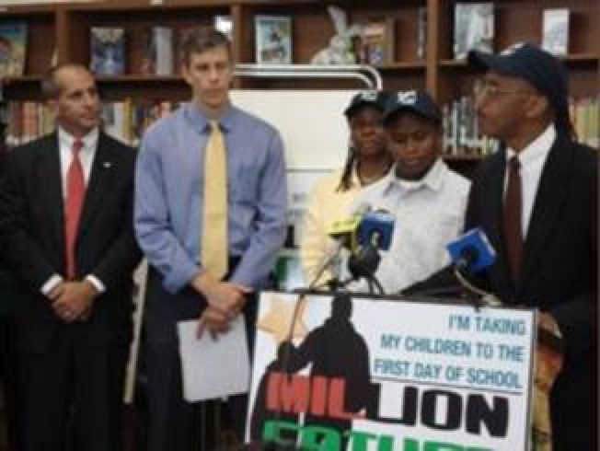
The Black Star Project’s motto is:
Any Man; Any School; Any Child!!
Be There!!
The Million Father March 2013

