Slide 1


Literacy: Where We Are and Where We Need to Be

Slide 2

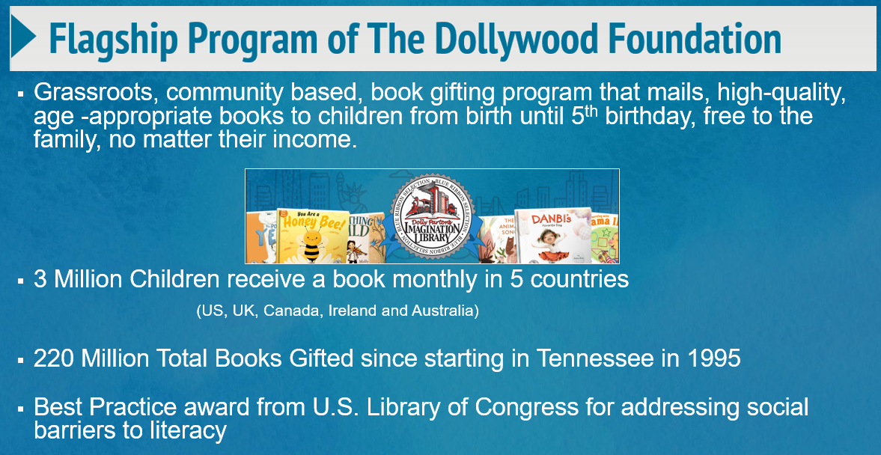
Slide Title
Bulleted text
Bulleted text
Bulleted text

Slide 3
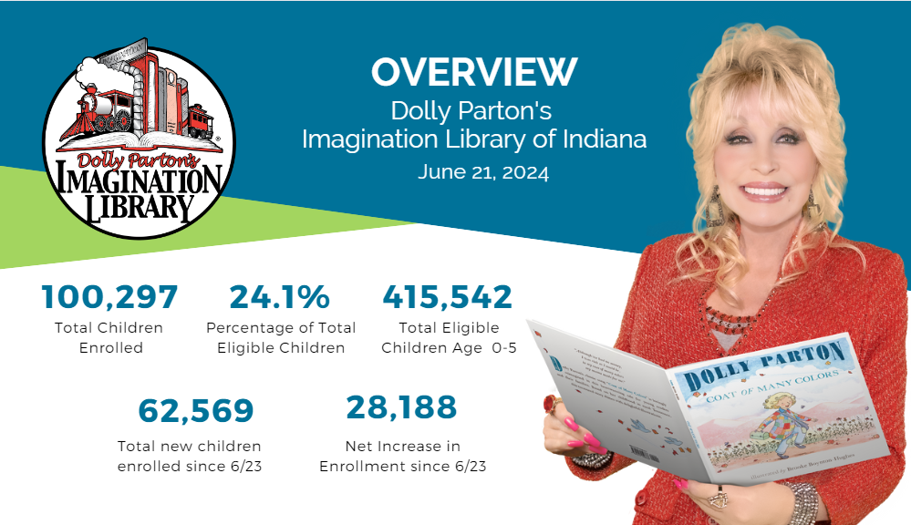
Slide Title
Bulleted text
Bulleted text
Bulleted text

Slide 4

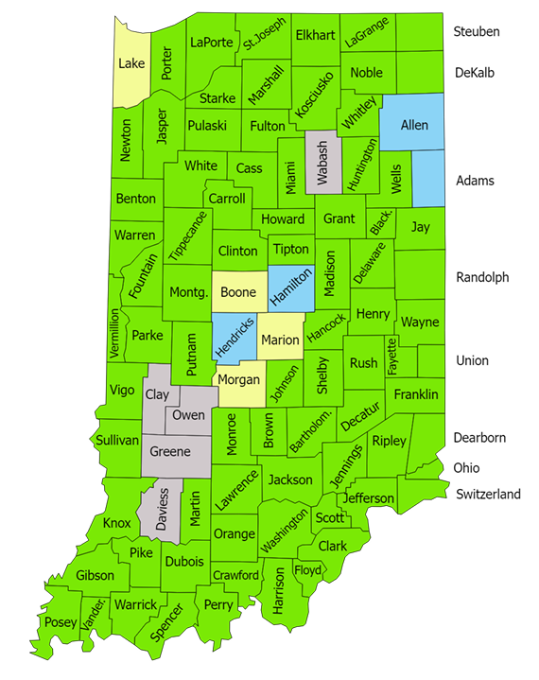
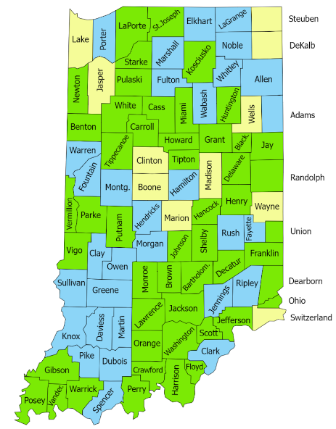
Slide Title
Bulleted text
Bulleted text
Bulleted text
June 2024
June 2023

Slide 5

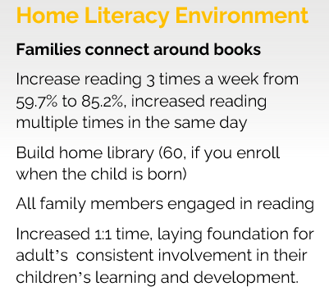
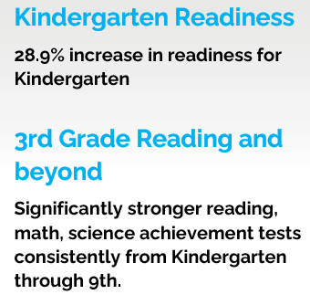
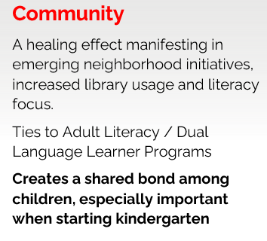
Slide Title
Bulleted text
Bulleted text
Bulleted text

Slide 6
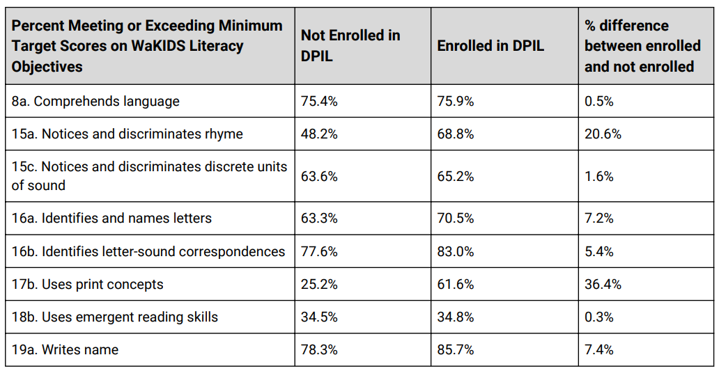
Slide Title
Bulleted text
Bulleted text
Bulleted text
https://www.imaginationlibrarywashington.org/kindergarten_readiness_assessment

Slide 7

Slide Title
Since receiving Imagination Library books, 77% of parents/caretakers read once a day or more with their child.
76% of families said that their child is more interested in reading and books since receiving books from the Imagination Library
92% of parents/caregivers believe that participating in Dolly Parton’s Imagination Library is helping to prepare their child(ren) for kindergarten
85% of families reported seeing positive changes in their children in terms of increased vocabulary, increased listening and social skills, and an increased interest in reading.
Bulleted text
Bulleted text
Bulleted text
https://www.imaginationlibrarywashington.org/kindergarten_readiness_assessment

Slide 8

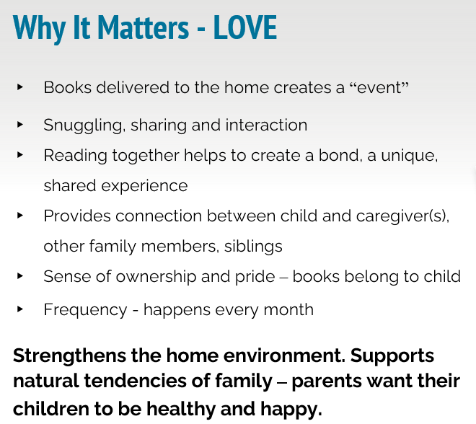
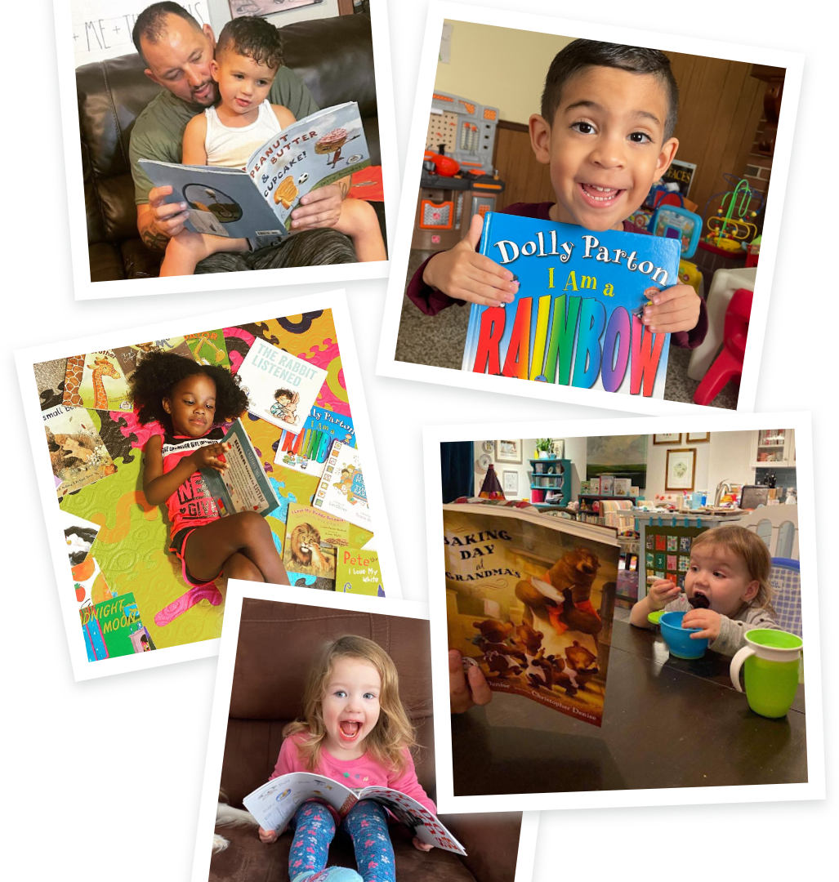

Slide 9
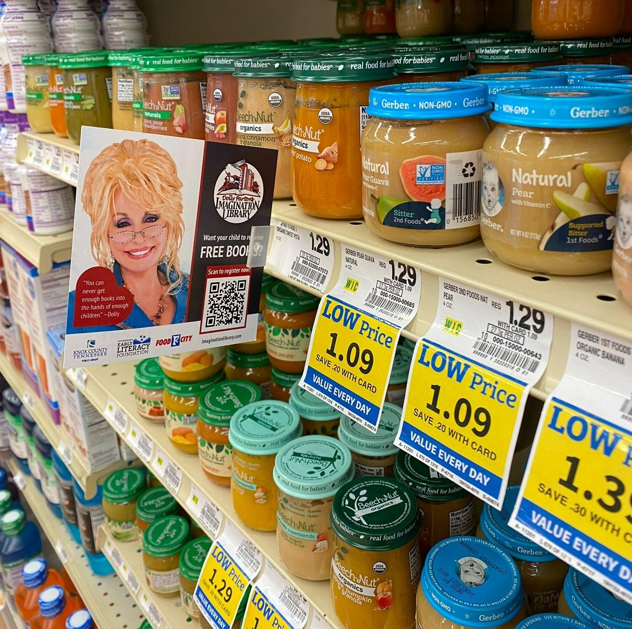
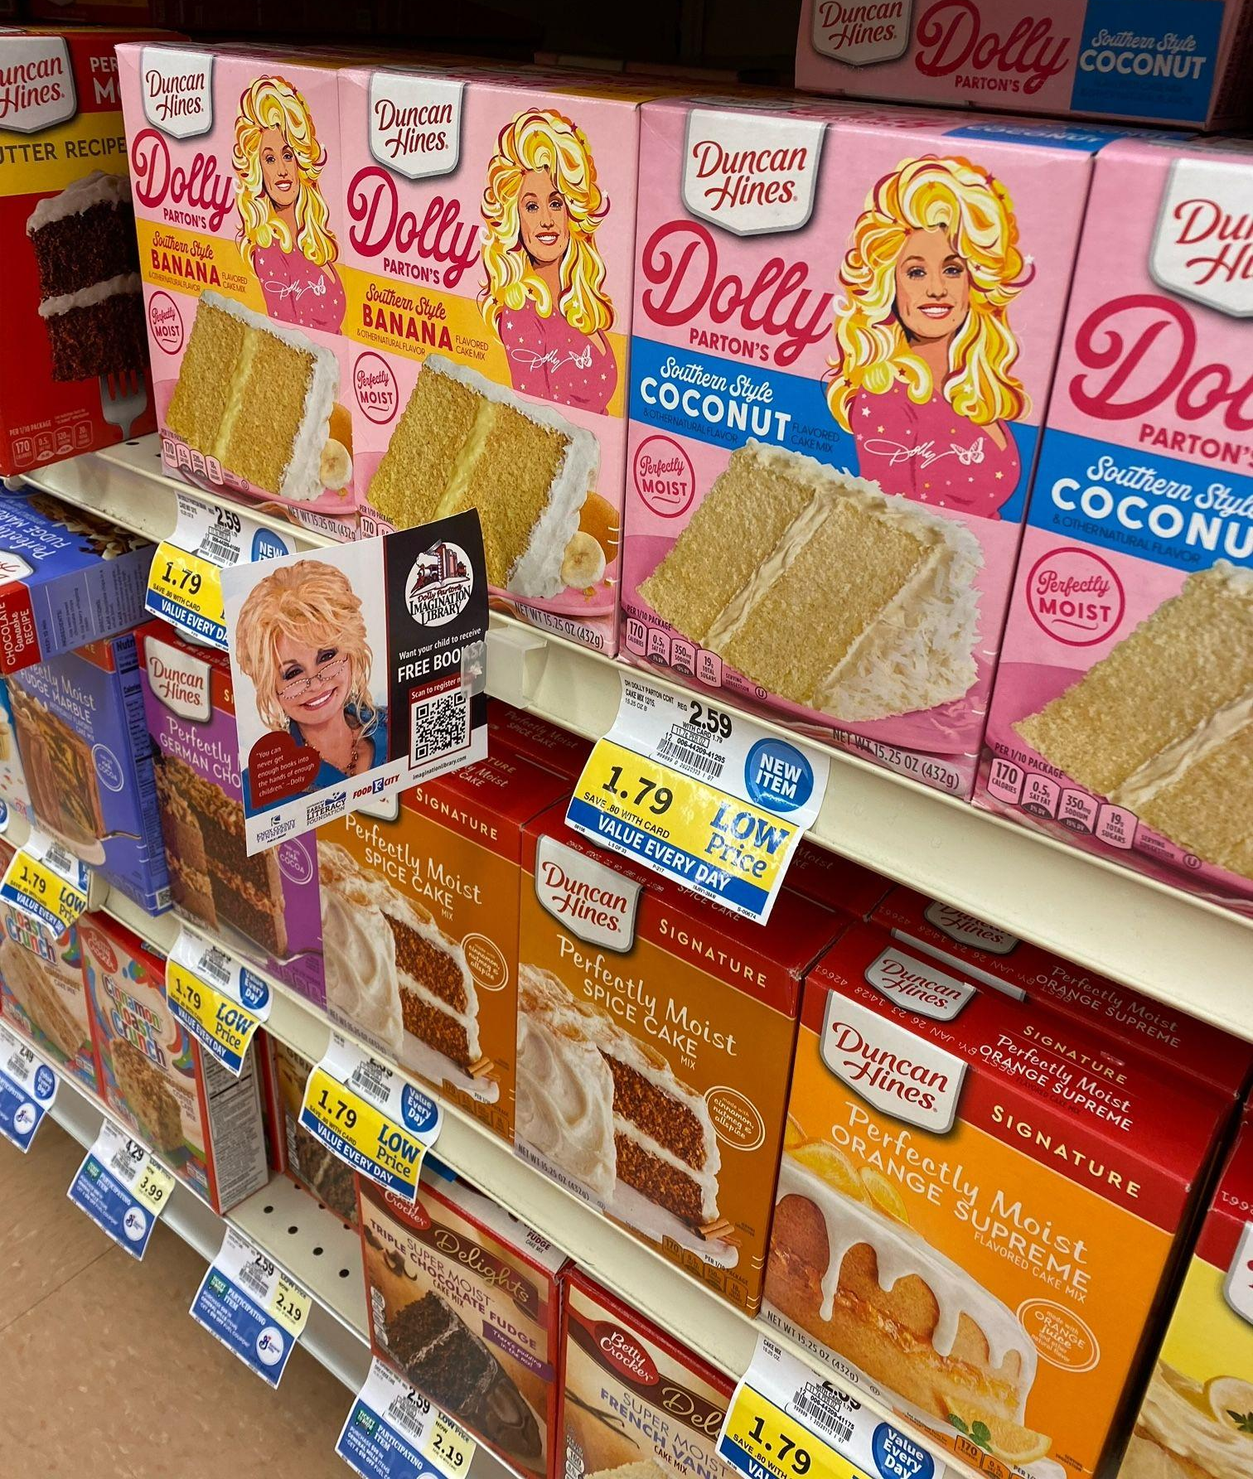
How Can You Help…
Birthing Centers and Hospitals
Health Department
Home visitation programs
Public Libraries
Little Free Libraries
Child Care centers & Preschools
Festivals & Community Events
Doctor/Dentist Offices
Community Centers
Laundromats

Slide 10
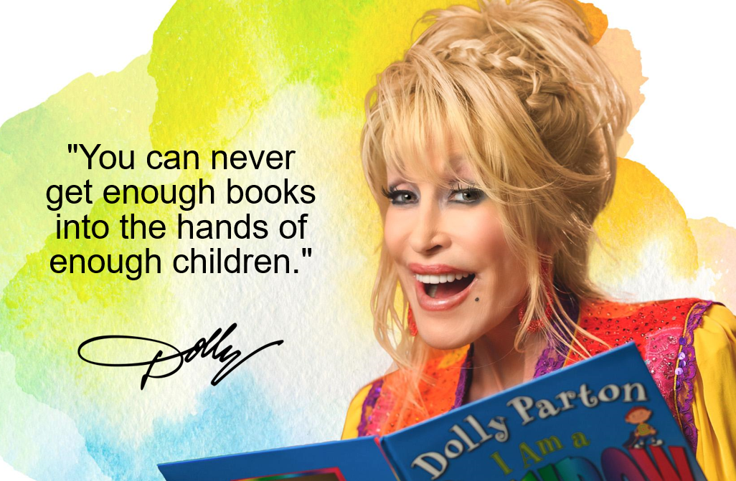
Thank you!
Melinda Brown
State Director mbrown@in.imaginationlibrary.com
Katie Mullins
Community Engagement Coordinator kmullins@in.imaginationlibrary.com

Slide 11
Literacy:
Where We Are & Where We Are Going
Dr. Rebecca Estes
Assistant Secretary for Educator Talent
Indiana Department of Education
June 21, 2024

Slide 12


Learning Objectives
Participants will be able to articulate Indiana’s literacy challenges and opportunities.
Participants will be able to identify resources available for schools, parents, and community members to help improve literacy rates in Indiana and ensure more students learn to read by the end of third grade.

Slide 13

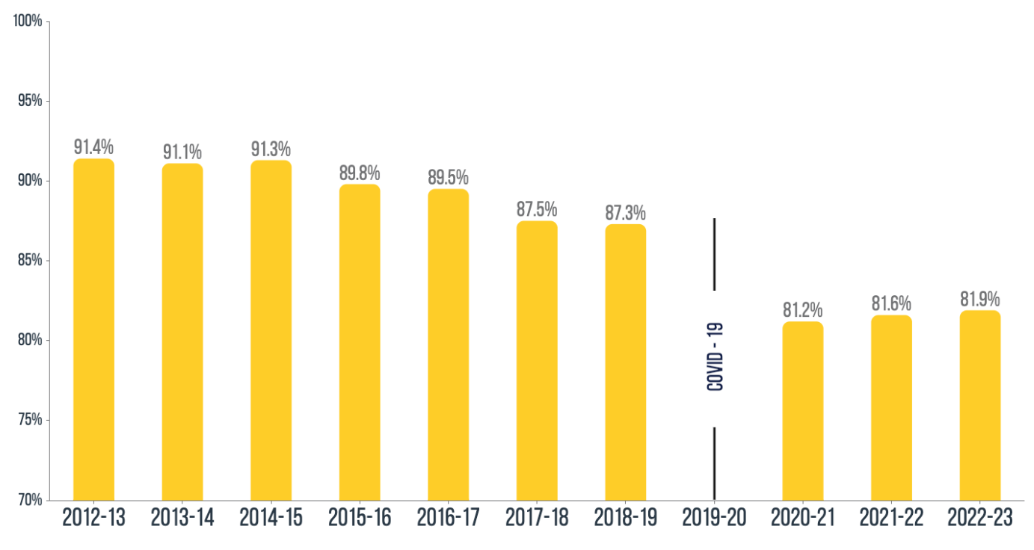
Understanding Indiana’s Literacy Crisis
Indiana’s literacy rates have been in decline for a decade…well before the COVID-19 pandemic. IREAD passage rates peaked at 91.4% in the 2012-2013 school year.

Slide 14
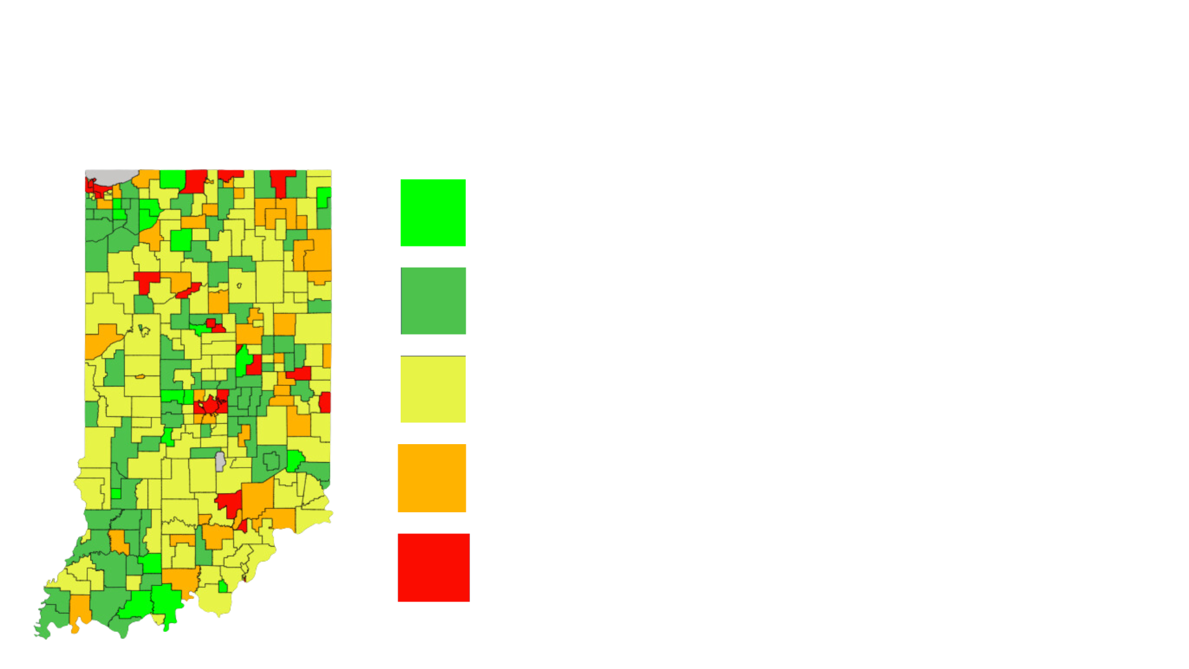
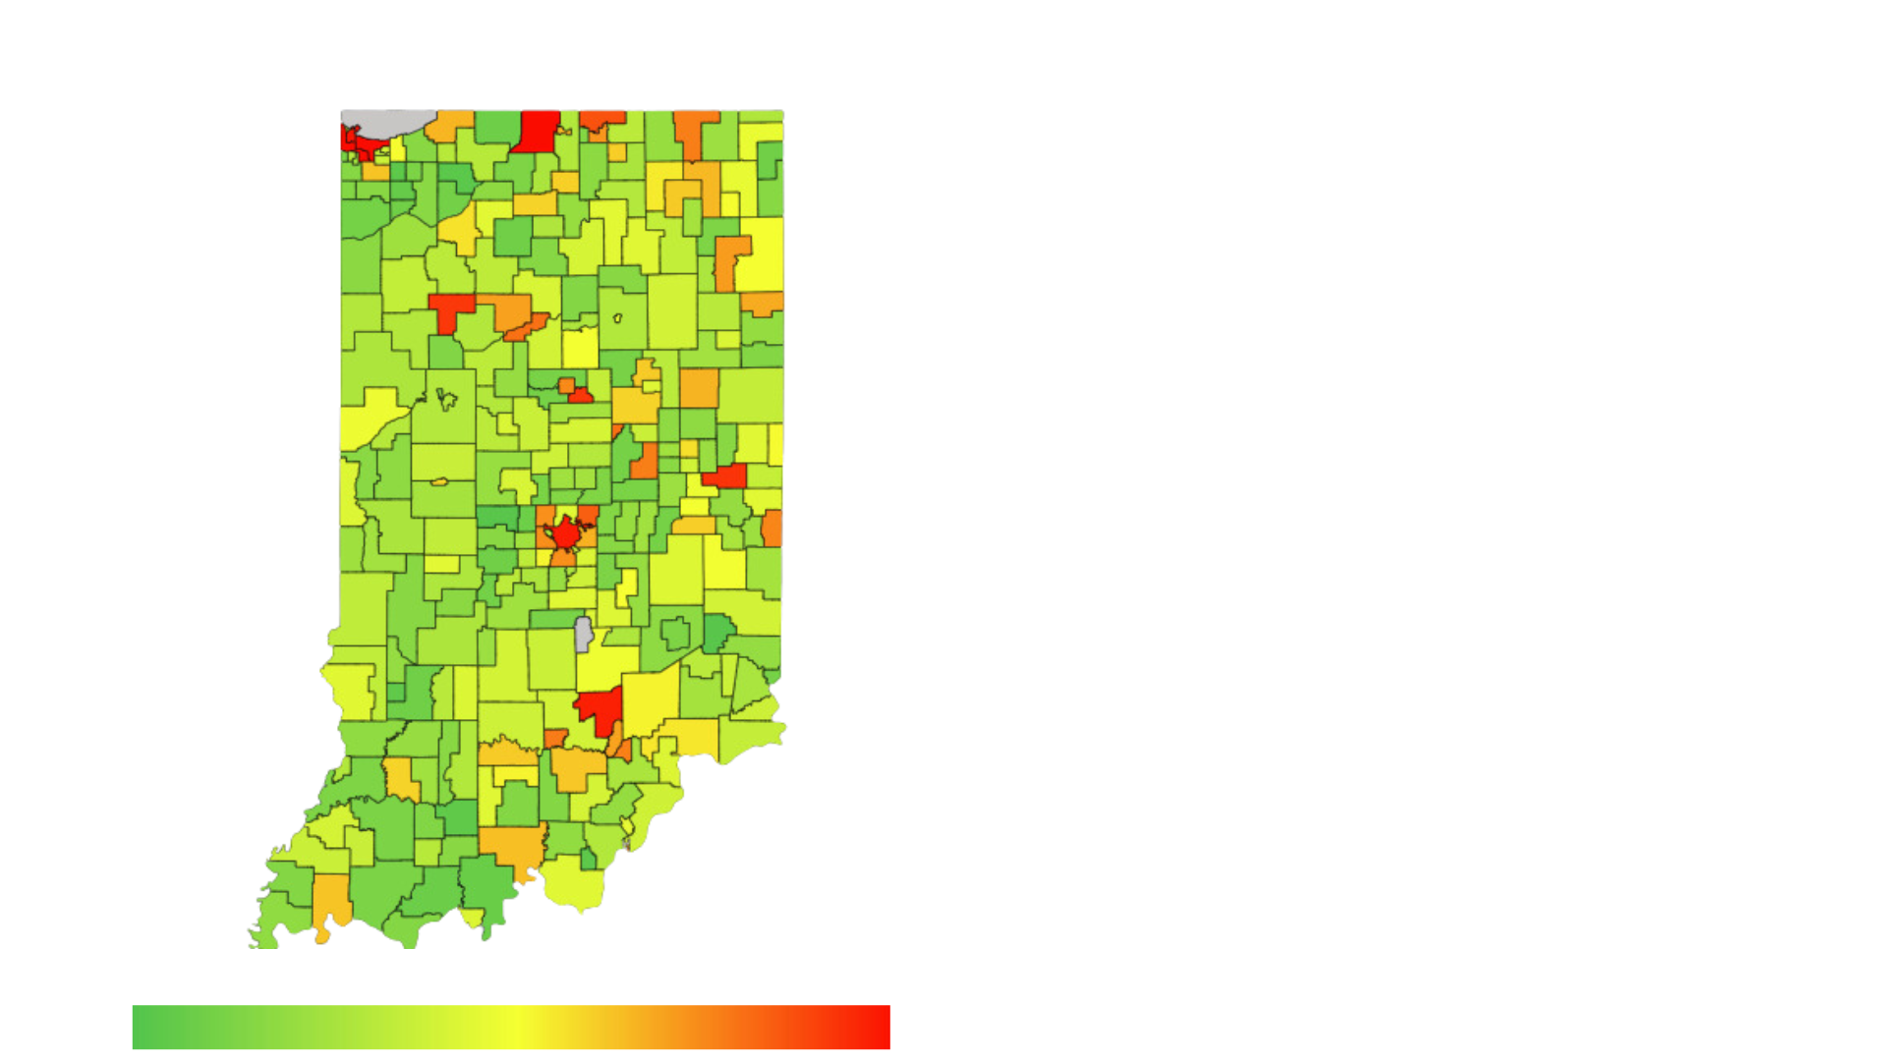
Current Data
2023 IREAD Passage by Corporation
Nearly one in five third grade students in Indiana is not proficient in key literacy skills.
While third grade enrollment has declined since 2012, the number of students who do not pass IREAD has more than doubled.
As reading scores have decreased, retention rates have also decreased, causing thousands of students to enter fourth grade unable to read.
Longitudinal data show the majority of these students continue
to struggle academically, rarely achieving proficiency on
future assessments, and are less likely to graduate.
Percentage of Third Graders Promoted to Fourth Grade Who Have Not Mastered Reading
https://eddata.doe.in.gov/PublicHome/GetObjectByUuidAndViewType?uuid=df4a26e1-eedc-4480-812d-da6cad5528ff&viewType=Report&currentPage=1

Slide 15
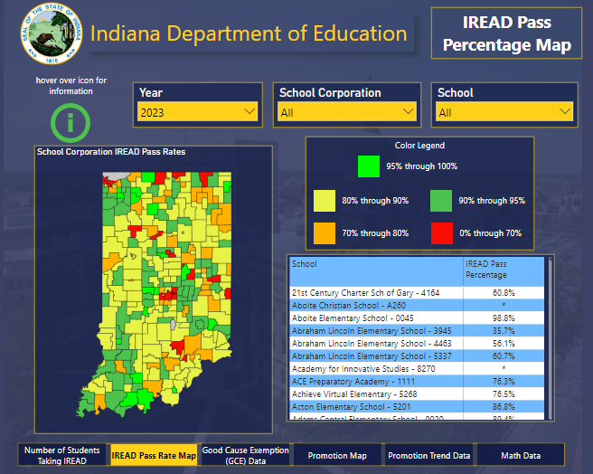

Slide Title
New Literacy Data Visualization Tool
For the first time ever, a new data visualization tool allows educators, parents and families, community leaders, and policymakers to view key literacy data.
As this tool is refined, it will help to:
quantify the number of students in each grade level who are unable to read;
track the long-term impacts of illiteracy;
evaluate the impact of the state’s current literacy efforts; and,
inform ongoing policy decisions.
Bulleted text
Bulleted text
Bulleted text
https://eddata.doe.in.gov/PublicHome/GetObjectByUuidAndViewType?uuid=df4a26e1-eedc-4480-812d-da6cad5528ff&viewType=Report&currentPage=1

Slide 16

Slide Title
Gov. Holcomb’s Goal: 95% of 3rd Grade Students Reading Proficiently by 2027
Bulleted text
Bulleted text
Bulleted text
To support schools and educators, as well as parents and families in preparing students with foundational reading skills, Indiana continues to make historic investments in literacy, totaling over $170 million. Below are examples of how this investment has been used to positively impact students:
Indiana Literacy Cadre
Competitive Science of Reading Grant
Indiana Learns
Science of Reading Modules (in partnership with Marian University)
Indiana Learning Lab
IREAD at Second Grade
Literacy Achievement Grants
Dolly Parton’s Imagination Library
Notes:
Increased school-level science of reading instructional coaching and support for educators through the Indiana Literacy Cadre. Participation in 2023 grew nearly five-fold, with 199 total schools opting into cohorts one and two.
Provided over 77,000 hours of learning support and tutoring services to over 18,000 students through Indiana Learns, regardless of a family’s ability to pay. The recent expansion allows students and families access to additional funds once their initial $1,000 award has been spent.
Grew the Indiana Learning Lab to over 55,000 users in two years, including launching the Parent and Family Support Hub, which provides no cost, 24/7 access to resources for parents and families
Developed online professional development modules supporting Indiana educators with additional science of reading training.
Expanded the number of schools opting-in to administer the state’s IREAD-3 assessment for second grade students to 771 schools. This allows teachers, parents and families to immediately know if a child is on-track or at-risk when it comes to mastering foundational literacy skills.
Provided $10 million in cash stipends to school staff at all corporations and charter schools who are responsible for the implementation and delivery of early literacy and reading instruction through the Literacy Achievement Grants.
Increased the implementation of evidence-based instructional practices for over 65,000 students across Indiana through the competitive science of reading grant, which awarded nearly $15 million to 72 school corporations. This is in addition to the multiple other initiatives supporting science of reading.

Slide 17
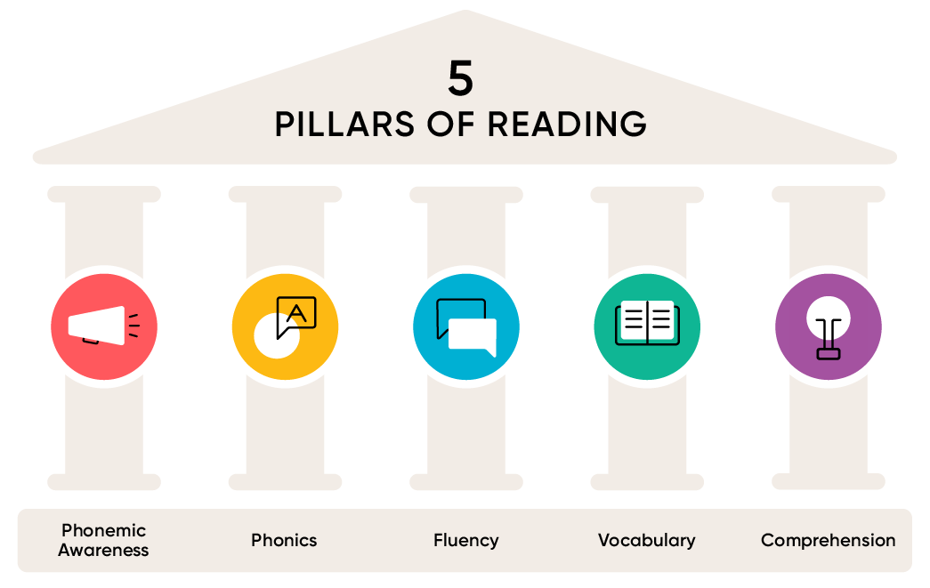
Slide Title
How To Get There: Science of Reading
Bulleted text
Bulleted text
Bulleted text
What is science of reading?
Science of reading means a vast, interdisciplinary body of scientifically-based research that requires the explicit, systematic, inclusion of five essential reading components: phonemic awareness, phonics, fluency, vocabulary, and comprehension.
Reference.
Notes:
This definition is supported by evidence that informs:
How proficient reading and writing develops;
Why some students experience difficulty with reading and writing; and
How to effectively assess and teach reading and writing to improve outcomes for all.
Science of reading is not a curriculum, phonics, or a one-size-fits-all approach. It’s a comprehensive, scientific approach to supporting student literacy using word and language comprehension skills.

Slide 18

Slide Title
Science of Reading Implementation
Teacher Training
Bulleted text
Bulleted text
Bulleted text
Future Teachers: Teachers applying for their license after July 1, 2025, will complete an educator preparation program aligned with science of reading.
Current Teachers: Teachers responsible for PK-5 Literacy who are renewing after July 1, 2027, will complete 80 hours of science of reading professional development.

Slide 19

Slide Title
Science of Reading Implementation
Student Supports
Bulleted text
Bulleted text
Bulleted text
Beginning with the 2024-2025 school year, all second grade students will participate in IREAD.
This participation provides vital data to serve as an early indicator of student reading proficiency.
Second grade results provide specific proficiency level descriptors: Pass, On Track, and At Risk with descriptions to support interventions, if needed. Students who pass in second grade do not need to retest in third grade.
Existing summer school funding will be prioritized to support students in greatest need.

Slide 20

What Can Communities Do?
When it comes to ensuring more students learn to read, we all have a role to play, including educators, families, community members, philanthropy, and more. Together, we can maximize our impact for students and ensure more students have the foundational literacy skills they need for future success!
Indiana Learning Lab Parent and Family Hub
Notes:
Here’s how you can be a part of the solution:
Parents and families – ask your local school leadership if teachers are receiving training and utilizing instructional strategies aligned to science of reading; encourage your child to read at home for at least 30 minutes each day (make sure they’re reading by “sounding out the words”); and if your child is eligible for free/reduced price meals and is struggling with reading, sign them up for Indiana Learns to receive additional learning support at no cost to your family.
K-12 educators – encourage your administrators to provide increased opportunities for professional development aligned to science of reading.
K-12 school administrators – make sure EVERY teacher receives training aligned to science of reading, so they have the tools needed to best serve our students. Contact the Literacy Center at inlitcenter@doe.in.gov to learn more about joining the Indiana Literacy Cadre, applying for upcoming state grants, and participating in training opportunities.
Higher

Slide 21

Thank you!
Rebecca Estes, IDOE
Email: restes@doe.in.gov

