Slide 1
InTERS Digital Registration

Slide 2

Inters Contact inters@dwd.in.gov
Matt Crites
mcrites@dwd.in.gov

Slide 3
Digital Registration Process
Create a registration course
Set up the Digital Registration presence
Use a Logo
Use a Favorites Icon
Use of a QR Code
Student Registrations
Convert Student Registrations

Slide 4
Course Creation
Log Into InTERS
Click Views
View Courses
Click the Add button or right click on the grid to add
Name the course Online Registration

Slide 5
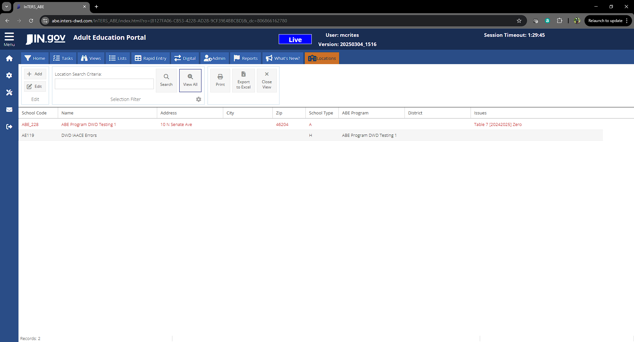
Digital Presence
Log Into InTERS
Click Views
Click Locations
Click View all
Right Click on the ABE Program (not ABE FA)
Click Digital Presence

Slide 6
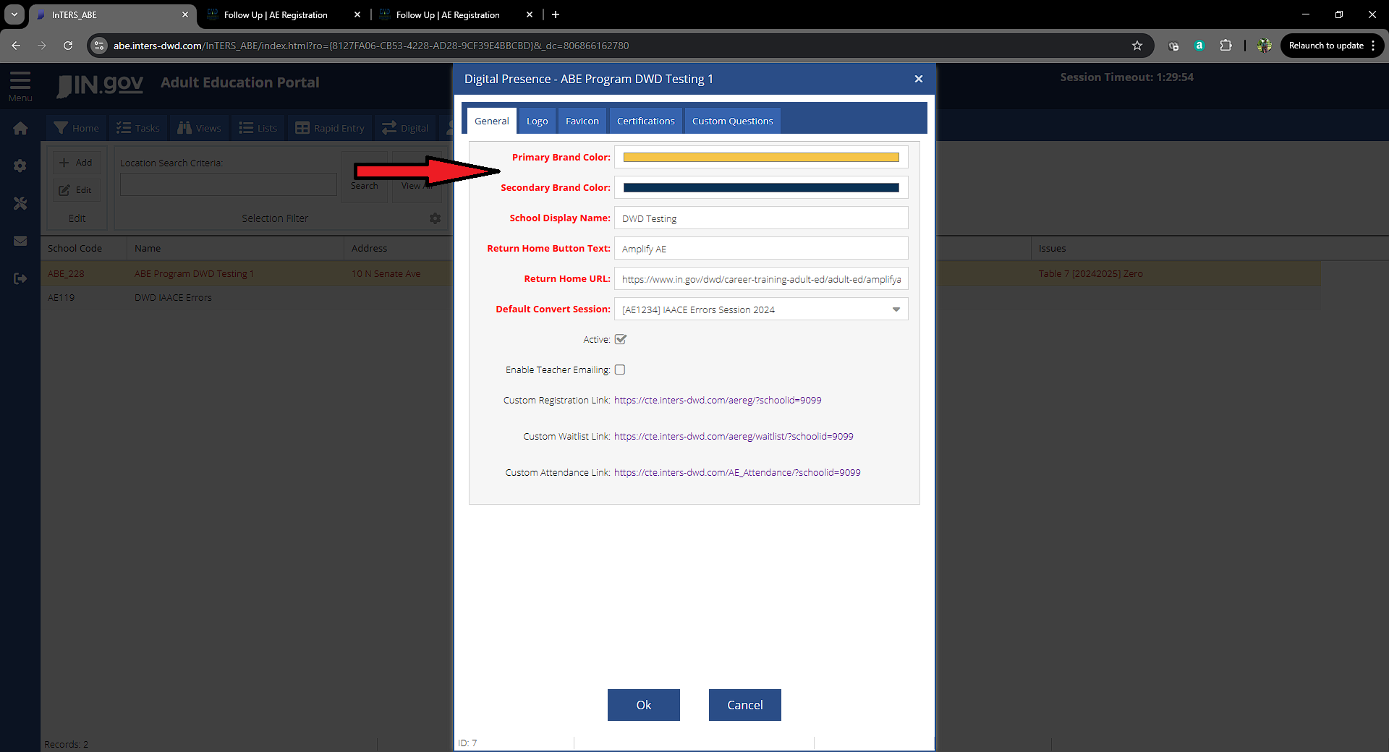
Digital Presence
Select Primary Brand Color
Select Secondary Brand Color
Input your Program Name
Input the Display Name for the Return button
Enter the URL for the return button/home page
Select the InTERS digital registration course

Slide 7
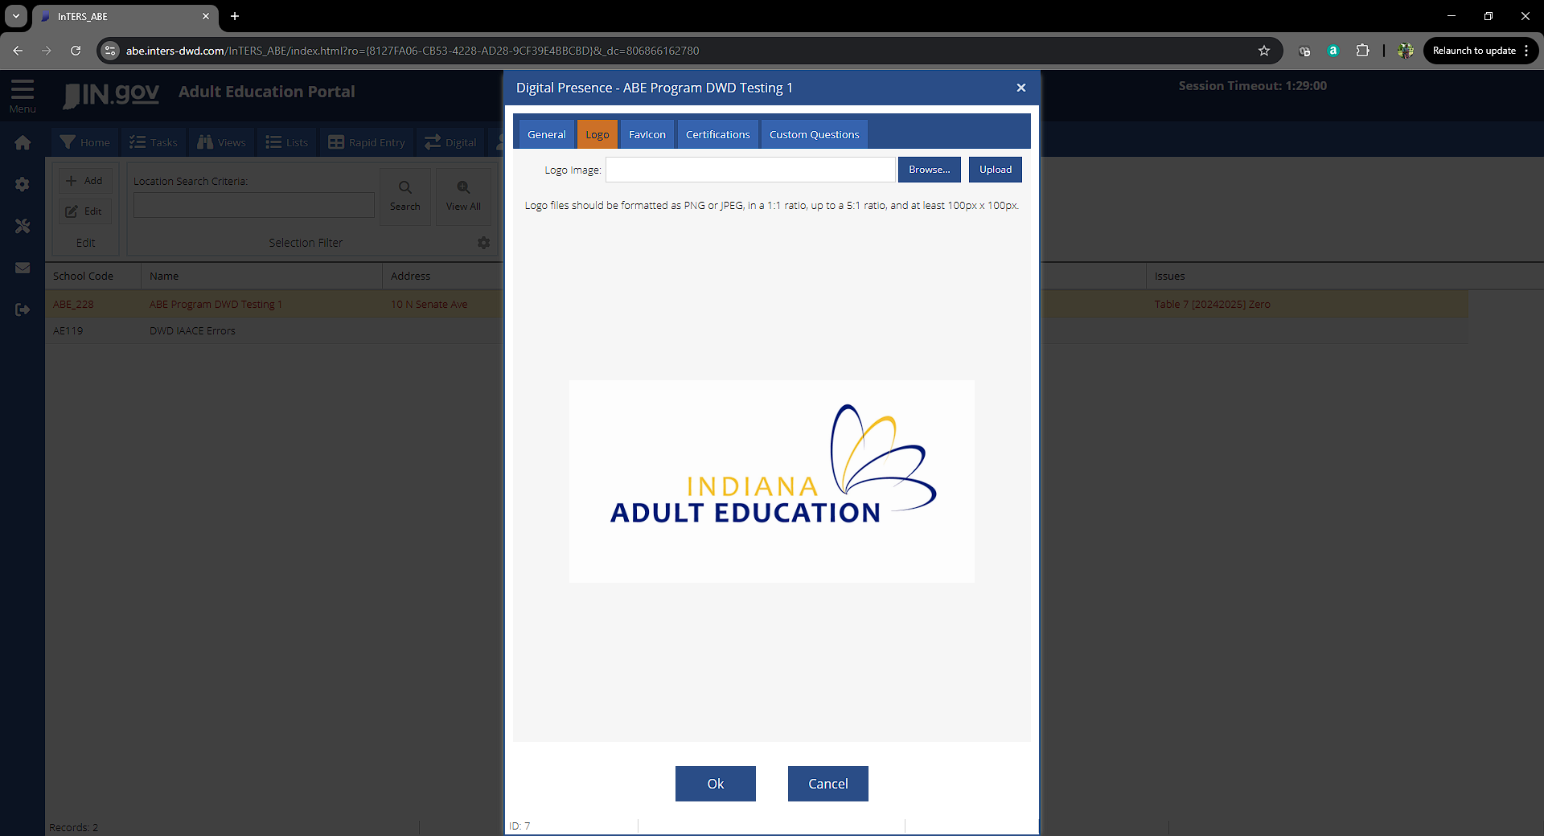
Digital Presence LOGO
Import a quality .png or .jpeg file for your logo
Click ok
Open the digital presence editor and click on you registration link

Slide 8
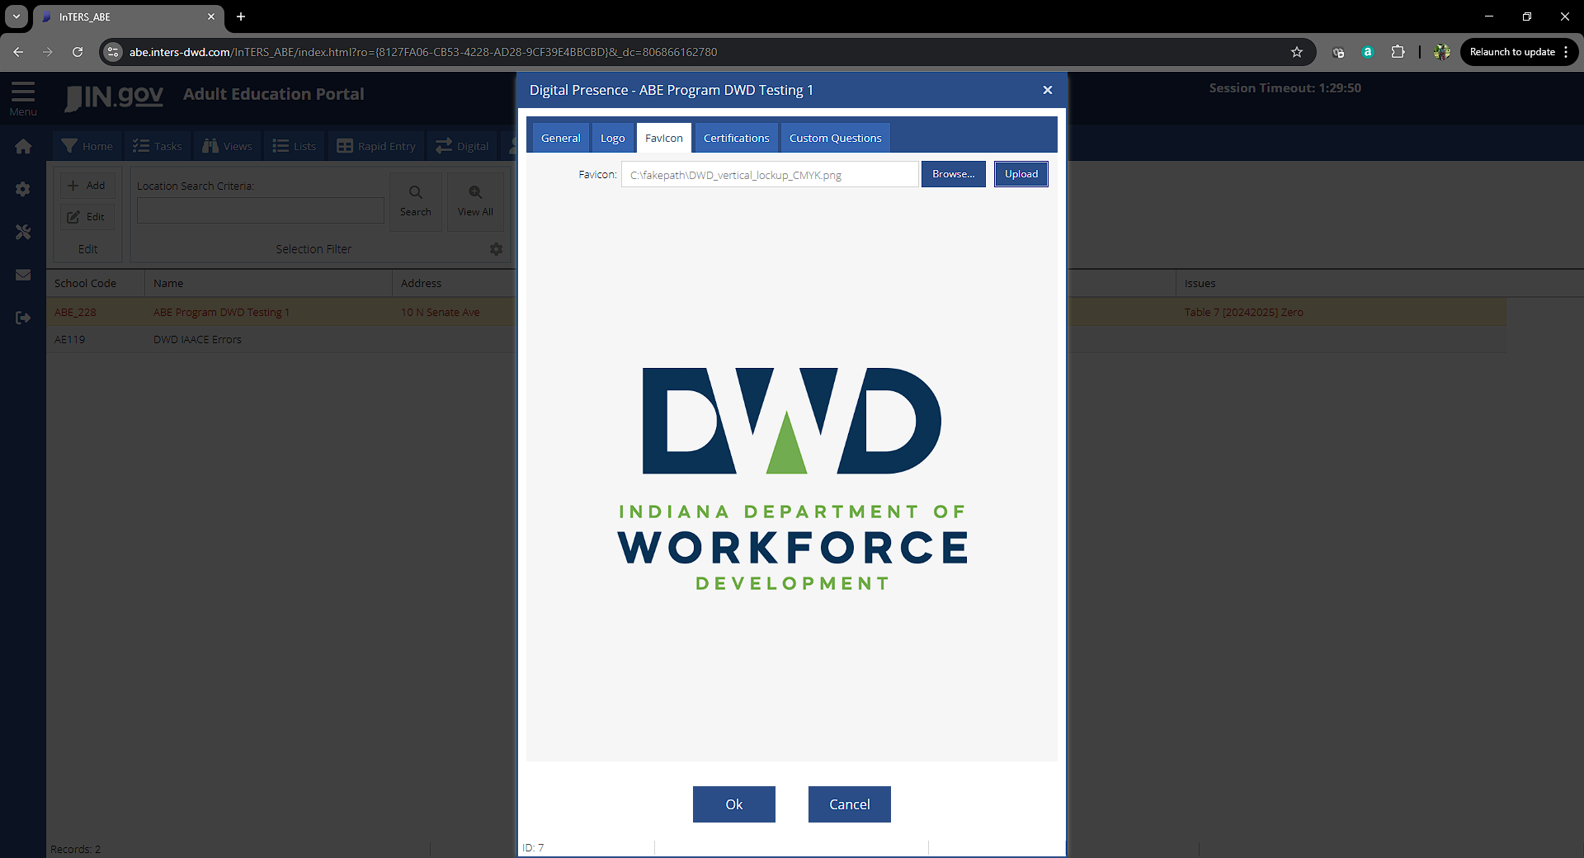
Digital Presence Favicon
Import a quality .png or .jpeg file for your logo
Click ok
Open the digital presence editor and click on you registration link

Slide 9
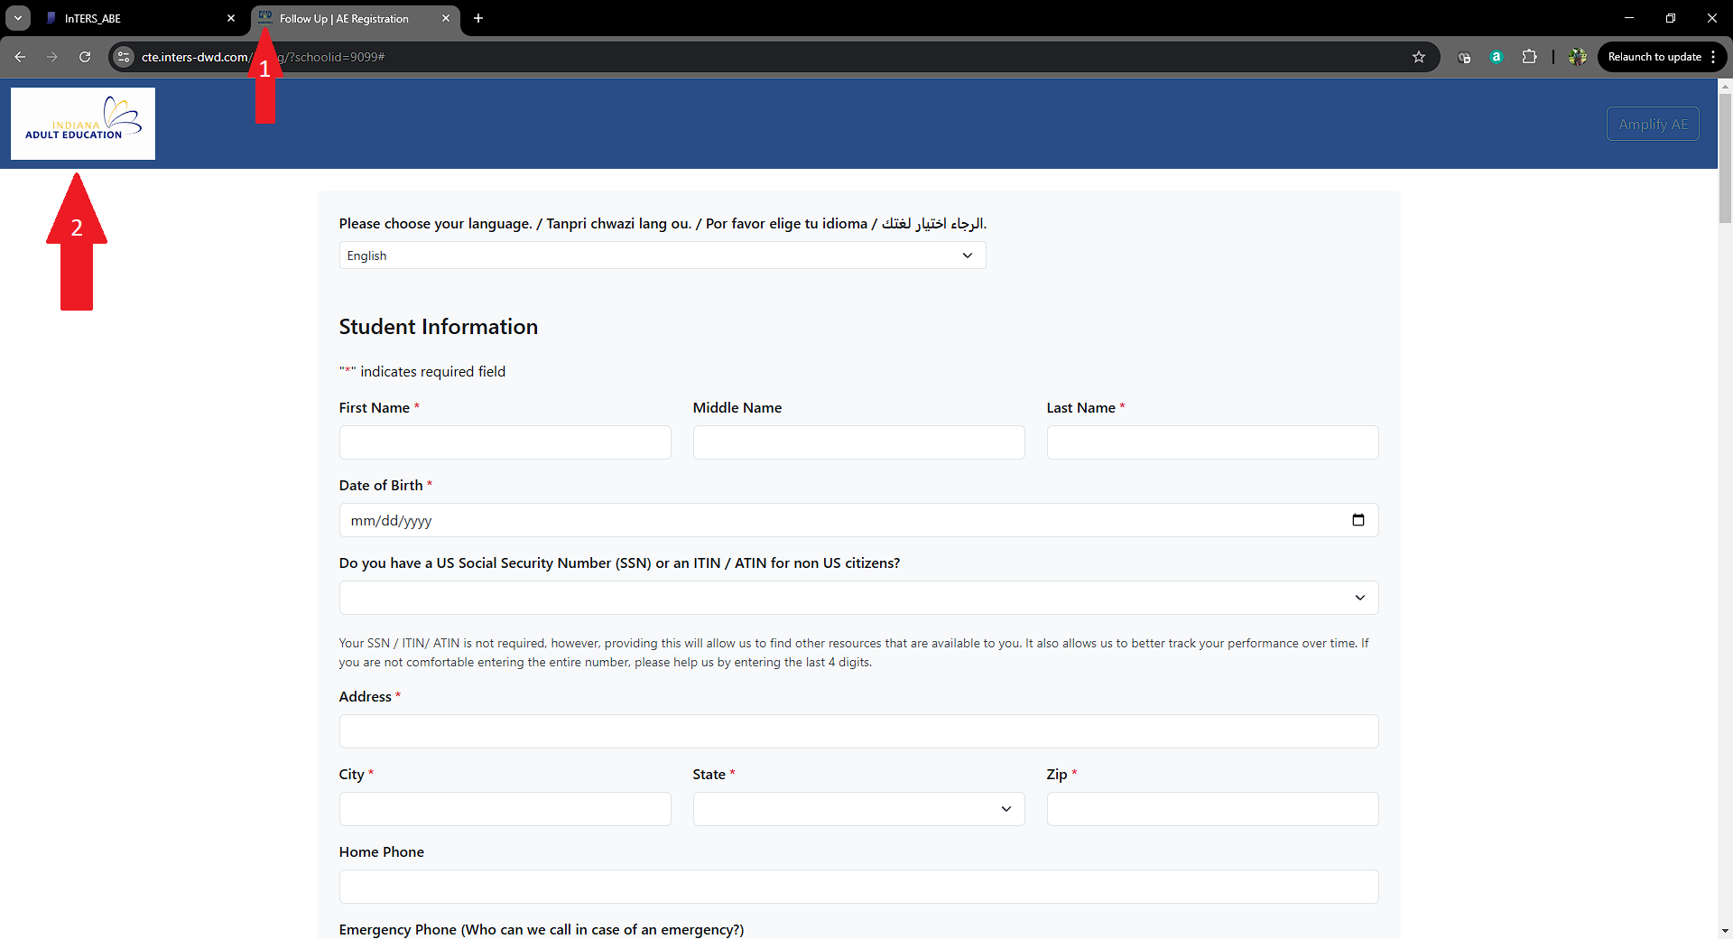
Digital Presence

Slide 10
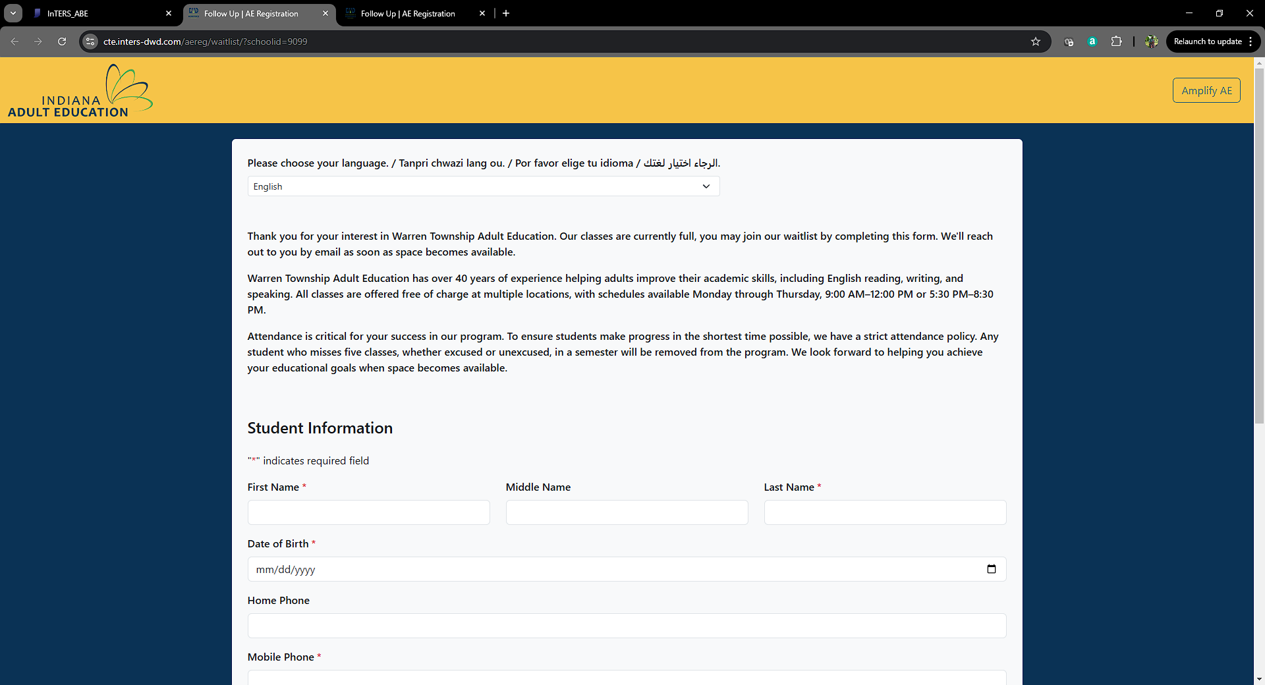
Digital Presence

Slide 11
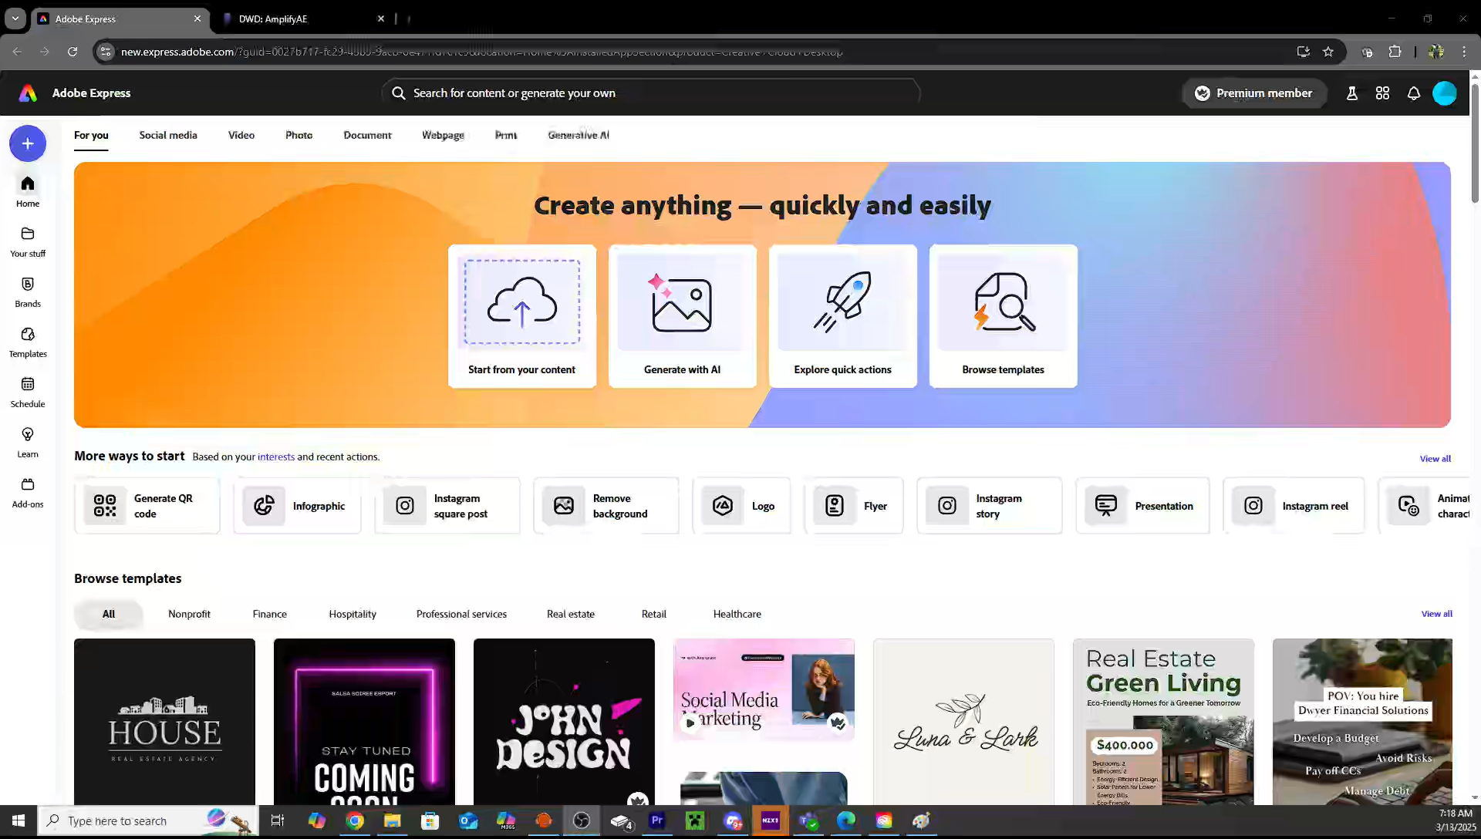
Digital Presence QR Code
Use any QR Code tool
In the video Adobe Express is used(click play on the image on this slide)
Copy the registration link
Paste into the QR Code generator
Download the QR Code
Post the QR Code or Use in the classroom or reception area

Slide 12
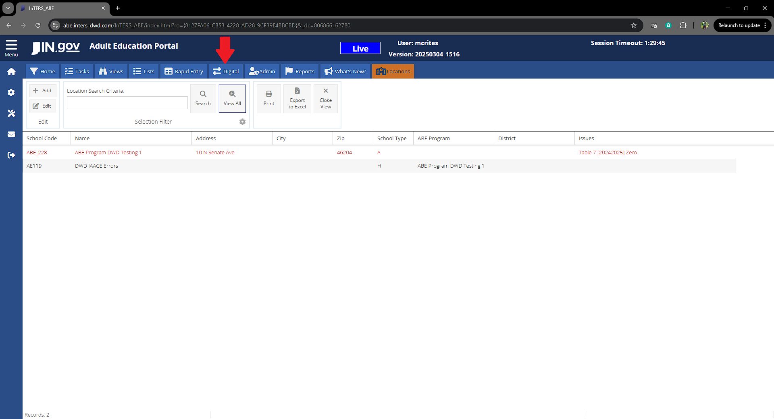
Digital TAB

Slide 13
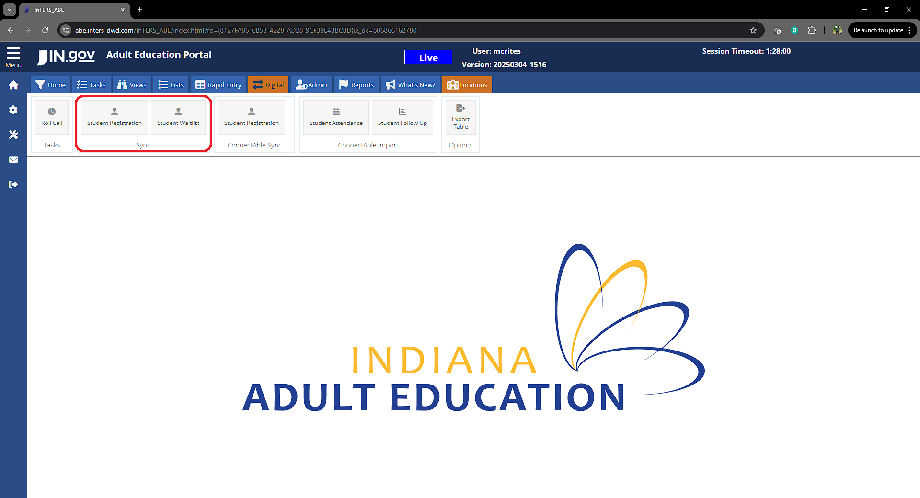
Digital Sync Student Registrations

Slide 14
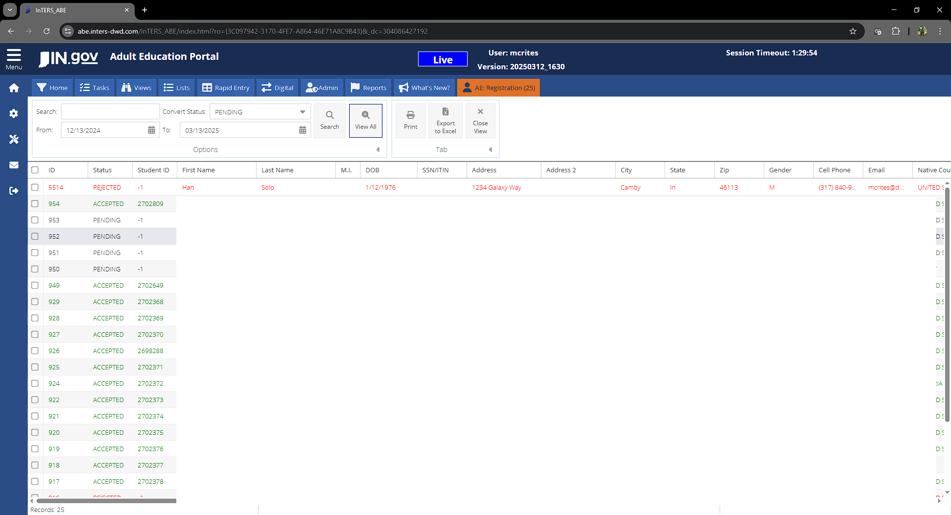
Digital Sync Student Registrations

Slide 15
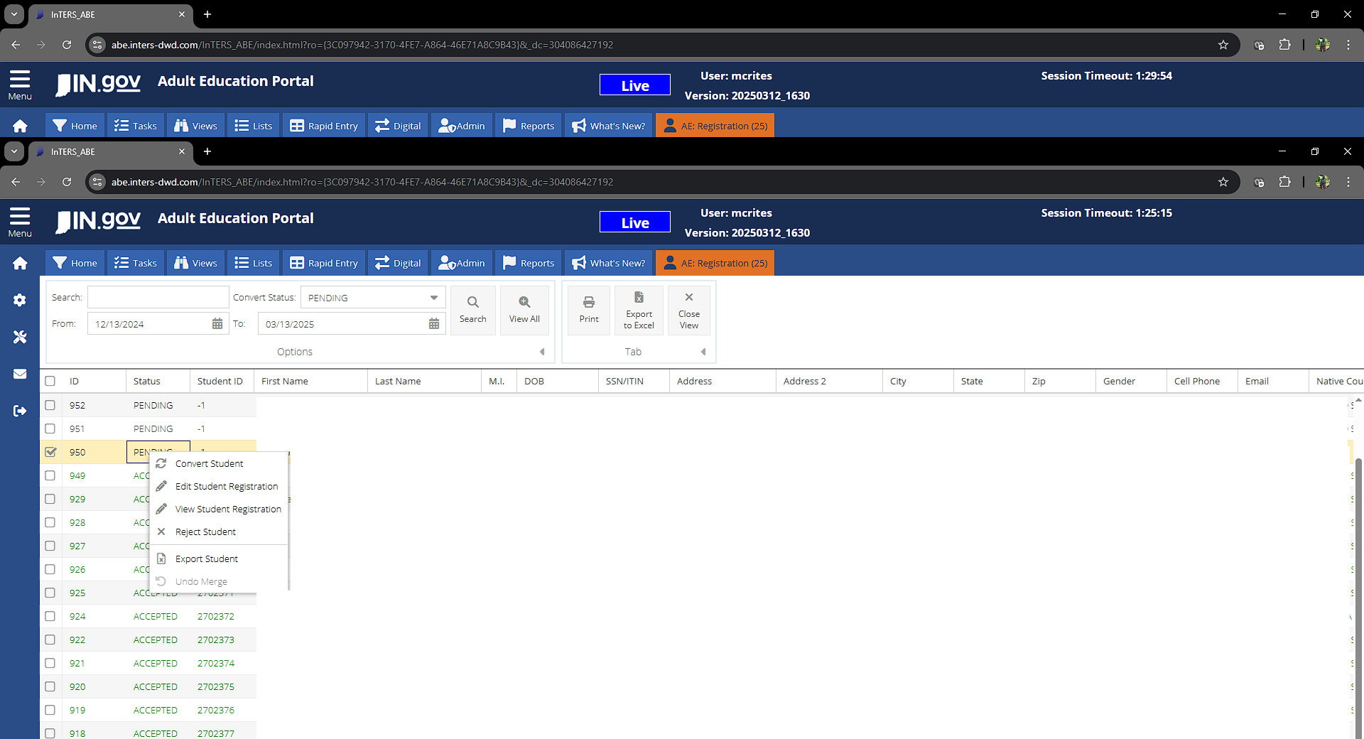
Digital Sync Student Options Right Click

Slide 16
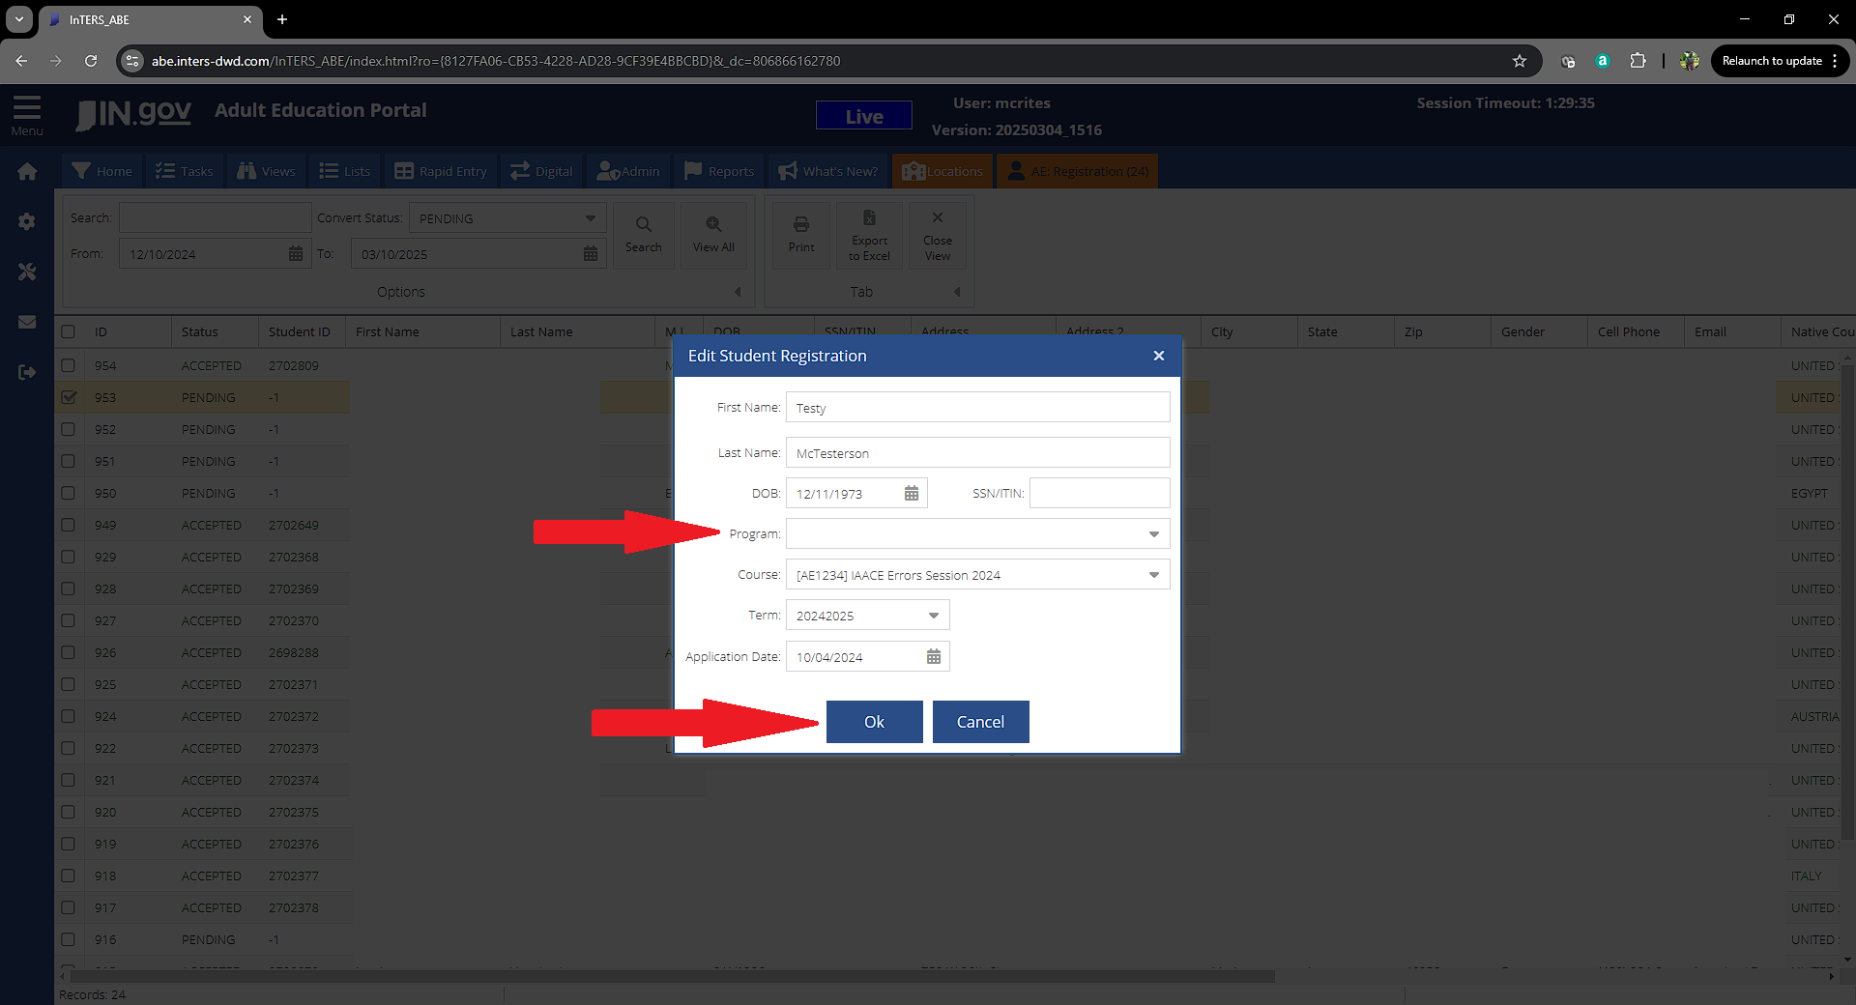
Digital Sync Student Convert

