Slide 1

Student Success at Indiana State
Joshua Powers AVP for Student Success
Richard Toomey, AVP for Enrollment Management
Tradara Mclaurine, Associate Director, Career Services
Beth Whitaker, Director, Faculty Center for Teaching Excellence
Kelah McKee, student
Notes:
Thank you for coming this morning.
Introductions

Slide 2

Student Success Strategy at ISU
Guiding Strategy: Strategic Plan with robust implementation process.
Tactical Strategy - Incoming Students: Addressing underpreparation, intrusive commitment to students, actionable data.
Tactical Strategy – Continuing Students: Aid innovations, clear degree pathways and ongoing curricular reform, graduation specialist
Tactical Strategy – Issue Framing:
  Excellence defined by who we include, not exclude
  Students our greatest asset
  Success is a contact sport
  Asking for help a sign of strength
Notes:
Basic background. You can refine if/as needed.

Slide 3
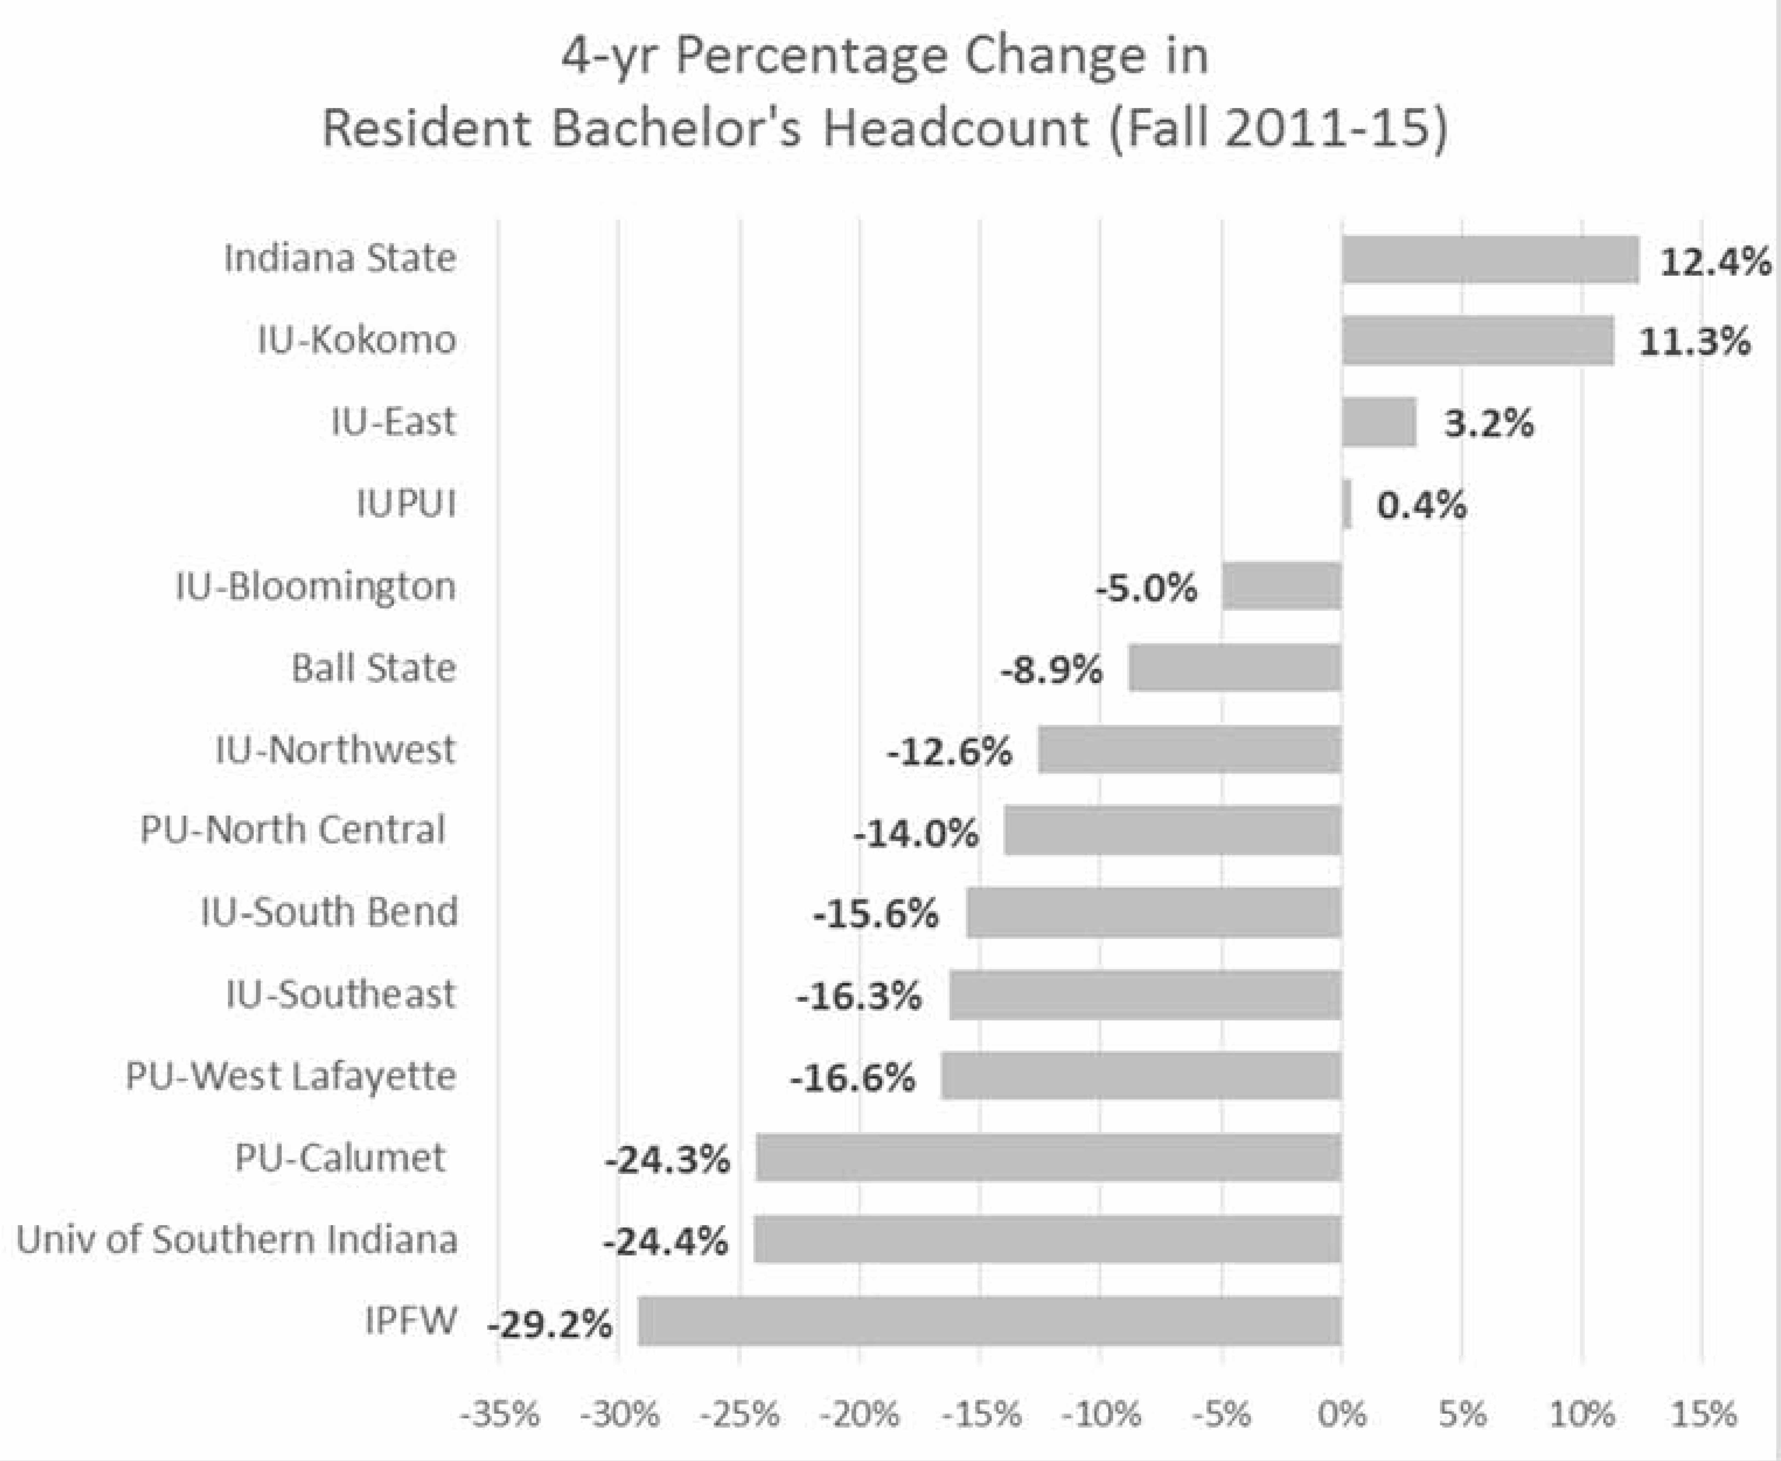
Staying Focused on Our In-State Mission
ISU In-State Sub-Population Changes
FTFT-BDS FR | 2011 to 2015 | Change
21st C. Scholars | 501 to 818 | +63%
Pell | 1,285 to 1,499 | +17%
African Am. | 409 to 554 | +35%
Overall 4-year ISU Graduation Rate:
Highest since recorded; 23.4%
(+4% in one year)
Source: Fall 2015 CHE Public Postsecondary Institution Enrollment Update & ISU IR data.
Notes:
Basic background. You can refine if/as needed.

Slide 4

Student Success at ISU
At STATE, we support student success through service, awareness and counseling. Knowing our students, and their needs, is the first step to their future success.
A holistic approach to student success includes intentional attention to the academic, the financial and the personal wellness of each student’s transition to higher education.
Notes:
Basic background. You can refine if/as needed.

Slide 5
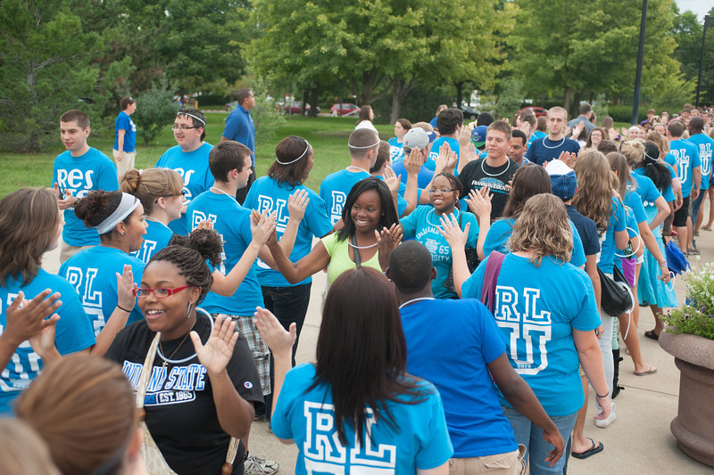
Programming for Student Success
Early Outreach and Partnerships
  Service to students
Merit & Need-based Scholarship programs
  On-Track Scholarship
New Student Transition Programs-Summer Orientation
  Financial Wellness Meeting
Notes:
Basic background. You can refine if/as needed.

Slide 6

Microscholarships for College
Creating awareness for the new student classes of 2018, 2019, 2020 and beyond!
Raise.Me
    4,041 Followers
    1,890 profile views
    218 “sign-ups” in last 5 days!
Introducing Micro‑Scholarships
from colleges for your achievements in high school.
Notes:
Basic background. You can refine if/as needed.

Slide 7
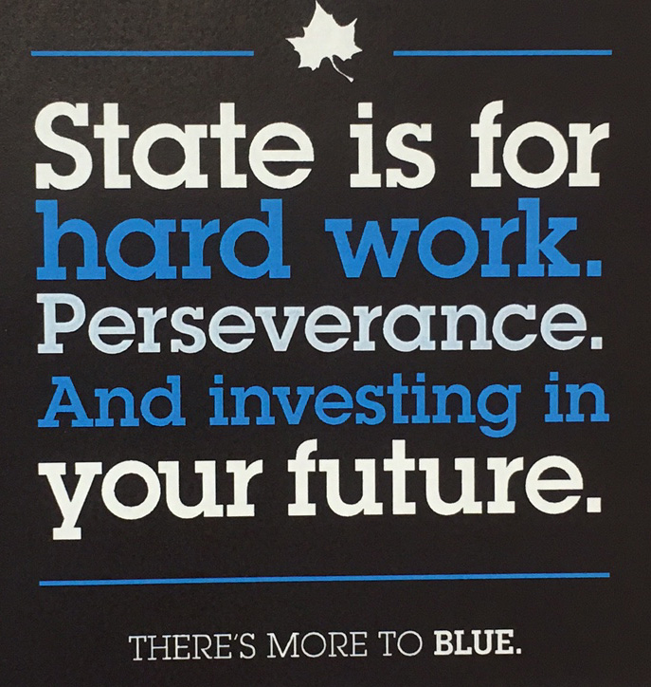
STATE Works-Program Objectives
Provide students a means to pay for their educational expenses and reduce loan debt.
Prepare students for their careers through the development and application of work ethic and work-related skills.
Provide a pathway for student employees to advance to positions with increasing levels of responsibility and complexity.
Maintain or increase University services without increasing labor cost.
Notes:
Basic background. You can refine if/as needed.

Slide 8

Participant Benefits with STATE Works
$1,000 ($500) textbook award through Barnes & Noble bookstore.
“Guaranteed” on-campus job with the opportunity to work a minimum 10 hours per week.
Half of a student’s earnings goes directly to his/her bank account and other half to any unpaid balance.
Available to 150 applicants based on financial need determined by the Office of Financial Aid.
Notes:
Basic background. You can refine if/as needed.

Slide 9

Career Readiness Competencies
Critical Thinking/Problem Solving
Oral/Written Communication
Teamwork/Collaboration
Information Technology Application
Leadership
Professionalism/Work Ethic
Career Management
Notes:
Basic background. You can refine if/as needed.

Slide 10

Sycamore Career Readiness Certificate
Enhance students’ preparation for professional work.
Students earn the certificate based on a set of career experiences and activities.
Benefits
  Gain competitive advantage with employers
  List completion on resume and co-curricular record
  Receive leather padfolio and other items
  Fulfill one of the Category #2 UDIE requirements
All items must be completed prior to graduation.
Notes:
Basic background. You can refine if/as needed.

Slide 11
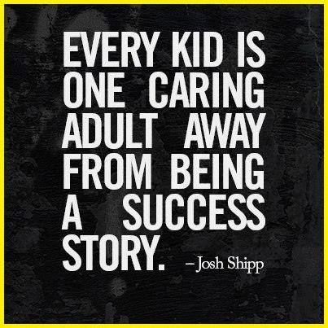
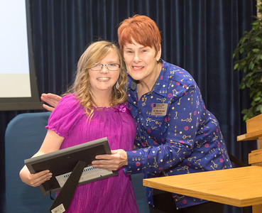
The Student Success Equation
Notes:
Basic background. You can refine if/as needed.

Slide 12
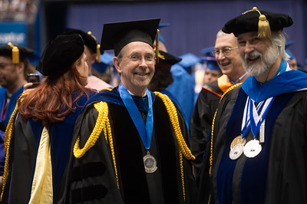
Faculty = Part of This Equation
Notes:
Basic background. You can refine if/as needed.

Slide 13

ISU Student Success Meets Teaching Excellence
Notes:
Basic background. You can refine if/as needed.

Slide 14





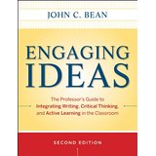
We Love to Read and Talk
Notes:
Basic background. You can refine if/as needed.

Slide 15

Engaging Our Faculty
Book Study Groups
High Impact Practices
Course Transformation Academy
Individual Consultation
Writing Across the Curriculum
Technology/Social Media
Student Success Conference
Mornings in May
Faculty Teaching Circles
Notes:
Basic background. You can refine if/as needed.

Slide 16

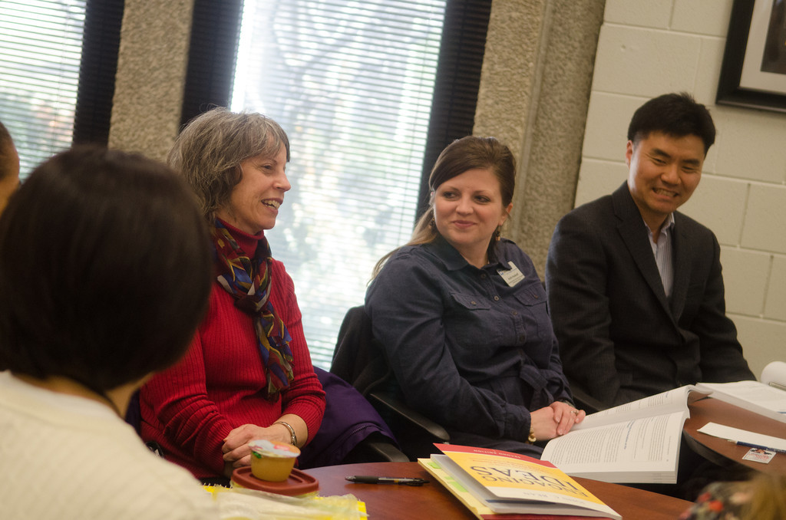
Engaging Our Faculty
Discuss faculty excellence with faculty focus groups
Explore the measurement and reward of faculty excellence
Overtly involve faculty in student success agenda discussion
Convene a conference focused on teaching assessment and development
Be a cheerleader!
Notes:
Basic background. You can refine if/as needed.

Slide 17
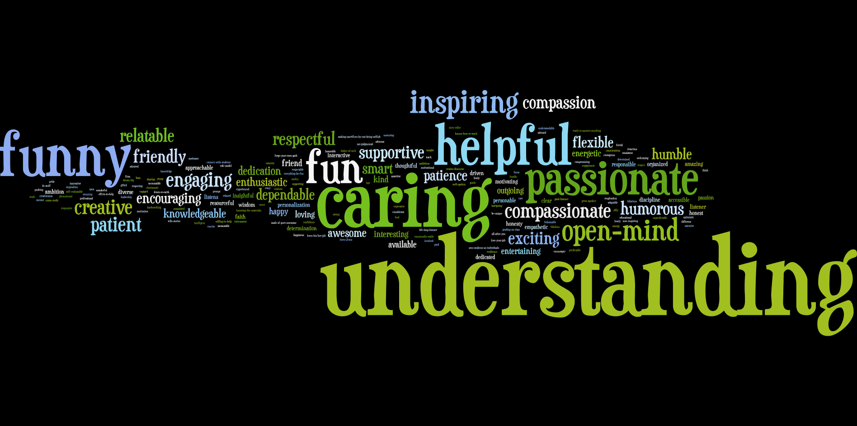
A GREAT College Professor …
Notes:
Basic background. You can refine if/as needed.

Slide 18
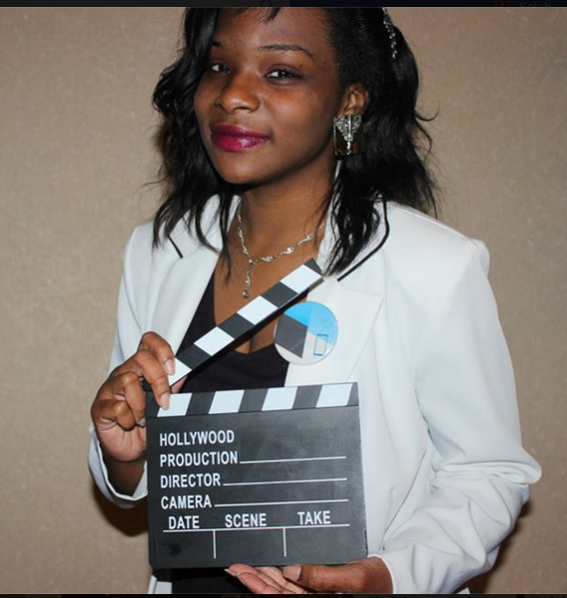
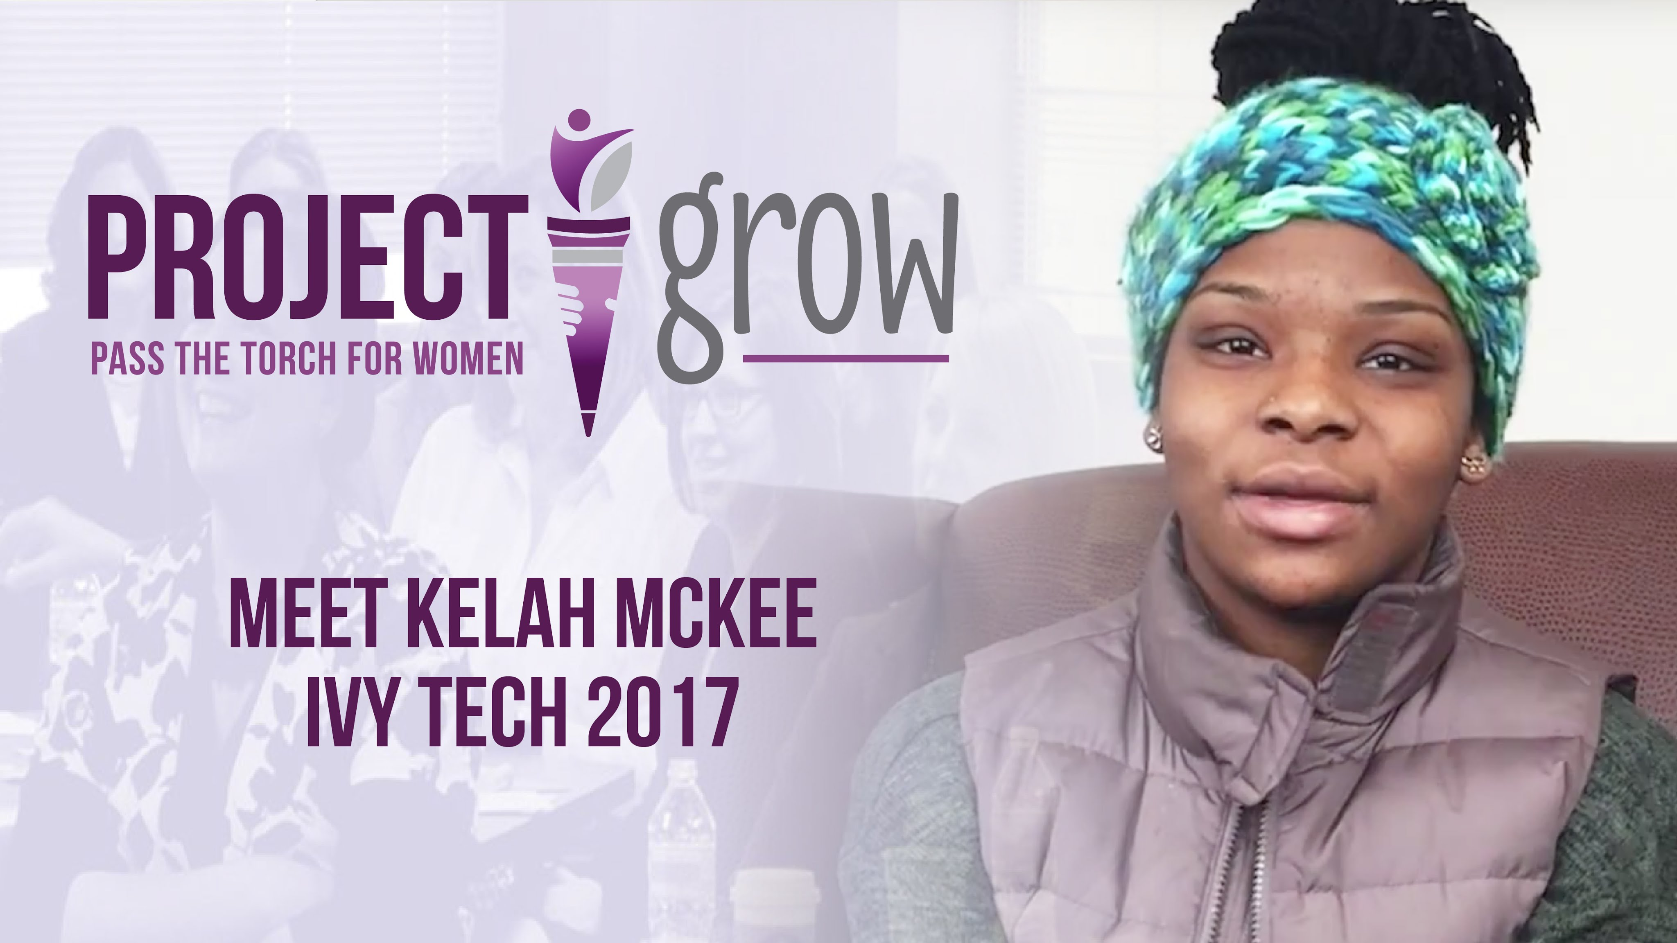
Student Success from a Student Perspective
From Indiana State to Ivy Tech:
A 21st Century Scholar Story
Notes:
Basic background. You can refine if/as needed.

Slide 19

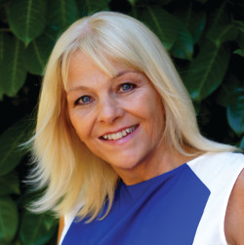
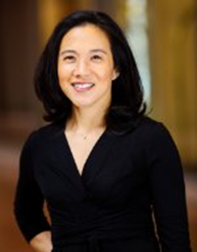



Oct. 4 & 5
ISU Campus
Donna Beegle
Empowering College Students
from a Background of Poverty
National consultant & trainer on working with low income persons
Angela Duckworth
Grit, Perseverance, and
the Science of Success
Author & MacArthur Genius Award Winner
Statewide
Event
And featuring:
Indiana
Notes:
Basic background. You can refine if/as needed.

