Slide 1

Pollution Prevention
Lunch and Learn
Detecting and Fixing Air Compressor Leaks

Slide 2

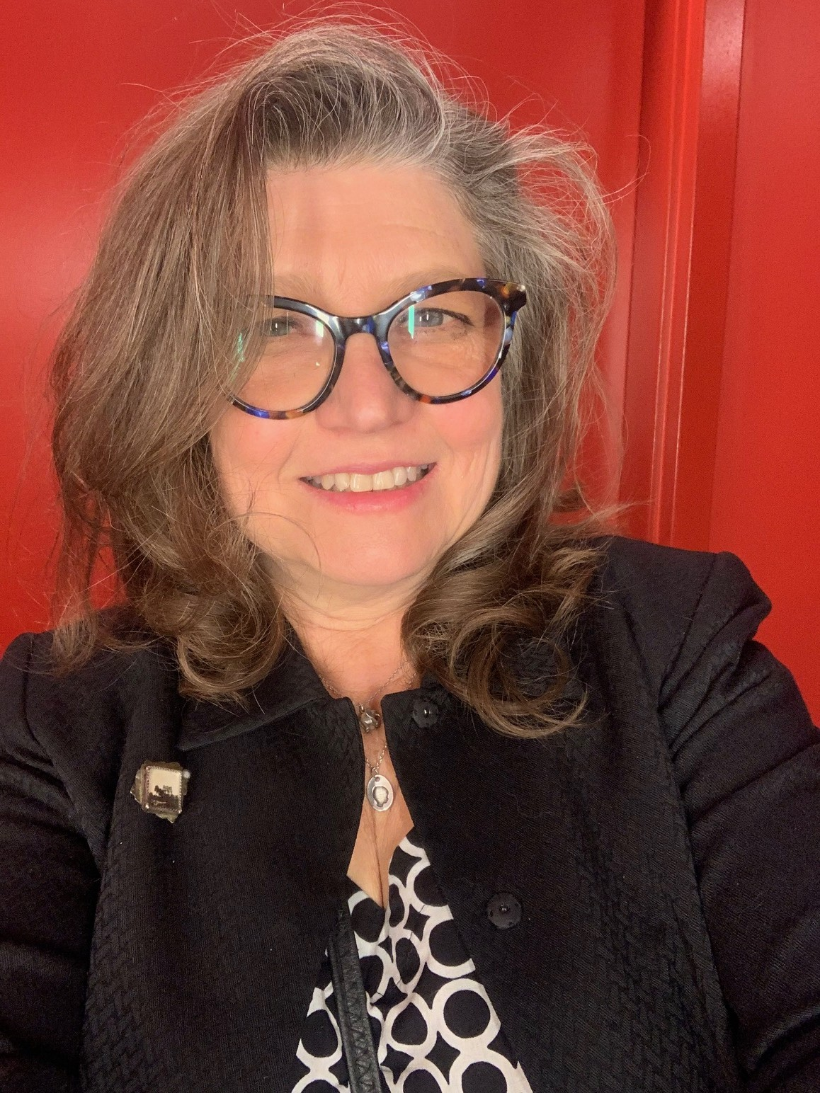


Pollution Prevention Team
Julie L Rhodes
317-233-4477
jlrhodes@idem.in.gov
Pollution Prevention and Compliance Assist Section Chief
Samantha Nunnery
317-233-0572
snunnery@idem.in.gov
Small Business Regulatory Coordinator / CTAP
Katya Drake
317-495-9348
kdrake@idem.in.gov
Pollution Prevention Program Mgr
Hannah Kmetz
317-234-0519
hkmetz@idem.in.gov
Pollution Prevention Intern

Slide 3
Housekeeping Items
Stay muted throughout the webinar.
Post your questions to the Chat to be answered during Q&A.

Slide 4
Today's Agenda
Detecting and Fixing Air Compressor Leaks Video
Compliance and Technical Assistance Presentation
Additional Materials Preview
Q&A Session
Conclusion and Survey

Slide 5
Video
See the video link on the website or visit https://youtu.be/Zt6u3_bHbgE on YouTube

Slide 6



Samantha Nunnery
317-233-0572 | snunnery@idem.in.gov| idem.IN.gov/ctap
Small Business Regulatory Coordinator
Indiana Department of Environmental Management
Office of Program Support
Pollution Prevention and Compliance Assistance Section

Slide 7


Slide 8
Free and Confidential
CTAP services are available to all sectors
of Indiana’s regulated community at
NO COST!
CTAP offers environmental regulatory assistance to Indiana businesses and organizations of ALL sizes and types including:
Existing facilities with legacy issues.
New companies looking to locate in Indiana.
Government agencies.
Trade associations, industry groups, environmental consultants, and other interested stakeholders.

Slide 9
Non-Regulatory
CTAP staff are NOT regulators and do not have regulatory authority to issue violations, permits, fees, fines, or take enforcement actions.
Those who receive CTAP services will NOT be penalized for reporting relevant environmental information to CTAP when requesting assistance.
Notes:
CTAP provides a Quality Assurance Guarantee for written assistance provided and relied upon. Ask a CTAP representative for details.

Slide 10
CTAP Services
CTAP Hotline and Online Portal
Site Assessments
Training
Online Resources
Contact CTAP to:
Receive timely assistance with interpreting a rule or permit requirement.
Determine what steps are needed to obtain a permit to operate or modify processes.
Ask general environmental regulatory or compliance questions
Request a site assessment.
Submit a confidential request via CTAP’s online portal:
portal.idem.IN.gov.
Or call our hotline: 317-232-8172 or 800-988-7901

Slide 11
CTAP Services
Site assessments
A site assessment is a free on-site consultation to observe and evaluate operations and determine environmental regulatory obligations, current compliance status, and identify potential pollution prevention opportunities.
CTAP staff can help troubleshoot a particular process or regulation or conduct an entire facility review. CTAP site assessments may be in-person or virtual.

Slide 12
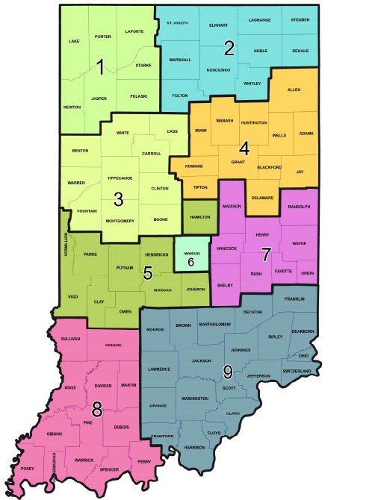
CTAP Staff
Northwest Regional Office:
  1 - Malorie Medellin
Northern Regional Office:
  2 – Hannah Hack
Indianapolis Central Office:
  3 – Mark Stoddard
  4 – Leigh Anne Harvey
  5 – Chrystal Wagner
  6 – Hani Sharaya
    CTAP Small Business Regulatory Coordinator:
        7 - Samantha Nunnery
    Southwest Regional Office:
      8 - Tammy Haug
Southeast Regional Office:
  9 - Susan Raisor
Notes:
Understanding our map, other staff members and their expertise.

Slide 13
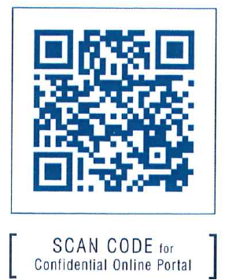

How to Contact
Confidential online portal: portal.idem.IN.gov
Toll-free hotline:
  800-988-7901
  317-232-8172
Website:
  idem.IN.gov/ctap
Email:
  ctap@idem.in.gov

Slide 14
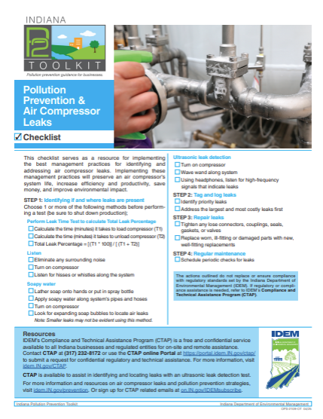
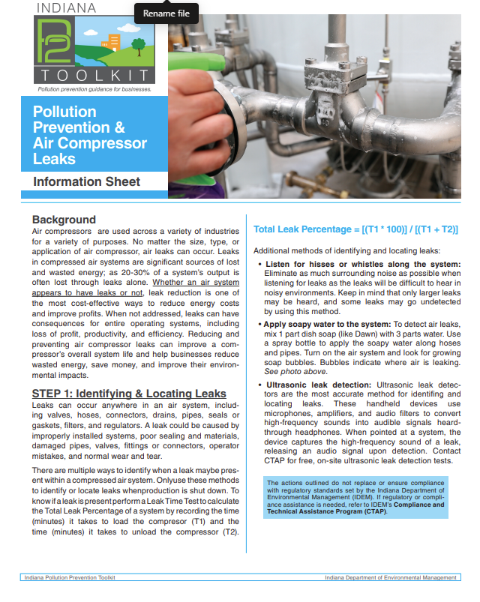
Info Sheet and Checklist
Detecting and Fixing Air Compressor Leaks Checklist
Detecting and Fixing Air Compressor Leaks Info Sheet

Slide 15
Q&A Session
Please ask any questions about detecting and fixing air compressor leaks in the Chat.
If you want to unmute and ask a question, raise your hand and unmute your mic when called on.
*Confidential compliance questions should be sent privately to our CTAP representative.

Slide 16

Please give us feedback!
Indiana P2 Lunch & Learn: Detecting and Fixing Air Compressor Leaks Survey
Pollution Prevention Questions:
Katya Drake
317-495-9348
p2@idem.in.gov
Pollution Prevention Program Manager
Compliance Assistance Questions:
Samantha Nunnery
317-233-0572
snunnery@idem.in.gov
Small Business Regulatory Coordinator

Slide 17
Thank you for joining us for our first P2 Lunch and Learn!
Additional materials to be added to the P2 Toolkit website and emailed to you by 07/25/25.
https://www.in.gov/idem/prevention/pollution-prevention-toolkit/
Be on the lookout for addition P2 Lunch and Learns:
  October 2025 - Spray Paint Efficiency
Pollution Prevention Questions:
Katya Drake
317-495-9348
p2@idem.in.gov
Pollution Prevention Program Manager
Compliance Assistance Questions:
Samantha Nunnery
317-233-0572
snunnery@idem.in.gov
Small Business Regulatory Coordinator

