Slide 1
INAIAC Director’s Report
MeLissa Williams
October 17th, 2018

Slide 2
September 10th to Now
Attended Conferences
  American Indian Women Indigenous Conference-
  North Carolina American Indian Commission
Women of Influence Symposium,
2018 Minority Health Partners Conference
Governor’s Interstate Council in South Dakota
Region V ICRC, Fair Housing Conference

Slide 3
What did I learn from the conferences?
Plan a health conference for health professionals about Native American Indian health.
Native American Indian statistics should be included at any conference in the State of Indiana. (Health, Fair Housing, Civil Rights, Education, Employment)
Networking is critical!
INAIAC needs to be more proactive, strategic in finances, issues, and events.
INAIAC needs to create a newsletter to send out.
INAIAC needs to create a Native American Indian event for NAI to receive resources on Fair Housing, health, education, employment and civil rights .

Slide 4
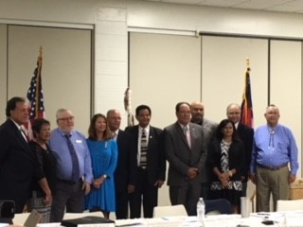
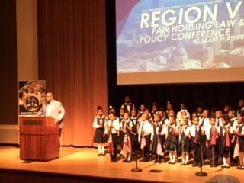
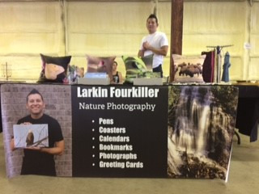
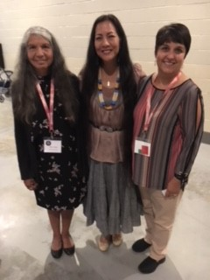
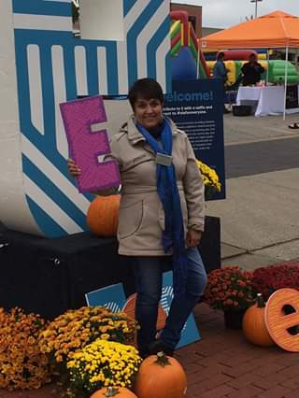
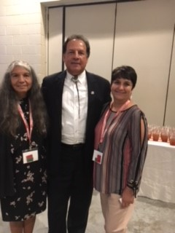
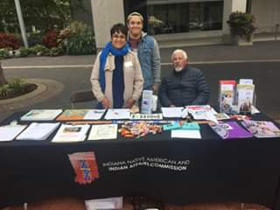

Slide 5
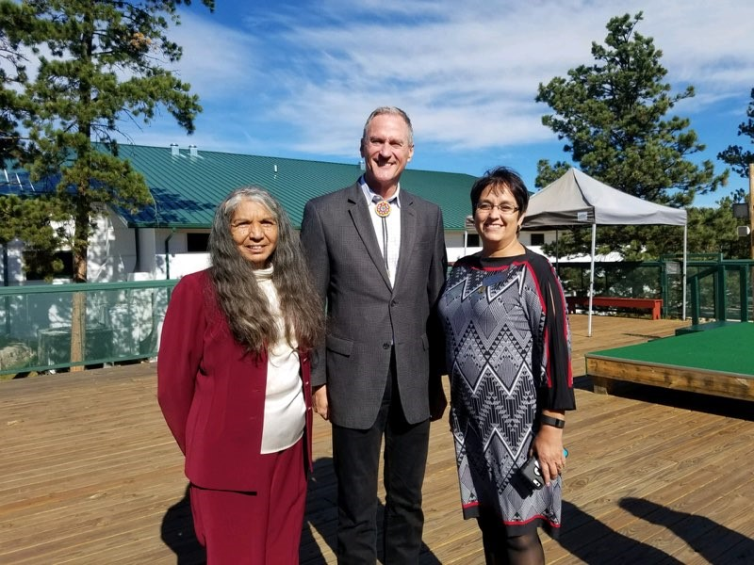
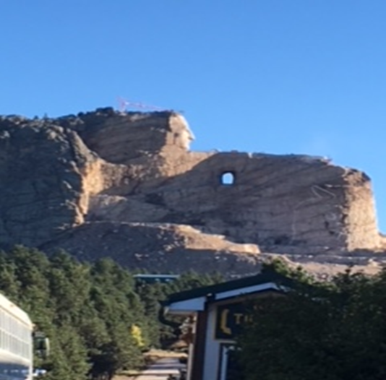
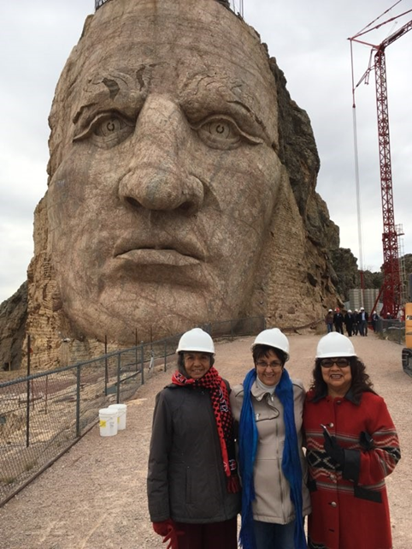
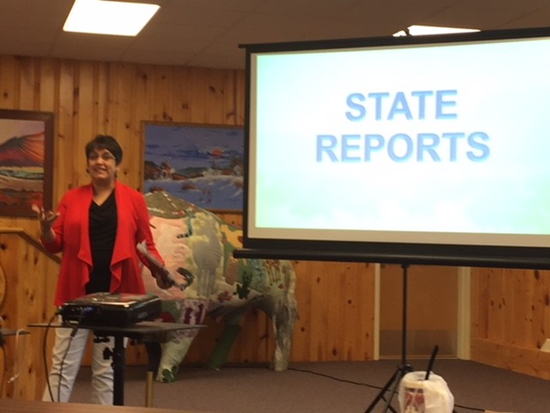

Slide 6
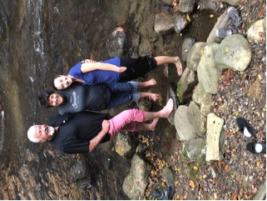
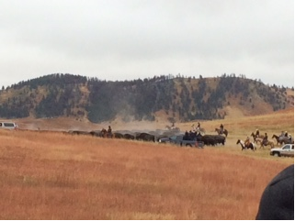
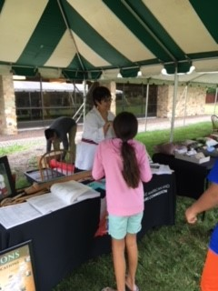
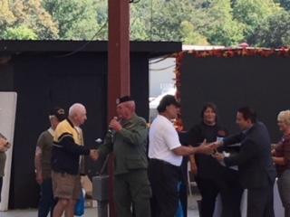
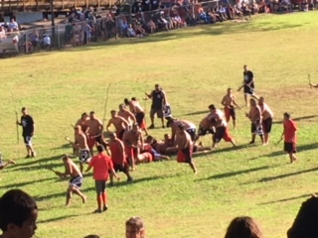
Activities

Slide 7
Meetings
Meetings in setting the November 2nd Native American Days at the Capitol.
Meeting in setting up the November 3rd INAIAC Honors Native American Indian Veterans Ceremony. See attached draft of the ceremony.
Set up meeting to meetings with the Pokagon Band of Potawatomi and his staff.
Set up to be a conference speaker at the Indiana Census Bureau.
Set up the activities for Native American Indian Days at the Veteran’s Hospital.
Met with the Executive Director, Greg Wilson on several occasions to talk about the INAIAC progress.
Written reports and reported on the progress of the commission to the GIIC Indiana Civil Rights staff meetings, and Cultural Commission meetings and to the Executive Director, Greg Wilson.
Introducing myself all the time and looking for ways to network, collaborate and partner. Networking to create partnerships so to forward the mission of the INAIAC in assisting our Native American Indian people.

Slide 8
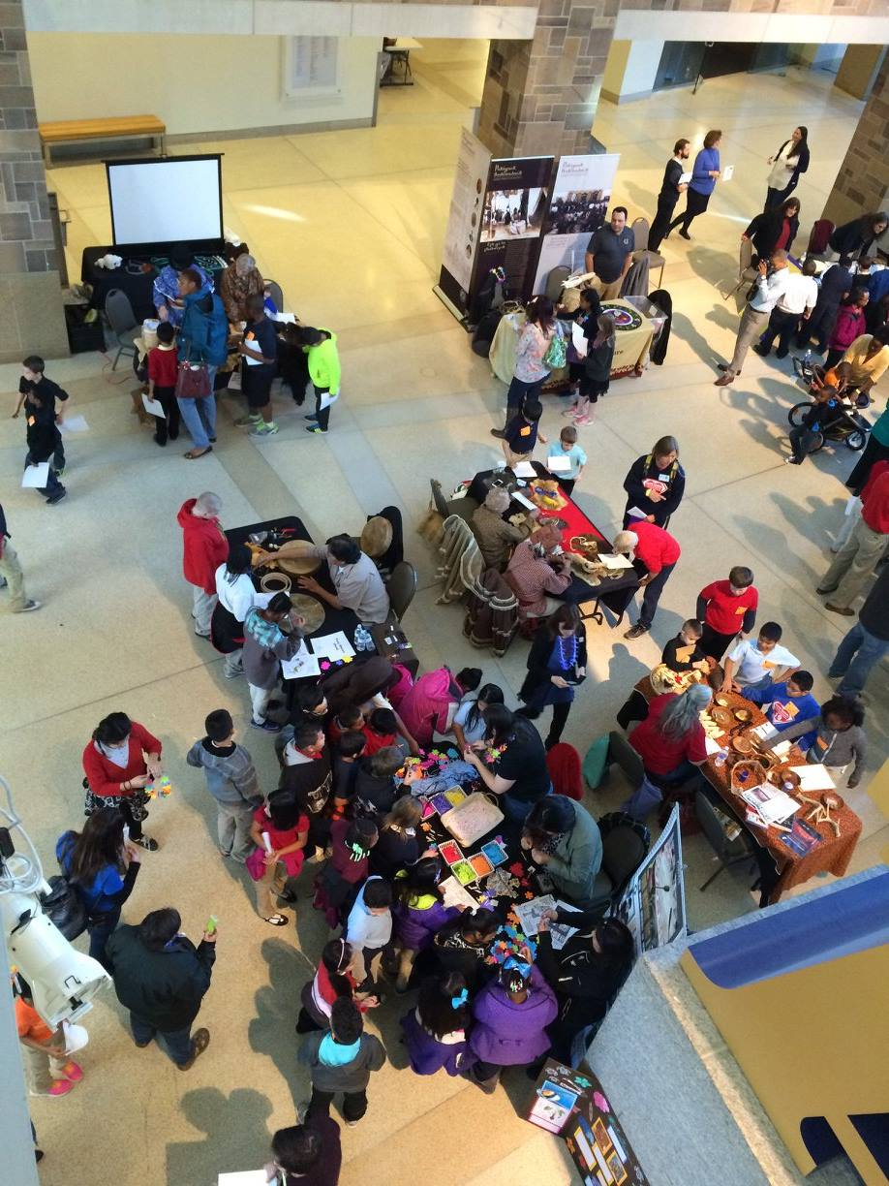
Financials for INAIAC Native American Indian Days at the Capitol
Budget =$5000.00
Total Expenses=
Use of the Capitol=FREE
Use of Capitol Equipment=FREE
Catering= Waiting on bids.
Hotel Expense for our Drum
Teacher Programs= Free
Students Activity Page= Free
Proclamation Framing=$75.00
Advertising the NAI Days=Free
Expectation of at least 1000 students with 25 Teachers utilizing the INAIAC Teacher Grants=$6250.00

Slide 9
Financials for INAIAC Honors Native American Indian Veterans Ceremony
Budget=$15,000.00 for 400 people License Plate Fund
Expenses=
Honor Guard= still pending
Speakers=Free
Programs=FREE
Indiana War Memorial=FREE
Invitations to 992 Native American Indian Veterans=$2004.00
Challenge Coins =$6810.00
Catering=$7425.78 * Trying to reduce.
Clean Up=$200.00
Singer=Mileage from Evansville to Indianapolis
Feeding Singer and Drum= INAIAC Director will provide out of pocket.

Slide 10
Challenge Coins Appearance

Slide 11
Invitations
992 invitations will be sent out on October 17th.

Slide 12
Financial Budget for Veteran’s Hospital
Budget=$500.00
Expenses=
Craft-Keychain for 100 people
Video- Free
Cookies and Punch
Waiting on bids for materials on the craft.
Waiting on bids on the cookies and punch for the Veteran’s Hospital event.
May need to be adjusted.

Slide 13
Scholarships
Applicants
Alaina Bryant-IUPUI
Noah McClerkin-Purdue
Haley Begay-IU
Increased from $2500 to $3000.00.

Slide 14
Finances for September 2018
Received the bill for the tablecloth.

