Slide 1

Equal Opportunity 101
Ensuring Equal Opportunity and Nondiscrimination
Department of Workforce Development

Slide 2
What is Equal Opportunity?
Color
Race
Religion
Sex
Age
National Origin
Political Affiliation
Disability
Citizenship
Participation in WIOA program
“No individual in the United States may, on the basis of race, color, religion, sex, national origin, age, disability, or political affiliation or belief, or, for beneficiaries, applicants, and participants only, on the basis of citizenship or participation in any WIOA Title I-financially assisted program or activity, be excluded from participation in, denied the benefits of, subjected to discrimination under, or denied employment in the administration of or in connection with any WIOA Title I-financially assisted program or activity.”
  -29 CFR 38.5

Slide 3
How do you ensure EO is being PROVIDED?
Notice and Communication
Limited English Proficiency
Affirmative Outreach
Accessibility
Addressing Complaints
Monitoring

Slide 4
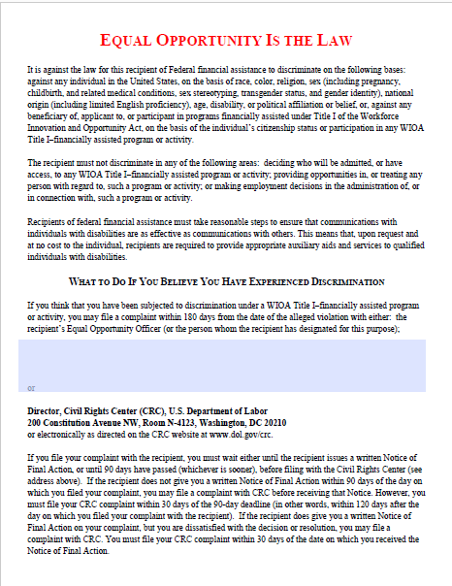
Notice & Communication
EO is the Law Notice
  MUST:
    Be posted in prominent places around the office, including resource areas, and on web site pages
    Be included in orientations, registrations, and in both employee and participant handbooks
    Have the local EO officer’s name and contact information
    Be available in appropriate languages
      Based on number or proportion of LEP Individuals in area
    Be provided in appropriate formats
      Example: Large print for visual impairment
    Be disseminated in internal memos/other written communications with staff
    Be provided to each participant and employee and be part of their file
Notes:
29 CFR 38.39: Communication of notice in orientations.
During each presentation to orient new participants, new employees, and/or the general public to its WIOA Title I-financially assisted program or activity, in person or over the internet or using other technology, a recipient must include a discussion of rights and responsibilities under the nondiscrimination and equal opportunity provisions of WIOA and this part, including the right to file a complaint of discrimination with the recipient or the Director. This information must be communicated in appropriate languages as required in §38.9 and in formats accessible for individuals with disabilities as required in this part and specified in §38.15.

Slide 5
Notice & Communication
EO Tagline
  “Equal Opportunity Employer/ Program”
  and
  “Auxiliary aids and services are available upon request to individuals with disabilities”
  Both the above clauses must be on all recruitment brochures and other materials that are ordinarily distributed or communicated to staff, clients, or the public
    Includes written, oral, electronic, or paper materials/communications
    Includes materials/communications that describe programs financially assisted under WIOA or the requirements for participating by recipients and participants
Notes:
29 CFR 38.38

Slide 6
Limited English proficiency
What is Limited English proficient (LEP):
An individual whose primary language for communication is not English and who has a limited ability to read, speak, write, and/or understand English
LEP individuals may be competent in English for certain types of communication, but still be LEP for other purposes
  Example: A Spanish speaking individual who speaks English well, but cannot read or write in English
Discrimination against LEP individuals falls under national origin – 29 CFR 38.9
Notes:
29 CFR 38.4(hh)

Slide 7
Limited English proficiency
  Vital documents/information
    Information, whether written, oral or electronic, that is necessary for an individual to understand how to obtain any aid, benefit, service, and/or training; or required by law.
    Examples of documents containing vital information include, but are not limited to:
      Applications, consent and complaint forms
      Notices of rights and responsibilities
      Notices advising LEP individuals of their rights under this part, including the availability of free language assistance
      Rulebooks/Instructions
      Written tests that do not assess English language competency, but rather assess competency for a particular license, job, or skill for which English proficiency is not required
      Letters or notices that require a response from the beneficiary or applicant, participant, or employee
Notes:
29 CFR 38.9 (g)- With regard to vital information (as defined in 20 CFR 38.4(ttt)):
For languages spoken by a significant number or portion of the population eligible to be served, or likely to be encountered, a recipient must translate vital information in written materials into these languages and make the translations readily available in hard copy, upon request, or electronically such as on a Web site. Written training materials offered or used within employment-related training programs as defined under §38.4(t) are excluded from these translation requirements. However, recipients must take reasonable steps to ensure meaningful access as stated in §38.9(b).
Recipients must include a “Babel notice,” indicating in appropriate languages that language assistance is available, in all communications of vital information, such as hard copy letters or decisions or those communications posted on Web sites.
To the extent otherwise required by this part, once a recipient becomes aware of the non-English preferred language of an LEP beneficiary, participant, or applicant for aid, benefit, service, or training, the recipient must convey vital information in that language.

Slide 8
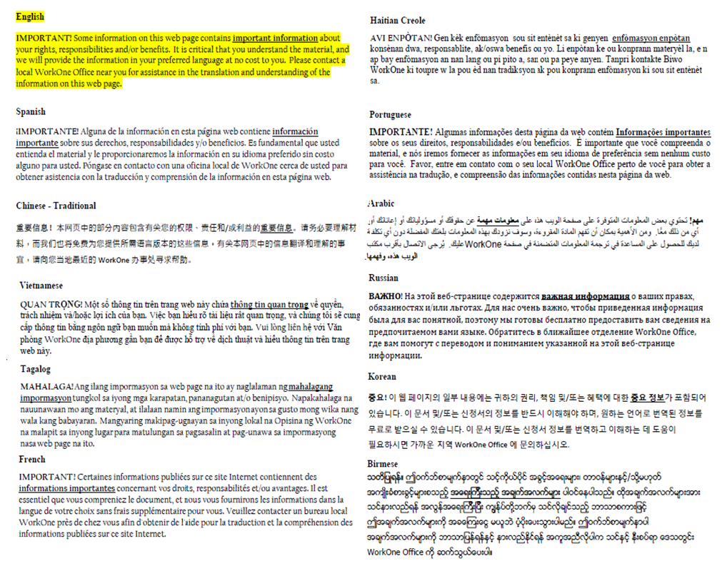
Limited English proficiency
Vital documents/information – Notice and Translation
  Must be translated into languages spoken by a significant number or portion of population eligible to be served or likely to be encountered.
  Babel Notice:
    A short notice included in a document or electronic medium (e.g., Web site, “app,” email) in multiple languages informing the reader that the communication contains vital information, and explaining how to access language services to have the contents of the communication provided in other languages.
Notes:
29 CFR 38.4(i)

Slide 9
Language Services
Translation and interpreter services
  Vendors: Proprio, Luna, and LTC Language Solutions
  Cannot require LEP individual to rely on their own interpreter except in emergency situations or if the individual decides to use their own interpreter
    Recipient can still provide their interpreter when they need to ensure accurate information
  When a phone number is provided, must be accompanied by telephone number of the text telephone (TTY) or equally effective communication system
  Any services provided are at no cost to the client
Notes:
Vendors:
Proprio - https://propio-ls.com/services/ - over the phone and on-site interpreting services for over 40 languages.
LTC Language Solutions – face to face, phone, and Video Remote Interpretation
https://ltclanguagesolutions.com/interpretation/
29 CFR 38.9(f)
29 CFR 38.38(a)

Slide 10
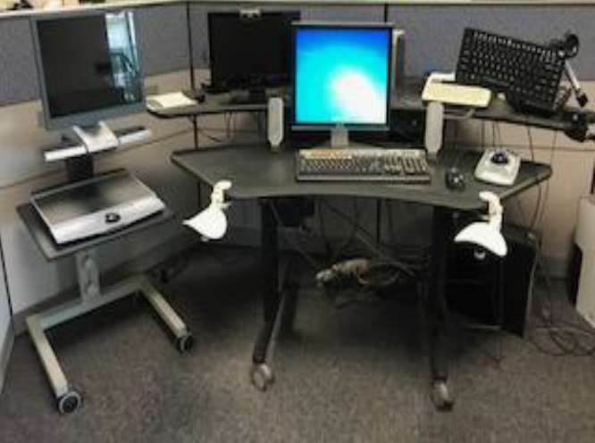
Disability and accessibility
Physical Accessibility
  Facilities must be accessible and usable by individuals with disabilities
    Review of the center’s access to bathrooms, adjustable work stations, and appropriate signage, including signage to meet multilingual needs common to the specific region of the State.
    Review of the availability of transportation to the American Job Center and access into the site location via ramps consistent with the Americans with Disabilities Act’s (ADA) standards.
Notes:
29 CFR 38.13
Title II of ADA
Section 504 of Rehabilitation Act

Slide 11
Disability and accessibility
Programmatic Accessibility
  Must:
    Make modifications to policies, practices, and procedures
    Provide appropriate auxiliary aids or services
    Provide reasonable accommodations for individuals with disabilities
    Administer programs in the most integrated setting appropriate
    Communicate with persons with disabilities as effectively as with others

Slide 12
Affirmative Outreach
Must make reasonable efforts to include members of the various protected groups, including, but not limited to;
  Persons of different sexes
  Various racial and ethnic/national origin groups
  Various religions
  Individual with Limited English Proficiency
  Individuals with disabilities
  Individuals in different age groups
Notes:
29 CFR 38.4

Slide 13
Affirmative Outreach
Examples of affirmative outreach efforts:
  Targeting specific populations when advertising programs/services
  Sending information to schools or community service groups that serve various populations
  Consulting with community service groups on ways to improve outreach and service
Notes:
Indiana Latino Institute, social service organizations, neighborhood organizations, Community Health Networks to name a few. Each LWDA has a variety of service organizations that they can share with their own AJC staff.

Slide 14
Complaints of Discrimination
What are regular complaints versus complaints of discrimination?
  Non-Discrimination Complaint:
    I was not approved for a specific training that was not on the approved training provider list or the case manager didn’t provide me with accurate information
  Discrimination Complaint:
    I didn’t get approved for training because of my age or the case manager didn’t provide me an interpreter and therefore she/he discriminated against me because of my language barrier
Notes:
Region can edit this slide or add an additional slide to add their own regional process and procedures for AJC staff.

Slide 15
Complaints of Discrimination
Complainant may file a complaint by completing and submitting CRC’s Complaint Information and Privacy Act Consent Forms
  can be obtained from your local Equal Employment Officer or from the Civil Rights Center
Complaints must be filed in writing (electronically or in hard copy)
Complaints must contain the following information:
  Complainant name
  Complainant mailing address
  Complainant email address, if available (or another means of contact)
  Identity of respondent
  Description of allegations
  Written or electronic signature of the complainant or complainant’s representative
Notes:
LWDA can enter their contact information for their local EO officer
29 CFR 38.69 and 29 CFR 38.70

Slide 16
Complaint Processing Procedures
  Procedure must include the following elements
    Initial written notice to complainant acknowledging receipt of complaint, right to representation, notice of rights in EO poster, right to request and receive auxiliary aids at no cost, language assistance services
    Written statement of the issue provided to complainant and whether Recipient will accept or reject each issue
    Period for investigation
    Period for attempt to resolve complaint, provision for alternative dispute resolution (ADP)
    Written Notice of Final Action
      Recipient will issue a written Notice of Final Action on complaints within 90 days of the date on which it was filed
      Must include:
        Decision on issue and explanation of reasons or description of the way parties resolved the issue
        Notice of right to file complaint with CRC within 30 days if dissatisfied
Notes:
29 CFR 38.72

Slide 17
Monitoring
Local Monitoring of Equal Opportunity Program
  Conducted by your Local EO Officer at each of the WorkOne offices in the region
Annual Monitoring by State EO Officer
  DWD Regulatory Oversight and Compliance (ROC) Division will monitor region
Includes:
  Structural accessibility, parking for individuals with disabilities, designated restrooms, appropriate signage, program accessibility, and effective communication for persons with disabilities and LEP individuals
  Desk review of local EO policies, job description of the Local EO Officer, EO Notice requirements, complaint procedures, and contracts, training agreements, and Memoranda of Understanding
  On-site interviews with local EO officer and assessments of the WorkOne offices
Notes:
29 CFR 38.51

Slide 18
Equal Opportunity Officers
State EO Officer
Overseeing development and implementation of the state’s Nondiscrimination Plan
Serving as state liaison with CRC
Monitoring compliance with WIOA Title I EO and nondiscrimination requirements
Undergoing and providing training and technical assistance to local EO officers
Developing procedure for and investigating discrimination matters that rise to the state level
Local EO Officer
Reporting EO matters to the State EO Officer
Ensuring overall implementation of the NDP
Conducting outreach and education about EO and nondiscrimination requirements and complaint filing process
Reviewing region’s policies to ensure they are nondiscriminatory
Surveying WorkOne offices to ensure compliance with accessibility requirements
Undergoing and providing training for staff and service providers
Monitoring compliance of regional WIOA Title I recipients
Processing and investigating regional discrimination complaints
Notes:
The NDP (Nondiscrimination Plan). 29 CFR Part 38.54(a) requires each Governor to establish and implement a Nondiscrimination Plan for State Programs. Each Nondiscrimination Plan must be designed to give a reasonable guarantee that all recipients will comply, and are complying with the nondiscrimination and equal opportunity provisions of WIOA and its regulations.
The NDP consists of nine distinct elements. Combined, the information contained in the nine elements describes how each Workforce Development Board achieves compliance in all its Title I Workforce Innovation and Opportunity Act (WIOA) programs and activities.
The State Equal Opportunity (EO) Officer reviews the Nondiscrimination Plan every two years to determine if changes are necessary in order for Indiana to achieve compliance with WIOA and its regulations.

Slide 19

Questions?
Notes:
Questions?

Slide 20
Authorities
WIOA Section 188: Nondiscrimination and 29 CFR Part 38
  https://www.dol.gov/oasam/programs/crc/external-statutes-regs.htm
  https://www.ecfr.gov/cgi-bin/retrieveECFR?gp=&SID=f93578defc0df53d553a30c5b65b1edd&mc=true&r=PART&n=pt29.1.38
  https://www.dol.gov/agencies/oasam/civil-rights-center/statutes/section-188-workforce-innovation-opportunity-act/guide
DWD Policy 2016-09: Equal Opportunity and Nondiscrimination Guidance Letter
  https://www.in.gov/dwd/files/2016-09.pdf
DWD Compliance – Equal Opportunity is the Law
  https://www.in.gov/dwd/eo.htm
Americans with Disabilities Act
  https://www.dol.gov/general/topic/disability/ada
Indiana’s Nondiscrimination Plan 2018 - 2020
  https://www.in.gov/dwd/3195.htm

