Slide 1
Hoosier Riverwatch
Macroinvertebrate Training
Instructor Name
Instructor Organization

Slide 2

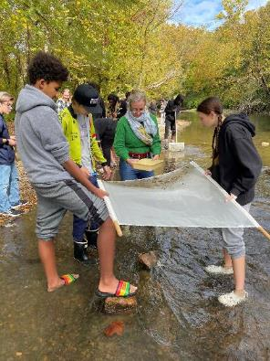
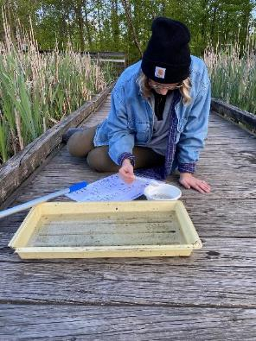
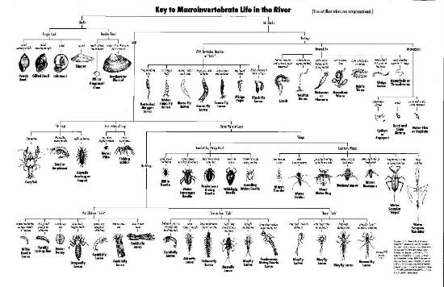
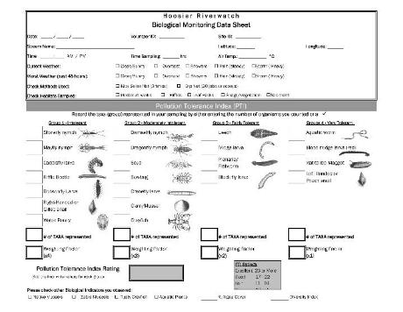
Macroinvertebrate Methods

Slide 3
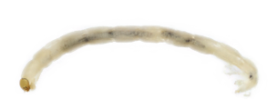
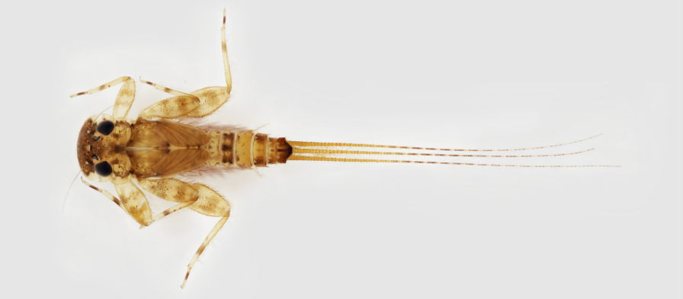
Anatomy
Lateral
Prolegs
Head
Thorax
Abdomen
Gills (abdomen -or- thorax)
Wing Pads
Tail Filaments
Antenna
Jointed Legs (6)
Lateral
Anterior
Posterior
Notes:
The ability to identify the different taxa relies heavily on knowing their forms and characteristics that gives them their classification.
NOTE:
start by engaging learnings in morphology and terms that may be new. Give your learners a copy of this form and have them take notes as you go along.
point out that there are ‘instars’ so you may not see certain characters (i.e. wing pads). Insects (Arthropods) molt or shed their exoskeleton at different developmental stages.
We will mostly be identifying macroinvertebrates in their juvenile stage of metamorphosis (larva or nymph) not the pupae; sometimes adults (i.e.beetles, snails, mussels, etc.)
SIZE is very important, so note sizes (usually found in keys) to distinguish between taxa
Here we show insect morphology: Head, Thorax, Abdomen. A majority (approx.70%) of what you find in the stream will be of the Insecta Class.
You can ask the audience what they might notice on each of these three major segments (and the adaption) that would be good to look for such as antenna (head), and on the thorax: number of jointed legs (note: sometimes these break off; sometimes there are no legs, and sometimes there are prolegs which don’t have joints or bend), wing pads (Note: these aren’t always present- depends on the instar/phase of the insect as to if this is shown or not), placement of the gills (here shown on the abdomen, but can be anywhere on the body and come in a variety of forms; sometimes no gills are present), number of tails (note: sometimes these break off).

Slide 4

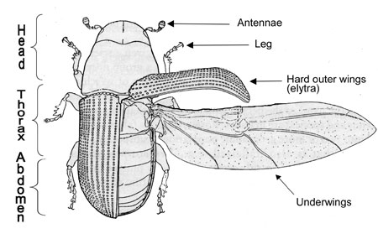
Anatomy
Notes:
The ability to identify the different taxa relies heavily on knowing their forms and characteristics that gives them their classification.
NOTE:
start by engaging learnings in morphology and terms that may be new. Give your learners a copy of this form and have them take notes as you go along.
point out that there are ‘instars’ so you may not see certain characters (i.e. wing pads). Insects (Arthropods) molt or shed their exoskeleton at different developmental stages.
We will mostly be identifying macroinvertebrates in their juvenile stage of metamorphosis (larva or nymph) not the pupae; sometimes adults (i.e.beetles, snails, mussels, etc.)
SIZE is very important, so note sizes (usually found in keys) to distinguish between taxa
Here we show insect morphology: Head, Thorax, Abdomen. A majority (approx.70%) of what you find in the stream will be of the Insecta Class.
You can ask the audience what they might notice on each of these three major segments (and the adaption) that would be good to look for such as antenna (head), and on the thorax: number of jointed legs (note: sometimes these break off; sometimes there are no legs, and sometimes there are prolegs which don’t have joints or bend), wing pads (Note: these aren’t always present- depends on the instar/phase of the insect as to if this is shown or not), placement of the gills (here shown on the abdomen, but can be anywhere on the body and come in a variety of forms; sometimes no gills are present), number of tails (note: sometimes these break off).

Slide 5
Functional Feeding Groups
Grazers – scrape the algae off substrate (snails, caddisfly, mayfly)
Shredders – tearing mouthparts rip apart leaves and detritus (caddisfly, mayfly, cranefly)
Collector/Gatherer – scavenge stream bottom for dead organisms, detritus, et. (caddisfly, mayfly, stonefly)
Filter Feeders – filter particles that float by in the current, may be predatory (midge larve, mussels, scud)
Predators – eat other organisms (insects, tadpoles, fish), may be larval or adult forms (dragonfly, water strider)
Notes:
Parasitic may be additional feeding group (leech)

Slide 6
Habits
“mode of existence” (locomotion, attachment or concealment)
Clinger – adapted to attach to substrate in fast-flowing water
Sprawler – lives on top of plant debris or fine sediment
Burrower – adapted to living in the silt, sediment, organic material
Climber – move vertically up stems, roots, other debris
Swimmer – perform minnow-like swimming, usually clinging when not in the water column

Slide 7
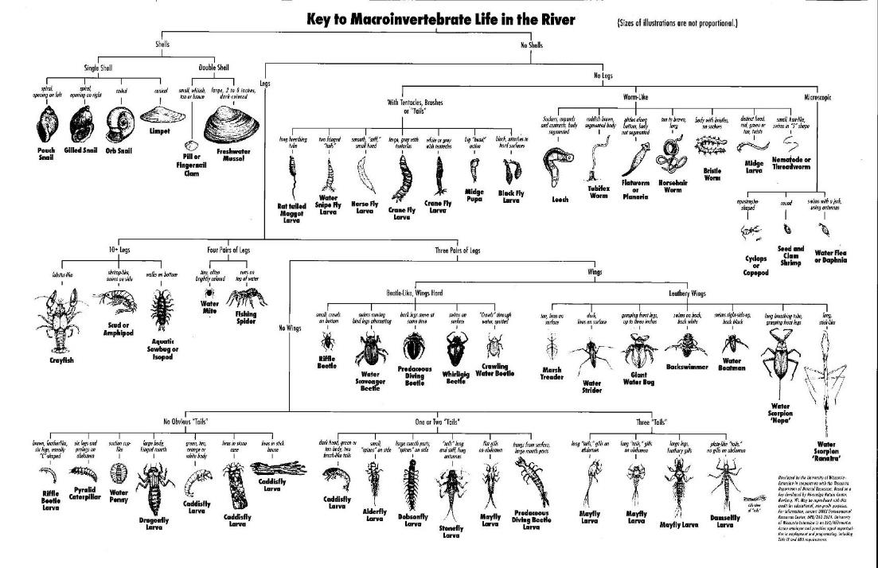

Slide 8
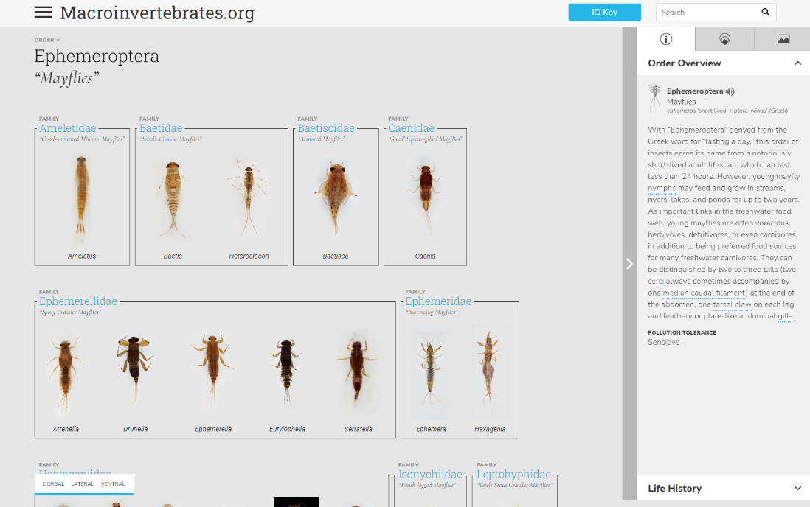

Slide 9
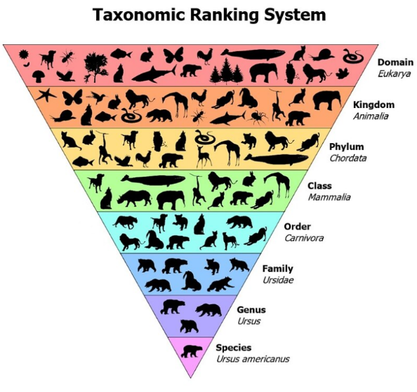
Binomial Nomenclature
Most HRW identification
This training explores

Slide 10
Ephemeroptera – Mayflies
short-lived
Typically live 24-48 hours as adults
Oldest winged insect – fossils from 300 million years ago
>600 species/21 families in U.S.
Incomplete metamorphosis, Duns (sub-imago) & Spinners (imago)
Usually scraper/collecter
Usually 3 tails, abdominal gills, single tarsal claw
Peak emergence in May
Pollution sensitive

Slide 11
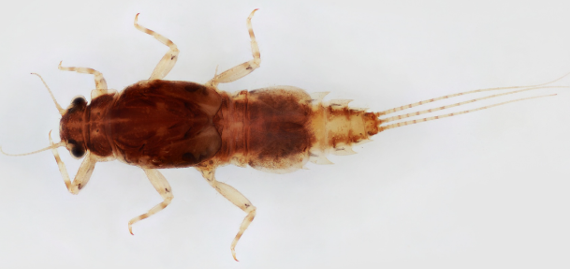
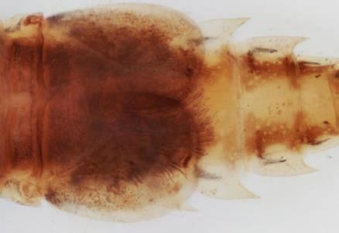
Family: Caenidae
“SEE-ni-dee”
“Small Square-Gilled”
  Enlarged gills on abdominal segment #2 are nearly square in shape, overlap & protect other gills
Small body, 2-8mm
Prefer slow or stagnant water, often ponds/lakes
Clinger/Sprawler
Grazer/Collector
Notes:
More pollution tolerant than other Mayfly families

Slide 12
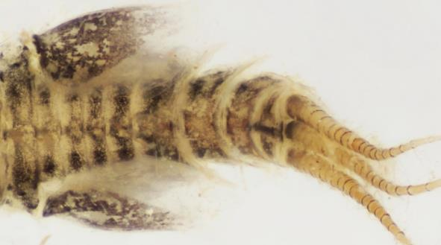
Family: Leptohyphidae
“lep-toe-HIFE-i-dee”
“Little Stout Crawler”
Similar to Caenidae but operculate gills on abdominal segment #2 are triangular or oval instead of square
Clinger/Sprawler
Grazer/Collector
Notes:
Gill cover protects from silt clogging gills, to exchange DO the gill covers are raised and gills wave & circulate underneath
More pollution tolerant than other Mayfly families

Slide 13
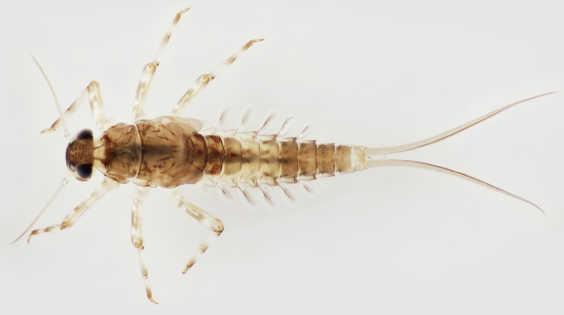
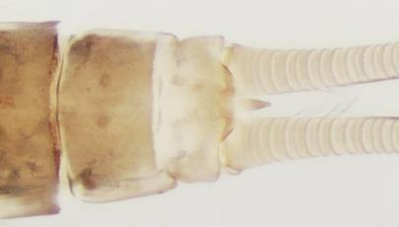
Family: Baetidae
“BEE-ti-dee”
“Small Minnow”, torpedo-shaped
Grazer/Collector
Swimmer/Clinger
Short body, 3-12mm
Three tails, but center tail shortened
Notes:
More pollution tolerant than other Mayfly families
Some sp. In northern regions can reproduce by parthenogenesis (asexual without male)

Slide 14
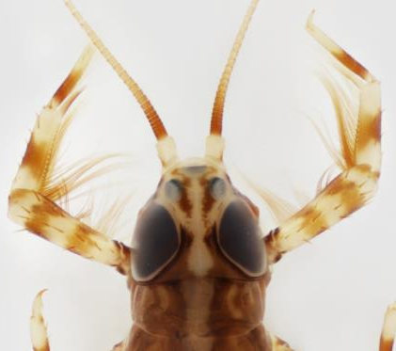
Family: Isonychiidae
“iso-nick-KEY-i-dee”
“Brush-legged”
Look like larger Baetidae with long hair on inner forelegs
Swimmer/Clinger
Filter feeder/Predator
Prefer fast-flowing habitat

Slide 15
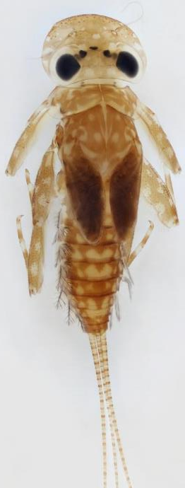
Family: Heptageniidae
“hep-ta-gen-KNEE-i-dee”
“Flat-Headed”, eyes visible from above
11 genera/ >100 species
5-20mm body length, sprawling legs with thick “femur”
Grazer/Collector
Clingers
Positive thigmotaxis – instinct to contact solid surface, even if the only surface is another mayfly

Slide 16
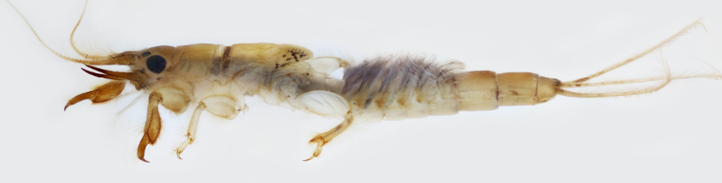
Family: Ephemeridae
“ef-ah-MARE-i-dee”
“Burrowing”, large mandibular tusks
Very common, especially in lakes, > 50% biomass of invertebrates
10-32mm body length
Prefer silty/sandy substrates in slower water
“Fluffy” gills undulate to increase flow for oxygen
Filter feed through U-shaped burrow
Notes:
Note from Mitchell: we get a couple other families/species of burrowing mayflies that are rarer, but can be distinguished by the shape/orientation of their tusks

Slide 17
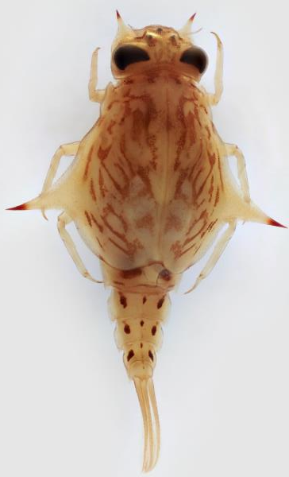
Family: Baetiscidae
“bee-TISS-i-dee”
“Armored”
  pronotum covers thorax and some of abdomen
Prefer silty stream bottoms
Proportionately shorter tails
Grazer/Collector
Clinger/Sprawler

Slide 18
Trichoptera - Caddisflies
hair wings
Largest insect order with all aquatic larvae
  10K species worldwide, 21 families/1,400 species in N. America
Diverse habitat preferences
Complete metamorphosis
Short adult life, ~1 month
All except 1 family uses silk (cadaz 15th century English for “yarn” or “ribbon”)
  Anchor
  Case building
  Camouflage
  Food collection
Most taxa are pollution sensitive

Slide 19
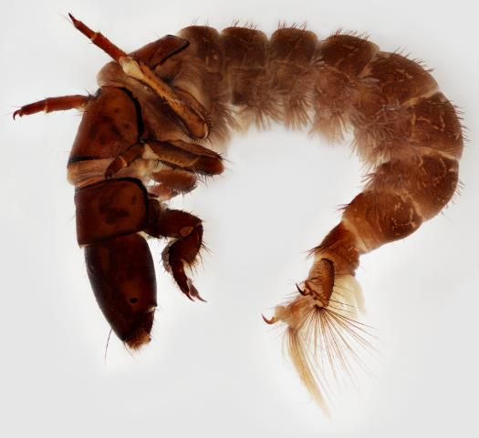
Family: Hydropsychidae
“hi-dro-SIKE-i-dee”
“Common Netspinner”
13 genera, 155 species in U.S.
Prefer course substrate (clinger)
3 thorax plates (saddles), “hairbrush” gills below abdomen and tail hooks
Collector/Filterer
  Entrance to stationary shelter has silken net that catches detritus in current
Notes:
High densities where high detritus- one study found 47K per sq. meter near the outflow of a dam
Larvae will defend their territory- first by stridulation, then by “wrestling”

Slide 20
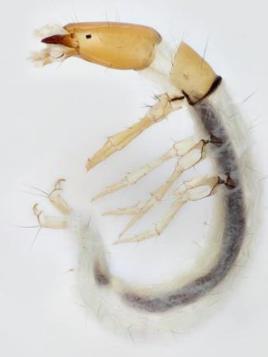
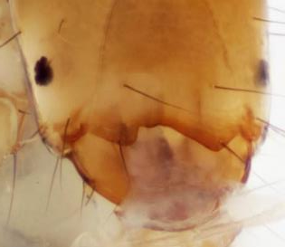
Family: Philopotamidae
“fill-oh-pot-TAM-i-dee”
“Finger-Net”
76 species in N. America
Prefers riffle habitat, very fine mesh nets underneath rocks (filter feeder)
Only 1 thorax plate with posterior dark line
Lacking abdominal gills
Most common genera (Chimarra) has very noticeable, asymmetric notch at front of head capsule

Slide 21
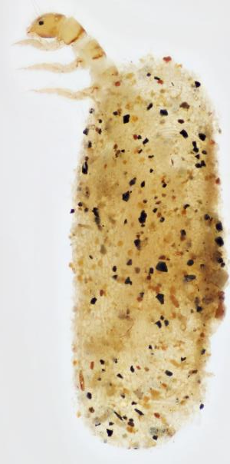
Family: Hydroptilidae
“hi-dro-TILL-i-dee”
“Purse Casemaker” or “Micro Caddis”
Very small, < ¼ inch
Prefers sandy substrate
Free-living until huge growth in 5th instar
Distinctive purse-like case made of silk and sand
3 sclerotized thoracic segments
Lacks abdominal gills
Climber/Clinger
Grazer/Piercer Herbivore

Slide 22
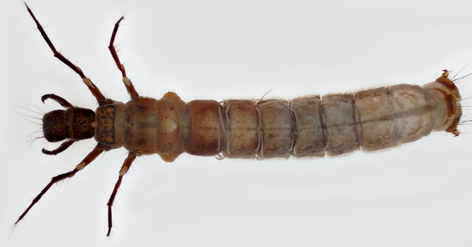
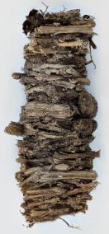


Family: Limnephilidae
“lim-neh-FILL-i-dee”
“Northern Casemaker”
Large, diverse family – 252 N. American species
“Hump” on first abdominal segment
Diverse habits & feeding groups
Variety of case materials

Slide 23
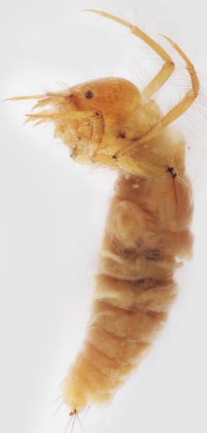
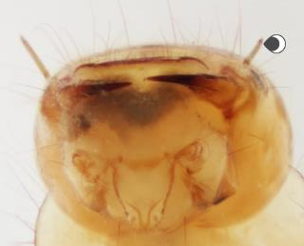
Family: Leptoceridae
“lep-toe-SARE-i-dee”
“Long-horned Casemaker”
Diverse habitats & case materials
Small bodied, 7-15mm, with noticeable antennae
Adult antennae longer than body, wings colorful
Diverse habits & feeding groups

Slide 24
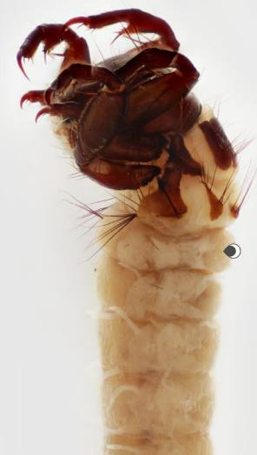
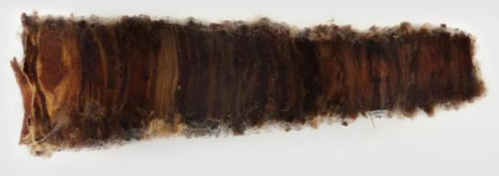
Family: Brachycentridae
“brack-i-SEN-tra-dee”
“Humpless Casemaker”
Prefer riffle habitat (clinger)
Lacks hump on first abdominal segment
Often 4-sided case of thin material
Filter/grazer
Stream flow

Slide 25
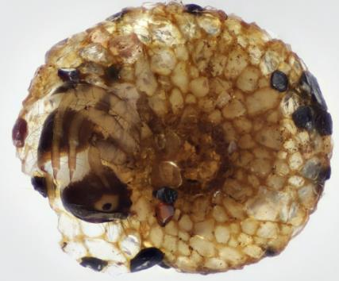
Family: Helicopsychidae
“hell-i-koh-SIKE-i-dee”
“Snail Casemaker”
Uncommon
Case made of fine sand, spiral like snail
  More resistant to crushing among substrate
Clinger
Grazer

Slide 26
Plecoptera - Stoneflies
folded wings
Adult hindwings fold under forewing
626 species in N. America
Incomplete metamorphosis
  Eggs and adults for ~4 weeks, nymph up to 3 years!
Prefer crawling on rocky or leafy substrate
Often 2 long antennae and tails
“Brushy” gills may be present on ventral thorax
Wing pads present on late instars
  Divergent vs Parallel
Many species emerge in late spring/early summer and are best collected in winter/spring
Very sensitive to pollution

Slide 27
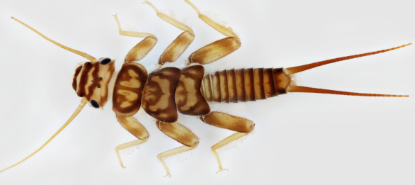
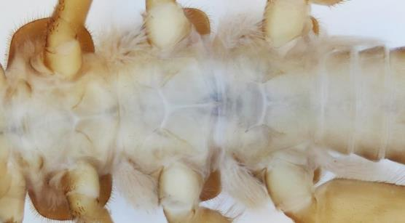
Family: Perlidae
“PER-li-dee”
“Common Stonefly”
84 N. American species
Large bodied, 8-35mm
Appear neckless with brown and yellow markings
Crawler
Predator
Notes:
Note from Mitchell: it's not the only family with branched gills on the thorax, but it is the only family that has those gills *just* on the thorax (Pteronarcyidae has gills on first couple ab segments as well; Peltoperlidae has simple or forked gills, but not branched/tufty, on thorax only
Stoneflies may exhibit “push-up” behavior when in low O2 conditions to promote respiration

Slide 28
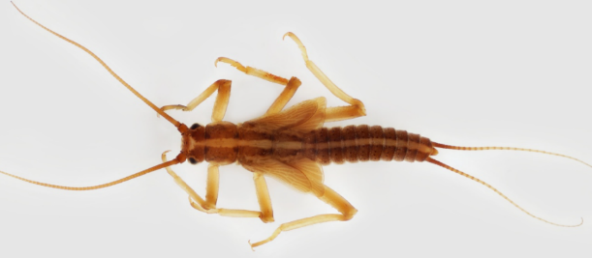
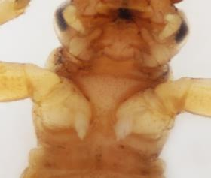
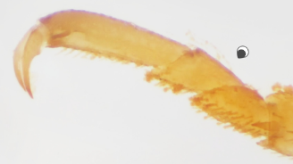
Family: Taeniopterygidae
“tee-knee-op-ter-RIDGE-i-dee”
“Winter Stonefly”
Uniform color with stripe
Divergent wing pads
Mature & emerge in winter
Crawler/Sprawler
Shredder/Collector/Grazer
Notes:
Note: These larvae can be easily confused with Nemouridae as they both have wing pads divergent (not parallel with the body axis) but can be distinguished because the second tarsal segment of each leg of Taeniopterygidae is about the same length as the first.
Taeniopteryx, largest genus - single, finger-like gill behind each leg

Slide 29
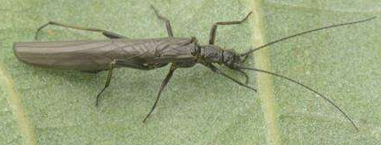
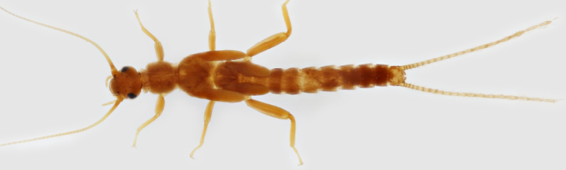
Family: Leuctridae
“LUKE-tra-dee”
“Rolled-winged Stonefly”
Small & slender, 6-10mm
Prefers fast, rocky riffles
Extended adult emergence
Crawler/Sprawler
Shredder
Parallel wingpads
No gills
Notes:
Mitchell’s Note: Leuctridae and Capniidae are extremely annoying to separate, especially if they're not extremely mature larvae.
Hind Legs Don't Reach - when extended, hind legs do not reach end of the abdomen.

Slide 30
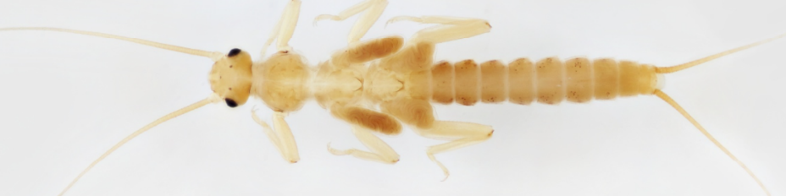
Family: Capniidae
“cap-KNEE-i-dee”
“Small Winter Stoneflies”
  Emerge as adults in winter, “antifreeze” compound in hemolymph
Small bodied, 3-6mm
Short, parallel hindwings
Crawler/Shredder
No gills
Notes:
Hind Legs Don't Reach - when extended, hind legs do not reach end of the abdomen

Slide 31
Odonata – Dragonflies & Damselflies
toothed ones
Suborders Anisoptera (dragonflies) & Zygoptera (damselflies)
Incomplete metamorphosis
Predatory- nymphs have extendible labium (lower lip)
Lotic (fast) & lentic (slow) habitats
Dragonflies lack visible gills, Damselflies have 3 tail-like gills
Moderately tolerant to pollution
Second oldest insect order (basically dinosaurs!)
Notes:
Lower labium feeding - https://www.youtube.com/watch?v=nqX-oKsHLCY

Slide 32
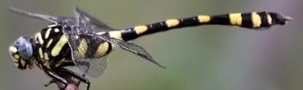
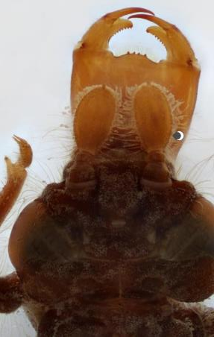
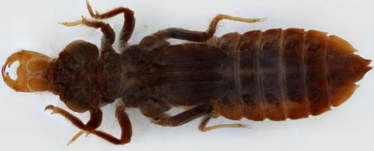
Family: Gomphidae
“GOM-fi-dee”
“Clubtails” – refers to shape of tail in adults
80 N. American species
Short, broad bodied
Flat labium
Burrower/Predator
Only 4 antennal segments (3rd segment enlarged)

Slide 33
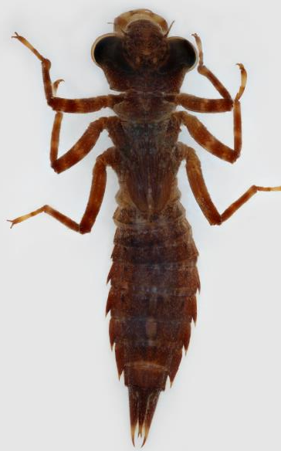
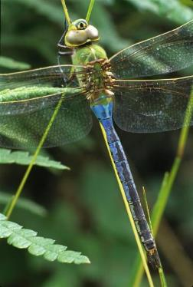
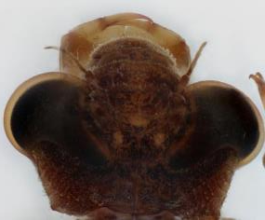
Family: Aeshnidae
“EESH-ni-dee”
“Darners” – refers to needle-like tail in adults
Head wider than body
Slender antennae with 6-7 segments equal in size
Flat labium
Climber/Predator

Slide 34
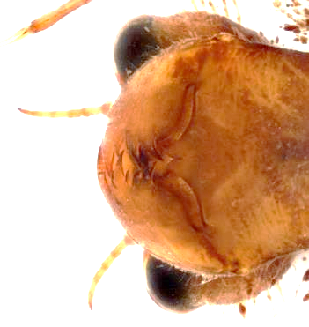
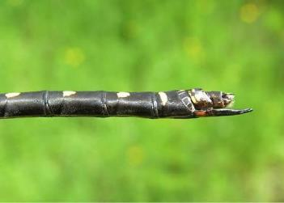
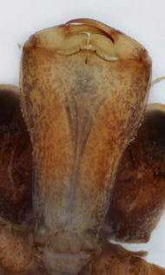
Family: Cordulegastridae
“cord-you-li-GAS-tra-dee”
“Spiketails” – refers to ovipositor in adult females
Slender 7-segment antennae
Spoon-like prementum with extremely irregular teeth
Burrower/Predator
Darner
Notes:
Mitchell’s Note: "nightmare devil mouth"

Slide 35
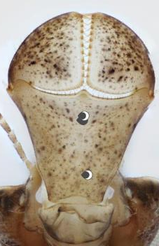
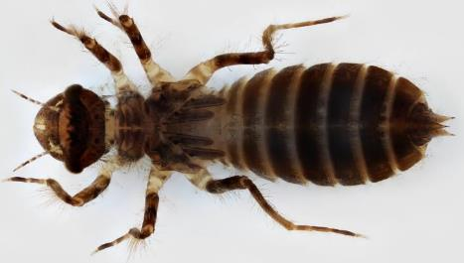
Family: Libellulidae
“lie-bell-LOO-li-dee”
“Skimmers” – refers to behavior from adult females
Most common family, 90 N. American species
Spoon-shaped labium without median groove
Sprawler/Crawler

Slide 36
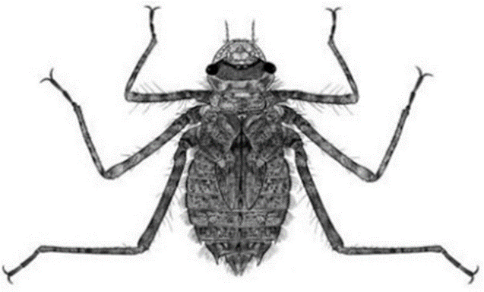

Family: Macromiidae
“mack-crow-MEE-i-dee”
“Cruisers”
Formerly considered a sub-family of Corduliidae
Rounded abdomen, long legs appear spider-like
“Unicorn” horn between antennae
Sprawler
Predator

Slide 37



Family: Corduliidae
“cord-you-LEE-i-dee”
“Emeralds” – refers to colorful eyes
Spoon-shaped labium with median groove
Abdomen ends abruptly
Sprawler/Crawler

Slide 38



Family: Calopterygidae
“cal-op-ter-RIDGE-i-dee”
“Broad-winged Damselflies”
Adults usually dark winged with green-blue bodies
3 “tails” - paddle-like gills
Long first segment of antennae
Large notch in the front of the labium
Climber/Predator

Slide 39



Family: Coenagrionidae
“see-nag-ree-ON-i-dee”
“Narrow-winged Damselflies”
Largest damselfly family, 90 N. American species
3 “tails” - paddle-like gills
Short first segment of antennae
Climber/Predator

Slide 40


Look-Alikes
Which is a Mayfly & which is a Damselfly?
Hint: Location of the gills
Notes:
Left: damselfly, Right: Mayfly (gills on tail vs abdomen but both have 3 tails)

Slide 41
Coleoptera - Beetles
sheathed wing
Largest order – 24K species in N. America, 300K worldwide
  Many species aquatic for part of its life
  The only insect order where species can be aquatic for both larval and adult lifestages
Adults usually oval & hard-bodied
  Shell-like forewing (elytra) adapted to cover hind wing and abdomen meets in straight line down the back
Complete metamorphosis
Lotic & lentic habitats
Often chewing mandibles

Slide 42

Features of Larval Beetles
Distinct head usually sclerotized (hardened)
No wingpads
Usually 3 pairs of jointed legs on thorax
Usually 8-10 abdominal segments, may have filaments

Slide 43

Family: Elmidae
“EL-ma-dee”
Riffle Beetles
Almost 100 species
Prefer fast flowing, high oxygen habitats
Crawlers/clingers
Collector/scraper diet
Adults 1/8-inch long, larvae up to 1/2-inch
Intolerant of pollution
Notes:
Taxonomist note: Neither adult nor larval Elmids have features that make them easy to ID in a key, but they do have fairly recognizable shapes and collections of features (i.e. adults all have long, spindly legs; long, thin antennae; and narrow, ovate shape) that make them easy to pull out of a group of beetles once you get a sense of what you're looking for

Slide 44



Family: Elmidae
Adult
  Slender, thread-like antennae
  Last tarsal (ankle) segment long
  Two large claws on each foot
Larvae
  Sclerotized (hardened) body
  Visible eye spot
  Operculum hides hair-like gills on tail
Notes:
Adult demonstrates “plastron respiration” - In this process, a thin film of air (called a plastron) is trapped in hairs on the body surface, and the plastron functions like a gill. This sheet of air is in contact with an air space beneath the elytra (shell-like modified forewings), where the openings to the insect’s respiratory organs are located. As the insect consumes oxygen, the reservoir of the plastron is replenished by diffusion of more dissolved oxygen from the water.

Slide 45


Family: Psephenidae
“sef-FEN-i-dee”
Water Pennies
16 species in N. America
Terrestrial adults & pupae
Intolerant of pollution
Clinger
  Flattened body “suction cup”
Scraper diet

Slide 46

Family: Dytiscidae
“die-TISS-i-dee”
Predaceous Diving Beetle
Largest family of aquatic beetles, >400 species in N. America
Prefer lentic (slow) habitat
Painful bite

Slide 47


Family: Dytiscidae
Adults
  Long, slender antennae
  Large bodied, up to 1-inch
  Convex top and bottom
  Swimmer/Predator
Larvae
  Distinct head, visible eye spots
  Soft bodied with 8 tapered abdominal segments ending in 2 filaments
  Swimmer/Predator- hangs upside down to hunt (collects air at surface)
Notes:
https://www.youtube.com/watch?v=Hwqja6FWUzA

Slide 48


Look-Alikes
Which one is a Predaceous Diving Beetle & which one is a Stonefly?
Hint: antennae length, gills present
Notes:
Left: Predaceous Diving Beetle
Right: Stonefly (note long antennae, gills on thorax)

Slide 49


Family: Gyrinidae
“jie-RIN-i-dee”
Whirligig Beetle – refers to circular swimming behavior
Lentic or lotic habitat
Predator/Engulfer diet
Adults often congregate on surface in large groups
Terrestrial pupae

Slide 50



Family: Gyrinidae
Adult
  ¼ - ¾ inch
  Dorsal and ventral eyes
  Often only see the longer front legs from above
  Short clubbed antennae
Larvae
  Lateral filaments (gills)
  Visible eye spots
  4 posterior hooks

Slide 51

Family: Hydrophilidae
“hi-dro-FILL-i-dee”
Water Scavenger Beetle
2nd largest family of aquatic beetles, 200 species in N. America
Terrestrial pupae
Prefer lentic or slow-moving water
Adults hold air bubble for gas exchange underwater
Larvae predatory, but most adults are omnivores or detritivores

Slide 52


Family: Hydrophilidae
Adult
  Short, bulbed antennae with hydrophobic hairs
  Ventrally concave
  Alternate strokes with hind legs to swim
Larvae
  Soft bodied, ends in blunt abdomen
  Short legs
  Darkened head with toothed jaws
  Often lateral filaments

Slide 53


Family: Haliplidae
“hal-LIP-li-dee”
Crawling Water Beetle
Adult
  Yellowish coloration with rows of dark indentations
  Small bodied, 2-6mm, with small head
  Slender antennae
Larvae
  Often dorsal projections
Notes:
Taxonomist commentary: Basically think yellow ladybugs

Slide 54

Diptera – True Flies
two wing
Hind wings are adapted into halteres (small knobs) that help balance
All adults terrestrial
Complete metamorphosis, lifecycle from 10 days – >2years
Larvae soft bodied with no legs or wingpads
  Prolegs may be present
Often sclerotized head, may be retracted
  Presence and completeness of sclerotized head one way to distinguish between sub-orders (along with orientation of mandibles)
Notes:
Taxonomist commentary: learning how to identify Diptera families through the common keys is a nightmare, and this is the one order where I might suggest just memorizing key features of distinct families/genera rather than learning through repeated use of a key.
Taxonomist definition: slashy/bitey mandibles (horizontal) vs stabby/vampire-y mandibles (vertical)

Slide 55


Family: Simuliidae
“sim-you-LEE-i-dee”
Black Flies
255 N. American species
Distinct head with brush-like mouth parts (filter feed)
Swollen abdomen hooks onto silk, hang in the current
Notes:
Video?

Slide 56


Family: Chironomidae
“ki-ro-NOM-i-dee”
Non-biting Midges
2,000 N. American species
Diverse habitats, feeding habits, etc.
Distinct head
Prolegs by head and tail
Pre-anal brush
Some species are red because hemoglobin
Notes:
Taxonomist commentary: The only real way to parse this diversity through genus/species-level identifications is by looking at their mentum (basically their teeth) and features of specific hairs on their heads. You basically have to slide-mount them and look at them under a high-powered microscope to ID them, and even then, it can be extremely annoying-to-impossible to do

Slide 57

Family: Ceratopogonidae
“sare-at-top-ah-GONE-i-dee”
Biting Midges
Less common, > 100 species in N. America
Diverse feeding habits as larvae, adult females feed on blood
Small head visible, slender bodied
Usually no prolegs, hairs on tail

Slide 58

Family: Culicidae
“cue-LISS-i-dee”
Mosquitoes
Distinct head with mouth brushes (filter feeder)
Thorax segments fused, wider than head and abdomen
Not usually benthic
  Hang from water surface with abdominal respiratory syphon
Notes:
Taxonomist commentary/fun fact: This is why putting soap in standing water can be used as an anti-mosquito measure. The hairs on their siphons use the surface tension of the water to keep their airholes exposed so the larvae can breath. If you break the surface tension with dish soap (or some other surfactant), the larvae can no longer hold on to the surface, so they drown.

Slide 59


Families: Tipulidae/Limoniidae/Pediciidae
“tip-PEW-li-dee”
“lie-mo-KNEE-i-dee”
“ped-i-SEE-i-dee”
Crane Flies
Large (up to 4 inches) soft body, retracted sclerotized head
Posterior spiracles with lobes (only 6 on Tipulidae)
Burrower/Varied diet

Slide 60


Family: Syrphidae
“SIRF-i-dee”
Hover Flies, “Rat-tailed Maggot”
Large bodied, up to 2.5 inches
Non-sclerotized head not evident
Posterior respiratory tube

Slide 61

Megaloptera - Alderflies, Dobsonflies, and Fishflies
large wings
Predatory, chewing mouthparts
Complete metamorphosis, short adult lifespan
6 legs with lateral abdominal filaments
Large bodied, 3-4 inches
Pollution intolerant
Notes:
Taxonomist commentary: These mouthparts will bite. These mouthparts will hurt. You have been warned.

Slide 62



Family – Corydalidae
“core-ah-DAL-i-dee”
Dobsonfly (Corydalus) & Fishfly (Nigronia) – “hellgrammites”
Dobsonfly have brushy gills at base of filaments, Fishfly lack gills
Two abdominal prolegs with claws

Slide 63

Family: Sialidae
“sigh-AL-i-dee”
Alderflies
7 pairs of lateral filaments with one terminal “tail”

Slide 64


Look-Alikes
Which is Megaloptera & which is Coleoptera?
Notes:
Left: Coleoptera (Water Scavenger Beetle)
Right: Megaloptera (Fishfly)

Slide 65


Look-Alikes
Which is Megaloptera & which is Coleoptera?
Notes:
Left: Megaloptera (Alderfly)
Right: Coleoptera (Whirligig Beetle)

Slide 66
Hemiptera – True Bugs
half wing
Refers to adult wings, leathery at base but membranous at tip
  Unlike beetles, wings overlap over abdomen
Incomplete metamorphosis
Piercing mouthparts
Varied pollution tolerance

Slide 67

Family – Notonectidae
“no-toe-NECT-i-dee”
Backswimmers – swims upside down
Body is parallel sided & convex dorsally, ¼ inch long
Short antennae
Long, oar-like hind legs

Slide 68

Families: Gerridae & Veliidae
“JARE-i-dee”
“vel-EE-i-dee”
Water Striders & Broad-shouldered Riffle Bugs
Wingless adult resembles nymph
Piercer predator – detect vibrations of prey on tarsi (feet)
Hairs on feet allow “skating” on surface
Claw before tip of leg
Notes:
Taxonomist commentary: The way "piercer predator" works (for water striders and other applicable Hemiptra) is extremely metal. These critters have straw-like mouthparts (sorta like mosquitoes) which they use to pierce the skin of their prey. Once they pierce into their prey, they inject it with stuff that *liquifies their prey from the inside* and then suck out the liquified goo through their straw-mouth. It is absolutely wild.

Slide 69


Families: Gerridae & Veliidae
Gerridae
  Prefer lentic (slow) flow habitats
  Narrower body, femurs longer than abdomen
  Body ¾ inch
Veliidae
  Small bodied, < ¼ inch
  Prefer lotic (fast) flow habitats
  Broad “shoulders”, short femurs

Slide 70


Family: Belostomatidae
“bell-oh-stow-MAT-i-dee”
Giant Water Bug
19 N. American species
Up to 2.5 inches
Prefer lentic (slow) habitats
Piercer predators, “toe-biter”
  Reports of larger species eating juvenile turtles and snakes
Antennae shorter than head
Short, flat air tubes on end of abdomen
Notes:
There are reports of the largest species consuming baby turtles and water snakes. They are known to feign death, lying still while secreting a fluid from the anus. Even small specimens should be handled carefully because they can inflict a very painful bite; fortunately, the effects soon wear off with no lasting consequences. Males of many species tend the clutch of eggs laid by the female either on the male's back or on vegetation while the male stands guard nearby. Giant water bugs are eaten for food and are considered a delicacy especially by people in eastern and southern Asia.
Taxonomist commentary: Also, I got bit by one last year when one got stuck under my watch. Can confirm that it is extremely unpleasant (think bee or jellyfish sting)

Slide 71


Family: Nepidae
“NEEP-i-dee”
Water Scorpions
10 species in N. America
Antennae shorter than head
Long tail is respiratory tube
Piercer predator, not venomous like scorpions
Climber, so slow that algae will grow on them
Nepa apiculate has different body shape

Slide 72



Family: Naucoridae
“knock-OR-i-dee”
Creeping Water Bug
20 N. American species, only one genus in eastern US
Prefer lentic (slow) habitat
Similar to Belostomatidae but eyes do NOT protrude from head and have distinctly enlarged forefemurs
Hold bubble (plastron) underwater for respiration

Slide 73

Family: Corixidae
“core-IX-i-dee”
Water Boatmen
130 N. American species
Up to ½ inch
Prefer lentic (slow) habitat, vegetated bottom
  Strong swimmers, long oar-like hind legs
  Hold bubble (plastron) underwater for respiration
Piercer/Collector diet
  Stir up sediment with front legs and consume any living organism disturbed, also puncture plants for sap
Notes:
Often congregate in large groups

Slide 74

Non-Insects

Slide 75

Class: Gastropoda
Subclass: Pulmonata
Lunged, Bladder, or Pouch Snail
“Left-Handed”
Lack operculum (hardened “door” on shell opening)
High numbers may indicate low DO
Cannot leave/change shells (continuously grow)

Slide 76

Class: Gastropoda
Subclass: Prosobranchia
Gilled Snail
“Right-Handed”
Has operculum “trapdoor”
Require clean, well-oxygenated water
Notes:
20K species! (mostly marine)

Slide 77

Order: Amphipoda
Scud or Side-swimmers (Old English for ‘to move quickly’)
3 common families only distinguishable by microscope
5-20mm
Body flattened laterally
>3 pairs of legs
Variety of feeding groups
10,000 per m² in certain conditions
Notes:
+10K species

Slide 78


Order: Isopoda
Family: Asellidae
Sow Bugs
5-20mm
14 legs, flattened, oval bodies
4 antennae, different sizes
Abdominal segments fused into “shield”
Named after the care they provide young
“ay-SELL-i-dee”
Notes:
115 species
Taxonomist commentary: You may be familiar with a terrestrial isopod that's relatively closely related to these: pillbugs/roly-polies!

Slide 79

Order: Decapoda
Family: Cambaridae
“cam-BEAR-i-dee”
Largest crayfish family, >400 species
10-150mm
Abdominal segments flattened
10 legs, first pair enlarged claws
Notes:
EXTREMELY IMPORTANT TAXONOMIST COMMENTARY:
Rusty Crayfish are a easily recognizable and in-the-news species of crayfish, most known for being a spreading invasive species throughout the midwest and southeast. Rusties ARE NATIVE to most of Indiana! Indiana (and western Ohio) is like the one place they are supposed to be! Unless you're in the Kankakee or Lake Michigan basins, you have 0 reason to be concerned if you find a Rusty in your streams.

Slide 80

Phylum: Annelida
Sub-class: Hirudinea
“ah-NELL-i-dah”
“hear-oo-DIN-ee-ah”
Jawless Leeches
Flattened, segmented bodies
Two ventral suckers
Parasite or predator
Common, pollution tolerant

Slide 81

Phylum: Platyhelminthes
Class: Turbellaria
“play-tee-hell-min-THIS”
“ter-bell-AIR-ee-ah”
Aquatic Flatworms
5-20mm
Triangular head, small eye spots
Flattened body, no segments
Pollution tolerant

Slide 82




Aquatic Worms
Phyla: Annelida, Nematoda, Nematomorpha
Segmented body
May have bristles
Ex: Tubifex Worms, Bristle Worms
Very long, >2 feet
Parasitize insects
Ex: Horsehair Worms
Small, hair-like
Swims in “S” shape
May be parasitic
Ex: Nematode, Round Worms, Pin Worms
*Usually pollution tolerant
Notes:
Taxonomist commentary: Think earthworms (but usually much smaller) (Annelida)

Slide 83

Class: Bivalvia
Order: Unionoida
Largest order of freshwater mussels
Larvae (glochidia) parasitize fish in life cycle
  Mostly used for dispersal, not nutrition
Filter feeder
  2 siphons create one-way flow, cilia capture algae, bacteria & detritus
Endangered or species of concern
Notes:
Growth rings out from umbo (raised area on top of shell, origin of growth as juvenile)
Latin musculus = muscle (refers to the strength of holding shells together)

Slide 84

Class: Bivalvia
Order: Sphaeriidae
“SPHERE-ah-i-dee”
Pea Clams or Fingernail Clams
German klamma = constriction, Old English clamm = to bond
  References how strong the shells remain closed
Juveniles not parasitic, instead released as miniature version of adult
Smallest adult size of bivalves, but largest offspring (¼ size of adult)
  < 200 offspring released compared to mussel’s millions
Notes:
Pea Clams smaller and shiny & thinner shell than Asian clam
Missouri Dept of Conservation – “In fingernail clams, the shells are thin and fragile, often translucent, the outsides typically shiny, fairly smooth, and gray, tan, yellowish, or whitish. Fine growth lines are often visible, but they are not strongly raised, ridged, or rough.”
Can overwinter/survive intermittent waters by burrowing up to 25 cm into substrate

Slide 85


Class: Bivalvia
Order: Veneroida
“core-bik-CUE-li-dee”
“ven-er-OID-ah”
Family Corbiculidae, Asian Clam (invasive)
  Millions of non-parasitic young released into current
Family Dreisseniidae, Zebra Mussel (invasive)
  Clinger (other bivalves are burrowers)
  Up to 1 million free-swimming larvae (veligers) released, disperse widely
“drays-SEN-ah-i-dee”
Notes:
When veligers transform into juveniles with shells, they settle onto surfaces while the size of grains of sand – underwater objects may feel like sandpaper when zebra mussels are reproducing!
Zebra Mussel introduced in ~1988, Asian clam in 1938

Slide 86

Pollution Tolerance
Indicate pollution levels by presence or absence of sensitive species
Tolerance can vary among regions within the same species
Tolerance may vary within large orders
Biodiversity is key to stream health

Slide 87

Tips for diving into ID
Start with characteristic features (morphology)
Pay attention to general size ranges
Go slow!
Dive into one Order at a time, and compare Orders
Know habitat: where to expect them, sensitivity levels
Watch live movement
Repetition!
Confirm IDs = Confidence
Use multiple resources
Cool facts and compelling videos!
Notes:
How does one learn? To see? Insert strategies to ID and to train
To learn macro ID: show bubble of components
OVERALL
hands-on with live macros in the field (in RED) category of the best
Confirmation of IDs is imperative for your learning
Time – take it slow and ID at your own pace learning
Use a Key, know your characteristics
Receive guidance to start
Have fun (no stress)
Repetition
Preserved specimens
Time looking closer
ONCE ID’ing
Look at characteristic features
Go slow
Repeat
Go through a key

Slide 88
Resources
Morse, J., Broomall, M., Wenzel, J., Kautz, A., Louw, M. (Eds) (2020) The Atlas of Common Freshwater Macroinvertebrates of Eastern North America. Available from
https://www.macroinvertebrates.org (accessed 3/7/2024)
Missouri Department of Conservation. (2024) Discover Nature Field Guides. Available from https://mdc.mo.gov/discover-nature/field-guide (accessed 3/7/2024)
National Park Service. (2020) Giant Water Bug. Available from https://www.nps.gov/articles/giant-water-bug.htm (accessed 3/7/2024)
U.S. Geological Survey. (2024) NAS – Nonindigenous Aquatic Species. Available from https://nas.er.usgs.gov/queries/FactSheet.aspx?speciesID=5 (accessed 3/7/2024)
Bartlett, Troy. (2014) BugGuide. Available from https://bugguide.net/ (accessed 3/7/2024)
Hamrsky, Jan. (2015) Life In Freshwater. Available from https://lifeinfreshwater.net/ (accessed 3/7/2024)

Slide 89
Questions?
Instructor Name
Contact Info

