Slide 1
Injury prevention advisory council (IPAC) & Indiana violent death reporting system (INVDRS) Meeting
2/21/25

Slide 2
OUR MISSION:
To develop, implement and provide oversight of a statewide comprehensive trauma care system that:
Prevents injuries.
Saves lives.
Improves the care and outcomes of trauma patients
OUR VISION:
Prevent injuries in Indiana.

Slide 3
Round Robin and Introductions (in chat)
Name
Position
Organization/ Association
Updates
Current Projects and Programs
Upcoming events

Slide 4
Upcoming Events
February
Teen Dating Violence Awareness Month
Burn Awareness Week
  February 2-8
March
Traumatic Brain Injury Awareness Month
National Poison Prevention Week
  March 16 – 22
National Drug and Alcohol Facts Week
  March 17 - 23
April
Sexual Assault Awareness and Prevention Month
Youth Sports Safety Month
Distracted Driving Awareness Month
National Public Health Week
  April 7 - 13
National Prescription Drug Take Back Day
  April 26

Slide 5
INVDRS Dashboard update

Slide 6
Wireframe
Violent Deaths by Manner and Year
Demographics
Suicide Deaths
Homicide Deaths
Firearm Deaths

Slide 7
Violent Deaths by Manner and Year
Manners
  Unintentional firearms
  Law enforcement intervention
  Undetermined
  Homicide
  Suicide
Age-adjusted death rates over time since 2016

Slide 8
Demographics
4 Groups:
  Age Range
  Sex
  Race
  Ethnicity
Heat map of Indiana showing rates for desired filters.
Can hover over county to get direct demographics
5 Filters:
  Year
  Count vs Rate
  Manner of Death
  Weapon Used
  Veteran Status?

Slide 9
Suicide Deaths
Same filters as demographics
4 Groups:
By Means
Location Type
Substances
Circumstances

Slide 10
Homicide Deaths
Same filters as demographics
4 Groups:
By Means
Location Type
Victim-Suspect Relationship
Circumstances

Slide 11
Firearm Deaths
Same filters as demographics
3 Groups:
By Manner
Firearm Type
Location Type

Slide 12
SUICIDE and overdose report, 2023
Allison Martin, MPH, CHES
Drug Overdose Prevention Epidemiologist
Morgan Sprecher, MPH
NVDRS Epidemiologist
02/25/2025

Slide 13
Background

Slide 14
Report Background
SECTION 1. IC16-37-5 IS ADDED TO THE INDIANA CODE AS A NEW CHAPTER TO READ AS FOLLOWS [EFFECTIVE UPON PASSAGE]:
Chapter 5. Suicide and Overdose Fatality Reporting
Sec. 1. (a) Not later than November 30 of each year, the state department shall prepare a report concerning all fatalities in Indiana that are the result of suicide or overdose during the preceding calendar year. The report must include the following information:
    (1) The number of fatalities that occurred in each county.
    (2)The number of fatalities that occurred during each month.
    (3) The age, sex, and race of each fatality victim.
    (4) The number of fatalities by method of suicide or overdose, including the type of weapon or each substance used, if applicable.
    (5) If known, whether the fatality victim has served in the armed forces of the United States(as defined in IC 5-9-4-3) or the national guard (as defined in IC 5-9-4-4).
(b) The first report required by subsection (a) must also include all fatalities in Indiana that are the result of suicide or overdose during the 2020 calendar year. (c) Not later than November 30 of each year, the state department shall submit the annual report required by subsection (a), including an executive summary of the report, to the general assembly and the governor. The report submitted to the general assembly must be in an electronic format under IC 5-14-6.

Slide 15
2023 Overdose Findings

Slide 16
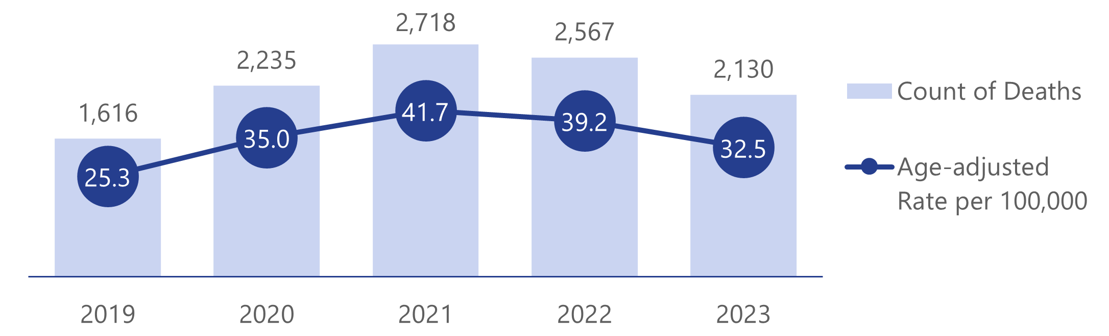
Statewide Trends
In 2023, 2,130 Indiana residents died by drug overdose, a decline from the previous year
The statewide overdose death rate decreased 17.1% from 2022-2023
Overdose rates increased slightly among Hispanic persons and persons identified as being of multiple races or races other than white, black or African American
Note: Includes only unintentional and undetermined intent overdose deaths
Notes:
In 2023, 2,130 Indiana residents died by drug overdose, a decline from the previous year.
This marked the second consecutive year of declining overdose rates and the lowest fatal overdose rate since 2019.
The statewide overdose death rate decreased 17.1% from 2022-2023 .
Additionally, as the graph below shows, the overdose death rate in 2023 was lower than in the preceding three years.
While declines in overdose rates were observed across most demographic groups,
Overdose rates increased slightly among Hispanic persons and persons identified as being of multiple races or races other than white or Black or African American.

Slide 17
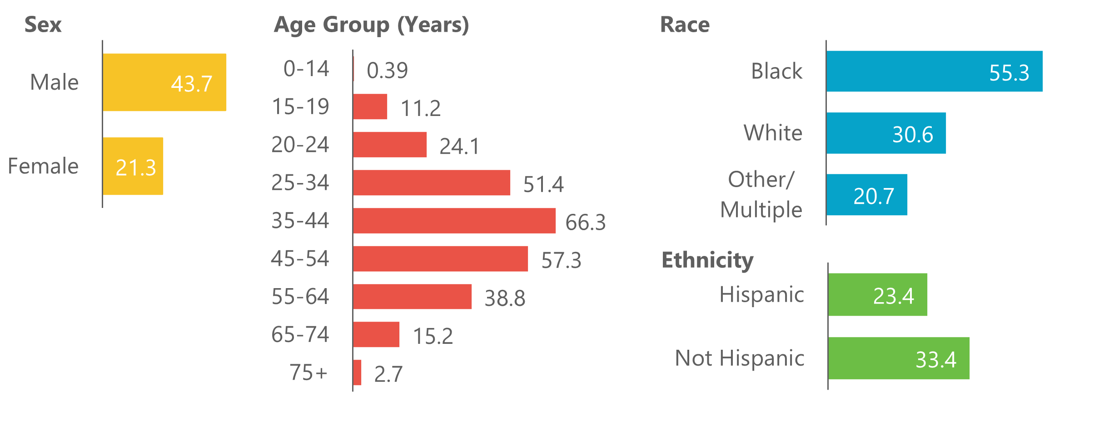
Overdose Fatalities by Demographics
Rates of fatal overdose in 2023 were higher among: males than females, persons ages 35 to 44, Black or African American persons
Note: Includes only unintentional and undetermined intent overdose deaths
Notes:
Overdose affects people of all ages, genders, races, ethnicities, and backgrounds. However, in Indiana, rates of fatal overdose in 2023 were higher among: males than females, persons aged 35 to 44, Black or African American persons

Slide 18
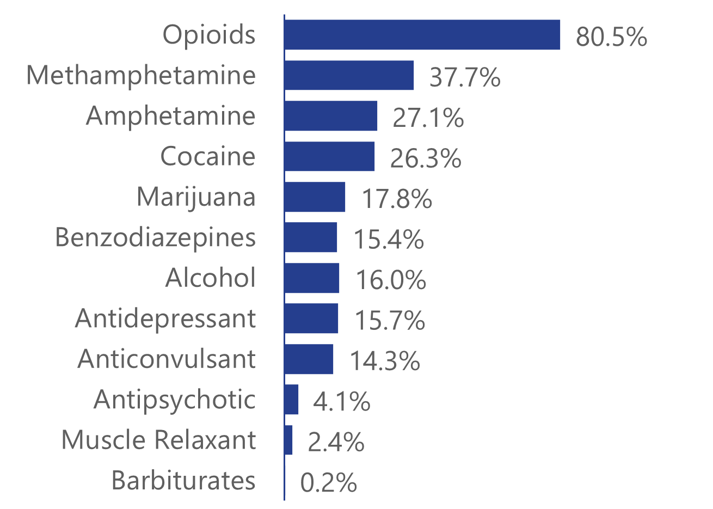
Overdose Fatalities by Drug Type
The overdose crisis in Indiana is primarily driven by illicit fentanyl, its analogs, and methamphetamine
The overall distribution of substances detected in overdose decedents has remained similar between 2020 and 2023
Note: Includes only unintentional and undetermined intent overdose deaths
Notes:
The overdose crisis in Indiana is primarily driven by illicit fentanyl, its analogs, and methamphetamine.
This follows national trends as fentanyl is the most common drug involved in fatal overdoses (approximately 69%), followed by psychostimulants, including methamphetamine (approximately 33%).
The overall distribution of substances detected in overdose decedents has remained similar between 2020 and 2023.

Slide 19
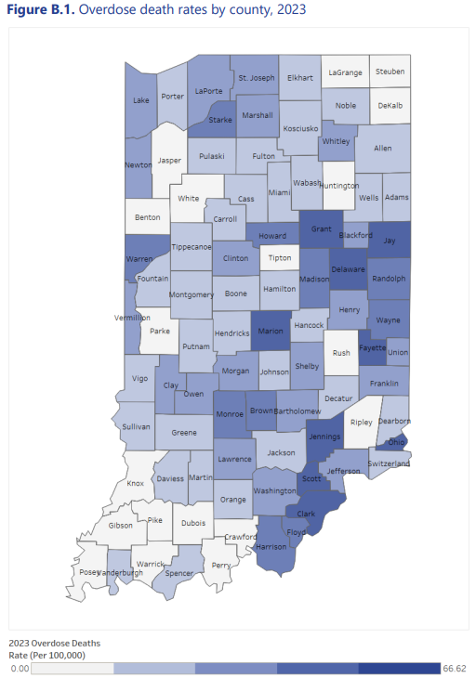
Overdose Fatalities by County of Residence
In 2023, overdose rates were higher in urban counties (34.1) than rural counties (27.5)
Overdose rates declined in both urban and rural counties compared to 2022
Between 2022 and 2023, the number of overdose deaths increased in 25 counties and decreased in 59 counties
17 of the 25 counties that showed an increase had fewer than 10 total overdose deaths for the year
Note: Includes only unintentional and undetermined intent overdose deaths
Notes:
In 2023, overdose rates were higher in urban counties (34.1) than rural counties (27.5).
Overdose rates declined in both urban and rural counties compared to 2022. (41.1 and 33.5, respectively).
Between 2022 and 2023, the number of overdose deaths increased in 25 counties and decreased in 59 counties.
Seventeen of the 25 counties that showed an increase had fewer than 10 total overdose deaths for the year.
Eight counties had no change.
In 2023, the five counties with the highest stable rate of overdose deaths were Grant (68.2), Marion (59.2), Delaware (58.5), Wayne (54.0), and Clark (52.3).

Slide 20
2023 Suicide Findings

Slide 21
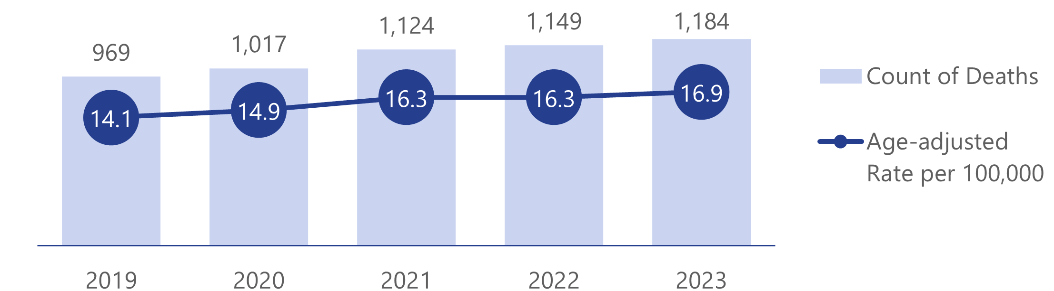
Statewide Trends
In 2023, 1,184 Indiana residents died by suicide, an increase from the previous year
The statewide suicide rate increased 3.7% between 2022-2023 (16.3 to 16.9 per 100,000, respectively) and has been increasing slightly throughout the past five years

Slide 22
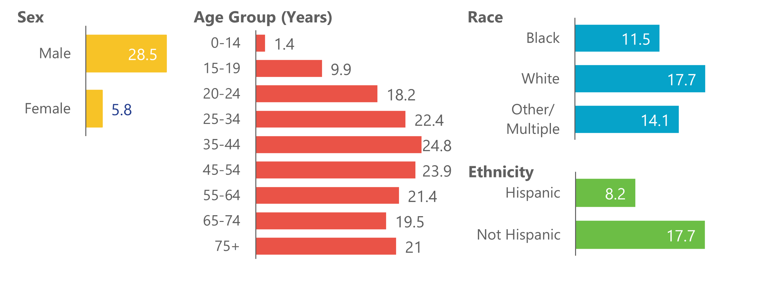
Suicide Fatalities by Demographics
Rates of suicide in 2023 were higher among: males than females, persons ages 35 to 44, and white persons

Slide 23
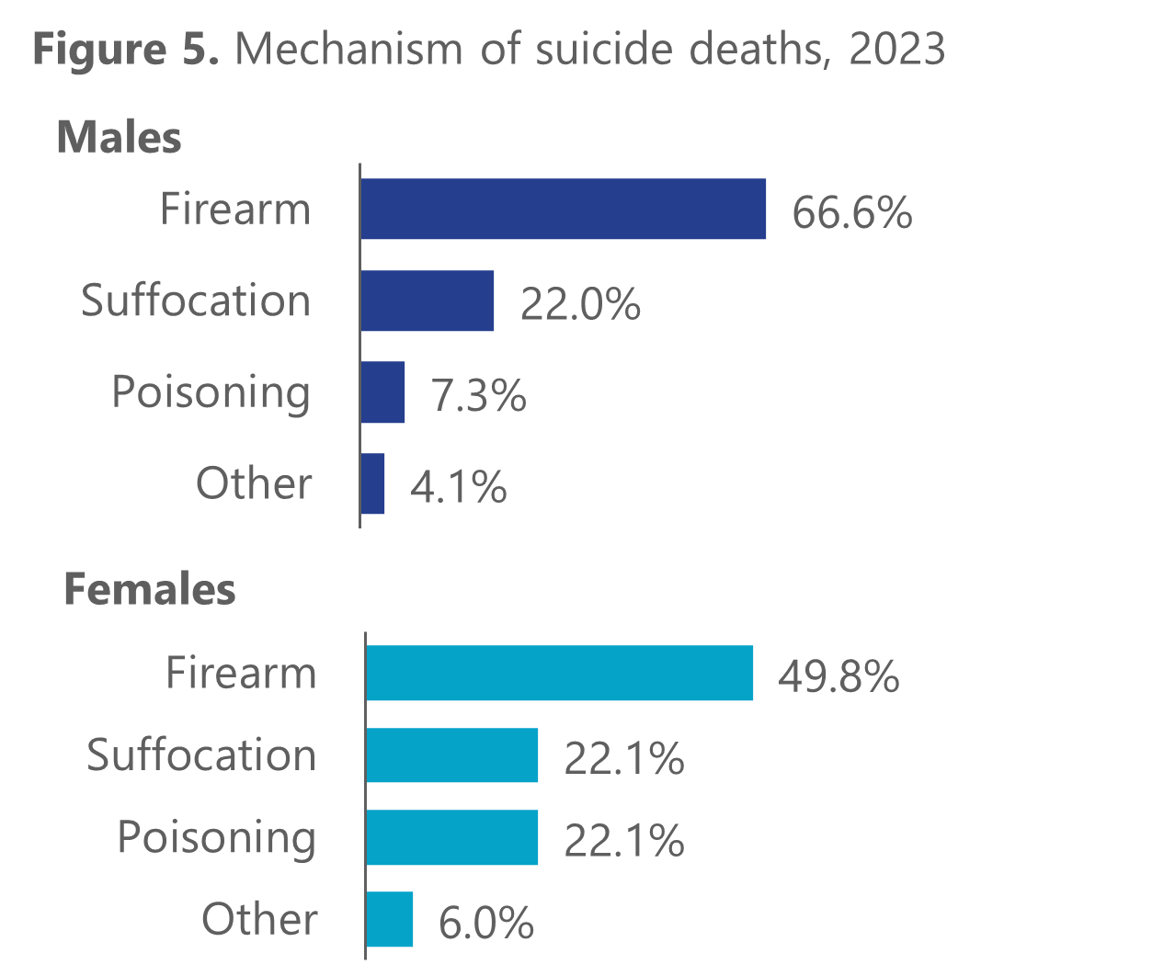
Suicide Fatalities by Mechanism
In 2023, firearms accounted for 63.8% of suicide deaths which was increase from 2022
Firearms accounted for a higher proportion of suicide deaths among males
Poisoning accounted for a higher proportion of suicide deaths among females

Slide 24
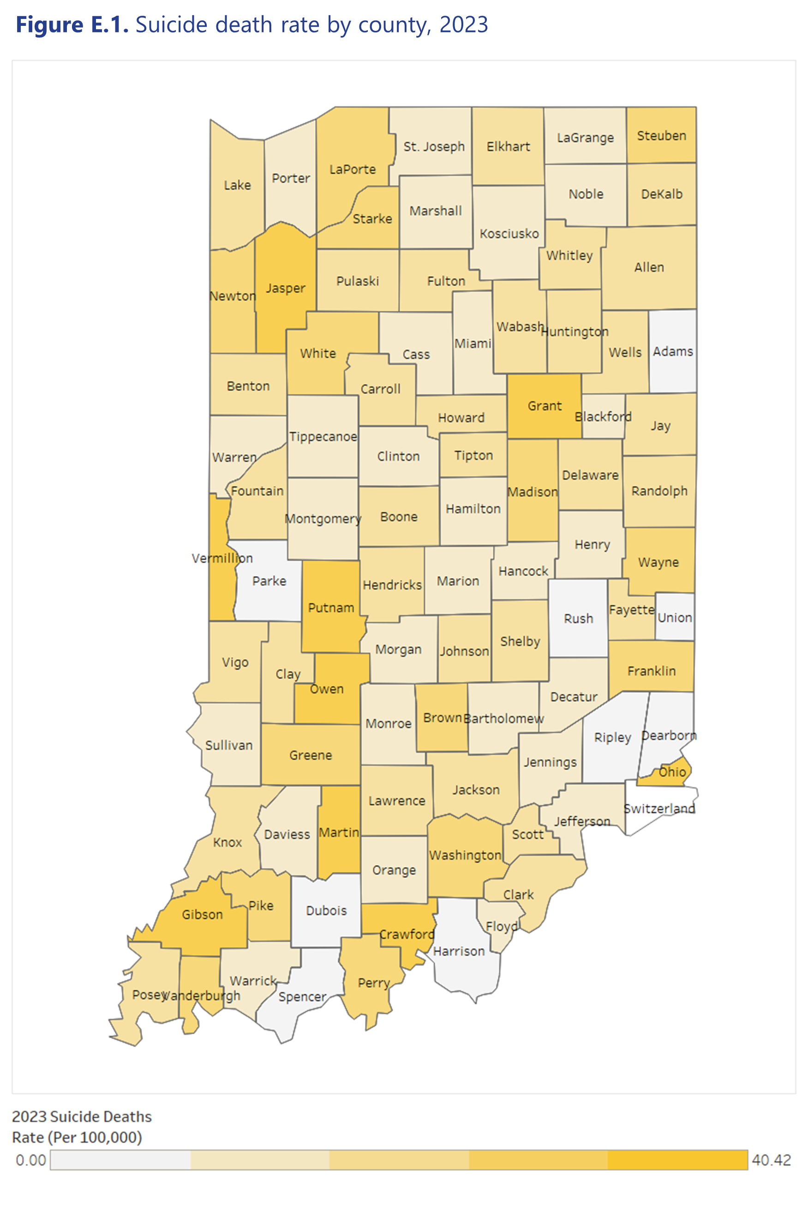
Suicide Fatalities by County of Residence
In 2023, suicide rates were higher in rural counties (19.4) than urban counties (16.1)
Between 2022 and 2023, the number of suicide deaths increased in 44 counties and decreased in 35 counties

Slide 25
Veteran Status Findings
Overdose: In 2023, 124 overdose decedents (5.8%) were identified as veterans, an increase from 116 in 2022.
Suicide: In 2023, 186 persons who died by suicide were identified as veterans (15.7%), compared to 205 in 2022. Firearms accounted for 81.7% of veteran suicide deaths compared to 78.7% in 2022. Among veterans who died by suicide, 98.9% were male, 28% were 75 and older, and 93.5% were white.

Slide 26
THANKS!
Presenter | Phone | Email
Morgan Sprecher | 317-234-9825 | msprecher@health.in.gov
Annika Barce | 317-234-3265 | abarce@health.in.gov
Allie Martin | 317-234-9656 | allimartin@health.in.gov
Lauren Milroy | 317-233-1243 | lmilroy@health.in.gov

