Slide 1
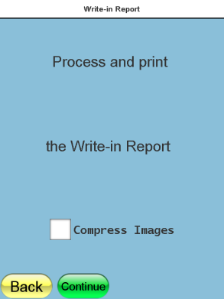
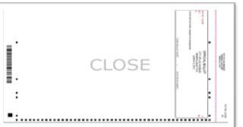
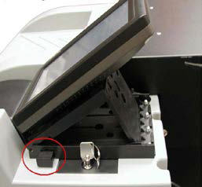
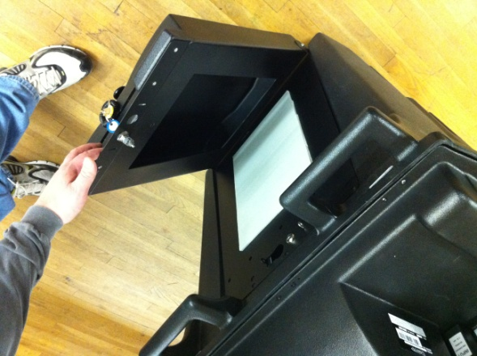
Instructions for Closing The Polls - OVO
STEP # 1
STEP # 2
Follow the on screen prompts to close voting. Then enter Election password.
The Election Officials should sign and retain the summary report that has now been printed.
Ensure that there are no ballots in the emergency ballot bin and then Insert the “Close” ballot into the OVO Precinct Scanner.
A. For additional copies press the “Print” button located at the bottom of screen. Once all copies are obtained press the “Done” button.
B. Press “Write-in Report” button.
C. Touch the white box next to “Compress Images” and then press “Continue”. The Write-In Report will now print one time. For additional copies please repeat step B and C.
STEP # 3
C. Once the scanner has powered off, press and hold the button on the side of the screen. While holding this button, lift the screen to expose the TM (memory stick) compartment.
D. Use the barrel key to open the compartment and remove the TM (memory stick).
E. Put compartment cover back on and place the screen back into place. Collapse the screen back into “down” position.
Remove all ballots from the ballot box and place them into envelopes or boxes provided.
To shut down press “shut down” button.

