Slide 1
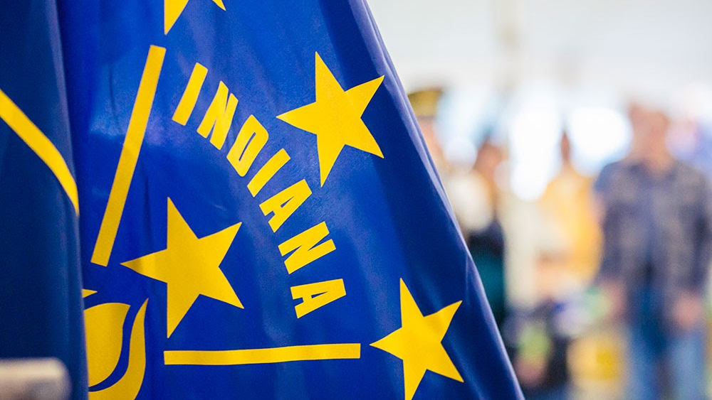


FVPSA 2023-2024 Update to Program Reports

Slide 2
Thank you for joining us today:
Please keep your lines muted during the presentation.
The webinar will be recorded and will be posted on ICJI’s website.
Questions and Answers will follow the presentation.
Utilize the chat box during the webinar as this will be monitored during the presentation.
Contact info:
Dalayna Anderson, Victim Services Program Specialist
DaAnderson1@cji.in.gov
Deirdre Westrate, Victim Services Senior Grant Manager
Dwestrate@cji.in.gov

Slide 3

Family Violence Prevention and Services Act (FVPSA)
ICJI has revised and updated the FVPSA Program report, and the revised version will be used for the 2023-2024 grant cycle beginning with Program Report 1.
Updates include:
  Responses to many questions will be based on FVPSA & any domestic violence service provided by your agency REGARDLESS of funding source.
This webinar is intended to walk through each question on the report to avoid confusion as to whether to report FVPSA only data or general domestic violence data pertaining to your agency.

Slide 4
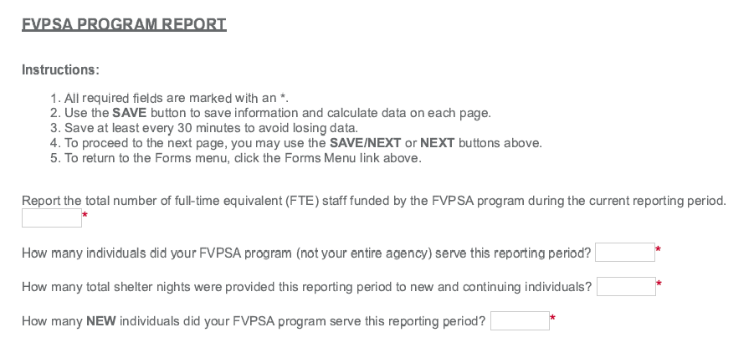

Questions 1, 2 and 4 are related to your FVPSA program and question 3 is related to ALL FUNDING sources:
Notes:
Report FVPSA data on question 1, 2 and 4. Question 3 should be zero because this will be reported on the DVPT report.

Slide 5
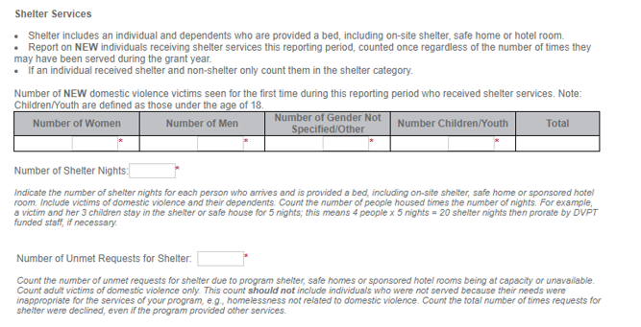
Individuals Served
The first part of this section is for Shelter Services that were provided to NEW individuals.
(Note that explanations are included to help you determine shelter services).
*If you receive DVPT, do not complete this table. This information will be entered into your DVPT report for this period.

Slide 6
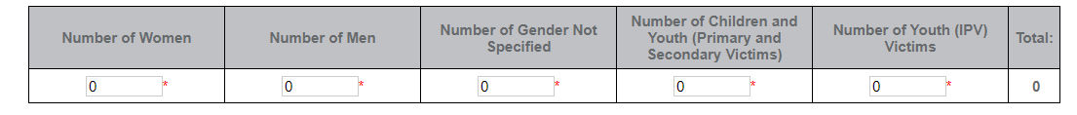
Non-Shelter Services Individuals Served:
The second part is for NON-SHELTER SERVICES that were provided to NEW domestic violence victims seen for the first time during this reporting period who received non-shelter services
*If you receive DVPT, do not complete this table..

Slide 7
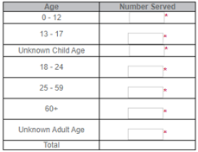
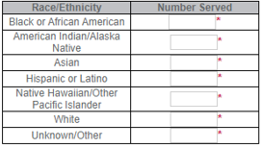
DEMOGRAPHICS information should only be reported on NEW individuals being seen for the first time this grant period and should include both shelter and non-shelter.
Report race and/or ethnicity of the Individuals served, including children and youth.
Clients may self-identify in more than one category.
Include both Shelter and Non-Shelter Individuals.
*If you receive DVPT, do not complete these tables.

Slide 8

OTHER DEMOGRAPHIC INFORMATION for the NEW individuals reported above for shelter and non-shelter services.
Number of individuals needing language services, such as interpretation.
Number of individuals self-identifying as lesbian, gay, bisexual, transgender, or queer (LGBTQ).
Number of youth ages 13-17 receiving services due to be a victim of dating violence.
Crisis Calls
Number of Crisis/Hotline Calls received for this reporting period
*If you receive DVPT, do not complete these tables.
Notes:
The next section pertains to the number of Crisis Calls received by your agency that relate to an individual or family in need of some kind of service. Additional information is provided to assist with responding to this question. A response is required.

Slide 9
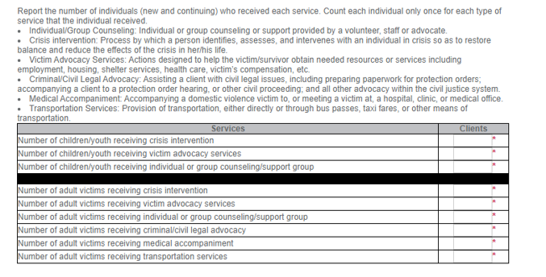
This section pertains to Services to Victims provided by your agency to individuals new and continuing for this reported period.
Review the descriptions provided to help assist in entering accurate data.
*If you receive DVPT, do not complete this table.

Slide 10

COMMUNITY EDUCATION
Presentations or trainings about domestic violence, dating violence, healthy relationships and/or available services provided by your agency.
Presentations dedicated to Adults/General Population
Presentations dedicated to Youth
Participants for each Population
*If you receive DVPT, do not complete this table.
Notes:
The next section pertains to Community Education provided in the form of presentations or trainings about domestic violence, dating violence, healthy relationships and/or available services. The number of participants is also required. A response is required for each question.

Slide 11
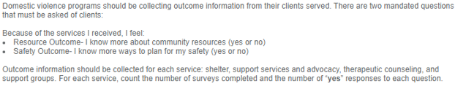
SERVICE OUTCOME DATA
Outcome data collected by your agency regarding the individuals served for this reporting period.
NOTE the TWO mandated questions that must be asked of clients.
*If you receive DVPT, do not complete this table.
Survey Type | Surveys Completed | Number of YES to Resource Outcome | Number of YES to Safety Outcome
Shelter Survey
Support Services/Advocacy
Counseling
Support Group
TOTAL:
Notes:
The next section pertains to Service Outcome Data that includes outcome data collected by your agency regarding these individuals served for this reporting period. An explanation is included to help assist in accurate data reporting. Note the two mandated questions that must be asked of clients –
For each service, count the number of survey’s completed.

Slide 12


FINAL QUESTIONS RELATED TO FVPSA
Describe the impact of FVPSA funding has had in this reporting period.
Based on activities performed by FVPSA funded staff for this reporting period include any information regarding how the FVPSA funding supports the mission of your agency.
Describe any challenges that your FVPSA program faced this reporting period.
What were they? How were they handled? and How did they impact the program?
Is there any assistance that ICJI could provide?

Slide 13


Agencies that receive
DVPT and FVPSA (not ARP) funding:
FVPSA and DVPT Program Reports are very similar in terms of the sections reporting individuals served by your agency (regardless of funding source).
FVPSA agencies also receiving DVPT funding will report ZERO individuals served by your agency on your FVPSA Program Report. That data will be reported on the DVPT Program Report.
(This will avoid double reporting for the same period).
A response is required for all other questions identified as FVPSA related activities.
NOTE: FVPSA-ARP PROGRAM REPORTS ARE TO BE COMPLETED AS NORMAL

Slide 14




Attachments – are not required but feel free to attach any news, articles or information about your agency that you might want to share with ICJI.
You are welcome to attach any press releases, news articles, or other information regarding any trainings or presentations that your agency provided to your community.
Attachments

Slide 15


Reporting Frequency
All FVPSA program reports will be reported on the quarterly basis
If you are a monthly reporter, your month 1 program report’s time frame will be for the whole quarter but still say “month”
Month 4 will be the final report

Slide 16
THANK YOU
Dalayna Anderson, Victim Services Program Specialist
DaAnderson1@cji.in.gov
Deirdre Westrate, Victim Services Senior Grant Manager
Dwestrate@cji.in.gov
Contact info:

