Slide 1


Partnering with Locals
Mike Smith, Commissioner
Indiana Department of Transportation
June 21, 2024
Notes:
Good Morning! My name is Mike Smith, Commissioner of the Indiana Department of Transportation.
Thank you for having me today. I’m excited to have the opportunity to share about INDOT and the many ways we work with and impact local agencies.
I just celebrated two years as INDOT Commissioner earlier this year.
I joined the agency in 2015 as Deputy Commissioner in Greenfield District, Deputy Commissioner of Operations in 2017 and Chief Financial Officer in 2021.

Slide 2

Learning Objectives
INDOT overview
Exploring local funding opportunities
Identifying future partnerships & resources
Notes:
There are three objectives for this session:
Learning more about INDOT as an agency and how we function
Exploring local opportunities through state and federal funding
Identifying future partnerships and agency resources

Slide 3

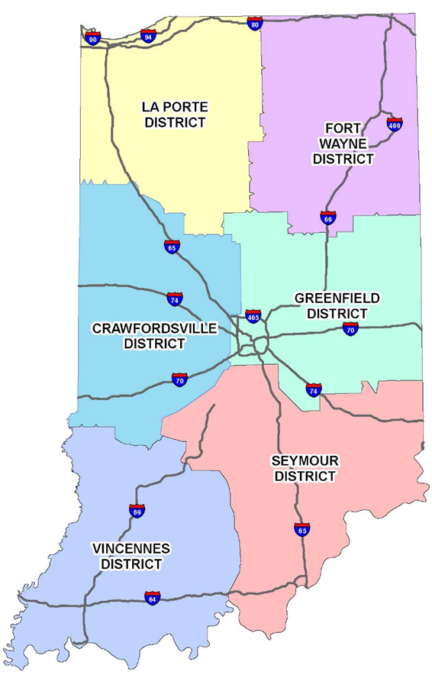
Slide Title
INDOT At-A-Glance
Six district offices & a central office
29,140 total roadway lane miles
5,771 INDOT-owned & maintained bridges
Impacts cities, towns & communities in all 92 counties
Connects people, drives economic growth, & improves quality of life
Bulleted text
Bulleted text
Bulleted text
Notes:
I know some of you are familiar with INDOT, but I’d like to start with a quick overview of INDOT as a whole.
INDOT is divided into six districts across the state, plus the agency’s Central Office in Indianapolis.
INDOT maintains more than 29,000 roadway lane miles and over 5,700 bridges, touching cities, towns and communities across all of Indiana’s 92 counties.
Our world-class transportation network provides connectivity for both Hoosiers and visitors alike, drives economic growth and improves quality of life for those who call Indiana home.

Slide 4

Slide Title
INDOT District Deputy Commissioners
Matt Deitchley
Todd Johnson
Bulleted text
Bulleted text
Bulleted text
Val Cockrum
Debbie Calder
Tony McClellan
Rusty Fowler
Notes:
Shown here are each’s District’s Deputy Commissioner.
These individuals are part of INDOT’s executive leadership team and oversee District operations and programs.
La Porte – Matt Deitchley
Fort Wayne – Todd Johnson
Crawfordsville – Debbie Calder
Greenfield – Val Cockrum
Vincennes District – Rusty Fowler
Seymour District – Tony McClellan

Slide 5
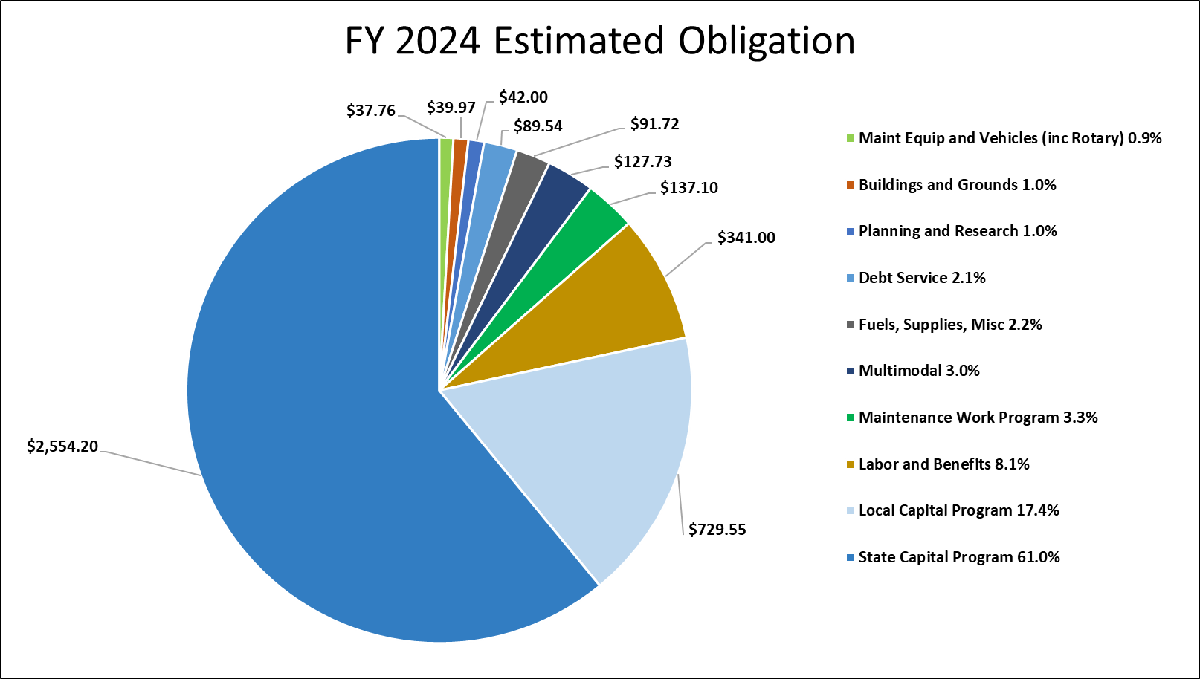
Slide Title
FY 2024 Budget
Bulleted text
Bulleted text
Bulleted text
Notes:
FY 2023 $3.9 billion program included:
$3.26 billion annual state program obligations
$573 million annual operating obligations
Fiscal Year 2024 $4 billion program includes:
$2.6 billion annual state program obligations
$647.6 million annual operating obligations
$729.5 million local capital program

Slide 6
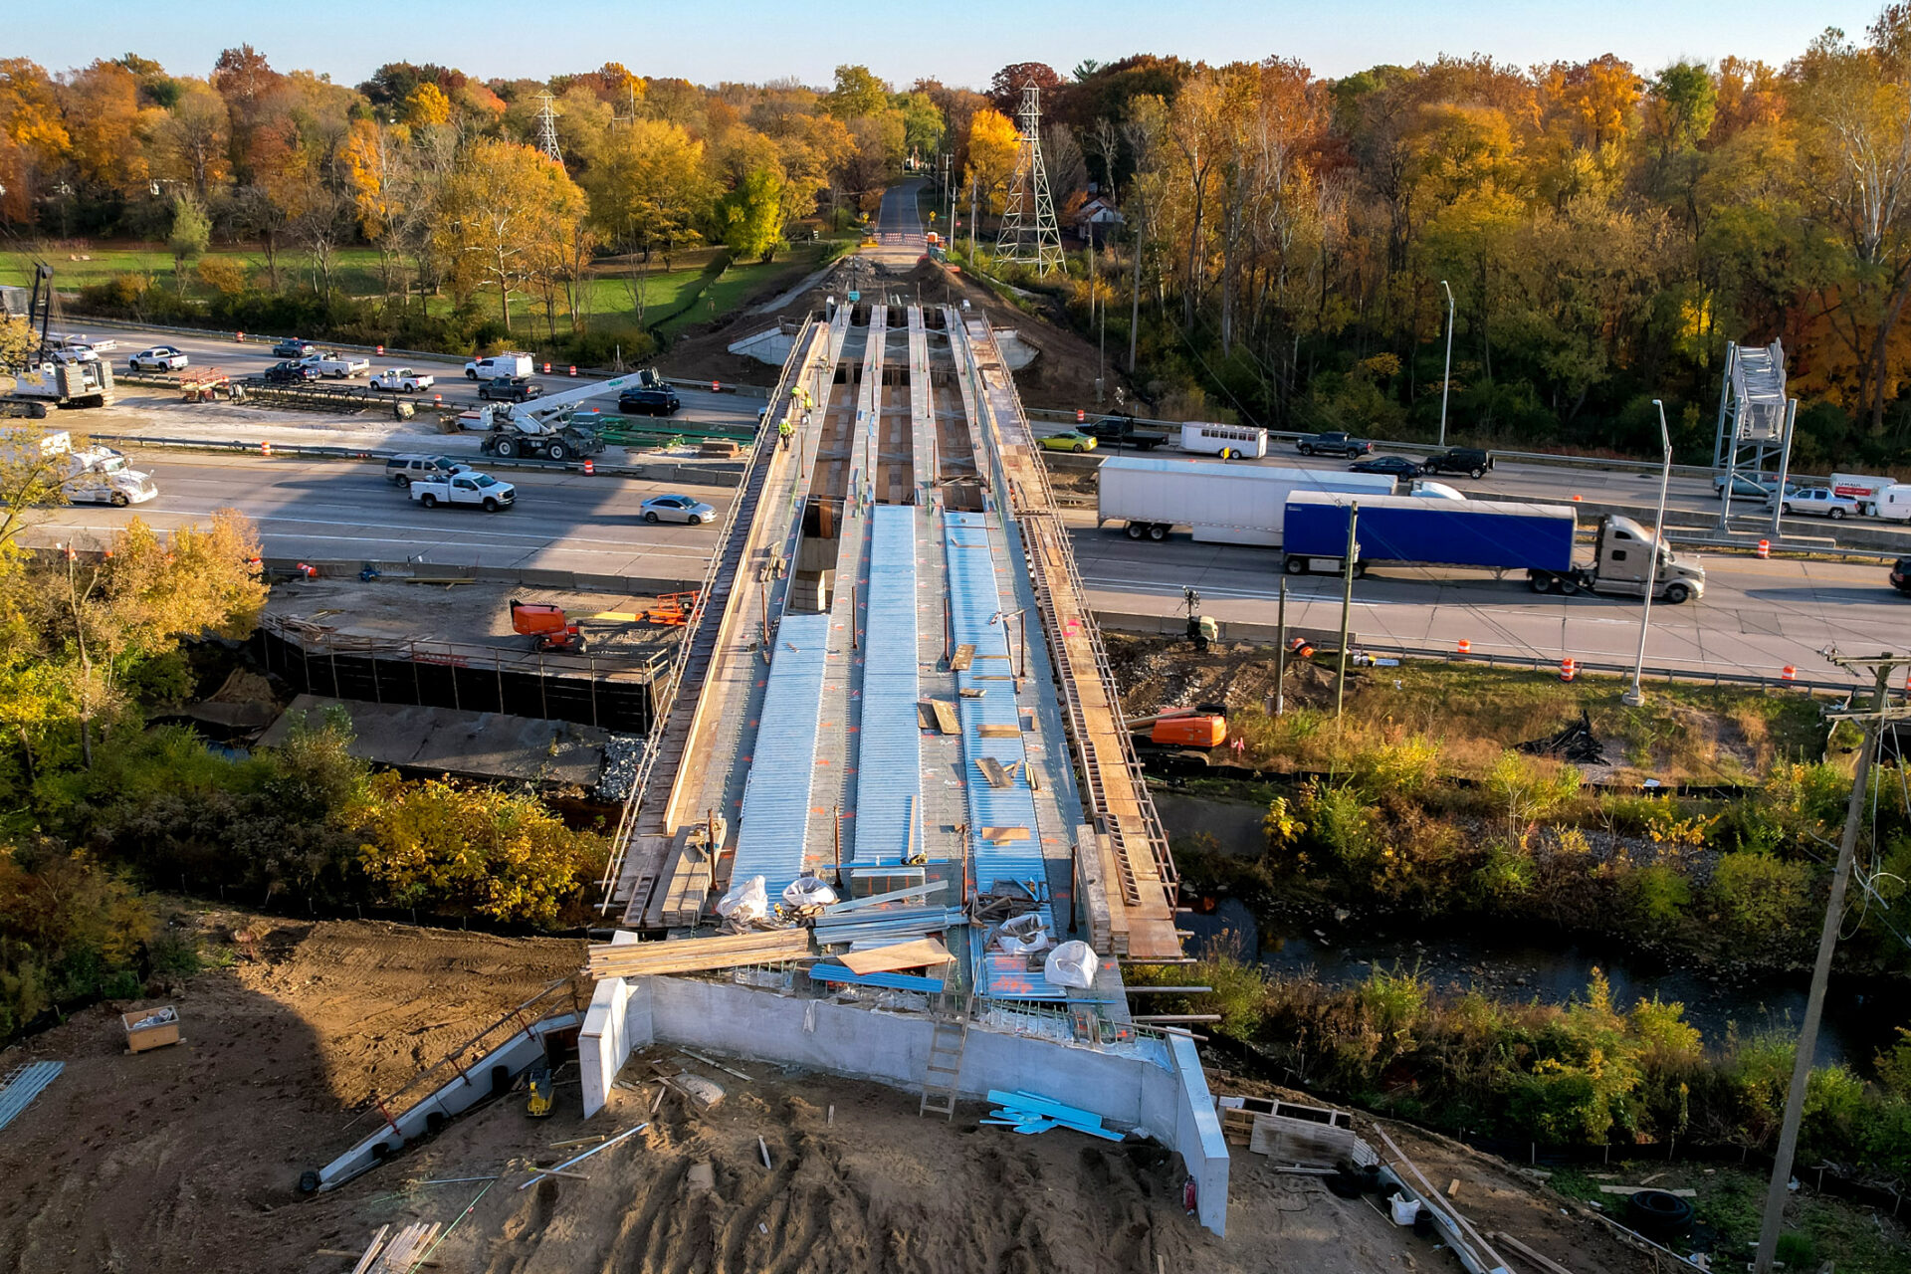

Slide Title
Next Level Roads
Bulleted text
Bulleted text
Bulleted text
Gov. Holcomb’s long-term, fully funded 20-year plan to improve Indiana’s roads & bridges
Made possible through passage of HEA 1002 in 2017
Fixing What We Have
Finishing What We Started
Planning for the Future
Impact on Cities, Towns &
Counties
Notes:
This year marks the seventh year of delivering Gov. Holcomb’s Next Level Roads plan, a 20-year, fully funded plan to improve Indiana’s transportation infrastructure.
The plan was made possible through bipartisan support of HEA 1002 in 2017.
The plan is guided by four key deliverables:
Fixing What We Have:
The plan funnels $60 billion toward building and maintaining the state’s roads and bridges.
90% of those funds are dedicated toward improving the condition of roads and bridges, enhancing safety and correcting drainage issues.
These targeted dollars have allowed us to invest in preservation techniques that help keep roads in good condition longer.
Finishing What We Started:
Fully funding design and construction of the sixth and final section of I-69, known as I-69 Finish Line, between Martinsville and Indianapolis and accelerating completion from 2027 to the end of 2024 (on track).
Delivering other major construction projects across the state.
Planning for the Future:
Provides flexibility to continue development of projects that will positively impact Indiana’s economy and quality of life, such as added travel lanes on I-65 and I-70 statewide and the I-69 Ohio River Crossing near Evansville. Mid-States?
Multiple planning studies underway (ProPEL US 30, ProPEL US 31, ProPEL Indy)
Impact on Cities, Towns and Counties:
Next Level Roads has increased funding for projects on local road networks, in addition to INDOT’s Community Crossings Matching Grant program

Slide 7
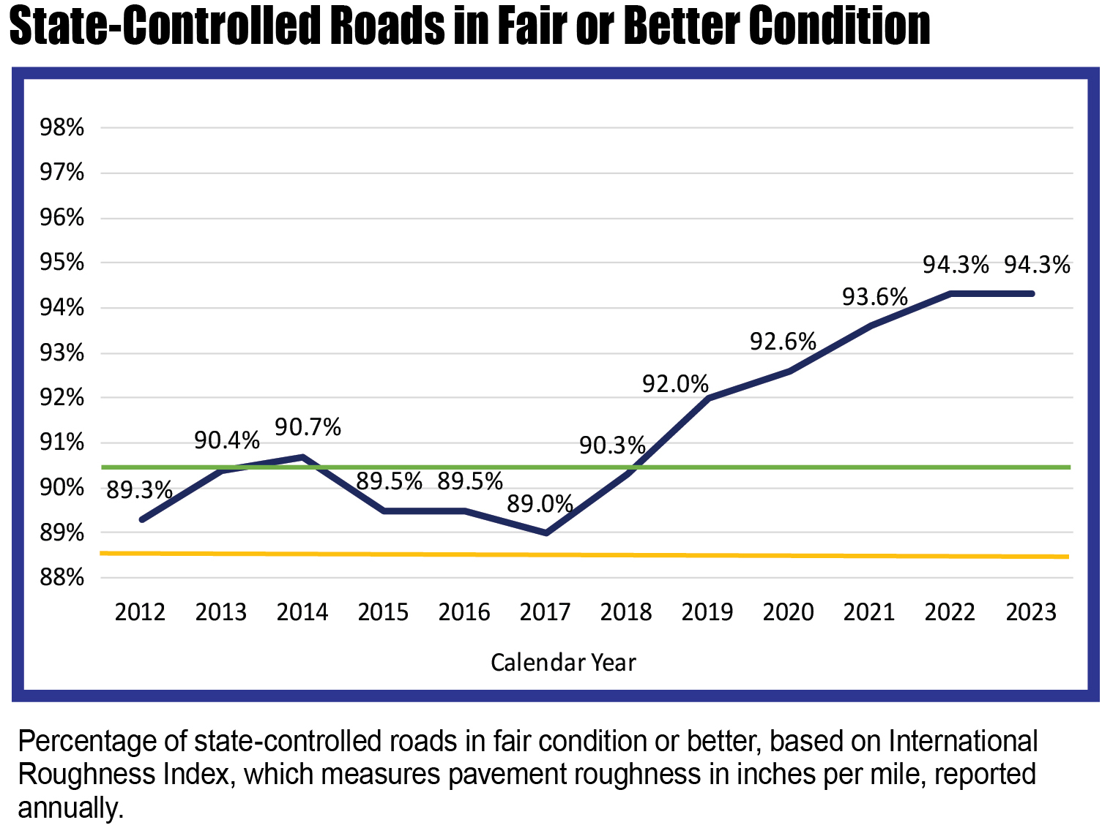
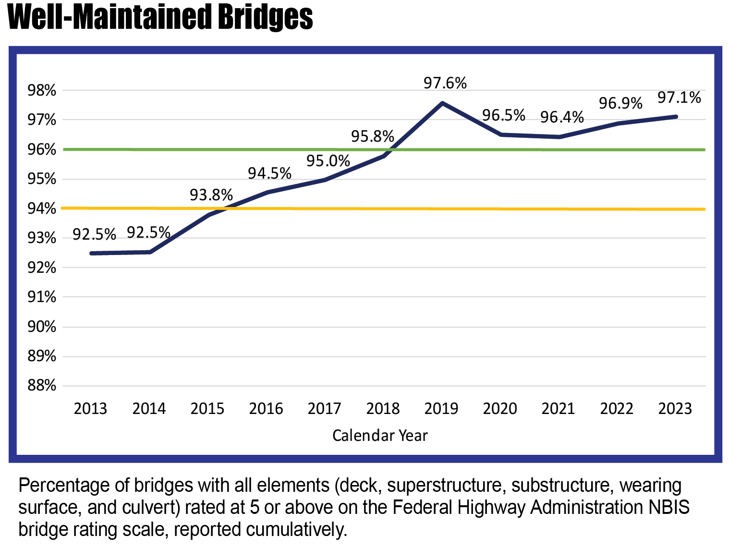
Slide Title
Condition – Roads & Bridges
Bulleted text
Bulleted text
Bulleted text
Notes:
The graphs here show how INDOT’s pavement and bridge conditions have improved over time, specifically since the passage of HEA 1002 in 2017.
The state’s laser focus on existing infrastructure has brought us ever closer to the goals set as part of the Next Level Roads plan:
95% of all state-maintained pavement in fair or better condition (by 2037)
98% of all state-maintained bridges in fair or better condition (by 2037)
As of 2023, we’re sitting at:
Just over 94% of all state-maintained roads in fair or better condition
Just over 97% of all state-maintained bridges in fair or better condition

Slide 8


Slide Title
CNBC Top States for Business
Bulleted text
Bulleted text
Bulleted text
Indiana Named #1 in the Nation for Infrastructure
in the 2022 CNBC America’s Top States for Business ranking
Notes:
The state’s leadership has prioritized infrastructure by passing a once in a generation funding package for Indiana’s roads and bridges through HEA 1002. This has shown dividends here in the state and it is being recognized nationwide.
In 2022, Indiana was recognized as having the #1 infrastructure in the country by CNBC.
As of 2023, for the seventh consecutive year, Indiana has placed within the top five in the nation for infrastructure in CNBC’s “America’s Top States for Business” rankings.

Slide 9
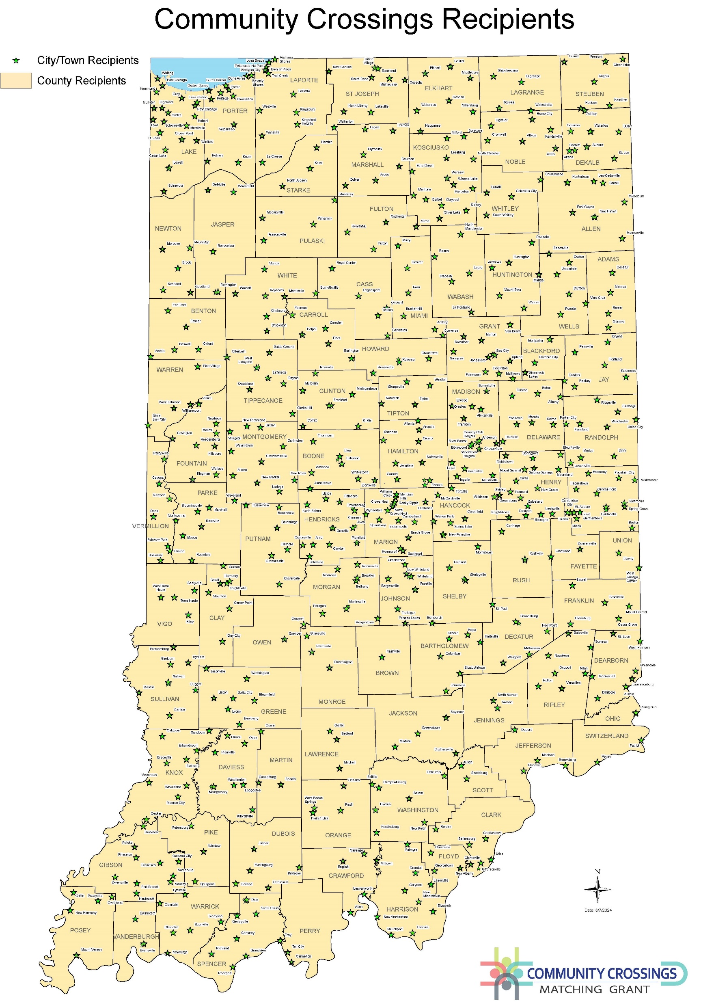
Slide Title
Community Crossings Matching Grant
Since 2016, nearly $1.7B in state funds have been awarded to local communities.
2024-1 Call: $207.3M to 252 communities
  Award cap increased to $1.5M
  2024-2 Awards to be announced in Fall 2024
2016-2022: $1.26B to 2,765 communities
Bulleted text
Bulleted text
Bulleted text
Notes:
Back in April we gathered in Clay County to announce the first round of Community Crossings grant recipients for 2024.
Since its inception in 2016, nearly $1.7 billion in state funds have been awarded to local communities.
The success of this program cannot be overstated. Community Crossings has helped deliver more than 26,000 local road and bridge improvement projects, transforming communities, improving safety and fostering economic development and commerce in cities, towns and counties across the state.
I’m looking forward to hearing about continued progress at the local level and kicking-off our second- round of 2024 funds, which opens in just a few weeks on July 1.

Slide 10
Slide Title
Formula Funding – Bipartisan Infrastructure Law (BIL)
Bulleted text
Bulleted text
Bulleted text
Reauthorizes and adds to the FAST Act formula funding for FY22-FY26 for several surface transportation programs
Establishes several new discretionary grant programs for state, LPAs & MPOs
The table below shows the new distribution funding above FAST Act formula levels.
 | FY 2022 | FY 2023 | FY 2024 | FY 2025 | FY 2026
INDOT | $156M | $175M | $194M | $213M | $233M
LOCALS | $52M | $58M | $64M | $71M | $77M
Notes:
Bipartisan Infrastructure Law was passed in 2021.
Reauthorizes and adds to federal formula funds, including the Federal-Aid Highway Program, transit programs, highway safety, motor carrier safety and rail programs.
Also includes discretionary grant programs for states, LPAs and MPOs (covered on later slide).
The table outlines new formula distribution above existing levels.
MPOs distribute to urban areas, INDOT distributes to rural areas through the local Federal-Aid Highway Program.

Slide 11
Slide Title
Federal-Aid Highway Program (FAHP)
Bulleted text
Bulleted text
Bulleted text
FAHP is an umbrella term for the separate highway programs administered by FHWA.
INDOT provides support to LPAs by sharing 25%.
Funds can be used for road & bridge preservation projects, sidewalks, trails, signage, guardrail & other safety projects.
Examples:
  Congestion Mitigation & Air Quality Program
  Highway Safety Improvement Program
  Rail Crossing Program (Local Trax)
  Surface Transportation Block Grant
  Rural Transit Program
  Airport Improvement Program
Notes:
The Federal-Aid Highway Program houses various highway programs administered by FHWA.
INDOT provides support to LPAs by sharing 25%.
Funds may be used for road and bridge preservation projects, sidewalks, trails, signage, guardrail, other safety improvement projects.
Program examples include: Highway Safety Improvement Program, Rail Crossing Program (Local Trax), Rural Transit, Airport Improvement Program

Slide 12
Slide Title
Eligibility Requirements
INDOT typically issues a rural call for federal-aid projects in November of each year.
Application period typically closes in December, with project selection in Q1 of the following year
Projects are programmed five years in advance.
To be eligible for funds, communities must provide a local match & meet other federal requirements, including maintaining an Employee in Responsible Charge (ERC).
Bulleted text
Bulleted text
Bulleted text
Notes:
INDOT’s rural call for federal-aid projects typically occurs in November, with the application period closing in December.
Award announcements are expected in the first quarter of the following year.
Projects are programmed five years in advance.
Communities must provide a local match and meet other federal requirements to be eligible.

Slide 13
Slide Title
BIL Discretionary Grants
The federal Guidebook has the full list of funding available for each grant.
Examples:
  Active Transportation Infrastructure Investment Program
  Bridge Investment Program
  Charging & Fueling Infrastructure Grants Program (Community & Corridor Charging)
  INFRA & MEGA Programs
  Reconnecting Communities Grants (Capital Construction & Planning)
  Safe Streets & Roads for All (SS4A)
Bulleted text
Bulleted text
Bulleted text
Notes:
This slide outlines some of the many federal discretionary grant opportunities.
Such as:
Active Transportation Infrastructure Investment Program
Bridge Investment Program
Charging and Fueling Infrastructure Grants Program
INFRA and MEGA Programs
Reconnecting Communities Grants
Safe Streets for All

Slide 14


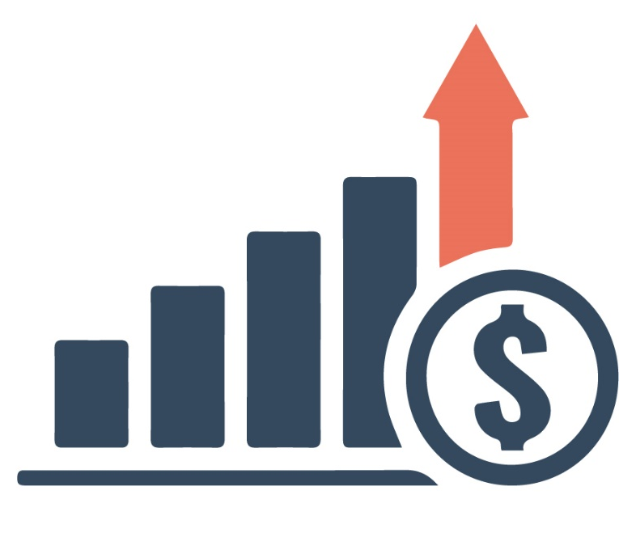
Slide Title
Looking Ahead…
Sustainable funding model
Challenges
  Inflation
  EV/alternative fuel adoption
  Federal funding instability
Funding taskforce established
  Funding of Indiana’s roads for a stronger, safer tomorrow (FIRSST)
Bulleted text
Bulleted text
Bulleted text
Notes:
While we continue to see much success through Next Level Roads and increased federal support, we’re working toward the development of more sustainable funding solutions.
The reality is that INDOT, local entities and the industry in general are up against a number challenges as we move look ahead. These are issues we’re all facing, and it’s not limited to just Indiana.
Inflation – INDOT consistently monitors and forecasts trends related to funding and inflation rates. The Bipartisan Infrastructure Law has helped us tremendously in weathering impacts of inflation up to this point.
The costs associated with materials and simply doing business are leveling out somewhat, however, these impacts have caused some movement/adjustments within INDOT’s capital program.
EV Adoption/Conversion – We have started and will continue conversations surrounding the state of transportation funding in Indiana and how we work with the General Assembly to bridge potential gaps in funding that may evolve, especially those related to adoption and/or conversion to EVs and other alternative fuels.
Federal Funding Instability – Bipartisan Infrastructure Law reauthorizes funding through FY 2026. We are approaching a new administration in Washington.
INDOT and others have provided data and information through FIRSST (taskforce) so informed decisions can be made regarding the future of Indiana’s transportation funding. The taskforce has been extended so that collaboration and conversation can continue to the next legislative session.

Slide 15
Slide Title
New in 2024: Focus on Safety
Bulleted text
Bulleted text
Bulleted text
Work in partnership with local governments to prevent injuries & loss of life
  Reduce fatalities & incapacitating injuries Indiana roadways by 25% in 10 years
Collaborate with employees & external partners to continue to foster a safety culture
  Reduce work zone incidents by 5%
Notes:
Each year INDOT sets agency goals. Those priorities remain largely the same in 2024, with the addition of a new goal focused on safety.
Safety is always top priority at INDOT, but the agency has embraced a renewed focus on safety in 2024.
New safety goal: Reduce fatalities and incapacitating injuries on Indiana roadways by 25% in 10 years (not just state roads), reduce work zone incidents by 5%
Over the past several years, and especially in the years during and following the height of the COVID-19 pandemic, there was a rise in serious injury and fatal crashes (nationwide, not just in Indiana).
Trends include speed and distracted driving.
Something has to change, including driver behavior, which is likely our biggest challenge in this endeavor.
How are we working toward this goal?

Slide 16

Slide Title
Buckle Up Phone Down (BUPDIN.com)
Bulleted text
Bulleted text
Bulleted text
Launched by Missouri DOT in 2017, adopted by INDOT in 2023
An estimated 30% of crashes are reported to be related to distracted driving.
Six percent of vehicle occupants are unbelted but account for 47% of fatalities in Indiana.
Notes:
One effort specific to changing driver behavior is Buckle Up Phone Down. INDOT started to push this last fall and I know many of you may have heard about it at Road School this past spring.e
Buckle Up Phone Down a public awareness campaign launched in Missouri back in 2017.
They’ve seen success in Missouri and we believe we can see similar success in Indiana.
Since 2017, seatbelt usage increased from 81% to 87% in Missouri
As mentioned, distracted driving and cell phone use is a major contributor to crashes
In 2022, over 7,000 crashes were related to distracted driving and mobile devices
30% of crashes are reported to be related to distracted driving in Indiana.
We’re also seeing a large number of roadway departure crashes (468 in 2022)
Wearing a seatbelt makes all the difference in any kind of crash, but especially when vehicles are leaving the roadway.
Just 6% of vehicle occupants are unbelted but account for nearly half of all fatalities on Indiana roadways.
We realize that changing driver behavior is a huge challenge, but this is just one way that we’re reminding and challenging people to be safe on Indiana roadways
Simple decisions like buckling up or putting the phone down save lives
We’re asking locals, the industry and the traveling public to help by setting an example for others by doing those two things every time you get in a vehicle, and encouraging your friends, families and colleagues to do the same
You’ll be seeing more of the Buckle Up Phone Down effort across agency communications, on social media, DMS boards and even in our official email signatures, with more in the works.
We hope that you all will join us in making roadways and work zones safer not only for workers, but for all road users.
Visit BUPDIN.com to learn more and take the pledge.

Slide 17
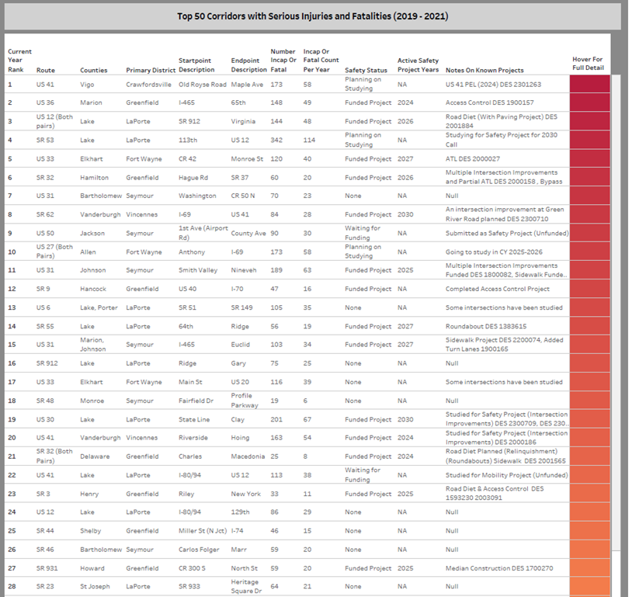
Slide Title
Identifying Solutions – Top 50 Corridors
Safety Action Plan
  Collaboration with ISP to identify the Top 50 Corridors with serious injuries & fatalities
  Increased patrols & enforcement
  Determining long-, medium- & short-term improvement plans for problematic corridors & intersections
Bulleted text
Bulleted text
Bulleted text
Notes:
INDOT has worked with ISP to identify the top 50 corridors with serious injury and fatal crashes.
We’re determining long-, medium-, and short-term improvement plans for corridors and specific intersections on the state road network.
This includes increased patrols and enforcement to encourage drivers to slow down, reduce distractions, buckle up, and put the phone down.

Slide 18

Slide Title
Local Safety Improvements
$50M in Highway Safety Improvement Program (HSIP) funds available to local agencies for safety improvement projects
NOFA released June 10
  Call for projects open Sept. 3 – Oct. 11, 2024
Awarded funds to be utilized in two years
Bulleted text
Bulleted text
Bulleted text
Notes:
Earlier this month INDOT announced $50 million in Highway Safety Improvement Program funds available to local agencies for safety improvement projects
These will be systemic, low-cost improvements that do not require additional right-of-way.
Examples: new or updated warning devices, raised medians, curb extensions, pedestrian/crosswalk improvements, guardrail additions or improvements, traffic signal enhancements or adjustments, improvements at rail crossings
Awarded funds are to be utilized within two years.
The Call for Projects opens September 3, 2024.

Slide 19
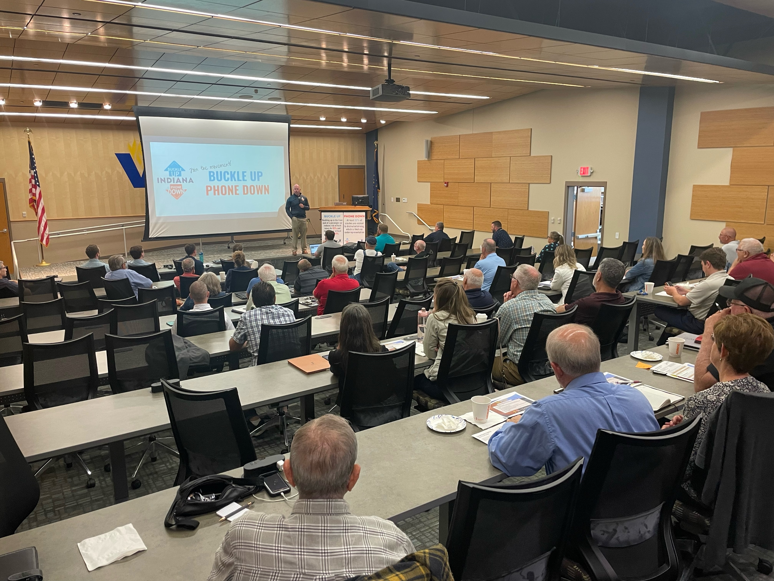
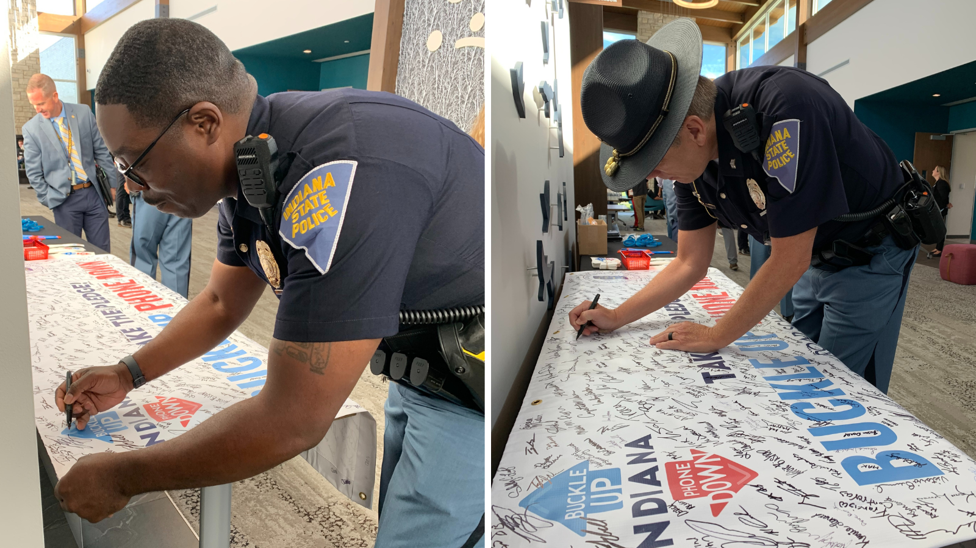
Slide Title
Intentional Partnership
Safety Summits
Future Planning
Open Communication
Better Together
Bulleted text
Bulleted text
Bulleted text
Notes:
Another one of INDOT’s agency goals is Intentional Partnership and we’ve connected that to our safety efforts this year.
In January INDOT hosted a statewide Safety Summit, followed by regional summits in each INDOT District.
Thank you to those who took the time to join us out in the Districts to take part in meaningful conversation and discussion related to issues and solutions related to roadway safety.
We’re also in the business of building relationships, sharing future plans and two-way communication.
We want to work with you and for each of you to work with us as we make progress toward this goal.

Slide 20

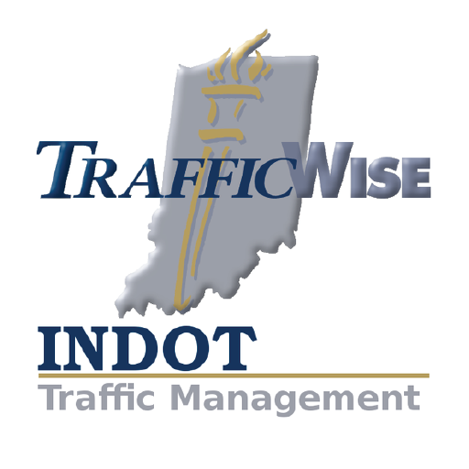
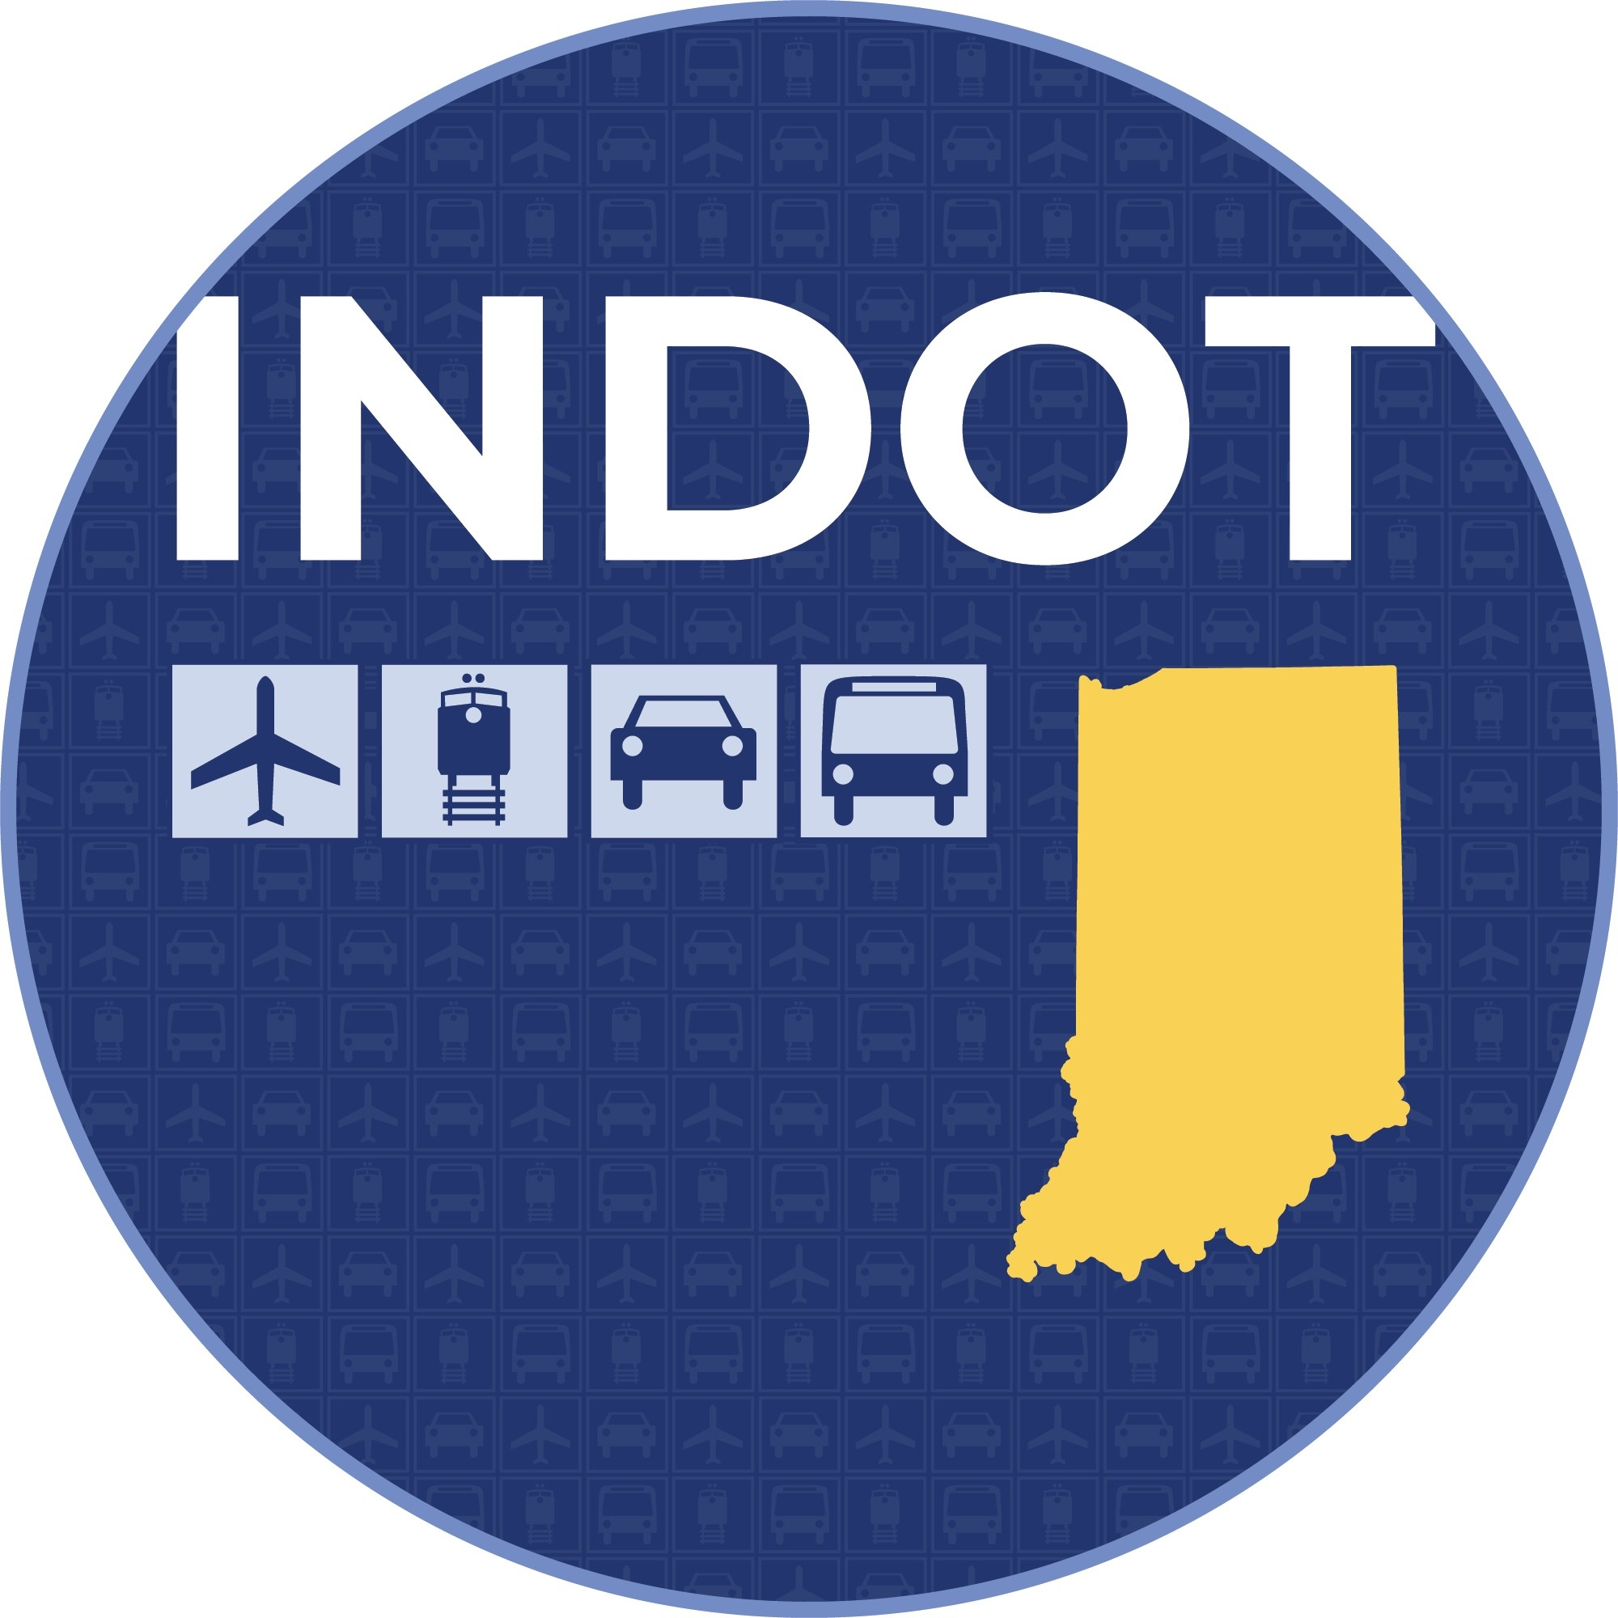
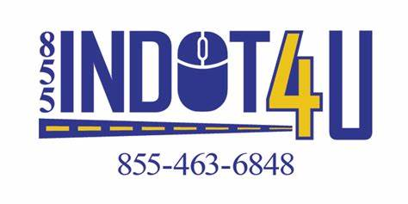
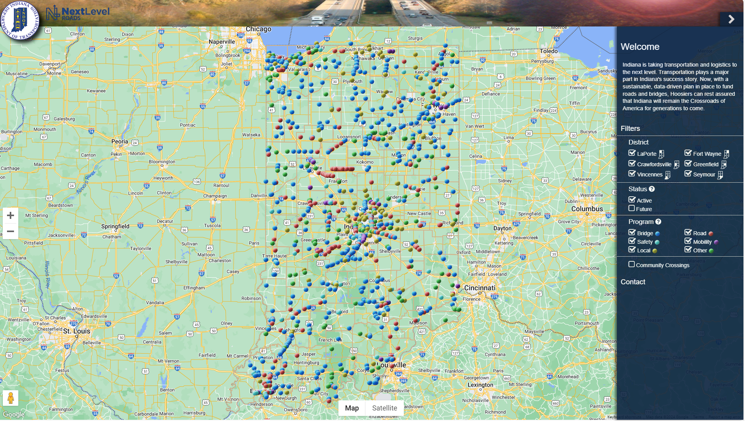
Slide Title
INDOT Resources
Website
  in.gov/indot
INDOT News
  alerts.indot.in.gov
INDOT Customer Service
  indot4u.com
Social Media
  Facebook, X (formerly Twitter), Instagram, LinkedIn
TrafficWise
  511in.org
Next Level Roads Map
  bit.ly/INDOTNLR
Bulleted text
Bulleted text
Bulleted text
Notes:
Before I wrap up, I want to highlight a few of the many public-facing resources INDOT has to offer.
Hopefully, you’re familiar with most if not all of them.
Website – the INDOT website hosts a wide range of agency information and resources. We’re working to improve the user experience and accessibility.
INDOT News – you can subscribe to email and/or text updates sent directly to your inbox through GovDelivery, includes construction and maintenance updates, INDOT programs and other projects
INDOT4U Customer Service – quick and easy way to ask questions, report issues or concerns on state roadways, inquiries are tracked through our system, routed to the appropriate personnel to be addressed
TrafficWise – an interactive map showing existing road closures and restrictions, allows the traveling public to plan their route, etc.
Next Level Roads Map – an interactive map tool available online provides information about future and current construction projects (includes local projects)

Slide 21
Thank you!
Mike Smith, Commissioner
Michael.Smith@indot.in.gov
Notes:
With that, I want to thank you again for having me today and we look forward to working together to build and maintain Indiana’s world-class transportation network.

Slide 22
Broadband Equity, Access, and Deployment (BEAD) Program
Stephen Cox
Indiana Broadband Office
June 21, 2024

Slide 23
Learning Objectives
What is BEAD?
What is coming in BEAD?
How can local communities get involved moving forward?
What is the Digital Equity program?

Slide 24

Broadband Equity, Access, and Deployment (BEAD)
$868 million federal dollars for broadband expansion
No local match required

Slide 25
Broadband Equity, Access, and Deployment (BEAD)
Challenge Phase
  March 4, 2024 – April 17, 2024
Rebuttal Phase
  May 2, 2024 – June 1, 2024
Final Determination
  July 2024
Subgrantee Selection Process
  Fall 2024 – Spring 2025

Slide 26
Broadband Equity, Access, and Deployment (BEAD)
Permitting
Letters of recommendation
Engagement with internet service providers
Digital Equity program

Slide 27
Thank you!
Stephen Cox
Stcox@iot.in.gov
(317) 407-1530

