Slide 1

Indiana’s Roadmap to Improving Mental Health and Substance Use Services
Douglas Huntsinger
Office of the Governor
June 21, 2024

Slide 2

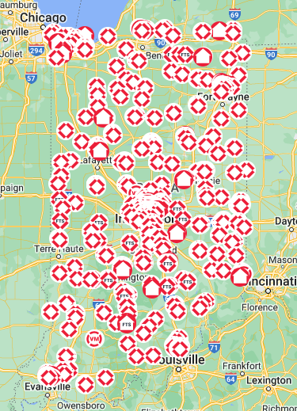
Slide Title
Naloxone Distribution
In partnership with Overdose Lifeline, Indiana has distributed over 578,000 doses of naloxone since 2020.
In 2023, Overdose Lifeline distributed on average 24,000 doses of naloxone each month.
Through the State Opioid Response grant, Indiana has funded the placement of 430 NaloxBoxes and 18 naloxone vending machines.
Bulleted text
Bulleted text
Bulleted text

Slide 3


Slide Title
Treatment Atlas
First-of-its-kind online tool to connect Hoosiers with SUD to high quality treatment
Over 600 DMHA-certified treatment facilities listed
More than 42,000 Hoosiers have accessed the site since September 2023 launch
Bulleted text
Bulleted text
Bulleted text
TreatmentAtlas.org

Slide 4
Slide Title
Regional Recovery Hubs
The state’s regional recovery hub network launched in 2020 as a partnership with Indiana Recovery Network.
Since 2020, over 186,900 services have been provided by Indiana’s 21 hubs.
Bulleted text
Bulleted text
Bulleted text

Slide 5

Slide Title
Integrated Reentry and Correctional Support Program
Bulleted text
Bulleted text
Bulleted text
IRACS connects incarcerated individuals with certified peers for reentry support services.
More than 6,600 individuals served since June 2022 launch.
An incarcerated individual who does not engage with an IRACS peer before reentry experiences an 88% reduction in odds of having a successful discharge.

Slide 6
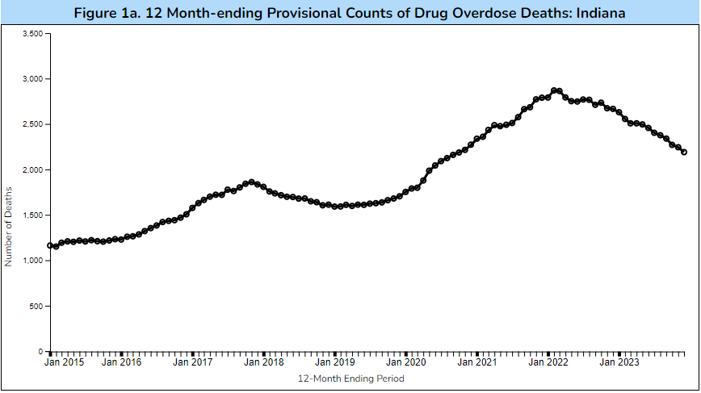
Slide Title
Overdose Rate
Bulleted text
Bulleted text
Bulleted text
Indiana reported an
18%
18%
decrease in overdose deaths in 2023.

Slide 7
Slide Title
National Opioid Settlement
$918 million over 18 years from settlements with distributors, manufacturers, and marketers
  IC 4-6–15 - Distribution Formula
    Creates state-local split at 50/50
      35% of the 50% must be used for abatement (Exhibit E)
      15% of the 50% is unrestricted
    Specifies that the distribution of funds from an opioid litigation settlement is subject to bankruptcy court order or bankruptcy settlement
    Annual distribution of less than $5,000 rolls up to the county
    Permits city, county or town to transfer all or part of payment to another city, county or town to benefit both communities
Bulleted text
Bulleted text
Bulleted text

Slide 8
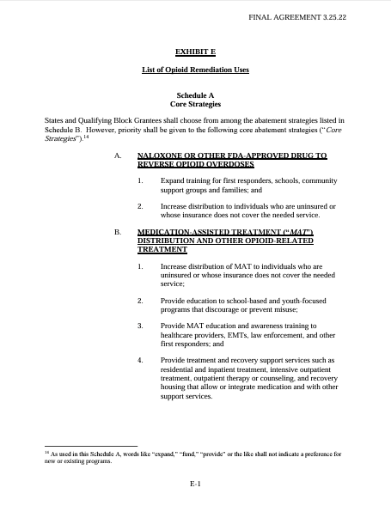
Slide Title
National Opioid Settlement
Exhibit E of the National Opioid Settlement outlines the allowable uses of abatement funds.
Common uses include:
  Recovery residence expansion
  Transportation
  Community coordinators
  Peer recovery coaches
  School-based prevention
Bulleted text
Bulleted text
Bulleted text
in.gov/recovery/settlement

Slide 9
Slide Title
National Opioid Settlement
Matching Program
  78 proposals totaling $93M
  Awarded $19M to 30 recipients covering 28 counties
Capital for Recovery Residences
  43 proposals totaling $25M
  Awarded $4.2M to 7 recipients in 7 counties
Harm Reduction Street Outreach Teams
  Awarded $1.5M to 8 recipients,
  bringing total to 15 statewide
Department of Correction
  $4.6M to expand addiction treatment services, educational curriculum and trainings
Office of Judicial Administration
  $5M over five years to expand behavioral health supports in the justice system, including civil legal aid for persons/families impacted by SUD
Other Priorities
  Peer Recovery Coaches
    RFF released May 21
Bulleted text
Bulleted text
Bulleted text

Slide 10

Future of Public Health
Now in implementation phase – Health First Indiana
Historic, FIRST-of-its-kind investment in public health
Investment in prevention leads to healthier communities and workforce, which attracts businesses and benefits economy
Convenes local elected officials, public health, clinical health and community partners
Partnerships allow communities to organize care, reduce duplication of services, be more efficient
Benefits rural communities that often have fewer resources
Allows counties to create innovative solutions tailored to address local health needs

Slide 11
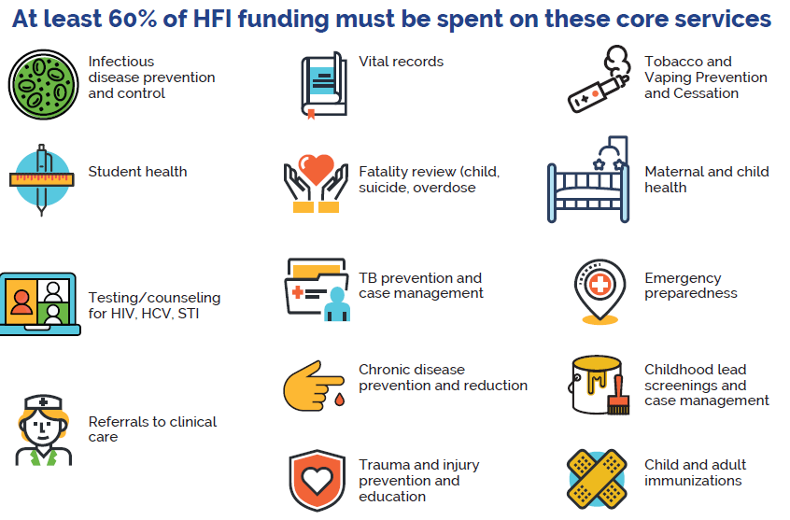
Slide Title
Core Services
Bulleted text
Bulleted text
Bulleted text

Slide 12
Slide Title
Core Services
Bulleted text
Bulleted text
Bulleted text

Slide 13

Slide Title
Bulleted text
Bulleted text
Bulleted text

Slide 14



Slide Title
Indiana’s Future Crisis Response System
Pillar 1: Someone to Contact
Pillar 2: Someone to Respond
Pillar 3: Somewhere to Go
Bulleted text
Bulleted text
Bulleted text
A collaborative network of 988 centers will respond to every call, chat, and text in a standardized and informed manner to resolve crises
Mobile Crisis Teams (MCTs) will be stationed across Indiana, ready to be dispatched by 988 centers for individuals who need in-person support
Crisis Stabilization Units (CSUs) across the State will be open to receive individuals whose crises cannot be resolved over the phone or by an MCT
The Crisis Response Pillars, an integral part of the future state of CCBHC, are the most costly and underdeveloped portion of CCBHC. They are in need of the most direct to provider funding support during the transition to CCBHC.

Slide 15
Slide Title
988 Suicide and Crisis Lifeline
24/7 line for those currently experiencing a mental health or substance use crisis.
July 2022 – December 2023
  68,803 calls routed to IN
  63,527 calls answered in-state
  92% in-state answer rate
Bulleted text
Bulleted text
Bulleted text
988Indiana.org

Slide 16
Slide Title
Progress Update for Year 1 CMH Funds
Bulleted text
Bulleted text
Bulleted text
$50M Year 1 Breakdown
DMHA has obligated $28M in 15 contracts with CCBHC-eligible organizations to provide key crisis services as part of pillars 2 and 3 of the 988 Crisis Response System
DMHA is working with community partners to stand up a $10M MCT Accelerator Program that would expand mobile crisis services to underserved populations
DMHA is meeting with regional leaders to discuss how to close the geographic gaps in Crisis Services
Less than 1% of funding planned for administrative costs such as hiring Grant Coordinators
$28M
$10M
$12M

Slide 17
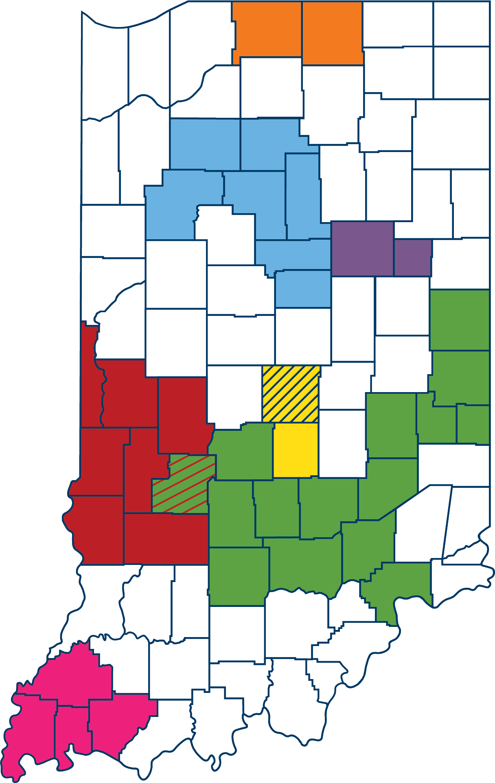
Slide Title
CCBHC Pilot Sites
Adult and Child Mental Health Center
Bulleted text
Bulleted text
Bulleted text
Centerstone
4C Health
Radiant Health Services
Hamilton Center
Sandra Eskenazi Mental Health Center
Oaklawn Psychiatric Center
Southwestern Behavioral Healthcare

Slide 18






Slide Title
Current BH System to Future CCBHC State
Bulleted text
Bulleted text
Bulleted text
Structural barriers and practices keep care siloed and leads to disparate service provision
Established standards for integrated and coordinated care
Fee-for service drives quantity, so programs are designed by what is billable
Prospective payments can be tied to outcomes & quality, so programs are designed to meet needs
Staff turnover is high due to low pay
Better salaries achievable through prospective payment system (PPS)

Slide 19










Slide Title
Who Can Access CCBHC Services?
Crisis Services
Bulleted text
Bulleted text
Bulleted text
Screening, Diagnosis, & Risk Assessment
Anyone who requests care for mental health or substance use
Accessible regardless of one’s ability to pay, place of residence, or age
  Includes developmentally appropriate care for children and youth
Psychiatric Rehabilitation Services
Outpatient Primary Care Screening & Monitoring
Targeted Case Management
Peer, Family Support, & Counselor Services
Community-Based Mental Health Care for Veterans
Person- & Family- Centered Treatment Planning
Outpatient Mental Health & Substance Use Services

Slide 20



Slide Title
Key Benefits of CCBHC
1
Ensure complete transparency into the effectiveness of the behavioral health system.
Bulleted text
Bulleted text
Bulleted text
Strengthen the whole ecosystem by linking behavioral health care with other community pillars such as education, justice, and housing systems.
2
Build tailored treatment pathways for individuals, rather than fit complex individuals into a one-size fits all approach.
3

Slide 21
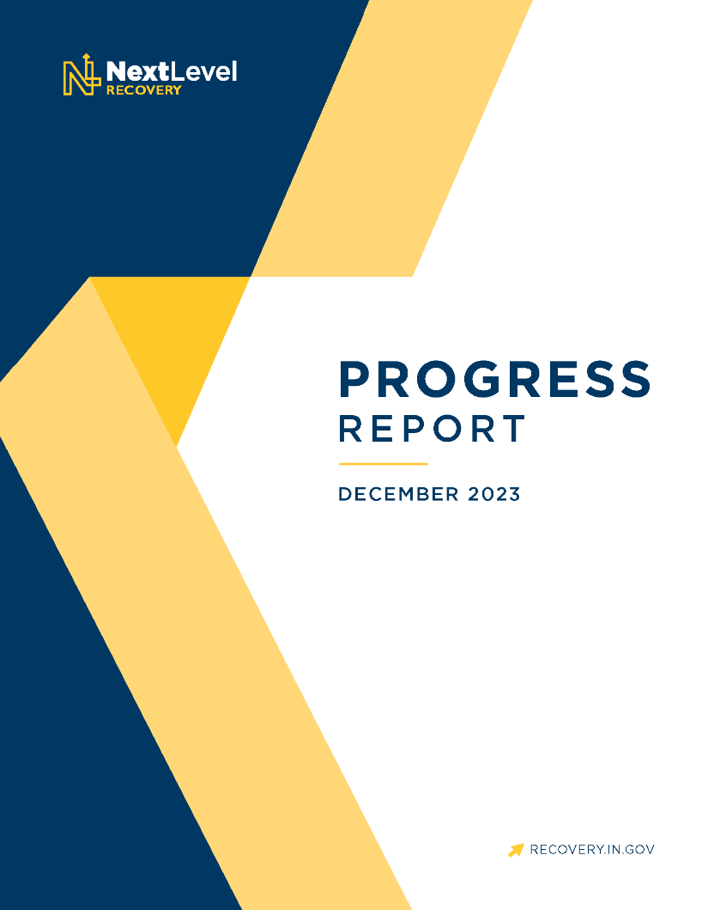
Slide Title
Progress Report
The 2023 Next Level Recovery Progress report details the collective efforts of the state toward reducing overdose deaths and improving Hoosier behavioral health.
Indiana reports an 18% decline in overdose deaths in 2023.
Read more at: in.gov/recovery/progress-report
Bulleted text
Bulleted text
Bulleted text

Slide 22



Thank you!
dhuntsinger@gov.in.gov
317-232-4574
in.gov/recovery

Slide 23




Slide 24
About Us
501(c)(3) Organization
Subsidiary of the Indiana Chamber of Commerce
Workplace and Community Well-Being
Member Organization
Notes:
The Wellness Council of Indiana is a 501(c)3 not-for-profit organization and subsidiary of the Indiana Chamber of Commerce. Through this partnership, we take a workforce and economic development-approach to employee health and well-being. We view strong well-being efforts as a strategic business practice to help recruit and retain top talent.
We work with workplaces and communities throughout the state to develop, maintain and evolve their strategic well-being strategies.
We meet our member organizations where they are and guide them in their own unique well-being journey. We are proud to work with over 400 member organizations throughout the state.

Slide 25
Wellness Council of Indiana Goal
To improve the quality of life for Indiana residents by empowering employers and communities to create thriving places to live, work, learn and play through connection, collaboration, education and evaluation.
Notes:
We serve as a connecter (connect to other organizations, similar size/industry) and convener to help bring companies together to learn and share from one another. Thus, helping to strengthen wellness networks across Indiana/state. We try to meet organizations where they are and help companies think more strategically about health and wellness.

Slide 26

Notes:
Challenges faced by individual:
Briefly discuss the challenges faced by individuals with justice involvement or substance use disorder in finding employment
Emphasize the need for tailored resources and support
JENNIFER: (Question) How deep do we need to go? I pulled your data from chamber bod presentation. I don’t know if this is appropriate.

Slide 27
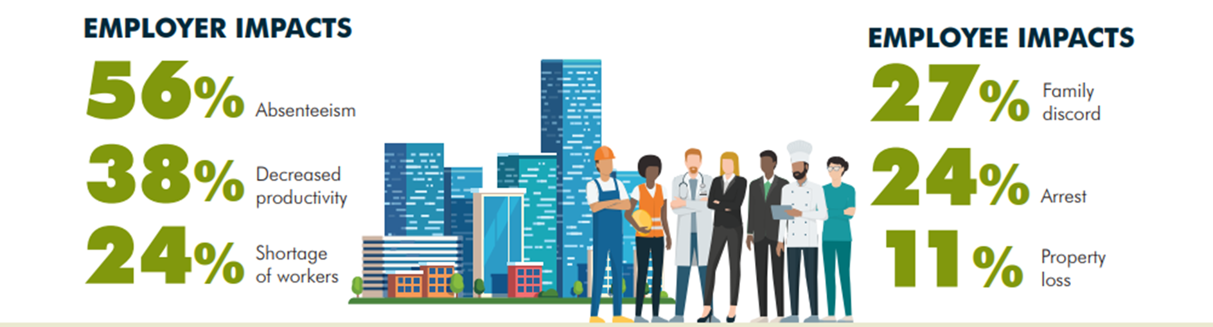

Slide 28
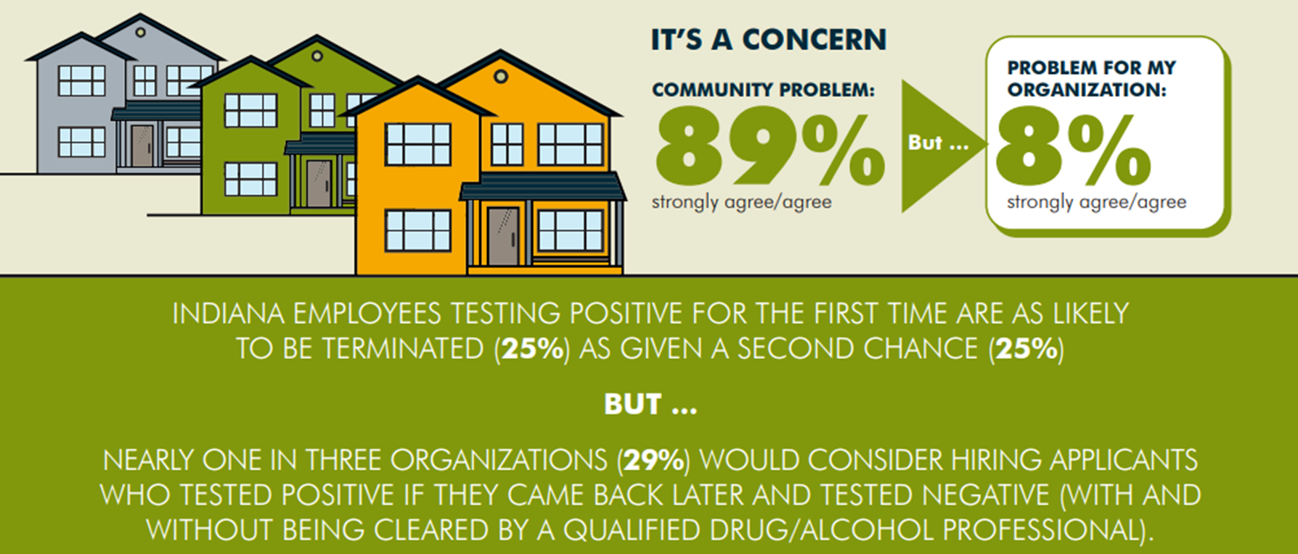

Slide 30
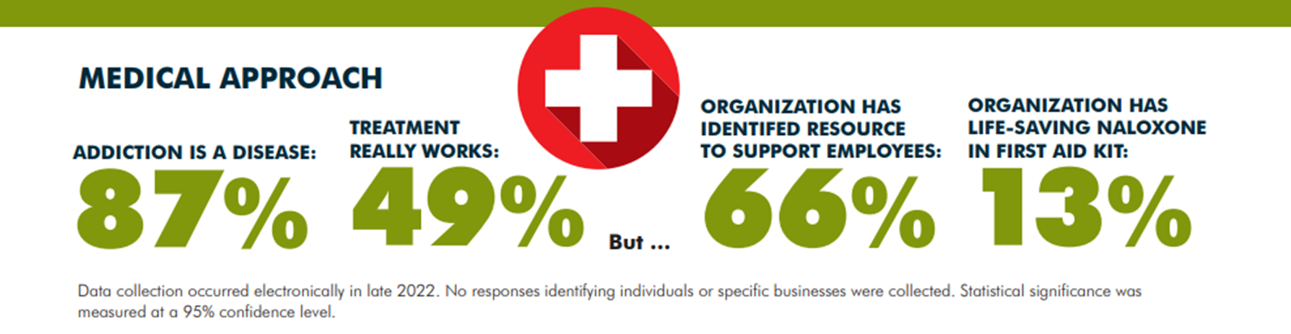

Slide 31


Slide 32
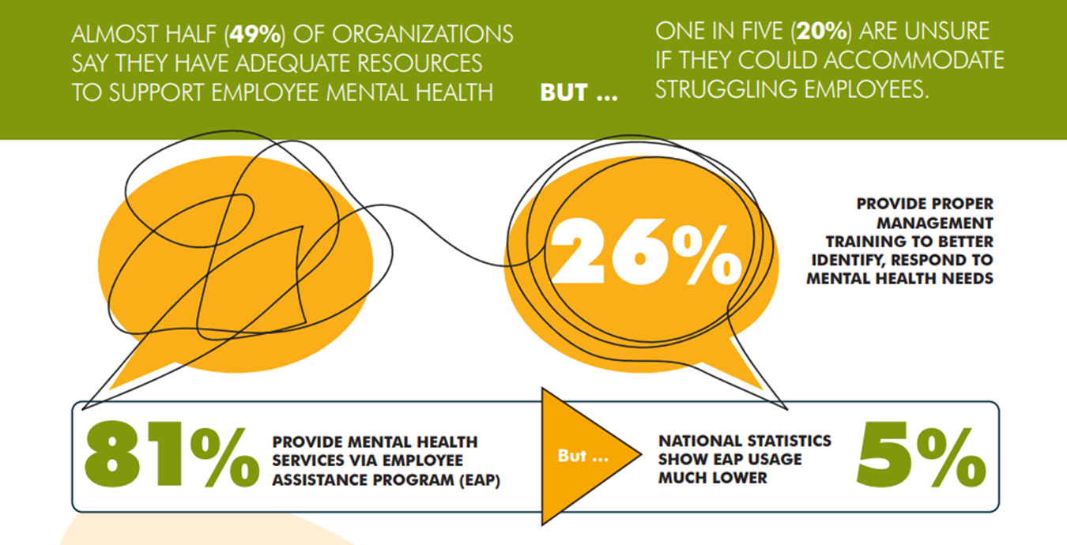

Slide 33
Employer Resources
Individualized Mental Health Consultation
Mental Health First Aid Training
Best Practice Second Chance Policy
Stigma Free Toolkit
Recovery at Work

Slide 34

Strategic Mental Health Consultation
Free, virtual consultation services and support to Indiana organizations that seek guidance in evolving their workplace mental health and overall well-being efforts.
A consultation can support your organization with:
education on mental health in the workplace and the burden on health care costs;
key strategies and best practices for supporting mental health and well-being in the workplace;
promoting mental health coverage and connecting employees with resources; and
tools and resources for understanding the link between physical health conditions and mental health.

Slide 35

Mental Health First Aid Training
An evidence-based training that teaches employees how to identify, understand and respond to signs of mental illnesses and substance use concerns or crisis in a work environment and how to guide a person toward appropriate care if necessary.
Notes:
Mental Health First-Aid (MHFA) introduces participants to identify common signs and symptoms of mental health and substance use-related challenges, builds understanding on their impact and provides an overview of common supports. This eight-hour course utilizes role play, scenarios, and activities to demonstrate how to offer initial help in a mental health crisis and connect persons to the appropriate professional, peer, social and self-help care.
MHFA takes the fear and hesitation out of starting conversations about mental health and substance use problems by improving understanding and providing an action plan that teaches people to safely and responsibly identify and address a potential mental illness or substance use disorder.
Training is intended for all employees of your organization who wish to learn and support mental health well-being efforts.
Wellness Council of Indiana staff members are trained as Mental Health First Aid instructors to provide quality and timely training to your organization.
You only need to attend one eight-hour training to become a certified Mental Health First Aider, a certification that lasts for three years.

Slide 36


Slide 37
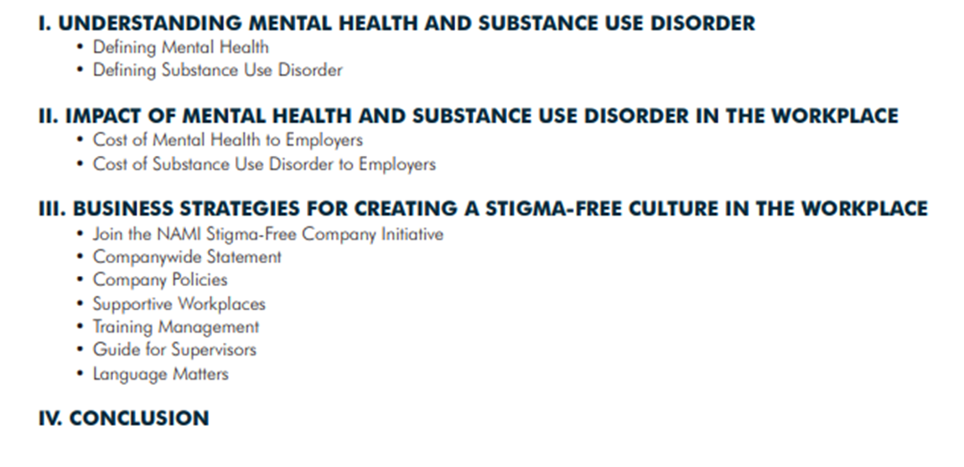
Mental Health Stigma Free
Workplace Culture Toolkit

Slide 38
Indiana Substance Use
Treatment Law lHEA 1007

Slide 39
Best Practice Second Chance
Employer Guidelines
Testing within a Second-Chance System
Assessment and Referral
Administrative Guidance
Paying for Services
Identifying an Assistance Provider and plan
Accountability

Slide 40
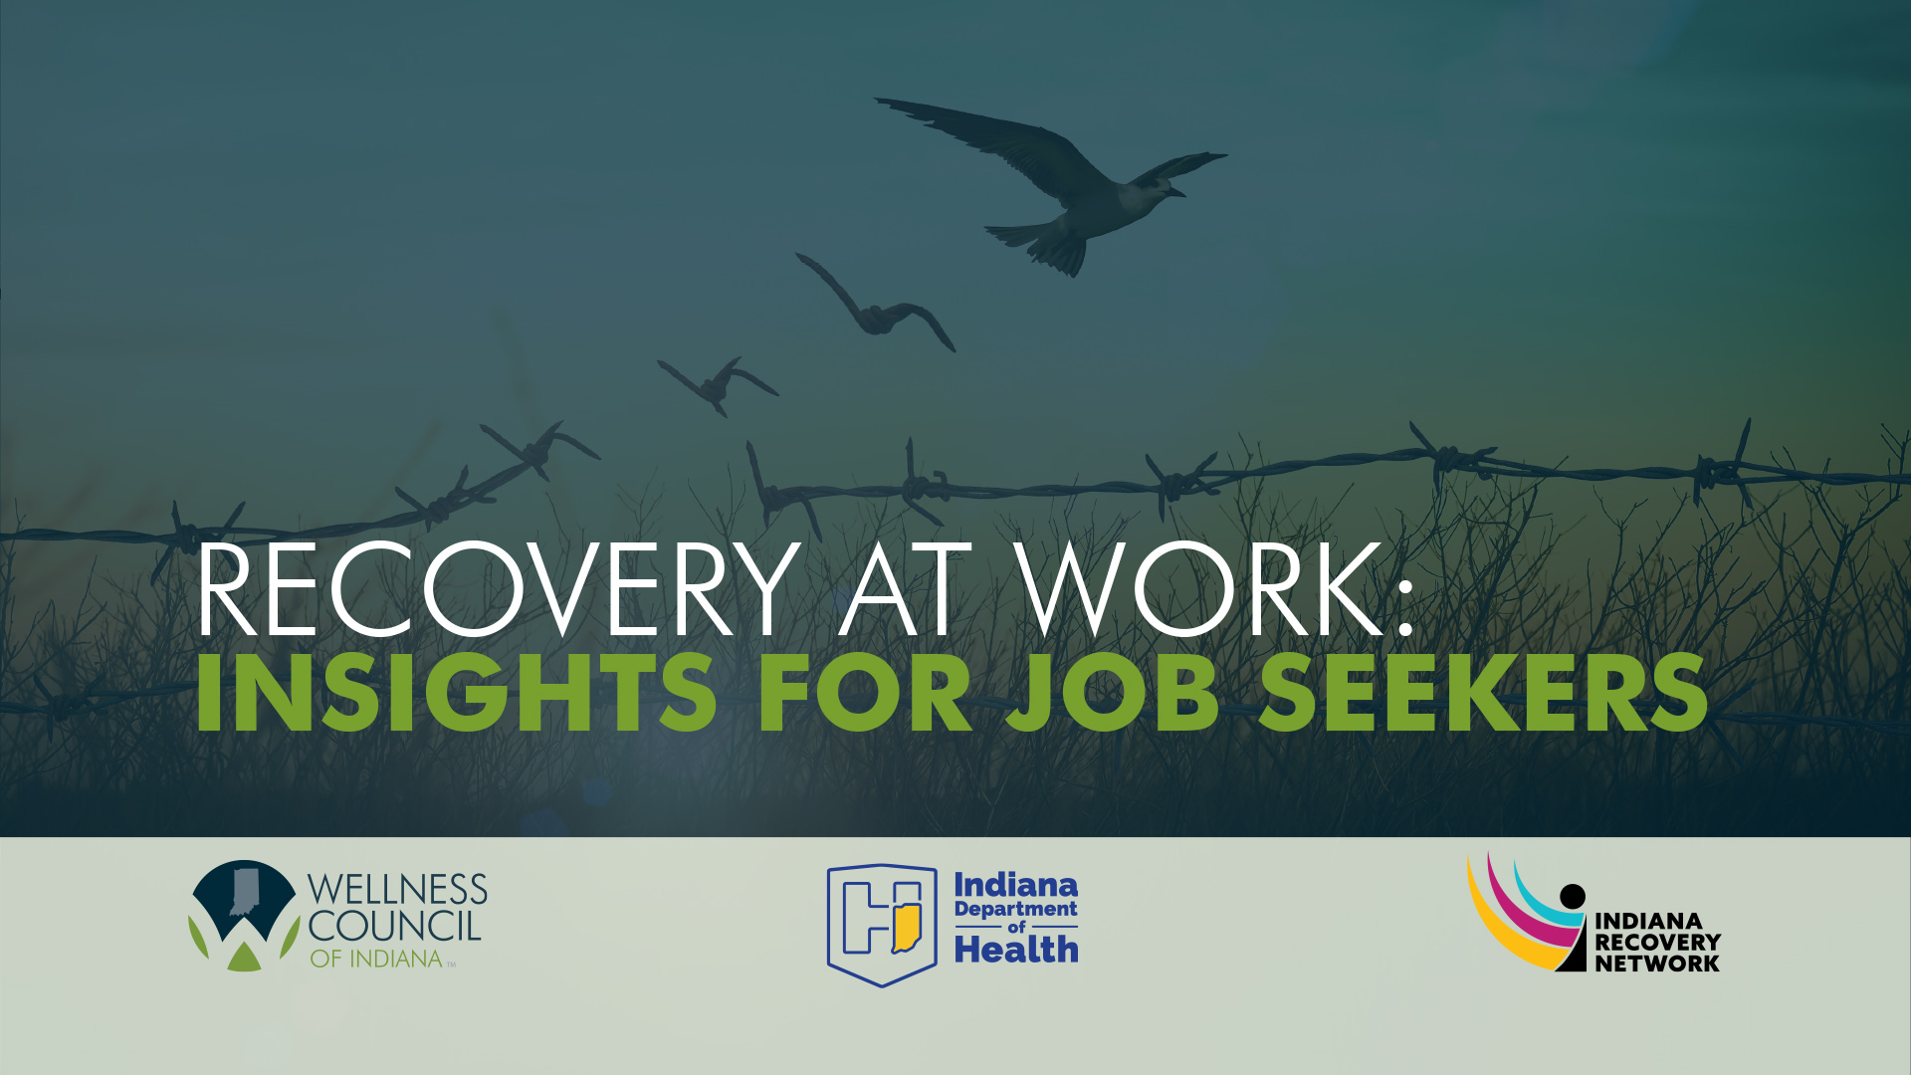
Notes:
GOAL OF VIDEO SERIES: This video series supports individuals in recovery and/or with justice involvement to access employment resources. Employers learn to overcome stigma and become recovery-ready.
Note: The specific content being addressed is a result of our findings from both the 2022 Employer MH & Substance Misuse Survey, but also a statewide survey directed at local Recovery Hubs through partners at the Indiana Recovery Network.

Slide 41
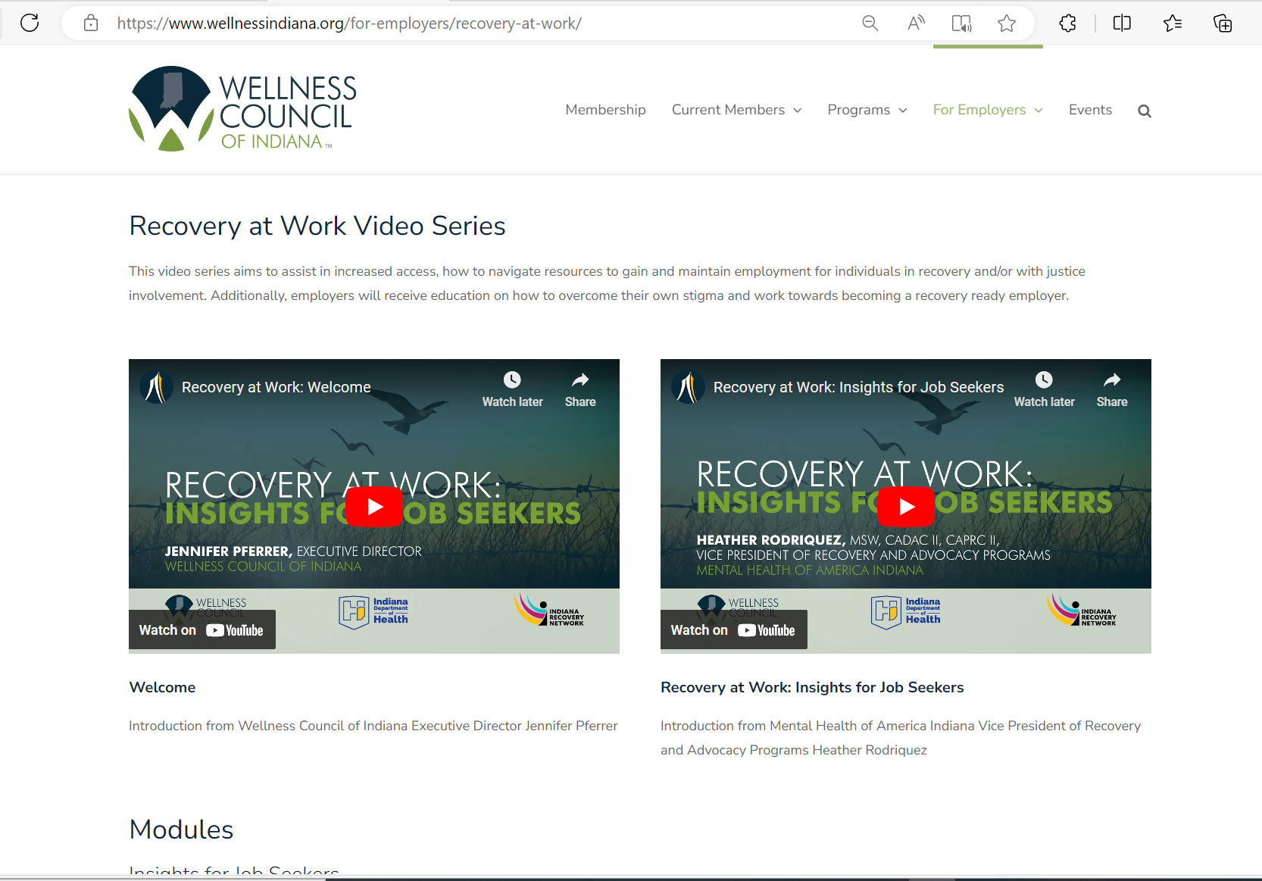
Notes:
Showcase the "Recovery at Work" video series
Highlight key features, such as real-life success stories, practical tips, and expert advice
Outline the specific benefits of the video series, such as:
-Skill-building for employment
-Motivational and inspirational content
-Expert insights on overcoming challenges

Slide 42
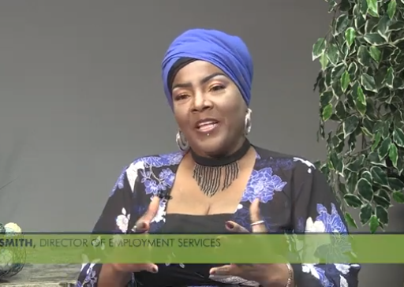
Recovery at Work:
Insights for Job Seekers
Module 1: Helping Individuals Address Their Own Stigma
Module 2: Resume Writing: Filling Out Employment Applications
Module 3: Interviewing: With Integrity, Interviewing the Company
Module 4: Recovery Ready Employers
Notes:
Module 1: Helping Individuals Address Their Own Stigma
-What advice do you have for individuals anxious of entering or reentering the workforce?
-How can individuals work through their own stigma or self-doubt?
Module 2: Resume Writing: Filling Out Employment Applications
-What is a skill-based resume?
-What advice would you give a candidate on filling out an employment application?
Module 3: Interviewing: With Integrity, Interviewing the Company
-Why is language important when sharing your story in an interview?
-What should you look for when “interviewing” the company?
Module 4: Recovery Ready Employers
-What do the most successful recovery-ready employers have in common?

Slide 43
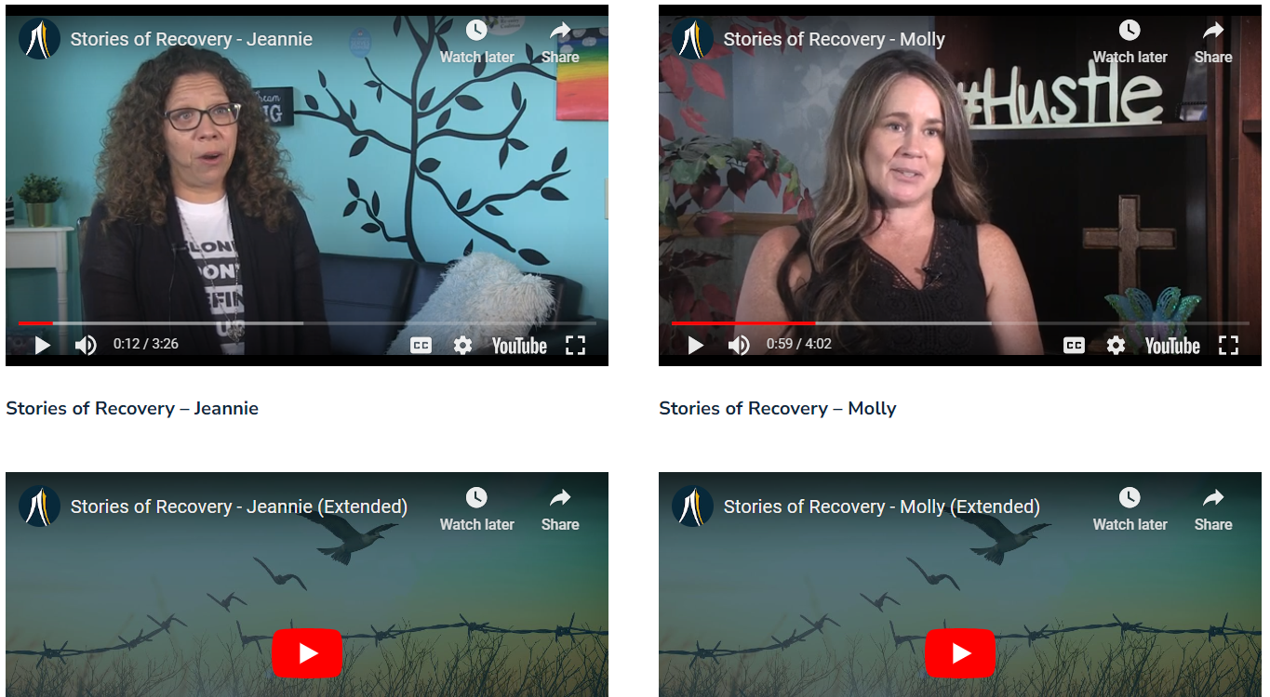
Stories of Recovery
Individuals find success in recovery with the assistance of their employers.
Notes:
Share a couple of success stories from the video series. Or high-level what to expect.

Slide 44
Additional Resources:
www.wellnessindiana.org/recovery.
Mental Health Consultations
Mental Health First Aid Certification
The Right Dose Video Toolkit
Second Chance Guidelines
Notes:
Jen: Add CTA?

Slide 45
Emerging Themes
Upstream prevention
Social Determinants of Health
Community Wellbeing
Employee centric
Artificial Intelligence
Digital Health

Slide 46
Emerging Themes
Direct Primary Care/Surgery
Family forming policies
Flexible work environment
Pharmacy/biosimilars

Slide 47
Strive to allow employees to show up to be their best authentic self every day.

Slide 48
Contact Information
Jennifer Pferrer
jpferrer@indianachamber.com
Office Phone: 317-264-2168
Mobile Phone: 317-910-2484
LEARN MORE
Website: https://www.wellnessindiana.org/
LinkedIn: Wellness Council of Indiana | LinkedIn

