Slide 1
IOT Microsoft Power Platform Center of Excellence (CoE) Overview
Created Date: January 2024
Last Revised: November 2024
Version: 1.0.5

Slide 2

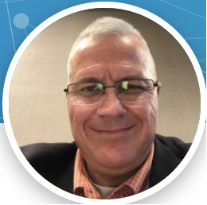
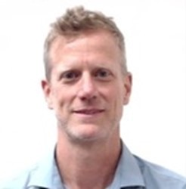
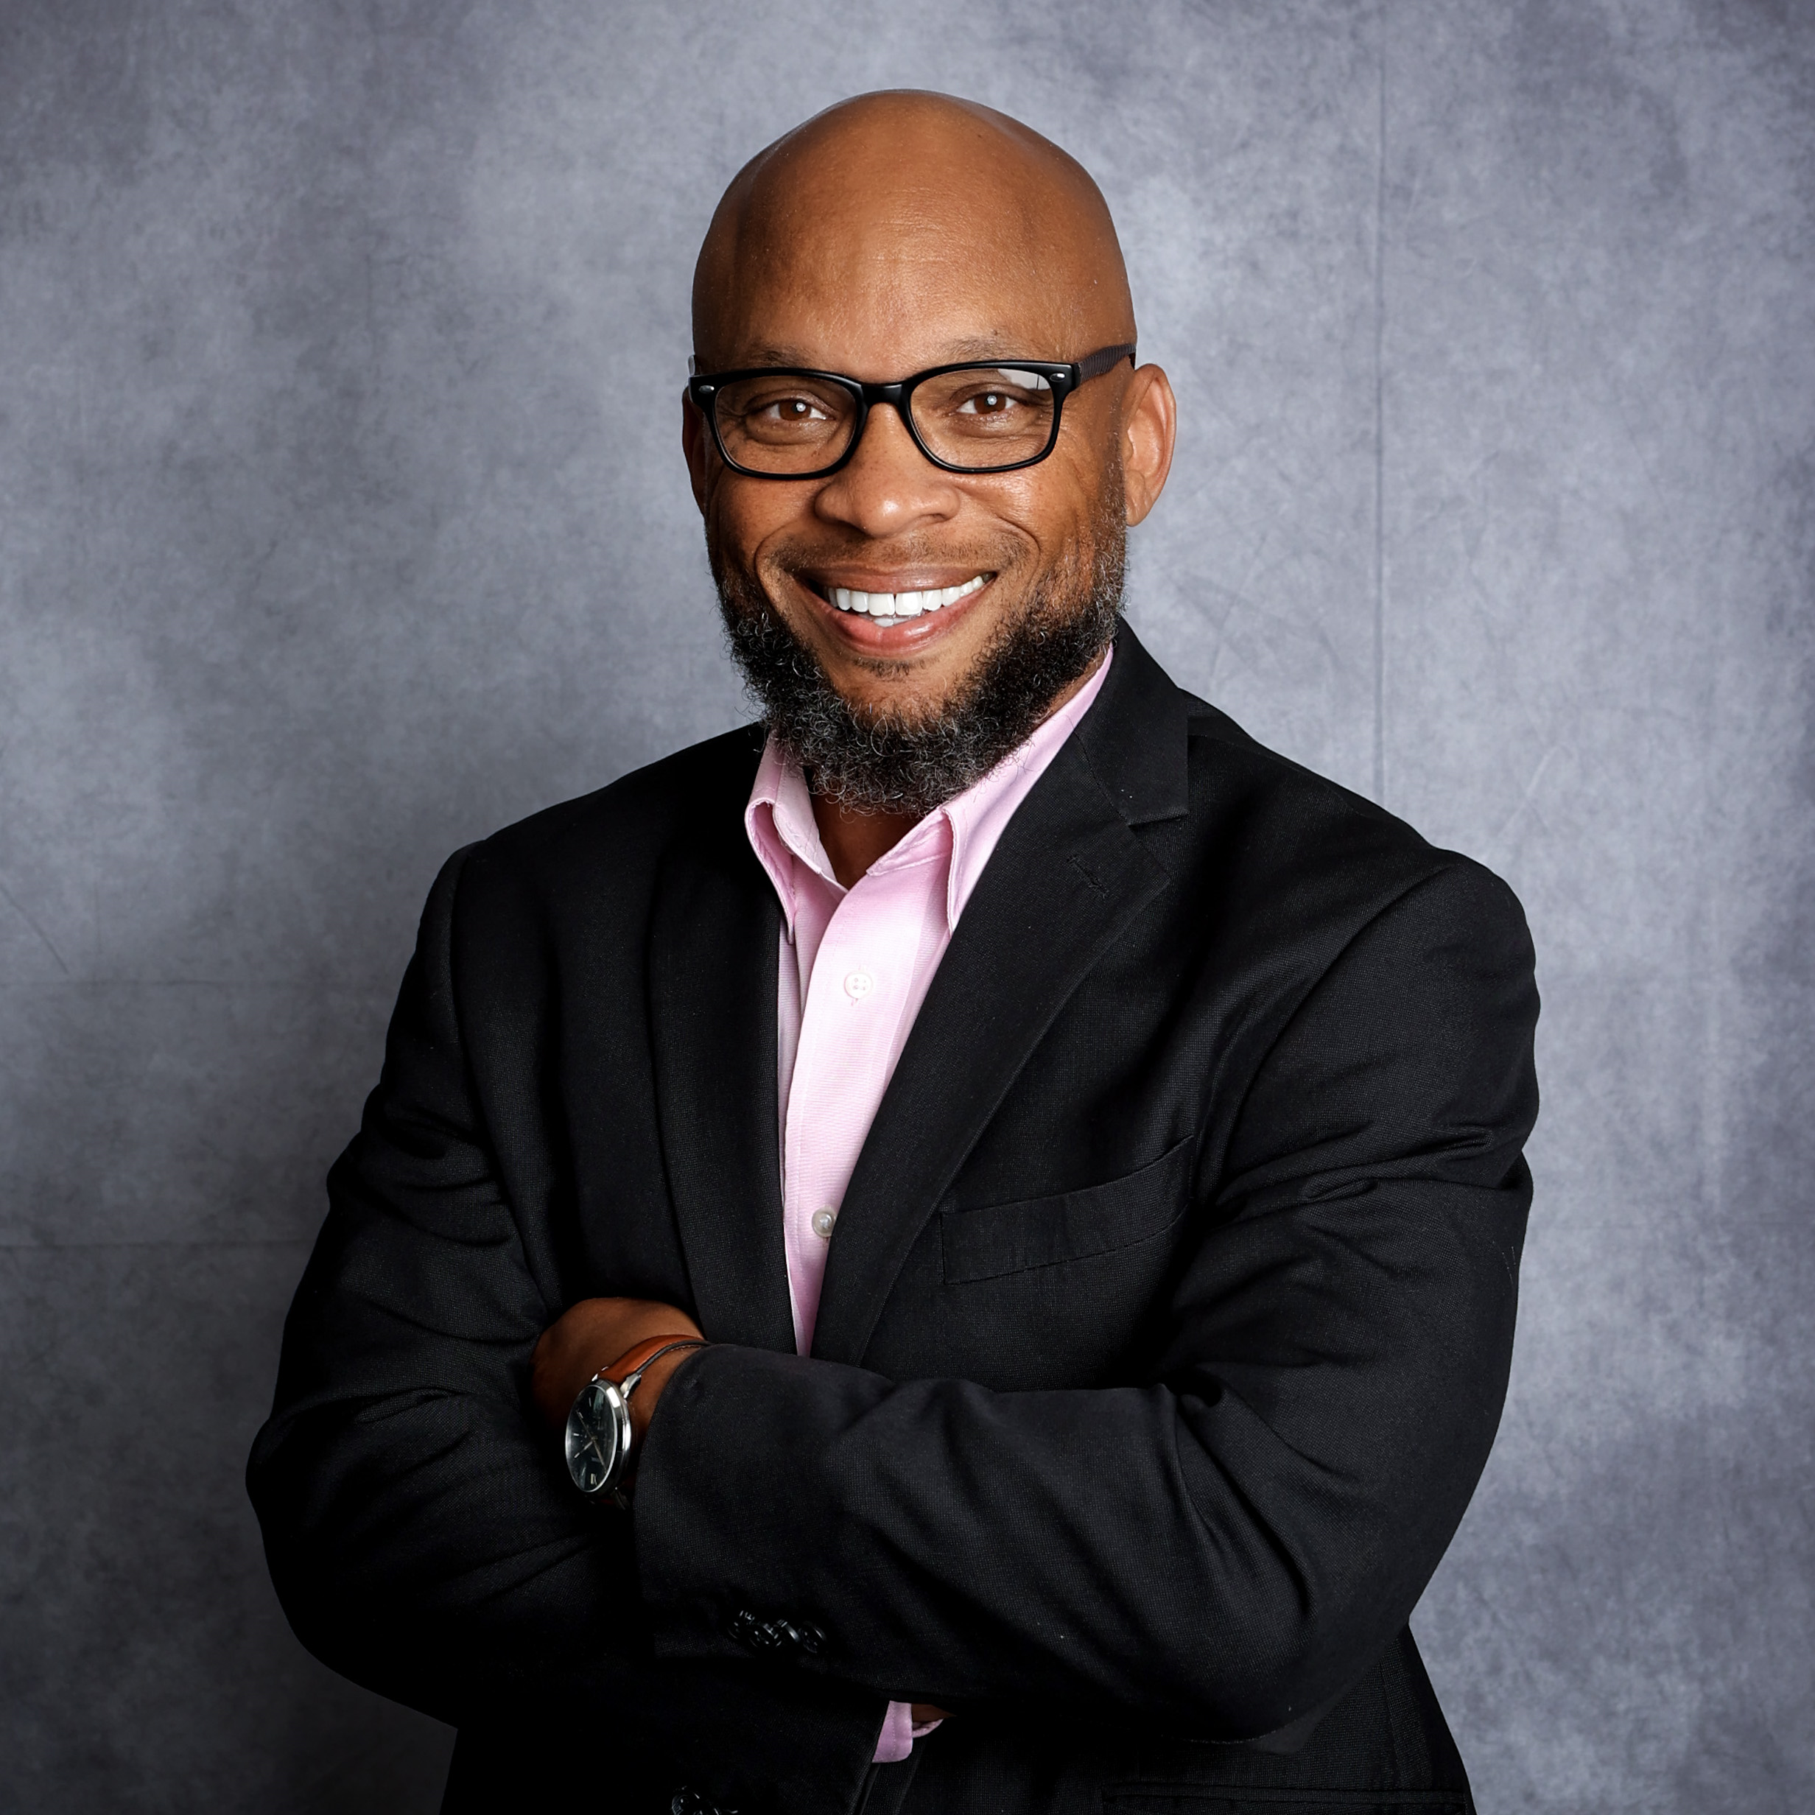
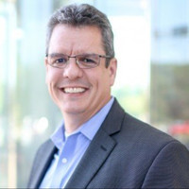
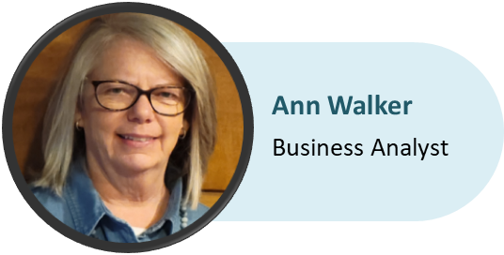
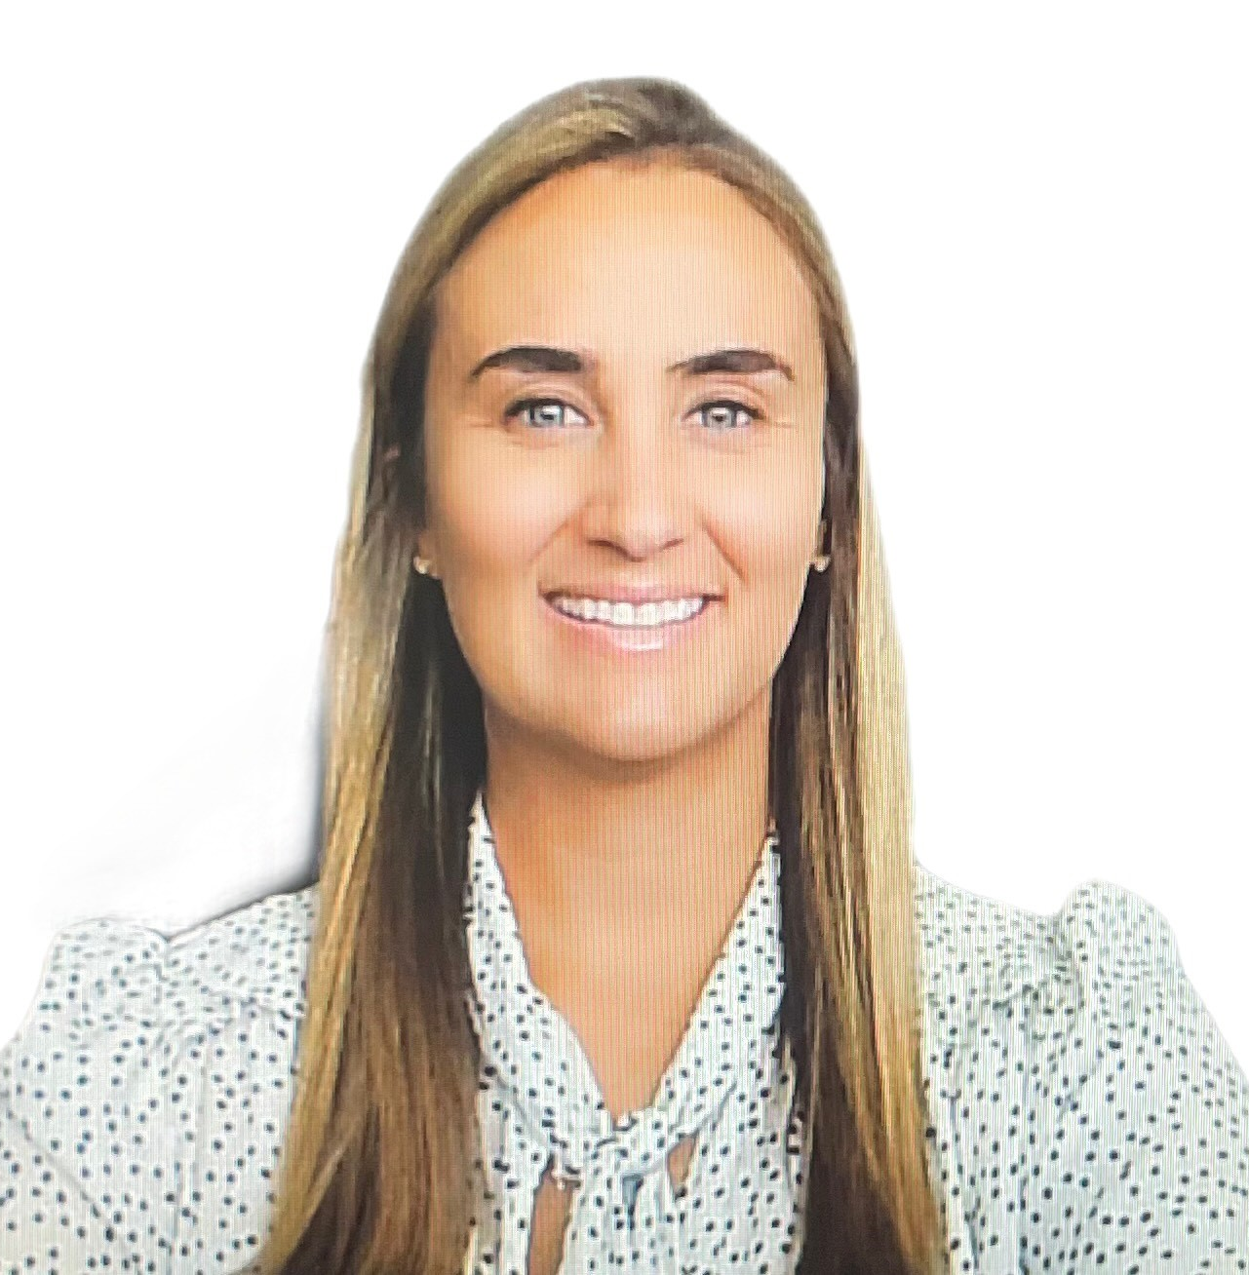
Meet the Microsoft Center of Excellence Team
Larry Jenkins
CoE Project Sponsor Deputy CTO
Jeremy Chenevert
CoE Low/No Code Program Manager
Brian O’Neal
Project Manager - Application Dev.
Tony Masopust
MSFT Architect / Sr. Dev
Elyse Caldwell
Business Analyst
Notes:
Add Brian

Slide 3

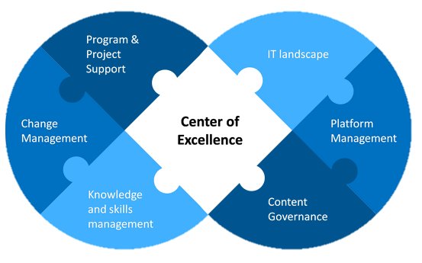
What is a MS Center of Excellence (CoE)?
WHO: A governance committee who ensures that Microsoft Power Platform strategies are aligned with business goals, strategies, and culture.
WHAT: Provides a coordinating function so that change initiatives are delivered consistently and proficiently, through standardized processes.
WHY: Drive innovation and improvement, foster collaboration and support, share knowledge and success.

Slide 4
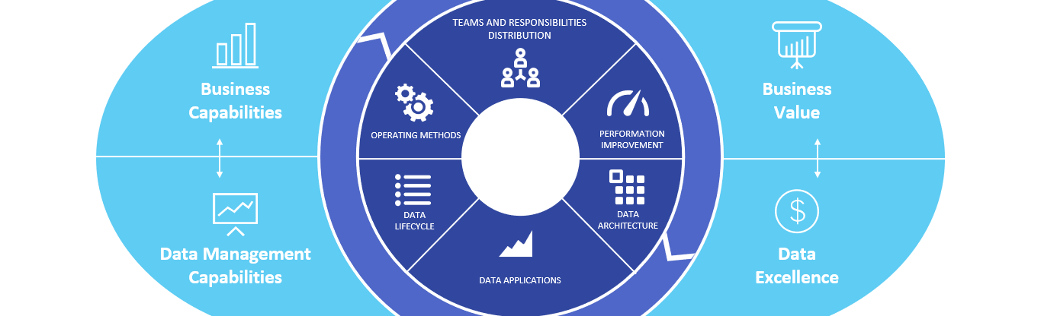
Why have a MS Center of Excellence (CoE)?
PERFORMANCE
The Microsoft Power Platform Center of Excellence (CoE) is a critical principle that helps to drive organizational strategy around the Power Platform and ensures the success of pre-determined business outcomes.
The Power Platform CoE is designed to pull together your community of citizen developers while also sharing knowledge and providing standards, consistency, and governance over the platform. A true CoE cannot succeed without people and collaborative teamwork driving it forward, to manage its success.

Slide 5



What is the function of a
MS Center of Excellence (CoE)?
The LCNC (Low Code No Code) CoE Governance Committee promotes, shares, and collaborates on the MS Power Platform to efficiently and effectively achieve business objectives, with the goals of maximizing return on investment (ROI), accelerating automation, standardizing around best practices, and facilitating knowledge sharing.
Invest in and nurture organic growth while maintaining governance and control.
Drive modernization and improvement, and as a central function, break down geographic and organizational silos.
Provide a powerful way to align around business goals rather than individual department metrics.
Foster greater creativity and innovation across the organization by digitizing and automating business processes.

Slide 6





IOT MS Center of Excellence Overview
CoE COMMITTEE
CoE Sponsor: Larry Jenkins
Chairman: Jeremy Chenevert
Analysts: Ann Walker & Elyse Caldwell
Architect: Tony Masopust
Partnerships: IOT and Agency Planning & Technology
Governance Board Meeting: 1 Hr. / Month
GUIDING PRINCIPLES:
"Start Where You Are" - ITIL
Maximize business value from the use of MSFT LCNC technology
IOT co-create value with Agencies
Enabling a skilled workforce
Balance governance & innovation
SCOPE
Increase enterprise-wide LCNC adoption
Project acceleration & standardization
Risk mitigation by providing guidance on proven practices, and architecture
Training and skilling support
OBJECTIVES
Align CoE with overall business & technology strategy and objectives.
Create/maintain a strategic 4-year plan and enterprise adoption roadmap for future growth.
Deliberate and proper use of LCNC platforms; fitting into overall Enterprise Architecture
Foster collaborative IOT & Agency technology partnerships to expand LCNC use cases & implement IT enterprise standards.
Establish and mature MS LCNC platform architecture, governance, and delivery framework.
Standardize execution paths.
Grow talent, skills and resources to support LCNC platforms.
Provide tracking, auditing and reporting to meet CoE objectives.
Power Apps
Power Automate
Power Pages
Dynamics 365

Slide 7
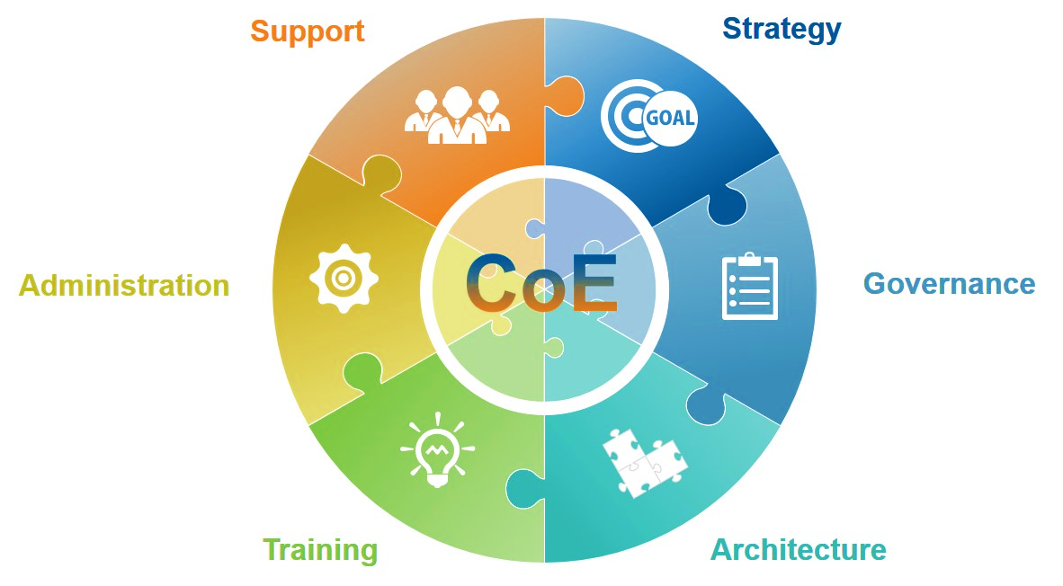
Why engage with the Microsoft CoE?
The MSFT CoE can provide the following:
  Training and support
  Maintenance and support
  Licensing guidance and analysis
  Develop Power Platform solutions
  Act as advisor to evaluate solicited proposals
  Technical consultation for LCNC applications
  Support end-to-end full implementation needs
  Aid with SOW development for LCNC initiatives
  Assist agencies in achieving business objectives
  Determine if a LCNC platform fits an agency’s needs
  Conduct health assessment of current environments

Slide 8
Thank You!

