Slide 1
Meth Residue Sampling by Local Health Departments
Steve Yeary, REHS
Environmental Public Health Division
Indiana State Department of Health
9/26/2017

Slide 2

Why would a LHD sample?
NEVER when there’s a clear OR of drug manufacture in a residence
When there is strong suspicion that manufacture occurred in a residence, but there is not an OR to clearly show this
-or-
To check up on a QI’s cleanup

Slide 3
LHD Sampling₂
318 IAC 1 requires Qualified Inspectors for certifying sites as clean and issuing the Certificates of Decontamination
So, NEVER sample to “clear” any property that has an OR indicating drug manufacture occurred within a residence

Slide 4
LHD Sampling₃
Health officials enter and inspect private property for the possible presence, source, and cause of disease under the authority in IC 16-20-1-23
The ISDH lab can test meth residue samples FREE for county health departments, as long as the LHD is not attempting to “clear” a home, or fill the role of the QI

Slide 5
LHD Sampling₄
LHDs only need to show that some portion of a property is contaminated and then require further assessment by a Qualified Inspector
Focus sampling on the areas suspected of having the worst contamination
Take a small number of individual samples (batches of 6, including any blanks)
Always test the HVAC system

Slide 6
LHD Sampling₅
Field kits/indicators NOT recommended
Samples must be analyzed using EPA
8270C or equivalent (a lab)
Collect wipe samples using
ASTM D 6661-01 (follow ISDH lab protocol)

Slide 7
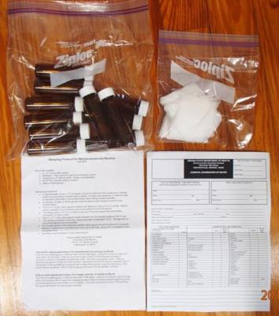
Assemble a Sampling Kit₁
Contact Mark Starzynski @ ISDH labs
(317) 921-5580 to get sample VOC vials, 3x3” sampling gauze, forms, and the sampling protocol.

Slide 8
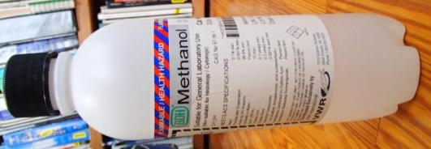
Assemble a Sampling Kit₂
Obtain lab-grade methanol as the wipe solvent.
  ISDH cannot ship HAZMAT.
  ISDH can provide in person
  VWR International is a supplier 1 (800) 932-5000.

Slide 9
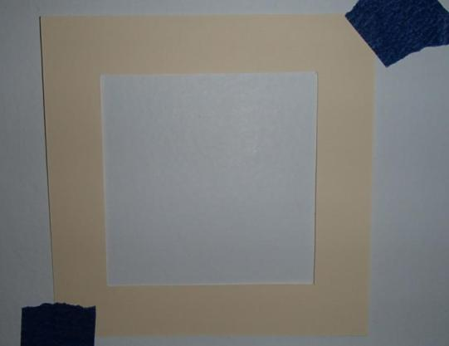
Assemble a Sampling Kit₃
Make or obtain 10cm x 10cm templates. Environmental Express is one option;
843-881-6560.

Slide 10
Assemble a Sampling Kit₄
Use a fresh set of nitrile gloves for each sample to prevent cross-contamination
Use a syringe or dropper to wet the 3x3” cotton sampling gauze with methanol (3-5 ml)
Zip lock bags, marker, and tape
A protective storage container is recommended

Slide 11
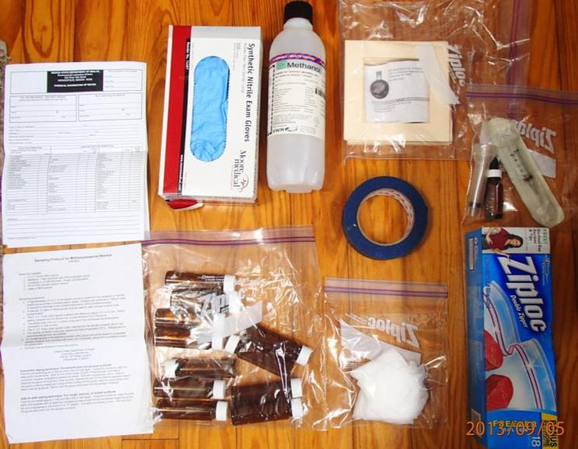
Assemble a Sampling Kit₅

Slide 12
Wipe Sampling₁
Pick sample locations and label vials/forms appropriately
Plan for at least one blank (1:10 ratio)
Tape the 10 cm by 10 cm templates at the selected locations
Make a sketch and/or take photos

Slide 13
Wipe Sampling₂
Wear new gloves for each sample
Wet a piece of cotton sampling gauze with methanol, using a clean syringe or dropper (same syringe or dropper throughout site)
Squeeze out excess methanol

Slide 14
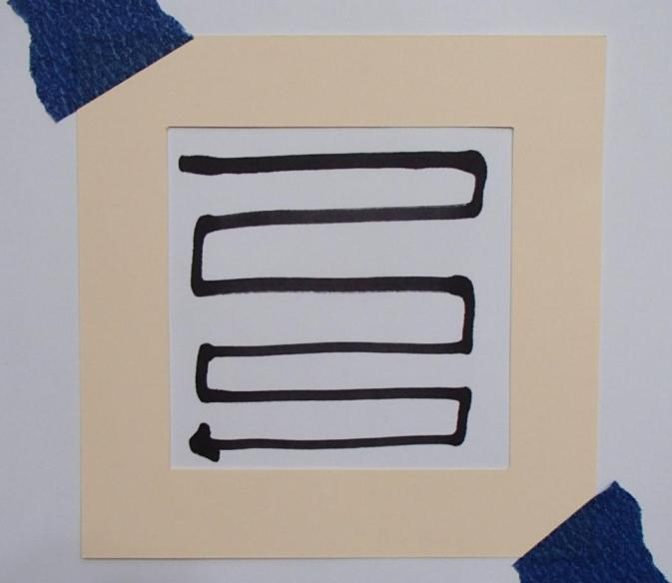
Wipe Sampling₃
Fold the gauze once, wipe back and forth.
Cover all
the area
inside the template

Slide 15
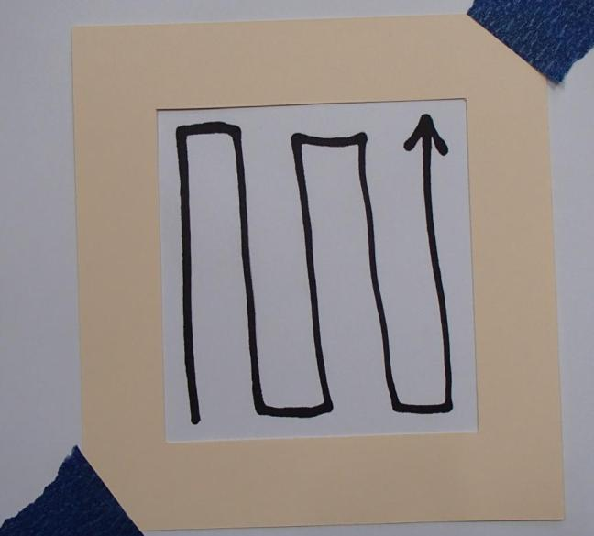
Wipe Sampling₄
Fold the gauze again,
wipe up
and down. Cover all the area inside the template

Slide 16
Wipe Sampling₅
Put each wipe in its own pre-labeled VOC Vial for the ISDH lab
When finished, create one field blank by wetting a clean piece of gauze with the same methanol and syringe/dropper
Ship/deliver to ISDH lab

Slide 17
Interpreting Sample Results
Indiana’s standard in 318 IAC 1 is 0.5ug/100cm²
A health official should use IC 16-41-20 to order a contaminated home vacated until remediated per 318 IAC 1 whenever samples exceed the standard.

Slide 18
Your Safety IF you enter:
Criminal Element
Immediate chemical threats; explosions, fires, burns to eyes/skin
Chemical vapors/particulates associated with an active cook
Residual contamination; skin absorption
Sharps & biohazards

Slide 19
My contact info:
  Steve Yeary, REHS
  Environmental Public Health Division
  Indiana State Department of Health
  317-964-1442
  styeary@isdh.in.gov

