Slide 1


Governor Holcomb’s
2019 Next Level Agenda
21st Century Talent Regions
Building a 21st Century Workforce
Blair Milo
Secretary for Career Connections and Talent

Slide 2


21st Century Talent Regions
WHAT
Designation earned by regions to attract, grow, connect and retain talent.
Regions who build and implement a plan to:
  increase education attainment
  raise household income
  grow population
12 Pilot regions to receive Technical Assistance

Slide 3
21st Century Talent Regions
WHO/WHERE:
Self-defined by participants, but will include at least 3 cities, towns or townships with a designated leader
Membership including, but not limited to:
  Business
  K-12 education
  Higher Education
  Non-profit(s)
Regions may also be a county or multiple counties
Economic development
Workforce development
Local government

Slide 4
21st Century Talent Regions
WHEN:
  Regions can begin organizing and collaborating with the Office of Career Connections and Talent/IEDC immediately
  Timeline for gaining the designation will be dependent on the progress of the region
  12 regions receiving technical assistance will be phased and developed over biennium commencing 2019
WHY:
  Regionalism works
  Proven model
  Synthesizes efforts through common metrics, goals, efforts and regular communication

Slide 5
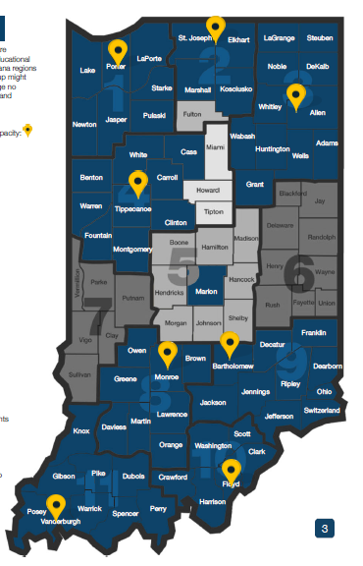
21st Century Talent Regions
HOW:
  Start where the energy is
  Evaluate Collaboration Readiness
  Help regions understand their current state
  Provide a systems-based talent framework
  Provide key data for populating framework -> dashboard
  Engage/organize stakeholders
  Set goals
    Education attainment
    Household income
    Population
  Implement/continue connecting initiatives
  Measure progress
Emerging regions participating in the Indiana Talent Network (ITN)

Slide 6
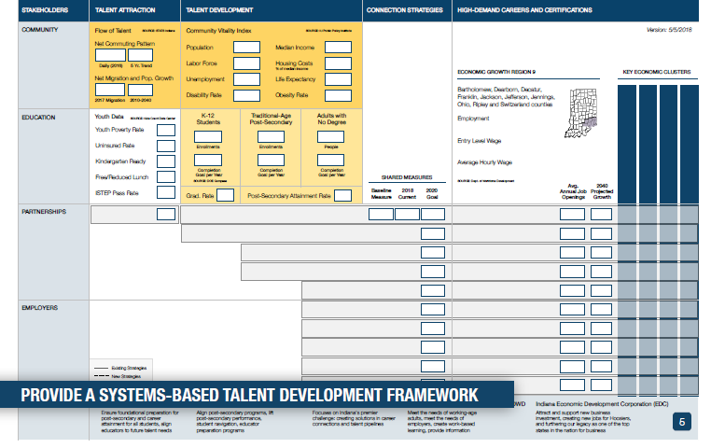
21st Century Talent Regions

Slide 7
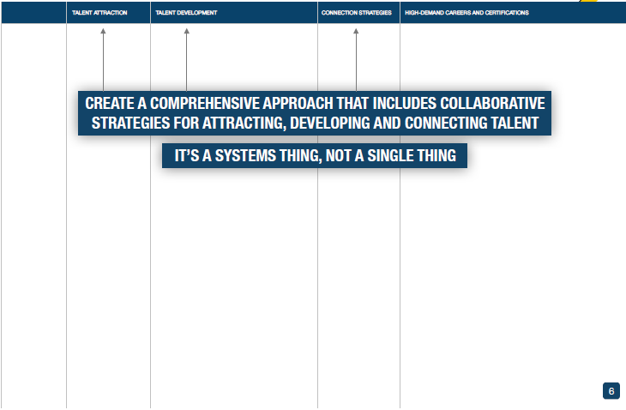
21st Century Talent Regions

Slide 8
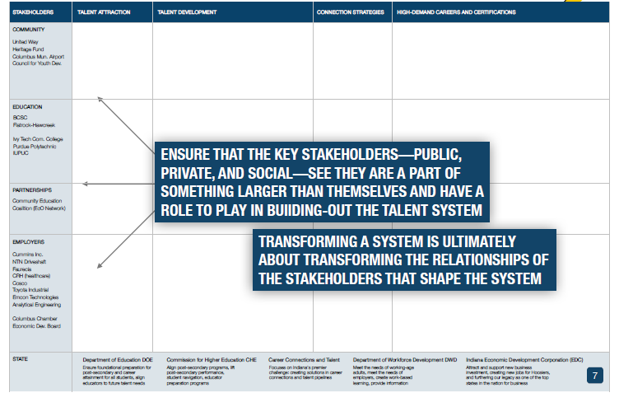
21st Century Talent Regions

Slide 9
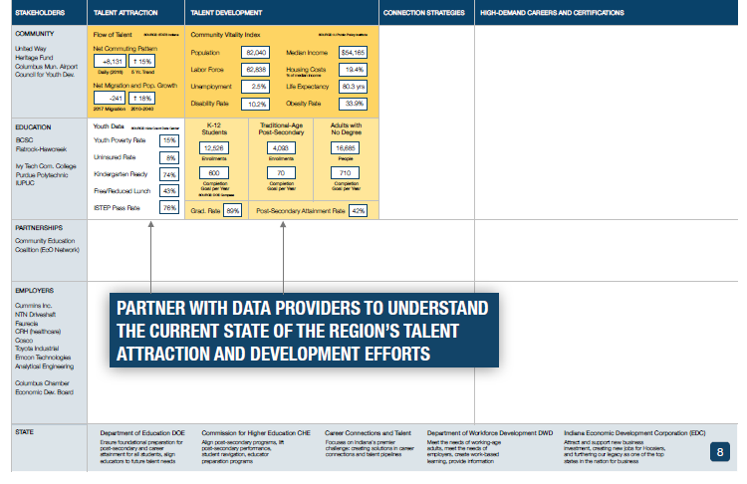
21st Century Talent Regions

Slide 10
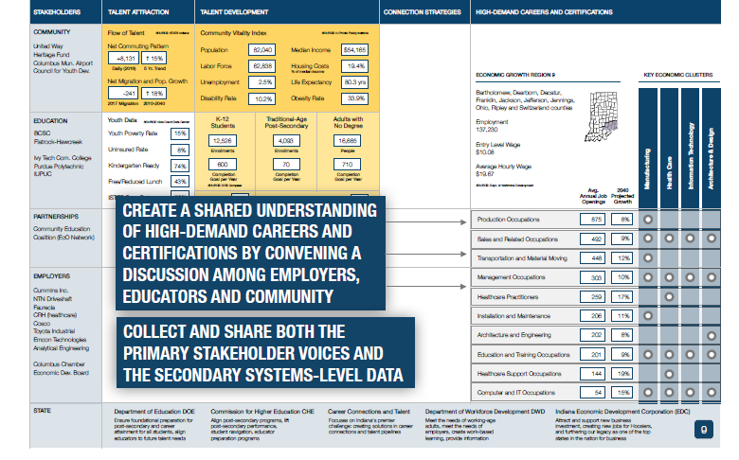
21st Century Talent Regions

Slide 11
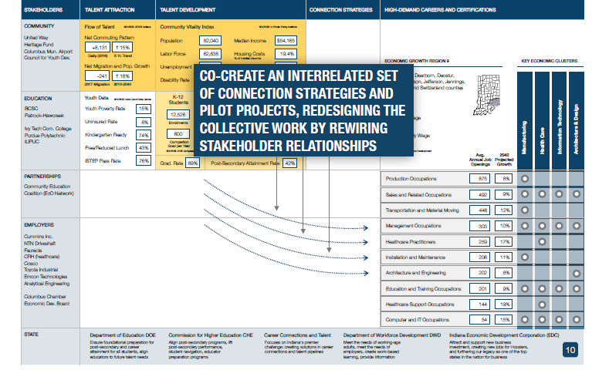
21st Century Talent Regions

Slide 12
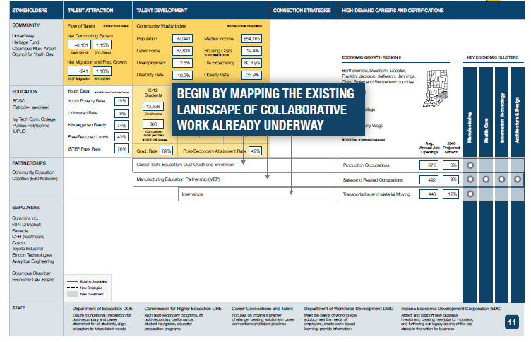
21st Century Talent Regions

Slide 13
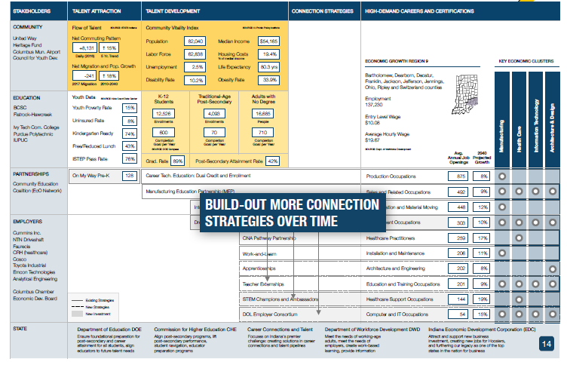
21st Century Talent Regions

Slide 14
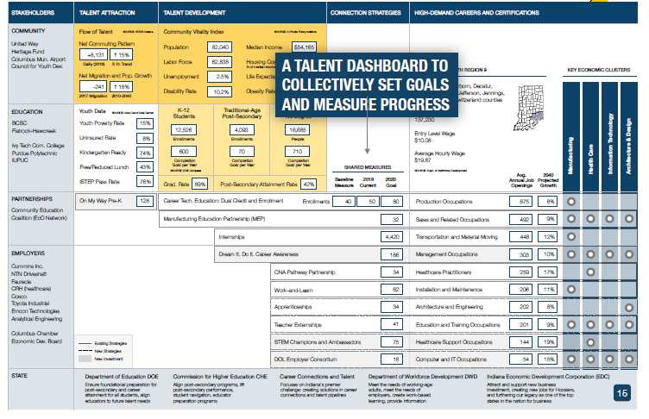
21st Century Talent Regions

Slide 15
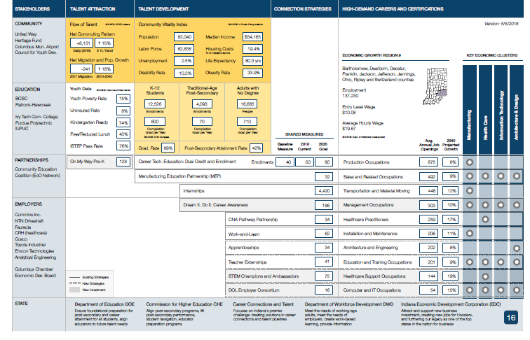
21st Century Talent Regions

Slide 16
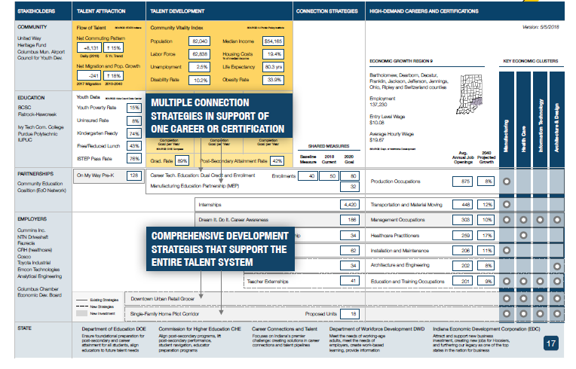
21st Century Talent Regions

Slide 17
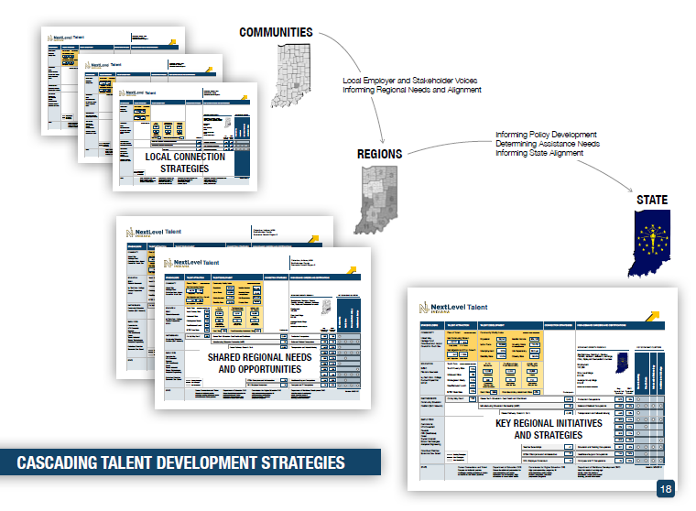
21st Century Talent Regions

Slide 18
21st Century Talent Regions
Further information
Contact:
Indiana Office of Career Connections and Talent
Website: www.IN.gov/CCT
E-mail: secretary@cct.in.gov
Phone: 317-234-4311

