Slide 1

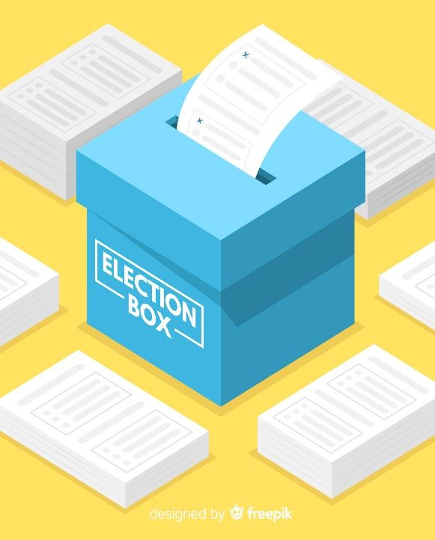
Last Minute Reminders for November General Election
Paper vector created by freepik - www.freepik.com
Angie Nussmeyer, Co-Director
2024 Fall Clerk’s Association Meetings

Slide 2
Acronyms
ABS = Absentee
CEB = County Election Board
ePB = electronic Poll Book
FPCA = Federal Post Card Application
SVRS = Statewide Voter Registration System
VR = Voter Registration

Slide 3
Where are you in your ballot preparation?
Remember the deadlines:
  Making ballot estimates and orders
    Absentee & Provisional Ballot Ordering Deadline: Sept. 6, 2024
    Election Day Ballot Ordering Deadline: Anytime to ensure ballots are ready to given to inspectors on Inspector Saturday or Sunday (November 2 or 3, 2024)
  Ballot printing and delivery
    Absentee & Provisional Ballot Delivery Deadline: Sept. 16, 2024
    Election Day Ballot Delivery Deadline: Before November 2, 2024
  Deadline for absentee ballots to be sent:
    Not later than 5-days after the CEB receives the ABS ballot delivery OR
    45-days from the election (Sept. 21, 2024), whichever is sooner
      Submit a CAF to update your ballot ready date to reflect accurate mailing dates!
MUST order enough election day ballots to cover 100% of all registered voters assigned to each precinct reporting to a voting location

Slide 4

What ballot types do I need for the general election?
Scenario 1
No public questions were certified to the Cardinal County Election Board for the general election.
What ballot types would the election board need to produce for the general election

Slide 5
General Election Ballot Types
Scenario 1
“Everything” ballot
  Statewide constitutional question
  Local public question
  Straight Party Device
  Candidates for election to office in November
  Judicial retention questions
    Indiana Supreme Court, Indiana Court of Appeals
    Local judicial retention questions in Lake, Marion & St Joseph counties
Federal Only Ballot
  For overseas voters who mark on the FPCA: “U.S. citizen whose return is uncertain”
Presidential Only Ballot
  For voters who move to another state in the final 30-days before an election and fail to register to vote in their new state

Slide 6
What ballot types do I need for the general election?
Scenario 2
Northwestern County Community School Corporation is a countywide school corporation
The school board has certified to the election board a school tax levy referendum to be placed on the general election ballot
What ballot types would the election board need to produce for the general election?

Slide 7
General Election Ballot Types
Scenario 2
“Everything” ballot
“Everything” ballot MINUS school board public question
  If voter moves out of the school corporation boundaries in the final 30-days before an election, then the voter is not able to vote on a public question involving a capitol improvement project, tax levy, or safety for a school corporation
Federal Only Ballot
  For overseas voters who mark on the FPCA: “U.S. citizen whose return is uncertain”
Presidential Only Ballot
  For voters who move to another state in the final 30-days before an election and do not meet the residency requirements to register to vote in their new state

Slide 8
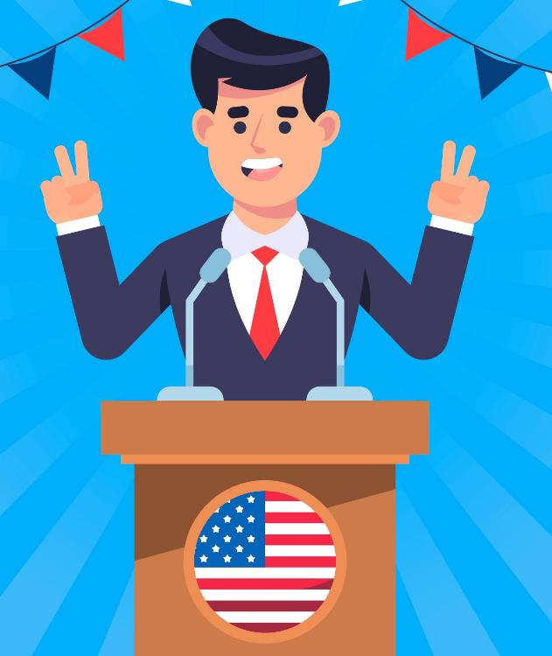
What if the county clerk is a candidate? How does it affect our ballot?
State law requires absentee ballots to have the seal of the county and clerk’s signature printed on the ballot UNLESS…
County clerk is a candidate for any office in the election
  Instead, a uniform seal authorized by IED and found on the SVRS county portal replaces the official county seal, AND
  Clerk’s signature may not be printed on the ballot
Image by freepik

Slide 9
Who can help us review ballots for accuracy?
You may contact IED to request a review for statutory accuracy
CEB must give the following persons the opportunity to inspect all ballot proofs not later than Aug. 30, 2024
  D/R/L county chairs
  School corporation superintendents when ballot contains a school board candidate or a local public question involving the school corporation
  Feedback must be provided by Sept. 6, 2024
    After Sept. 6, 2024 deadline, CEB can move forward with their ballot printing
Must alert county chairs that sample ballots are ready for inspection not later than Oct. 28, 2024

Slide 10
What if we find an error on the ballot?
Is there a candidate vacancy after ballots are printed?
  CEB MUST re-print ballots to remove person who ceases to be a candidate, except when it is five days or less before Election Day
    Include new name of candidate, if party fills the ballot vacancy
    Include “no candidate,” if party does not
  In final five days before the election, CEB may reprint the ballot but not required to do so
  Example: David, the Democratic Dog Catcher candidate, dies on Oct. 1, 2024
    Democratic Party has 30-days to fill ballot vacancy under IC 3-13-1
    CEB is required to reprint the ballot with the name of the replacement candidate OR, if no candidate selected, must remove David’s name from the ballot OR use “No Candidate” instead

Slide 11
What if we find an error on the ballot?
Was an error discovered on the ballot?
  CEB can meet and decide to reprint the ballot to correct the error OR
  CEB can hold a hearing to determine whether error will cause confusion to voters:
    If CEB finds the error will NOT create confusion…
      If NO voter files an objection before the hearing is over, then ballot does not need to be re-printed
      If voter files an objection before the hearing is over, then ballot MUST be re-printed
    If CEB finds the error WILL create confusion, the ballot is re-printed
Absentee voters can request a replacement ballot using the ABS-5 form

Slide 12

VOTING LOCATION REMINDERS
Vote Center Counties
  Vote Center plan can be amended at any time
    Requires unanimous vote of county election board
    NEW! Vote center plan & amendments can now be filed by email
Non-Vote Center Counties
  County Commissioners must file any changes to locations
  with CEB not later than 29-days before the election
  Emergency Provisions
    CEB can change a location in final two days before election IF
    an emergency warrants it

Slide 13
NOTICE OF ELECTION/POLLING LOCATIONS
Notice of Election (CAN 39)
  Can generate using SVRS (Reports Library)
  List of all offices on the November ballot
    Not required to include names/addresses of candidates
  List all public questions, including statewide and judicial retention
  List all early voting locations, dates & times
  Deadline to publish in newspaper: October 15, 2024
Election Day Polling Location List
  No state form
  Deadline to publish in newspaper: October 15, 2024

Slide 14
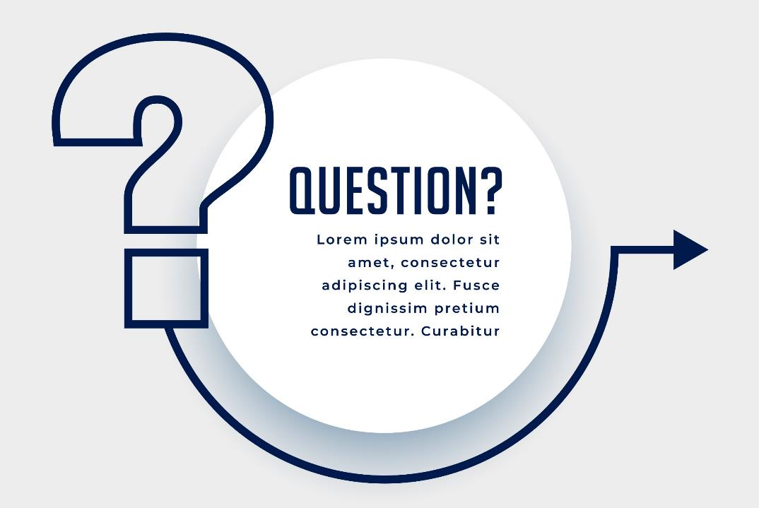
CAN THE PUBLIC VIEW CENTRAL COUNT? CANVASSING?
QUESTION:
Arrow vector created by starline - www.freepik.com

Slide 15
Central Count/Canvassing = Public Meeting
CEB meets on EDay to manage election, including central count & canvassing of election returns
  Must follow “Open Door” Law
  Members of the public do not need to be given access to the “floor” where central count or canvassing occurs
    May cordon off public viewing section to allow people to watch
  Central Count Watchers (no watchers for canvassing)
    D/R/L state & county party chairs may appoint
      Limit one watcher per one absentee ballot counting team
      Must have written credentials from chair
    Media watchers can be appointed by their news organization
      News org covers several counties? Credential comes from IED
    Watchers can be on the “floor” but cannot interfere with process
IC 3-11.5-3-1 | IC 3-12-4-6

Slide 16
WHO CAN GO INTO AN EARLY VOTING OR ELECTION DAY VOTING LOCATION?
QUESTION:
Arrow vector created by starline - www.freepik.com

Slide 17
State law lists who can enter the chute or area where voting occurs at a voting location on or before Election Day
  Poll workers (and absentee voter board members)
  Pollbook holders/challengers/watchers
  Voters for the purposes of voting
  Minor children accompanying voters
  Individual authorized to assist voter under IC 3-11-9
  CEB member, acting on behalf of the board
  Technician authorized by CEB to repair a voting system
  County party chair or vice chair, if issued credentials signed by the CEB
    Cannot be a candidate on the ballot for elected office, however
  SOS, unless SOS is a candidate on the ballot
  Indiana Protection & Advocacy Services (IPAS) Commission, if credentialed
    Must be issued a credential from IPAS that includes person’s name, statement they’re credentialed to enter site & person is conducting activities provided under federal law
IC 3-11-8-15

Slide 18
PARTY CHALLENGERS
  Election Day only
  Can be appointed by each political party or independent candidate on the ballot
  Maximum Number Allowed
    Vote Center County: One challenger per entity type per ePB present at the vote center OR number of ePBs specified in vote center plan, whichever is greater
    Non Vote Center County: One per precinct, even if multiple precincts use the same voting location
  Eligibility
    Must be at least 18 & registered voter of the county
    Cannot be a candidate, except as an unopposed candidate for PC or delegate
    Must have a credential
  Duties
    May only challenge a voter on whether person is a qualified voter of the precinct such as not a US citizen, unable to provide residence documentation (if required for a first time voter), or a photo ID
      If challenged, the voter and challenger complete the PRE-4 affidavit to initiate provisional process
    May enter polling place 30-minutes before polls open and remain through closing of polls
      Can enter, leave, re-enter the polls at any time on Election Day
    Subject to the orders of the precinct election board (Inspector, 2 Judges) while in polls
IC 3-6-7, generally | IC 3-11-8-20 to IC 3-11-8-23.5

Slide 19
PARTY WATCHERS
  Appointed by D/R/L state AND county party chairs
    Independent candidates for federal or state (not local!) office can, too
    Possible for those advocating for the support/defeat of public question to request watcher credentials from CEB (IC 3-6-8-1(b))
  Maximum Number Allowed
    Early Voting
      D/R/L county party may appoint up to two watchers at each early voting location
    Election Day
      Vote Center County: One challenger per entity type per ePB present at the vote center OR number of ePBs specified in vote center plan, whichever is greater
      Non Vote Center County: One per precinct, even if multiple precincts use the same voting location
  Eligibility
    Must be a registered voter of the county
    Cannot be a candidate, except as an unopposed candidate for PC or delegate
IC 3-6-8, generally

Slide 20
PARTY WATCHERS – “Watch, but Can’t Interfere”
  Duties during Early Voting
    May enter, leave, re-enter site any time it’s open
    Inspect voting systems before ABS ballots are received, each day
    Inspect work of election officials except for confidential log-in procedures
    Witness any proceeding
  Duties on Election Day
    May enter polling place 30-minutes before polls open and remain through tabulation completed
      Can enter, leave, re-enter the polls at any time on Election Day
    Inspect voting system before votes are cast
    Inspect work being done by precinct workers except for confidential log-in procedures
    Witness any proceeding
    Receive a summary of vote totals
    Accompany inspector & judge delivering election results/materials to CEB
    Be present when inspector takes receipt for delivering election results/materials from CEB
IC 3-6-8-4 | IC 3-6-8-7

Slide 21

PARTY WATCHERS
  Watchers must report any violation of election law that comes to their attention to:
    Inspector of the precinct (on election day);
    County election board (early voting or on election day); or
    Prosecuting attorney (early voting or on election day)
  On Election Day, watchers can be removed
  from the polls & credentials revoked if CEB
  unanimously agrees watcher violated IC 3-6-8-6(c)
  or engages in disruptive behavior
Image by freepik
IC 3-6-8-6

Slide 22
POLLBOOK HOLDERS
  Qualifications
    No requirement to be a registered voter of the county or to be of a certain age
    Cannot be a candidate, except for an unopposed candidate for party office
  Duties on Election Day Only
    May enter polling place 30-minutes before polls open and remain until polls close
      Can enter, leave, re-enter the polls at any time on Election Day
    May record names of voters who have signed the poll list on a “scratch list” for their political party
      Completing a scratch list may not delay a voter from casting their ballot
      May not engage in electioneering
  Less common to see pollbook holders now that ePB data is available
    Vote center plans are required to include in their plan when this data is to be provided to party chairs
  Note: A poll clerk may maintain the “scratch list” for their party but cannot be appointed or credentialed to serve as the pollbook holder.
IC 3-6-7-1 | IC 3-6-7-1.5 | IC 3-6-7-5| IC 3-11-8-10.5 | IC 3-11-8-29 | IC 3-11-18.1-4(16)

Slide 23
CREDENTIALS FOR PARTY CHALLENGERS, POLLBOOK HOLDERS & WATCHERS
  NO State Form
  Party Chair responsible for issuing them, IN WRITING:
    Status of individual (challenger or watcher)
    Name of the individual serving as challenger or watcher
    Name of person appointing the individual & whether the person is a political party, an independent candidate (or in limited circumstances, the CEB)
    If appointed by a political party, the name of the political party
  Challengers, Pollbook Holders & Watchers MUST produce credentials when requested by a member of the precinct election board (Inspector, 2 Judges)
  Generally, no requirement to file names of challengers, pollbook holders or watchers with CEB
    Limited exception for certain types of media watchers, candidates for school board, those petitioning to be a challenger for a public question, and certain candidates in a primary election
IC 3-6-7-1 | IC 3-6-7-5 | IC 3-6-8-3 | IC 3-6-10-5

Slide 24

Questions?
Angie Nussmeyer, Co-Director
317.232.3940 | anussmeyer@iec.in.gov
Matthew Kochevar, Co-General Counsel
317.232-3942 | mkochevar@iec.in.gov

