Slide 1
2023 INDOT Hydraulic
Policy Updates
Bill P Schmidt, P.E.
Alex Schwinghamer, P.E.

Slide 2
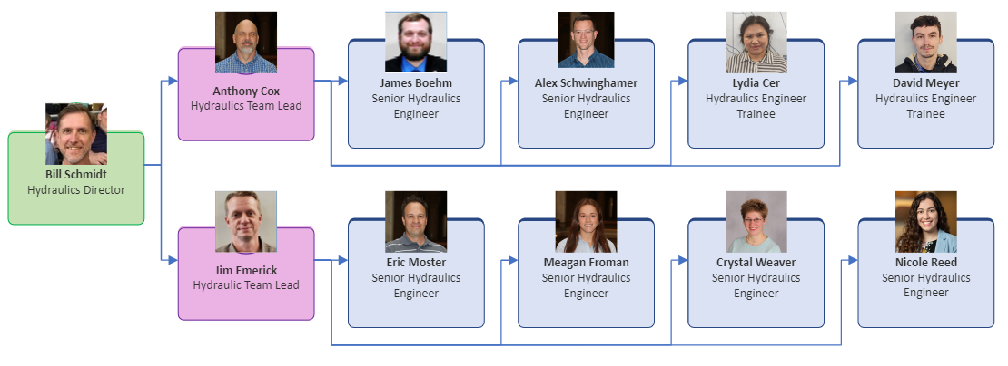
Hydraulics Division
Notes:
6 SR ENG, 3 JR ENG

Slide 3
Agenda
  Replacement in Kind (RIK) Policy
  Riprap Size for Small Culverts
  Joint Probability of Indiana Confluences (JTRP Study)
  Slab Top Design

Slide 4
What is Replacement in Kind (for this policy) ?
  The ability to replace a culvert with a similar structure without requiring hydraulic calculations or INDOT Hydraulics review under certain conditions.
  The key words are “under certain conditions”. The conditions are in place to limit the policy to the lower risk scenarios

Slide 5
RIK Policy – Key Highlights
Expansion of existing Maintenance Memo (11-06) to include other types of projects
Culvert size increased from <36” span to <48” span to capture all CLVs
When meeting all the conditions of IDM 203-2.08, hydraulic analysis is not required and doesn’t require a INDOT hydraulic review

Slide 6
Why?

Slide 7
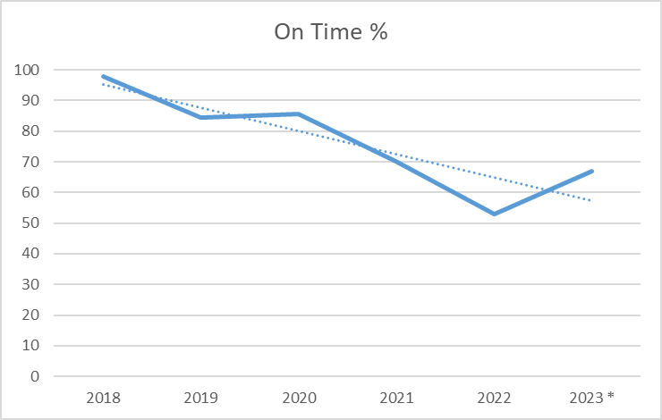
Reasons for the RIK Policy Expansion
Capacity, work-flow, and non-production goals
* Extrapolated from Jan thru Sep, to end of year

Slide 8
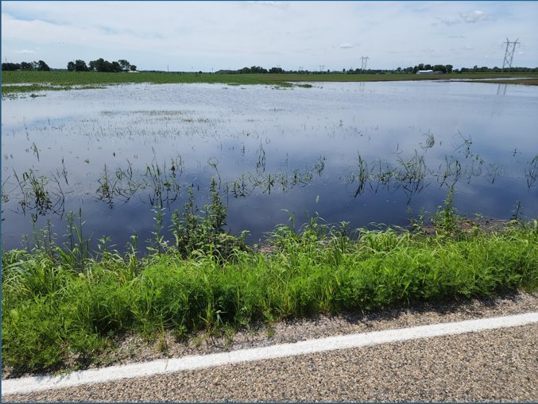
Reasons for the RIK Policy Expansion
Constraints in hydrologic and hydraulic methods that overestimate results
  Mainly watersheds that are flat, sandy, high storage, field tiles, or watershed limitations

Slide 9


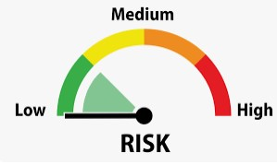
Side Benefits for the RIK Policy Expansion
Cost Benefits
Time Benefits
Only Used in Low Risk Scenarios (Avoid making it potentially worse)

Slide 10
Types of Projects

Slide 11
Types of Projects
YES
  Design contract projects such as overlays and minor pavement repairs that are intended to extend the life of existing pavement
NO
  Fully access-controlled corridor (example: freeway)
  Reconstruction projects
  New pavement

Slide 12
Existing Conditions

Slide 13
Existing Conditions
Must be Culverts < 48” span (all CLVs)
The existing culvert does not have any known drainage issues – Designer should contact District Culvert Asset Engineer. Culvert Asset Engineer should contact the Maintenance Engineer for verification. Documentation should be placed in the Engineering Assessment Report, Field Check Minutes, or Design Computations.
  EXAMPLES:
  No scour holes/erosion
  No siltation
  No history of overtopping
  No ponding debris
  No drainage complaints

Slide 14
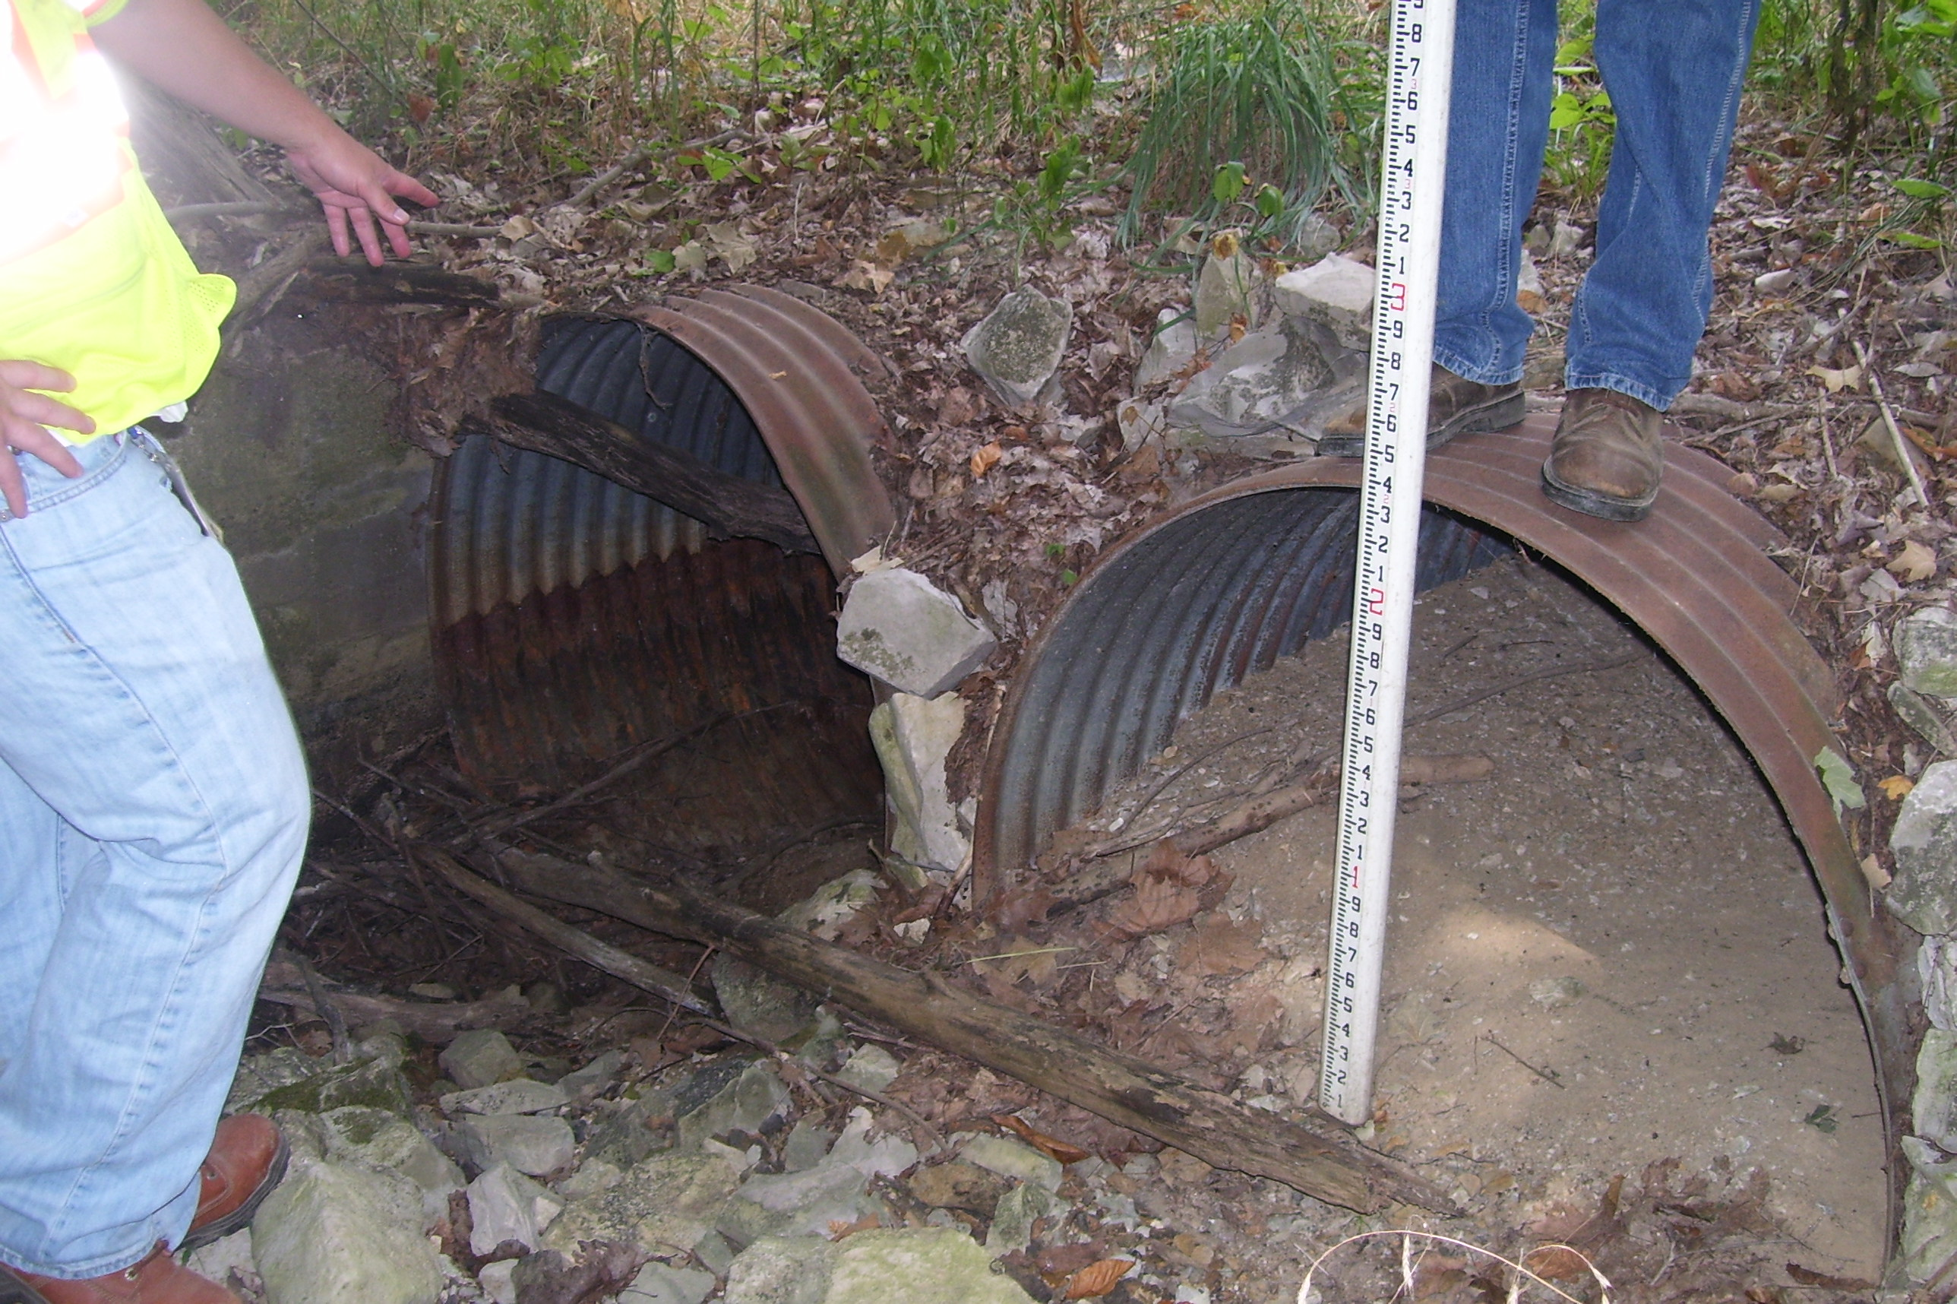
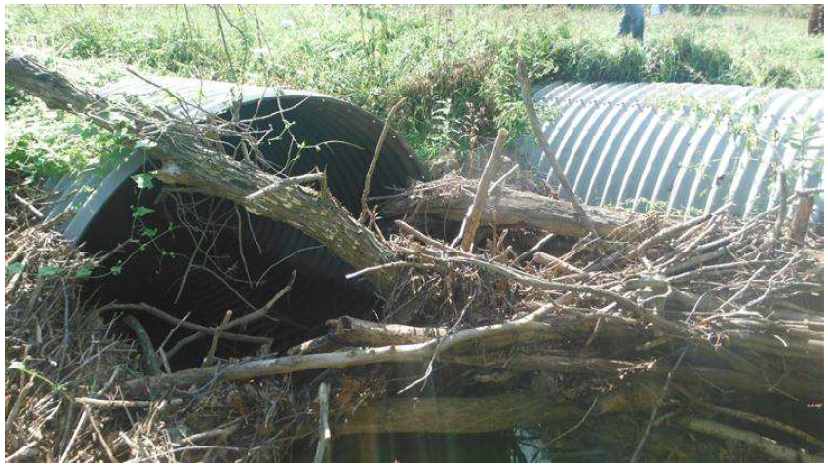
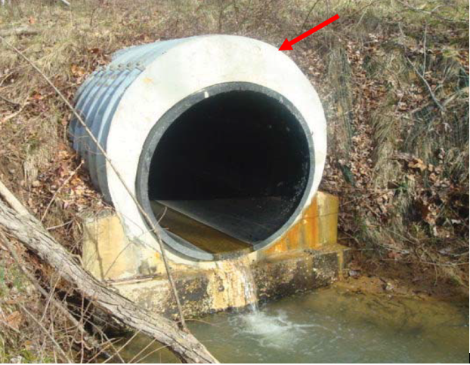
Existing Conditions
No twin pipes
No liners
  You can replace in kind an existing liner, but it will have to match the original host pipe size

Slide 15
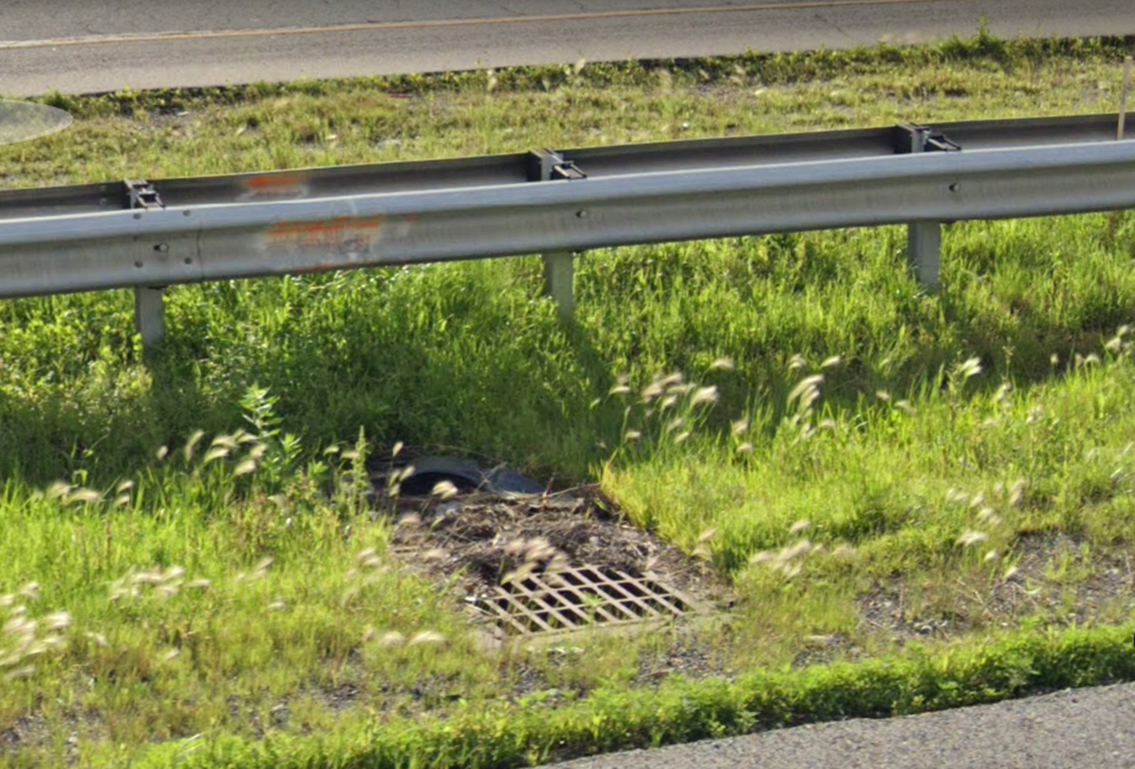
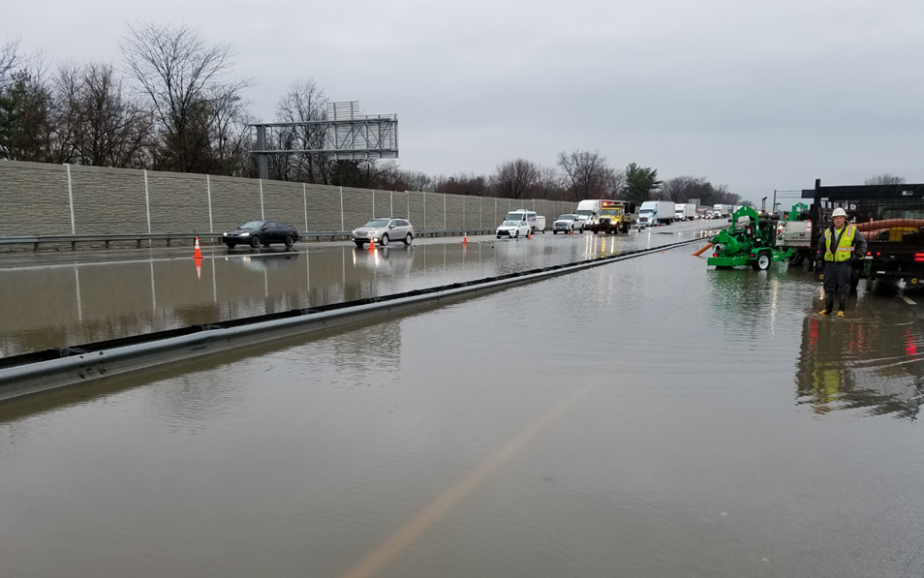
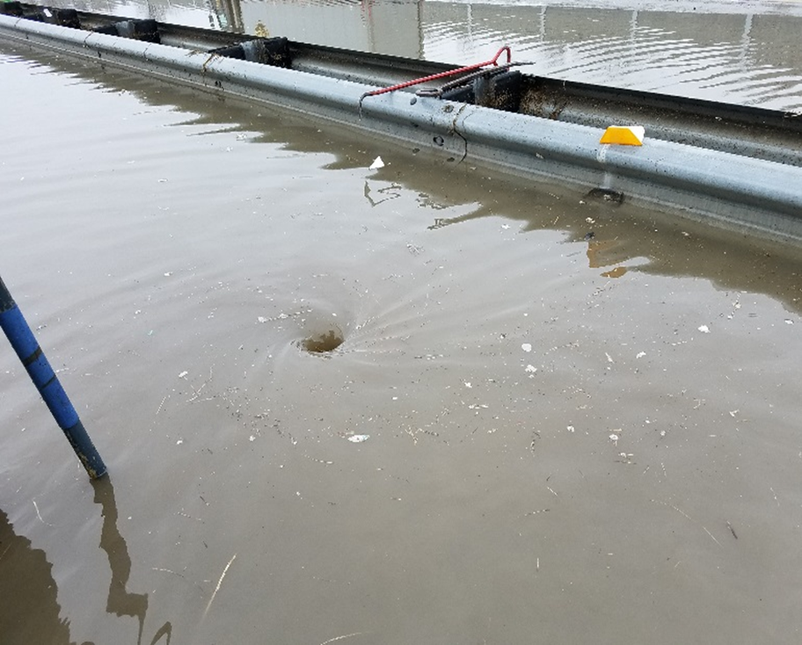
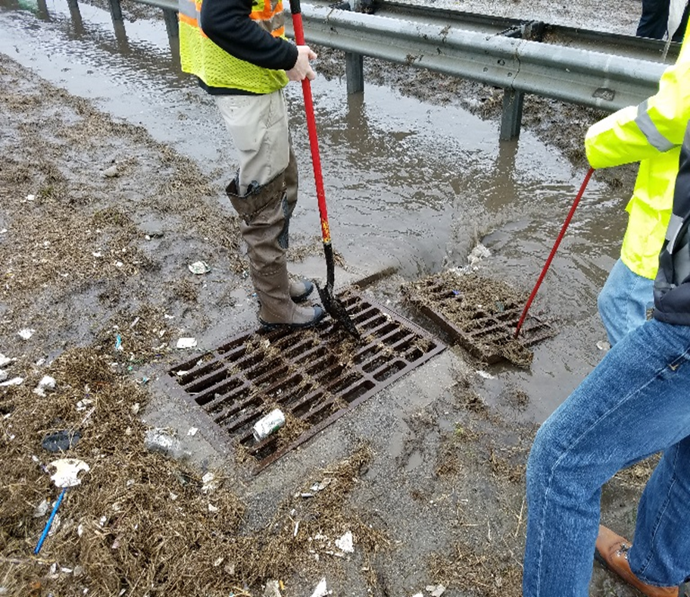
Existing Conditions
No Median Drains
  They will need to be analyzed and reviewed
  Considered high risk

Slide 16
Proposed Conditions

Slide 17
Proposed Conditions
Replacement culvert must be same dimensions as existing…..except
  If Required to be sumped, the rise of culvert should be increased by the sump amount
Replacement pipe must be the same material (example: corrugated to corrugated)
  would likely allow corrugated to smooth with revetment riprap at the outlet if slope is not too steep

Slide 18
Proposed Conditions
The road profile does not change
The replacement culvert should have the same length and invert elevations as the existing
The end treatments should match existing or have the same entrance loss coefficient (See Figure 203-2 I)
  Example: Headwalls should be replaced with headwalls. A metal flared end section could replace a headwall because it has the same entrance loss coefficient

Slide 19
Proposed Conditions
Riprap should be replaced in-kind. If no existing riprap, use revetment per the dimensions in IDM Figure 203-2J.
Should meet cover requirements or gain approval from the appropriate INDOT District Pavement Engineer or Culvert Asset Engineer
Meet all permitting requirements from the INDOT Ecology and Waterway Permitting Office (EWPO)

Slide 20
Documentation

Slide 21
Documentation
Roadway Design Computations Report - Design
Engineering Assessment Report - Scoping
Field Check Minutes - Other

Slide 22
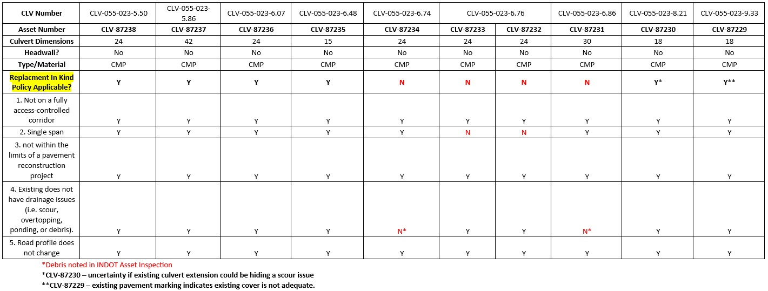
Example RIK Matrix Table

Slide 23
Design Submittals for CLVs (cross culverts)
If meeting all the conditions of IDM 203-2.08, RIK Policy
  INDOT hydraulics review not required, analysis not required
If meeting full INDOT hydraulics design standards
  INDOT hydraulics review not required, analysis is required
  Include computations in roadway design comps
  Exception: liners, median drains, etc.
  Proposed condition must still be a CLV
Not meeting all the conditions of IDM 203-2.08, but still interested in RIK
  INDOT hydraulics will decide on case-by-case basis
  INDOT hydraulics review is required, analysis is required
See IDM 201-1.02 for more details

Slide 24
Questions
Can I use RIK if pipe slopes are to be changed due to embankment slope corrections?
  Case-by-case, but likely "yes". However, analysis and INDOT hydraulic review would be required
Can I use RIK if existing pipe doesn't meet minimal pipe size requirement?
  Yes, if meeting all the conditions of IDM 203-2.08

Slide 25
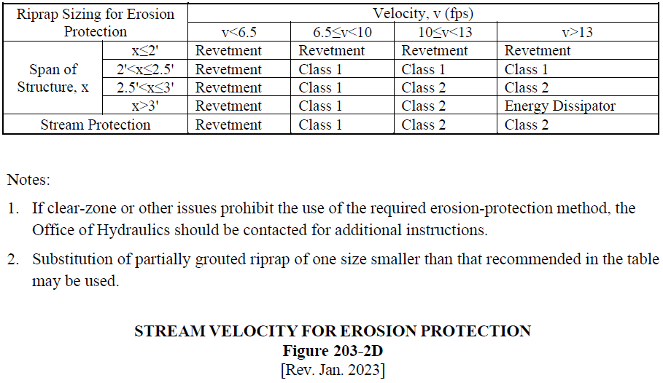
Riprap Protection
IDM Figure 203-2D Update

Slide 26
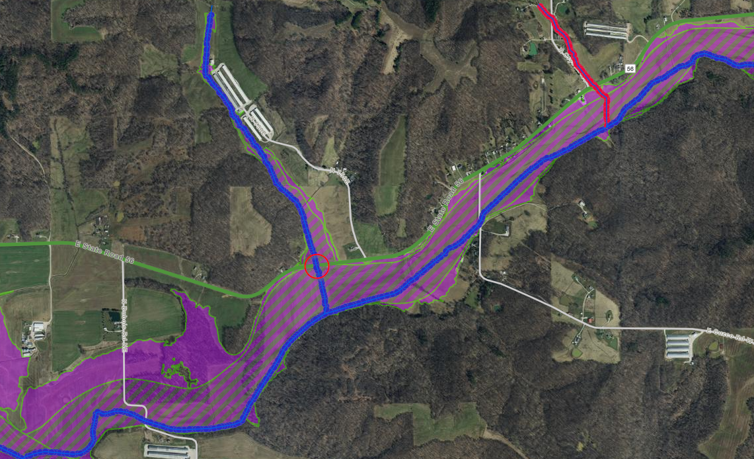
Joint Probability of Indiana Confluences

Slide 27
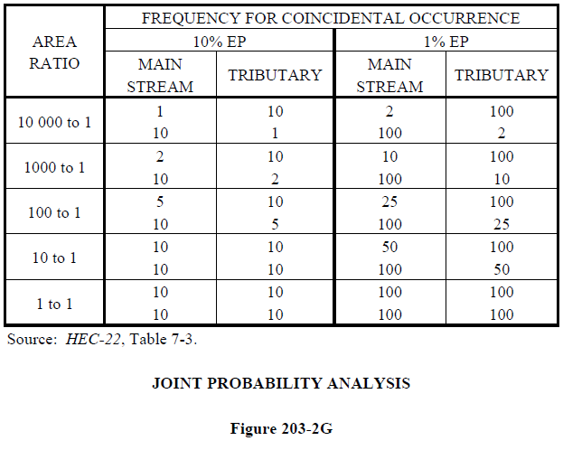
Joint Probability of Indiana Confluences
Previous
FHWA – one stream off the east coast

Slide 28
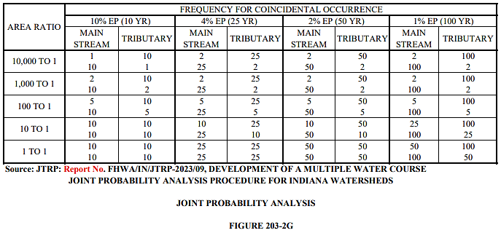
Joint Probability of Indiana Confluences
Updated
JTRP (Joint Transportation Research Program) Study
  Medium Resolution Hydrography Dataset (NOAA)
  4500 confluences from IN
  Minimum threshold of 1 km²

Slide 29
Joint Probability Example
Storm sewer outlets to a creek with an 85:1 watershed ratio
Both storm scenarios should be analyzed
  5-year flow to a 50-year flood as well as a 50-year flow to a 5-year flood

Slide 30
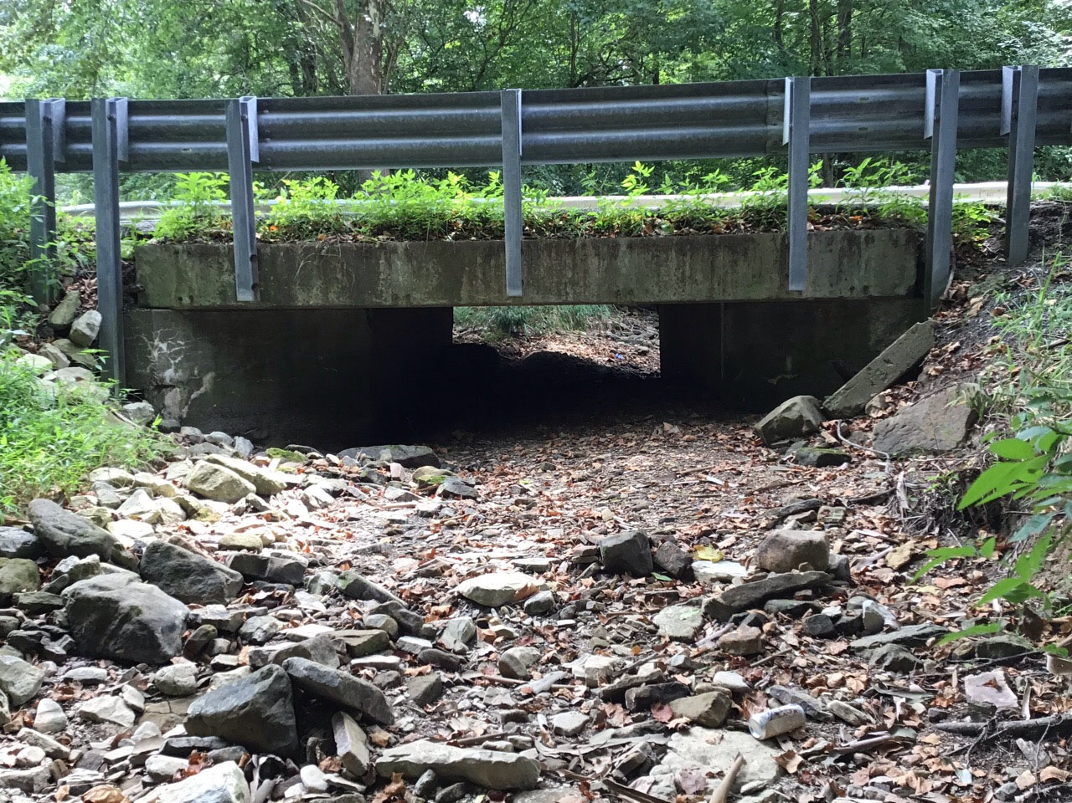
Slab-Top Design

Slide 31
Slab-Top Design
Concrete slab installed on 2 vertical abutments
Ideal for situations with limited cover
Note: The following slab thicknesses and structure depths are only estimates to be used for hydraulic analysis. Actual slab thicknesses and structure depths are to be determined by the engineer of record.
All Spans:
  Minimum desirable structural free board = 1ft
  Should not be designed to be under pressure flow.

Slide 32
Slab-Top Design
Span ≤ 15'
  Minimum slab thickness = 12"
  Structure depth=12" + 0.02* (½ roadway width + shoulder)
    0.02 is based on a 2% super elevation to the crown.
  Example: 15' span, normal crown, 2- 12' lanes and 4' shoulders
    Min structure depth=12"+0.02(12'+4')*(12"/ft) =15.84"
15' < Span ≤ 20''
  Minimum slab thickness = 15"
  Structure depth=15" + 0.02* (½ roadway width + shoulder)
Spans > 20'
  INDOT Bridge design group should be contacted to estimate

Slide 33

Division of Hydraulics

