Slide 1
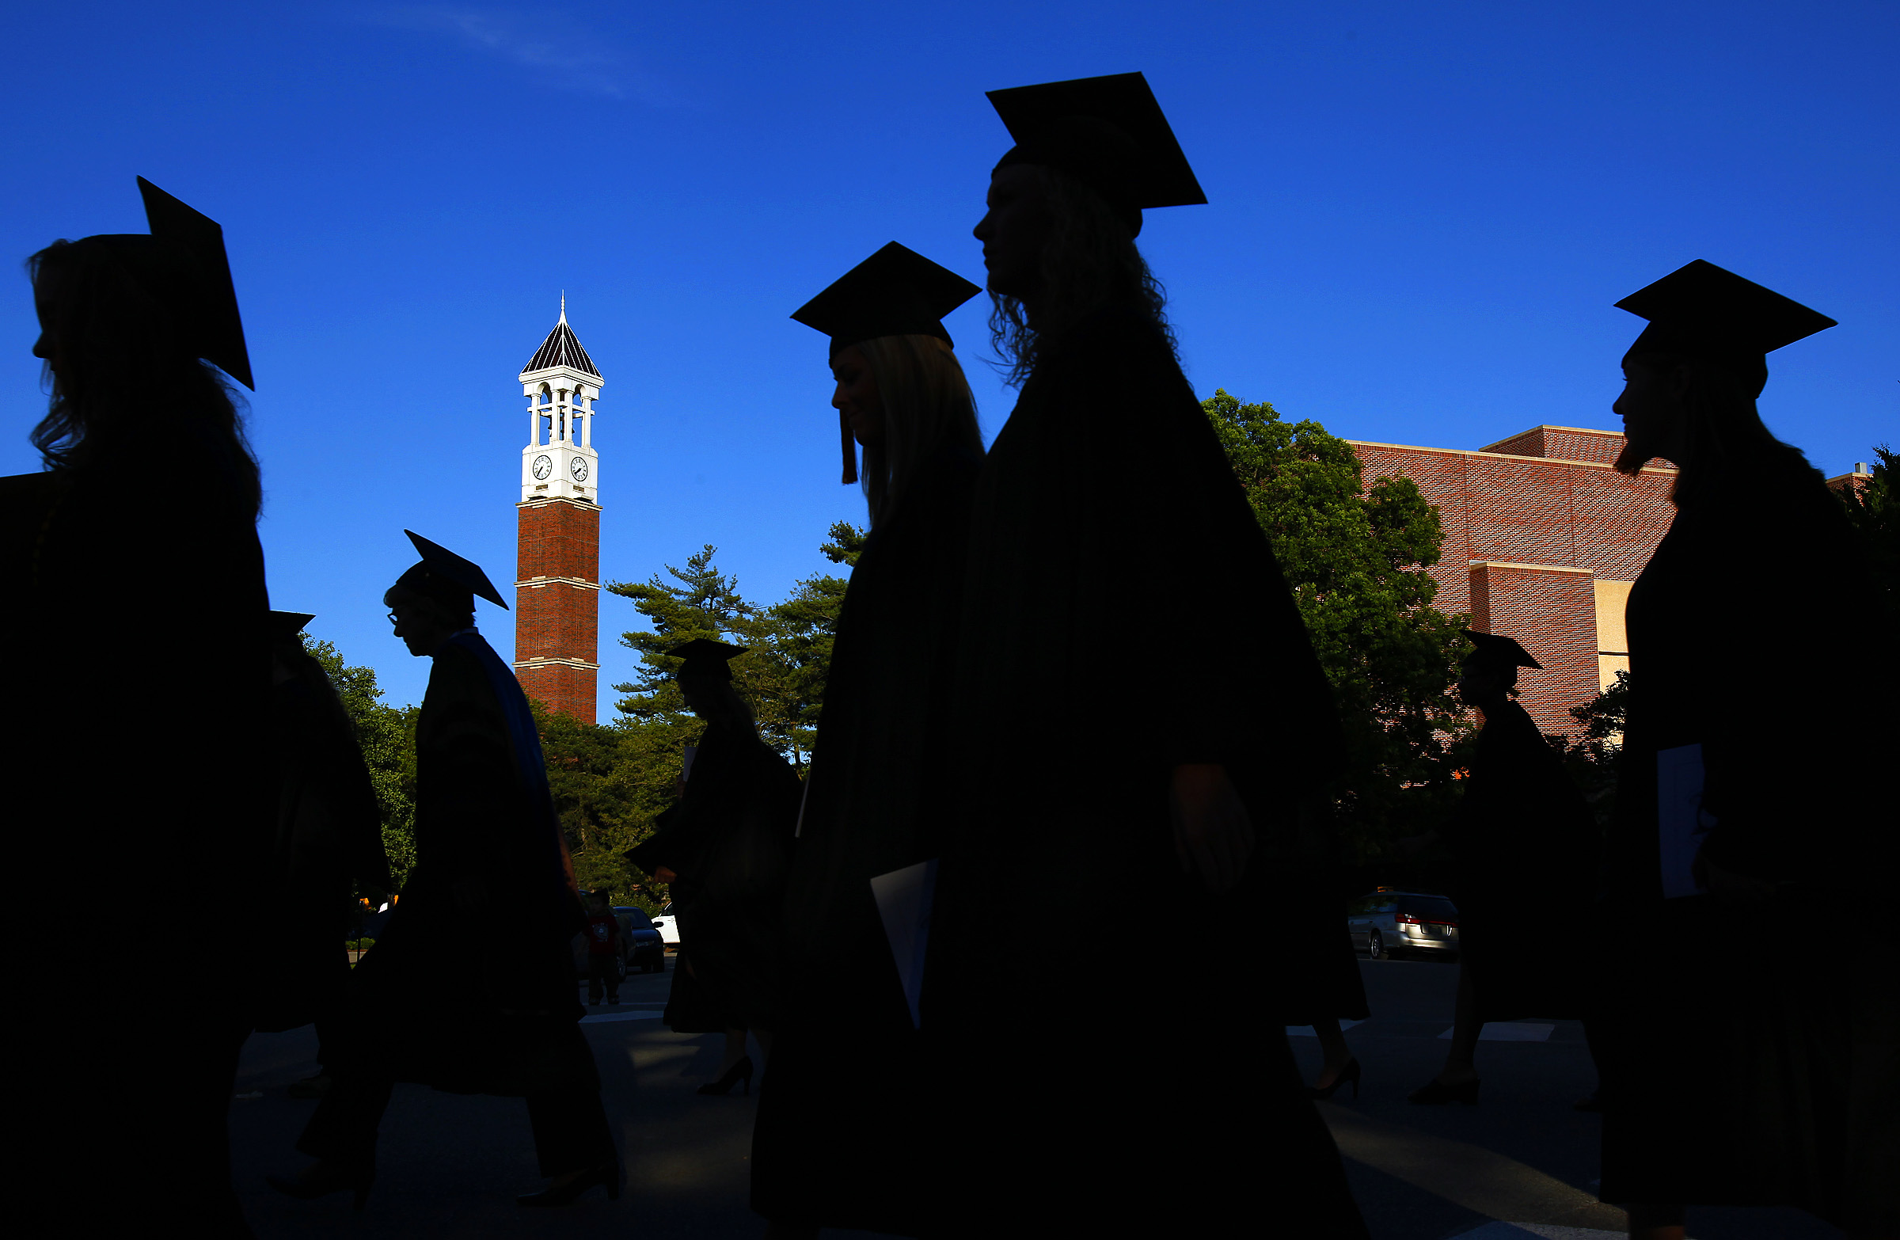

First-Generation Students at Purdue
Dan Carpenter – Executive Director, Student Success Programs
Dennis Bowling – Senior Associate Director, Student Success Programs

Slide 2
Why is Purdue Thinking About First-Generation Students?
Like most universities, we’ve known that these students’ outcomes are different when compared to their peers
Consultants, internal surveys and conversations revealed a growing desire to act
The data about first-generation students is robust
Leaders recognize the intersection of first-generation status with other aspects of diversity
Connection to strategic goal of “Maximizing the Potential of All Students”
Recent symposium illuminated both the challenge and the opportunity

Slide 3
First-Generation Student Data
* 1G students are under-represented in STEM majors
Notes:
Define 1G
First generation students represent 20.2% (6,782) of the fall 2019 undergraduate student body. The percentage of first generation students has remained over 20% since the fall of 2014.

Slide 4
Intersectionality of First-Generation Students
Total Purdue Undergraduate Population - Fall 2018
1G students are more likely to be Indiana residents (67.9%)
Close to half of all Pell recipients are 1G (47.1%)
Over a third of all URM students are 1G (35.4%)
Over 2,400 students are both Pell recipients and 1G (7.6%)
Close to 700 students are Pell recipients, URM and 1G (2.1%)
Notes:
Non-1G students – 47.9%

Slide 5
First-Generation Student Data
* There has been a consistent 1 year retention gap for the past 7 years
Notes:
From the fall of 2011 to fall of 2018, the first-time full-time (FTFT) first generation students have consistently maintained a gap in first year retention rate compared to non-first generation students. The gap has ranged from 3.6% to 6.6%. 2018 gap was 6.3%

Slide 6
First-Generation Student Data
* The gap tends to widen between the 1st and 2nd year retention rate
Notes:
From the fall of 2011 to 2017, non-first generation students’ second year retention rate had a decrease of an average of 4.5%. The second year retention rate for first generation students had a decrease of an average of 6%.

Slide 7
First-Generation Student Data
* 1G 4 year graduation rate has increased over 10% within 5 years
Notes:
Increase over the past 5 years has been strong. Gap is decreasing from 5.2% in 2011 to 3.4% in 2015. Data indicates that if a 1G student can be retained through there Junior year, there is seemingly an equal change of them graduating as a non-1G student.

Slide 8
First-Generation Student SIF Data
Student Information Form (SIF) is completed at least one week prior to incoming students’ summer orientation session.
1G Students Are Less Likely
1G Students Are More Likely
To have Purdue as their first choice institution (85.77% vs 78.20%)
To commute (13.60% vs 5.72%),
To work 20 or more hours (10.99% vs 4.39%)
To join campus organizations (72.22% vs 82.64)
To live in the resident halls (69.84% vs 86.53%)
To take AP Exams (67.85% vs 77.25%)
Notes:
Explain SIF, ask students about academic concerns campus involvement, and living situation.

Slide 9
First-Generation Student SERU Data
Student Experience in the Research University (SERU) seeks students’ thoughts on topics related to engagement, personal development, campus climate, and satisfaction with the campus and their program of study.
1G Students are more likely
1G Students are less likely
To complete an academic experience with a diversity focus (51.8% vs 43.8%)
To increase their student loan amount to meet expenses (30.5% vs 16.7%)
To be concerned about their accumulated educational debt (53.1% vs 34.4%)
To complete an honors program (5.9% vs 17.2%)
To be involved in student orgs (77.7% vs 83.3%)
To assist faculty in conducting research (19.9% vs 25.2%)
To complete a living-learning program (13.3% vs 21.6%)
1G and non-1G Students are almost equally satisfied and feel that they belong at Purdue
Notes:
Student Experience in the Research University (SERU) seeks students’ thoughts their engagement, personal development, campus climate, and satisfaction with the campus and their program of study. Last given in 2017 – 2018. Less involved in high impact programs. More issues with financial concerns. Excited to see that 1G and non-1G Students are almost equally satisfied and feel that they belong at Purdue

Slide 10
First-Generation Student Additional Data
1G students have a lower cumulative GPA average than their peers (In fall of 2018, 3.01 vs 3.20)
1G students earn on average less credit hours per semester than their peers (In fall of 2018, 14.52 vs 14.84)
1G students have a higher percentage of DFW grades (In the fall 2018, 11.1% vs 6.7%)
1G students are less likely to study abroad (In the 17-18 academic year, 18.8% vs 21.6%)
1G students are underrepresented within leadership roles in student organizations (16.2%)

Slide 11
First-Generation Students’ First Destination Data
Are more likely to work in Indiana (65.78% vs 57.09%)
Were less likely to hold an internship during their tenure at Purdue (27.5% vs 23.1%)
Have a lower average adjusted starting salary ($51,854 vs $57,840)
Were less likely to continue their education after gradation (19.6% vs 21.3%)

Slide 12

First-Generation Student Success Efforts at Purdue
Purdue Promise
Horizons Student Support Services
Purdue - West Lafayette - First-generation Student Symposium
NASPA’s First-Gen Forward Program
Purdue System-wide forum
First Scholars® Network
Exploring Grant Opportunities

Slide 13
First-Generation Student Success
In your opinion:
  What obstacles do first-generation students face in Indiana?
  What do you think higher education institutions are missing about serving first-generation students in Indiana?
  What high impact practices are employ by Indiana colleges and universities that close the achievement gap between first-generation and non-first-generation students?
  Why is the success of first-generation students important in Indiana?

