Slide 1




“Children will live in safe, healthy and supportive families and communities.”

Slide 2

Educational Neglect Allegation Change
Hotline Screening Practice Change

Slide 3

Current Educational Neglect Definition
A child age 5 or 6 is currently or was previously enrolled in school, and the parent is now refusing to allow or failing to support the child in attending school or receiving homeschooling.
  Consider number of unexcused absences in the current year
  Attempts to engage parents/response
A child is age 7–12 and there is unreasonable delay, refusal, or failure on the part of the caregiver to seek, obtain, and/or maintain education for the child.
  Consider number of unexcused absences in the current year
  Attempts to engage parents/response
A child is age 13 or older, enrolled in school, and not attending to the extent that educational neglect is present.
  10 unexcused absences
  Caregiver is aware
  Indications that a caregiver refuses or is unable to support the
  child in attending
www.in.gov/dcs

Slide 4

Current Practice
Today, we would generally assign for educational neglect any time a report source indicates the child has ten unexcused absences, along with the attempts to contact the parent and parental response. The current screening practice does not require reporters to identify an adverse impact within education from missing school.
www.in.gov/dcs

Slide 5

New Practice
The Hotline will be piloting a screening practice change surrounding Educational Neglect as it relates to an adverse impact within the child’s education.
Reports will no longer be recommended for an assessment when the adverse impact is unknown or not influencing the child’s academic progress along with the other components that have always been in place.
www.in.gov/dcs

Slide 6
New Educational Neglect Definition
A child age 5 or 6 is currently or was previously enrolled in school, and the parent is now refusing to allow or failing to support the child in attending school.
Child needs to have at least 10 unexcused absences AND there is a significant adverse impact to academic progress (e.g. significant drop in grades, in jeopardy of retention). Consider whether the school has made reasonable efforts to address the issue with the parents (e.g. mailed letters, attempted phone calls, home visits).
A child is age 7–12 and there is unreasonable delay, refusal, or failure on the part of the caregiver to seek, obtain, and/or maintain education for the child.
Child needs to have at least 10 unexcused absences AND there is a significant adverse impact to academic progress (e.g. significant drop in grades, in jeopardy of retention). Consider whether the school has made reasonable efforts to address the issue with the parents (e.g. mailed letters, attempted phone calls, home visits).
A child is age 13 or older, enrolled in school, and not attending to the extent that educational neglect is present.
Child has over 10 unexcused absences during the current school year;
There is a significant adverse impact to the child’s academic progress (e.g. significant drop in grades, in jeopardy of retention);
Caregiver has been made aware of the situation; AND
Information provided indicates that the caregiver refuses to allow or appears unable to support the child in attending school.
www.in.gov/dcs
Notes:
No clear information about the baby, not related to reason for call or the focus family. This could be considered a “loose reference”.

Slide 7

Why Change?
Educational neglect reports skyrocketed during the 2020-2021 school year; however, cases that resulted from such allegations did not. This means we were involved with many situations where abuse/neglect was not discovered. An opportunity was discovered to better tailor our recommendations to situations that merit further DCS action. Additionally, through this improvement project, field response to these types of assessments will be reviewed and best practice guidance given to ensure that families that do need further intervention are identified, and that intervention is provided.
Year | Educational Neglect Hotline Calls | Cases opened with Educational Neglect
March 2021 | 1350 | 17
March 2020 | 427 | 10
March 2019 | 653 | 31
March 2018 | 604 | 40
www.in.gov/dcs

Slide 8
Educational Neglect Data: June 2019 - April 2021
 | Screened In | Screened Out
Maltreatment Present | True Positive 4,078 28.77% | False Negative 150 1.06%
Maltreatment Not Present | False Positive 9,573 67.53% | True Negative 374 2.64%

Slide 9
We have developed an educational neglect form that outlines updated criteria. This criteria includes a requirement of obtaining the number of unexcused absences, the adverse impact, the parental contact, and the parental response.
This form will also allow school report sources that prefer email to complete a comprehensive report.
This form will be available on the DCS website, and we would encourage report sources to utilize these forms as guidance of what we are needing.
The Hotline Intake Specialist will educate appropriate callers regarding the criteria for educational neglect.
A false positive is a result that indicates a given condition exists when it does not. As a result of this increase, we are creating changes.

Slide 10
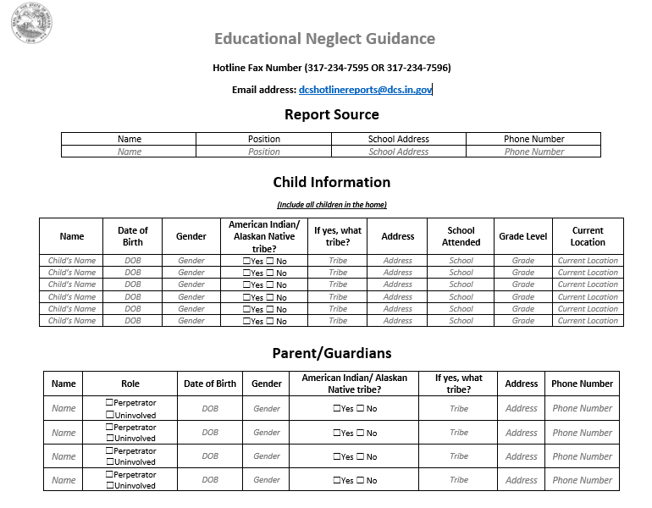

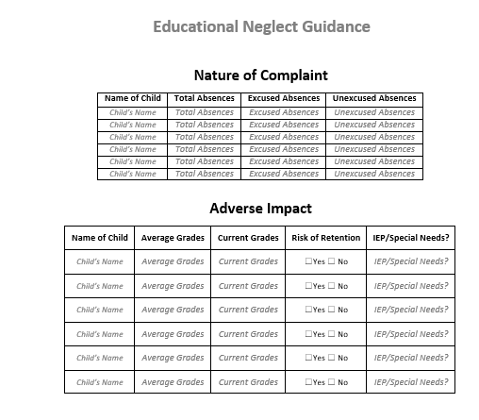
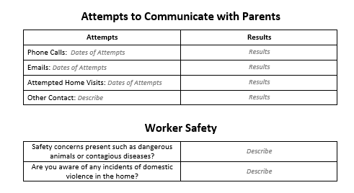

Slide 11
Pop Quiz!
True or False?
Jane Smith (5) lives with her parents, John and Julie Smith. Jane has never been enrolled in school. Jane’s parents have been known to say they do not plan to enroll Jane in school, and the school year has already started. It is unknown why they do not want to send her to school. This report should be screened out.
  Answer: True
If a Hotline Intake Specialist recommends screening out due to lack of information, or it not hitting all components of the new definition, they can explain to the school report source why.
  Answer: True. The IS can explain what criteria is missing, and the IS can share the new educational neglect form that will be available on the website.
The new element added onto the SDM definition is an adverse impact to education.
  Answer: True

Slide 12
Let’s Practice!
Jane Smith (13) lives with her parents, John and Julie Smith. Jane has been missing school and has at least 14 unexcused absences. Jane’s grades are F’s, but she has had failing grades all year. It is believed Jane’s parents have been contacted by the Principal, but it is unknown how many times, or what the response was.
Decision: Screen out
Reason: No information that indicates the caregiver refuses to allow the child to attend school. This is a truancy issue. This would be screened out prior to the change, and after the change.

Slide 13
Let’s Practice!
Jane Smith (10) lives with her parents, John and Julie Smith. Jane has been missing school and has a mixture of unexcused and excused absences. Jane has fifteen unexcused absences. Jane’s grades consist of B’s, C’s, and F’s. Jane has an IEP that depicts services received at school. Jane has regressed in treatment due to missing school, which has contributed to her grades. Jane’s parents have been contacted more than three times, and they are dismissive and not communicating a plan to address the issue.
Decision: Assessment
Reason: The child’s fluctuating grades and the treatment regression contributing to grades displays an adverse impact.

Slide 14
Let’s Practice!
Jane Smith (10) lives with her parents, John and Julie Smith. Jane has been missing school and has a mixture of unexcused and excused absences. Jane has twenty unexcused absences. Jane’s grades consist of A’s and B’s. Jane’s parents have been contacted, and they have been dismissive and are not addressing the issue.
Decision: Screen out
Reason: There is no adverse impact to the child’s grades. Prior to the change, this would have been recommended for assessment.

Slide 15
Let’s Practice!
Jane Smith (10) lives with her parents, John and Julie Smith. Jane has been missing school and has a mixture of unexcused and excused absences. Jane has ten unexcused absences. Jane’s grades consist of F’s and D’s. Jane’s parents have been sent letters and have been contacted three times, but no response has been received.
Decision: Assessment
Reason: Child has ten unexcused absences, reasonable parental contact has been made, and the adverse impact is displayed within the child’s grades.

Slide 16
Let’s Practice!
Jane Smith (10) lives with her parents, John and Julie Smith. Jane has been missing school and has a mixture of unexcused and excused absences. Jane has ten unexcused absences. Jane’s grades had consisted of B’s and now she has C’s. Jane’s parents have been sent letters and have been contacted three times. Each time they were contacted they have responded that Jane has been ill.
Decision: Screen Out
Reason: The adverse impact to the child’s grades is not significant. The school has made reasonable attempts of contact.

Slide 17
Let’s Practice!
Jane Smith (12) lives with her parents, John and Julie Smith. Jane has been missing school and has a mixture of unexcused and excused absences. Jane has twenty unexcused absences. Jane’s grades are unknown. The parents have been contacted, and there was a discussion with the parents within the last couple of months regarding retention.
Decision: Assessment
Reason: The components of ten unexcused absences and adverse impact are present.

Slide 18
Let’s Practice!
Jane Smith (10) lives with her parents, John and Julie Smith. Jane has been missing school and has a mixture of unexcused and excused absences. Jane’s specific number of absences are unknown, but she has over ten unexcused. Jane’s grades are unknown, and it is unknown if she is facing any type of retention. It is unknown if parental contact has been made.
Decision: Screen Out
Reason: All components are not present due to the unknown. The Hotline Intake Specialist would educate on the missing criteria. They can also refer the report source to the DCS website and encourage them to utilize the new form that depicts details regarding new standards for educational neglect.

Slide 19
Let’s Practice!
Jane Smith (10) lives with her mother, Julie Smith. Jane’s father, John Smith, has been contacted by the school and informed she is in danger of retention and has 15 unexcused absences. The father says he does not know if the school has contacted the mother.
Decision: Assessment
Reason: The components of ten unexcused absences and adverse impact are all present.

Slide 20
Let’s Practice!
Jane Smith (10) lives with her parents, John and Julie Smith. RS reports Jane has 10 unexcused absences, and has regressed academically. RS reports her GPA has gone from a 3.1 to a 1.2, and she’s started to regress in reading ability. RS reports the school has made no attempts to contact the parents, as “that’s DCS’s job.”
Decision: Screen Out
Reason: While the components of ten unexcused absences and adverse impact are there, the school has made no attempts to engage the parents. Encourage school to attempt engagement with parents. Furthermore, encourage that if attempts to contact are unsuccessful or problem persists after contact, to re-report.

Slide 21
How can we better serve families struggling with children’s educational needs?
Community Based Approach
Individual reports are not going to address the overall increase in need
Focus on prevention of abuse/neglect

Slide 22
Community Partners for Child Safety
Community Partners for Child Safety
(CPCS)
The Primary goal of the program is to prevent families from entering the DCS child abuse and neglect system by improving family functioning
It is a community-based child abuse and neglect prevention program funded by the Department of Child Services available in all 18 regions of the state of Indiana
CPCS collaborates with other community resources within each region to create a coordinated prevention network.
Families access prevention services through self-referral or referral from another community agency (Schools, Probation, DCS, Faith Based Organizations, Mental Health Centers, etc.)
Participation in services is voluntary and free.
CPCS Community Liaisons provide direct services to connect families to resources to strengthen the family unit and prevent child abuse and neglect.
Link to CPCS https://www.in.gov/dcs/2455.htm

Slide 23
Pop Quiz!
True or False?
Participation in Community Partners is mandatory.
  False!
The focus of Community Partners is the prevention of abuse and neglect.
  True!
Participation in Community Partners is free.
  True!

Slide 24

“Children will live in safe, healthy and supportive families and communities.”

