Slide 1
INDOT Hydraulics Workshop
Small Structure Memorandum Template Guidance
James Boehm, INDOT Hydraulics Engineer
Meagan Froman, INDOT Hydraulics Engineer
Notes:
Welcome to the INDOT Office of Hydraulics Workshop. I am James Boehm, and presenting with me today is Meagan Froman. We thank you for taking the time be here. Today we will be giving guidance on how to correctly complete the new small structure memorandum template.

Slide 2
Overview
New small structure memorandum template
Subject section
Site parameters table
Culvert properties table
Memo body
Riprap design
External energy dissipator
Inlet depressions
Beveled headwall detail
Contact information
Notes:
The topics this presentation covers are:
informing you there is a new memo template and why
the subject section
the site parameters
the culvert properties table
the memo body
riprap design tips and how to document it in the memo
external energy dissipator design tips and what is required to document in the memo
how to design an inlet depression and the required data for the memo
the inclusion of a beveled edge headwall detail
the contact information section

Slide 3
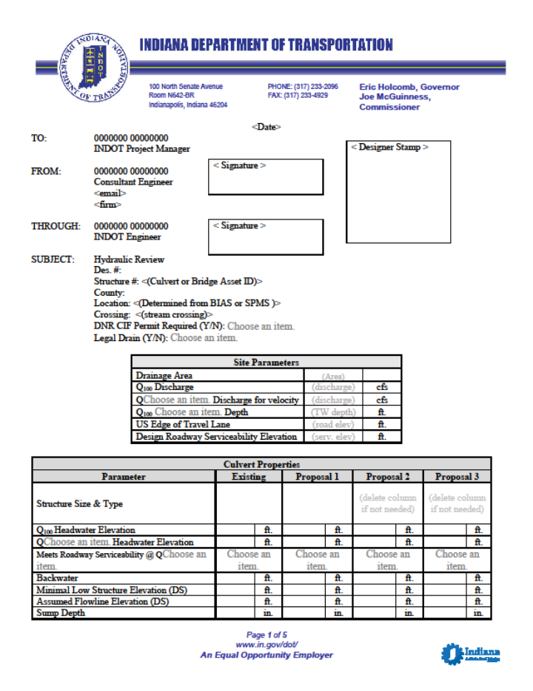
New Memorandum Template
Why the new template?
  Bring better uniformity to the submitted hydraulic memos
  Reduce the amount of errors in the submitted hydraulic memos
  Remove uncertainty of what is needed in the hydraulic memos
INDOT Small Structures Memorandum Template
Notes:
You may ask, why the new template? Since July of 2018, we have required completed hydraulic memos be submitted as part of the small structure design submittal packages, and due to this there has been a lot of variability in what has been included in the memos. Therefore, we thought it would be a good idea to standardize the memo. Standardizing the memo is intended to bring better uniformity and should help to reduce the amount of errors in submitted hydraulic memos, thereby reducing the amount of back-and-forth to fix the errors. Lastly, it is intended to aid in removing the uncertainty of what is required to be included in the hydraulic memos.

Slide 4
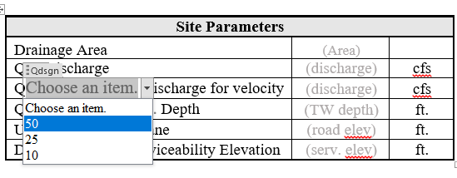
Dropdown Selection Boxes
The greyed out “Choose an item.” indicates a dropdown selection box.
  Click on the greyed “Choose an item.”
  Click on the dropdown arrow, and select the correct item.
  Not all greyed words are dropdowns (only “Choose an item.”)
Notes:
In the new template there are now dropdown selection boxes. They are indicated by the greyed out words “Choose an item”. Where you see this click on the greyed “Choose an item,” and a dropdown box will appear. Click on the dropdown arrow, and make the necessary selection. Not all greyed out words in the memo indicate a dropdown. The one dropdown that is not indicated by the words “Choose an item.” is the cell in the site parameters table for the drainage area units.

Slide 5
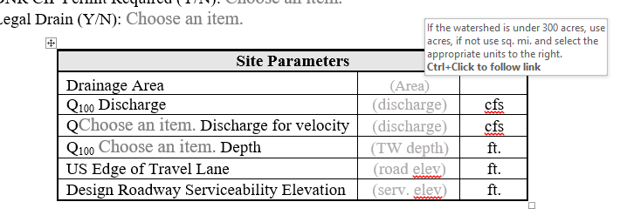
Hover Instructions
Hover the curser over certain items.
  Instruction or guidance may appear.
  Comments are intended to be a FAQ guide only.
  There is nothing that indicates where they are in the document.
  Refer to the instruction document if no hover comment is present for an item.
Notes:
Another feature included in the new template is hover instructions. Certain items in the memo have instruction or guidance associated with them in the form of an instruction box that appears if the cursor is hovered over them. The instruction box will automatically appear, and the comments are typically related to FAQ’s or guidance on something that may not be apparent. There is nothing that indicates where these are located in the memo template. If there is an aspect of the template that does not have hover instructions, consult the hydraulic memo instructions document that can be found on the Office of Hydraulics website.

Slide 6
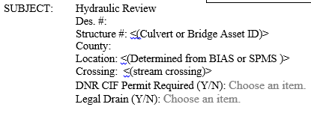
Subject Section
“No Des.” and “N/A” both acceptable when there is no des. number.
Drop-downs for Construction in a Floodway (CIF) Permit and Legal Drain
The memo must be stamped before submittal.
Notes:
Shown above is a screenshot of the subject section. It is the last section in the memo before any data needs to be entered and is mostly self-explanatory. However, there are a few things worth noting. Often times the small structures do not have des. numbers assigned to them, and if that is the case, putting either “No Des.” or “N/A” is acceptable.
Again, dropdown menus were added to the memo, and there are now dropdowns in the subject section for the CIF permit and legal drain lines. Both of those drop-downs offer “yes” and “no.”
Before submitting memos for review go ahead and stamp them because without the stamp the memo is not official. If something needs to be changed after the memo has been submitted, the INDOT reviewer will explain what he/she thinks needs to be changed and make sure both parties are aware of any changes that are made.

Slide 7
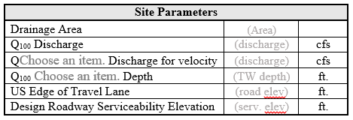
Site Parameters
Design-year storm
Tailwater depth vs. outlet depth
Edge of travel lane (ETL) vs. roadway serviceability elevation (RSE)
Notes:
The first section after the subject section and where data needs to be entered is this site parameters table. The first two lines are self-explanatory, but in the last column of the first row there should be a dropdown menu to select either “sq. mi.” or “acres.” If the drainage area is smaller than half a square mile, enter the size of the drainage area in acres.
In the third line where the design-year storm is indicated, open the dropdown menu where it reads “Choose an item.” to select the corresponding design year. This line may not be necessary; if it is not needed, delete it from the table.
Unsure of which design-year storm to select? In the design manual there is a figure, IDM Figure 203-2C, that gives that information (see next slide).

Slide 8
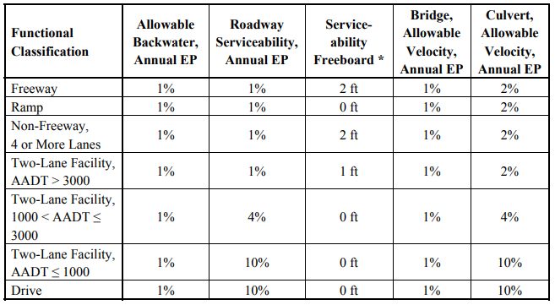
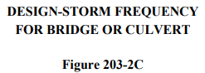
Site Parameters – Design-Year Storm
Notes:
The third column of IDM Figure 203-2C indicates what design-year storm to use, and it is based on roadway classification.
For example if the roadway is a two-lane facility with 1,000<AADT<3,000 vehicles, the design-year storm is a 25-year storm. Another example is if the AADT<1,000 vehicles, the design-year storm is a 10-year storm.

Slide 9
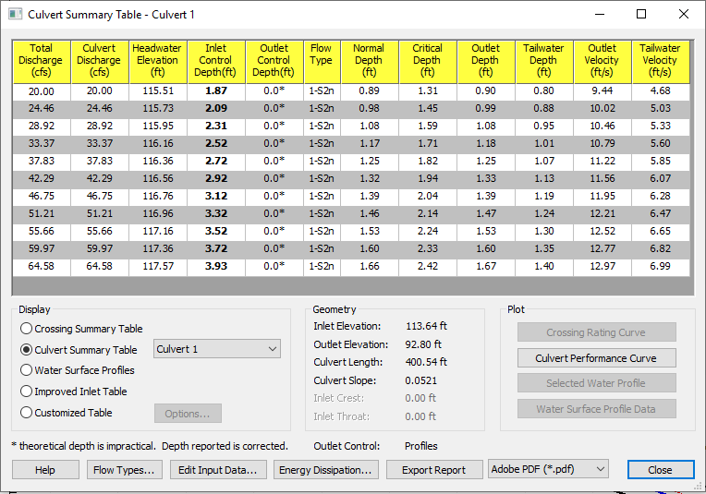
Site Parameters – Tailwater Depth vs. Outlet Depth
Notes:
The middle part of the site parameters table is where to enter either the Q₁₀₀ tailwater depth or Q₁₀₀ outlet depth. There has been confusion on which to enter because there is no clear-cut rule of which to select. Generally speaking it will likely be most appropriate to enter the tailwater depth. However, there are times when entering the outlet depth would be better. Both of those values can be obtained in the last line of the culvert summary table in HY-8.
A couple examples of when it may be better to use the outlet depth are when
there is a steep drop-off at the outlet of the structure
it would be more economical
When in doubt, use the tailwater depth, and if the INDOT reviewer thinks it would be more appropriate to use the outlet depth, he/she will indicate that.

Slide 10
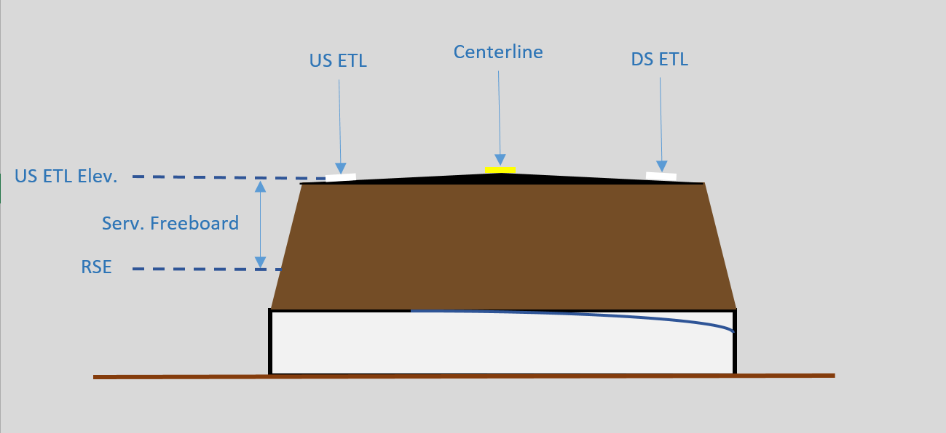
Site Parameters – ETL vs. RSE
Notes:
The last part of the site parameters table is where to specify the edge of travel lane (ETL) elevation and roadway serviceability elevation (RSE). Conceptually they are two different things. As far as entering them into the memo, the ETL elevation is going to be exactly as it was measured in the field during the survey, and the roadway serviceability elevation is the ETL elevation minus the serviceability freeboard.

Slide 11
Site Parameters – ETL vs. RSE
Notes:
The serviceability freeboard can be obtained from the same figure shown earlier, IDM Figure 203-2C, in the middle column.
For a two-lane facility with 1,000<AADT<3,000 vehicles the table shows 0 feet of serviceability freeboard, so in that case the ETL elevation and roadway serviceability elevation are the exact same value.

Slide 12
Question #1
True or false? Better uniformity and eliminating uncertainty of needed data in the hydraulic memorandum are the main reasons for the new memorandum template.
Answer: True

Slide 13
Question #2
True or false? If you are unsure of whether to use the tailwater depth or outlet depth in the calculations, use the outlet depth.
Answer: False
If you are unsure, use the tailwater depth. If the reviewer feels the outlet depth is more appropriate, he/she will notify the designer.

Slide 14
Culvert Properties Table
The table is a snapshot of most important parameters.
If Q_{design} is Q₁₀₀, remove the second headwater elevation line.
Remove any proposal column that is not used.
Use the dropdowns to select the respective parameter or item.
Culvert Properties
Parameter | Existing |  | Proposal 1 |  | Proposal 2 |  | Proposal 3
Structure Size & Type |  |  |  |  | (delete column if not needed) |  | (delete column if not needed)
Q₁₀₀ Headwater Elevation |  | ft. |  | ft. |  | ft. |  | ft.
Q Choose an item. Headwater Elevation |  | ft. |  | ft. |  | ft. |  | ft.
Meets Roadway Serviceability @ Q _{Choose an item.} | Choose an item. |  | Choose an item. |  | Choose an item. |  | Choose an item.
Backwater |  | ft. |  | ft. |  | ft. |  | ft.
Minimal Low Structure Elevation (DS) |  | ft. |  | ft. |  | ft. |  | ft.
Assumed Flowline Elevation (DS) |  | ft. |  | ft. |  | ft. |  | ft.
Sump Depth |  | in. |  | in. |  | in. |  | in.
Notes:
The culvert properties table is intended to be a snapshot of the most important data needed regarding the existing structure and the proposed options. If the design discharge is for a 100-year storm event, the second row for the design discharge should be removed from the table as it would be redundant to put the Q₁₀₀ headwater elevation in twice. Any proposal columns not used should be removed. There are dropdowns included in this table to make editing it simpler and faster.

Slide 15
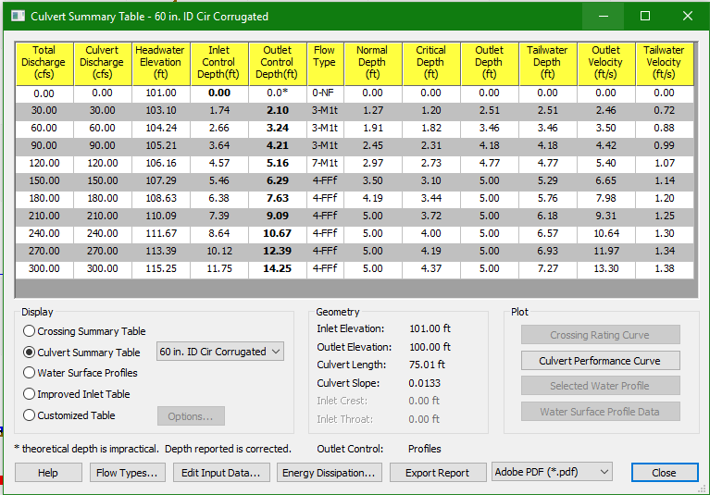
Data Needed From HY-8
Q₁₀₀ headwater elevation
Q_{design} headwater elevation
Q₁₀₀ tailwater depth
Q₁₀₀ outlet depth (if needed)
Outlet invert elevation/assumed flowline elevation
HY-8 Culvert Hydraulic Analysis program v 7.2
Notes:
The data from HY-8 to include in the culvert properties table are the following:
Q₁₀₀ headwater elevation
Q_{design} headwater elevation
Q₁₀₀ tailwater depth (or outlet depth if applicable)
Outlet invert elevation (which in most cases is the assumed flowline elevation)
All these values can be found in the HY-8 culvert summary table by clicking the “analyze culvert.” The red outlined boxes shown on this slide indicate where the required data is located in the table.

Slide 16
Calculating Backwater – Method 1
Existing backwater calculation
  backwater depth = control depth – tailwater depth
Notes:
Backwater is one of the parameters that must be provided in the culvert properties table, and there are three methods for calculating it depending on the situation. The first and simplest method is to take the control depth minus the tailwater depth. The difference is the backwater depth. This method can be used to calculate the backwater for existing culverts or when the inverts and tailwater depth of the proposed culverts are the same as the existing.

Slide 17
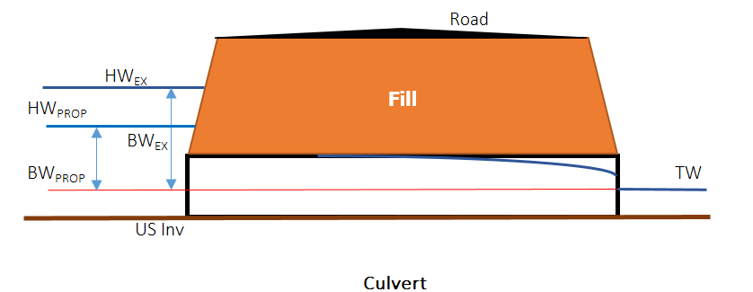
Calculating Backwater – Method 2
Existing backwater calculation
backwater depth = Q₁₀₀ HW elev. – (US inv. elev. + Q₁₀₀ TW depth)
Notes:
The second method to calculate backwater is the Q₁₀₀ headwater elevation minus the upstream invert elevation minus the Q₁₀₀ tailwater depth. This method is used to calculate backwater for existing culverts or proposed culverts when the inverts and tailwater depth are the same as the existing.

Slide 18
Calculating Backwater – Proposed
Proposed backwater calculation
backwater depth_{prop} = backwater depth_{ex} + (Q₁₀₀ HW elev._{prop} – Q₁₀₀ HW elev._{ex})
Notes:
The last method for calculating backwater is referred to as the proposed or relative backwater method. This method can be used for all proposed options, but is most critical to use when the inverts of the proposed structure change from the existing. This method was developed so a comparative backwater value could be obtained from culverts that had different elevations from the existing. It takes the backwater of the existing structure and adds the quantity of the Q₁₀₀ headwater elevation of the proposed structure minus the Q₁₀₀ headwater elevation of the existing structure. The sum is the proposed backwater depth.

Slide 19
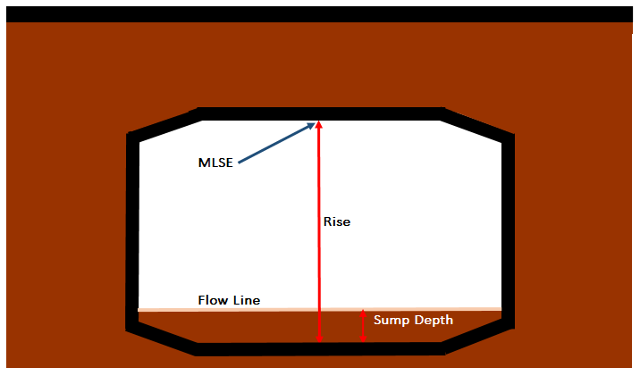
Minimal Low Structure Elevation
It is not necessary to specify the rise for three-sided or slab top culverts.
The minimal low structure elevation(s) should be included for all replacement proposals.
MLSE = DS flowline elev. – sump depth + rise (at the center of the culvert outlet)
Notes:
Another change to the memo is to include the minimal low structure elevation in the culvert properties table. It is also no longer necessary to specify the rise for three-sided or slab top culverts. Both of these changes were done to aid in eliminating any confusion regarding whether the specified rise was the total structural rise or hydraulic rise. The minimal low structure elevation should be included for all replacement proposals and measured at the center of the culvert at the downstream flowline. To calculate it, take the downstream flowline elevation minus the sump depth plus the rise.

Slide 20
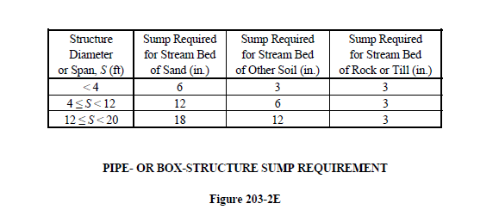
Sumping Requirements
Pipe and box sumping requirements
  IDM Figure 203-2E
Replacement structures that convey Waters of the State & Waters of the US should be sumped.
Sumping is no longer required for three-sided culverts.
Notes:
The last row in the culvert properties table is for sump depth. For pipe and box sumping requirements there is an IDM figure that specifies the necessary depth, which depends on the span of the structure. This is IDM figure 203-2E. All replacement structures that convey Waters of the State and Waters of the U.S. should be sumped except for three-sided culverts. This rule could change in the future, but as of now it is still a requirement.

Slide 21
Question #3
The backwater calculation below should be used when?
backwater depth_{prop} = backwater depth­_{ex} + (Q₁₀₀ HW elev._{prop} – Q₁₀₀ HW elev._{ex})
A) Never
B) For culverts being lined
C) When the culvert inverts of the proposed are different from the existing
D) Answers B and C
Answer: D

Slide 22
Question #4
True or false? Three-sided structures should be sumped a minimum of 12 inches below the flowline?
Answer: False
Three-sided structures are not required to be sumped at all.

Slide 23
Memorandum Body/Narrative
Briefly discuss existing conditions
  Existing size
  location
  Regulated drain
  Channel conditions
Discuss pertinent analysis
  Method for obtaining discharge (Rational, Unit hydrograph, IDNR, etc.)
  Tailwater method (channel, constant, or zero tailwater depth)
  Joint probability (if used)
  Design-storm frequency (IDM Figure 203-2C) requirements
  Modeling method or software used
Discuss special conditions or requirements
  Special inlet configuration (headwall required, or inlet depression)
  Sumping requirements
  Grade changes
  Change in invert elevations
Notes:
For the body or narrative section of the memo, briefly discuss the existing conditions, pertinent analysis, and any special conditions.
For the existing conditions, include the existing size, location, if it is or is not a regulated drain, and channel conditions.
It is also helpful to have information about the analysis used to design the culvert. This could include the method for obtaining discharge; examples of methods used might include the rational method or an IDNR determination. Another thing that should be included is the method used to obtain the tailwater condition. Was a surveyed channel section used to calculate the Q₁₀₀ depth, or is the culvert in a zero tailwater condition? If joint probability was used in the analysis, indicate what your design storm exceedance probability is. Lastly, what software was used?
It is important to discuss any special conditions or requirements. These could include special inlet configurations, such as an inlet depression or a beveled edge headwall. Are there any special sumping requirements? This could include extra sump to meet minimum cover requirements or no sump due to the structure not requiring it. Also, are there are any grade changes, channel modifications, or changes to the invert elevations?

Slide 24
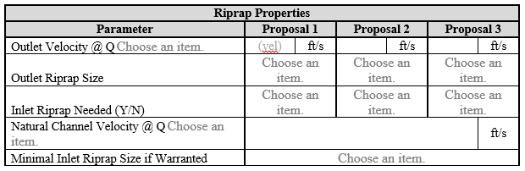
Riprap Design
Notes:
The first line in the riprap properties table is where to enter the outlet velocity for each of the proposals. Which outlet velocity to select can be found in IDM Figure 203-2C.

Slide 25
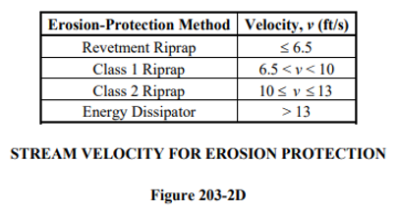
Riprap Design – Outlet and Tailwater Velocities
Notes:
The actual number that should be entered into the table can be found directly in HY-8 in the second to last column. The selected outlet velocity determines what type of riprap to use at the outlet, so once the velocity is obtained, refer to IDM Figure 203-2D for the riprap type.
The next line in the table is where to indicate whether or not riprap is needed at the inlet. Generally speaking, riprap is needed at the inlet for three-sided structures and boxes, but even if the proposed structure is not one of those two shapes, inlet riprap may still be needed. The inlet riprap type is determined by the natural channel velocity, in other words the tailwater velocity. That velocity can be found in the last column of the culvert summary table, and just like with the riprap at the outlet, use IDM Figure 203-2D to determine what riprap type to use.
It should be noted that IDM Figure 203-2D states that if the outlet velocity is greater than 13 ft/s, an energy dissipator is required. The dissipator can be designed directly in HY-8.

Slide 26
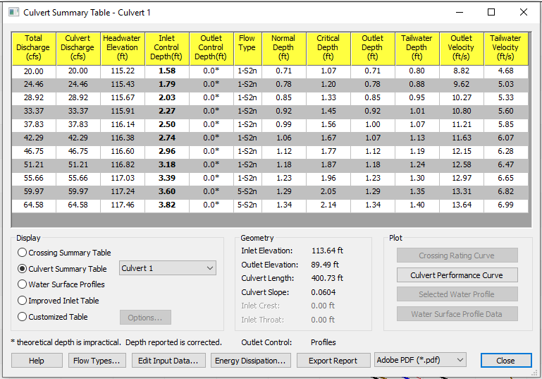
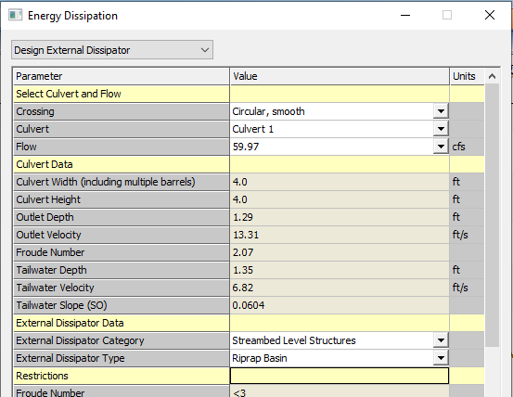
External Energy Dissipator
Notes:
Click on “energy dissipation” at the bottom of the culvert summary table window, and HY-8 will bring up a new window to design the energy dissipator.
Make sure the dropdown at the top of the window reads “design external dissipator.”
Select “streambed level structures” for the external dissipator category.
Select “riprap basin” for the external dissipator type.
There are instances where a riprap basin is not sufficient for the proposal. It is unusual, but if that is the case, consider using an alternate form of an energy dissipator, such as a contra costa. The remainder of this example is for a riprap basin.

Slide 27
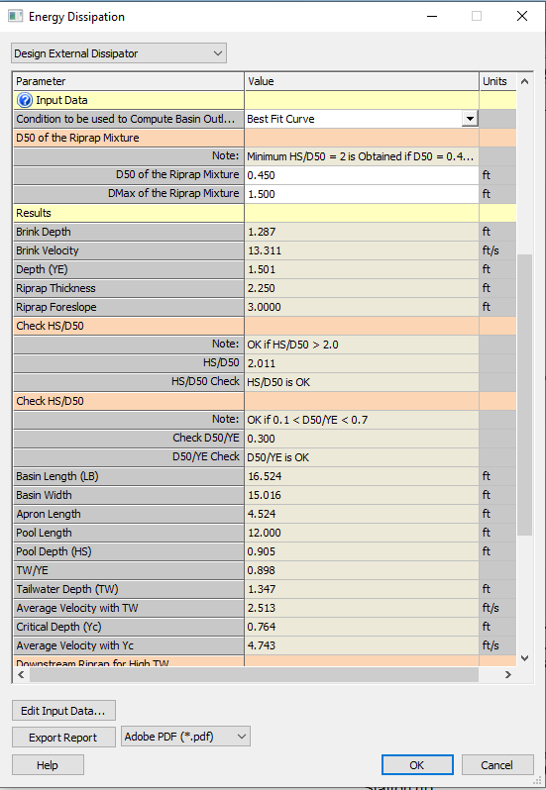
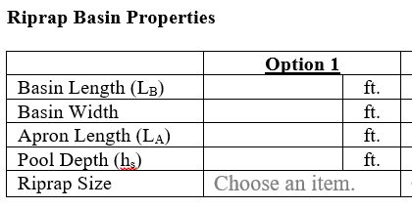
External Energy Dissipator
Notes:
This is a view of the same window shown in the previous slide just further down.
After selecting “riprap basin,” enter the D₅₀ and D_{Max} dimensions. A good starting point for the D₅₀ dimension is 0.75’ - 1.00’ to represent revetment riprap. If an error message appears after entering a value, that is not necessarily a bad thing. That is HY-8 indicating the value entered for D₅₀ is too large, and the program will adjust it to the appropriate value. If no error message appears, move up to the next size of riprap. Start with revetment riprap, and move up in size to Class 1 and Class 2 as needed. Once the correct size riprap has been determined, enter the corresponding D_{max} value.
Once those values have been entered, HY-8 will display the dimensions needed for the energy dissipator further down in the window. Those values can be copied directly into the riprap basin properties table in the memo. Round the dimensions up to the nearest half foot.

Slide 28
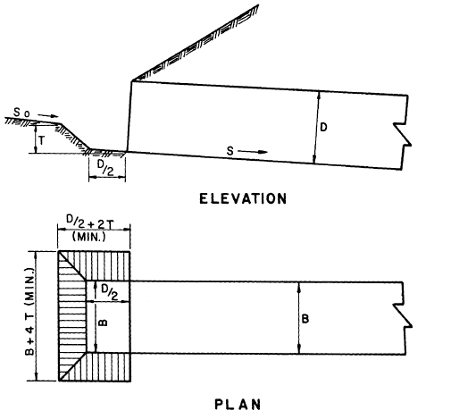
Inlet Depression
HDS 5 – Figure 3.5 Culvert with Inlet Depression
Inlet Depression Properties Table
Parameter | Inlet Depression Properties
Replacement Option | Option #1 |  | Option #2 |  | Option #3 |  | Option #4
T | User Def | ft |  | ft |  | ft |  | ft
D | Rise | ft |  | ft |  | ft |  | ft
B | Span | ft |  | ft |  | ft |  | ft
D/2 (apron) | Calc 1 | ft |  | ft |  | ft |  | ft
B + 4T (total width) | Calc 2 | ft |  | ft |  | ft |  | ft
D/2 + 2T (total length) | Calc 3 | ft |  | ft |  | ft |  | ft
Total Crest Width | Calc 2 + 2(Calc 3) | ft |  | ft |  | ft |  | ft
Riprap Class | Choose an item. |  | Choose an item. |  | Choose an item. |  | Choose an item.
Include both the figure and completed table in the memorandum if proposing an inlet depression. Otherwise delete it.
Notes:
The new memo template includes a section for inlet depressions. If an inlet depression is not needed, remove this section. If you do design an inlet depression for one or more of the proposals, the table must be filled in, and the table and figure should be included in the finished memo. The data that is needed for the inlet depression properties table are:
Depression depth, T
Structure rise, D
Structure span, B
Size of the depression apron, D/2
Total width of the inlet depression, B+4T
Total length of the inlet depression, D/2 + 2T
Total crest width or perimeter, which is the sum of the total width and the total length
Class of riprap to be used for the inlet depression

Slide 29
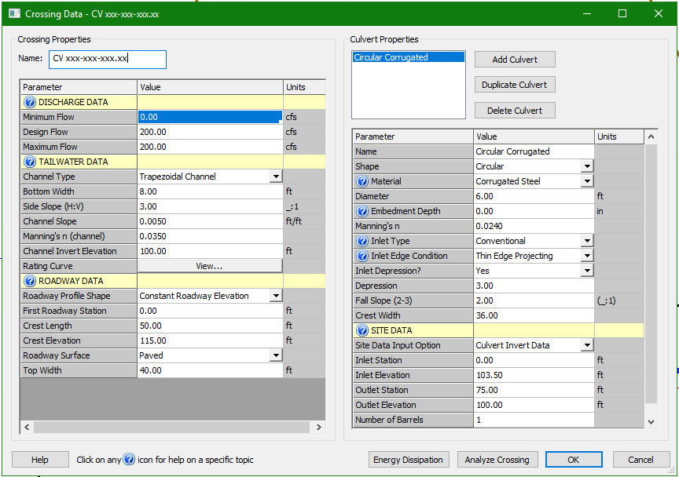
Inlet Depression Inputs – HY-8
Select “yes” for “Inlet Depression?”
Type in the depression depth.
Type in the fall slope (2:1 - 3:1).
Type in the crest width (total crest width from the table).
The inlet invert elevation should be the intended invert plus the height of the depression.
HY-8 Culvert Hydraulic Analysis program v 7.2
Notes:
The inlet depression can be designed in HY-8. To do this, select “yes” in the dropdown for “Inlet Depression?” This will add a few more input parameters that are needed for the design. Next input the depression depth and then the fall slope of the depression sides. This value must be between 2:1 and 3:1; only slope ratios between 2:1 and 3:1 will be accepted by HY-8. The total crest width needs to be indicated in feet, and this is dependent, as we saw from the calculations section, on the pipe size. Therefore, this is an iterative process because as the structure size changes, the inlet depression dimensions need to, as well. When designing an inlet depression in HY-8 the inlet invert must be modified. The inputted invert elevation must be the intended invert elevation plus the depression depth. If you fail to do this, the output will not be correct.

Slide 30
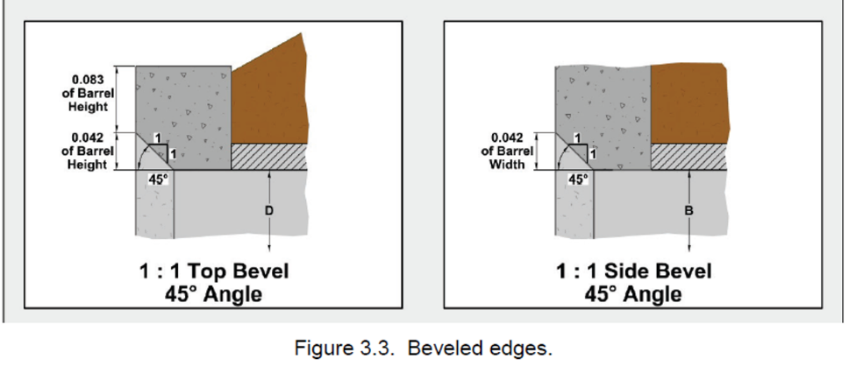
Beveled Edge Headwall Detail
Include the detail and source whenever a beveled edge headwall is proposed.
The included detail is for a 1:1 bevel.
The figure is not required for a square edge headwall.
Source: J. D. Schall, Hydraulic design of highway culverts, 3rd ed. Washington, D.C.: U.S. Dept. of Transportation, Federal Highway Administration, 2012. Pg. 3.5, Fig. 3.3
Notes:
If you include a beveled edge headwall for any of the proposals, the included beveled edge headwall detail should be included in the memo. The detail and source information are included in the template. The detail is for a 1:1 beveled edge headwall, so if a headwall bevel other than 1:1 is proposed, make sure to include the proper documentation for detailing the configuration. If there are not any beveled edge headwalls proposed, the figure and source should be removed from the final draft of the memo.

Slide 31
Question #5
At what outlet velocity is an energy dissipator required?
A) Velocity ≥ 10 ft/s
B) Velocity > 10 ft/s
C) Velocity ≥ 13 ft/s
Velocity > 13 ft/s
Answer: D

Slide 32
Question #6
What structures require inlet riprap based on shape alone?
A) Only three-sided structures
B) Three-sided structures and boxes
C) Three-sided structures and structures with a span ≥ 8 feet.
None
Answer: B

Slide 33
Question #7
When designing an inlet depression using HY-8 the intended fall slope must be?
A) Any slope ratio the designer desires
B) Equal to or between 2:1 and 3:1
C) Equal to or between 3:1 and 4:1
Equal to or between 1:1 and 3:1
Answer: B

Slide 34

Contact Information
Notes:
The contact information is the last part of the memo. No changes were made to this section since the most recent update of the memo.
Leave this section as it is because the contact information that is supposed to go in there is that of the INDOT reviewer.

Slide 35
Thank You
Access the new memo template and instructions on the hydraulics website.
https://www.in.gov/indot/3595.htm

