Slide 1

ONLINE FILING
Updates and Review
INDIANA LOBBY
REGISTRATION COMMISSION

Slide 2
Overview
MOU Changes
Registrations
Activity Reports
Terminations
Gift/Purchase Reports
Signatures

Slide 3
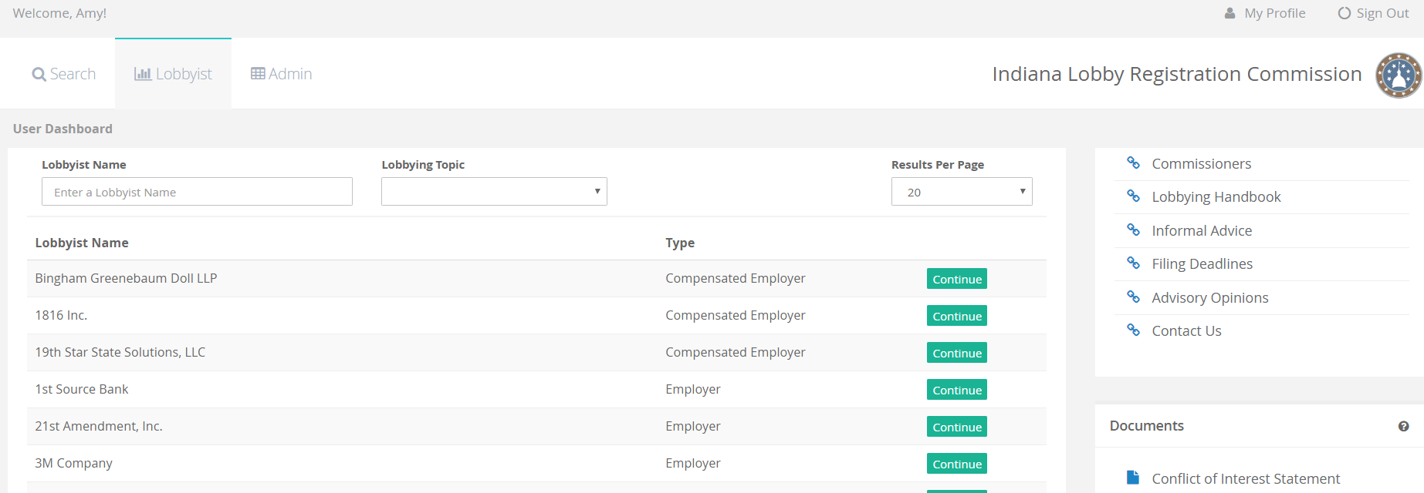
Lobbyist Dashboard

Slide 4
Lobbyist Dashboard
Current system uses a drop down box to provide filing options.

Slide 5
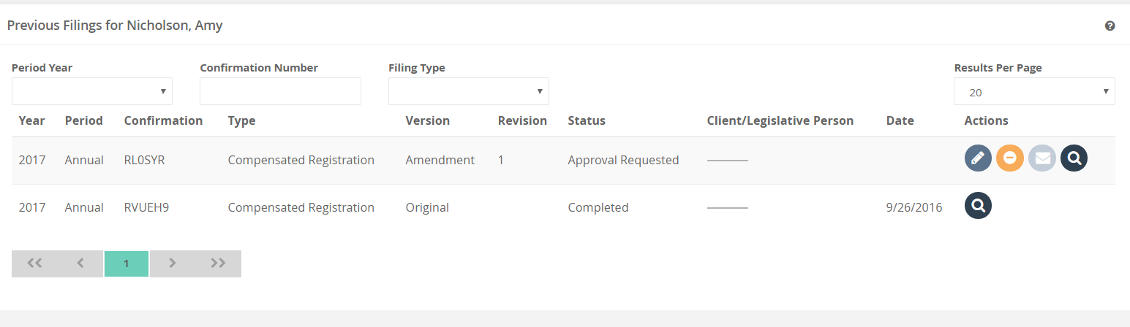




NEW!!
NEW FUNCTIONS
EDIT
EMAIL
CANCEL
VIEW

Slide 6
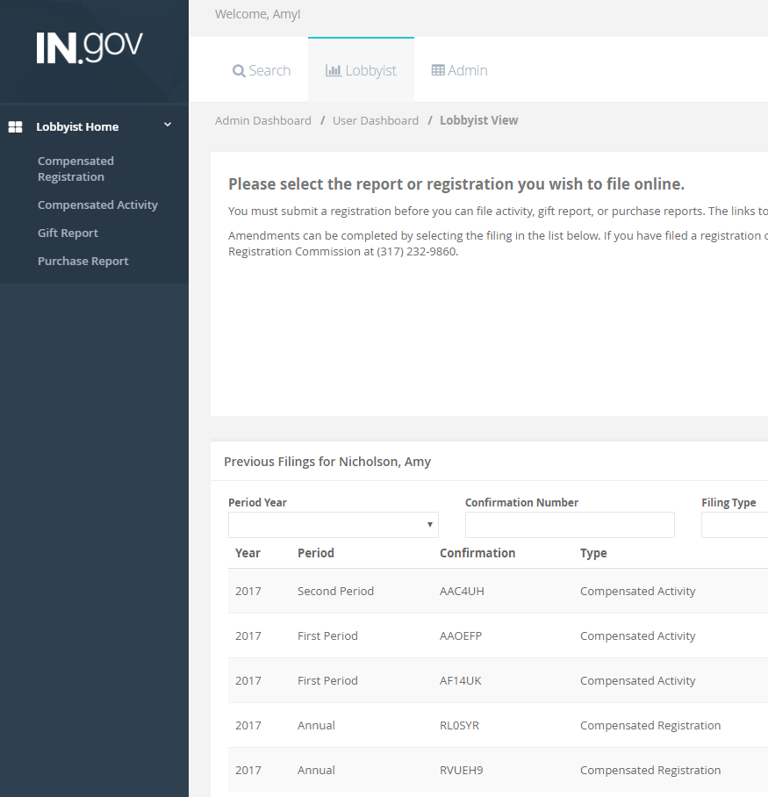
`
**New filings use the left navigation options.
**All amendments are done using the list below

Slide 7
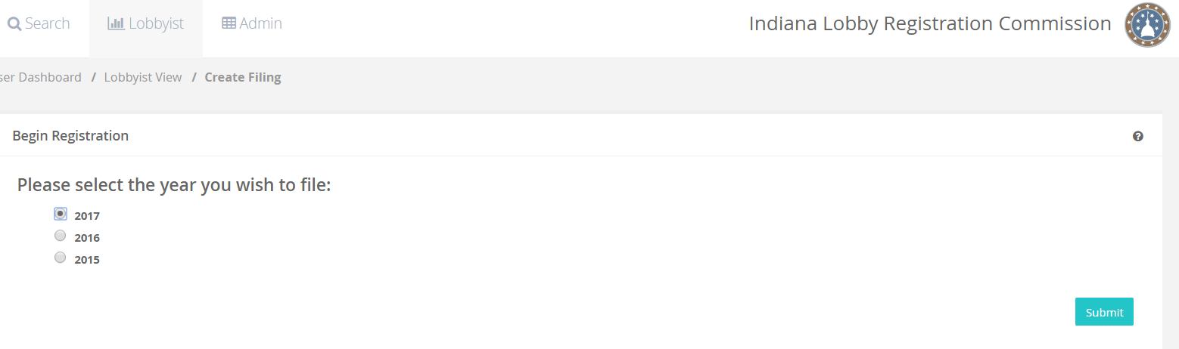
Please note the “lobbying start date” is no longer available in the user experience.
**The contract start date is now obtained on the Memorandum of Understanding (MOU) filed by each lobbyist. The lobbyist will have fifteen (15) business days to registration from the date on the MOU.
Memorandum of Understanding is located on the ILRC homepage:
1. MOU-Filing on your own behalf
2. MOU-In-house preparer
3. MOU-Company filings prepared by a 3rd Party
4. MOU-Individual filings prepared by a 3rd Party
**MOU’s can be faxed or mailed to the ILRC—do not accept filing via email.

Slide 8
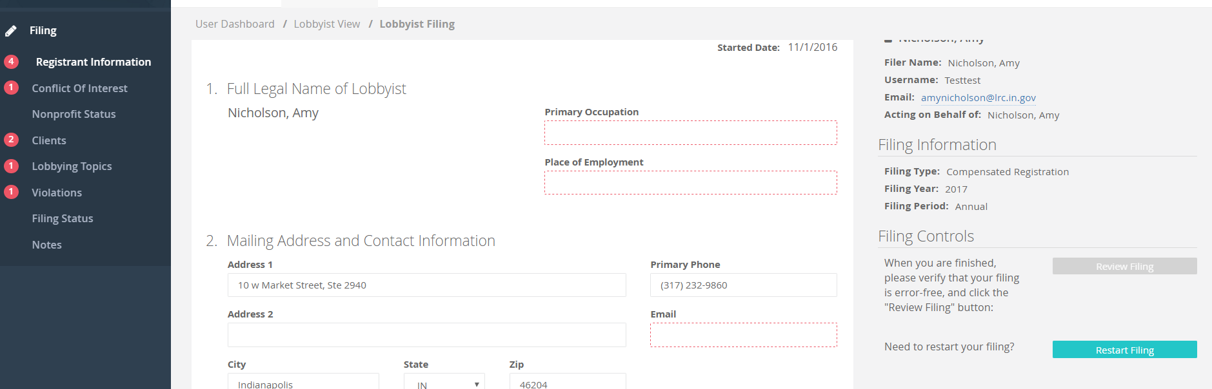
Registrations
Compensated Lobbyist Registration
MOU Start Date
APPROVER email address

Slide 9
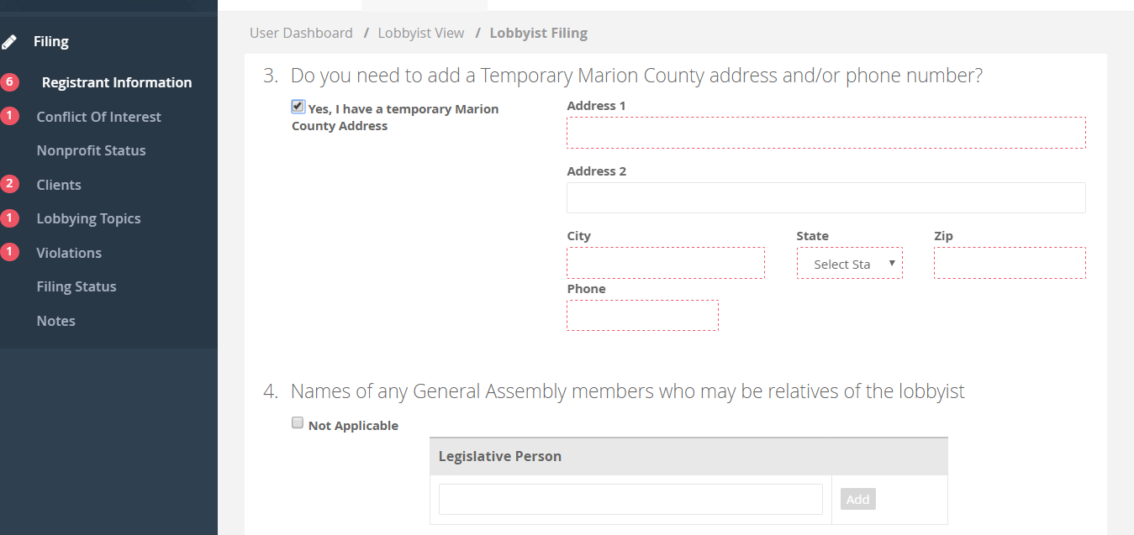
Registrations
Compensated Lobbyist Registration

Slide 10
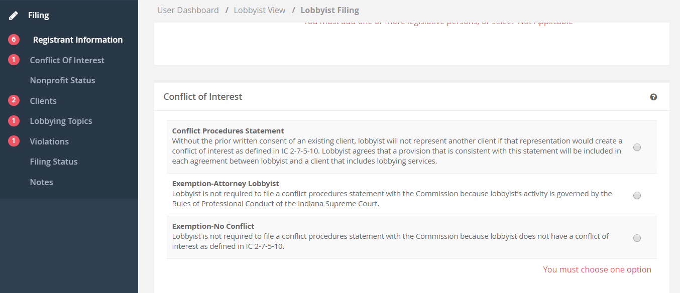
Registrations
Compensated Lobbyist Registration
Must clear all validation errors before the filing can be completed.

Slide 11
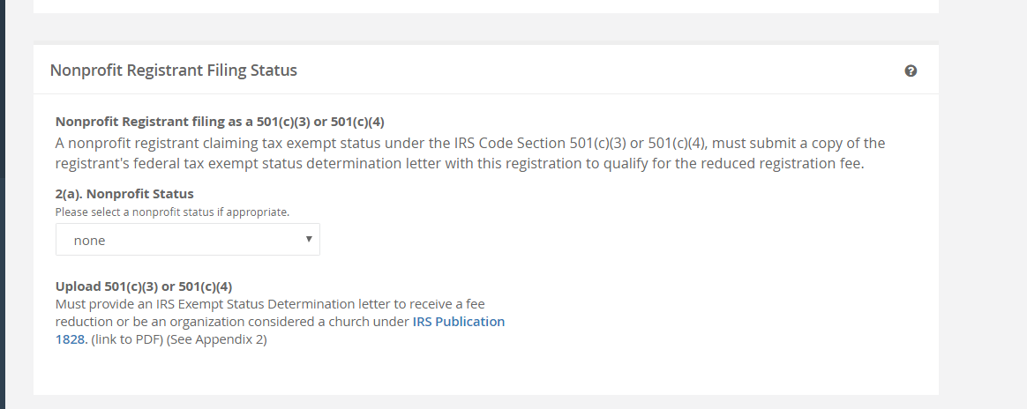
Compensated Registrations
To receive a registration fee reduction you must upload the appropriate documentation for 501c3 or 501c4.

Slide 12
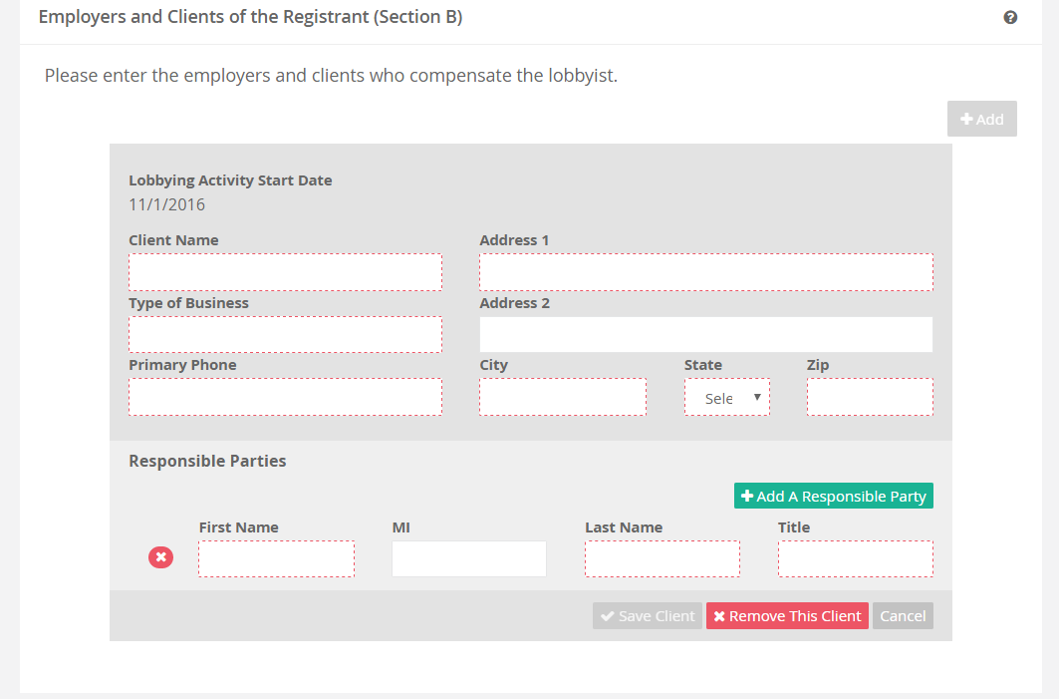
Registrations
Compensated Lobbyist Registration
**Start date will default to 11/1 for annual registrants

Slide 13
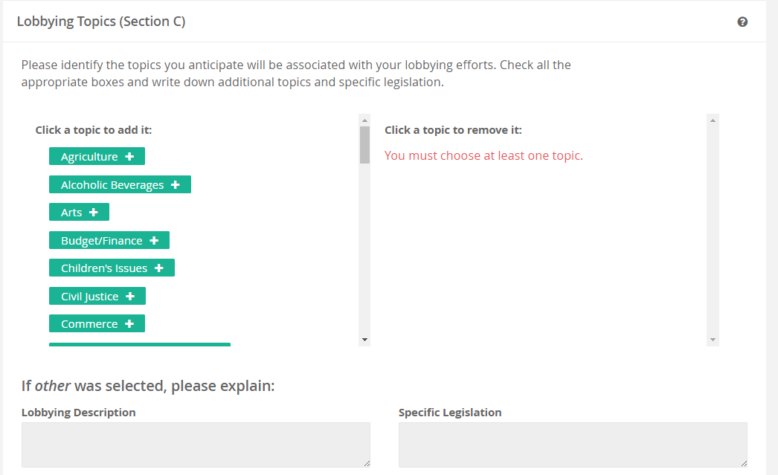
Registrations
Compensated Lobbyist Registrations

Slide 14
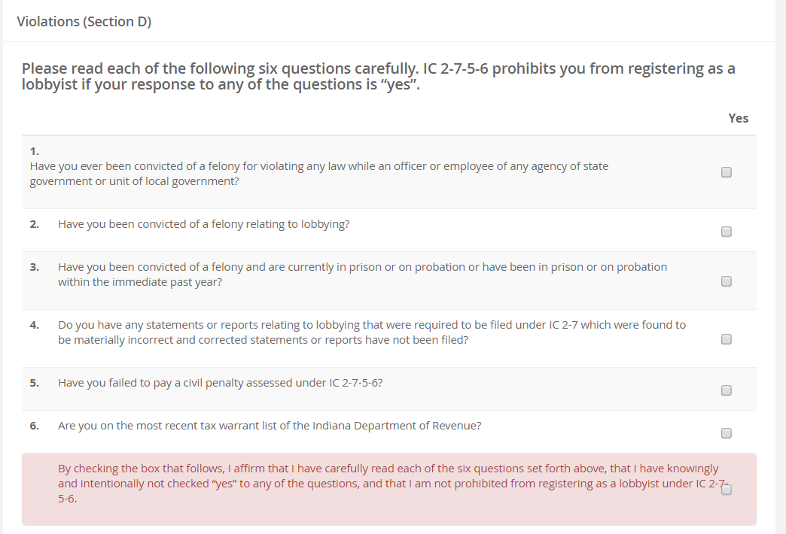
Registrations

Slide 15
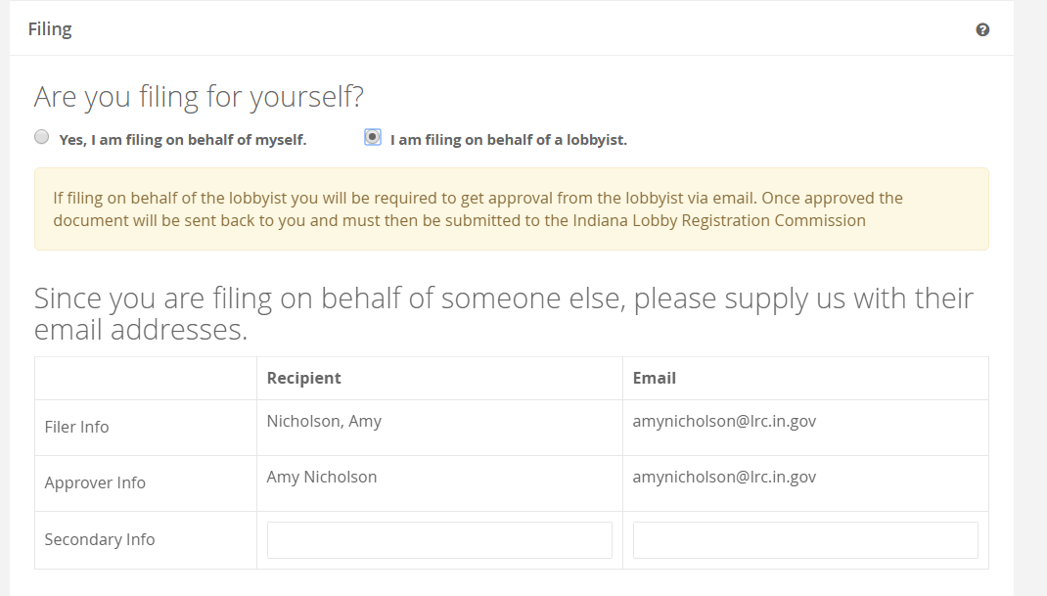
Registrations

Slide 16
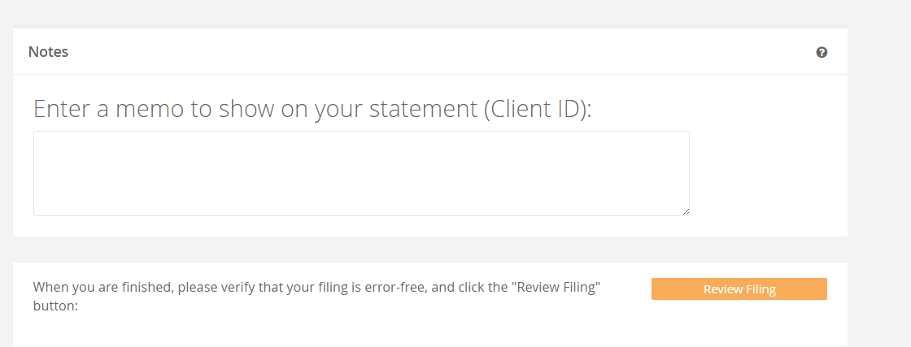
Registrations
Select “Review Filing” when all validation errors have been cleared

Slide 17
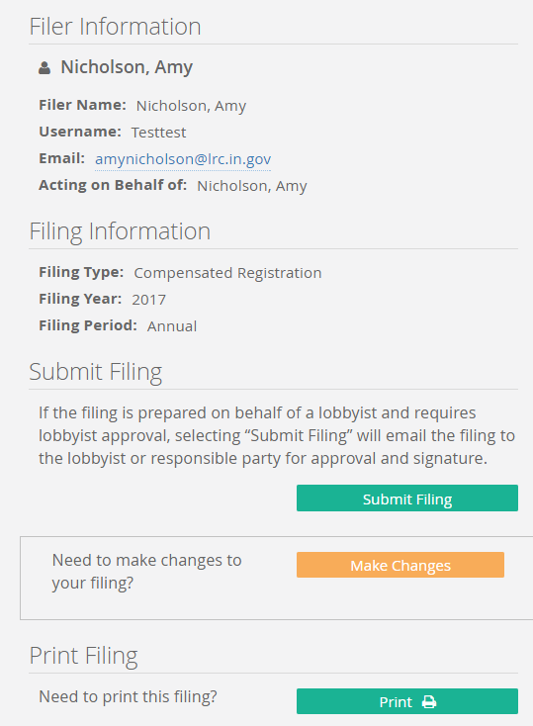
Signature
NOTE: Signature section of filings has been changed. The preparer will no longer be able to sign the filings when filing on behalf of the lobbyist. The signature section has been moved to the email portion sent to the lobbyist for approval.

Slide 18
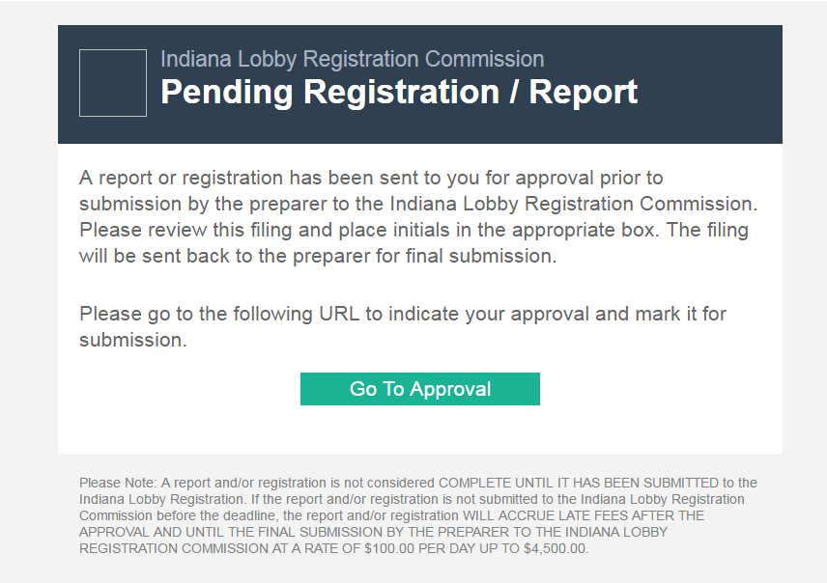
Email to Approver

Slide 19
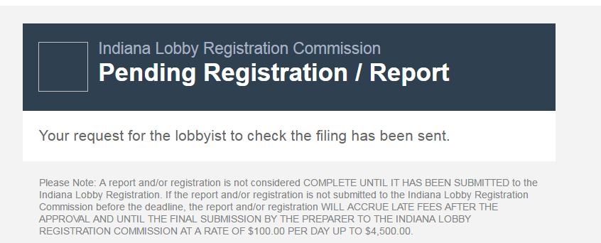
Email to Preparer

Slide 20
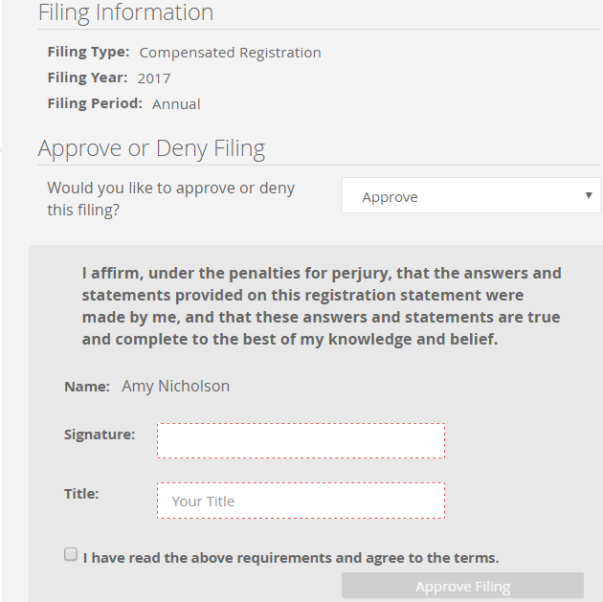
Signature Section: You will now be required to type the name exactly as it appears in the signature line.

Slide 21
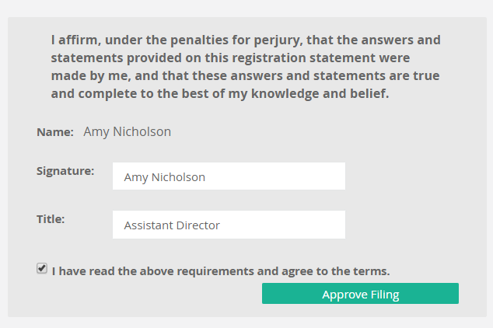
Once you select “approve” and the signature box matches the prefilled name, you will be able to select APPROVE FILING

Slide 22
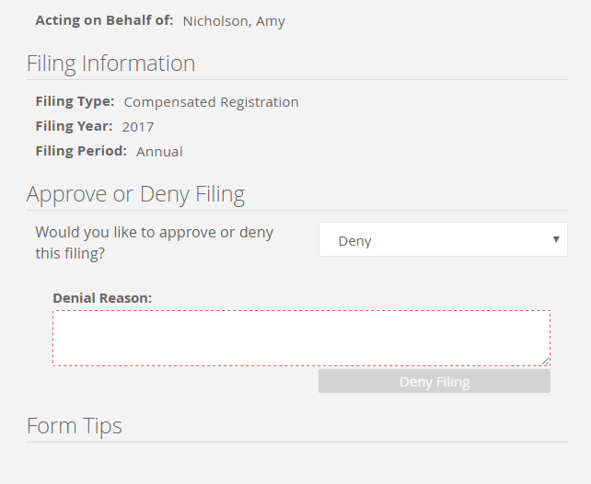
If additional changes are needed, the approver should select “deny” and insert the changes the preparer must make.

Slide 23
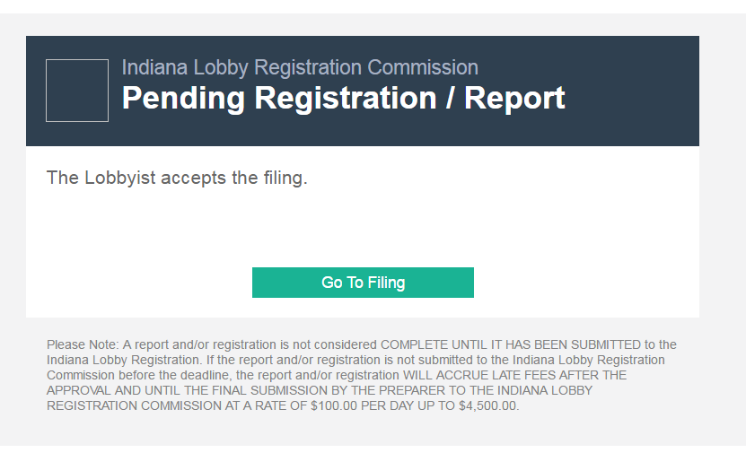

Slide 24
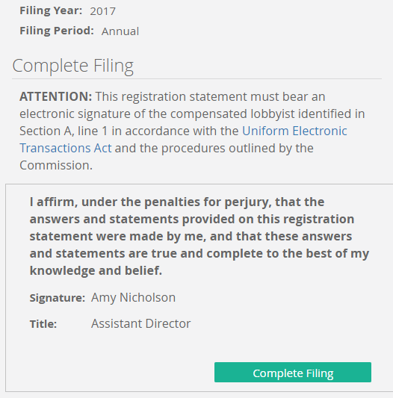
FINAL STEP: In order to be considered complete, the final step to filing a report or registration on behalf of the lobbyist is to open the link sent to the preparer and select “Complete Filing”

Slide 25
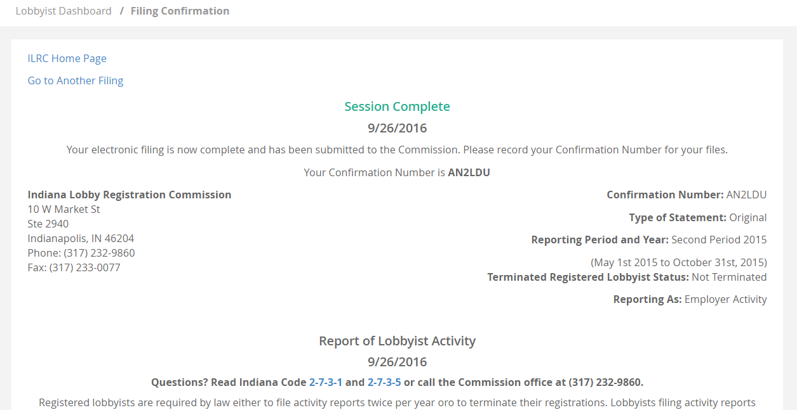
Upon final submission to our office you will see “Session Complete” at the top of the filing in GREEN

Slide 26
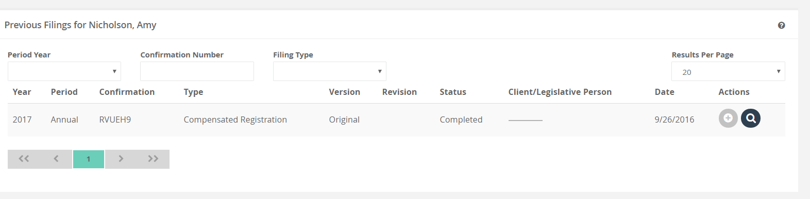
Amending Compensated Registrations
The plus sign indicates the filing which is available for amending.

Slide 27
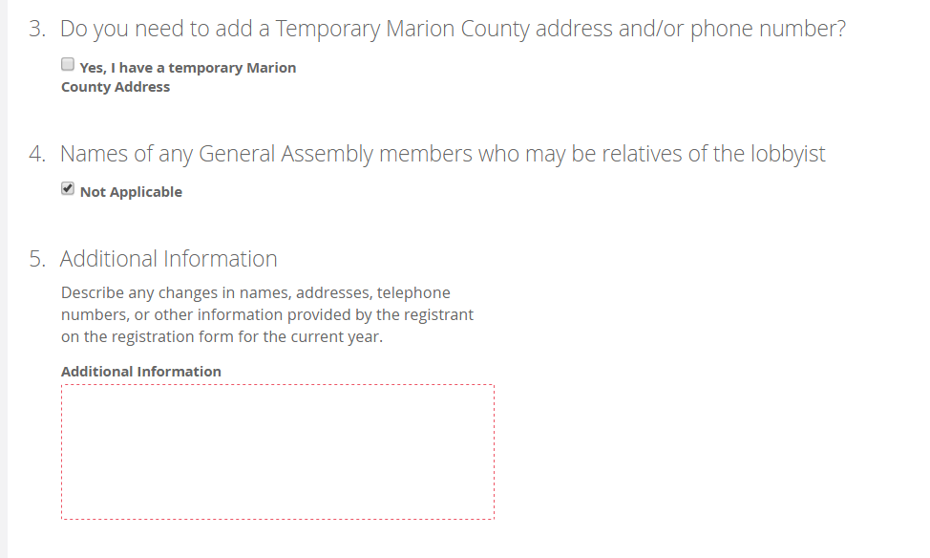
Amending Compensated Registration
REQUIRED: You must enter the information you are amending on the registration.

Slide 28
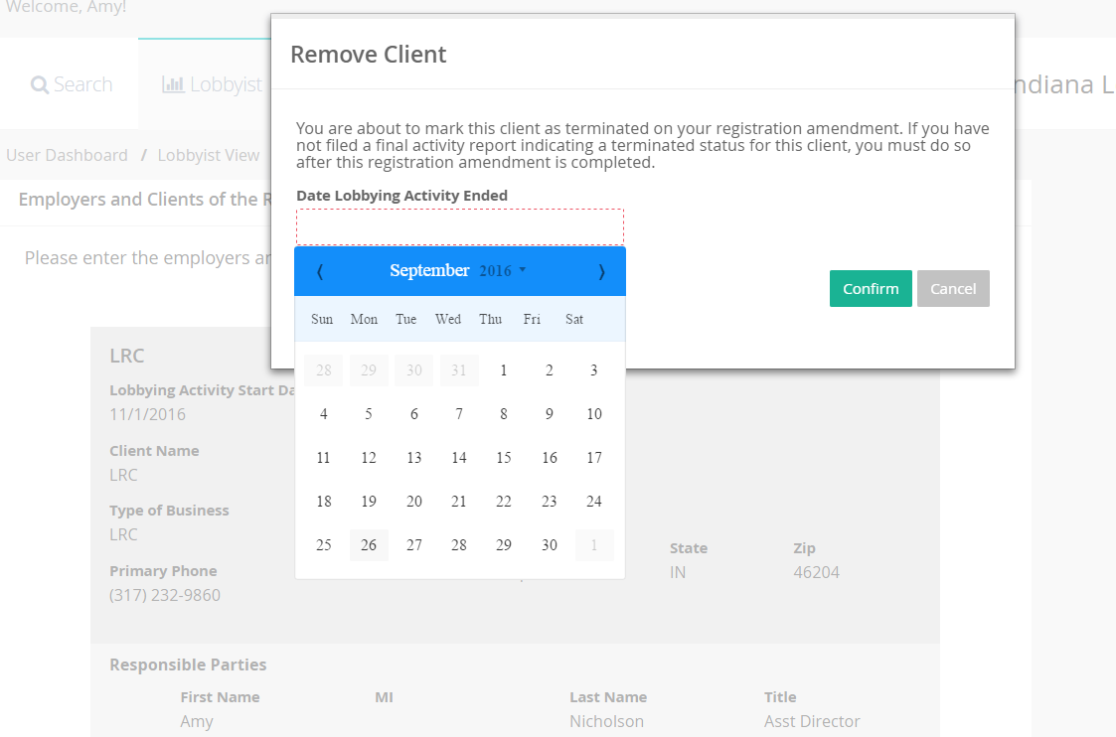
NEW FEATURE
Selecting “Remove this Client”

Slide 29
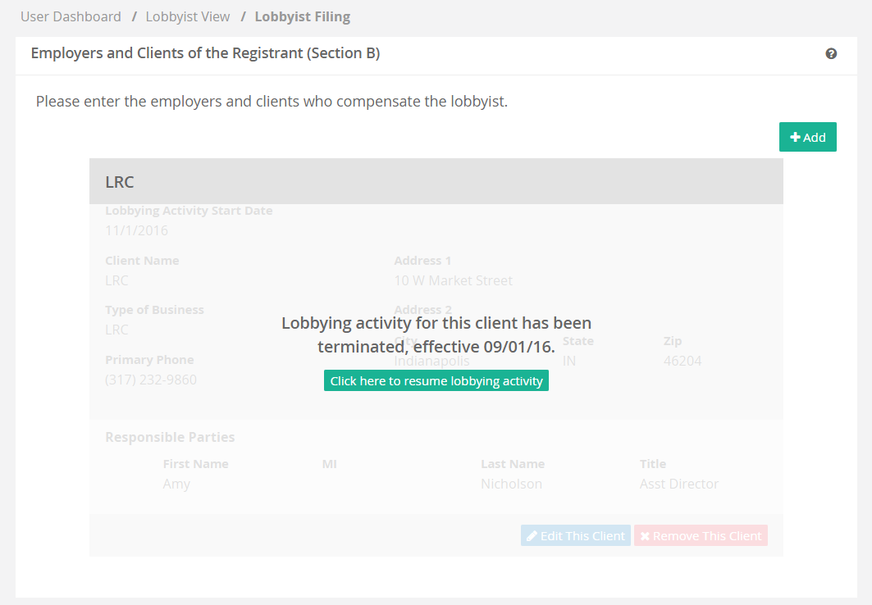
NEW FEATURE
If the client signs a new contract you will select “resume lobbying”
Information is visible to the preparer but will NOT print on the public view.

Slide 30
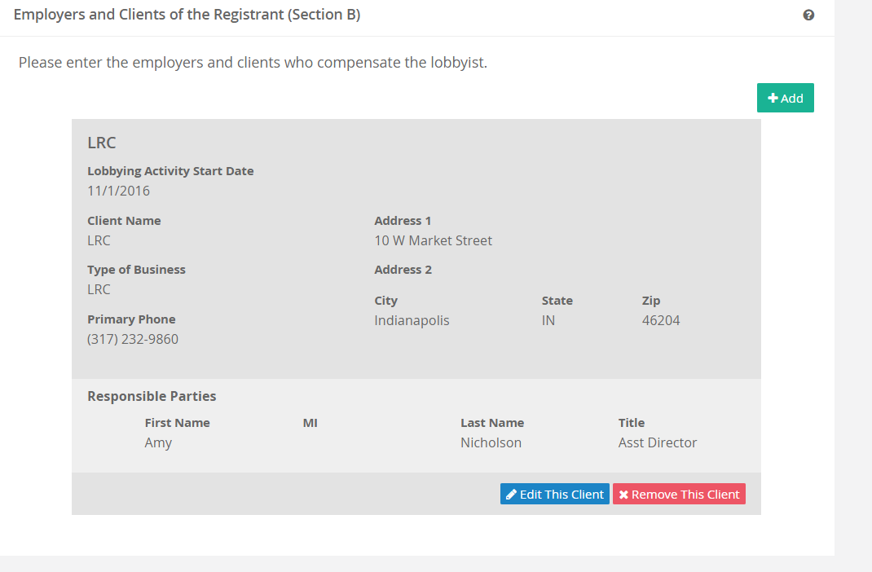
Amendments
The client information appears on the registration again.

Slide 31
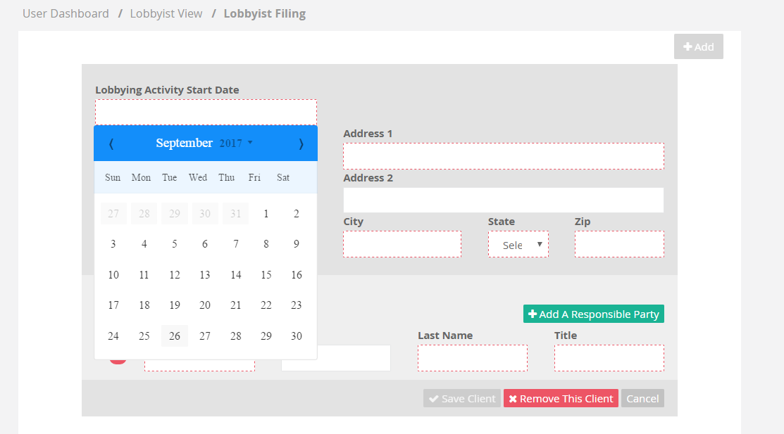
Adding a new client
NEW FEATURE: Lobbying Start Date

Slide 32
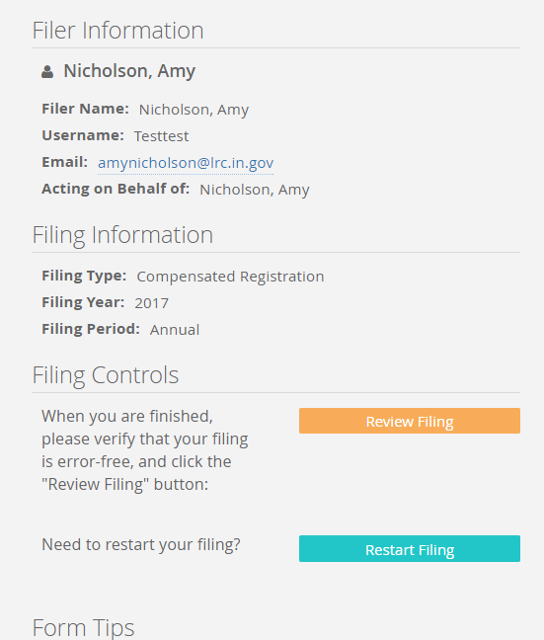
After all amendments have been complete, you will select “Review filing” and complete the filing or “Restart Filing” to erase changes.

Slide 33
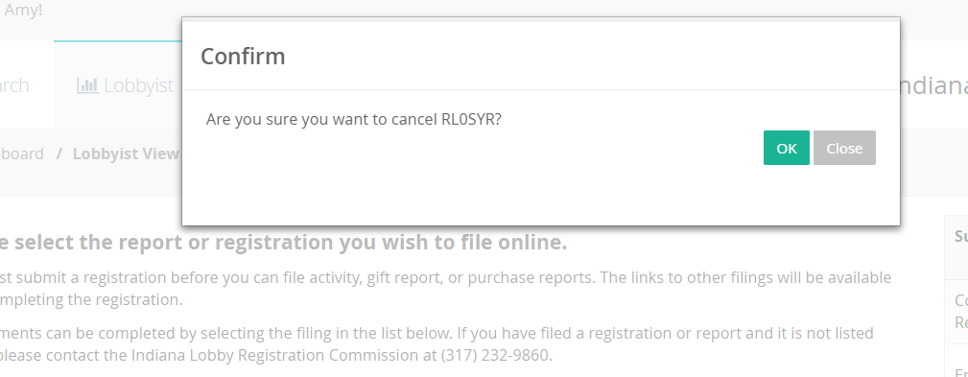
New Feature-CANCEL

Slide 34
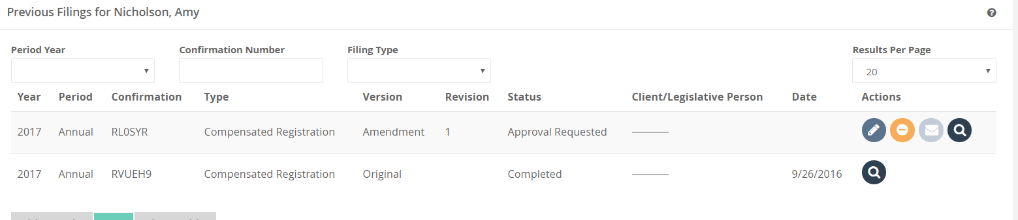
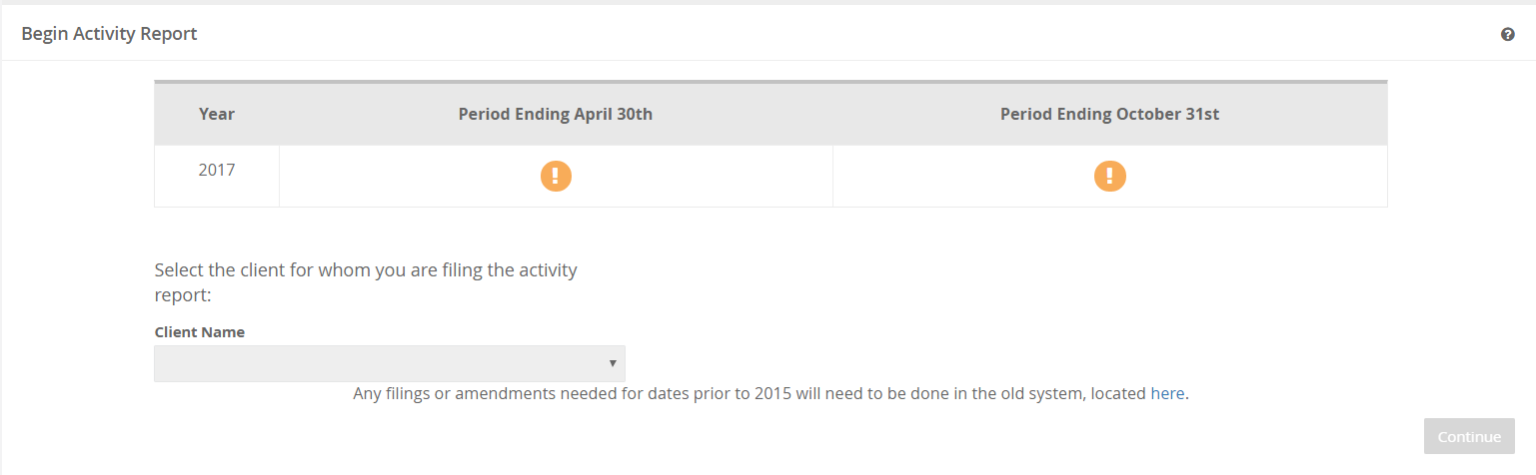
NOTE: NEW FEATURE—You will NOT be able to start an activity filing until all the PENDING registrations for the period have been completed.
The symbol above indicates there is a registration issue preventing you from accessing the filings.

Slide 35
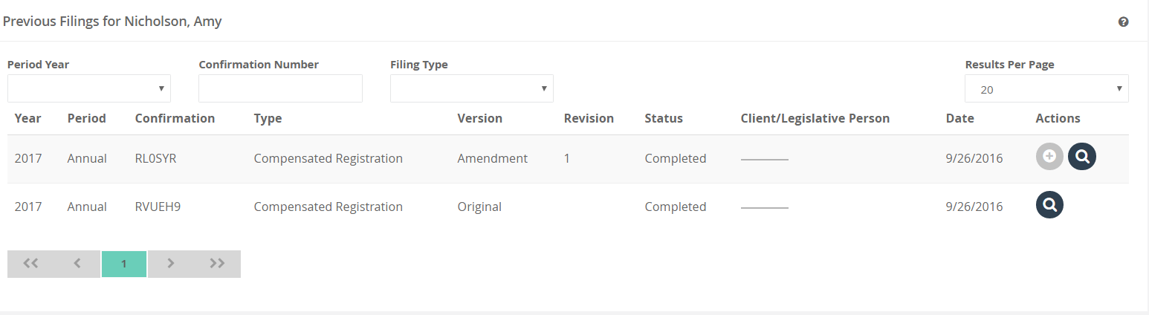
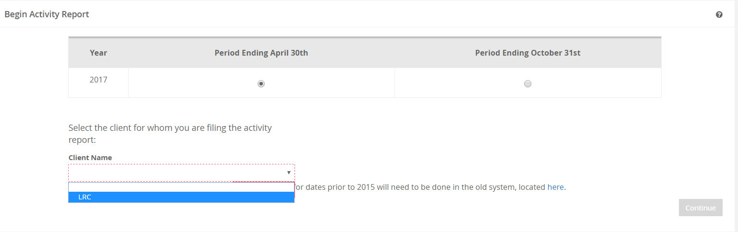
Once you have submitted the pending filing you will see the screen below indicating available reports.

Slide 36
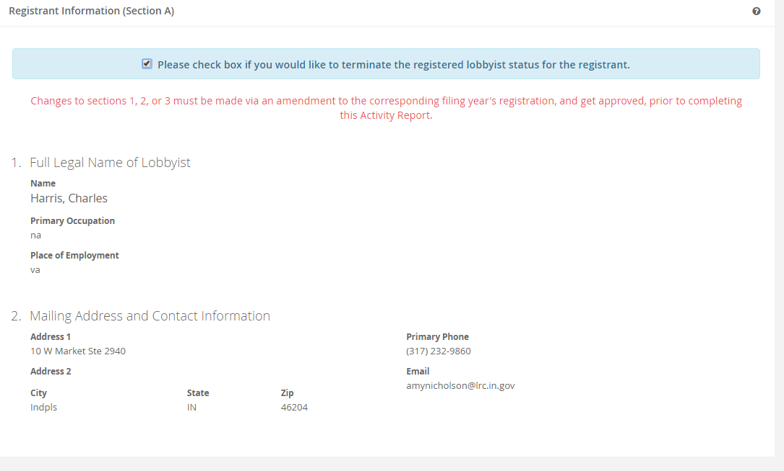
Compensated Activity Reports

Slide 37
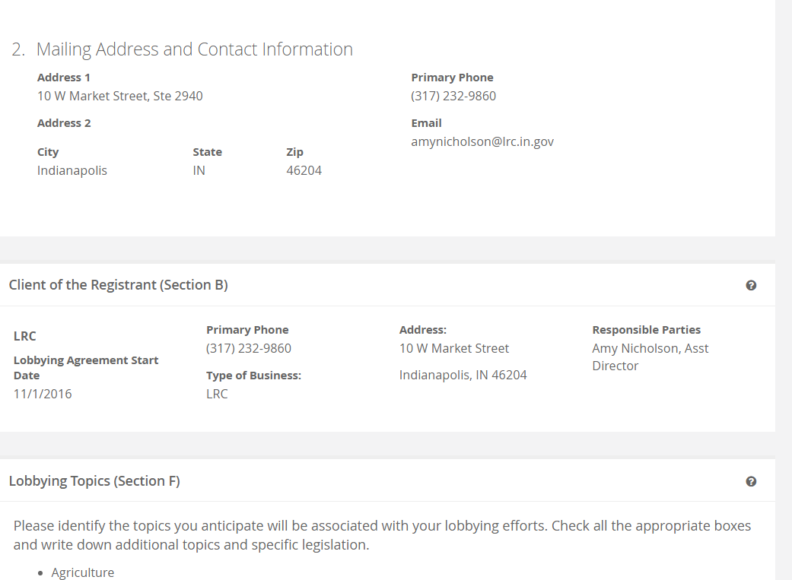

Slide 38
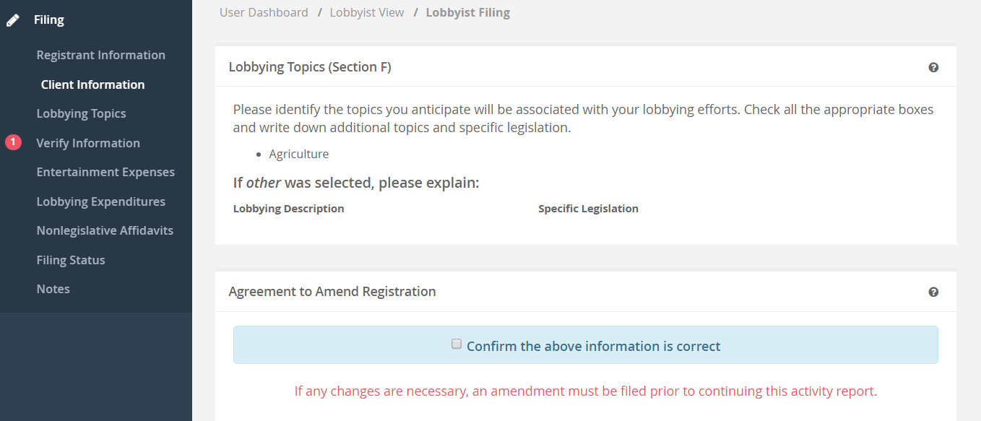
You must verify all information is accurate. Any changes must be made on the registration statement

Slide 39
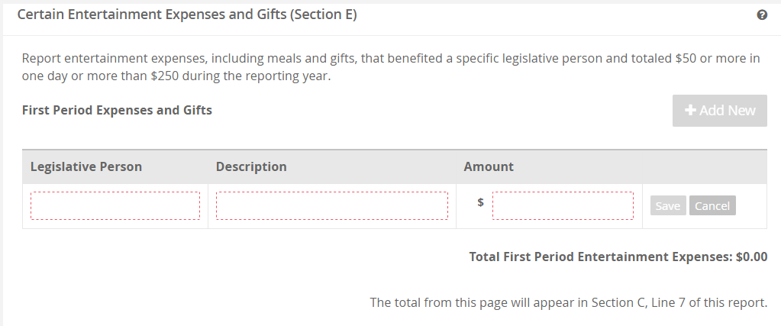
Section E-Activity Report

Slide 40
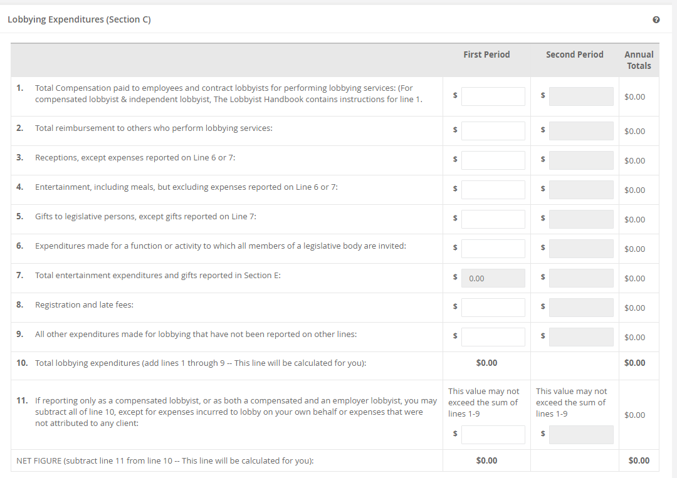

Slide 41
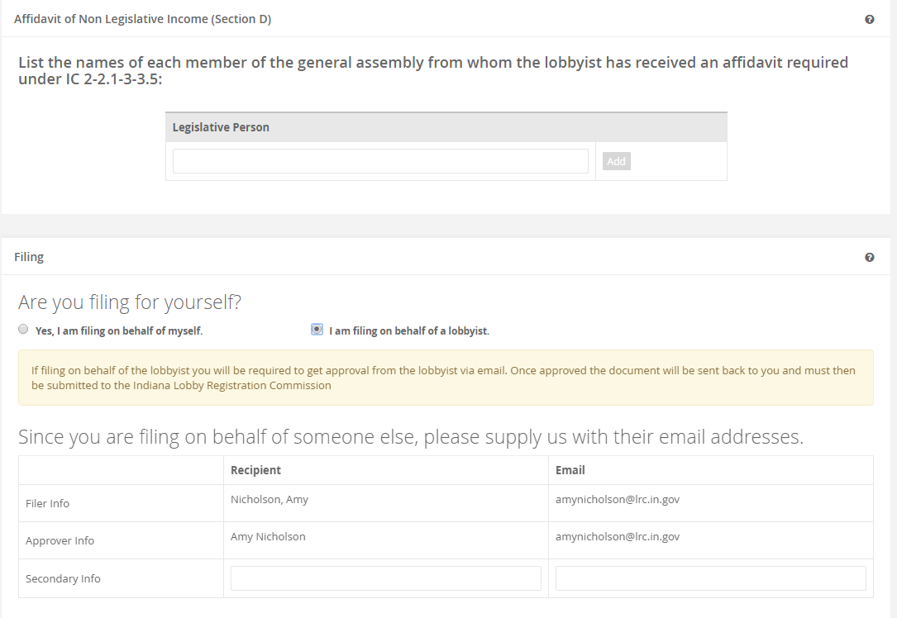

Slide 42
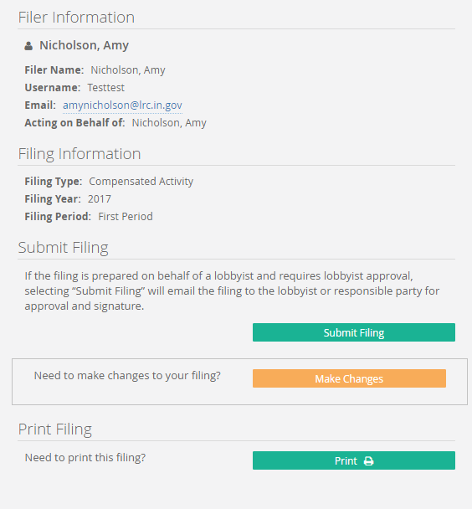
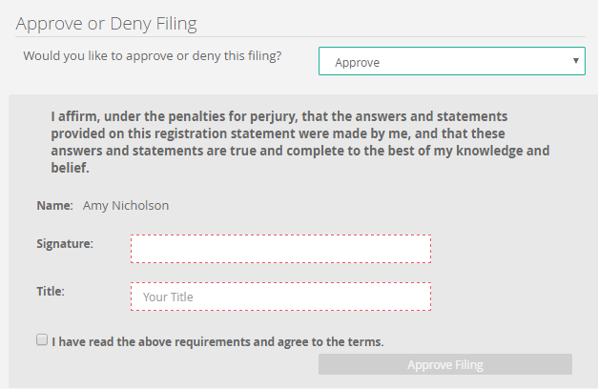
Approval process for activity reports is the same as the registration

Slide 43
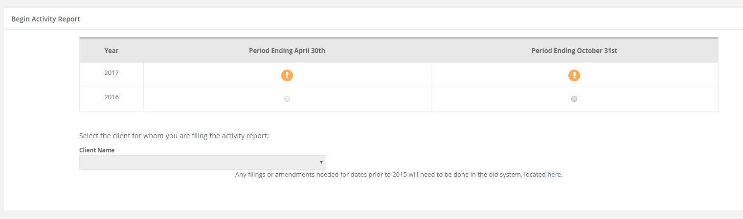
This will appear if you have a registration pending, you will need to finalize the most recent registration before attempting to file the report.

Slide 44
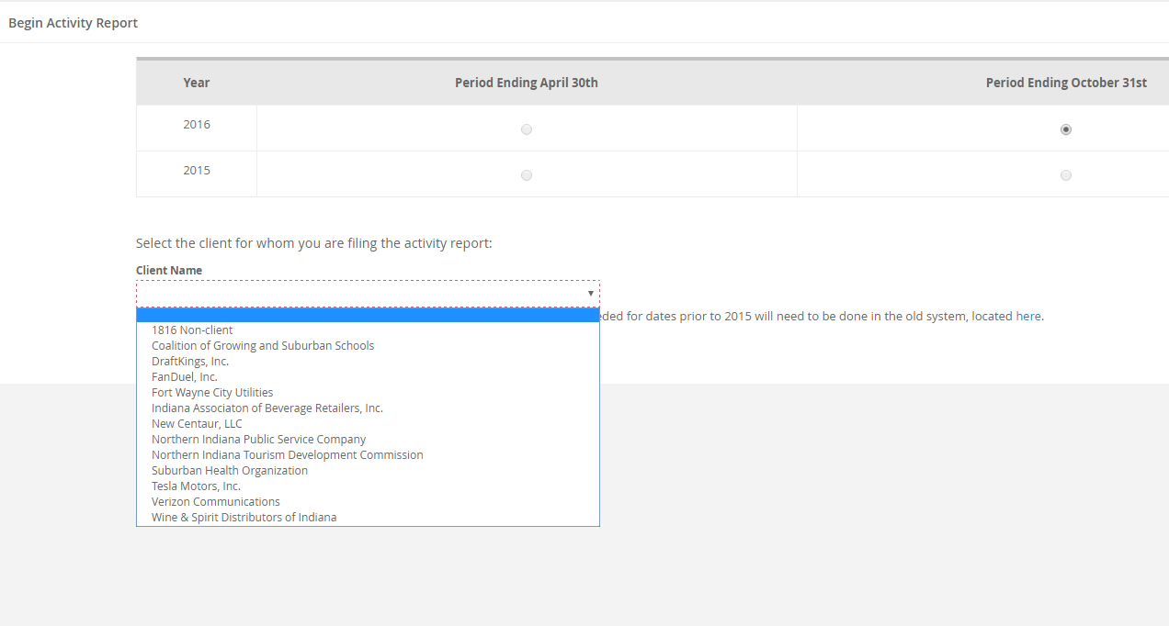
A lobbyist filing multiple compensated reports will see the clients in the list that NEED to be filed. Once filing is complete the client is removed from the list.

Slide 45
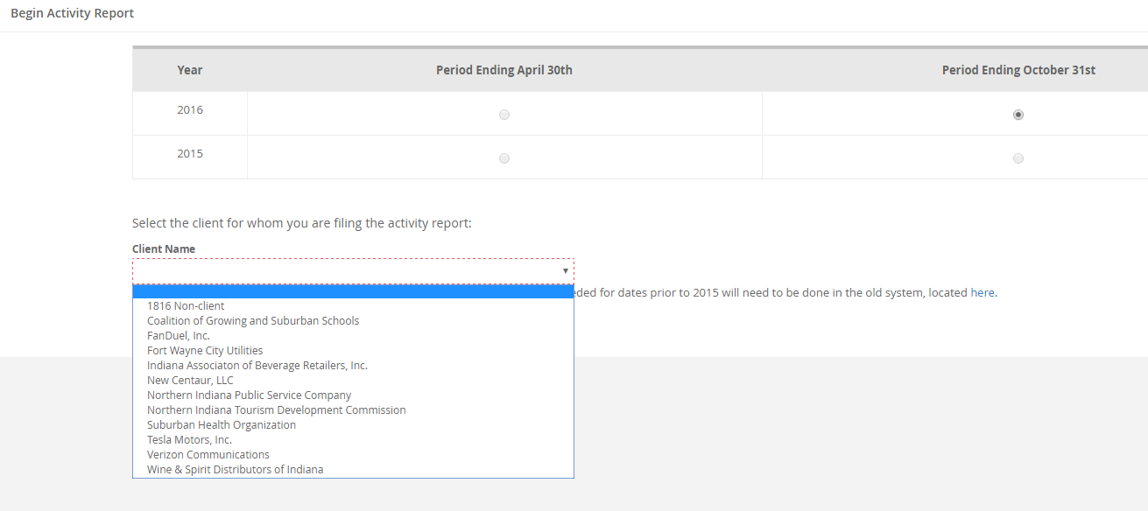
We completed the DraftKings report and you will now see it is not available in the drop down list.

Slide 46
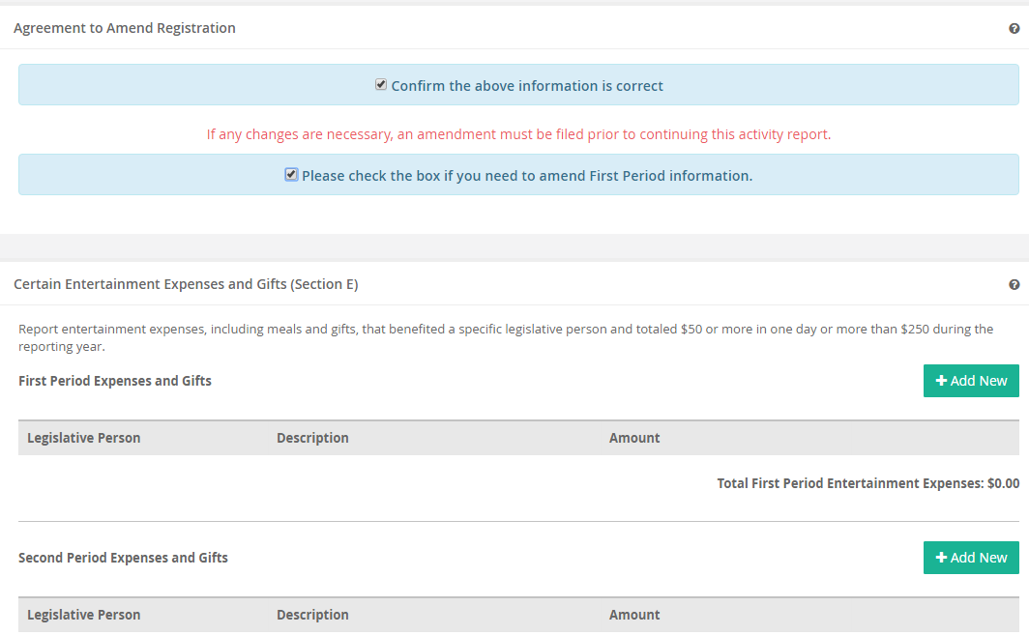
Amending Period One
Check the box to amend period one

Slide 47
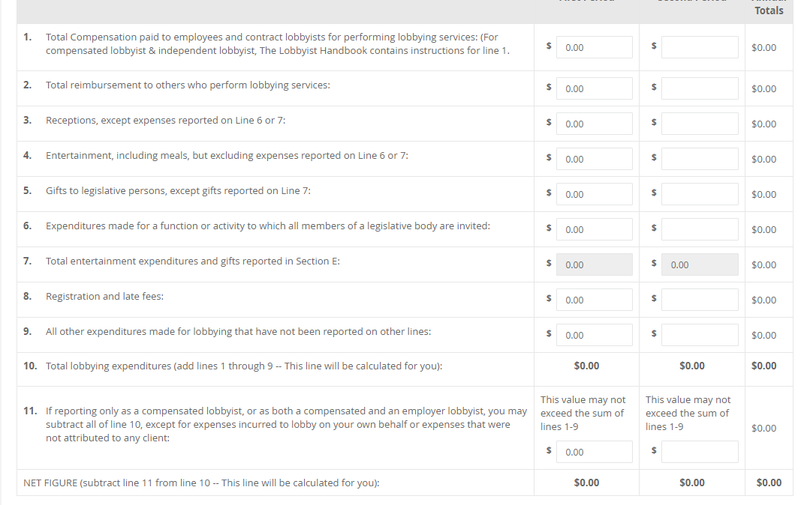
Both periods are available

Slide 48
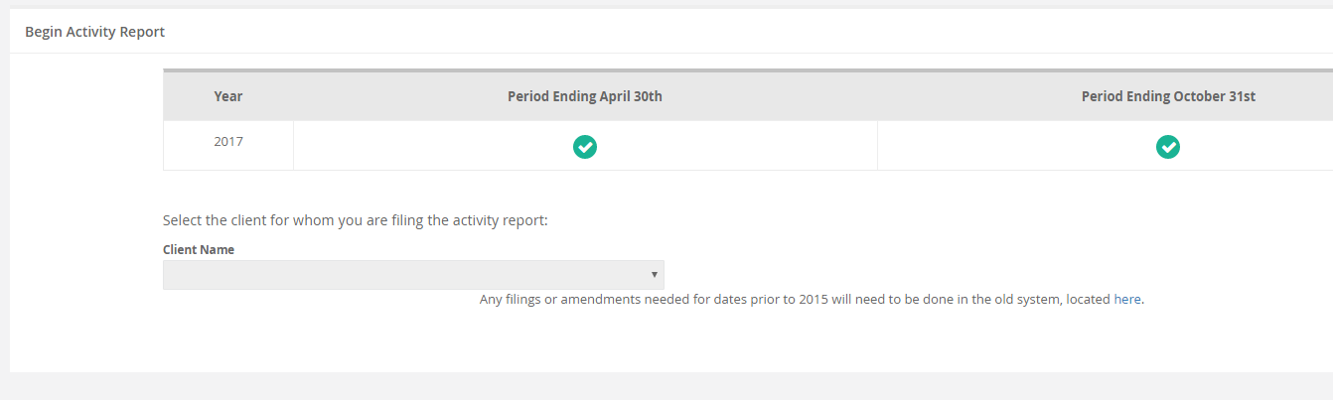
When all filings for all clients in the period are complete the screen will show check marks.

Slide 49
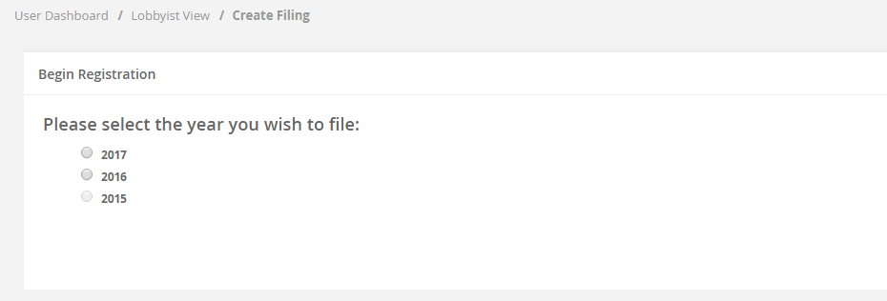
Registrations
Employer Lobbyist Registration
Please note the “lobbying start date” is no longer available in the user experience at the beginning of a registration filing.

Slide 50
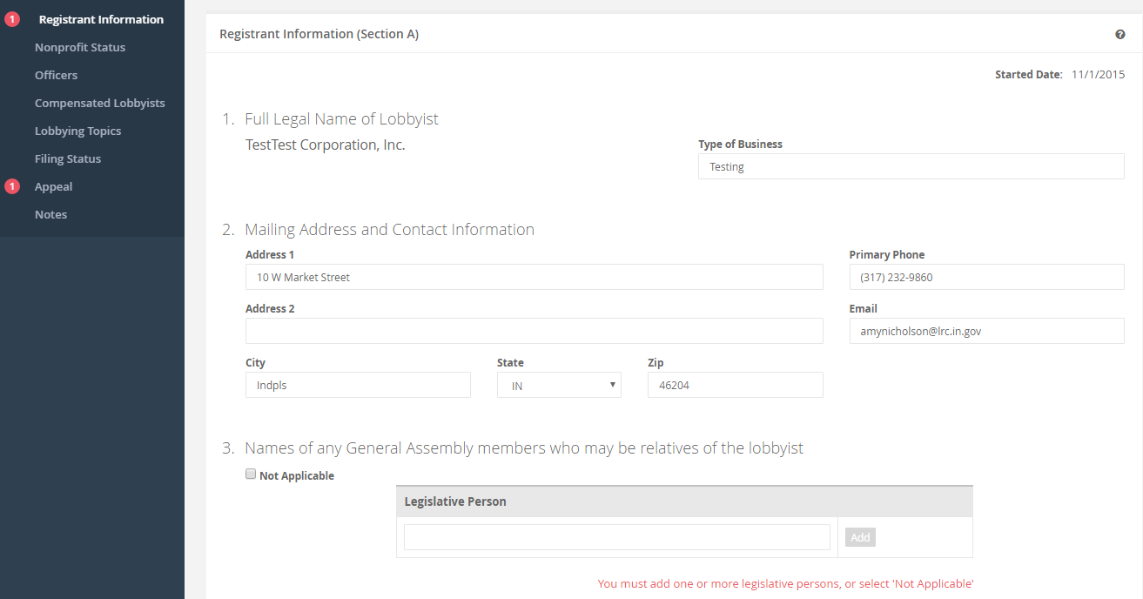
Employer Registration
APPROVER email address

Slide 51

Employer Registration
To receive a registration fee reduction you must upload the appropriate documentation for 501c3 or 501c4.

Slide 52

Edit Responsible Party

Slide 53

Edit Lobbyist

Slide 54

Remove Lobbyist

Slide 55

When selecting to REMOVE the lobbyist and you only have one lobbyist listed, you will not see the removal until you add a new lobbyist to this section. You must have at least one lobbyist working on your behalf.

Slide 56

Restrictions on Section B

Slide 57

Section B Continued
You will be asked to remove all but TWO persons listed as responsible for the company and file an MOU for the two you select before they are permitted to sign the reports and registrations.
The validation error on the left navigation will not permit filing until the list only shows TWO persons.

Slide 58

Approver Information

Slide 59

Amending Registration

Slide 60

Amend Employer Registration
Line 5 requires the reason for the amendment to be included.

Slide 61

Activity Report Employer
Period One Activity Report for this employer is completed.

Slide 62

Activity Report Employer

Slide 63

Verify information

Slide 64

Activity Report Employer

Slide 65


Slide 66

Activity Report Employer

Slide 67

Activity Report Appeal

Slide 68

Filing on my own behalf, my name is populated in the box. When the signature matches and “submit filing” is selected, the filing is complete.

Slide 69


Gift Report
Filings for Gift/Purchase Reports are available for registration years and the selected period of the gift/purchase.

Slide 70

Gift Report
Begin typing the name of the legislative person and the list will populate based on current information.

Slide 71

Gift Report
The description of the gift and the value of the gift are both mandatory fields.

Slide 72

Appeal section added

Slide 73

Gift and Purchase reports can only be signed by the person preparing the report. We have added a feature which will email the report to the lobbyist/responsible party for review and submission to the legislative person for which the gift was made.

Slide 74
Gift Report
Gift report will remain on 10 business day hold.
The time clock does not start over for each amendment.
Please provide the legislative person a copy of the report being filed
Be certain to get prior informed consent for each gift.

Slide 75

Purchase Reports
Online filing is identical to the Gift Report Filing

Slide 76
NEW FEATURE
Included in the latest updates to the system:
Countdown feature
Once filing deadline passes, the filing is reset and the appeal option is available.
This also applies to the filings in “pending” after the deadline passes.

Slide 77


Slide 78


Slide 79


Slide 80


Slide 81

Deadline passes, the appeal section will populate

Slide 82

PLEASE USE THE NEW MOU’s www.in.gov/ilrc

Slide 83

In-House Preparer

Slide 84

Third Party Individual Registrant

Slide 85

Third Party Company Registrant

Slide 86
Filing Deadlines
Registrations due NOVEMBER 1, 2016
Next Report of Lobbyist Activity due
    November 30, 2016
    QUESTIONS? COMMENTS?
    317-232-9860 Contact the office with any questions.
    Thank you!

