Slide 1
Injury prevention advisory council (IPAC) & Indiana violent death reporting system (INVDRS) Meeting
11/17/2023

Slide 2
OUR MISSION:
To develop, implement and provide oversight of a statewide comprehensive trauma care system that:
Prevents injuries.
Saves lives.
Improves the care and outcomes of trauma patients
OUR VISION:
Prevent injuries in Indiana.

Slide 3
Round Robin and Introductions (in chat)
Name
Position
Organization/ Association
Updates
Current Projects and Programs
Upcoming events

Slide 4

Program Updates
  Midwest Injury Prevention Alliance (MIPA) Conference
    https://www.midwestinjurypreventionalliance.org/2023-conference

Slide 5
Program Updates
  Injury Prevention Epidemiologist
    Annika Barce

Slide 6
Upcoming Events
November
17th: World Day of Remembrance of Road Traffic Victims
18th: International Survivor of Suicide Loss Day
December
Winter Weather Safety Month
Impaired Driving Awareness Month
  4th – 9th Older Driver Safety Awareness Week
January
National Stalking Awareness Month
National Winter Sports TBI Awareness Month
  11th: National Human Trafficking Awareness Day
  22nd – 27th: National Passenger Safety Week

Slide 7
Survivors of suicide loss day
Brandon Puszkiewicz
Indiana Programs Manager for the American Foundation for Suicide Prevention (AFSP)

Slide 8
Video from AFSP
https://www.canva.com/design/DAF0J_aCJJc/8SoHHK9xTdWSlKGkqpCrkQ/watch

Slide 9
Indiana suicide and overdose report 2022
Morgan Sprecher, MPH
Indiana Violent Death Reporting System (INVDRS) Epidemiologist

Slide 10
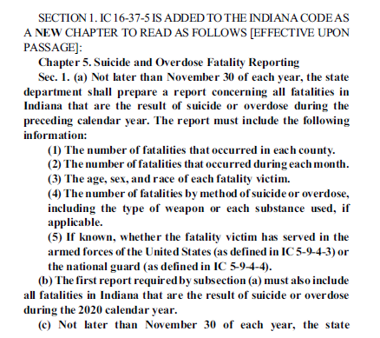


Senate Bill 84 Refresh

Slide 11
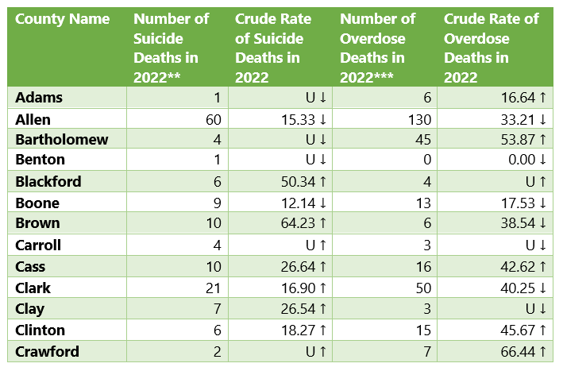
Fatalities by County of Residence
Notes:
The state suicide rate decreased 2.8% from 2021-2022.
the state overdose rate DECREASED 5.4% from 2021-2022.

Slide 12
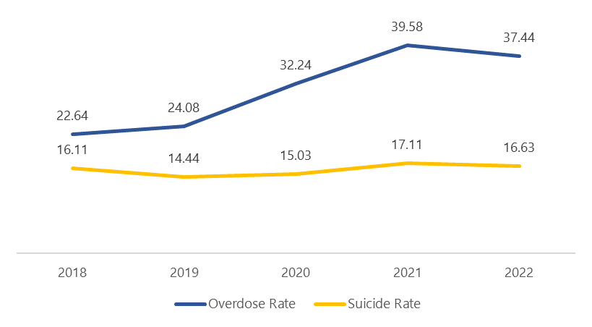
Overdose and Suicide Rate Over Time

Slide 13
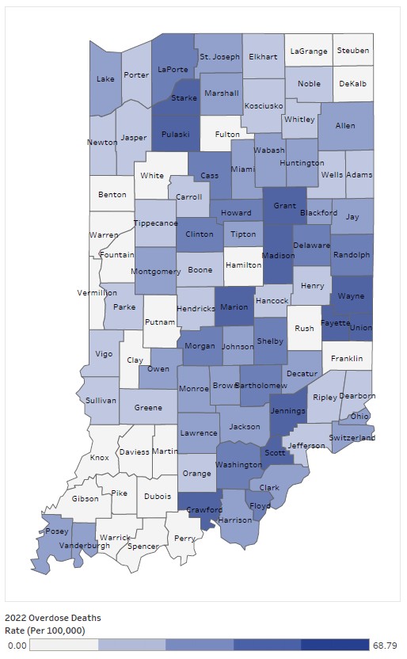
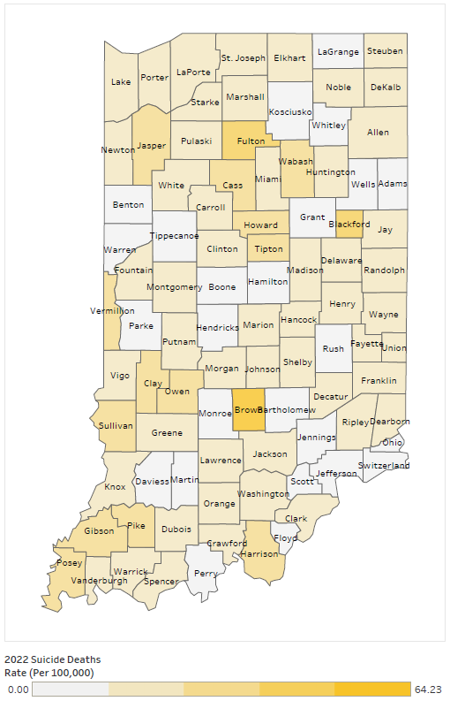
Overdose and Suicide Rate by County
Overdose Rate
Suicide Rate
Notes:
41 COUNTIES SAW AN INCREASE IN the number of SUICIDE DEATHS from 2021-2022.
35 COUNTIES SAW AN INCREASE in THE NUMBER OF overdose deaths from 2021-2022.

Slide 14
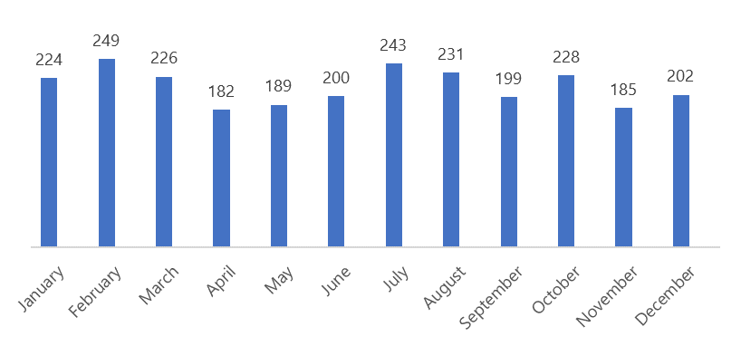
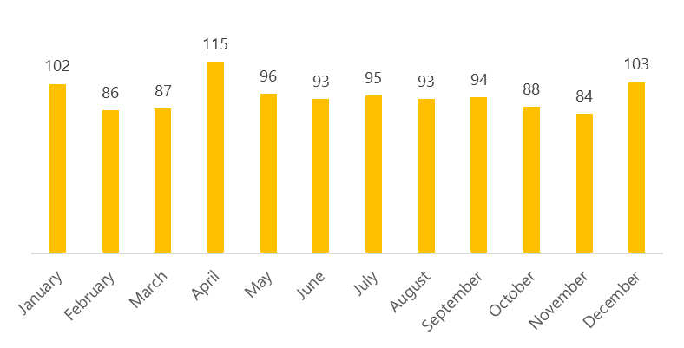
Number of Fatalities by Month
Overdose Deaths
Suicide Deaths
Notes:
february, JULY, and august had the highest overdose rates.
april, may, and june had the highest suicide rates which is consistent with the u.s.
june and OCTOBER SAW AN INCREAse in suicide and overdose deaths from 2021-2022.

Slide 15
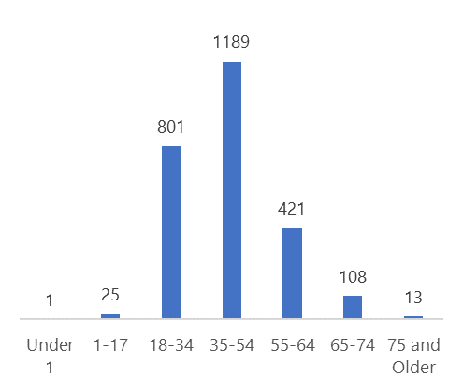
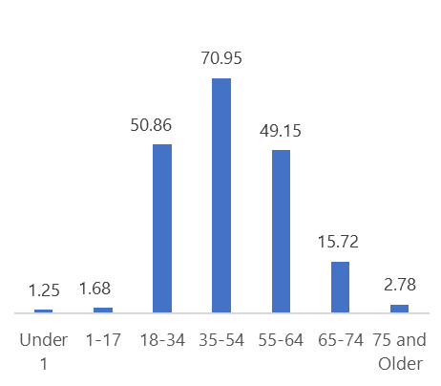
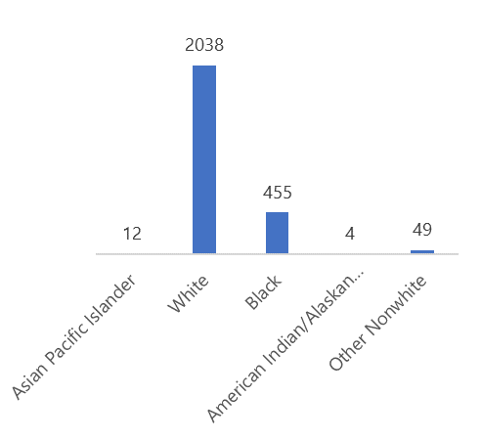
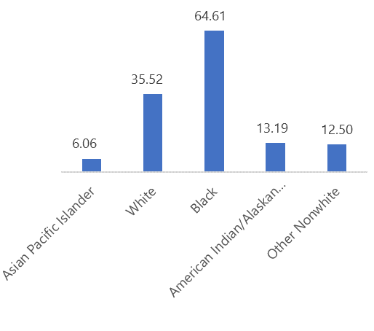
Overdose Death Demographics
Number
Rate
Age
Sex | Number of Overdose Deaths in 2022 | Crude Rate of Overdose Deaths in 2022
Female | 832 | 24.20
Male | 1726 | 50.83
Race
Notes:
35-54 year olds EXperienced a decrease in their overdose death rate from 2021-2022.
asian pacific islanders experienced an increase in their overdose death rate from 2021-2022 compared to all races
both male and female overdose rates decreased from 2021-2022.

Slide 16
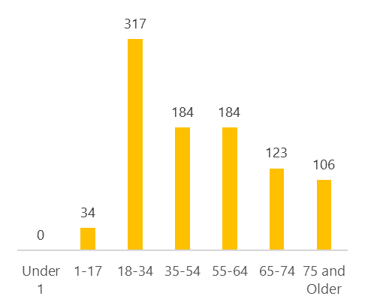
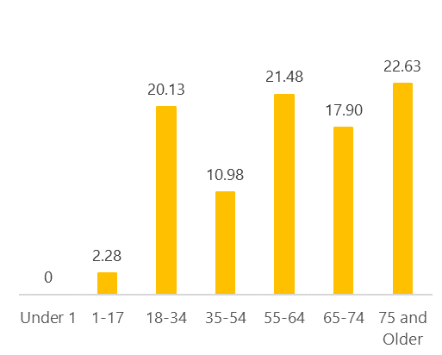
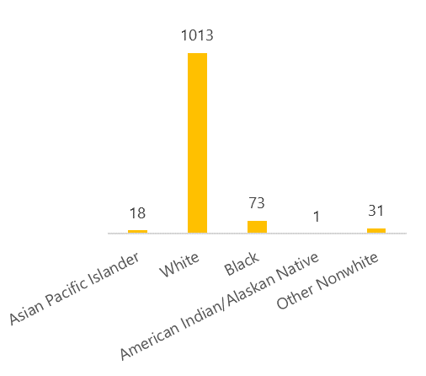
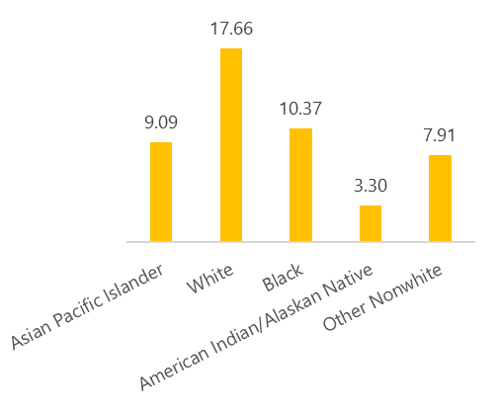
Suicide Death Demographics
Number
Rate
Age
Sex | Number of Suicide Deaths in 2022 | Crude Rate of Suicide Deaths in 2022
Female | 201 | 5.86
Male | 935 | 27.54
Race
Notes:
35-54 year olds HAD A 50% decrease IN suicide rate from 2021-2022.
55 and older ages had an increase in suicide rate from 2021-2022.
white and american indian/alaskan native races saw an increase in suicide rates from 2021-2022.
the male suicide rate increased 2.3% from 2021-2022.

Slide 17
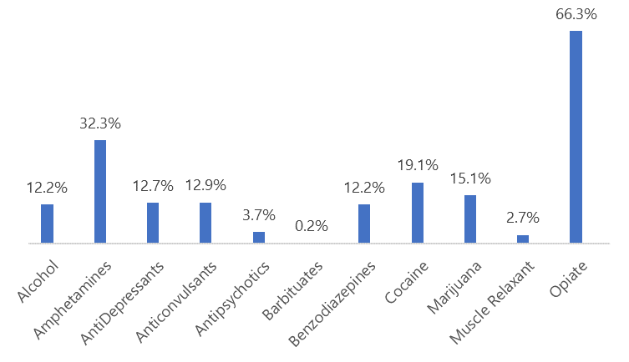
Substances Present at Time of Overdose Death
Substance Name | Number of Overdoses
Fentanyl | 1140
4-ANPP/despropionylfentanyl/4-anilino-N | 873
Methamphetamine | 730
Norfentanyl | 430
Amphetamine | 368
Notes:
4-ANPP (Fentanyl Precursor) aNd Norfentanyl (Fentanyl Metoblite) jumped Methamphetamine in 2022 top five.
Other drugs of interest: Acetylfentanyl, Delta-9-THC and its metabolites, Fluorofentanyl.

Slide 18
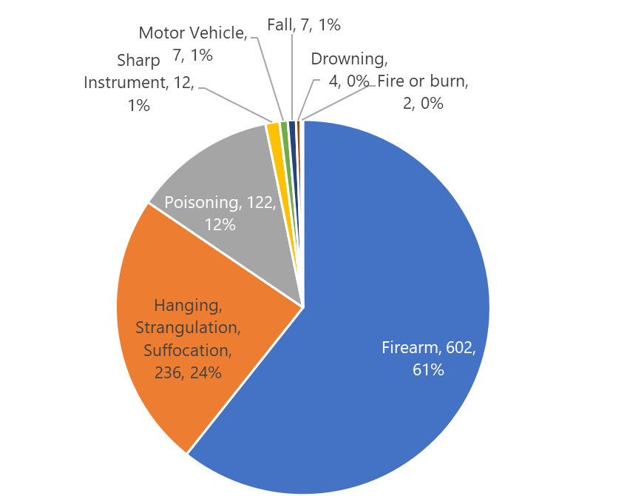
Method Used in Suicide Death
Notes:
the leading method type for females is poisoning.
the leading method type for males is firearm.

Slide 19
Fatalities by Veteran Status
Death Manner | Number of Veteran Deaths | Percentage of Decedents that Identify as Veteran
Overdose | 116 | 4.53%
Suicide | 205 | 18.05%
Notes:
The number of veterans that overdosed decreased 39% from 2021-2022.
The number of veterans that died by suicide increased 28% from 2021-2022.
firearms accounted for 78.7% of veteran suicide deaths.

Slide 20
Older Adult falls
Maria Cariaso
Injury Prevention Program Coordinator
11/17/2023

Slide 21
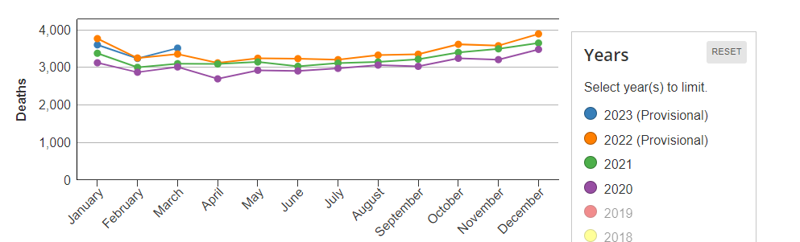
Older Adult Falls Trends
Unintentional Older Adults Falls (Age 65 and older)
https://www.cdc.gov/falls/index.html

Slide 22
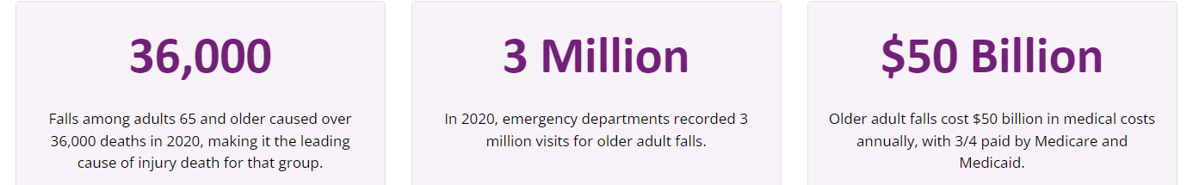
Older Adult Falls Facts
1 in 4 older adults falls each year
Falling once doubles your chances of falling again
Each year, 3 million older people are treated in emergency departments for fall injuries
Falls are the most common cause of traumatic brain injuries (TBI)
https://www.cdc.gov/falls/index.html

Slide 23

Risk Factors
Lower body weakness
Vitamin D deficiency (that is, not enough vitamin D in your system)
Difficulties with walking and balance
Use of medicines, such as tranquilizers, sedatives, or antidepressants. Even some over-the-counter medicines can affect balance and how steady you are on your feet.
Vision problems
Foot pain or poor footwear
Home hazards or dangers such as
  broken or uneven steps, and
  throw rugs or clutter that can be tripped over.
https://www.cdc.gov/falls/index.html

Slide 24

Stepping On
A 7-week (one 2-hour session per week) falls prevention program conducted by trained facilitators, and specially designed for older adult learners.
Stepping On brings together the life experience of its participants and the expertise of community professionals.
Physical therapists, pharmacists and other experts help the group adapt fall prevention practices for individual needs and levels.
Notes:
Stepping On is endorsed by the CDC because its one-of-a-kind multifactorial approach, a seven session small group community-based falls prevention workshop. The Wisconsin Institute for Healthy Aging (WIHA) is the national Stepping On license holder and disseminates the program and provides support to license holders and facilitators throughout the nation. The program is available for in-person or virtual delivery.

Slide 25
Community Feedback
“The program is more than exercises. Pharmacists are to know what drugs are correlated with falls, learning about safety with the paramedics… Learning how to be aware of your surroundings [in] your house, other people’s houses, [and the] outside environment, especially sidewalks… The class has so many facets, you learn so many different things on how to be safe.” - Jane Bannerman, Dane County
“I’ve changed my environment and moved to a safer house because of this program. It’s changed my whole outlook on life and aging healthily.”
–Indianapolis Stepping On past participant

Slide 26
Tai Chi
Evidence-based and CDC supported falls prevention program
Free virtual Tai Chi class
(Community in-person available for Indianapolis)
Starting Date: January 5 2024, 9:30AM-10:30AM every Friday for 8 weeks
People who are over 60 and want to prevent falls
What is Tai Chi?
Tai chi is a gentle, low-impact form of exercise in which you perform a series of motions while focusing on deep, slow breaths.
Benefits?
Muscle strength
Flexibility
Balance
Cognitive
Notes:
Tai chi doesn’t call for the same flexibility as yoga, nor is it as strenuous as other forms of exercise, making it easier on your joints and muscles. And you don’t have to be in shape already in order to do it. “Your fitness level doesn’t matter. Although tai chi is slow and gentle and doesn't leave you breathless, it addresses the key components of fitness — muscle strength, flexibility, balance, and, to a lesser degree, aerobic conditioning. Here's some of the evidence:
Muscle strength. Tai chi can improve both lower-body strength and upper-body strength. When practiced regularly, tai chi can be comparable to resistance training and brisk walking.
Although you aren't working with weights or resistance bands, the unsupported arm exercise involved in tai chi strengthens your upper body. Tai chi strengthens both the lower and upper extremities and also the core muscles of the back and abdomen.
Flexibility. Tai chi can boost upper- and lower-body flexibility as well as strength.
Balance. Tai chi improves balance and, according to some studies, reduces falls. Proprioception — the ability to sense the position of one's body in space — declines with age. Tai chi helps train this sense, which is a function of sensory neurons in the inner ear and stretch receptors in the muscles and ligaments. Tai chi also improves muscle strength and flexibility, which makes it easier to recover from a stumble. Fear of falling can make you more likely to fall; some studies have found that tai chi training helps reduce that fear.
Aerobic conditioning. Depending on the speed and size of the movements, tai chi can provide some aerobic benefits. If your clinician advises a more intense cardio workout with a higher heart rate than tai chi can offer, you may need something more aerobic as well.

Slide 27
Discussion
What do we, in Indiana, do well when it comes to the topics from today?
How can / where can we improve this?

Slide 28
Discussion – Part II
Please comment your email in the chat if you would like to receive access to the IPAC/INVDRS SharePoint folder.
Sign-ups for 2024 presentations

Slide 29
2024 Meeting Dates
February 9
May 10
August 9
November 8

Slide 30
THANKS!
Presenter | Phone | Email
Morgan Sprecher | 317-234-9825 | msprecher@health.in.gov
Maria Cariaso | 317-234-4943 | mcariaso@health.in.gov
Brandon Puszkiewicz | 463-271-0262 | bpuszkiewicz@afsp.org

