Slide 1
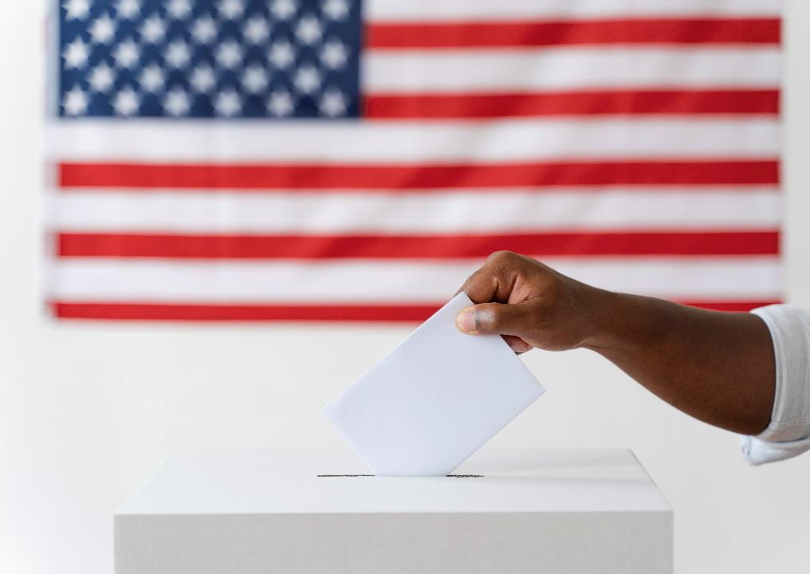
Voter Registration Updates & Reminders
Angie Nussmeyer, IED Co-Director
2024 IVRA Conference | 7/11/24
Images by Freepik

Slide 2

Acronyms
ABS = absentee
BMV = Indiana Bureau of Motor Vehicles
CEB = county election board
Credential = IN driver’s license or state ID card
DLN = driver’s license number
IED = Indiana Election Division
SOS = Secretary of State
SSN4 = last four digits of Social Security Number (SSN)
SVRS = statewide voter registration system
VR = voter registration
Images by Freepik

Slide 3

First Time Voters
Images by Freepik
Adding first time voters who register in person at a voter registration agency to the “proof of residency” procedures already used by counties for first time voters who register to vote by mail
“Voter Registration Agency” includes, but not limited to:
  IED/SOS office
  Clerk/CEB/VR Office
  Full Service Agencies: BMV, FSSA, DWD, etc.
  Law Enforcement Agencies during handgun licensing
IC 3-7-14-7 | C 3-7-15-5 | IC 3-7-15-7 | IC 3-7-16-12 | IC 3-7-16-14 | IC 3-7-18-4 | IC 3-7-18-6 | IC 3-7-22-5 |
IC 3-7-27-20.2 | IC 3-7-29-1 | IC 3-7-33-4.7 [NEW]

Slide 4
First Time Voters VR Application Review
Does app include IN DLN or SSN4?
  If yes, validate the number on the app within SVRS
    Match? Then voter does NOT need to provide proof of residency and NO flag should be added to the record
    No Match? Then voter DOES need to provide proof of residency
        Confirm whether voter provided proof of residency with application
        If included and valid, NO proof of residency flag should be added to the record
        If not included, proof of residency flag must be added to the record
  If no (that is, voter marked “none”) then voter must provide proof of residency
    Flag must be added to the voter’s record in SVRS UNLESS proof of residency documentation is included with the registration request
Voter’s VR app is processed, if otherwise qualified
IC 3-7-14-7 | C 3-7-15-5 | IC 3-7-15-7 | IC 3-7-16-12 | IC 3-7-16-14 | IC 3-7-18-4 | IC 3-7-18-6 | IC 3-7-22-5 | IC 3-7-27-20.2 | IC 3-7-29-1 | IC 3-7-33-4.7[NEW]

Slide 5
Proof of Residency
NOT the same as photo ID law
Confirm the voter’s address on residency doc corresponds to their registration address
  NO address conformity requirement when checking ID to vote
Some types of acceptable proof of residency documents include:
  Current & valid IN DLN/ID Card/Learner’s Permit
  Bank Statement
  Utility Bill
  Government Document
  Paycheck
IC 3-7-14-7 | C 3-7-15-5 | IC 3-7-15-7 | IC 3-7-16-12 | IC 3-7-16-14 | IC 3-7-18-4 | IC 3-7-18-6 | IC 3-7-22-5 | IC 3-7-27-20.2 | IC 3-7-29-1 | IC 3-7-33-4.7[NEW]

Slide 6
Proof of Residency
Absentee Voters with Proof of Residency Flag
  Send ABS-12 Form generated from SVRS with ABS balloting materials
    Includes ABS-Mail, ABS-Travel Board, ABS-VPD, ABS-Attorney General
    Voters using FPCA are exempt from this requirement
  Must return form & proof of residency to CEB not later than 6P on Election Day
    If not, ABS ballot is made provisional & cannot be counted
In-Person Voters with Proof of Residency Flag
  Applies to Election Day & Early In-Person Absentee Voting
  Pollbook entry should prompt workers to ask voter for proof of residency before signing poll list
    Voter can produce proof of residency using a smartphone, but can be an ID or paper document
  If voter can’t provide proof of residency OR has signed the poll list, then provisional ballot must be issued & PRO-9 provided to the voter
    Voter has until 6PM on Election Day to bring proof of residency to CEB for ballot to count
IC 3-7-33-4.7[NEW] | IC 3-11-4-17.5 | IC 3-11-4-18 | IC 3-11-8-10.3 | IC 3-11-8-23 | IC 3-11-8-25.2 | IC 3-11-10-28| IC 3-11.7-2-1 | IC 3-11.7-2-2 | IC 3-11.7-5-2 | IC 3-14-5-1

Slide 7
“First Time Voter” Form Updates
IED is adding updates first time voter info to the following forms effective July 1, 2024:
  ABS-12
    Proof of residency notice sent with ABS ballots & generated from SVRS
  PRO-9
    Notice & info given to voters when casting a provisional ballot
  ABS-VPD
    Instructions in voter registration section need an update
  VRG-7 & VRG-11
    State voter registration forms
    Note – have an address update for the ABS/VR forms? Now is the time to tell our office so we can work in the revision with the updated forms set
  VRG-6
    Used by FULL SERVICE agencies only; specialized forms unique to their office
    NOT a public facing form; agency needs to email elections@iec.in.gov to request an updated version
Voter’s Bill of Rights Poster is being updated for November 2024 election
Be sure to look at legislative summary & review statutes online as guidebooks and SOPs will be out-of-date on this topic

Slide 8

Confidence Factor
Full SSN: 40 points
SSN4: 10 points
IN DLN/ID Card Number: 50 points
DOB: 25 points
Last Name: 15 points
First Name: 15 points
Middle Name: 5 points
Suffix: 5 points
Street Address 1: 10 points
Zip Code (first five): 5 points
MAXIMUM POSSIBLE POINTS: 180
Image by katemangostar on Freepik
IC 3-7-38.2-5.5

Slide 9

BMV Credential Statuses
Images by Freepik

Slide 10
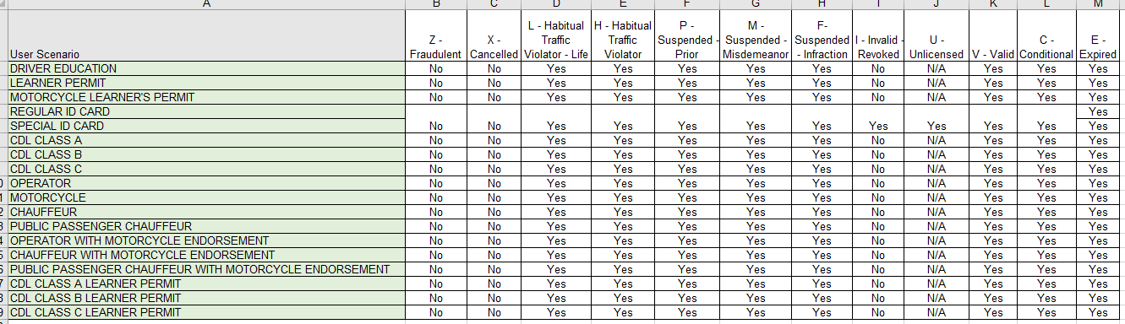
IN BMV Credential Numbers
(XXXX-XX-XXXX)
With rare exception, a person’s IN credential number remains with them for life BUT the status of the credential may change over time
For example, a person is a victim of identity theft and was given a new credential number.
Below are some of the SVRS Business Rules on whether an IN credential number can be accepted as valid (or not) for purposes of registration or adding it to a record through the ABS correction process.

Slide 11

If Indiana credential number is returned by the BMV through SVRS with a status of:
  Fraudulent (Z)
  Cancelled (X)
  Invalid/Revoked (I)*
  Unlicensed (U)*
then you should not accept the IN credential number as valid for purposes of registration or ABS voter ID confirmation.
* Those with state ID cards with an “I” or “U” status ARE considered valid for registration purposes, as those statuses are ONLY used when issuing a photo ID card.
  For example, “unlicensed” means the person does not have an operator’s license to drive and therefore, is truly unlicensed but is eligible and holds a state ID card.
Do NOT confuse validating a credential number for registration
with requirements to present photo ID to vote in-person under IC 3-5-4-40.5.
When presenting ID issued by the state or federal government to cast a ballot, the ID must be current or expired since the last general (November 2022) election and
include a photo and name that conforms to the name on their registration.
Images by Freepik

Slide 12

Out of State Voter Information
Can you use information provided by other states to cancel an Indiana voter’s registration?
It Depends!
IC 3-7-38.2-5.5
Image by snowing on Freepik

Slide 13
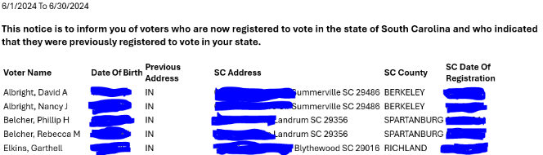
Example 1:
Sample Out of State Notice (SC)
Analysis:
  Does it contain the voter’s registration in South Carolina with the voter’s signature AND a statement noting the person authorizes cancellation at a previous address?
    NO!
Next Steps, if NEW state registration occurred AFTER their Indiana registration date:
  May send a SAMC to the voter
    Voter can update, cancel or confirm IN registration
    If no response after given 30 days’ notice (or SAMC is returned as undeliverable), move voter to “inactive” status if not in a freeze period
  May send a VRG-14 for voter to cancel their IN registration
    Cannot use undeliverable VRG-14 for VLM purposes

Slide 14
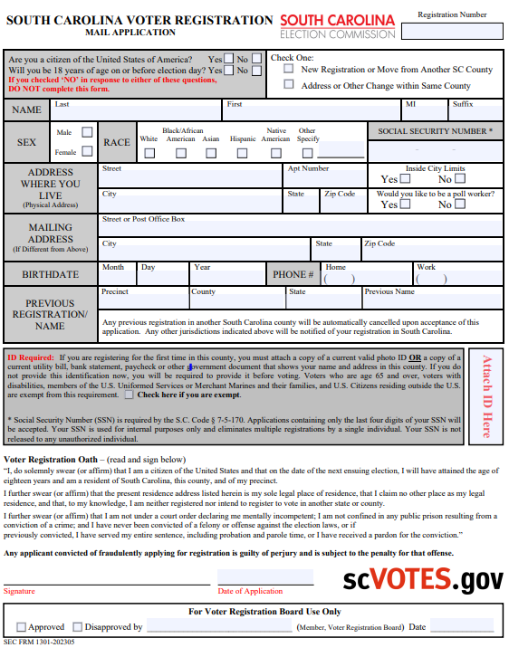
Example 2:
Signed VR Form
Analysis:
  Assuming the SC VR form is signed by the voter, can you use it to cancel the voter’s IN registration?
    Maybe
    “Magic words” to look for on the form will authorize cancellation at a previous address
If NEW state registration occurred AFTER their Indiana registration date:
  County VR official must decide if language on SC form authorizes cancellation at a previous out-of-state address
    If decision is “yes,” then voter’s status can be moved to cancelled
    If decision is “no” or “not sure,” then county can use this information to send a SAMC or VRG-14 to the voter

Slide 15
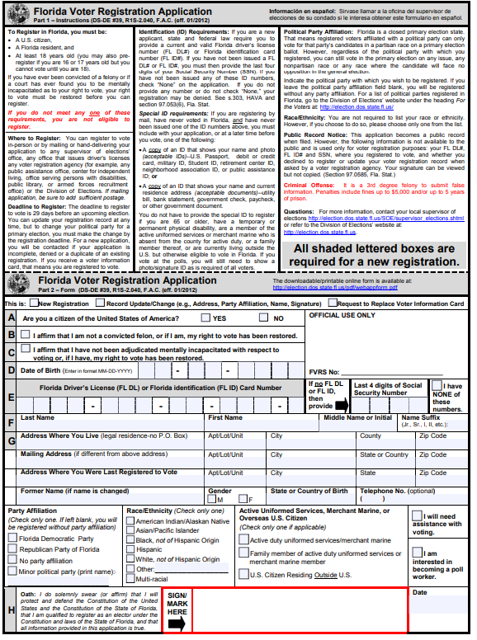
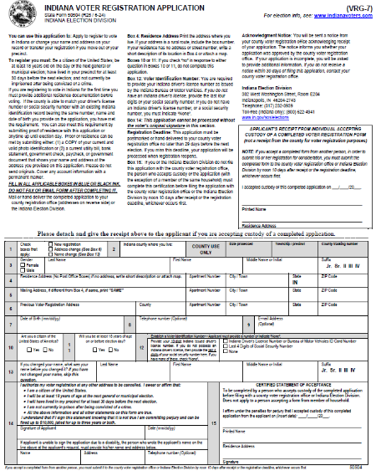

FL VR form does NOT appear to have “magic words” to cancel at another address
IN VR form DOES have “magic words” to cancel at another address

Slide 16
Military & Overseas Voters
Images by Freepik

Slide 17
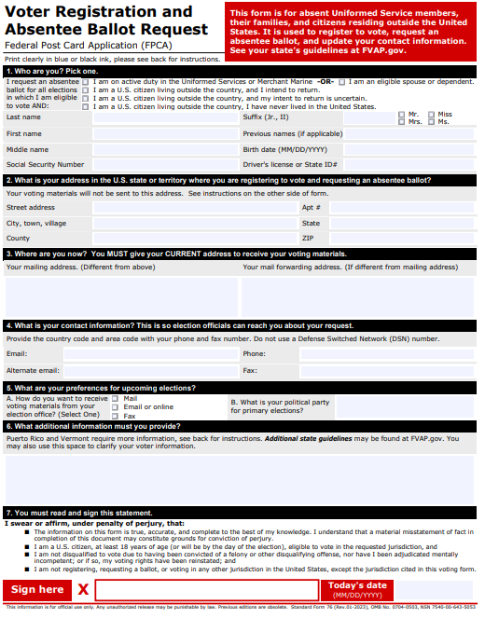
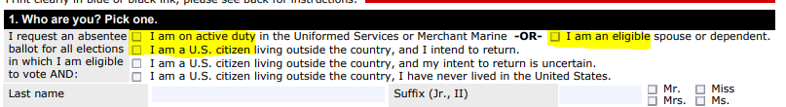
Can a military or overseas voter use indianavoters.com to register or request an absentee ballot?
In most cases, yes…BUT the Federal Post Card Application (FPCA) is the better resource and provides protections to those voters.
Registration using the FPCA
  Form can be accepted, even if sent by fax or email
  Must have live in Indiana for at least 30-days at some point in their life AND the Indiana address was their last known US residence
    Checked one of these 3 boxes?
      This person is to be registered to vote at their former IN address

Slide 18
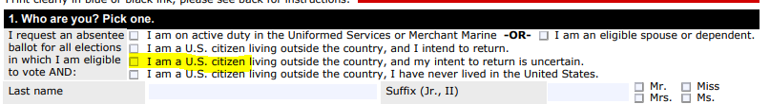
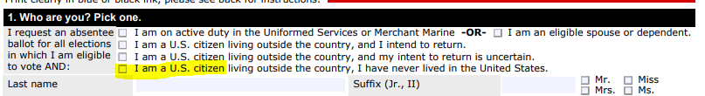
Registration using the FPCA, con’t
  Must have live in Indiana for at least 30-days at some point in their life AND the Indiana address was their last known US residence
    Checked the “I am a US citizen and my intent to return is uncertain” box?
      This person is to be registered to vote in the precinct where the VR office is located
    Checked the “I am a US citizen and I have never lived in the US” box?
      This person CANNOT be registered to vote in Indiana or receive an ABS ballot

Slide 19
Absentee Voting using the FPCA
  Valid for ONE calendar year (Jan 1 to Dec 31)
    For primary, voter must indicate a political party to receive an ABS ballot for their selected party (or public question only)
  Voter can request ABS to be sent by mail or by fax/email
    If sent by MAIL, then ABS ballot envelope can be postmarked on or before election day AND received up to NOON, ten-days after the election and be counted
    If sent by FAX or EMAIL, then ABS-9 secrecy waiver AND ABS ballot must be received by 6PM on election day to be counted
  ABS Ballot Type is dependent upon one of the boxes marked in section 1 of the FPCA
    Military voter or a dependent or spouse? Receives a FULL ballot
    US citizen living abroad but intends to return? Receives a FULL ballot
    US citizen living abroad but return is uncertain? Receives a FEDERAL ONLY ballot
      Only permitted to vote for US President, US Senate, US House
Images by Freepik

Slide 20
Other Reminders
  Voter ID Number Requirement for ABS
    Applies to military/overseas voters
    Form instructions request the information to be placed in section #6 (additional information) but also acceptable if included in section #1 (SSN or DLN boxes)
  Faxed or Emailed Ballots
    ABS-9 secrecy waiver is generated in SVRS
    Secure returns in ABS-10 (or ABS-10B, if using new envelope templates)
    MUST REMAKE these ballots on an optical scan ballot card using bi-partisan teams AFTER the central count team’s review to confirm voter is eligible to vote in this election
  Federal Write-In Absentee Ballot (FWAB)
    Used as a back-up in case military or overseas voter’s original ABS ballot, as requested by the FPCA, is not returned by the deadline
    FWABs CANNOT be accepted if voter does NOT have an FPCA on file for the year
Images by Freepik

Slide 21

Questions?
Angie Nussmeyer
anussmeyer@iec.in.gov
317-232-3940
Matthew Kochevar
mkochevar@iec.in.gov
317-232-3942
elections@iec.in.gov

