Slide 1
Small Structure Rehabilitation Design
November 15, 2018
Jim Emerick, P. E., Hydraulics Engineer
email: jemerick@indot.in.gov
Alex Schwinghamer, Hydraulics Engineer
email: aschwinghamer@indot.in.gov
INDOT Hydraulics Website: www.in.gov/indot/3595.htm

Slide 2
Topics of Discussion
Why INDOT rehabilitates small structures
Rehabilitation methods used
Good and bad candidates for rehabilitation
How to analyze the rehabilitation
Why provide replacement recommendations
INDOT flowchart for replacement options
Reporting results in the Hydraulic Memo
Notes:
The following are the key points we are going to discuss

Slide 3
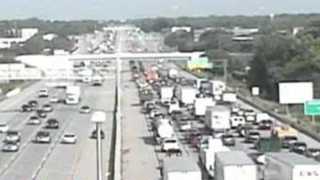
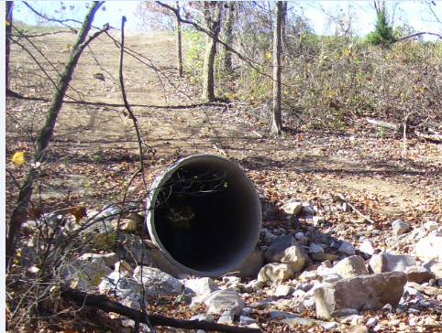
Why INDOT Rehabilitates Small Structures
Cost Savings over Replacement for:
High Traffic Roads
  Expensive M & PT
  Impact to Drivers
Structures Under Significant Cover
  Costly Excavation and Road Repair
  Can’t be done with INDOT Maintenance
Notes:
Why INDOT Rehabilitates Small Structures
INDOT rehabilitates structures in situations where replacement is costly and rehabilitation can extend the life of the structure while providing a cost saving alternative.
Places where it is beneficial to rehabilitate structures rather than replace
High Traffic Roads - Maintenance of traffic can be very costly and have a negative impact to the public
Structures with significant cover – the replacement cannot be done by INDOT maintenance and the excavation and repair to the road can be costly

Slide 4
Types of Small Structure Rehabilitation
INDOT Approved Rehabilitation Methods
  High Density Polyethylene (HDPE) Liner
  Cured in Place Pipe (CIPP) Liner
  Concrete Paved Invert
Other Types of Rehabilitation that Have Been Used
  Smooth Steel Liners – used in specific situations where the approved rehabilitation methods are not feasible due to size
  Centrically Cast Concrete Pipe (CCCP) – has been used on a experimental basis but still being evaluated by INDOT Hydraulics.
Notes:
INDOT Approved Liners and Rehabilitation Methods
High Density Polyethylene (HDPE) Liner
Cured in Place Pipe (CIPP) Liner
Paved Concrete Invert
Additional Methods for Specific Applications
Smooth Steel Liners – used in specific situations where the rehabilitation methods are not feasible due to large size
CCCP –used on a experimental basis still being evaluated by INDOT Hydraulics. Two per district during evaluation. Should not be recommended unless requested by district

Slide 5
Good Candidates for Rehabilitation
  Corrugated Metal Pipes and Pipe Arches
    INDOT has a lot of older metal pipes under high traffic roads
    Manning’s n is improved with rehabilitation
    Inlet losses can be improved
Notes:
Corrugated metal pipes are usually best candidates for liners
There are a large number of corrugated metal pipes under roads where replacement is difficult and costly
Although the capacity is negatively affected by area reduction it is positively affected by the improvement to the roughness
The existing inlet is usually thin edge projecting so improvements can typically be made to inlet to increase capacity

Slide 6
Poor Candidates for Rehabilitation
  Pipes with significant deflection, deformation or deterioration or bends
  Pipes with significant erosion issues due to velocity
  Reinforced concrete pipes and boxes
Notes:
Pipes with significant deflection, deformation or deterioration – liner may not fit or paved invert may not due to the deterioration
Pipes with have significant scour or stream degradation due to high velocities are not good candidates because lining increases the velocity and could compound the problem. In some cases a energy dissipator design may be required to mitigate the increased velocity
Reinforced Concrete Pipes Structures are not good candidates for liners unless:
Increase to headwater is contained in the right-of-way or within ditch
Improvements can be made to maintain existing capacity
beveled edge headwall
bored pipe

Slide 7
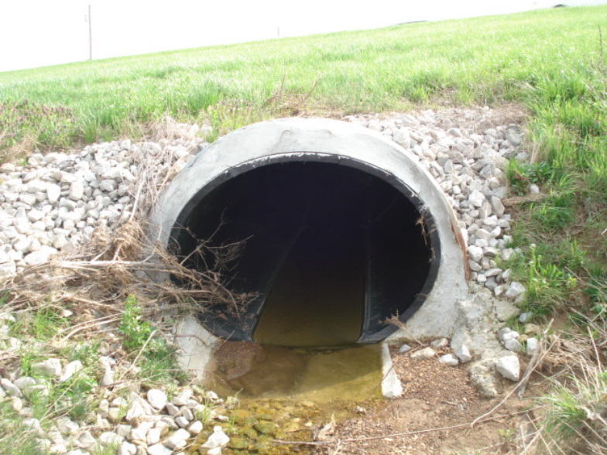
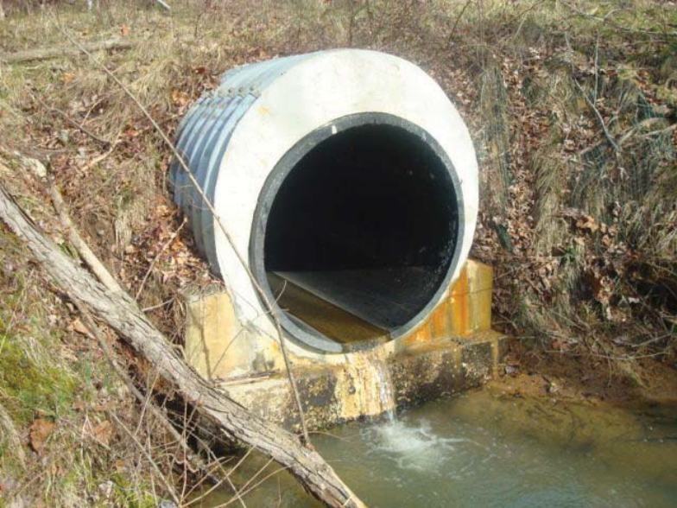
HDPE Liner - Installation Process
  The existing pipe is dewatered
  High density polyethylene pipe is inserted through the existing host pipe
  It may necessary to deform the pipe to fit into an arch pipe. Manufactures have specified maximum allowable crushing ratios.
  Grout is pumped through PVC pipes at the top of the liner to fill the void between the liner and the host pipe.

Slide 8
HDPE Liners - Design and Analysis
  Inlet coefficient
    For installation on projecting pipes use Ke = 0.7 (Mitered to Conform to Slope edge condition in HY-8). This determination was based on information provided in a study of inlet conditions by the National Cooperative Highway Research Program.
    If the existing pipe has a improved inlet (i.e. headwall), the HDPE liner should be modeled as mitered unless the headwall is to be constructed flush with the end of the liner
  Manning’s n should be 0.012
  Inverts raised by the wall thickness of liner
  There should be at least 2 inches left at the crown and sides of the pipe
  HDPE liners can be deformed to fit within a pipe arch host pipe
  The Elliptical HDPE Pipe Lining Worksheet found on the hydraulics website can be used to determine sizing and coordinates used in HY-8
  Minimum size should be large enough that the resulting lined pipe is not smaller than the minimum pipe sizes identified in Figure 203-2B of the IDM.
Notes:
An inlet coefficient (K_{e}) of 0.7 should be used for the HDPE and CIPP liners installed in projecting pipes. This is the same as the Mitered to Conform to Slope edge condition in HY-8. Due to the liner increasing the thickness of the pipe, the entrance is no longer thin nor is it as good as a headwall. The compromise was to use a Ke value of 0.7. This was based on information provided in a study of inlet conditions by the National Cooperative Highway Research Program.
Manning’s n should be 0.012
Liner sits on bottom of the host pipe - inverts raised by the wall thickness of liner
There should be at least 2 inches left at the crown and sides of the pipe
The Elliptical HDPE Pipe Lining Worksheet found on the hydraulics website can be used to determine sizing and coordinates used in HY-8
Minimum size should be large enough that the resulting lined pipe is not smaller than the Minimum liner sizes identified in Figure 203-2B

Slide 9
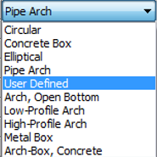

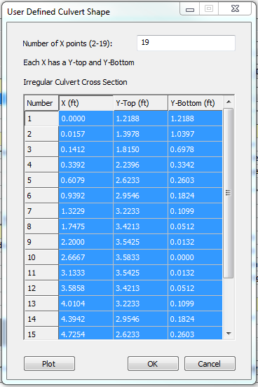
Elliptical HDPE Pipe Lining Worksheet
It is necessary to obtain the coordinates from the existing corrugated metal pipe arch. This can be done by opening the existing model and changing the shape from Pipe Arch to User Defined
select define
the User Defined Culvert Shape data entry window will appear with the coordinates from the existing CMPA. Select the number box in the upper left corner to highlight all and copy (Ctrl+c) data.
Notes:
The Elliptical HDPE pipe lining worksheet is available on the hydraulics website. It can be used to assist the designer in selecting an HDPE liner for a corrugated metal pipe arch. The next few slides will demonstrate how to use the worksheet. Some things to considered when choosing an HDPE liner for a CMPA. You need to make sure the host pipe size is correct or the liner will not fit. When the field data is collected make sure to carefully measure. It is good to have the size from the plans if available. If the size from the plans is not available. The size and photos from BIAS can be used to find the structure but the size from BIAS should be checked in the field since it is often not correct. It may also be good to have list of the sizes available when taking the field measurement and try to determine the one that most closely matches the measurement.

Slide 10
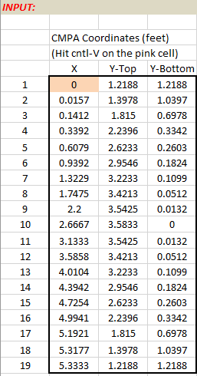
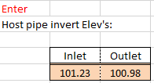
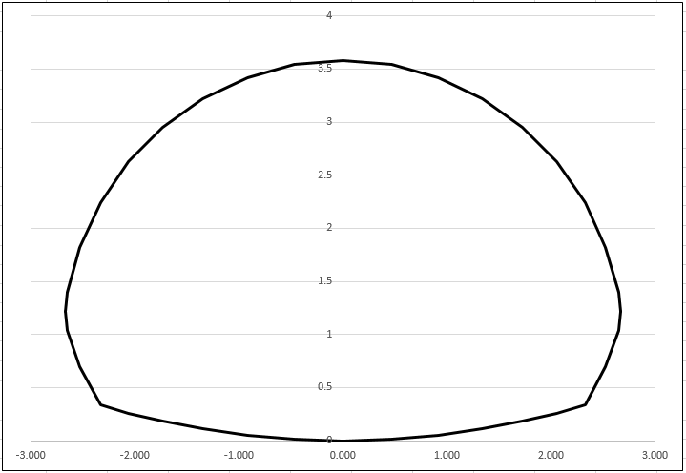
Elliptical HDPE Pipe Lining Worksheet
Paste (Ctrl+v) the coordinates into the input section of the worksheet. Enter the inverts of the existing culvert. The culvert will be plotted in the worksheet with a black outline.
Enter host pipe inverts
Paste host pipe coordinates here
Host pipe plot

Slide 11


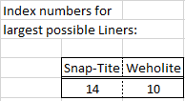
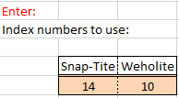
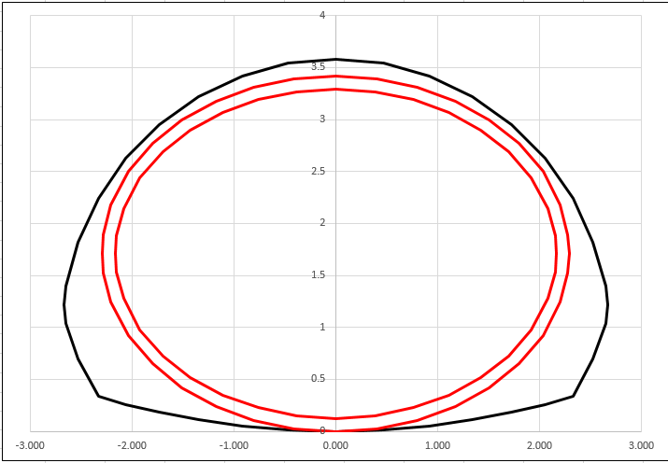
Elliptical HDPE Pipe Lining Worksheet
Review the host pipe rise subtract 2” and enter the value in the cell labeled “Liner max outside rise:”
The suggested largest liners will be populated. Enter this data in the index numbers to use and review the plot of the host pipe and liner and make adjustments as needed to the liner size.
It may be necessary to reduce the liner size to maintain 2”-3” around liner
Notes:
This is why it is critical to get the correct size of the host pipe when collecting field data. We don’t want to find out last minute that the pipe wont fit.

Slide 12
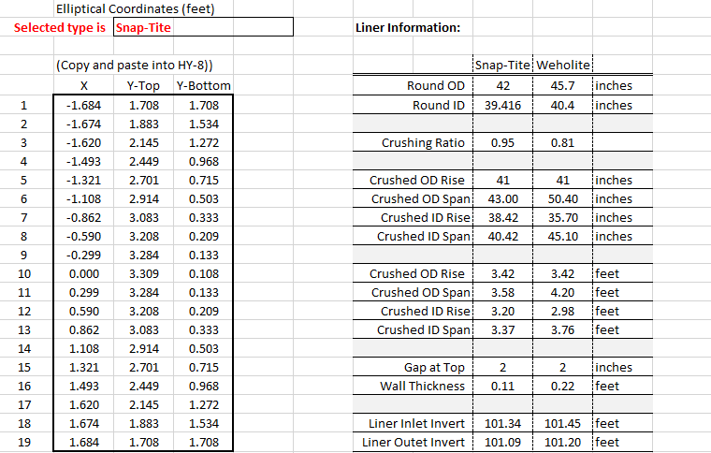
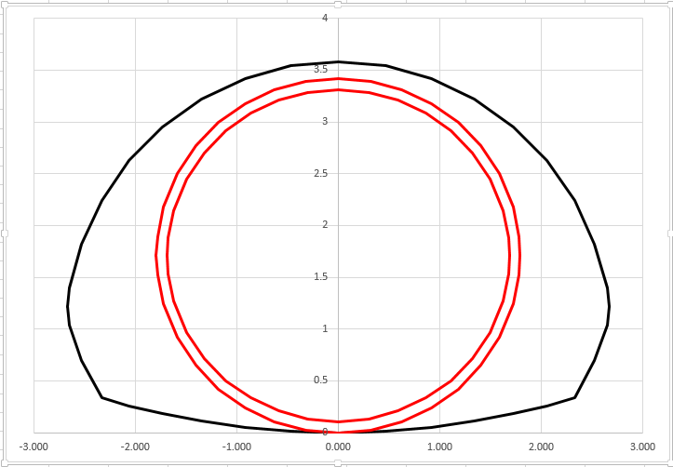
Elliptical HDPE Pipe Lining Worksheet
In this case it was necessary to choose one size smaller for the liner to provide appropriate room for fit inside of the host pipe and to allow for grouting. The coordinates from the lower left corner of the worksheet can then be copied and pasted into HY-8.
Inner and outer dimensions
Copy and paste into HY-8 user defined culvert shape entry
Liner inverts enter into HY-8

Slide 13
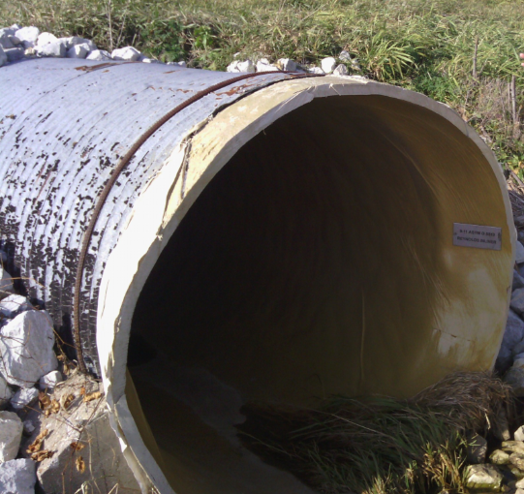
CIPP Liners - Installation Process
  The existing pipe is dewatered
  A lining tube saturated in resin is inserted into the host pipe
  Air pressure is used to inflate the lining tube inside of the host pipe
  Hot water or steam is used to cure the resin
  The cured resin tube forms a solid tightfitting liner within the existing host pipe

Slide 14
CIPP Liners - Design and Analysis
  An inlet coefficient
    For installation on projecting pipes use Ke = 0.7 (Mitered to Conform to Slope edge condition in HY-8) This determination was based on information provided in a study of inlet conditions by the National Cooperative Highway Research Program.
    If the existing pipe is not thin edge projecting, the liner should have an inlet type matching the existing structure.
  Manning’s n for CIPP should be 0.012
  Inverts should be raised by the thickness of the liner
  For circular pipes, the diameter should be reduced according to IDM 203-2.02(13) Pipe Lining
  For pipe arches the CIPP Lining Worksheet found on the hydraulics website can be used to generate coordinates for HY-8
  The maximum allowable size for INDOT projects is 96” equivalent diameter. Some districts have smaller size restrictions.
  Minimum size should be large enough that the resulting lined pipe is not smaller than the minimum pipe sizes identified in Figure 203-2B of the IDM.

Slide 15
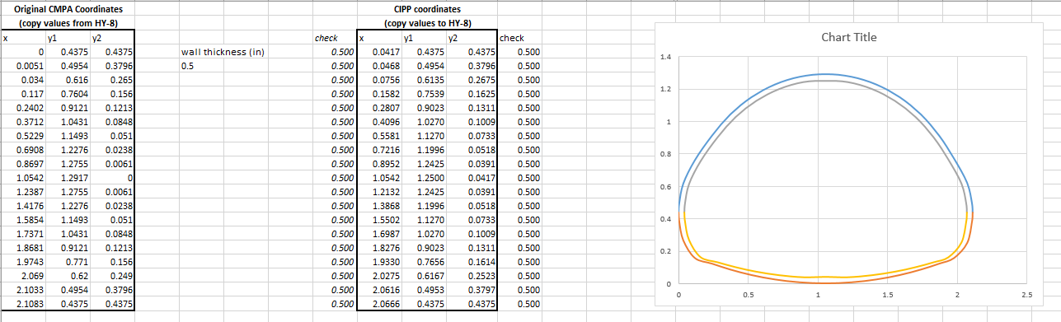
CIPP Lining Worksheet
In a similar process to the HDPE worksheet, copy the coordinates for the corrugated metal pipe arch from HY-8. The worksheet selects the appropriate thickness and provides coordinates that can be copied and pasted back into HY-8.
Copy and paste into HY-8 user defined culvert shape entry
Coordinates from HY-8 for the existing host pipe

Slide 16
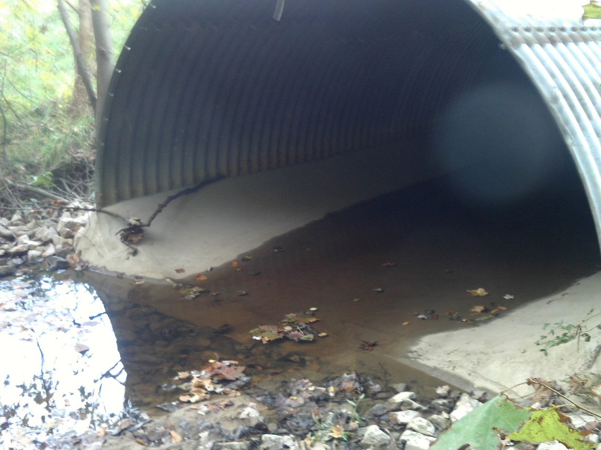
5” Paved Invert - Installation Process
  Existing pipe dewatered and cleaned
  Asphaltic coating is applied where the concrete will be in contact with the steel
  Steel Reinforcement is installed
  Concrete is installed along the invert of the pipe
  Hydraulics offers this as an option. It is up to the designer to determine if it is structure has sufficient integrity for this type of rehabilitation.
  Minimum size should be large enough that the resulting lined pipe is not smaller than the minimum pipe sizes identified in Figure 203-2B of the IDM.

Slide 17
5” Paved Invert - Design and Analysis
  An inlet coefficient (Ke) should be the same as the existing
  Manning’s n for the bottom of the pipe should be 0.012
  Manning’s n for the sides and top of the pipe should be same as existing
  Paved invert raises the bottom elevation of the structure so the inverts should be raised by 5” (0.42’) in HY-8
  The minimum size of the existing pipe should be large enough that the resulting lined pipe is not smaller than the minimum pipe sizes identified in Figure 203-2B
  There is a worksheet for determining the coordinates for the paved invert on the INDOT Hydraulics website

Slide 18
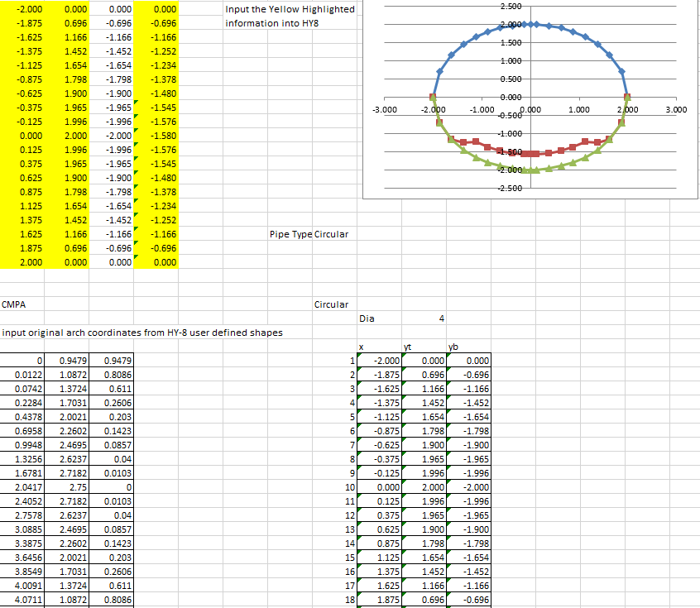
5” Paved Invert - Design and Analysis
Paved Invert Worksheet
Copy to the third column (y-bottom) to HY-8 user defined
Copy to first two columns (x, y-top) to HY-8 user defined
Choose shape from drop down
If shape is a pipe arch, copy coordinates from HY-8 and paste here
If circular enter diameter here

Slide 19
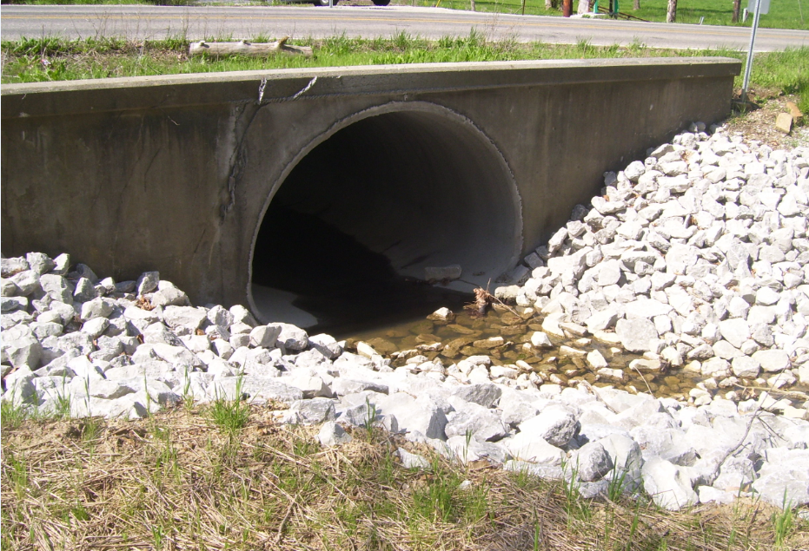
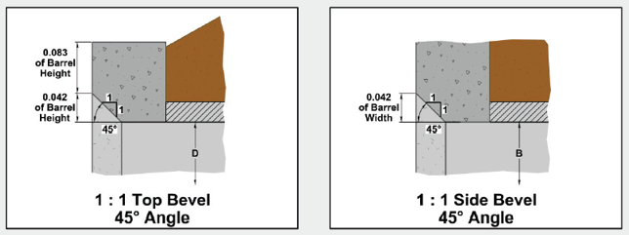
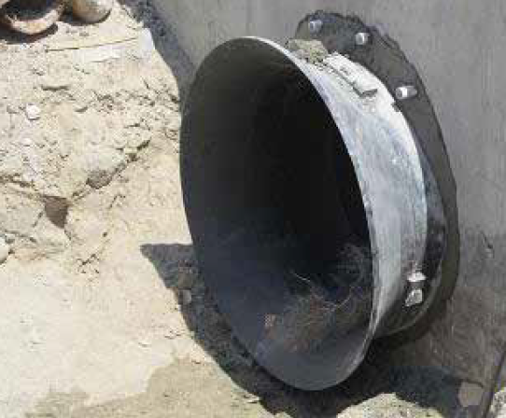
Hydraulic Capacity Improvements
  Hydraulics Improvements - Inlet Improvements
    Square Edge Headwall K_{e}=0.5
    Beveled Edge Headwall K_{e}=0.2 Bell shaped end section K_{e}=0.2

Slide 20
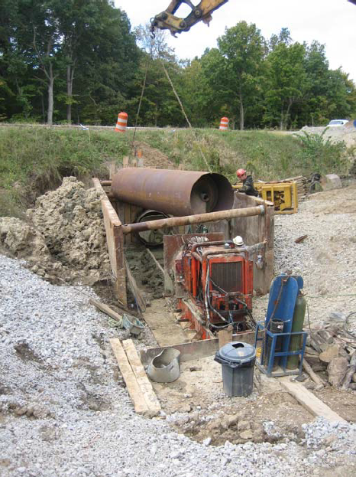
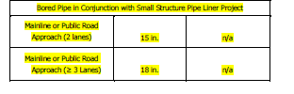
Hydraulic Capacity Improvements
  Bored Pipe Minimum sizes identified in Figure 203-2B
    Inverts should be 1’ above existing pipe
    Smooth interior
    Projecting Inlet condition unless headwall or end section is added

Slide 21
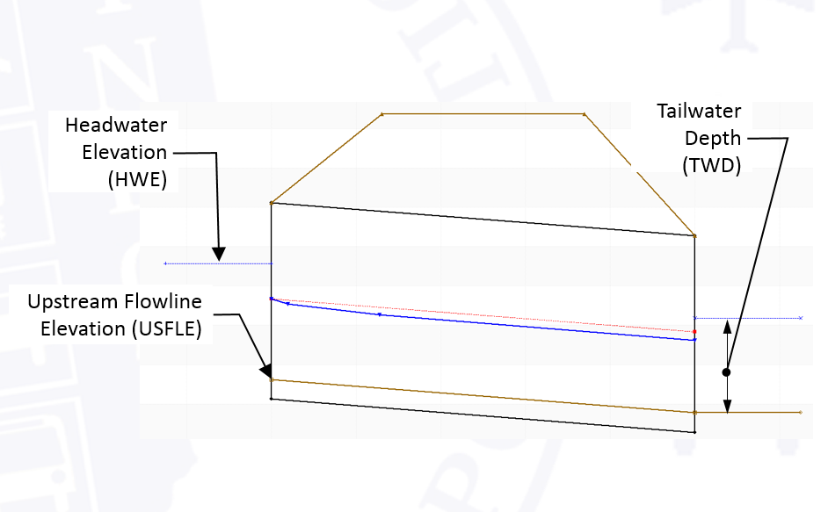
Backwater Calculation
Standard Backwater Calculation
BW = HWE – (USFLE+ TWD_{exist})
Backwater Calculation for Liners
BW_{prop} = BW_{exist} + (HWE_{prop} – HWE_{exist})
Notes:
The backwater is calculated using the 1% EP peak flow.
Existing and Replacement Options Backwater = Headwater Elevation – (Upstream Flowline Elevation + Tailwater Depth)
In cases the inverts are changing from the existing (liners, culvert extensions, etc.) the backwater should be determined by
The existing backwater + the difference in the Proposed Headwater elevation and the existing headwater elevation
The goal is to not increase the headwater. If the existing model shows overtopping it is also necessary to compare the capacity of the proposed culvert before overtopping occurs to ensure that the proposed capacity is greater than or equal to the existing.

Slide 22
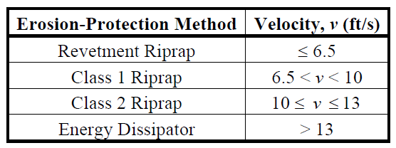
Design Criteria with Rehabilitation
No Increase to Backwater
  In some instances we have allowed exceptions if the headwater is contained in the right-of-way or within the channel
  If requesting an exception, provide a map showing the existing and proposed inundation from the headwater
  An alternative would be to purchase a flood easement
Provide mitigation for the increase in velocity
  Riprap apron or energy dissipator may be required

Slide 23
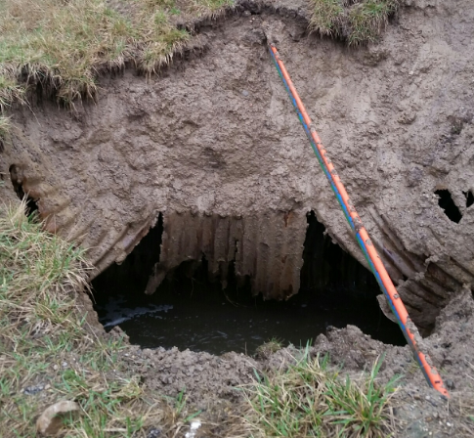
Replacement Options
Why Provide Replacement Options
If the lining becomes infeasible
Replacement size is available for future road projects
Notes:
Why does INDOT want to see replacement options analyzed for a pipe lining project.
Pipe further deteriorates – the existing pipe is typically not in good conditions and if the lining doesn’t happen soon enough the pipe can fail to the point where the lining is no longer an option and it needs to be replaced
Future road projects – the pipe may be lined for now but a future road project may come a long. At that time we INDOT doesn’t want to spend the money and resources to re-analyze the structure for replacement if it could have been provided initially.

Slide 24
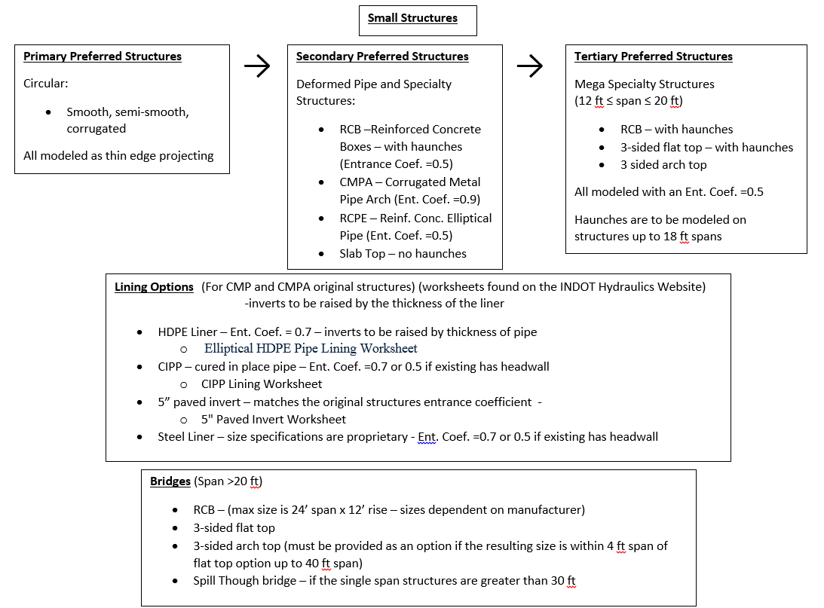
Replacement Options
Flow chart available on website

Slide 25
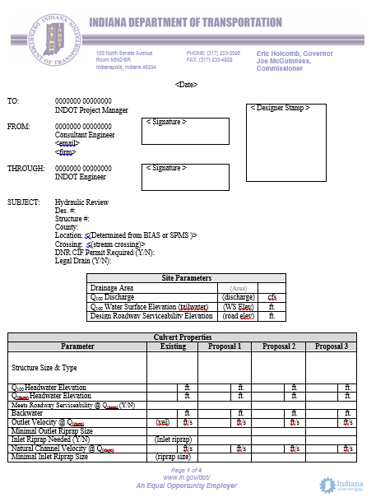
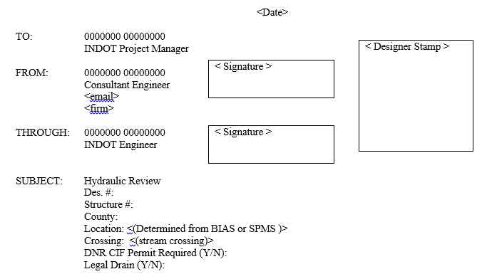
Reporting Results

Slide 26
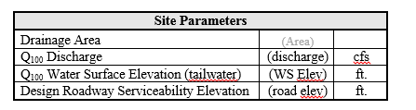
Reporting Results

Slide 27
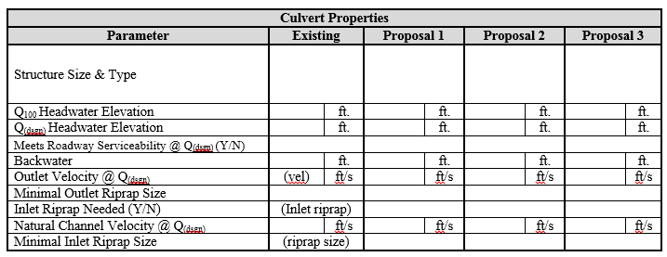
Reporting Results

Slide 28
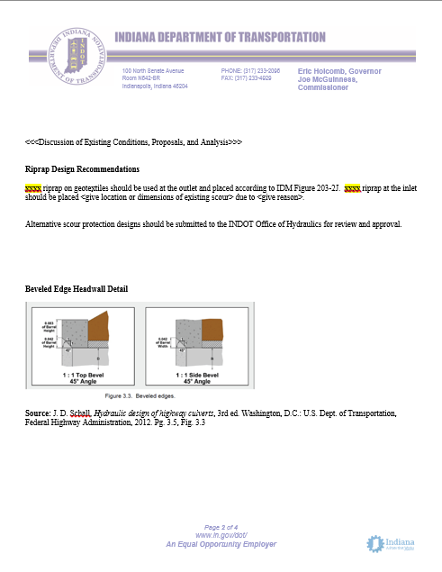
Reporting Results
Narrative
  Existing Conditions
  Proposed Conditions
  Analysis Notes

Slide 29
Reporting Results
Riprap Recommendations
  If all proposals have same size riprap – use template’s wording and rewrite the highlighted xxxx.
  If proposals use different sizes, categorize them by the size of rip rap required
  Give the reason why rip rap would be needed on the upstream side.
    If it is not needed provide the minimum size in case designer catches other issues that would call for its use.

Slide 30
Reporting Results
Beveled Edge Headwall Requirement
  If a beveled edge headwall is required for any proposal, use the figure provided.
    If not, delete section.

Slide 31
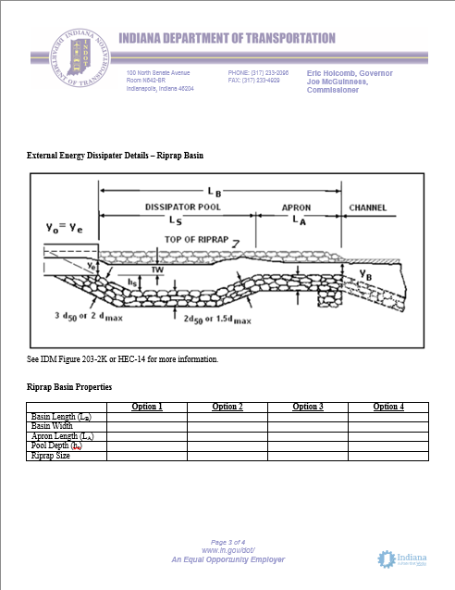
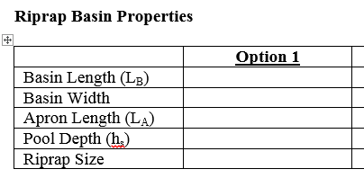
Reporting Results
Energy Dissipater Required
  For every proposal requiring an energy dissipater, fill out the table with the proper heading.
    The new heading should match the proposal name in the culvert properties table.
    Values received from
      HY-8 energy dissipater calculations
      IDM Fig. 203-2K and 2L
      Hec-14
  Delete section if not required

Slide 32
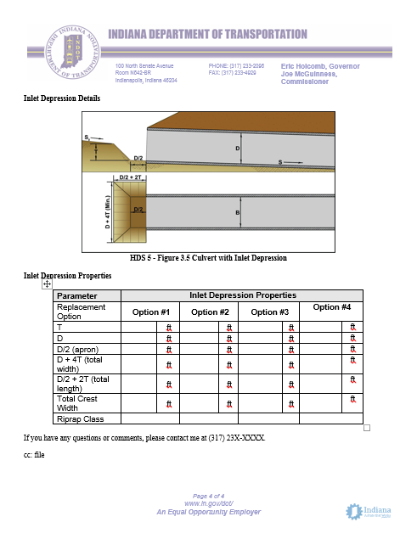
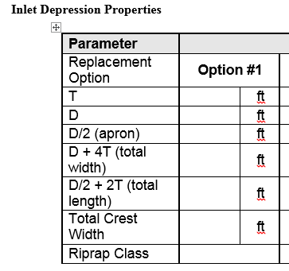
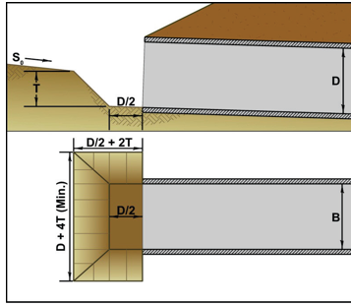
Reporting Results
Inlet Depression Required
  Fill out table with proper header
  Only required for replacements
  Delete section if not required

Slide 33

Contact Information and Questions
James Emerick, PE
  JEmerick@indot.in.gov
Alex Schwinghamer
  Aschwinghamer@indot.in.gov
INDOT Hydraulics Website
  www.in.gov/indot/3595.htm

