Slide 1
Hydraulics Request Application and How To Use It
Mark Bailey, P.E.
Updated 2/17/25 –Anthony Cox, to make preferred method of entry to be by Asset ID
Notes:
Welcome to the second session of the virtual 2021 Highway Design Conference. I have pre-recorded this edge of your seat PowerPoint presentation to try to minimize the technical glitches, to make sure I don’t go over on time, and to be available to answer questions in the chat during the presentation. Pay close attention to the slides with the gigantic exclamation points, they will point out the three things that at a minimum you need to take away from this presentation.
Note: Revision made to this presentation on 2/17/25. Deleted previous slides 38-43. Changed the preferred method to enter projects into HRA to be by Asset ID rather than by DES#. We noticed that for bridges that were entered by DES #, it was adding the DES # as the NBI number when reporting to the data warehouse/ITAMS/ERMS

Slide 2
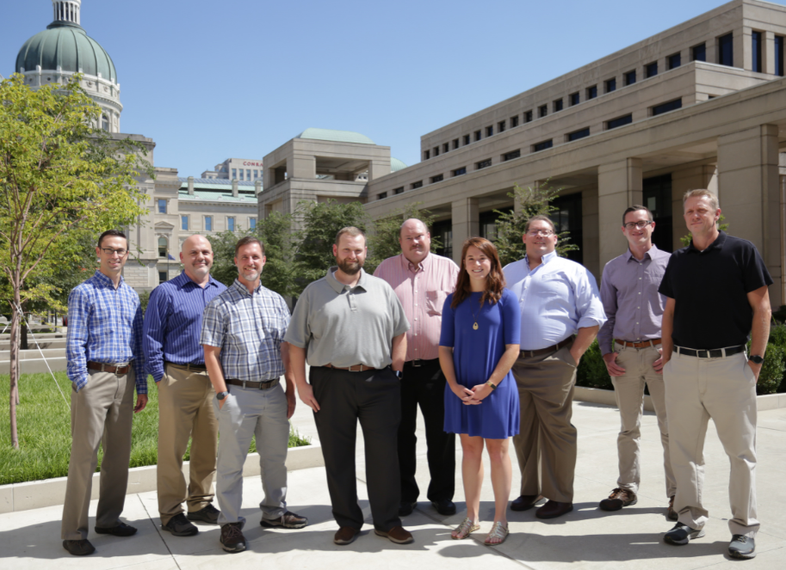
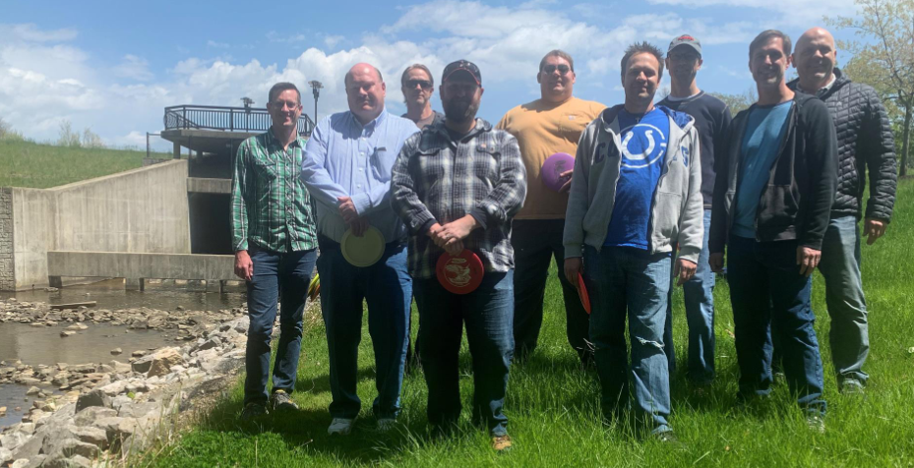

INDOT Hydraulic Engineering
Notes:
Since we are still virtual, I thought it would be good idea to start with showing you who we are. Between the three pictures you can see all 11 of us.

Slide 3
Overview
When?
What?
Why?
Who?
How?
Q & A
Notes:
Here is everything we’re going to cover in the presentation. Let’s start with the timeline.

Slide 4




When
Timeline
3/9/2020 Kickoff meeting (in person)
Lots of meetings!
3/26/2021 Live
Internal (hydraulics division) use only
Added bridge and culvert asset engineers
Added additional district staff
On-call consultants
6/29/2021
Open for all
Notes:
This is the timeline for the application. We had the kickoff meeting in person in March of 2020, plenty of virtual meetings, a soft open that started at the end of March of 2021 to work through the bugs and to try to minimize headaches. As of today we are declaring the app ready for everyone. Be on the lookout for a design memo in the near future that will give a mandatory use date for consultants, I am currently targeting August 1st 2021, but you don’t have to wait you can start using it now.

Slide 5

Overview
When?
What?
Why?
Who?
How?
Q & A
Notes:
Next let’s go over what this thing is.

Slide 6
What
Hydraulics Request Application (HRA)
  Latest and greatest application on the INDOT Technical Application Pathway (ITAP)
  Automate administrative tasks
    Design requests from INDOT staff (54% of workload)
      Small structures
      Bridge replacements
      Bridge scour analysis
      Drainage complaints
    Review requests from consultants and INDOT staff (46% of workload)
      All consultant hydraulic submittals.
      Designs by INDOT staff outside of the Hydraulics Engineering division
      Hydraulic reviews for permit applications in the Electronic Permit System (EPS)
Notes:
It’s called the hydraulics request application or HRA for short. The application was developed to automate as many administrative tasks as possible to free up time for staff to complete designs and reviews. Our work split is roughly 50 50 and includes the various types of work listed on the slide.

Slide 7
Overview
When?
What?
Why?
Who?
How?
Q & A
Notes:
Up next is why did we do this.

Slide 8
Why
Significant increase in project workload
Thousands of emails required for coordination
Manual data entry required for each request
11 staff members share 1 spreadsheet
Had to Innovate!
Notes:
We are processing over 4 times the number of requests that we had five years ago with no signs of slowing down.
There are typically at least 6 emails per request.
Most of the data that is manually entered already exists in other INDOT applications so we are duplicating our efforts and providing an opportunity for mistakes.
Our spreadsheet has macros, so only one person can edit it at a time.
We had no choice but to innovate to keep up with the workload demand.

Slide 9
Overview
When?
What?
Why?
Who?
How?
Q & A
Notes:
Next is who this application was developed for.

Slide 10

Who
Everybody that has the division of hydraulic engineering do a design or review for them!
Notes:
This app is for anyone that interacts with the division of hydraulic engineering.

Slide 11
Overview
When?
What?
Why?
Who?
How?
Q & A
Notes:
I’m sure you are all getting excited because it looks like we’re almost through the presentation and it’s only been a few minutes. The How is the meat of the presentation, and takes up the next 73 slides so let’s dive into how you use this thing.

Slide 12

How
Get access to the application!
Notes:
The first step is to get access to the app. Let’s go over how you get in that door!

Slide 13
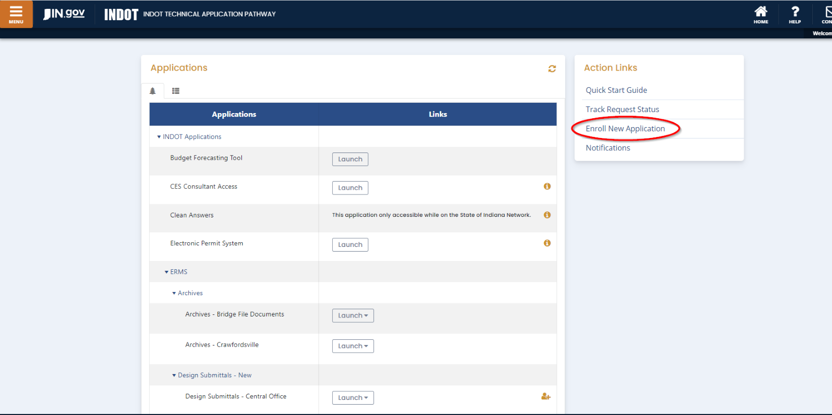
How
The HRA is accessed through the INDOT Technical Application Pathway (ITAP) at https://itap.indot.in.gov/.
Click Enroll New Application
Notes:
The HRA is an ITAP application, go to the ITAP website and under the action links, click on Enroll New Application

Slide 14
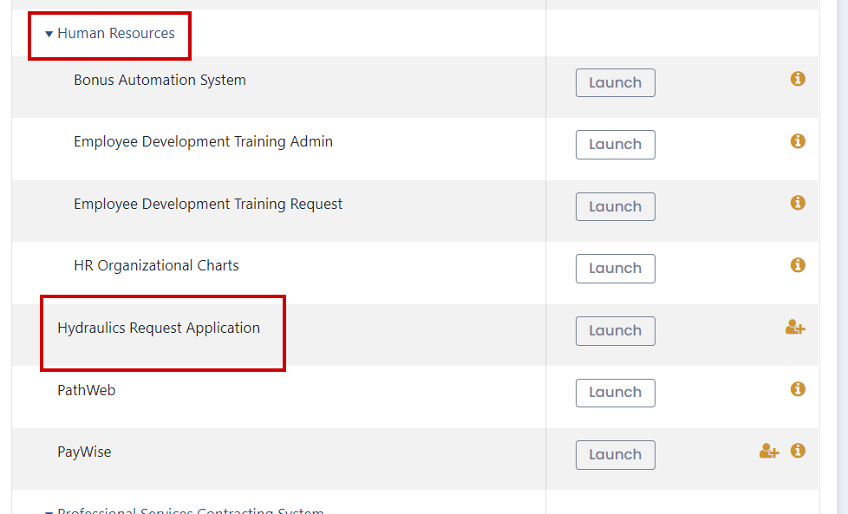
How
Notes:
There is a trick to getting this application, there are two apps with the word hydraulics in their names, this one is the Hydraulics Request Application under Human Resources, NOT Hydraulics under ERMS. You may be wondering why the HRA is under Human Resources, if so, you are not alone…

Slide 15
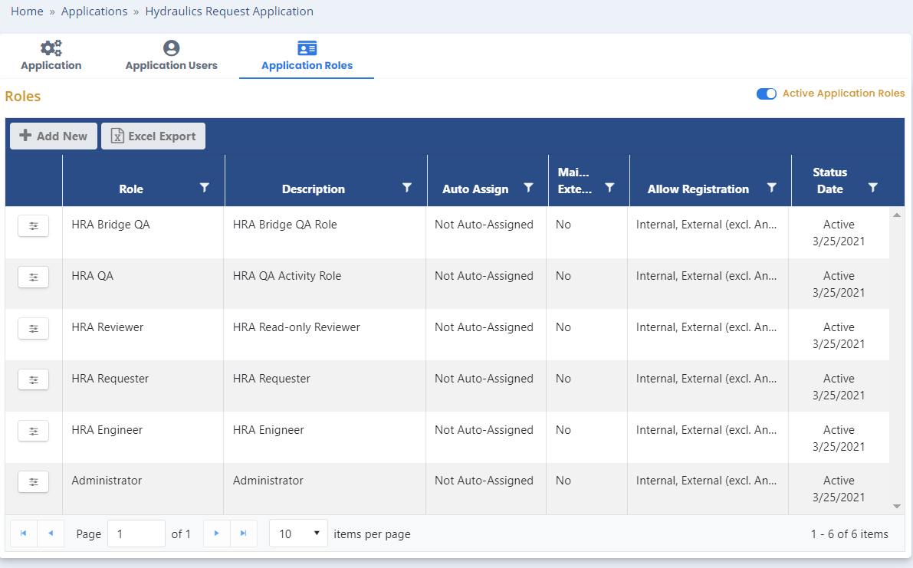
How
What role to you need to request?
Notes:
If you will be sending in submittals for review or asking us to do designs you want the HRA Requester Role. If you just want to track projects for your firm or agency and will not be doing any submittals yourself, you will want the HRA Reviewer role.

Slide 16
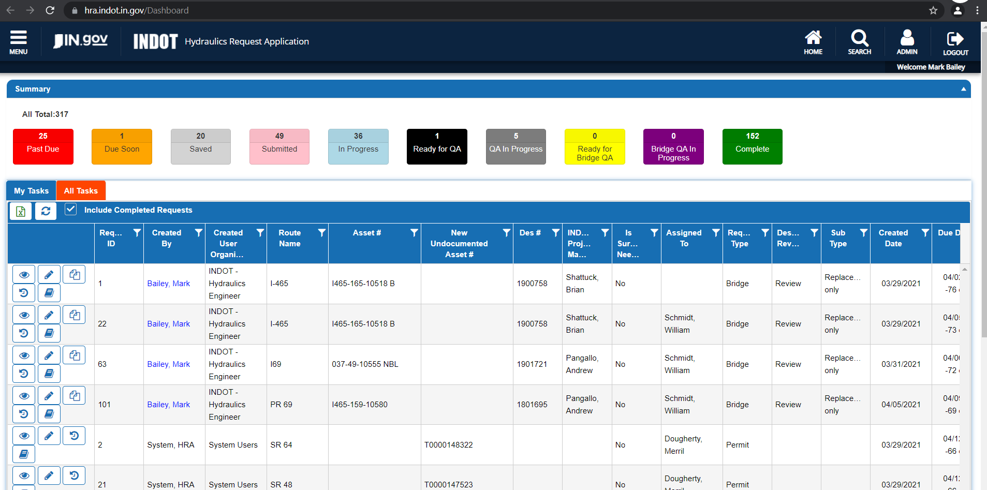
How
Notes:
Now that you’re in, let’s go for a tour and learn how to navigate in the system.

Slide 17
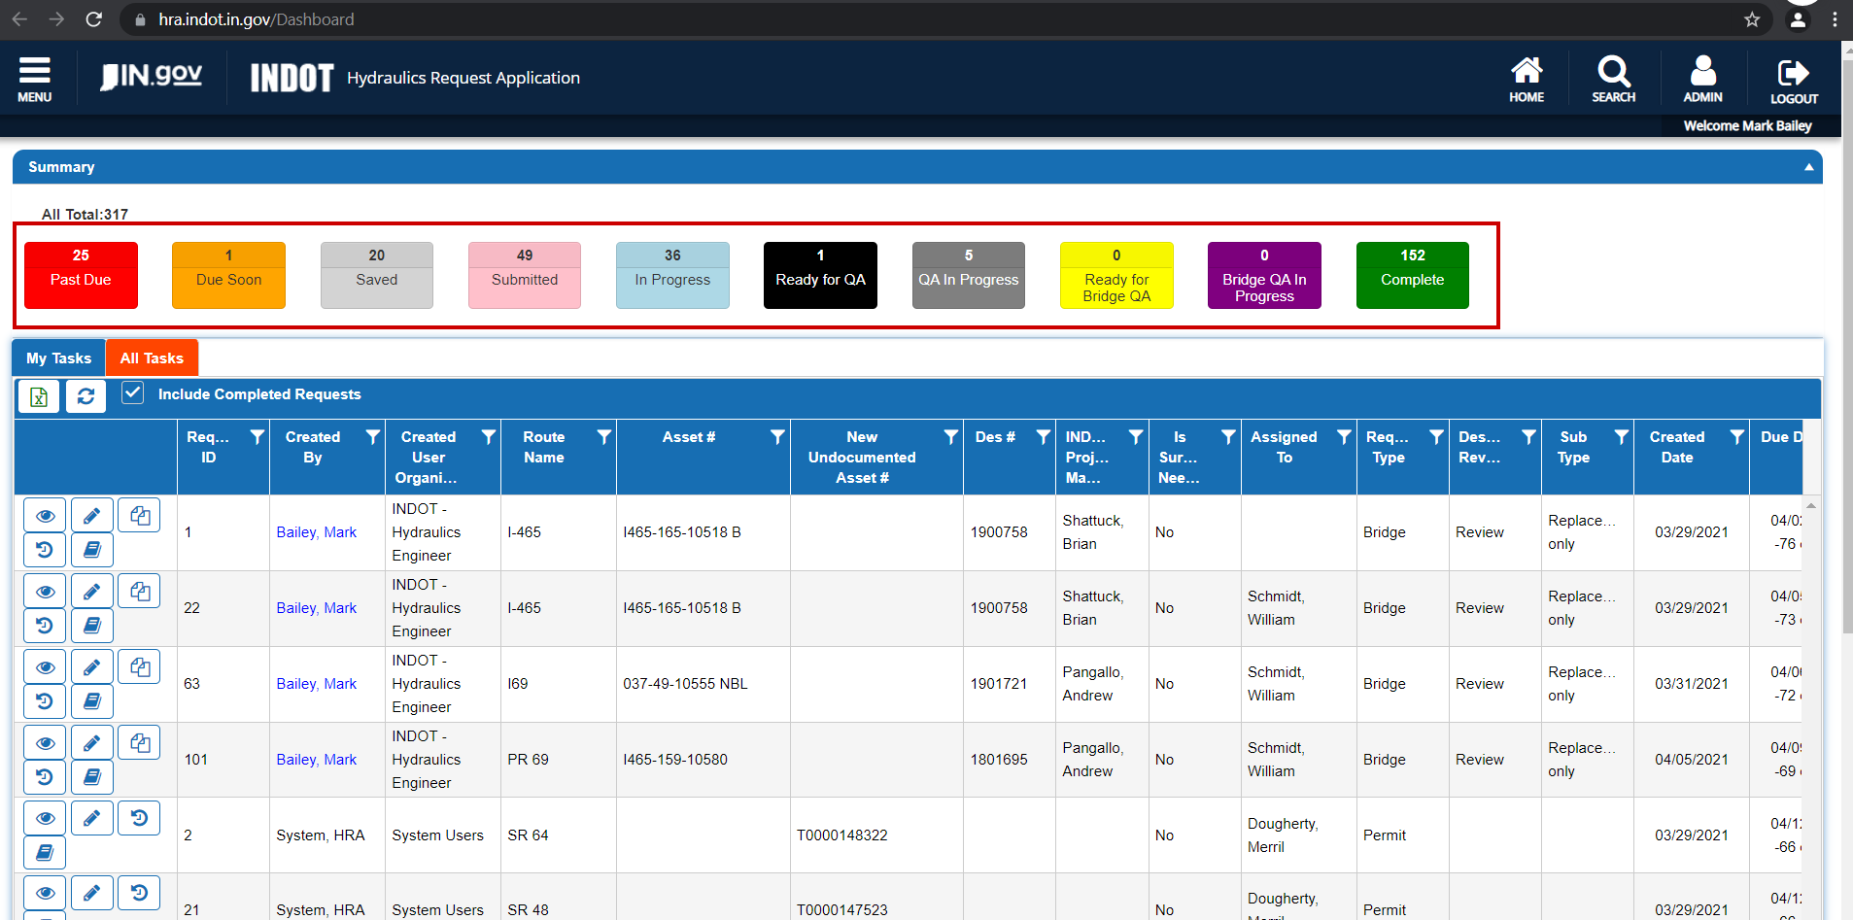
How
Notes:
These rectangles at the top not only let you know how many projects are in a certain status, they also are filters that you can click on to limit the projects that are shown on the dashboard. For example, if I wanted to see what projects are currently being QA’d, I click on the QA In Progress rectangle and only those projects are shown.

Slide 18
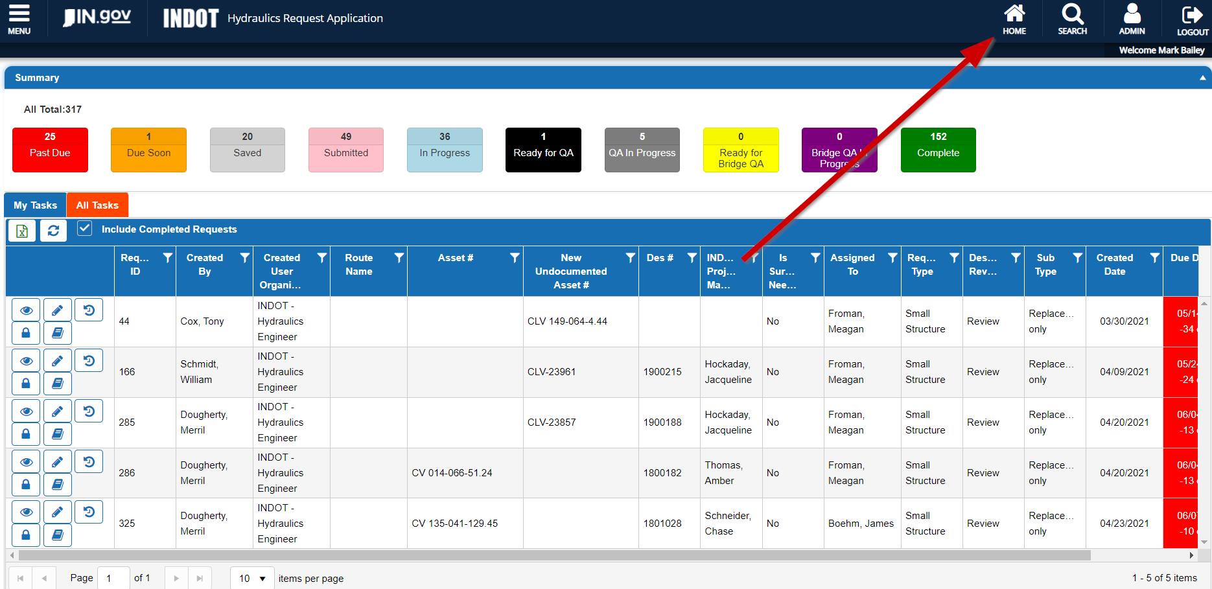
How
Notes:
To clear a filter click on the Home button in the top right

Slide 19
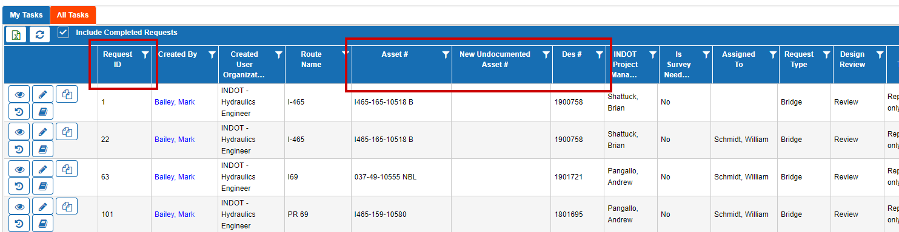
How
Notes:
The best ways to find a project are going to be by the Request ID, Asset #, or Des #. A unique Request ID is generated for each submittal, asset #’s are bridge asset names, culvert asset names or something called pipe asset name (human readable). The terminology is very important, so I will show you where you can find what the HRA calls asset #’s.

Slide 20
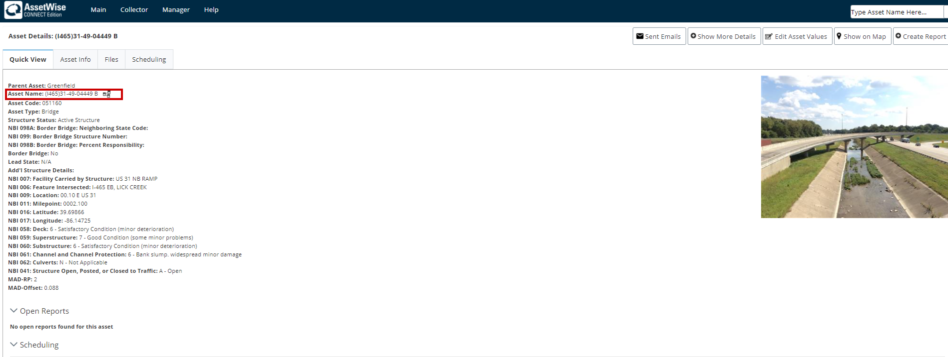
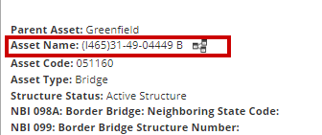
How
Notes:
Here is where to find a bridge asset name

Slide 21
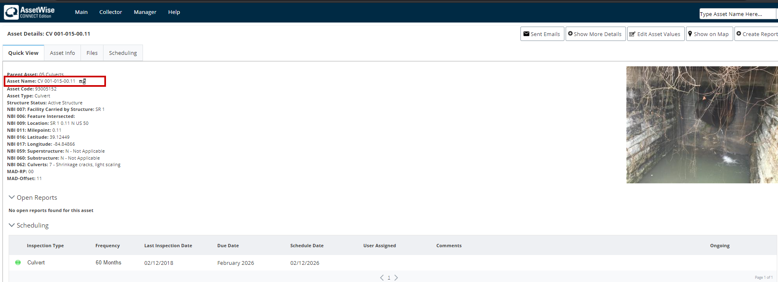
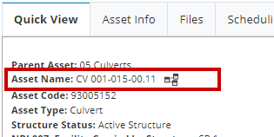
How
Notes:
This is a culvert asset name, they will all start with CV

Slide 22
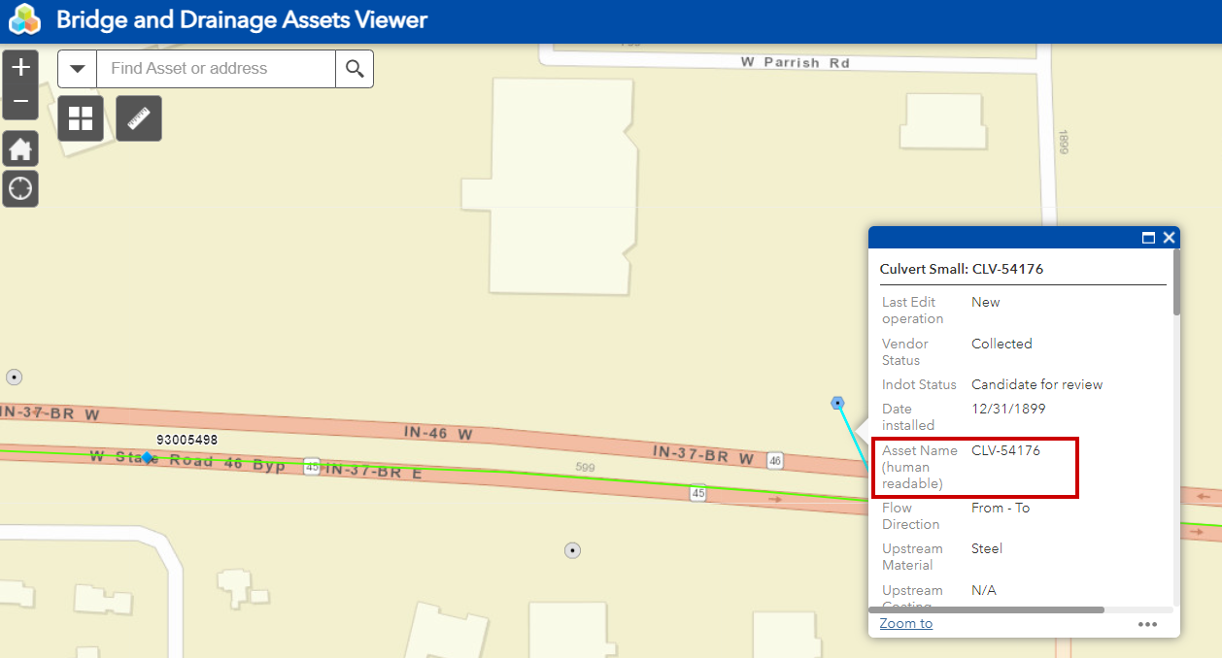
How
Notes:
And this is a pipe asset name (human readable) for anything with a span < 48”

Slide 23
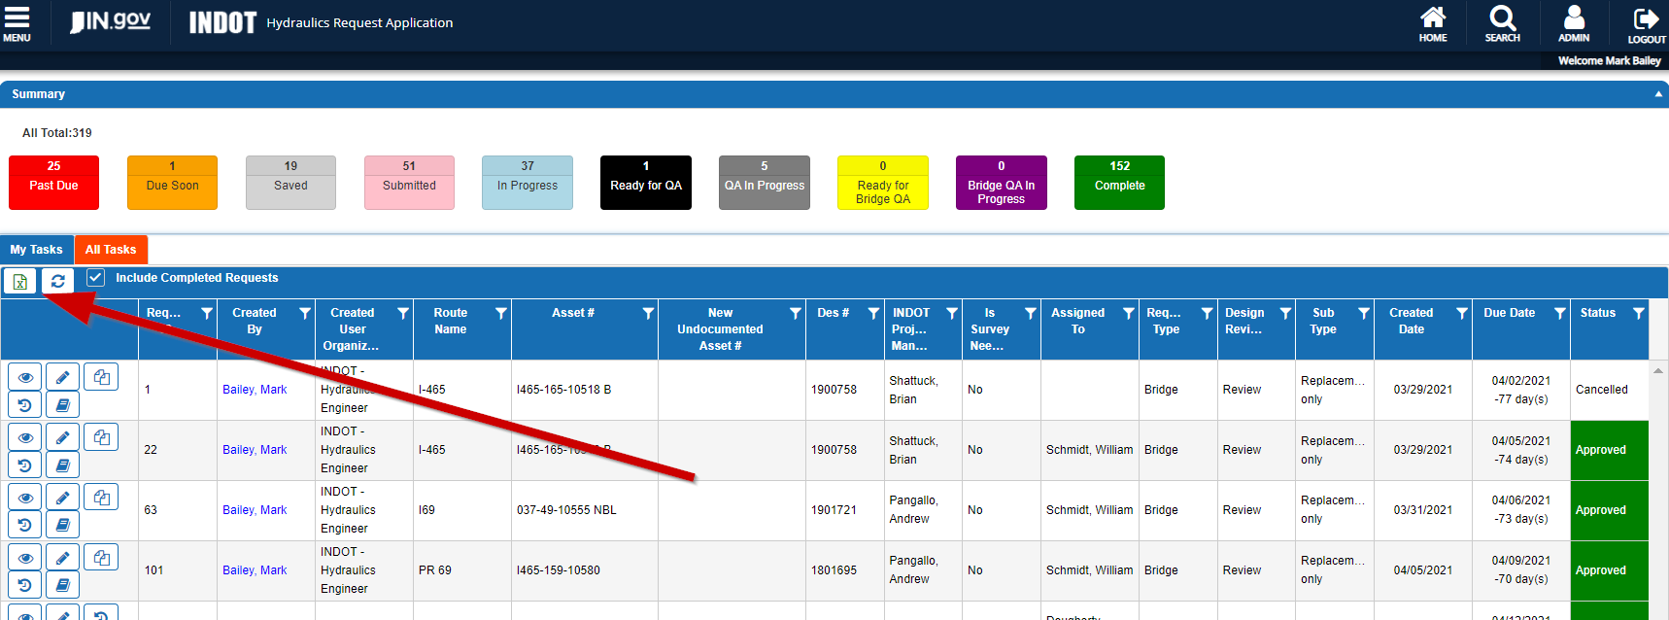
How
Notes:
If you are trying to look up the status of submittals and you are more comfortable working in Excel, click on this icon and the HRA will provide you with a spreadsheet that has all of the data for all of the projects currently shown on the dashboard. For example, if you click on the Ready for QA filter only one project will be shown on the dashboard, and that will be the only project in the spreadsheet.

Slide 24
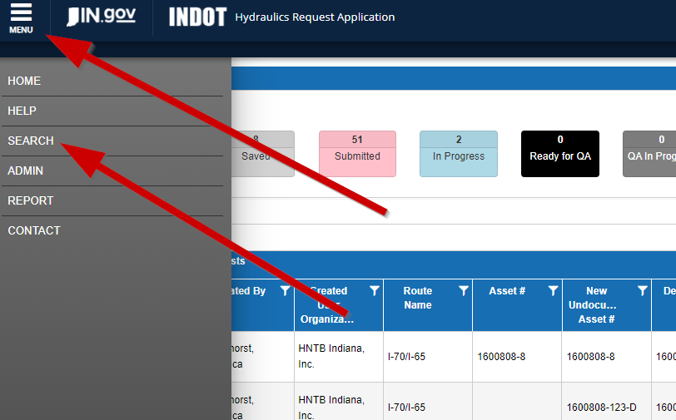
How
Notes:
Clicking menu and then search give you even more options to find your project.

Slide 25
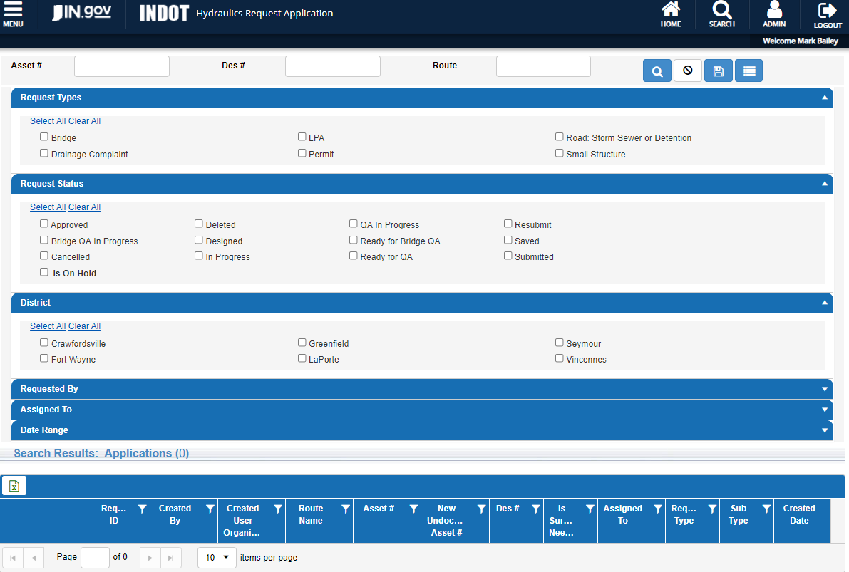
How
Notes:
You can search by request type, status, district

Slide 26
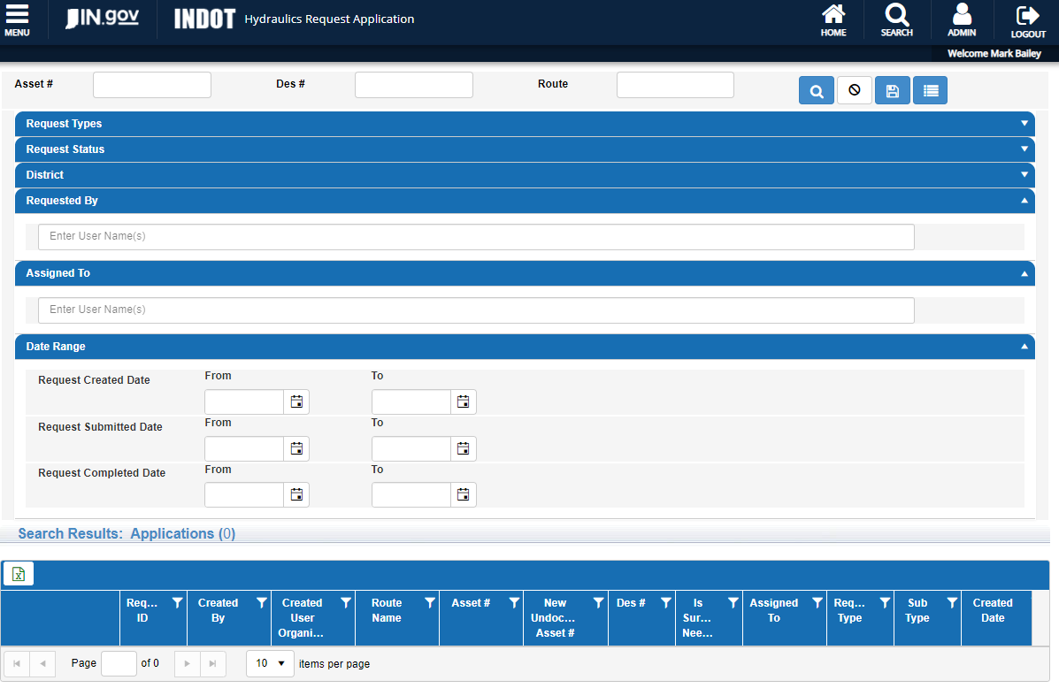
How
Notes:
Requests that you or someone else submitted, or dates

Slide 27

How
Notes:
Let’s jump right into this rabbit hole and get very detailed with a couple of submittal types. We don’t have time to demo all the possible combinations of design and review submittal types, but fortunately all the submittal types follow the same workflow.

Slide 28
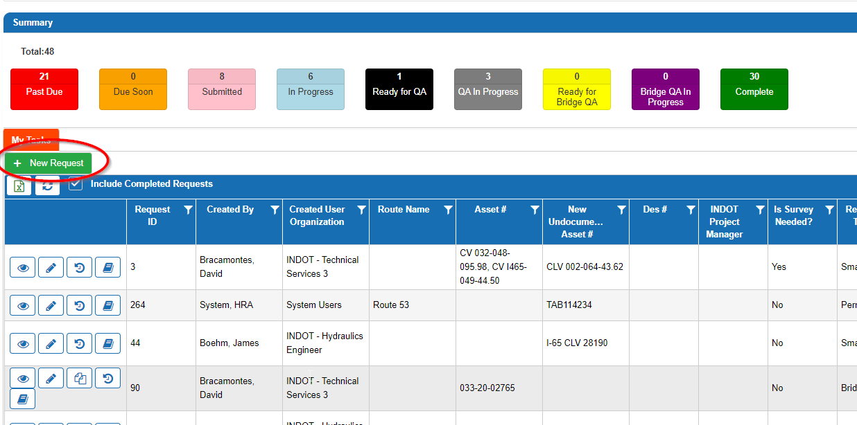
How
Submitting a New Request-Small Structures (Design)
Click New Request.
Notes:
Let’s start with how to do a request for a small structure design. A few hundred of these come in every year from the District bridge and culvert asset engineers. Start by clicking New Request.

Slide 29
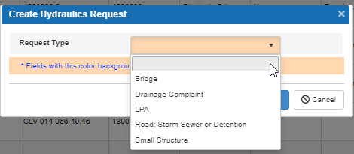
How
There are multiple types of Hydraulic Requests. For this type of request, choose Small Structure.
Notes:
Select your request type

Slide 30
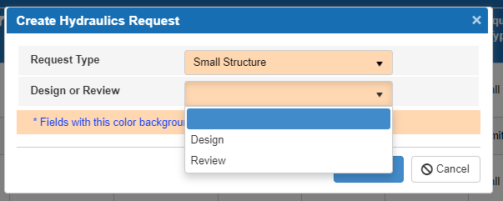
How
There are two options for small structure requests: Design and Review. For this type of request, select Design.
Notes:
Then let us know if you are asking for a design or review

Slide 31
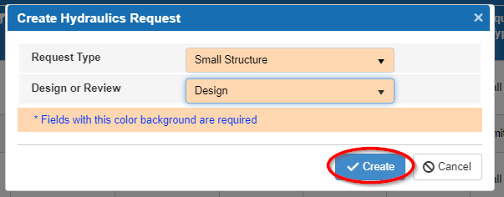
How
The screen should look like this for a small structure design request. Click Create to continue.
Notes:
Then click create

Slide 32
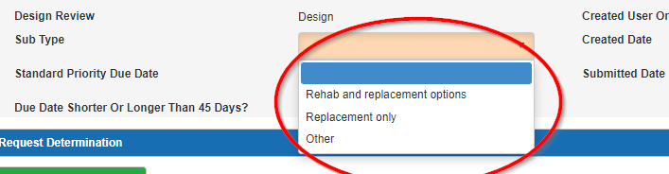
How
In the rating request window, fill in the Sub Type box with the correct option. Rehab options include requests for liners, paved inverts, etc.
  Note: Please select the sub type that matches the sub type for each small structure attached to this request (i.e. structures needing only replacement options, cannot be included with structures needing liner options). An additional request will need to be submitted for different sub types.
Notes:
Next pick the sub type of request. The great news is that you can quickly add multiple structures to a single request, the bad news is that they all have to be the same work type, either liners and replacement options or replacement only options.

Slide 33
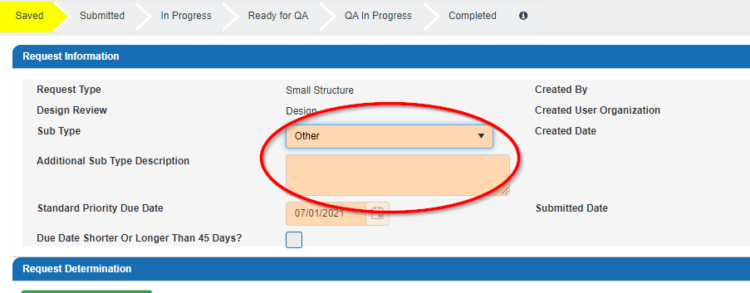
How
  If you choose Other as the sub type, fill in the description box with the intent of your request.
Notes:
If you pick other, let us know what you are sending in or need us to do

Slide 34
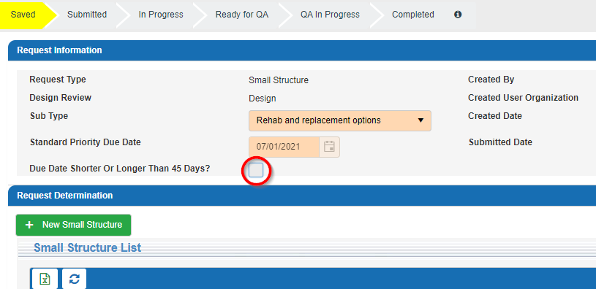
How
A standard priority date will be set to 45 calendar days from the day the request is submitted. If you do not need the design completed that quickly or need a quicker turn-around time, click the box next to Due Date Shorter or Longer than 45 days?
Notes:
Our metrics for providing services are based on 45 day turn around times so we use 45 calendar days to set the standard priority due dates. If you need something quicker or have more time, check the box and select the date you need the work completed by. Quicker requires a reason and approval, longer is automatically approved and always appreciated.

Slide 35
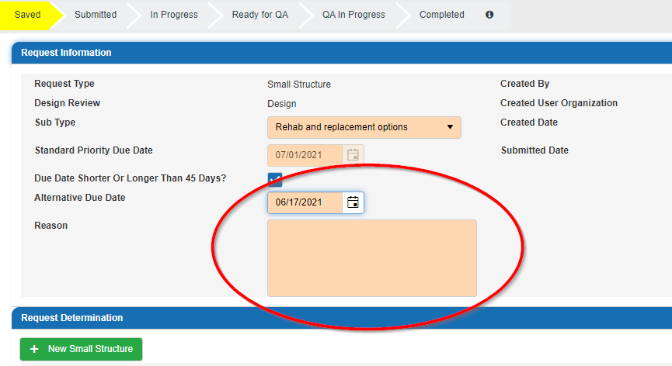
How
  Once clicked, an Alternative Due Date box will appear. If you choose a date earlier than the standard priority due date, you will need to provide a reason for the expedited date. This reason will be reviewed by the Office of Hydraulics and either approved or denied. If you choose a date later than the standard priority due date, you will not need to provide a reason.
Notes:
This is the text box to explain why the work needs to be expedited.

Slide 36
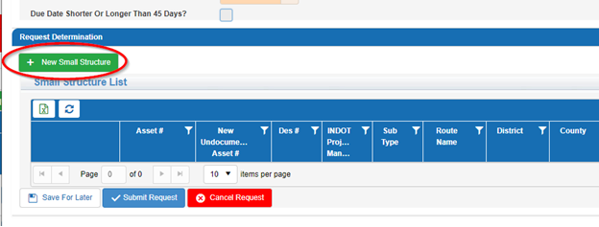
How
Add small structures to the request by clicking + New Small Structure.
Notes:
Then click the + New Small Structure button

Slide 37
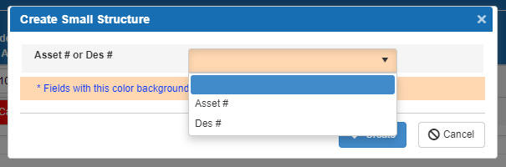
How
In the Create Small Structure Window, you can add new structures by either the Asset # or Des #.
Notes:
You can add a structure by asset # or Des #

Slide 38

How
Thou shalt have an asset #
Notes:
Important takeway #1, the previous few slides are extremely important. Thou shalt have an asset #, it can be one that you create if there is not one, but we have to have an asset number and you cannot submit a request without one!

Slide 39
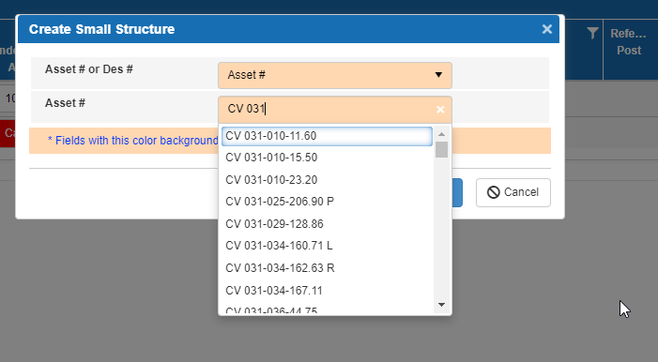
How
9. The preferred method is to add by Asset #. To add by Asset #, select Asset # in the first drop down. An Asset # box will appear. If you start typing the Asset # into the box, the system will search for the asset and you can select the asset you are wanting to add.
Notes:
The preferred method is to add a structure by asset #

Slide 40
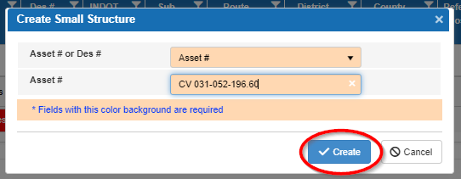
How
10. Click Create.
Notes:
Click Create

Slide 41
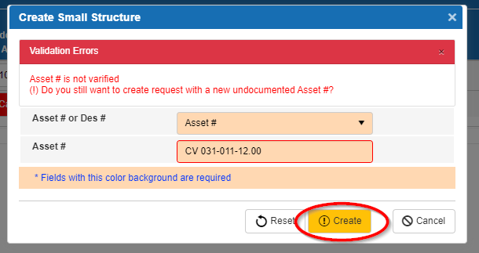
How
11. Adding an Undocumented Asset.
  If you type in an Asset # that is not in the system, an error will occur.
  If this was your intention, click Create and a new Undocumented Asset # will be created. If this was not your intention, please correct the Asset # before adding to the request.
  Please look at the naming convention of undocumented assets in the help file.
Notes:
If you don’t have an asset #, use an undocumented asset #. The naming convention for creating an undocumented asset # is in the help document.

Slide 42
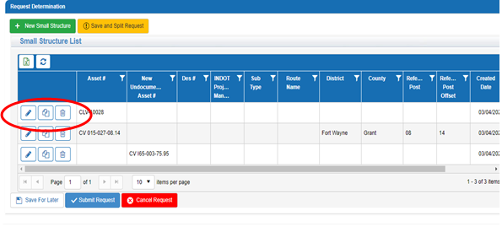
How
12. There is not a requirement for any files to be uploaded to submit this type of request (small structure design).
Notes:
Individual structures can be edited or deleted by using the buttons to the left of the Asset # column. The pencil is the edit button the trash can is the delete button, and the button between them is the view documents button. The view documents button is where you can upload documents relating to your request.

Slide 43
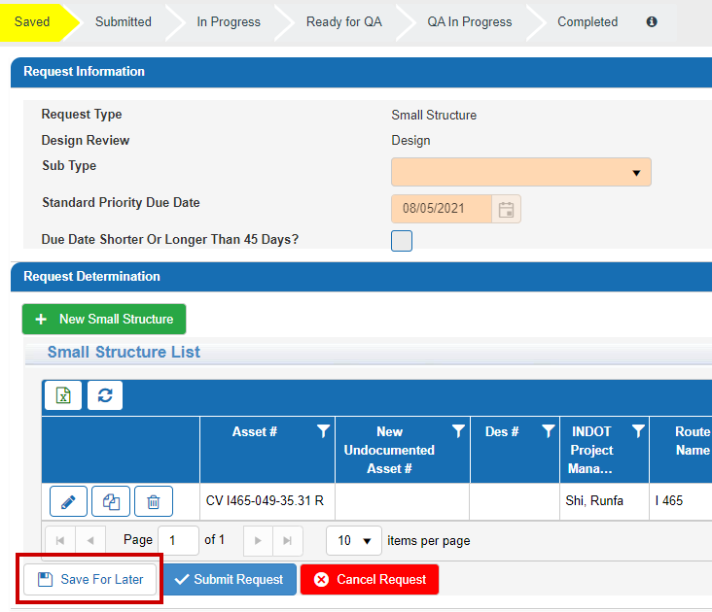
How
Note: If you are uploading documents for an Undocumented Asset ID, you must save the request before trying to upload documents.
Notes:
This is #2 of the 3 important takeaways. The document upload will fail if you have an undocumented asset ID and do not click Save For Later before you upload your files.

Slide 44
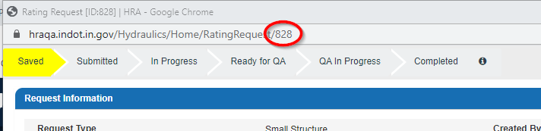
How
13. Continue adding structures until you are done with your request. You can submit up to 50 structures per request. Only submit structures with the same sub type in one request.
14. It may be beneficial to note your Request ID to quickly search for projects in the future. The request ID can be found in the address bar at the top of the window. For example, this request ID is 828.
Notes:
Keep adding structures as needed, the maximum number recommended is 10 for review requests. The number at the end of the address bar is the request ID.

Slide 45
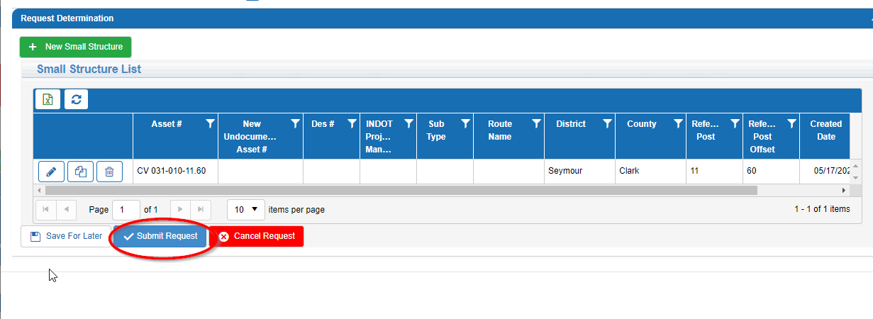
How
15. Then click Submit Request at the bottom on the screen. There is also an option to save your request for later or to cancel your request.
Notes:
Here is the final step, click submit request.

Slide 46
How
Click New Request.
Notes:
Next, let’s see how to submit a request for a small structure review. Start by clicking on New Request

Slide 47
How
choose Small Structure.
Notes:
Then click on small structure

Slide 48
How
select Review
Notes:
Click on review

Slide 49
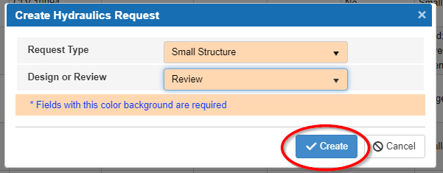
How
Click Create to continue.
Notes:
Then click Create

Slide 50
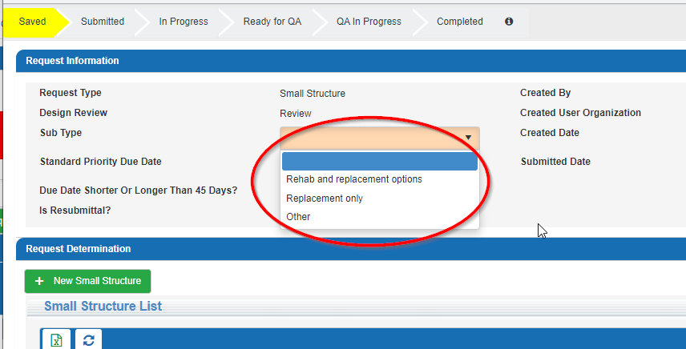
How
In the rating request window, fill in the Sub Type box with the correct option. Rehab options include requests for liners, paved inverts, etc.
Notes:
Next, fill out the sub type. Keep in mind that rehab means liners. If you have multiple small structures that need reviewed, group your submittals by sub type and try to limit each review submittal request to 10 structures.

Slide 51
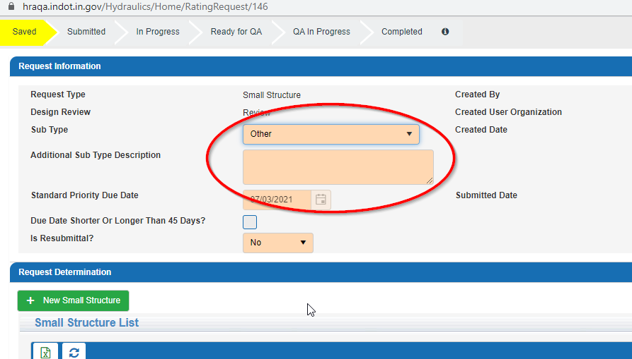
How
Notes:
If you pick the other sub type let us know what you did.

Slide 52
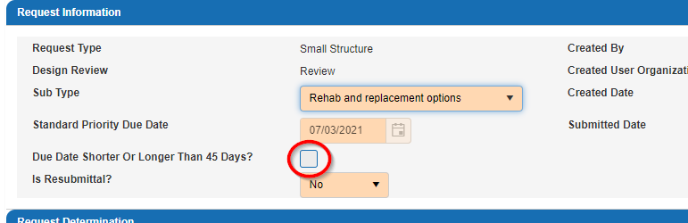
How
Set the due date.
Notes:
The standard priority date will be set to 45 calendar days from the day the request is submitted. If you do not need the design completed that quickly or need a quicker turn-around time, click the box next to Due Date Shorter or Longer than 45 days?

Slide 53
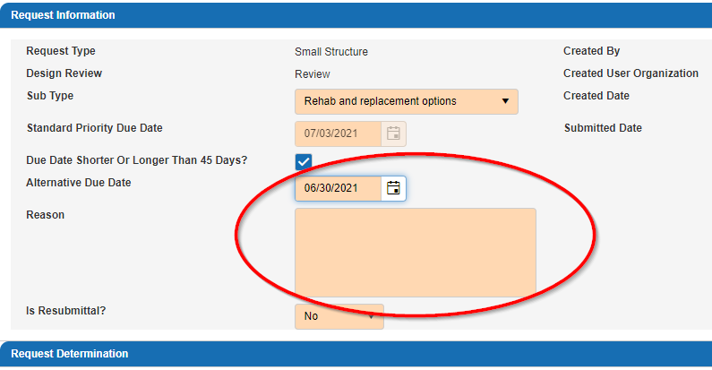
How
    Set the due date continued.
Notes:
If you click the box for Due Date Shorter Or Longer Than 45 Days?, an Alternative Due Date box will appear. If you choose a date earlier than the standard priority due date, you will need to provide a reason for the expedited date. This reason will be reviewed by the Office of Hydraulics and either approved or denied. If you choose a date later than the standard priority due date, you do not need to provide a reason, we will already know the reason is because you are awesome.

Slide 54
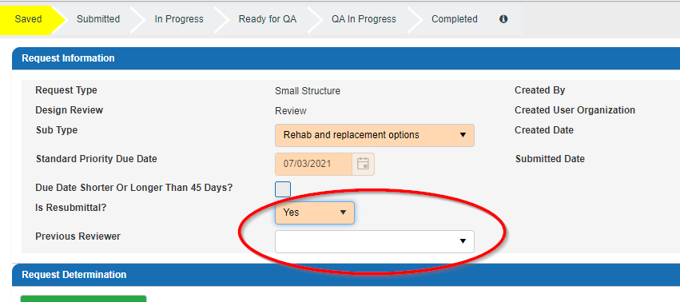
How
Resubmittal?
Notes:
It can happen to the best of us. If this is a resubmittal use the pull down menu to pick yes. Once you select Yes the Previous Reviewer pull down menu pops up. Select your previous reviewer so that this submittal can be routed to them which speeds up the review process.

Slide 55
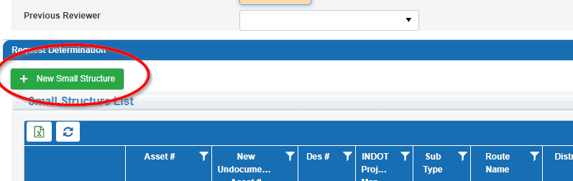
How
Which structure(s)?
Notes:
Click on the + New Small Structure button to add structures to be reviewed.

Slide 56
How
In the Create Small Structure Window, you can add new structures by either the Asset # or Des #.
Notes:
As with design requests, the preferred method is by Des # because the HRA will automatically pull information about the project from other systems.

Slide 57
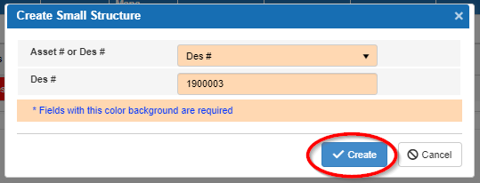
How
Click Create.
Notes:
Then click create

Slide 58
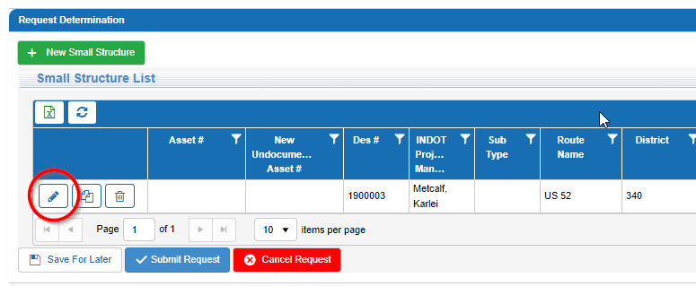
How
  Need an asset #?
Notes:
If the Des # did not have an asset # associated with it or if it did not have the correct asset # associated with it you will need to add the correct one. Click on the pencil icon to do this.

Slide 59
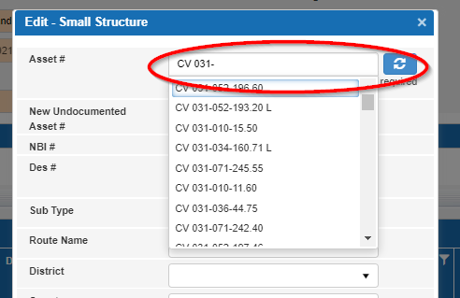
How
  Pick asset #.
Notes:
Start typing the asset # in the top box and then select the asset from the drop down.

Slide 60
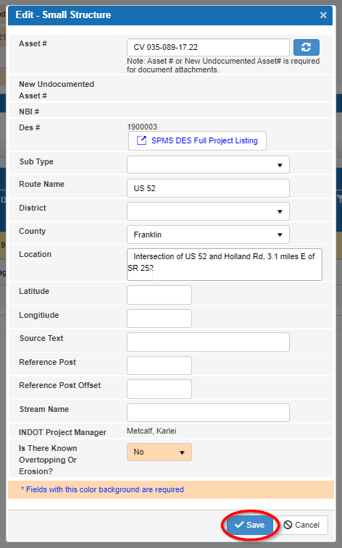
How
  Pick asset #.
Notes:
If you need to add an Undocumented Asset #, fill out the New Undocumented Asset # box. Please follow the naming convention in the help file when creating an undocumented asset number.

Slide 61
How
  Pick asset #.
Notes:
Fill in any additional information and click Save.

Slide 62
How
If no Des #. Use Asset #
Notes:
If there is not a Des # available, then Add by Asset #. To add by Asset #, select Asset # in the first drop down. An Asset # box will appear. As you start typing the Asset # into the box, the system will search for the asset and then you select the one you are wanting to add.

Slide 63
How
Click Create.
Notes:
Click Create

Slide 64
How
Adding an Undocumented Asset
Notes:
If you type in an Asset # that is not in the system, an error will occur. If this was your intention, click Create and a new Undocumented Asset # will be created. If this was not your intention, please correct the Asset # before adding to the request. Please follow the naming convention in the help file when creating an undocumented asset number. Once you click create the next thing that you should do is to save the request before uploading files.

Slide 65
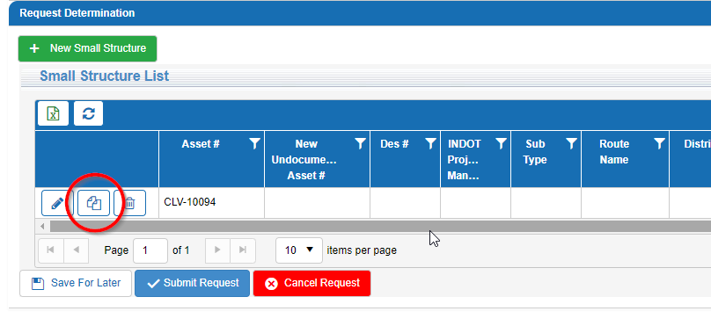
How
Add documents / files.
Notes:
Several documents need to be added before this type of request can be submitted. To add documents to a structure, click the View Documents button for an asset.

Slide 66
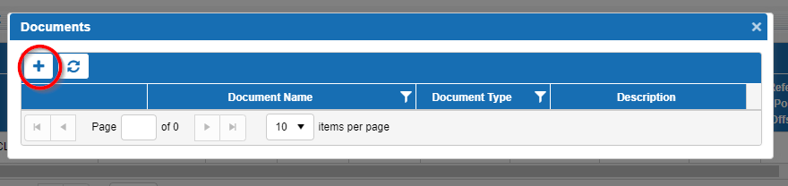
How
Add documents / files.
Notes:
On the Documents window, click the plus sign to add your documents.

Slide 67
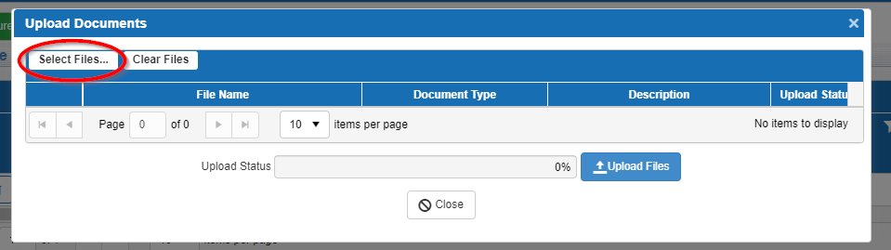
How
Add documents / files.
Notes:
On the Upload Documents window, click Select Files… and then select the documents that you want to add, you can add everything at one time.

Slide 68
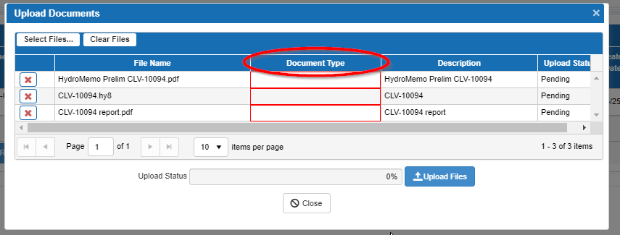
How
Add documents / files.
Notes:
Select a document type for each file you upload.

Slide 69
How
All design requests have no required file types.
 |  | Design Computations | Plans | Preliminary Memo | Model | Reports
Bridge | Scour | One of these | X | X | X | One of these
 | Replacement Only | One of these | X | X | X | One of these
 | Other | One of these |  | X |  | One of these
Drainage Complaint |  | One of these |  | X |  | One of these
LPA |  | One of these | X | X | X | One of these
Road: Storm Sewer or Detention | Storm Sewer | One of these | X |  |  | One of these
 | Detention | One of these | X |  |  | One of these
 | Other | One of these | X |  |  | One of these
Small Structure | Rehab and replacement options | One of these |  | X | X | One of these
 | Replacement only | One of these |  | X | X | One of these
 | Other | One of these |  | X |  | One of these
Notes:
These are the various files that will be required to submit a review request. If you have additional files or information please send it, but the file types listed above are required. As an example, if you are submitting a request to review a small structure liner design you will need to upload a preliminary memo, a model, and either design computations or a report.

Slide 70

How
Add documents / files.
Notes:
Once you have finished identifying the various document types click on Upload Files. Uploads fail for two main reasons, if the file size is larger than 40 megs or if you have an undocumented asset ID and did not click “Save For Later” in the bottom left hand corner. If your file size is larger than 40 megs use the program 7-Zip to break the file into 40 meg or less pieces and upload all of the files that get created.

Slide 71

How
Change the structures (if needed)
Notes:
Individual structures can be edited or deleted by using the buttons to the left of the Asset # column. The pencil is the edit button, and the trash can is the delete button.

Slide 72
How
Request ID
Notes:
It may be beneficial to note your Request ID(s) to quickly search for projects in the future. The request ID can be found in the address bar at the top of the window. For example, this request ID is 828.

Slide 73
How
Send it in!
Notes:
Then hit Submit Request at the bottom on the screen. There is also an option to save your request for later or to cancel your request.

Slide 74

How
Notes:
For similar step by step directions for each possible submittal type, in the HRA click Menu, then Help.

Slide 75
How
Hydraulic Engineering Website https://www.in.gov/indot/3595.htm
Notes:
Important takeaway #3, this presentation is on the INDOT hydraulic engineering website, the undocumented asset # naming convention is in the HRA help document. The website is full of useful information, anyone doing hydraulics at your firm should be subscribed to our email list, a link to sign up for the email list is at the bottom of our webpage.

Slide 76
How
Recap
  Thou shalt have an asset #
  Click “Save For Later” before uploading files if you have an undocumented asset #
  This and other important information lives on the Hydraulics webpage
Notes:
These are the three important takeaways from the presentation.

Slide 77
Special Thanks
Jennifer Hart Helping me to understand how to get an app created
Doug Glaser MIS Project Manager
Chen Qiao MIS ASAP Specialist
Joy Patel MIS Enterprise Applications
INDOT Hydraulics Engineering Staff Hours of testing
Merril Dougherty Even more testing, debugging, and creating the undocumented asset number naming conventions
Clair Bammann Writing the help manual & providing a lot of content for this presentation

Slide 78
Overview
When?
What?
Why?
Who?
How?
Q & A
Notes:
We have made it to the end!

Slide 79

Q&A / The End
Feedback? mbailey1@indot.in.gov
Notes:
As you work with the system, I welcome any feedback for possible incorporation in future enhancements to the application. I should have been answering questions as we went in the chat. Now I will be live and try to answer any questions from the moderators.

Slide 80
How

