Slide 1

I-465 at I-65 Interchange Modification
Public Meeting
6 p.m., Thursday, August 14
South Grove Intermediate School, Beech Grove, IN

Slide 2
Welcome
Sign-in table
  Project mailing list
  Electronic notification
  Attendance
  Information packet
    Copy of presentation
    Contact information
  Project web page
    www.IndyCommute.indot.in.gov
Submit a written comment

Slide 3
Welcome
Introduction of INDOT project officials
  Project Management
  Public Involvement
  Construction
  United Consulting
    Project environmental team
  American Structurepoint
    Project design team
Recognition of elected public officials

Slide 4
Project Stakeholders
Indiana Department of Transportation
Indiana Division Federal Highway Administration
Indianapolis Metropolitan Planning Organization
Marion County
City of Indianapolis and local communities
Elected public officials
Commuters
Trucking industry
Schools
Emergency services

Slide 5
Project Purpose and Need
Regional growth & development resulted in increased congestion along I-465 and
I-65
Address congestion at interchange
  Westbound to southbound traffic
  Northbound to eastbound traffic

Slide 6
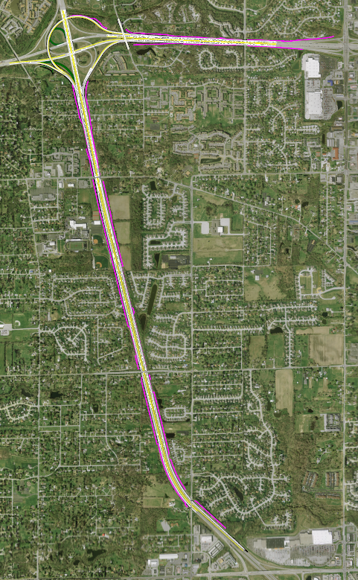
Noise Walls
Approved noise walls from original project scope and 2012 re-analysis
  I-465 Eastbound and Westbound
    From Sherman to Emerson
  I-65 Northbound
    From Gray Rd to north of Edgewood Ave
  I-65 Southbound
    From Roncalli H.S. to Edgewood Ave
Same wall limits as shown in prior meeting
I-465
Emerson
Thompson
I-65
Edgewood
Gray
Southport

Slide 7
Noise Walls
Noise walls added following 2012 public meeting
  Ramp I-465 Westbound to I-65 Southbound
    Northeast quadrant of interchange
  I-65 Northbound
    From I-465 to Gray Road
  I-65 Southbound
    From I-465 to Little Buck Creek
Walls added for continuity along corridor
I-465
Emerson
Thompson
I-65
Edgewood
Gray
Southport

Slide 8
Project Schedule
Road construction
  All lanes open – November 2014
Noise wall construction
  Clearing and preparation work – Ongoing
  Begin wall construction – January 2015
  Project complete – November 2015

Slide 9
Continued Steps
Public and project stakeholder input
  Always appreciated and can be submitted to INDOT via options described on page 1 of information packet
INDOT Customer Service Center
  Questions and concerns during construction
  Maintenance and operations following construction
Communication with residents and stakeholders
  Resident and stakeholder mailing list and database
  Project web page: www.IndyCommute.indot.in.gov
  Media outlets
Questions? Contact Public Involvement Team

Slide 10
Public Involvement Team
INDOT Greenfield District Office,
Customer Service Center
  32 South Broadway, Greenfield, IN 46140
  (855) 463-6848, eastcentralin@indot.in.gov
  Construction, maintenance and transportation project development activities in East Central Indiana
INDOT Office of Public Involvement, Central Office Communications
  Rickie Clark
  (317) 232-6601, rclark@indot.in.gov
  http://www.in.gov/indot/2366.htm

