Slide 1
Circuit Court Clerk Spring 2024 Conference
Brad King Republican Co-Director
Valerie Warycha Republican Co-Counsel

Slide 2
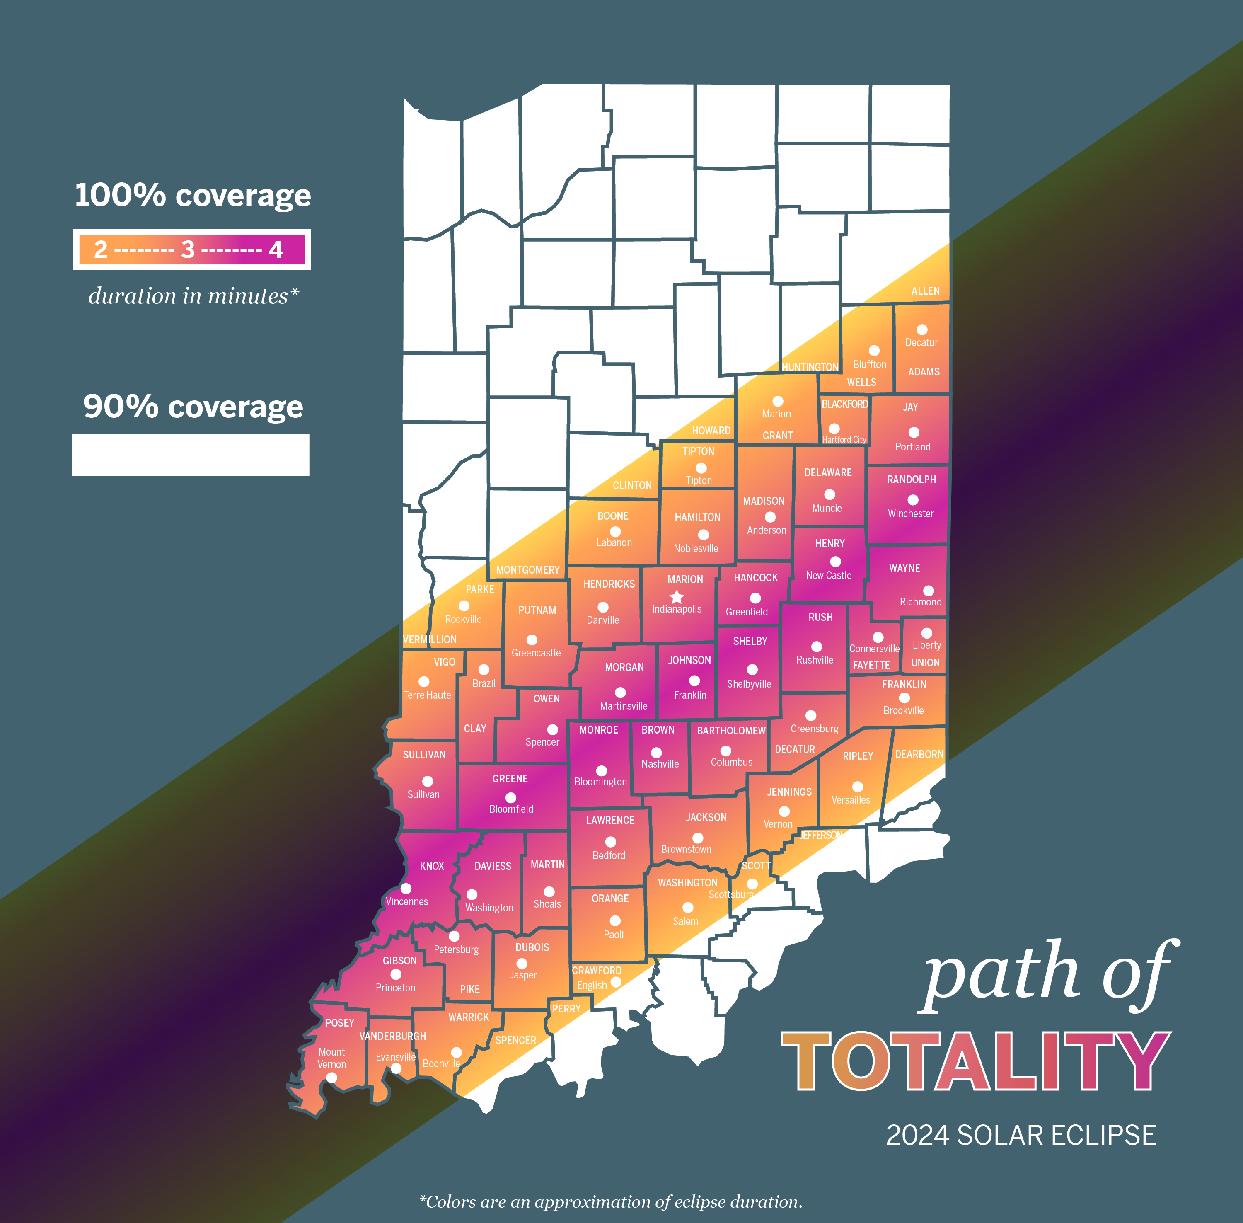
Is your county closing for the Eclipse?

Slide 3
Deadlines Roll
IC 3-5-4-1.5 Time for commencement of legal actions
Sec. 1.5. (a) This section applies if this title requires that a legal action be taken at the office of:
(1) the secretary of state or the election division; or
(2) a circuit court clerk or a political subdivision.
(b) Notwithstanding IC 4-1-2-2, if the final day or time for performing the action falls on a day or time when the office is not open to conduct public business or on a day observed as a holiday under IC 1-1-9, the legal action may be performed:
(1) on the next day that the office is open for public business; or
(2) through noon of the next day that the office is open for public business if the action to be performed is the receipt of a filing.

Slide 4
Voter Registration Deadlines Roll
If your office is closed on April 8, 2024, for the eclipse, the voter registration deadline roles to noon, April 9, 2024.
This will not change the start of absentee (early) voting in your county.

Slide 5
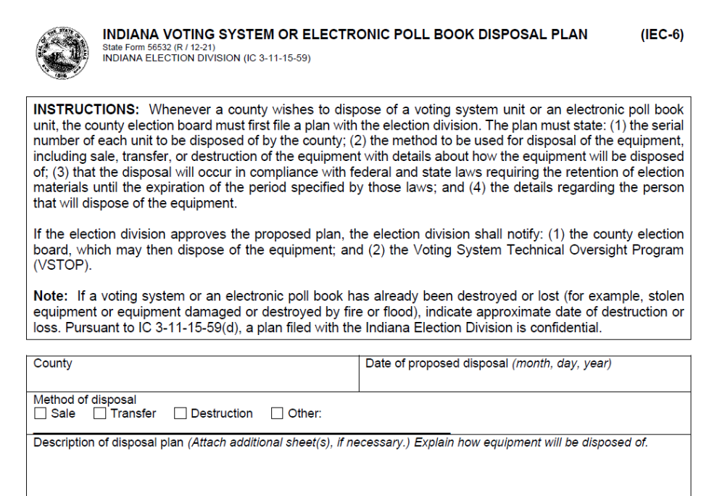
Voting System & ePB Disposal
You must get IED approval before disposal of your voting system or electronic pollbooks.
You do this by submitting an IEC-6 to the Co-Directors of the Indiana Election Division.

Slide 6
VVPATs and IEC-6s Disposals per VSTOP
Voter Verifiable Paper Audit Trail (VVPAT)
“Pre-VVPAT” MicroVote cases holding the DRE panels were NOT viewed by VSTOP as coming within the definition of “voting system” in IC 3-5-2-53, and therefore not subject to testing or references in reports to the Indiana Election Commission.
In contrast, the new “cases for both VVPATS and DRE panels” were reviewed and tested by VSTOP, and included in reports to the Indiana Election Commission, and therefore are viewed and treated as falling within the “voting system” definition above.
You cannot give your VVPATs to another county without Indiana Election Division approval through an IEC-6.

Slide 7

VVPATS
Beginning July 1, 2024, all direct record electronic voting systems must use a VVPAT.
This includes travel boards!
IC 3-11-15-13.3.

Slide 8
Ballot Vacancies
Parties cannot fill a primary ballot vacancy.
Parties can fill a vacancy for November through a caucus or, if authorized by county party committee, for the county chair or central committee officers to make a direct appointment.
  Direct appoints are only authorized for local offices including judges.
Ballot vacancies because no one ran in the primary must be filled by filing required documents by noon, July 3, 2024.
Candidate withdrawal
A candidate nominated in the primary may withdraw for any reason through noon, July 15, 2024.
After July 15, candidate must qualify for withdrawal under IC 3-13-1-7(b).
Party has 30 days to fill the vacancy.
IC 3-13-1

Slide 9
Early Ballot Vacancy Forms
At least noon, 10 days prior to the caucus
Caucus chair sends notice (CAN-30) by first-class mail to eligible precinct committeemen
For local offices, CAN-30 must also be filed with the clerk.
For judges and state level offices, CAN-30 must be filed with IED.
Candidate Requirements
For a local candidate, must file a CAN-31 with the caucus chair and clerk not later than 72 hours before the caucus.
For state and judicial candidates, must file CAN-31 and receipt showing statement of economic interest was filed with IED not later than 72 hours before the caucus.

Slide 10
After the Caucus
Ballot vacancy where no candidate ran in the primary
Not later than noon July 3, 2024
  For local offices, chair must file with the clerk the selected candidate’s statement of economic interests (CAN-12) and certificate of selection (CAN-29).
  For state and judicial offices, chair must file the certificate of candidate selection (CAN-27 for federal or statewide office/CAN-28 for state legislative office/CAN-29 for judge) with IED.
Ballot vacancy due to candidate withdraw or disqualification
Noon, 3 days (excluding Saturday and Sunday) after the caucus is held for other early ballot vacancies.

Slide 11
Direct Appointment
After a direct appointment, the chair must file CAN-12, CAN-29, CAN-31 and a copy of the party minutes documenting direct appointment authority or resolution with the clerk.
For judicial vacancies, the chair must file the copy of the statement of economic interests, CAN-29, and CAN-31, and copy of the party minutes or resolution with IED

Slide 12
Names on Ballots
You must place a candidates name on the ballot exactly how they requested on their declaration of candidacy.
  Example
  J. Bradley King
  Must include the period after the initial J.
  If the candidate did not include a period, you cannot add a period.
  IC 3-8-2-2.5

Slide 13
Protect 2024
Federal Cybersecurity & Infrastructure Security Agency Recommendations
  Get a physical security assessment
  Rehearse your incident response plan
  Join the EI-ISAC
  Enable Multi-factor authentication
  Know and manage your cyber vulnerabilities
  Get a .Gov Domain
  Need help? Call Steve Broniarczyk at 317-752-5721 or steven.broniarczyk@cisa.dhs.gov

Slide 14
Reminders
Don’t forget to send your certification of public test of voting equipment to IED. (IEC-9 for DRE or IEC-10 for optical scan)
&
Voter list maintenance affidavit (VRG-21)

Slide 15
Thanks!
Please keep this slide for attribution

