Slide 1
Level 2 Assessment
Notes:
In this lesson we are going to go over the Level 2 Assessment portion of the new Revised Total Coliform Rule, also known as the RTCR, that will go into effect on April 1st. 2016.

Slide 2
Abbreviations to Know
RTCR – Revised Total Coliform Rule
TCR – Total Coliform Rule
TC – Total Coliform
EC – E. Coli
PN – Public Notice
CCR – Consumer Confidence Report
PWS – Public Water Supply
TT – Treatment Technique
MCL – Maximum Contaminant Level
O&M – Operation and Maintenance
Notes:
Before we get started, I am going to go over some abbreviations that will be helpful to know throughout the presentation.
RTCR stands for Revised Total Coliform Rule
TCR means Total Coliform Rule
TC is Total Coliform
EC is E. Coli
PN is Public Notice
CCR is Consumer Confidence Report
PWS is Public Water Supply
TT is Treatment Technique
MCL is Maximum Contaminant Level
And O&M is Operation and Maintenance

Slide 3
How is the Standard Changing?
Under the proposed treatment technique for coliform, total coliform serves as an indicator of a potential pathway of contamination into the distribution system. A PWS that exceeds a specified frequency of total coliform occurrence must conduct an assessment to determine:
  if any sanitary defects exist and,
  if found, correct them.
Notes:
Let’s first start out by introducing how the standard is changing with the new RTCR.
Under the proposed treatment technique for coliform, total coliform serves as an indicator of a potential pathway of contamination into the distribution system. A PWS that exceeds a specified frequency of total coliform occurrences must conduct an assessment to determine:
if any sanitary defects exist and,
if any are found, correct them.

Slide 4
How is the Standard Changing?
In addition, under the proposed treatment technique requirements, a PWS that incurs an E. Coli MCL violation must conduct an assessment and correct any sanitary defects found.
Notes:
A requirement of the new RTCR, is that under the proposed treatment technique requirements, a PWS that incurs an E. Coli MCL violation must conduct an assessment and correct any sanitary defects.

Slide 5
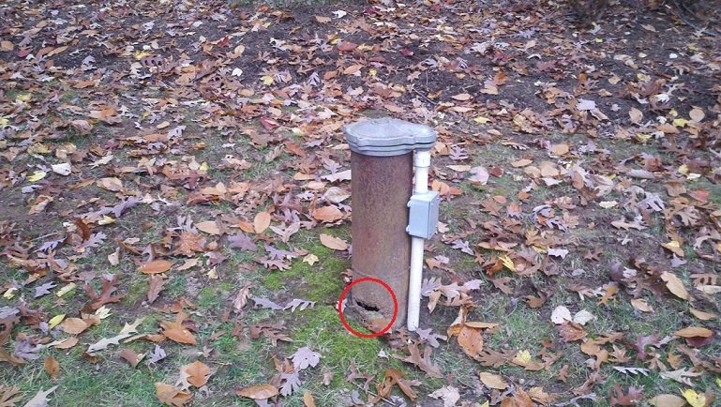

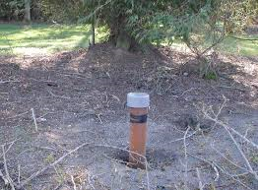
What is a Sanitary Defect?
Examples
  Cracked Well Casing
  Leak in the distribution line
  Improper grading around
  the Well Casing
Notes:
What is a Sanitary Defect? The rule defines “sanitary defects” as “defects that could provide a pathway of entry for microbial contamination into the distribution system or that are indicative of a failure or imminent failure in a barrier that is already in place.” [40 CFR 141.2]
Some examples of sanitary defects would be but are not limited to a missing well cap, cracks in the well casing, improper air gap on the softener brine waste line, a small leak in a distribution line, or improper grading around the well casing.

Slide 6
Treatment Technique (TT) Triggers
Level 2 Assessments
Notes:
Under the new RTCR instead of having an MCL for total coliforms, it is replaced with what is called a treatment technique. In this presentation we are going focus on treatment technique (TT) triggers that lead to conducting a Level 2 assessment.

Slide 7

TT Level 2 Assessment & Corrective Action
2nd Level 1
E. Coli MCL violation
Level 2 Assessment
Rolling 12 month period
PWS has:
-Second Level 1 trigger within a rolling 12 month period
-Or E. Coli MCL Violation
Notes:
So what are the triggers that will require a system to perform a level 2 assessment?
A level 2 assessment can be triggered by:
A second level 1 trigger within a rolling 12 month period;
Or an E. Coli MCL violation.
Either of these two things are going to put your system into a level 2 assessment.

Slide 8
TT Level 2 Assessments & Corrective Action
Level 2 Assessment
Can be conducted by State or State Approved Entity
A more in-depth examination of the source water, treatment, distribution system and relevant operational practices
Required when PWS has an E. coli MCL violation and/or previous level 1 assessment
PWS must fix all sanitary defects found and do any expedited actions required by IDEM
Notes:
Listed on this slide are the key points in regards to a level 2 assessment:
It can be conducted by State or State Approved Entity
It is a more in-depth examination of the source water, treatment, distribution system and relevant operational practices
It is required when PWS has an E. coli MCL violation and/or previous level 1 assessment
The PWS must fix all sanitary defects found and do any expedited actions required by IDEM

Slide 9
Level 2 Assessment
More comprehensive than Level 1 Assessment
Must be conducted by:
  A third party approved by the state who has completed the required training
  The state itself
  PWS where the system has staff or management with the required certification and qualifications specified by the state and has completed the required training
Notes:
The Level 2 assessment is similar to a Level 1 assessment; however, it is a more comprehensive look at the water system. Since this is a more in-depth look at the water system not just anyone can perform the level 2 assessment. A level 2 assessment must be conducted by a third party approved by the state who has completed the required training, the state itself, or a PWS that has staff or management with the required certification and qualifications specified by the state and has completed the required training.

Slide 10
Elements of Assessments
At a minimum, assessments must include review and identification of:
1. Events that happened that could create impaired water quality
2. Changes in distribution system O&M that may affect distributed water quality, including water storage
3. Source and treatment considerations that bear on distributed water quality
4. Existing water quality monitoring data
5. Inadequacies in sampling sites, sampling protocol, and sample processing
Notes:
In conducting a Level 2 the assessor must evaluate minimum elements as outlined in the Rule. These elements are as follows:
Atypical events that may affect water quality or indicate that water quality was impaired.
Changes in distribution system maintenance and operation that may affect distributed water quality, including water storage.
Source and treatment considerations that bear on distributed water quality, where appropriate.
Existing water quality monitoring data.
Inadequacies in sample sites, sampling protocol, and sample processing.
40 CFR 14.859(b)(2)

Slide 11
Assessments and Corrective Actions
If triggered by an E. coli MCL violation, Tier 1 Public Notice must be done within 24 hours.
Conduct a Level 2 assessment of the system when certain conditions occur.
Any sanitary defect found must be corrected within required time frame.
Completed assessment form must be submitted to IDEM within 30 days of learning of the trigger.
Notes:
The system must conduct a Level 2 assessment of the system when one is triggered.
Any sanitary defect found during the assessment must be corrected within required time frame.
The completed assessment form must be submitted to IDEM within 30 days of learning of the trigger. If not, a violation will occur.

Slide 12
Reporting
PWSs are required to report the following within a required timeframe:
Monitoring Results
EC+ routine sample: end of day
EC MCL violation: end of day
Treatment technique violation
Completed assessment form: 30 days from trigger
Completed corrective action: 30 days or IDEM determined
Certification of compliance with PN requirements
Failure to comply with any of the RTCR requirements
Notes:
With the new RTCR, PWSs are required to report the following within a required timeframe:
The required monitoring results
Any EC+ routine sample by the end of day
Any EC MCL violation by the end of day
All Treatment technique violations
The Completed assessment form is due 30 days from the trigger date
The Completed corrective action is due in 30 days or if IDEM determines a longer time is needed
All Certification of compliance with PN requirements
And any time your system fails to comply with any of the RTCR requirements

Slide 13
Recordkeeping
PWSs are required to keep records of the following within the required timeframe:
Monitoring results
Assessment forms and documentation of corrective actions completed
Copies of PN issued
Certifications
Site Sampling Plans
Notes:
Also, PWSs are required to keep records of the following within the required timeframe:
Any Monitoring results
All Assessment forms and documentation of corrective actions completed
Any Copies of PN issued
All Certifications
And Site sampling plans

Slide 14

Questions? Contact IDEM at (317) 234-7430.
Notes:
If you would like to talk to someone about these new requirements please call the IDEM DWB at (317)234-7430.

