Slide 1
Sccc Advisory Board Meeting
February 7, 2023

Slide 2
AGENDA
Call to order
Approval of the Agenda
Approval of the minutes and financial reports
Reports
Old Business
New Business
Discussion
Adjournment

Slide 3
Iv. Director’s report: 2022 supervision Numbers
Number of Cases Received: 199
Adult Home Detention: 117
BacTrack (Alcohol Monitoring): 20
Jail Intervention Program (JIP): 15
Recovery Support: 10
Adult Day Reporting (ADR): 2
Successful Completions: 132 or 85%
Unsuccessful Completions (Returned to Jail or DOC): 23 or 17%

Slide 4
Iv. Director’s report: 2022 Other Numbers
Number of Absconded Cases: 12
Adult Home Detention: 10
Pre-trial: 2
CSU Arrests: 16
Adult Home Detention: 5
Probation: 7
Not on a Program: 4

Slide 5
Iv. Director’s report: 2022
Juvenile Programming Numbers
JAG (Juvenile Assessment & Guidance: 9
Home Detention: 11
Why Try: 10
LifeSkills: 4
Community Service-Learning Project: 18
Restorative Justice: 2
Re-Entry: 2
Prevention Services: 55

Slide 6
2022 Review: Personnel
+ Additions
Bookkeeper
3 Field Officers
Juvenile Case Manager
Intake/Transfer Coordinator
-Losses
Field Supervisor
Monitoring Technician
Intake/Transfer Coordinator
Since June 2020:
4 part-time positions eliminated

Slide 7
2022 Review (Continued)
2020: Vision
To increase collaboration with our community and peers
To increase the efficiency and quality of the services we provide
To increase the sustainability and longevity of the agency
2021: Identifying Strengths and Weaknesses
Need for innovation
Employee Training
Creating a new culture
2022: Implementation
Organizational Change

Slide 8
2022 Review: Organizational Change
1. Field Office:
4 Previous FO’s = 40-50% contacts
3 Current FO’s = 90-95% contacts
2. Responding to:
Compliant/Non-Compliant Behavior with Participants
3. Intake Process:
Jobs
Mental Health
4. Case Management:
Reassignments
EBP
5. Community Partnerships

Slide 9
2023 Updates
Intake Process
Fully Electronic
Data Collection
Community Service
Web based

Slide 10
2023 Financial Update

Slide 11
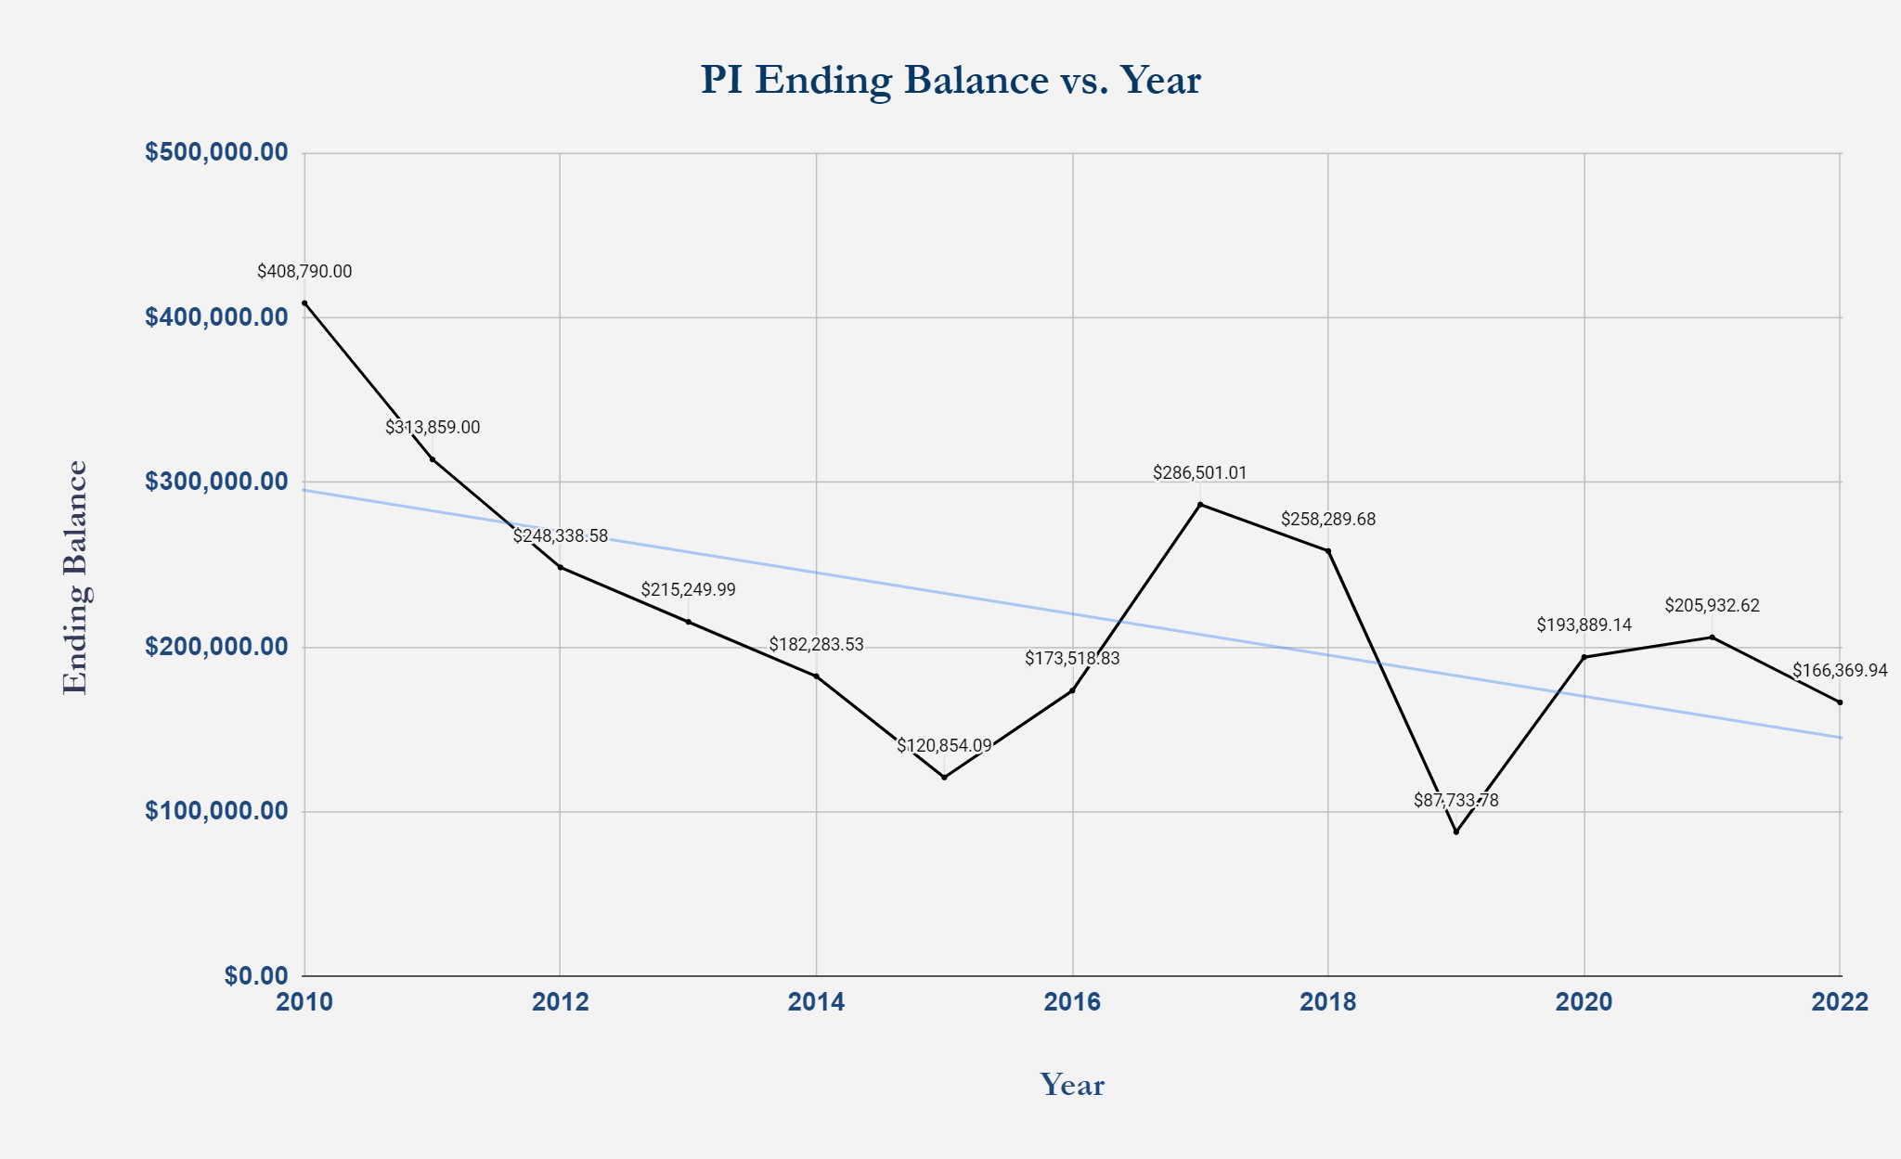
A. 4208: Adult Project Income Year-End Balances (Cont.)

Slide 12
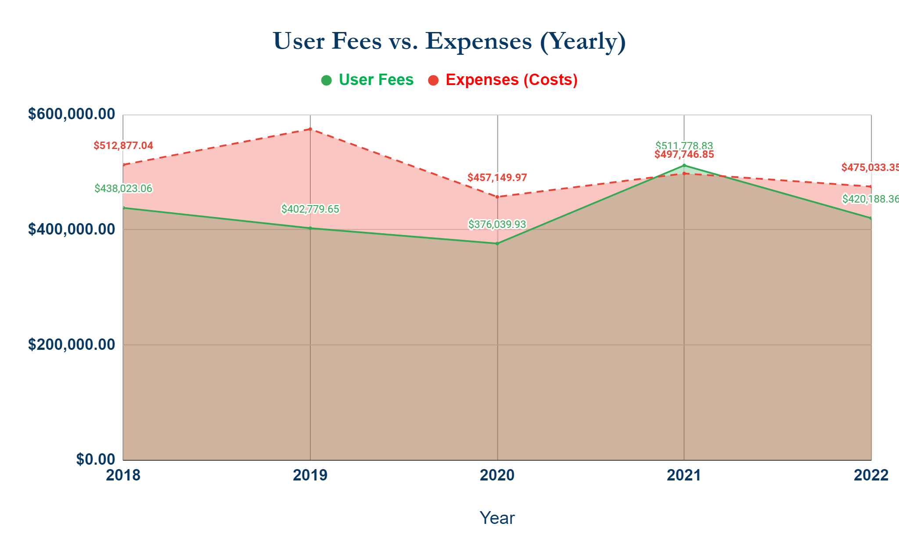
B. 4208: Adult Project Income User Fees vs Expenses (Cont)

Slide 13
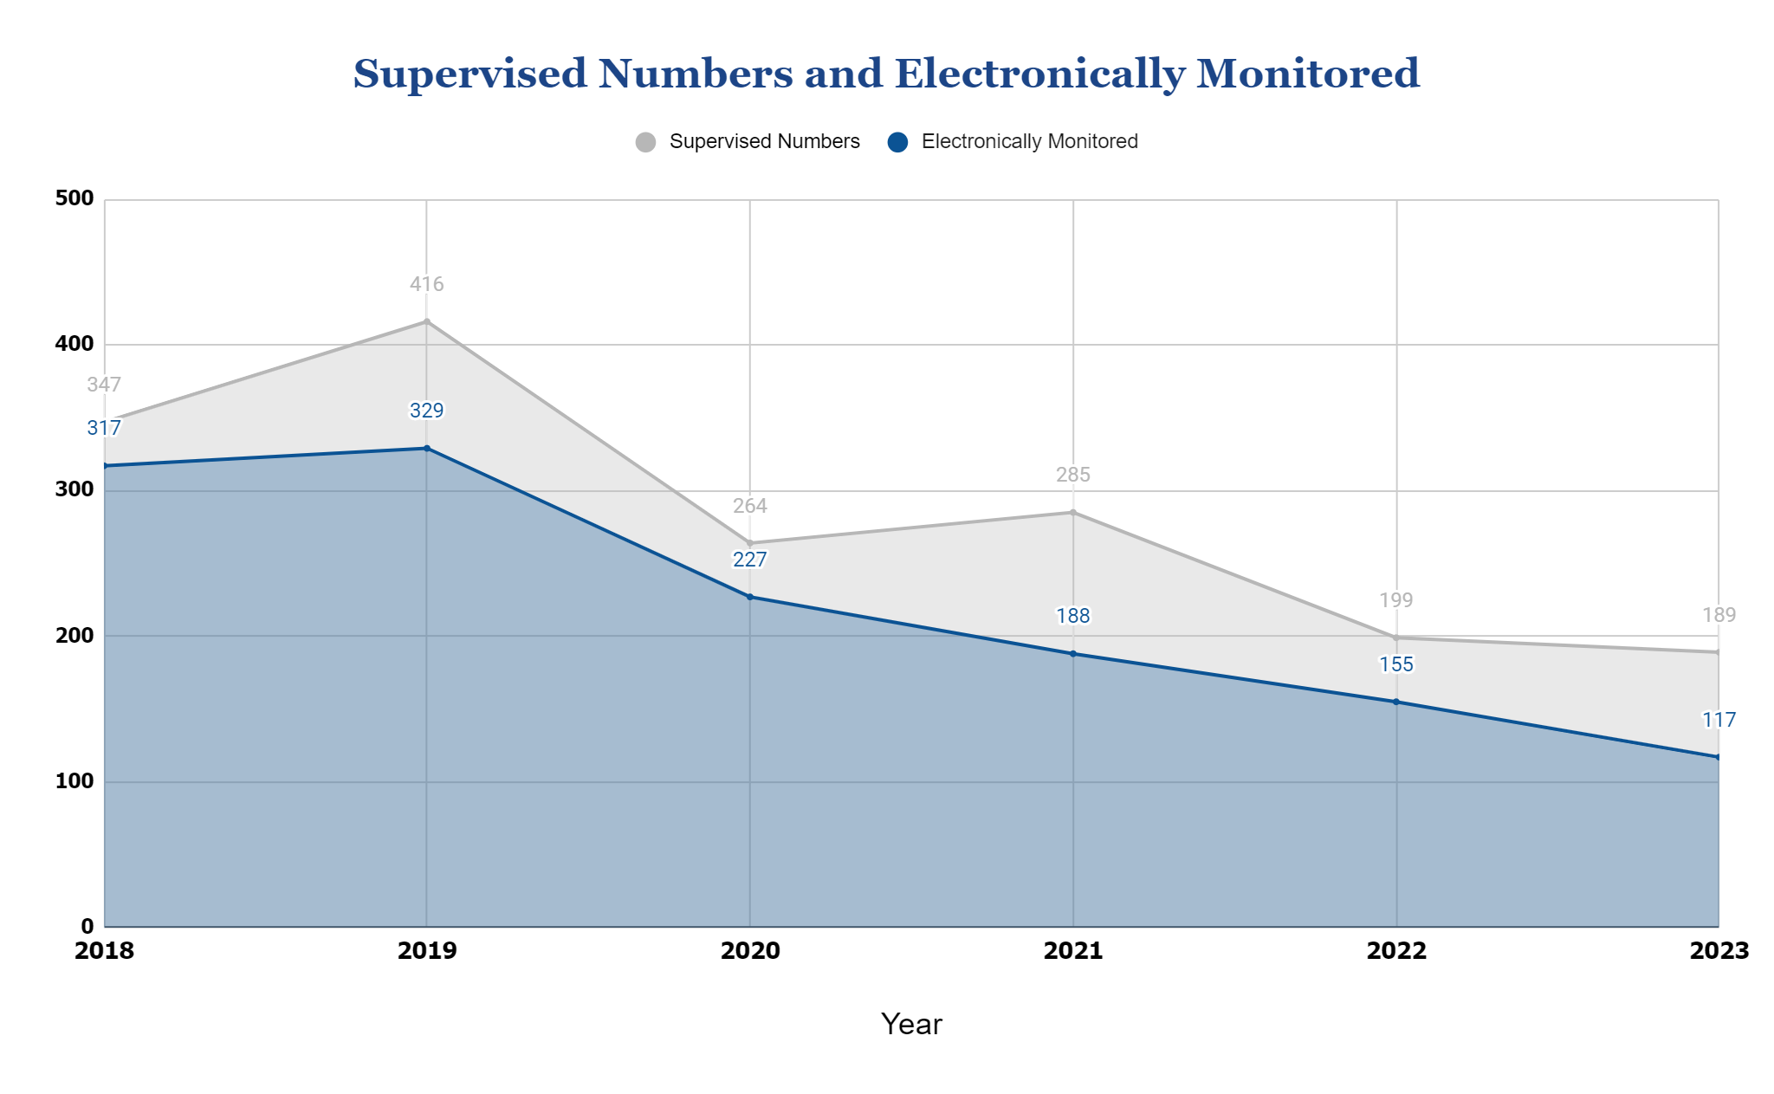
C. 4208 -Total Supervision Cases Received for Each Year (Cont)

Slide 14
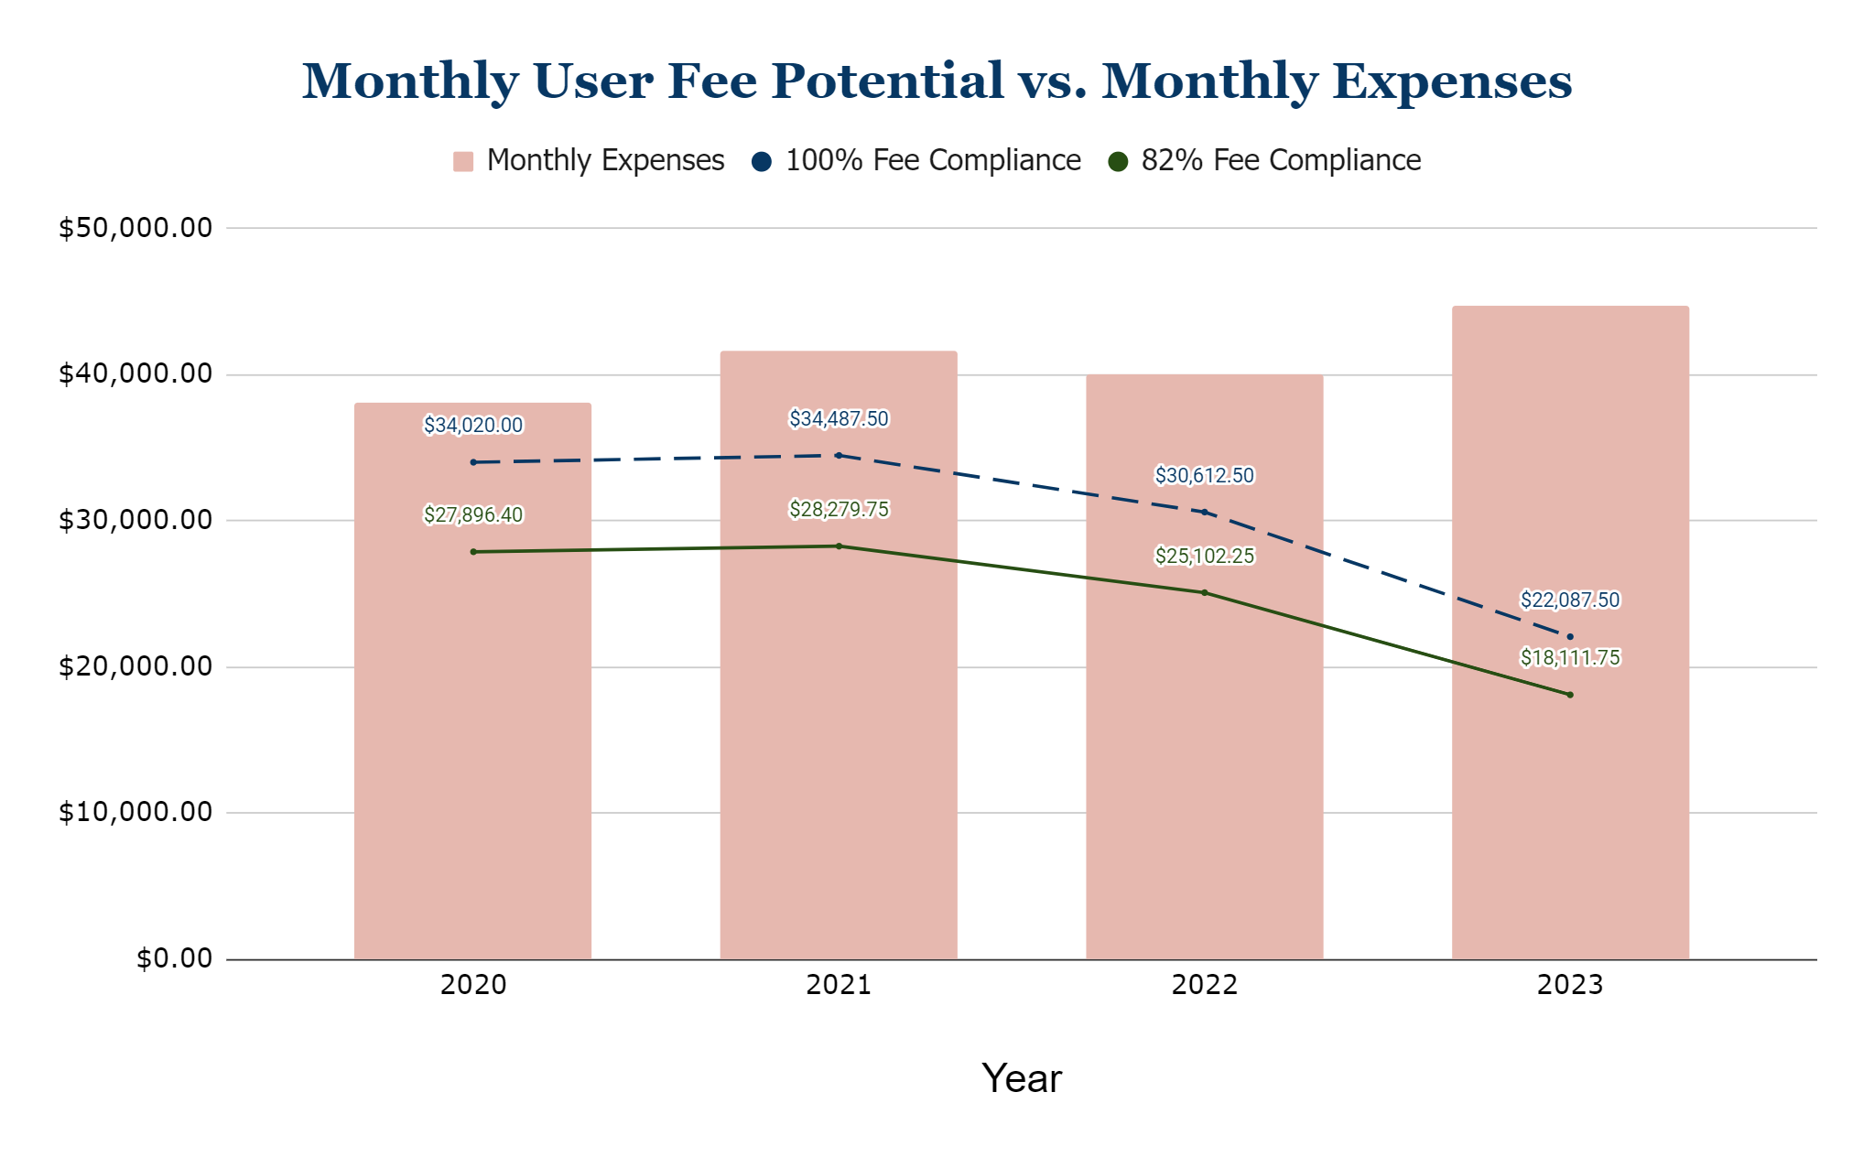
D. User Fee Potential Based on Actual Supervision Numbers (Cont)

Slide 15
E. 4208: Other User Fee Income
2021 Averages |  | 2022 Averages |  | Increase/Decrease
Fee Summary | Monthly Average | Fee Summary | Monthly Average
Fee |  | Fee
Administration Fee - Adult | $2,867.84 | Administration Fee - Adult | $2,666.63 | -$201.21
BACtrack Daily Fee | $825.00 | BACtrack Daily Fee | $2,242.84 | $1,417.84
Community Service Fee - Adult | $1,200.00 | Community Service Fee - Adult | $995.83 | -$204.17
Drug Screen Fee - Adult | $945.00 | Drug Screen Fee - Adult | $897.11 | -$47.89
Electronic Monitoring Daily Fee | $1,484.00 | Electronic Monitoring Daily Fee | $1,744.42 | $260.42
Home Detention Daily Fee - Adult | $30,508.00 | Home Detention Daily Fee - Adult | $24,503.26 | -$10,004.74
Road Crew Fee - Adult | $425.00 | Road Crew Fee - Adult | $331.82 | -$93.18
SOMP Daily Fee | $856.00 | SOMP Daily Fee | $575.33 | -$280.67
Grand Total | $43,208.00 | Grand Total | $34,836.54 | -$8,371.46

Slide 16
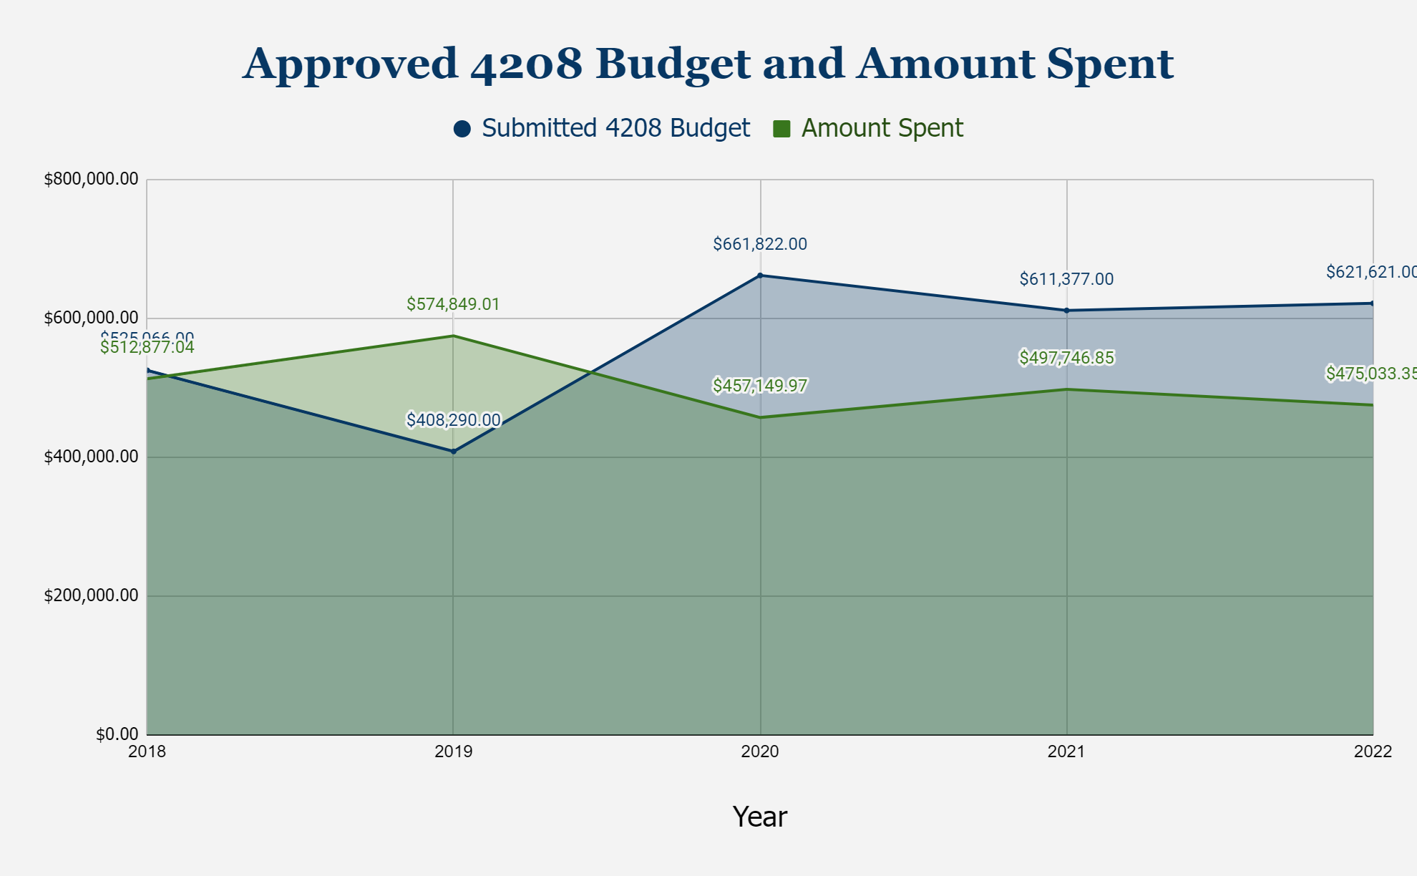
F. 4208 Approved Budget Submission vs. Actual Amount Spent

Slide 17
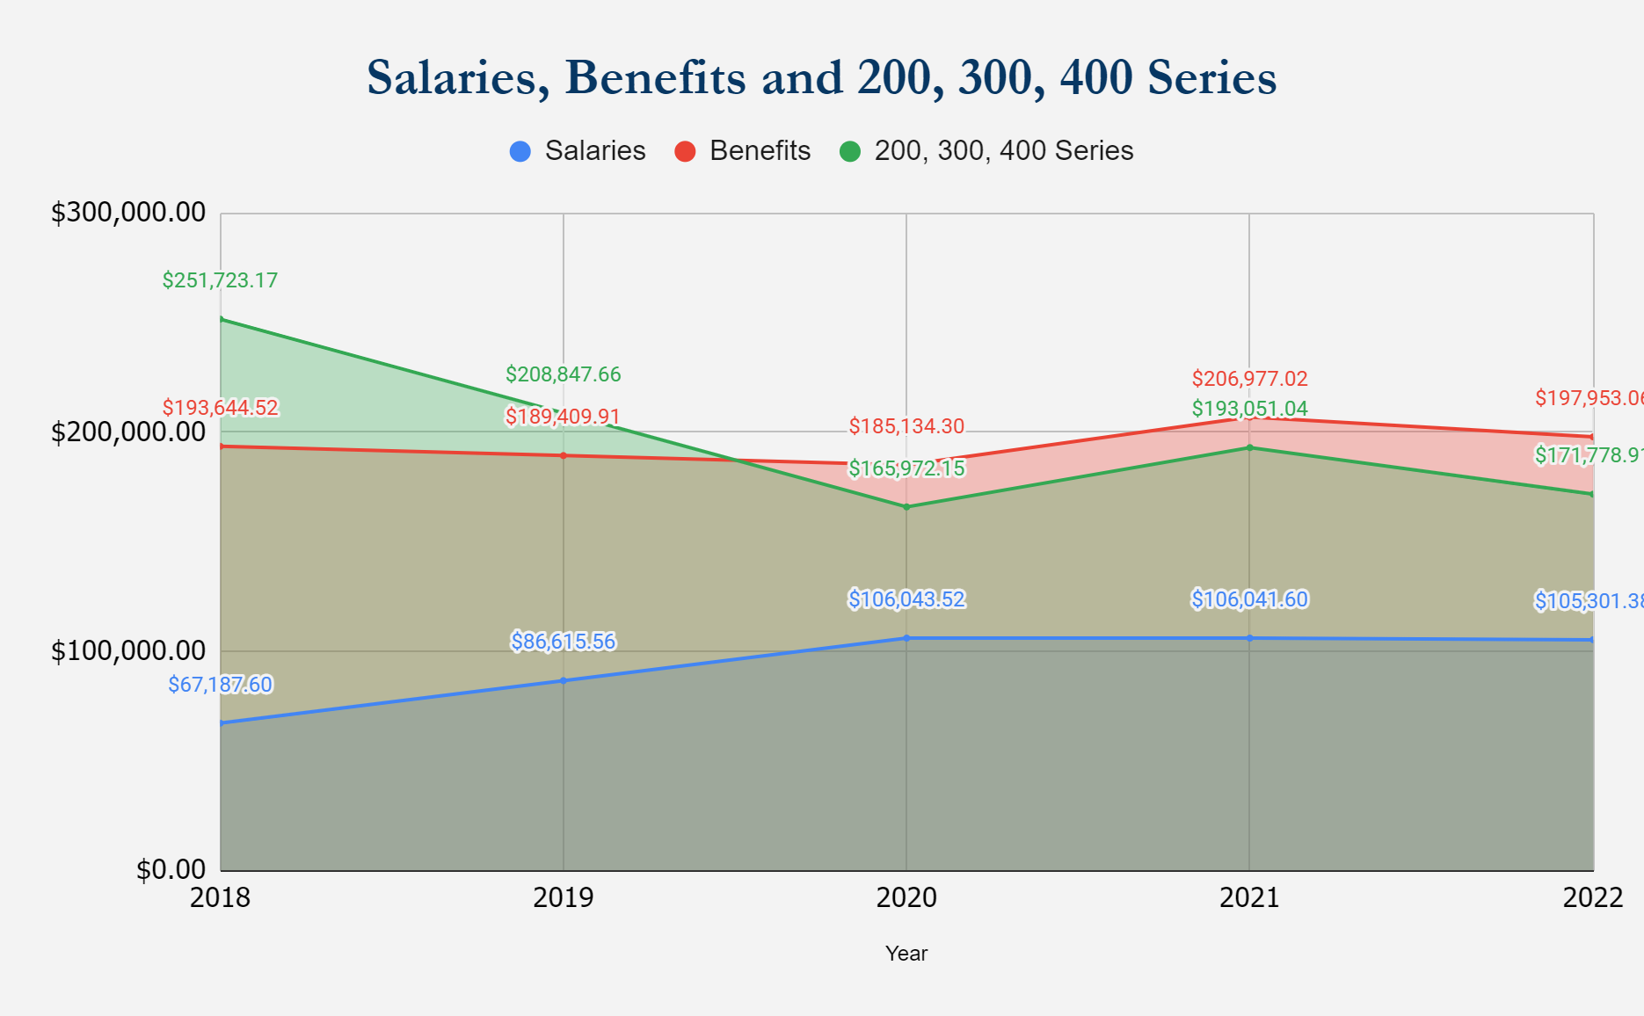
G. 4208 - Controlled Spending & Uncontrolled Spending

Slide 18
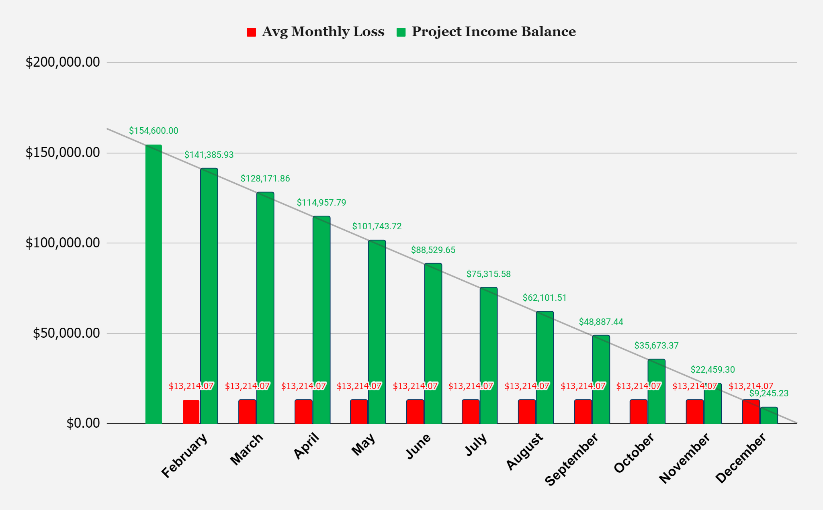
H. 4208 Sustainability

Slide 19
V. Old Business
CPC-CSA Update (Correctional Program Checklist - Community Supervision Agency)
b. 2023-24 Juvenile Grant Submission
co.shelby.in.us/community-corrections
19

Slide 20
Vi. New Business
Approval of the 2023 Meeting Calendar:
April 18, 2023
July 18, 2023
October 10, 2023
co.shelby.in.us/community-corrections
20

Slide 21
Vii. Discussion:​
Moving time: from 4pm to 12 pm
?
Viii. adjournment​

