Slide 1
2010 Floyd County MS4 Program Overview.

Slide 2
2010 MS4 Overview
Community Overview
Inception
Growing Pains
Partnerships
Successes
Second Permit
Future

Slide 3
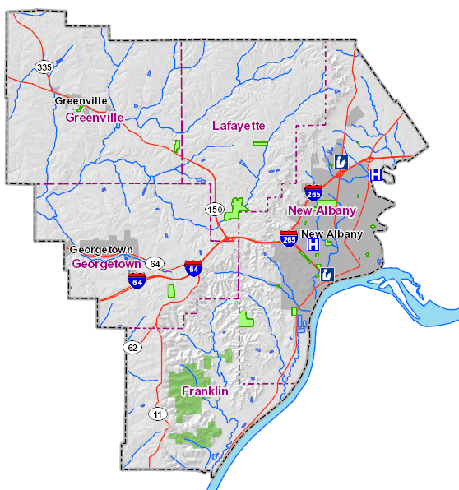
Community Overview
Floyd County’s MS4 contains roughly 29,000 constituents.
Floyd County is approximately 149 square
miles.
Floyd County contains 3
other MS4 Permit Holders.
New Albany, Georgetown, and
Indiana University Southeast
Outside the urban area,
the County is sparsely
populated with farms,
woodlands and undevelo-
ped areas.

Slide 4
Community Overview
The estimated size of the urban area is approximately one-tenth of the County or 15 square miles.
Instead of only implementing “Stormwater” in the urbanized area, the
county decided that we
would use an approach
that covers all the
unincorporated sections of
our county.

Slide 5
Community Overview
A summary of our land use is as follows:
10% Agriculture
60% Residential (Sparse)
20% Commercial
10% Industrial
Floyd County’s topography
is quite unique. Our culverts
have minimal influence on the
entire conveyance system.
Notes:
Other MS4’s have many miles of pipe that carry their waters underground. Where Floyd County’s culverts stop and the runoff stays above ground in creeks and streams throughout our rural county.

Slide 6
Community Overview
MS4 Infrastructure / Conveyance Totals
CATCHBASINS--1052
MANHOLES------51
INLETS--------1104
CULVERTS-----1326 (8.5MILES TOTAL)
PIPES FROM CATCHBASINS-
913 (18.3 MILES TOTAL)

Slide 7
Floyd County Stormwater Organizational Chart
Floyd County Commissioners
Floyd County Stormwater Board
Floyd County Council
Ron Quackenbush
Road Department Superintendent
Roger Jeffers
Parks and Recreation Superintendent
Ted Heavrin
Police Chief
Don Lopp
Director of Operations
Fire Departments
Kevin Feder
Urban Conservation Specialist—Floyd County Soil and Water Conservation District
Warren Nash
Administrator—Floyd County Solid Waste Management District
Stantec
MS4 Consultant
MS4 Cleaning Crew
(Vac Truck Crew)
Chris Moore
MS4 Department Coordinator
MS4 Maintenance Crew
Bob Frederick
Infrastructure Coordinator
Coordination on Stormwater Activities

Slide 8
Inception
Floyd County was notified in 2003 that we would have to comply with EPA’s NPDES Phase II rules for Stormwater Pollution.
Some of the first steps that we incorporated was writing and approving ordinances that evolved stormwater.
2004 FC XVIII Construction Site Runoff Control Ordinance (resolution)
2004 FCR XXI Illicit Discharge and Post Construction Site Runoff
2005 FC XVI Administration Fund (resolution)
2005 FC XVII Administration Fund (ordinance)

Slide 9
Inception
2005 hired an Urban Conservation Specialist in combination with the Soil and Water Department.
2007 FC V Establishing a Stormwater Department
2007 FC VI Establishing User Fees
One of the first project we started on was to map our conveyance system.
We also created a biannual news pamphlet that covered stormwater news call “The Storm Informer”
We started participating in events like: Earth Day, Harvest Homecoming, and Floyd County Fair.

Slide 10
Inception
The following is a list of events and information that was handed out over the last couple of years.
April 2, 2009 Home builders Association of Southern Indiana Show. Attendance 100 people
4/11/09- Falls of the Ohio Earth day Celebration
July 6-9, 2009- Floyd County 4-H Fair
21 Rain Barrel Instruction
8 Rain Garden Broachers
4 New Albany Flood Insurance Broachers
10 IDEM Waterway Permitting Handbooks

Slide 11
Inception
May 8, 2010 Falls of the Ohio Earth day Celebration
Attendance 900 people
Demonstrated the Enviroscape to 37 kids
3 IN Water Way Handbooks
17 Rain Barrel Instructions
22 Rain Garden
40 Clean Water Coloring Books - (OPCD)
15 Solution to Pollution Coloring Books
34 Non Toxic Cleaners
20 Homeowner Guide to Stormwater Pollution
15 WWYD - Groundwater Pollution - (OPCD)
20 Got Germs- Pet Waste (OPCD)
9 Stormwater - Clark County
50 Crayons- (OPCD)
68 Rain Barrel Kit - Register for Free Drawing

Slide 12
Inception
Arbor Day 2008
Floyd County 4-H Fair
2009

Slide 13
Inception
Formed partnerships with other entities like: Southern Indiana Stormwater Advisory Committee (SISWAC) Floyd County Soil and Water, and Floyd County Solid Waste.
Stopped using cinders to de-ice roadways and built a salt storage building and started using brine.
Had workshops to educate the construction community on erosion control standards.
Stormwater was handled out of the Engineers Office which was not dedicated to just Stormwater.

Slide 14
Inception
2007 Prosser Vocational School Presentation
2007 Prosser Vocational School Presentation
Notes:
Prosser Presentation was a targeted audience. As these were going to be future builders.

Slide 15
Inception
2009 Home Builders Association Of Southern Indiana
April 2, 2009

Slide 16
Floyd County Road Department
Salt Storage Building

Slide 17
Growing Pains
Much of our growing pains come from lack of knowledge of what “stormwater” is.
Many thought that this is just another “tax”
We set up our fees this way:
Residential (500 Property Class) $39.00
All other property class- based on impervious surface square footage.
The Agricultural community was extremely upset as they were being charged per square footage instead of a flat rate
Notes:
500 Property class involves the class that the property is given by the assessors office

Slide 18
Growing Pains
We scrapped the impervious approach and went with a flat rate.
This flat rate lasted two years.
With the outcry from citizens we created a Citizens Advisory Committee (CAC)
The CAC was made up of Farmers, Business Owners, Developers, School Board Members and General Public.
We had monthly meetings that went for about a year and a half.

Slide 19
Growing Pains
The CAC made recommendations to the Stormwater Board for final approval.
One recommendation was to raise the impervious square footage from 2,500 to 3,700 that generates 1ERU or $39.00
Another was to create an aggressive credit system that promotes good stewardship towards stormwater.
An example of a credit is Septic Tank maintenance. If a customer cleans out their septic tank one every five years can receive 10% credit for 5years.
County Engineer Retired.
Notes:
We reinstated the impervious approach in 2009

Slide 20
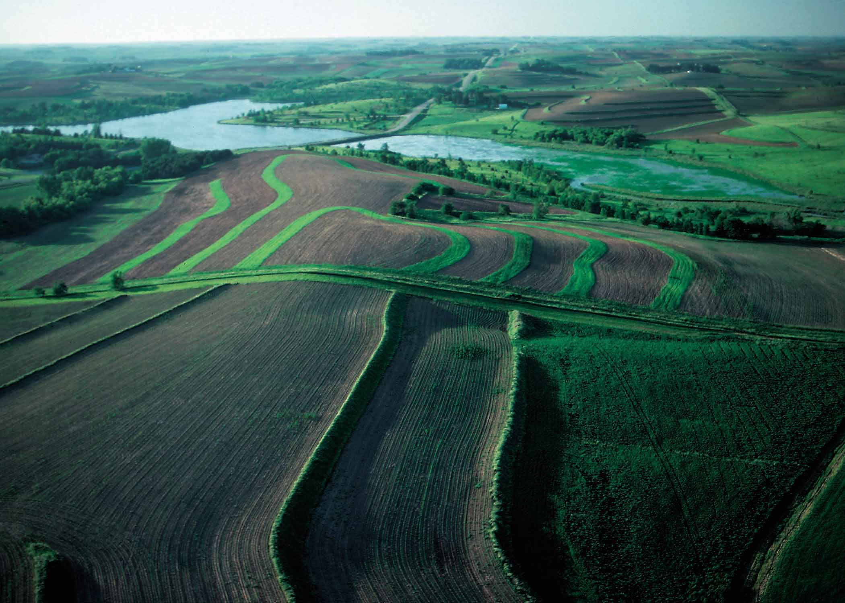
Growing Pains
Stormwater Credit Overview
Farmland Conservation Tillage
Description: Conservation tillage (CT) is a means of addressing several of these problems at once. It has the potential for increasing water infiltration and use efficiency, increasing profits, increasing energy efficiency, increasing carbon sequestration and decreasing emissions, improving air, soil, and water quality. Conservation tillage practices include any tillage system leaving 30% or more crop residue cover on the soil surface after planting. These practices maximize the volume reduction in agricultural runoff and contaminants associated with sediment loss. Farmers who plant using these practices may be eligible for credit.
To receive this Credit: Crops must be planted using a conservation tillage method, such as no-till or ridge-till. A 1% credit is offered for each 1% of total property area that is planted using conservation tillage methods. A site map showing the entire property and the areas that have been planted using conservation tillage methods. Statement certifying that the property meets the criteria for this credit and the date(s) of planting and any land disturbance. Any supporting documentation including receipts, photographs, etc.
Percent Off Bill: 10%
Term: 5-year term. A new application must be submitted to continue receiving credit when 5-year term is up.

Slide 21
Partnerships
Partnerships is one area we have from the beginning tried to work make a central part of our program
Below is a list of partnerships and which MCM they help us maintain.
Floyd County Soil and Water (MCM 1, MCM 2, MCM 4, MCM 5)
Floyd County Solid Waste (MCM 1, MCM2, MCM 6)
Floyd County Highway Department (MCM 1, MCM 3, MCM 6)

Slide 22
Partnerships
Southern Indiana Storm Water Advisory Committee (SISWAC) MCM1, MCM2, MCM3, MCM4, MCM5, and MCM6
St. Mary’s Church Navilleton (MCM1, MCM2)
Town of Georgetown (MCM3)
New Albany Stormwater Department (MCM1, MCM2)

Slide 23
Successes
Getting a fee schedule and credit policy that is tolerable for our customers.
Partnership with the CAC whose members were from all different societal classes.
Attending many festivals and events to get the word out about “stormwater”!
The use of brine, with beet juice, on roadways instead of cinders
We are a regional supplier of brine with beet juice. We supply the NAFC School Corp and the Town of Lanesville.
We produce over 700 gallons of brine with beet juice per year.

Slide 24
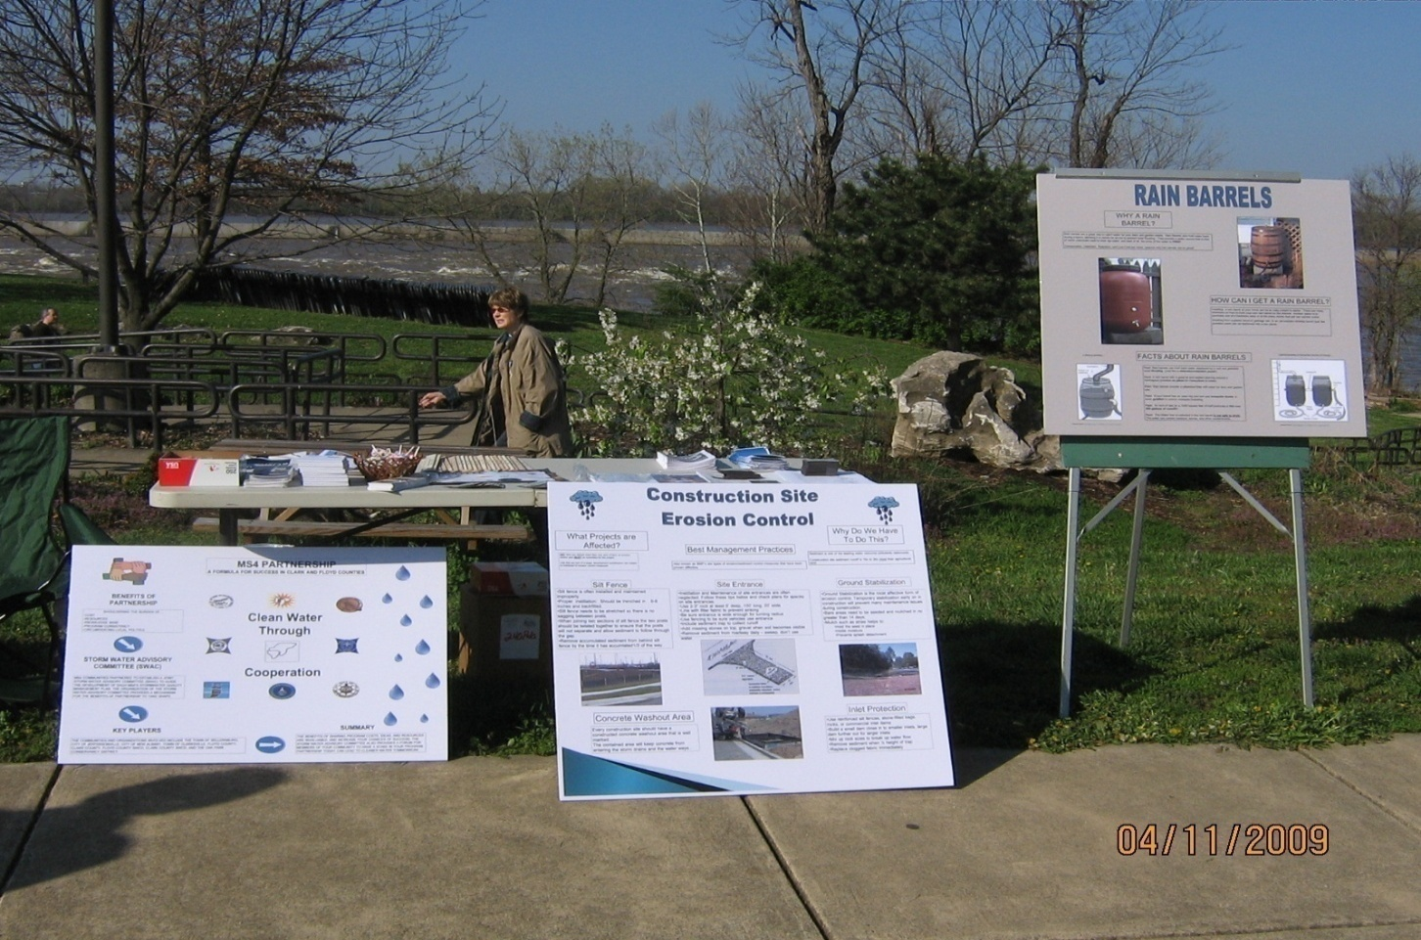
Successses
Earth Day Events 2009

Slide 25
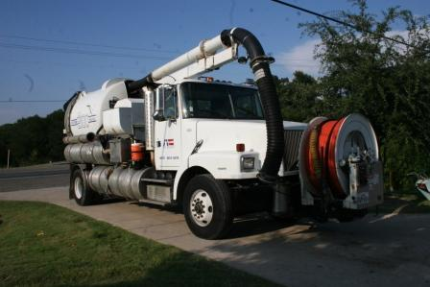
Successes
Purchase of a Vactor vacuum truck and started a cleaning schedule of the drainage system.

Slide 26
Successes
Having monthly Stormwater Board Meetings where our constituents can come in and listen to the open meeting and can speak at the end of the meeting to voice any complaints, concerns, or congratulations.
Estimated participants of the meetings are 60 constituents per year.
Creation of a Stormwater Quality Management Plan.
Mapped all culverts and catch basins and starting dry weather screening in the second permit cycle.

Slide 27
Successes
Developed a long-term strategy to for program implementation which include the MCM’s and projects that promote water quality and remove water quantity.
We also promoted stormwater education by going into the elementary schools.
We had contest, displays, and “environscape” interactive learning devise to help educate at the schools.

Slide 28
Successes
Statistics for schools within our MS4
2009
Floyd County Schools
School | Grade | # of Students | # of Handouts
Floyd Knobs Elem. | 4th | 104 | 107
Floyd Knobs Elem. | 5th | 22 | 23
Galena Elem. | 4th | 53 | 55
Galena Elem. | 5th | 68 | 70
Greenville Elem. | 4th | 62 | 65
Greenville Elem. | 3rd | 12 | 12
 |  | Total Students | Total Handouts
 |  | 321 | 332
Floyd Co. Head Start Year End Festival/Celebration
Handouts
20

Slide 29
Second Permit
We have been busy with our second permit as well.
We adopted the Qualified Professional Inspector (QPI) wording into our ordinances.
We adopted and have implemented the Stream Visual Assessment Program (SVAP) into our program.
Began mapping complaints on GIS so they can be tracked better in the future.

Slide 30
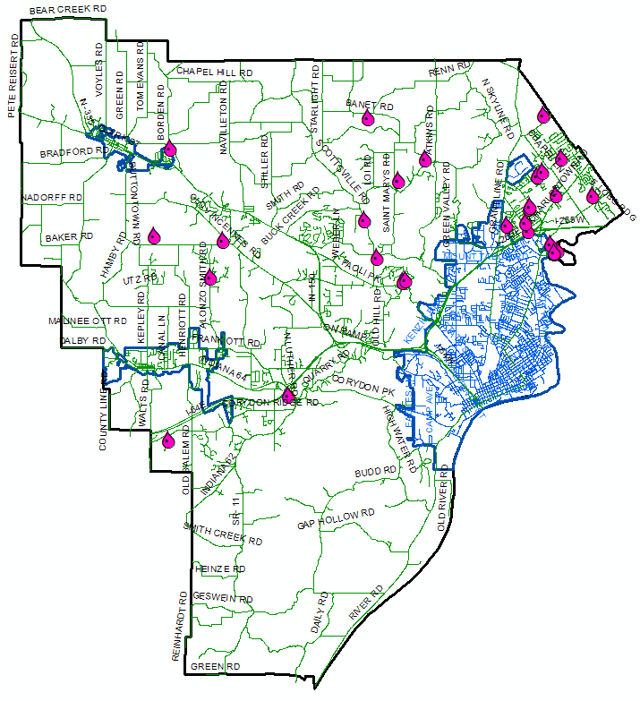
Second Permit
Pink rain drops represent calls

Slide 31
Second Permit
Setting up a “projects” list so we can track the progress of each one and document any concerns.
Repaired numerous catch basins and culverts throughout the county.
Helped sponsor the ORSANCO River Sweep of the Ohio River along with New Albany Stormwater Department.
Had a display at the 2010 Floyd County Fair

Slide 32
Second Permit
June 19, 2010 ORSANCO Ohio River Sweep- New Albany River Front Park. June 4-19,
2010 Sign in front of Reitz School Building
590 River Sweep Broachers handed out in Schools
A 30 yard dumpster was filled with 3.5 tons of trash collected at the sweep
32 People attended the event
July 6-8, 2010 Floyd County 4-H Fair
9 Rain Barrel Instructions
3 IDEM Waterway Permitting Handbooks
5 New Albany Flood Insurance Broachers
42 Crayons
49 Solution to Pollution Coloring Books
12 Homeowner Guide to Stormwater Pollution

Slide 33
Second Permit
2010 Floyd County Fair

Slide 34
2010 ORSANCO Ohio River Sweep
Volunteers help with debris removal

Slide 35
Sign out front of Reisz building
Advertising the 2010 ORSANCO River Sweep

Slide 36
Second Permit
We have added another website that promotes stormwater. It is on the Floyd County site.
This site is also bilingual (Spanish) for our constituents that use English as a second language.
We have also created a page on Facebook. We update it every other day to promote good practices that everyone can follow.
As of Aug 1st we had over 20 fans

Slide 37
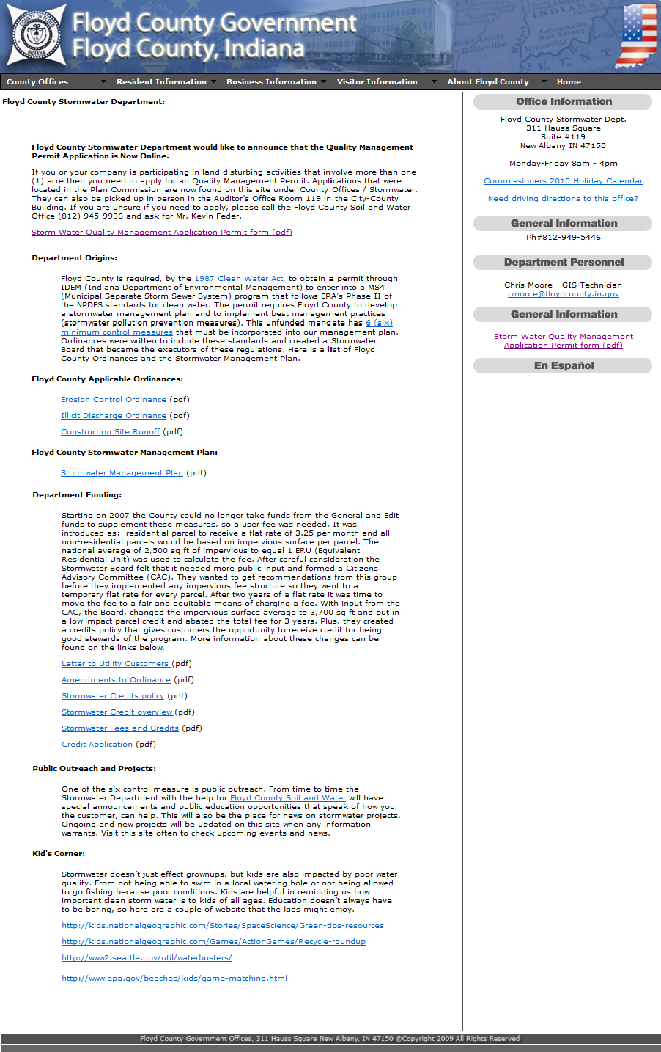
Second Permit
Floyd County Website

Slide 38
Second Permit
Floyd County Indiana Stormwater Dept.

Slide 39
Second Permit
SISWAC Website

Slide 40
Second Permit
Floyd County Soil and Water Website

Slide 41
Second Permit
Newspaper Article
Postcard
Notes:
This are examples of other ways we are trying to get the word out about stormwater.

Slide 42
Second Permit
Floyd County help facilitate an agreement between the Town of Georgetown and the City of New Albany that helps build a new waste water treatment plant for the Town of Georgetown.
This new treatment plant will help the quality of water in Georgetown by allowing close to 10 % of the septic tanks to eventually tie into the new plant.
We hired a Infrastructure Coordinator
And created a Stormwater Coordinator position.

Slide 43
Future
We have great ideas that we will implement within the next few years. Like……
Joining a partnership with the Purdue Extension Office
Gaining a partnership with Indiana University Southeast
Getting a shared advertisement on the community channel (cable 25) with the New Albany Stormwater Department
Having more churches and schools join in on public outreach and public education.

Slide 44
Future
Upgrading facilities at the County Highway Garage by adding a canopy at the brine mixture and the gas pumps and a washout area with a protected drain.
Adding new credits to an already robust credits policy that promote green infrastructure, like permeable pavement and green roof technology.
Adding report a polluter to one of the websites and start tracking and identifying problem areas.
Writing new ordinances that put design criteria of stormwater infrastructure into zoning requirements.

Slide 45
Floyd County Road Department
Floyd County Road Department

Slide 46
Floyd County North Annex
Floyd County Solid Waste
Floyd County Youth Shelter
Floyd County Juvenile Probation

Slide 47
Floyd County Reitz Building
Floyd County Soil and Water
Floyd County Adult Probation
Floyd County EMA

Slide 48
Floyd County Fairgrounds
4-H Fair
Receptions
Shows and Festivals

Slide 49
Future
Having the Infrastructure Coordinator check stormwater infrastructure before bonds are released on new construction.
More training opportunities for more County personnel.
Becoming more proactive in solving problems than reactionary.
And last but not least. Never stop thinking of ways to make stormwater better for all people in our County.

