Slide 1


VICTIMS OF CRIME ACT (VOCA) FUNDING UPDATE
Rikki Caito
Assistant Director, Victim Services Division Indiana Criminal Justice Institute

Slide 2




HISTORY OF VOCA
Established
1984 by Congress
Purpose
To provide grants to state and local programs to assist Victims of Crime
Funding
Fines, Penalties, Forfeited Bail Bonds, Deferred Prosecution, Non-Prosecution Agreements, and Assessments paid by federal criminal offenders
Allocation
Formula, Discretionary, and Set-Asides based on the annual funding cap

Slide 3
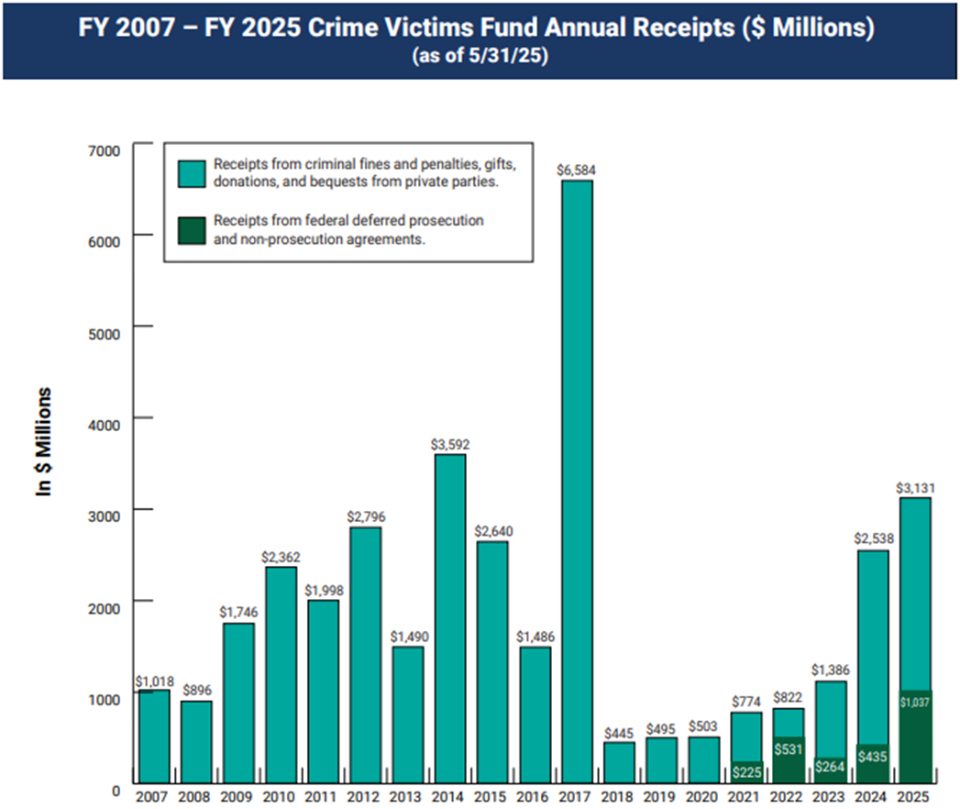

Federal Deposits
This bar graph and more information about the Crime Victims Fund are available through OVC’s Crime Victims Fund webpage.
https://ovc.ojp.gov/about/crime-victims-fund.

Slide 4
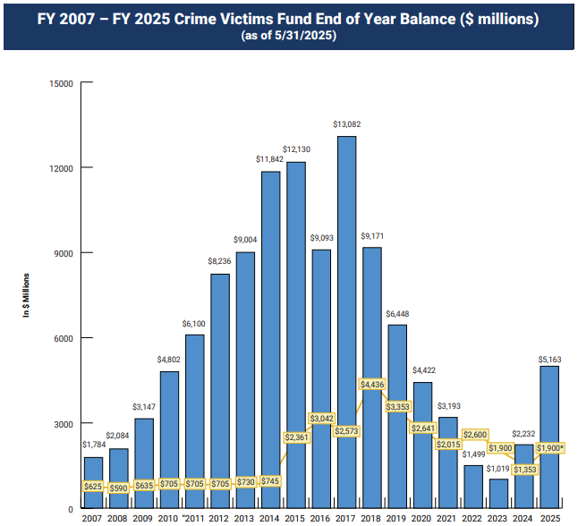
Federal Balance
This bar graph and more information about the Crime Victims Fund are available through OVC’s Crime Victims Fund webpage.
The yellow amount shows the annual limit (cap) on the spending (obligation) from the fund, set by Congress.
https://ovc.ojp.gov/about/crime-victims-fund.

Slide 5

Indiana’s VOCA Federal Allocation by Year
2016 | 2017 | 2018 | 2019 | 2020 | 2021 | 2022 | 2023 | 2024 | 2025
$ 45,110,084 | $ 37,415,802 | $ 67,298,989 | $ 45,529,895 | $ 33,793,835 | $ 21,066,456 | $ 29,053,333 | $ 27,337,125 | $ 15,747,693 | $ 25,505,776
Indiana’s VOCA Grant Cycle Amounts Awarded
2016 | 2017 | 2018 | 2019 | 2020 | 2021 | 2022 | 2023 | 2024 | 2025
$26,567,209.00 |  | $62,771,397.00 |  | $80,574,526.00 |  | $73,303,570.00 |  | $65,754,258.00
Federal Year Allocations Used to Fund Each VOCA Grant Cycle
2016-2017 |  | 2016-2018 |  | 2018-2019 |  | 2018-2021 |  | 2020-2023
*Funds Available for VOCA 2026-2028 awards: $41,253,469.00
(using 2024-2025 federal allocations)

Slide 6

What We’re Doing & Have Done
Applied for Federal No-Cost Extensions on our award(s)
Currently utilizing 4 years of funding for our current VOCA grant cycle 2024-2026
2-year grant cycle
Two yearly separate awards
Forecasted the amount of Admin funds needed from our 5% allocation and reallocated the remainder of the funds to but utilized for our Sub-Awards
Reallocated unspent or de-obligated Subgrantee funds
Ensured oldest funds are being utilized first
Met with large entity stakeholders
Prosecutors, CASAs, CACs, Coalitions
We will notify all current VOCA recipients
Ask all agencies to self-reduce their VOCA funded expenses and diversify their funding sources

Slide 7
THANK YOU

