Slide 1

2022-2024 VOCA RFP Webinar
February 23rd, 2022

Slide 2
Thanks for joining us today: Please keep your lines muted during the presentation. Webinar is being recorded. It will be posted on the ICJI website. Questions and Answers at the end. Feel Free to utilize the chat box during the webinar.

Slide 3

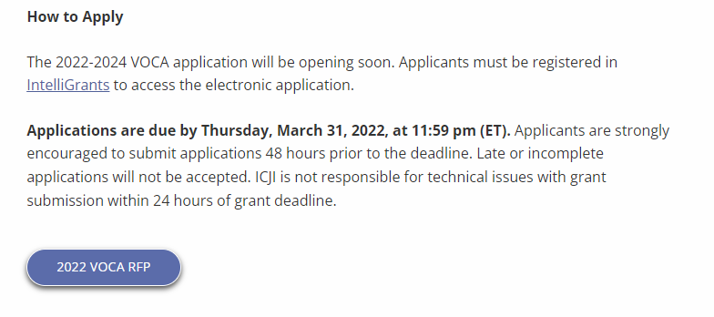
Accessing the RFP
Located on ICJI Website
CJI.in.gov → Victim Services → Scroll Down → Victims of Crime Act (VOCA) grant program “Learn More”→ 2022 VOCA RFP button
https://www.in.gov/cji/victim-services/voca/

Slide 4
2022 VOCA Grant Application
Application opened: Monday, February 14th at 9 AM
Application closes: Thursday, March 31st at 11:59 PM
Applicants are strongly encouraged to submit applications 48 hours prior to the deadline.
Award Period for VOCA: October 1, 2022 to September 30, 2024 (24-month award period)
Projects should begin on October 1, 2022 and must be in operation no later than 60 days after this date. Failure to have the funded project operational within 60 days from October 1, 2022 will result in the cancellation of the grant and the de-obligation of all awarded funds.

Slide 5
Overview:
The Victims of Crime Act (VOCA) of 1984 established the Crime Victims Fund in the U.S. Treasury. The Crime Victims Fund is financed by fines and penalties paid by convicted federal offenders, and includes deposits from federal criminal fines, forfeited bail bonds, penalties, and special assessments collected by U.S. Attorneys’ Offices, federal U.S. courts, and the Federal Bureau of Prisons. Federal revenues deposited into the Crime Victims Fund also include gifts, donations, and bequests from private parties.
The VOCA Victim Assistance Formula Grant Program is administered by the Office for Victims of Crime (OVC), Office of Justice Programs (OJP), U.S. Department of Justice (DOJ) and provides funding from the Crime Victims Fund in order to support and enhance direct services to crime victims in each state, the District of Columbia, and U.S. territories.
The purpose of VOCA is to support the provision of services to victims of crime throughout the nation. “Crime Victim” is defined as a person who has suffered physical, sexual, financial, and/or emotional harm as the result of the commission of a crime. Services are defined as those efforts that (1) respond to the emotional, psychological, and/or physical needs of crime victims; (2) assist victims to stabilize their lives after victimization; (3) assist victims to understand and participate in the criminal justice system; and (4) restore a measure of safety and security for the victim.

Slide 6

Areas of Emphasis
The Office for Victims of Crime (OVC) has encouraged States to support programs in the following areas:
Marginalized Communities
Equity and Racial Justice
Underserved communities
Including isolated rural areas and communities affected by persistent poverty or inequality

Slide 7
Funding Eligibility:
Eligible entity types include:
State Agencies
Units of local government
Nonprofit organizations
Faith-based organizations
Other Requirements include:
Registered DUNS number
Beginning April 4th, a Unique Entity ID (UEI) issued through the System for Award Management (SAM) will be required instead of a DUNS number to receive funding.
The UEI is entered in the Organization page in IntelliGrants and will pull automatically into applications.
Active and current registration with SAM.gov
Good standing with the Department of Revenue (DOR), Department of Workforce Development (DWD), and Secretary of State (SOS)

Slide 8
Other Requirements / Trainings
Determination of suitability to interact with participating minors
Every 5 years additional background checks (fingerprinting, etc.) must be run on any grant/match funded employees (including volunteers) that interact with anyone under the age of 18
This is a required condition of any DOJ grant- for more details about the required checks please visit https://www.ojp.gov/funding/explore/interact-minors
Civil Rights Training
The DOJ requires all recipients and subrecipients of federal funds to comply with a variety of Federal civil rights laws. ICJI has a checklist that each subgrantee needs to complete on an annual basis to remain in compliance
CJI Grantee Training and Resources Link-
https://www.in.gov/cji/grantee-training-and-resources/
These requirements along with other trainings including the most recent Grant Writing Webinar and Q&A form can be found at:
https://www.in.gov/cji/victim-services/training/

Slide 9
Initiating an application in IntelliGrants
https://intelligrants.in.gov

Slide 10
Steps to initiating an application in IntelliGrants (ICJI’s Grant Management system):
Log into your IntelliGrants account
If you do not have an account, then you can obtain one on the home screen of intelligrants (New User?)
On the “MY HOME” page access the “VIEW AVAILABLE PROPOSALS” section
Click on VIEW OPPORTUNITIES
Intelligrants will take you to the My Opportunities page
Access the 2022 VOCA Grant Application
Select “Apply Now”

Slide 11
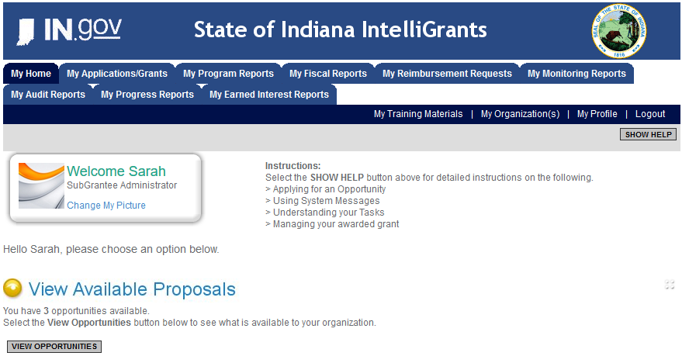

Slide 12
Intelligrants VOCA Application

Slide 13
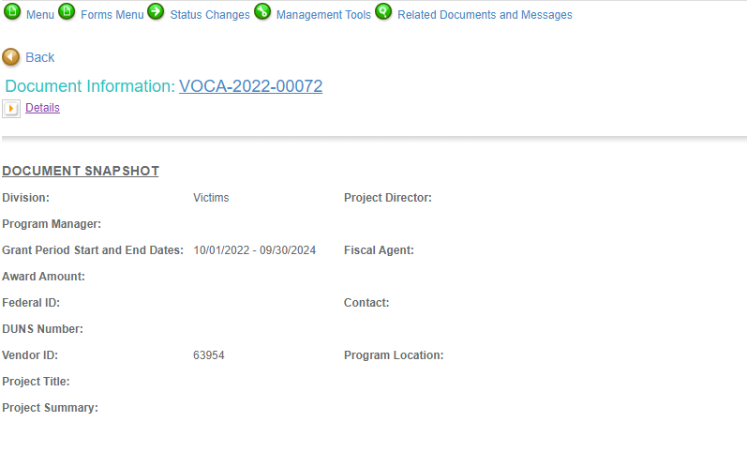
Notes:
To access the different components of the application you will need to navigate to the forms menu.

Slide 14
Forms that need to be completed:
Contact
Project Information
Programmatic Information
Problem Statement & Analysis
Goals, Objectives, & Outcomes
Program Descriptions
Evidence Based/Best Practices
Use of Volunteers
Budget
Budget Narrative
Attachments

Slide 15
Contact
Points of Contact for the grant (CJI will notify these individuals of your award notice)
Project Information
SAMs Registration must be up-to-date
Audit
If you receive more than $750,000 in federal grant funds, you are required to have an audit. This will be requested if CJI is aware that you receive more than $750,000.
Programmatic Information
Information about your proposed VOCA grant
Problem Statement & Analysis
All government agency’s audits are included in the County audit and should all have one attached
Forms to be Completed (continued)

Slide 16
Goal, Objective, and Outcomes
The goal should directly address the problem identified in the Problem Statement.
Objectives are the steps needed to achieve goals. Objectives should be concrete, action-oriented, measurable and Specific, Measurable, Achievable, Realistic, Timely (SMART).
Example of Objective: Provide shelter to 95% of domestic violence victims seeking safe shelter.
Outcomes measure objectives and are criteria for how the program is deemed to be effective.
Example of Outcome: Of the domestic violence victims who received shelter, 75% stayed at least 30 days and remained safe.
Program Description
What? Who? Where? Why? When? How?
Evidence Based/Best Practice
Use of Volunteers
Subrecipients must use volunteers unless the State determines there is a compelling reason to waive this requirement. The volunteers are not required to provide direct service to victims. A Match Waiver form can be found in the RFP and attached to your Intelligrants application.
Forms to be Completed (continued)

Slide 17
Please be sure to read and review the RFP prior to completing your application
All grants from ICJI Victim Services are reimbursement grants, which means that agency must first incur the expense prior to CJI reimbursing for the expense. Verification of expenses along with verification of payment of expenses must be provided to ICJI on a monthly or quarterly basis prior to reimbursement of expenses by ICJI.
There will be no match requirement for the 2022 VOCA grant period.
Important Notes

Slide 18
Important Budget Notes
Due to the decreased VOCA funding allocated to the State the past couple years, ICJI anticipates 20-25% less funding available for this grant cycle compared to previous years
No Match Requirement for the 2022 VOCA Funding Cycle
Due to the decrease in available funding, this grant cycle will consist of two separate grant periods – October 1, 2022, to September 30, 2023 (Year 1) and October 1, 2023, to September 30, 2024 (Year 2). As such, the proposed budget submitted will need to include Year 1 or Year 2 for each budget line item.
Due to split funding, Year 1 costs must be expended in Year 1 of the grant and will not be available in Year 2. Similarly, Year 2 costs must be expended in Year 2, and will not be available in Year 1.
Grant recipients will not be allowed to move costs in the approved grant budget from Year 1 to Year 2 or vice versa during any Project Modification Request (PMR).

Slide 19
Allowable Activities
Civil Legal Services for Victims
Facilitation of participation in criminal justice and other public proceedings arising from the crime
Forensic Interviews
Immediate Emotional, Psychological, and Physical Health and Safety
Legal Assistance for Victims
Mental Health Counseling and Care
Peer Support
Personal Advocacy and Emotional Support
Relocation Expenses
Services to Incarcerated Individuals
Transitional Housing
Transportation

Slide 20
Eligible Costs
Personnel Costs
Costs Necessary to Providing Direct Service
Skills Training for Staff
Training Material
Equipment
Repair and/or Replacement of Essential Items
Public Presentations and Awareness
Operating and Supply Costs
Administrative Time – cannot exceed 10% of the total award amount
Professional Fees
Supervision of Direct Service Providers

Slide 21
Ineligible Budget Items
Direct Cash Assistance to Victims
Most medical costs (nursing home care, in-patient treatment, hospital, and non-emergency medical or dental treatment)
Prevention of crime activities or activities that assist in prosecution of perpetrators
Perpetrator rehabilitation
Property loss such as replacement of stolen or damaged property
Substance abuse counseling for victims when not related to victimization
Alcohol, food (except emergency food for victims) and entertainment costs
Bonuses or commissions
Construction, capital improvement, or land acquisition
Costs associated with Boards including insurance and fees
Costs not associated with direct services to victims
Expenses incurred outside of the grant period
Fundraising
Inherently (or explicitly) religious activities
Legal Fees of applicant
Lobbying

Slide 22
Supplanting
Federal funds must be used to supplement existing funds for program activities and cannot replace or supplant non-federal funds that have been appropriated for the same purpose.

Slide 23

Budget Narrative
Be sure all items in the Budget are included in the Budget Narrative.
Ex: Office Supplies (copy paper, pencils, pens)
Grant reviewers are not required to contact you for clarification.
Any missing information in this section may disqualify that budget item for funding.

Slide 24
Budget Narrative – cont’d
Starting on the 2022 VOCA grant application there will be changes to the Budget Narrative form
Additional questions separating the Supplies and Operating Expenses sections, and how the expenses requested in that section will help meet your goals/objectives/outcomes
Additional examples to give a better idea of what we are looking for/needing from the information provided in the Narrative
Questions won’t appear until you enter at least 1 budget line item in that section

Slide 25

Attachments Required:
Total Agency Budget
Found on ICJI’s website (https://www.in.gov/cji/victim-services/resources/) – Nonprofit Applicant Budget Form
Sustainability Plan
Your plan to maintain the program once the grant funds expire
Timeline
Outlining the completion of the project/ or expenditures of the grant funds
Letters of Endorsement
For this program specifically
Miscellaneous
Job Descriptions for any position listed in personnel
If applicable any contracts
EEOP Certification

Slide 26
For technical assistance contact the ICJI Helpdesk at CJIHelpDesk@cji.in.gov. Help Desk hours are Monday – Friday, 8:00 am to 4:30 pm ET, except state holidays.
ICJI is not responsible for technical issues with grant submission within 48 hours of grant deadline.
For assistance with any other requirements of this solicitation, please contact The Victim Services Division at ICJI.

Slide 27

Questions?

Slide 28
Thanks for attending!
Presenters:
Max Brown, Victim Services Program Specialist
maxbrown@cji.in.gov
317-232-2927
Ellen Sheets, Senior Grant Manager
ESheets1@cji.in.gov
317-232-1229

