Slide 1

2024-2026 VOCA RFP Webinar
February 6, 2024

Slide 2


Thanks for joining us today:
Please keep your lines muted during the presentation.
Webinar is being recorded. It will be posted on the ICJI website.
Questions and Answers at the end.
Feel Free to utilize the chat box during the webinar.

Slide 3
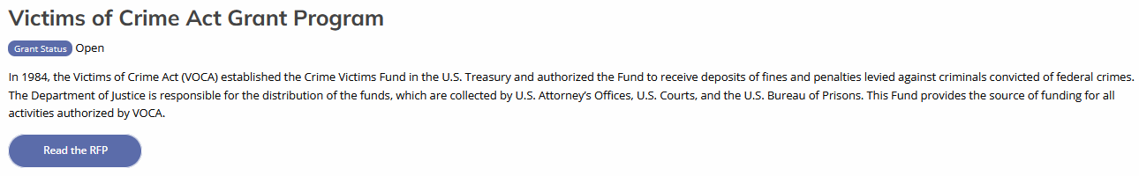
Accessing the RFP
Located on ICJI Website
CJI.in.gov → Victim Services → VOCA → VOCA RFP 2024
https://www.in.gov/cji/victim-services/voca/

Slide 4
2024-2026 VOCA Grant Application
Application opened: Wednesday, January 31st at 9 AM
Application closes: Thursday, March 14th at 11:59 PM ET
Applicants are strongly encouraged to submit applications 48 hours prior to the deadline.
Award Period for VOCA: October 1, 2024 – September 30, 2026 (24-month award period)
Projects should begin on October 1, 2024 and must be in operation no later than 60 days after this date. Failure to have the funded project operational within 60 days from October 1, 2024 will result in the cancellation of the grant and the de-obligation of all awarded funds.

Slide 5
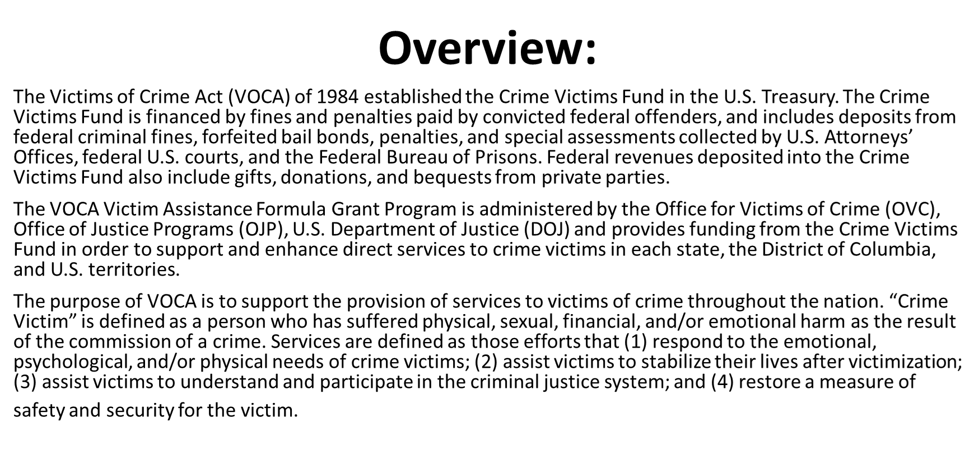

Slide 6
Funding Availability
The VOCA Crime Victims Fund is funded through fines and penalties paid by defendants in federal criminal cases. In recent years, the prosecution of federal crimes has decreased, resulting in a decrease in funding to states.
Although the 2021 VOCA Fix Act helped to address this issue, Indiana’s VOCA allocation has continued to decrease the past several years. As a result, ICJI anticipates 15% less funding available for this grant cycle compared to previous years.

Slide 7
Areas of Emphasis
The Office of Victims of Crime has encouraged States to support programs in the following areas:
Community Violence Intervention
  Programs that use evidence-informed strategies to reduce violence through tailored community-centered initiatives.
Marginalized Communities
  Programs that actively seek to include diverse and frequently marginalized communities and efforts in identifying the needs of these communities.
Equity and Racial Justice
  Programs that advance equity, civil rights, racial justice and equal opportunity.
Underserved
  Programs that serve underserved communities that include populations that have been systematically denied full opportunity to participate in aspects of economic, social and civic life, including isolated rural areas; communities affected by persistent poverty or inequality; and communities.

Slide 8
Allowable Activities
Civil Legal Services for Victims
Facilitation of participation in criminal justice and other public proceedings arising from the crime
Forensic Interviews
Immediate Emotional, Psychological and Physical Health and Safety
Legal Assistance for Victims
Mental Health Counseling and Care
Peer-Support

Slide 9
Allowable Activities
Personal Advocacy and Emotional Support
Relocation Expenses
Services to Incarcerated Individuals
Transitional Housing
Transportation

Slide 10
Eligible Costs
Personnel Costs
Costs Necessary to Providing Direct Service
Skills Training for Staff
Training Material
Equipment
Repair and/or Replacement of Essential Items
Public Presentations and Awareness
Operating and Supply Costs
Administrative Time
Professional Fees
Supervision of Direct Service Providers

Slide 11
Ineligible Activities and Costs
Direct cash assistance to victims.
Most medical costs (including nursing home care, in-patient treatment, hospital, and non-emergency medical or dental treatment).
Prevention of crime activities
Activities that assist in prosecution of perpetrators.
Perpetrator rehabilitation
Property loss such as replacement of stolen or damaged property
Substance abuse counseling for victims when not related to victimization

Slide 12
Ineligible Activities and Costs Continued
Alcohol, food (except emergency food for victims), and entertainment costs.
Bonuses or commissions
Construction, capital improvement, or land acquisition (purchase of real property)
Costs associated with Boards including insurance and fees
Costs not associated with direct services to victims
Expenses incurred outside of the grant period.

Slide 13
Ineligible Activities and Costs Continued
Fundraising.
Inherently (or explicitly) religious activities.
Indirect administrative costs over 10% of the total grant budget.
Legal fees of applicant.
Lobbying.
Management or administrative training
Needs assessments, surveys, research projects, and studies.

Slide 14

IMPORTANT NOTES
All grants from ICJI Victim Services are reimbursement grants, which means that agency must first occur the expense prior to ICJI reimbursing for the expense. Verification of expenses along with verification of payment of expenses must be provided to ICJI on a monthly or quarterly basis prior to reimbursement of expenses by ICJI.
All program reports will be quarterly reports only. You will still be able to choose monthly to report your fiscal reports, but the program report will only be available on a quarterly basis.
Please be sure to read and review the RFP prior to completing your application.
Page 4 of the RFP is a checklist for your VOCA application that includes items that should be reviewed prior to submission.

Slide 15
IMPORTANT
BUDGET
NOTES
The submitted budget will need to reflect Year 1 and Year 2 of funding on every expense.
Funds designated under Year 1 must be spent in Year 1 and will not be available in Year 2.
The same is true of Year 2. Funds designated under Year 2 will not be available in Year 1.
During any Project Modification Request, funds will not be able to be moved between years.

Slide 16

MATCH REQUIREMENT
There is a 20% match requirement imposed on grant funds under the VOCA Program. A grant made under this program may not cover more than 80% of the total costs of the project being funded.
The applicant must identify the source of the 20% non-Federal portion of the budget and how match funds will be used. Applicant may satisfy the required match with either cash or in-kind services. An entity can request a match waiver by completing the match waiver request form and uploading the form to the attachment section of the application under miscellaneous.

Slide 17
MATCH EXAMPLE
Step 1: Award Amount / % of Federal Share = Total Project Cost
Step 2: Total Project Cost - Award Amount = Required Match
Example: A grant recipient is awarded $150,000 in federal funding. The match requirement is an 80/20 ratio (federal percentage/recipient percentage).
$150,000 ÷ .80 = $187,500 Total Project Cost
$187,500 - $150,000 = $37,500 Required Match

Slide 18
MATCH REQUIREMENT
Matching funds must:
Be verifiable from the subgrantee’s records;
Not be included as contributions for any other federal award;
Be necessary and reasonable for the accomplishment of the project or program objectives;
Be allowable under 2 C.F.R. 200.400;
Not be paid by the federal government under another federal award, except where authorized by federal statute;
Be included in the subgrantee’s approved budget; and
Conform to all other provisions of 2 C.F.R. Part 200.

Slide 19

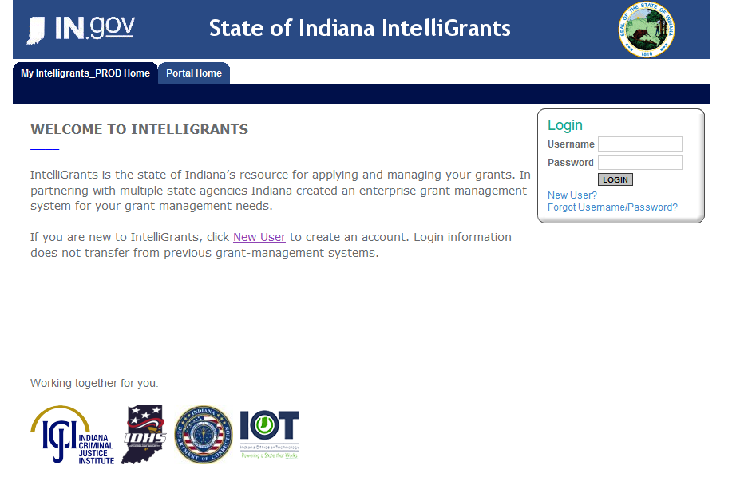
Initiating an application in IntelliGrants
https://intelligrants.in.gov

Slide 20
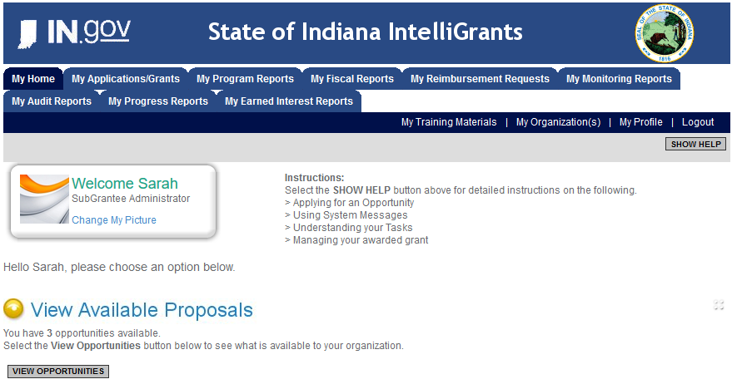
Steps to initiating an application
Log into your IntelliGrants account
  If you do not have an account, then you can obtain one on the home screen of intelligrants (New User?)
On the “MY HOME” page access the “VIEW AVAILABLE PROPOSALS” section
Click on VIEW OPPORTUNITIES
Intelligrants will take you to the My Opportunities page
Access the 2024 VOCA Grant Application
Select “Apply Now”

Slide 21
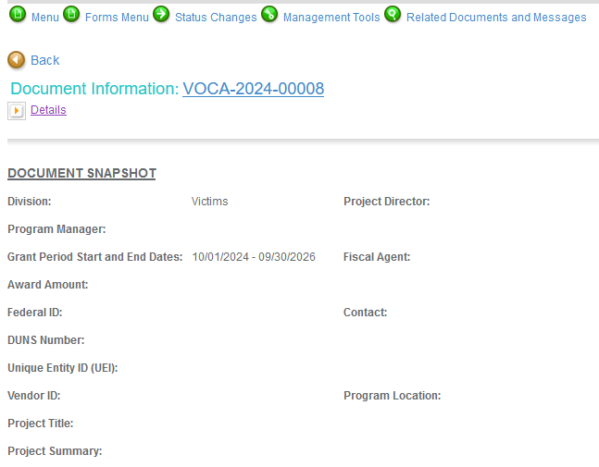
Navigating Forms Menu

Slide 22
Contact Information
Project Information
Programmatic Information
Problem Statement & Analysis
Goals, Objectives, and Outcomes
Program Description
Evidence Based/Best Practice
Use of Volunteers
Budget
Budget Narrative
Attachments
Forms that need to be completed

Slide 23
Contact Information
Points of Contact for the grant
(ICJI will notify these individuals of your award notice)
Project Information
SAMs Registration must be up-to-date
Audit
If you receive more than $750,000 in federal grant funds, you are required to have an audit. This will be requested if ICJI is aware that you receive more than $750,000.
Programmatic Information
Information about your proposed VOCA grant
Problem Statement & Analysis
All government agency’s audits are included in the County audit and should all have one attached
Forms that need to be completed Cont.

Slide 24
Goals, Objectives, and Outcomes
The goal should be a broad, general statement that identifies the desired result or outcome.
Program Description
What? Who? Where? Why? When? How?
Evidence Based/Best Practice
Use of Volunteers
The objectives are then the means for achieving the goal that was listed. These should be SMART.
The outcomes measure the impact the objectives had.
https://www.in.gov/cji/victim-services/resources/
Forms that need to be completed Cont.
https://www.in.gov/cji/victim-services/resources/

Slide 25

Budget Narrative
Be sure all items in the Budget are included in the Budget Narrative.
  Ex: Office Supplies (copy paper, pencils, pens)
Grant reviewers are not required to contact you for clarification.
Any missing information in this section may disqualify that budget item for funding.

Slide 26

REQUIRED ATTACHMENTS
Total Agency Budget
  Found on ICJI’s website (https://www.in.gov/cji/victim-services/resources/) – Agency Basic Budget (Nonprofit Applicant Budget Form)
Indirect Cost Rate
  If applicant has federally approved rate
Sustainability Plan
  Your plan to maintain the program once the grant funds expire
Timeline
  Outlining the completion of the project/ or expenditures of the grant funds
Letters of Endorsement
  For this program specifically

Slide 27
REQUIRED ATTACHMENTS
CONTINUED
Miscellaneous
  EEOP
  Certification of Advanced Determination of Suitability to Interact with Participating Minors
  Lobbying Certification and Disclosure to Report Lobbying
  Job Descriptions
  Match Waiver request if applicable
  Volunteer Waiver request if applicable
  Any other requested information
    Executed Contracts, Lease Agreements

Slide 28
NEW: Agency Basic Budget

Slide 29
NEW: Agency Basic Budget Continued

Slide 30
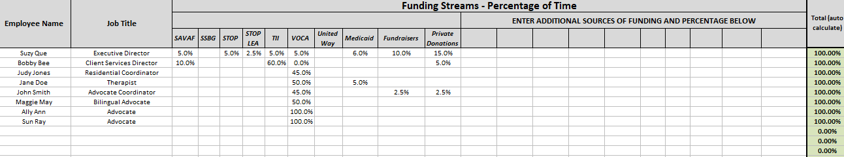
NEW: Agency Basic Budget Continued

Slide 31
Budget Requirement
The submitted budget will need to reflect Year 1 and Year 2 of funding on every expense.
Funds designated under Year 1 must be spent in Year 1 and will not be available in Year 2.
Funds designated under Year 2 will not be available in Year 1.
During any Project Modification Request, funds will not be able to be moved between years.

Slide 32
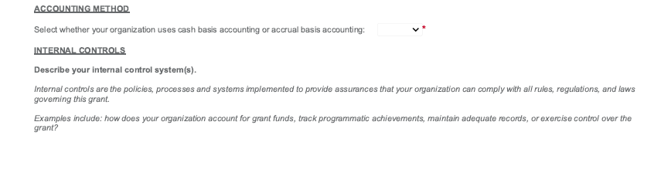
New in IntelliGrants: Budget Narrative

Slide 33
Technical Assistance
For technical assistance contact the ICJI Helpdesk at CJIHelpDesk@cji.in.gov. Help Desk hours are Monday – Friday, 8:00 am to 4:30 pm ET, except state holidays.
ICJI is not responsible for technical issues with grant submission within 48 hours of grant deadline.
For assistance with any other requirements of this solicitation, please contact The Victim Services Division at ICJI.

Slide 34
QUESTIONS?

Slide 35
Thanks for attending!
Presenters:
Dalayna Anderson, Victim Services, Program Specialist
DaAnderson1@cji.in.gov
317-232-3482
Becky Venus, Victim Services, Senior Grant Manager
Rvenus@cji.in.gov
317-233-5681

