Slide 1
Subgrantee Basic Budget form
How to complete

Slide 2
Subgrantee Basic Budget Form
The Subgrantee Basic Budget form is required for all Nonprofit Agency’s to fill out
The Subgrantee Basic Budget form can be found via a link in the RFP and by going to the ICJI website.
We require that this form be completed and not one that is created by an agency
As is expected with all other sections of the application, we expect this form to be completed fully for the specific grant that is being applied for.
There are instructions included on the form that should be followed

Slide 3
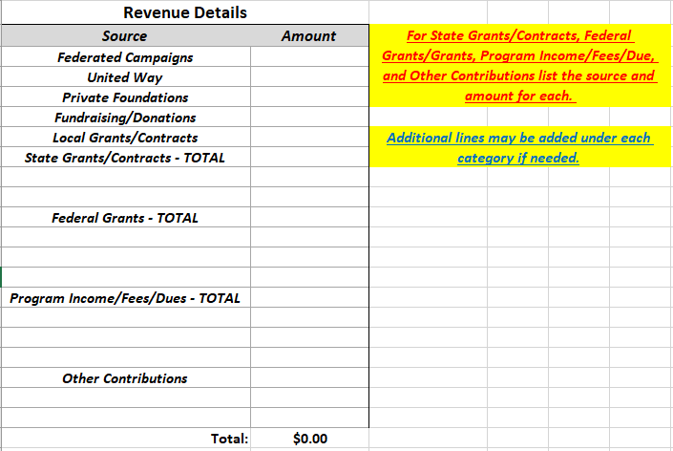
Revenue
This section should include all revenue for the Agency, not just the funded program.
For State Grants/Contracts, Federal Grants, Program Income/Fees/Dues and other contributions each source must be listed out. Lines can be added to this document in order to accommodate as many lines as needed.

Slide 4
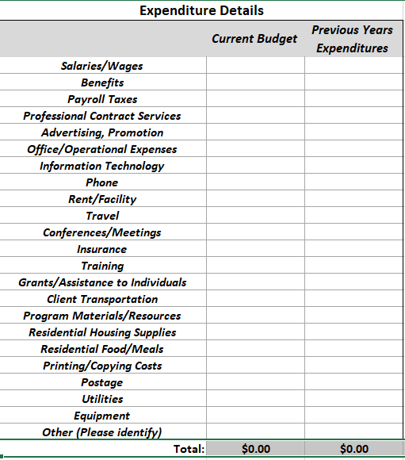
Expenditure
This section should be completed for the entire agency and not just the program being funded.
If additional lines are needed for the other line then they can be added.

Slide 5
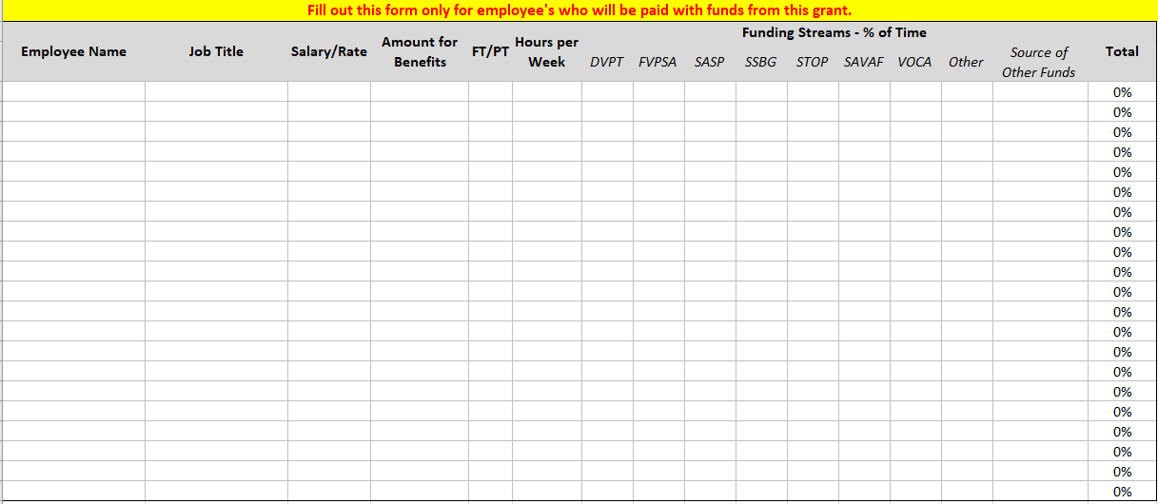
Employee Section of Subgrantee Basic budget

Slide 6
Employee section of Subgrantee Basic Budget
Each employee whose position is reimbursed by the grant must be on this form.
Salary should be what the Annual Salary is for the position and not the amount you are wanting to be reimbursed for.
Hours per week indicate how many total hours the employee is working per week not the number of hours the employee is spending toward the grant.
Amount for benefits is the total amount of each employees' benefits
Funding Streams is the % of time the employee will spend completing activities for the funding streams listed. The total must be 100%. If a % is added to the Other category, then those funds must be listed in the Source of Other Funds.

